Slide 1


Africa’s Turnaround:
From impoverishment to sustainable growth in agriculture, nutrition and health
Will Masters
Professor and Chair, Department of Food and Nutrition Policy, Tufts University
www.nutrition.tufts.edu | http://sites.tufts.edu/willmasters
MIT Knight Science Journalism Program
Food Boot Camp -- 29 March 2012

Slide 2


What’s behind these stories?

Slide 3

And this?

Slide 4

And this?

Slide 5
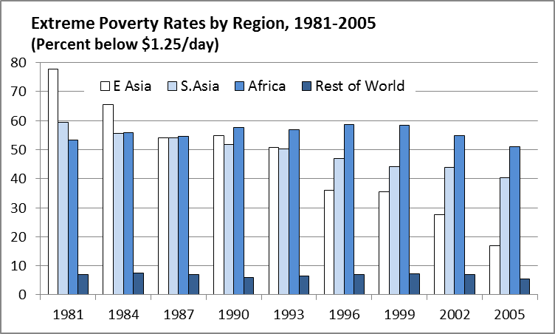
Africa’s impoverishment is relatively recent and may already be ending
Since 2000, African poverty has declined as it did earlier in Asia
In the 1980s & ‘90s, Africa became the world’s most impoverished region
Source: Calculated from World Bank (2011), PovcalNet (http://iresearch.worldbank.org/PovcalNet/), updated 11 April 2011. Estimates are based on over 700 household surveys from more than 120 countries, and refer to per-capita expenditure at purchasing-power parity prices for 2005.

Slide 6
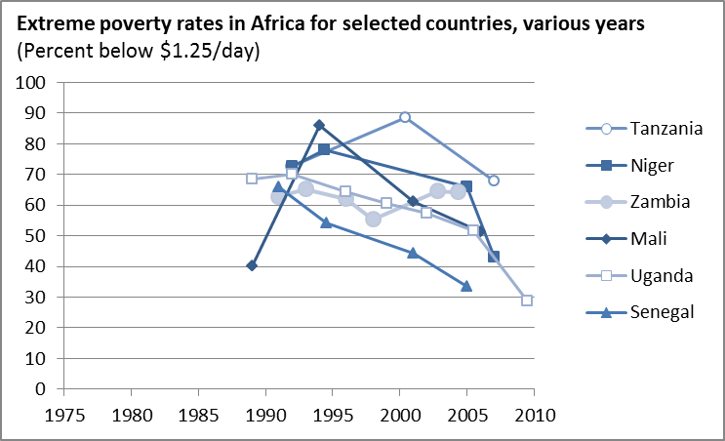
There are limited data and wide variation but many signs of improvement
The available surveys show widespread reduction in poverty rates
Source: Author’s calculation from World Bank (2011), PovcalNet (http://iresearch.worldbank.org/PovcalNet/), updated 11 April 2011. Estimates are based on over 700 household surveys from more than 120 countries, and refer to per-capita expenditure at purchasing-power parity prices for 2005.

Slide 7
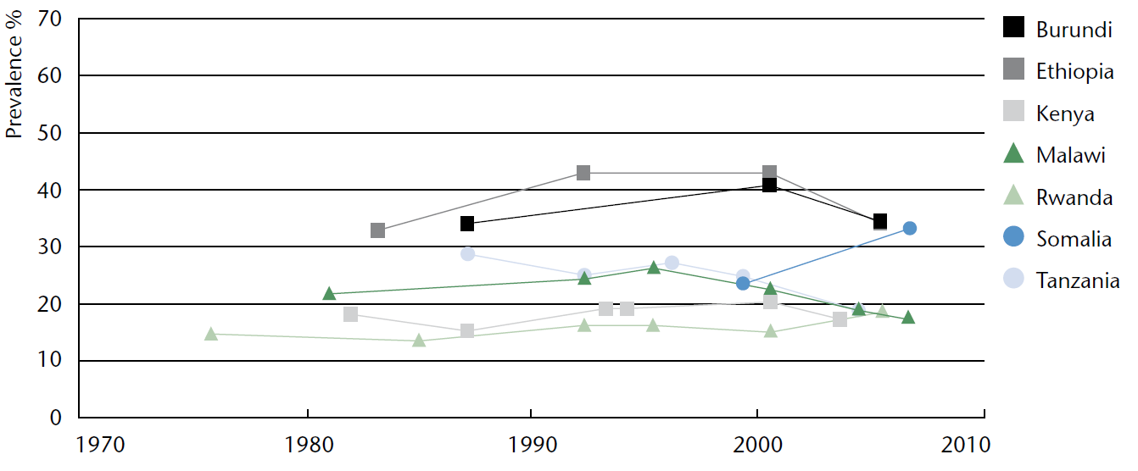
Undernutrition has also begun to improve
in some African countries
National trends in prevalence of underweight children (0-5 years)
Selected countries with repeated national surveys
Somalia is an exception, its malnutrition worsened before the 2011 famine
Source: UN SCN. Sixth Report on the World Nutrition Situation. Released October 2010, at http://www.unscn.org.

Slide 8
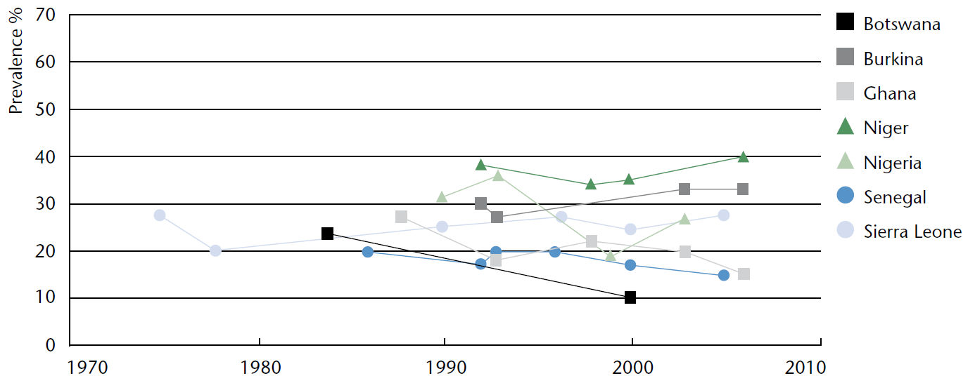
Undernutrition levels and trends
vary widely across Africa
National trends in prevalence of underweight children (0-5 years)
Selected countries with repeated national surveys
Conditions in the Sahel are bad and getting worse;
it is the next Somalia
Source: UN SCN. Sixth Report on the World Nutrition Situation. Released October 2010, at http://www.unscn.org.

Slide 9
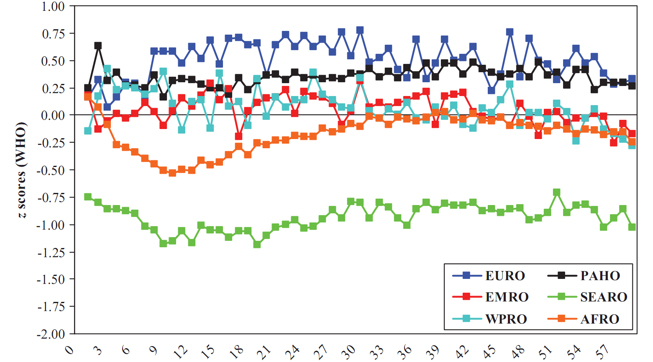
In Africa as elsewhere, nutrition shortfalls mostly occur before age two
Mean weight-for-height z-scores in 54 countries, 1994-2007, by region (1-59 mo.)
Despite Africa’s greater poverty,
Asian infants remain more malnourished
Weight loss relative to height occurs when breastfeeding becomes insufficient, but infants cannot yet rely on the family diet
Source: CG Victora, M de Onis, PC Hallal, M Blössner and R Shrimpton, “Worldwide timing of growth faltering: revisiting implications for interventions.” Pediatrics, 125(3, Mar. 2010):e473-80.

Slide 10
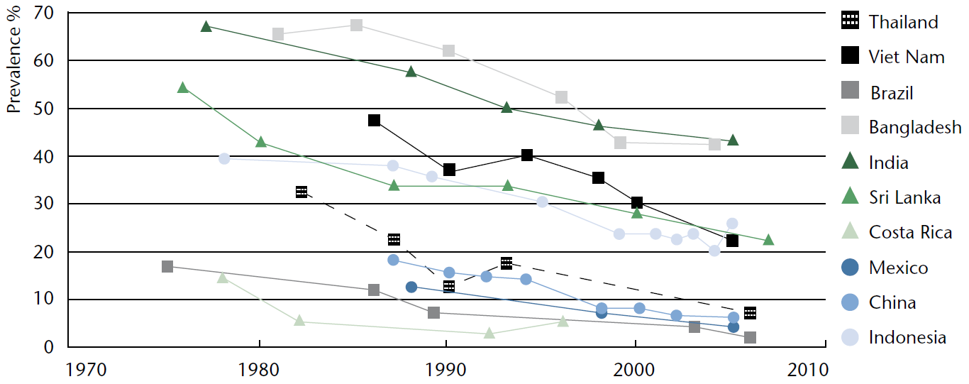
In Asia, where undernutrition was worst, we’ve seen >20 years of improvement
National trends in prevalence of underweight children (0-5 years)
Selected countries with repeated national surveys
Source: UN SCN. Sixth Report on the World Nutrition Situation. Released October 2010, at http://www.unscn.org.

Slide 11
Africa’s green revolution is
at least 20 years behind Asia’s
Source: Reprinted from W.A. Masters, “Paying for Prosperity: How and Why to Invest in Agricultural Research and Development in Africa” (2005), Journal of International Affairs, 58(2): 35-64.

Slide 12
The rise then fall in Africa’s child-survival baby boom is also 20 years behind Asia’s
Child and elderly dependency rates by region (0-15 and 65+), 1950-2030
Africa had the world’s most severe demographic burden (>45% )
now a demographic gift
Source: Calculated from UN Population Projections, 2008 revision (March 2009), at http://esa.un.org/unpp
.

Slide 13
The rise then fall in Africa’s rural
population growth is also 20 years later
Rural population growth rates by region, 1950-2030
Over 2% annual growth in the rural population, for over 30 years!
but now
around 1% and falling
Rural population growth eventually falls below zero;
land per farmer can then expand with mechanization
Source: Calculated from FAOStat (downloaded 17 March 2009). Rural population estimates and projections
are based on UN Population Projections (2006 revision) and UN Urbanization Prospects (2001 revision).

Slide 14
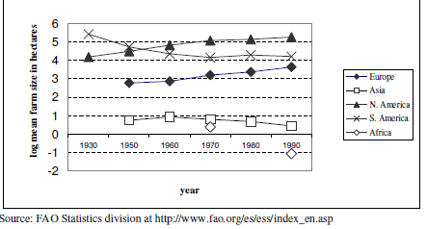
An underlying cause of Africa’s impoverishment in the 1970s-1990s was a sharp fall in land area per farmer
Land available per farm household (hectares)
Reprinted from Robert Eastwood, Michael Lipton and Andrew Newell (2010), “Farm Size”, chapter 65 in Prabhu Pingali and Robert Evenson, eds., Handbook of Agricultural Economics, Volume 4, Pages 3323-3397. Elsevier.

Slide 15
The rural population stops growing and farm sizes can rise when urbanization employs all new workers
…in Africa that won’t happen until the 2050s
Population by principal residence, 1950-2050
World (total)
Sub-Saharan Africa
2012
2012
Worldwide, rural population growth has almost stopped
Africa still has both
rural & urban growth
Source: Calculated from UN World Urbanization Prospects, 2009 Revision , released April 2010 at http://esa.un.org/unpd/wup. Downloaded 7 Nov. 2010.

Slide 16
Africa’s green revolution has just begun
USDA estimates of average cereal grain yields (mt/ha), 1960-2010
Source: Calculated from USDA , PS&D data (www.fas.usda.gov/psdonline), downloaded 7 Nov 2010. Results shown are each region’s total production per harvested area in barley, corn, millet, mixed grains, oats, rice, rye, sorghum and wheat.

Slide 17
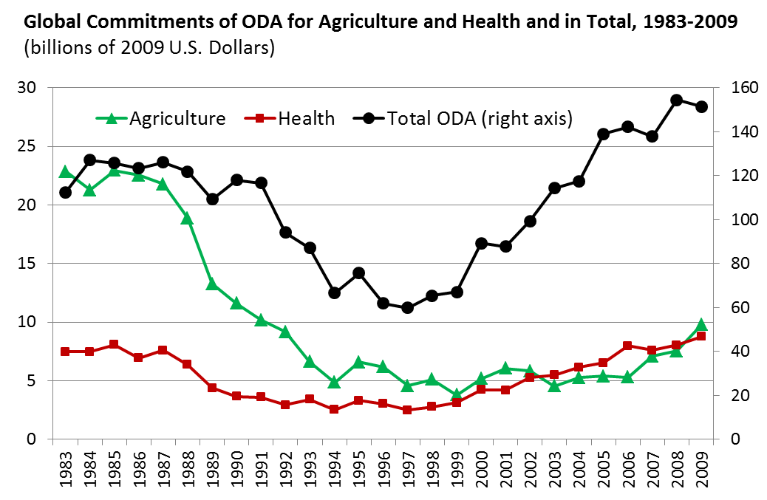
Foreign aid for agriculture has just begun to recover after being sharply cut in 1985-99
After 1985, global food abundance due to
the green revolution
led to complacency
about agriculture and foreign aid
...then donors discovered the health sector
and re-discovered agriculture
Source: Author's calculations from OECD (2011), Official Bilateral Commitments by Sector, updated 6 April 2011 (http://stats.oecd.org/qwids).

Slide 18
The wake-up of external aid for agriculture has been led by the Gates Foundation
Top 15 donors’ foreign aid commitments to African agriculture, 2005-2008
Note: Exact amounts for BMGF have been obscured because methodology differs from that used by the DAC. Source: P. Pingali, G. Traxler and T. Nguyen (2011), “Changing Trends in the Demand and Supply of Aid for Agriculture Development and the Quest for Coordination.” Annual Meetings of the AAEA, July 24–26, 2011.

Slide 19
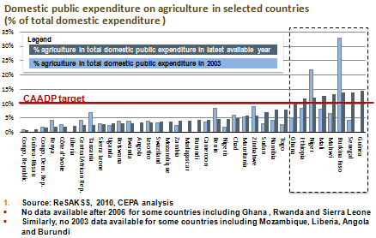
Many African governments are now focusing more on agriculture
Slide is courtesy of Prabhu Pingali, Greg Traxler and Tuu-Van Nguyen (2011), “Changing Trends in the Demand and Supply of Aid for Agriculture Development and the Quest for Coordination,” at the AAEA, July 24–26, 2011.
Notes:
Slide is courtesy of Prabhu Pingali, Greg Traxler and Tuu-Van Nguyen (2011), “Changing Trends in the Demand and Supply of Aid for Agriculture Development and the Quest for Coordination.” Presentation at the Annual Meetings of the AAEA, July 24–26, 2011.

Slide 20
Conclusions: Africa’s turnaround, from impoverishment to sustainable growth
“Africa” is 55 countries, >1000 languages, all ecosystems
  But the totals and averages can help us explain and predict each story
Africa’s total income fell from 1980 through 2000, but is now rising
  A major cause of impoverishment was change in land available per farmer, driven down by rural population growth which is now slowing
  Appropriate new farm technologies are finally arriving, so crop yields, output and input use are now rising
Investment in agriculture, food and nutrition security had shrunk to near zero, but is now being restored
  Agriculture and food supplies had been key to cutting Asian poverty 20-30 years earlier, then seen as no longer needed when Africa become poor
  Africa is now poised for rapid change, with many opportunities for sustained improvements – while remaining the last frontier of extreme poverty

