Slide 1


Food Wars in Africa?
Exploring the connection between food security, conflict and economic development
Will Masters
Professor and Chair, Department of Food and Nutrition Policy, Tufts University
www.nutrition.tufts.edu | sites.tufts.edu/willmasters | sites.tufts.edu/feinstein
18th Annual International Development Conference
Harvard Kennedy School of Government
14 April 2012

Slide 2
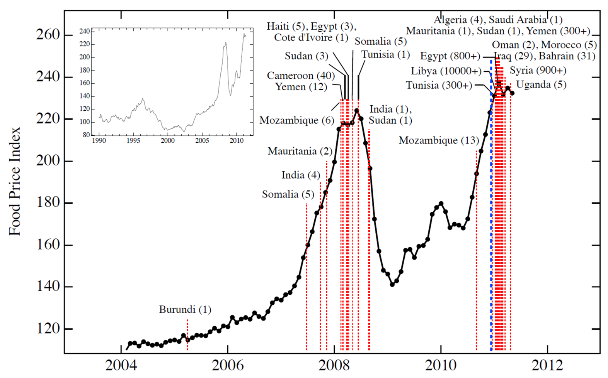
High food prices and price spikes are correlated with food riots
Source: M. Lagi, K.Z. Bertrand, Y. Bar-Yam, “The Food Crises and Political Instability in North Africa and the Middle East.” arXiv:1108.2455, August 10, 2011.
Note: Nominal FAO Food Price Index from January 2004 to May 2011, with red dashed
vertical lines correspond to beginning dates of “food riots" and protests, whose overall death toll is reported in parentheses.

Slide 3
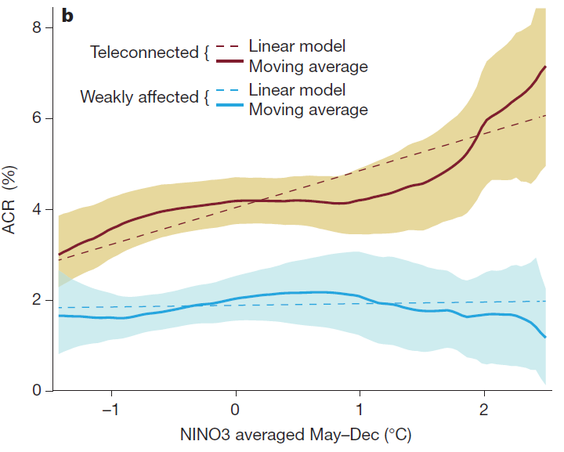
Civil conflicts are correlated with climate anomalies
“Using data from 1950 to 2004, we show that the probability of new civil conflicts arising throughout the tropics doubles during El Nino years.
…ENSO may have had a role in 21% of all civil conflicts since 1950”
Source: Solomon M. Hsiang, Kyle C. Meng & Mark A. Cane, “Civil conflicts are associated with the global climate” Nature 476, 438–441 (25 August 2011).
Note: Data show linear and non-parametric fit (n=554, weighted moving average, 90% confidence intervals shaded) of Annual Conflict Risk against temperature anomalies (NINO3), controlling for time trends and mean shift after the end of the Cold War.

Slide 4
Correlation is not causality
High food prices do not lead to riots where people have adequate incomes, coping mechanisms and social safety nets
Climate change does not lead to conflict where people have escaped from rural poverty
…but it is meaningful.
High food prices and rural poverty do cause vulnerability!

Slide 5
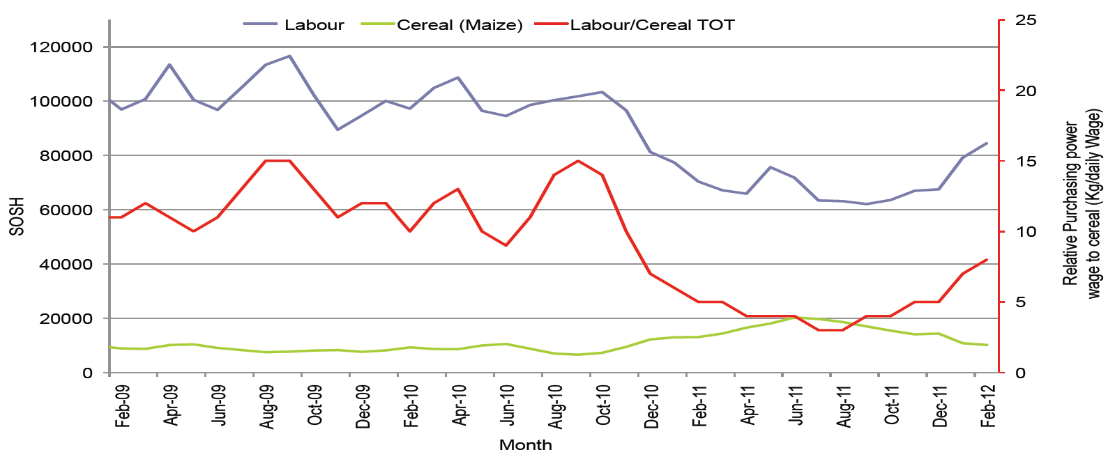
Famine in Somalia, 2011-2012
Usual coping strategies (off-farm work, livestock sales) exhausted by poverty;
migration disrupted by Shabaab, remittances disrupted by sanctions.
End of famine declaration
Feb. 3, 2012
Wage rates, maize prices and relative purchasing power in Juba regions of Somalia, Nov. 2008-Feb. 2012
Famine declared
July 20, 2011
Wages fell
Prices rose
Source: FSNAU-Somalia Market Data Update, 16 March 2012.
Nairobi: Food Security and Nutrition Analysis Unit – Somalia (www.fsnau.org).

Slide 6
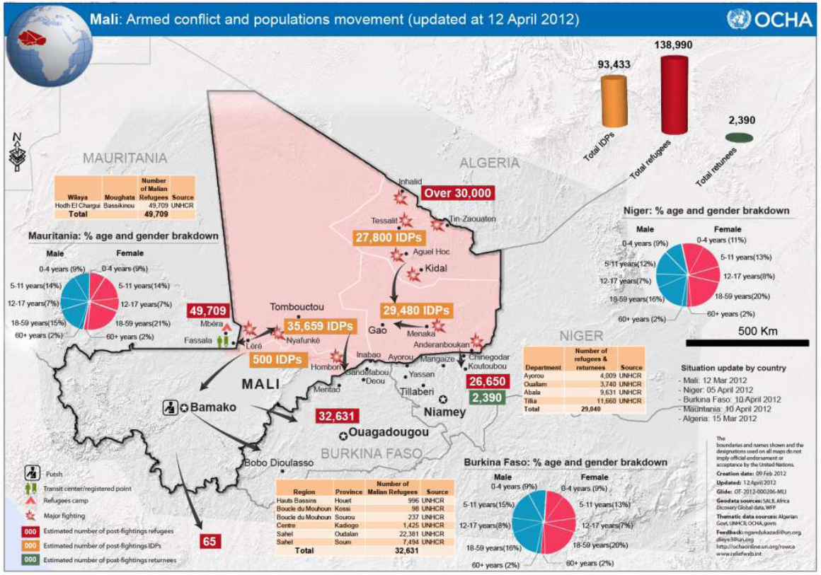
Mar. 22: coup d’etat
April 2: sanctions
April 5: transition
April 6: “Azawad”
Source: UN Office for the Coordination of Humanitarian Affairs (OCHA), “Situation au Mali - Bulletin spécial nº 9, 12 avril 2012.” http://reliefweb.int/node/489774.

Slide 7
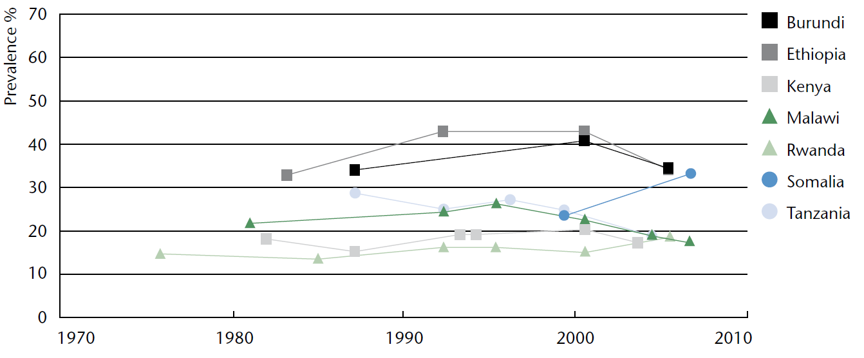
Outside crisis areas, in much of Africa undernutrition has been improving
National trends in prevalence of underweight children (0-5 years)
Selected countries with repeated national surveys
The few available surveys show widespread gains
Somalia is an exception, its malnutrition worsened before the famine
Source: UN SCN. Sixth Report on the World Nutrition Situation. Released October 2010, at http://www.unscn.org.

Slide 8
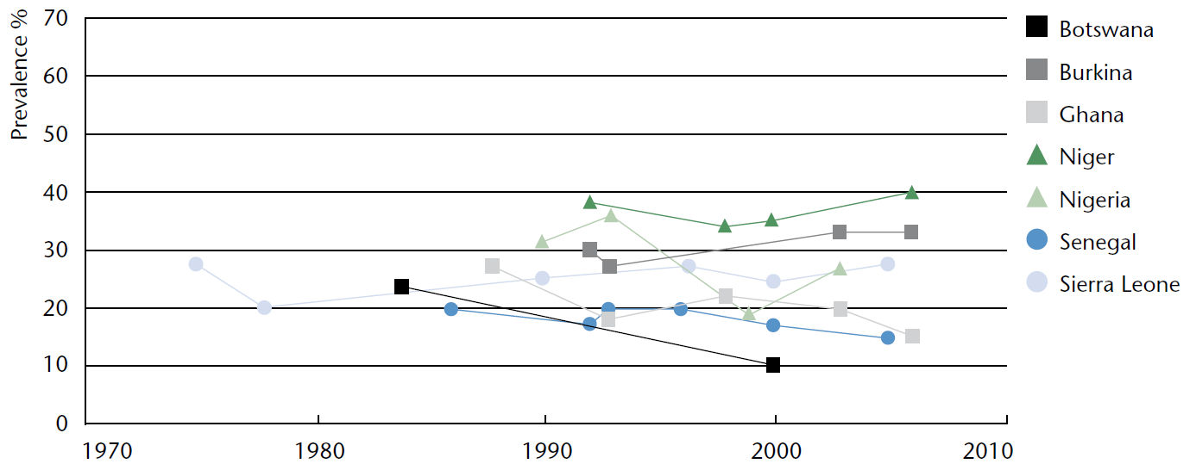
The Sahel remains one of Africa’s
worst danger zones for food insecurity
National trends in prevalence of underweight children (0-5 years)
Selected countries with repeated national surveys
Conditions in the Sahel are bad and getting worse
Source: UN SCN. Sixth Report on the World Nutrition Situation. Released October 2010, at http://www.unscn.org.

Slide 9
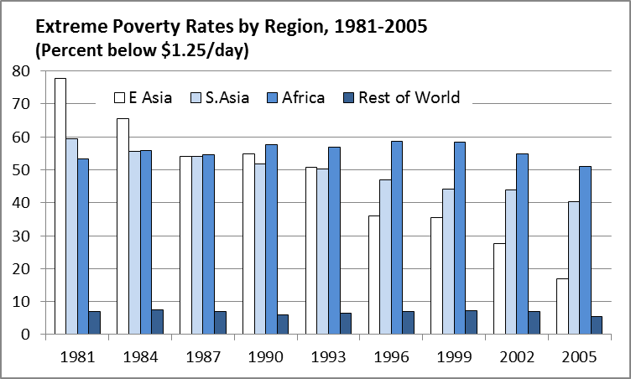
For Africa as a whole, impoverishment is relatively recent, and is already declining
Since 2000, African poverty has declined as it did earlier in Asia
In the 1980s & ‘90s, Africa became the world’s most impoverished region
Source: Author’s calculation from World Bank (2011), PovcalNet (http://iresearch.worldbank.org/PovcalNet/), updated 11 April 2011. Estimates are based on over 700 household surveys from more than 120 countries, and refer to per-capita expenditure at purchasing-power parity prices for 2005.

Slide 10
Africa’s impoverishment was closely linked
to a child-survival baby boom
that is now a demographic gift
Child and elderly dependency rates by region (0-15 and 65+), 1950-2030
High and rising child dependency imposed an unprecedented demographic burden
Since 1990, declining dependency offers a demographic gift similar to Asia’s
20 years earlier
Eventually,
old-age dependency becomes the problem
Source: Calculated from UN Population Projections, 2008 revision (March 2009),
at http://esa.un.org/unpp.

Slide 11
Africa’s demographic pressure
has been especially severe in rural areas
but the burden is getting lighter
Rural population growth rates by region, 1950-2030
Over 2% annual growth in the rural population, for over 30 years!
but now
around 1% and falling
Rural population growth eventually falls below zero;
land per farmer can then expand with mechanization
Source: Calculated from FAOStat (downloaded 17 March 2009). Rural population estimates and projections
are based on UN Population Projections (2006 revision) and UN Urbanization Prospects (2001 revision).

Slide 12
In the 1990s, Africa’s green revolution finally began to arrive
…about 20 years behind Asia & Latin America
Source: Reprinted from W.A. Masters, “Paying for Prosperity: How and Why to Invest in Agricultural Research and Development in Africa” (2005), Journal of International Affairs, 58(2): 35-64.

Slide 13
Africa is almost out of the most vulnerable zone
…but not yet, and not all of Africa
Africa faced extreme demographic stress in the ‘70s & ’80s
  Child dependency rate rose higher than Asia’s peak and kept rising
  Rural population growth rose higher than Asia’s peak and kept rising
Africa’s demographic pressure has slowed since the 1990s
  About 20 years after Asia’s similar transitions
  Allowing poverty reduction and nutrition improvements since 2000s
African agriculture continues to face extreme challenges
  Demographic pressure is declining but won’t end until the 2050s
  Climatic conditions are worsening, perhaps at an accelerating pace
“Africa” is 55 countries, >1000 languages, all ecosystems
  Pockets of extreme poverty will persist and could worsen

Slide 15
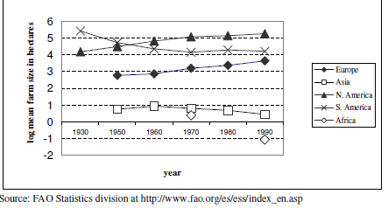
In the 1970s and ’80s, Africans faced unprecedented decline in land area per farm
Land available per farm household (hectares)
Reprinted from Robert Eastwood, Michael Lipton and Andrew Newell (2010), “Farm Size”, chapter 65 in Prabhu Pingali and Robert Evenson, eds., Handbook of Agricultural Economics, Volume 4, Pages 3323-3397. Elsevier.

Slide 16
The rural population stops growing when urbanization employs all new workers
…in Africa that won’t happen until the 2050s
Population by principal residence, 1950-2050
World (total)
Sub-Saharan Africa
2012
2012
Worldwide, rural population growth has almost stopped
Africa still has both
rural & urban growth
Source: Calculated from UN World Urbanization Prospects, 2009 Revision , released April 2010 at http://esa.un.org/unpd/wup. Downloaded 7 Nov. 2010.

Slide 17


For much of Africa, prosperity is already arriving

Slide 18
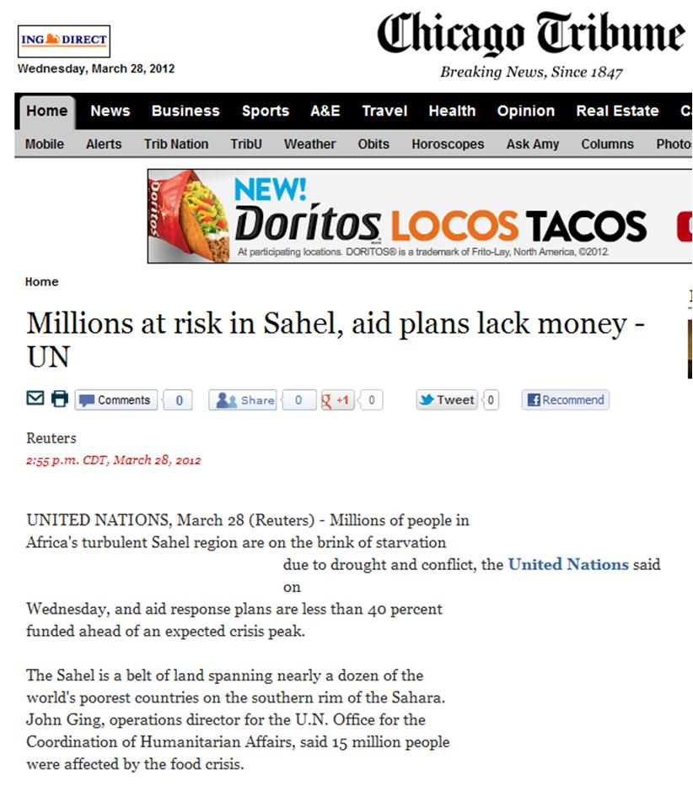
...but the Sahel region is still a tinderbox

Slide 19

...even as the rest of Africa becomes increasingly like us

