Slide 1


The Changing Face of Global Malnutrition
Will Masters
Professor and Chair, Department of Food and Nutrition Policy, Tufts University
www.nutrition.tufts.edu | http://sites.tufts.edu/willmasters
AAEA session on the evolving dual burden of obesity and malnutrition: driving forces and implications for development policy
Washington, DC – 6 August 2013

Slide 2
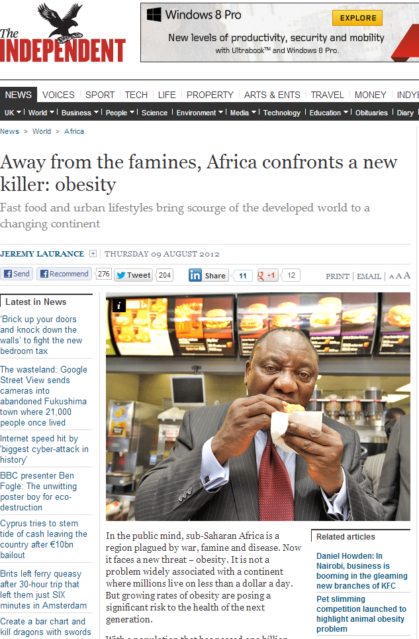
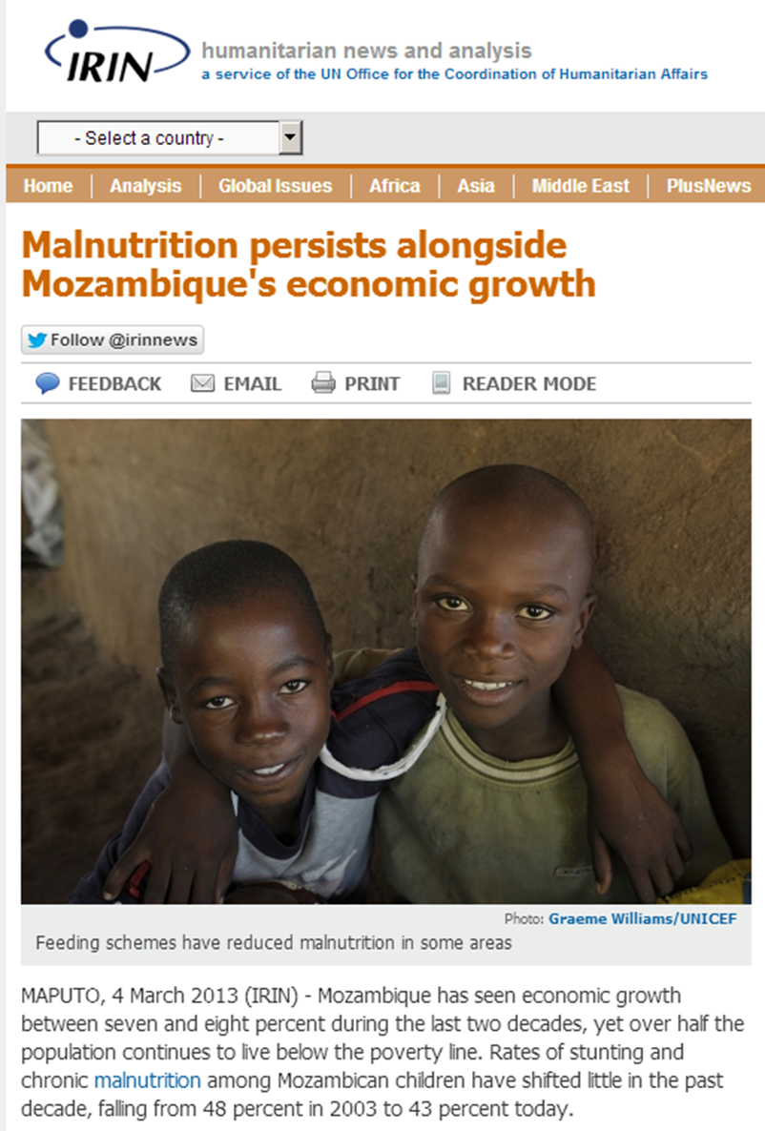
What’s behind these headlines?

Slide 3
The Changing Face of Global Malnutrition
From headlines to data…
and then program evaluations,
for cash transfers or other interventions
Malnutrition, from under- to over-consumption
  The search for just-right nutrition
  The end of scarcity?
Global malnutrition is diverse and rapidly changing
  Malnutrition (over or under) is a disease of poverty
  Africa fell into extreme poverty only recently and is already recovering, but has far to go

Slide 4
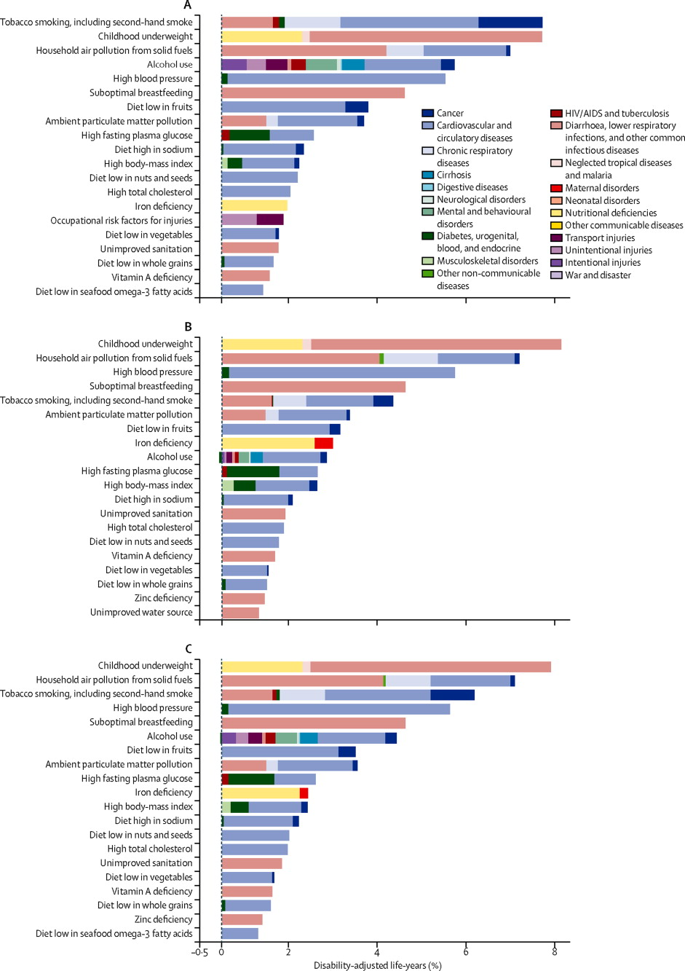
Undernutrition has long been the world’s leading cause of disease and disability
Percent of disability-adjusted life years lost, by risk factor (1990)
Under-nutrition
Over-consumption
Source: S.S. Lim et al., “A comparative risk assessment of burden of disease and injury attributable to 67 risk factors and risk factor clusters in 21 regions, 1990–2010: a systematic analysis for the Global Burden of Disease Study 2010,” The Lancet, v.380, no. 9859, 15 Dec. 2012–4 Jan. 2013, pages 2224-2260.

Slide 5
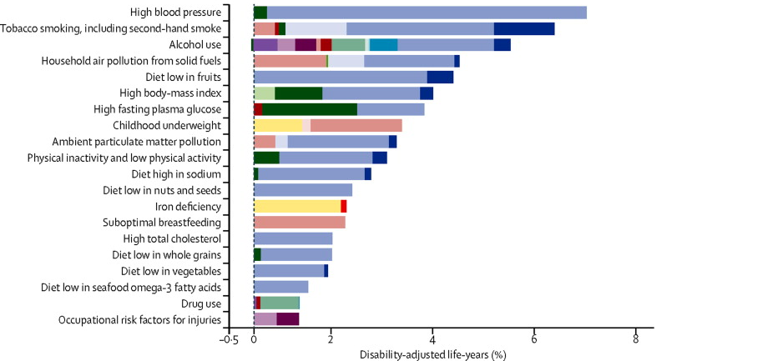
Globally, we are now Goldilocks, with too much and too little, looking for just-right nutrition
Percent of disability-adjusted life years lost, by risk factor (2010)
Over-consumption
Under-nutrition
Source: S.S. Lim et al., “A comparative risk assessment of burden of disease and injury attributable to 67 risk factors and risk factor clusters in 21 regions, 1990–2010: a systematic analysis for the Global Burden of Disease Study 2010,” The Lancet, v.380, no. 9859, 15 Dec. 2012–4 Jan. 2013, pages 2224-2260.

Slide 6
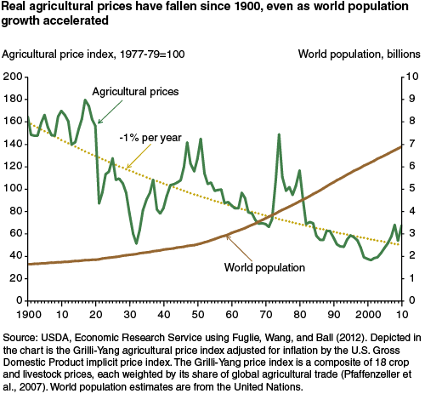



Did we beat Malthus?
The end of food scarcity?
From this...
To this?
Source: K. Fuglie and S. L. Wang, “New Evidence Points to Robust but Uneven Productivity Growth in Global Agriculture,” Amber Waves, September 2012. Washington: Economic Research Service, USDA.

Slide 7
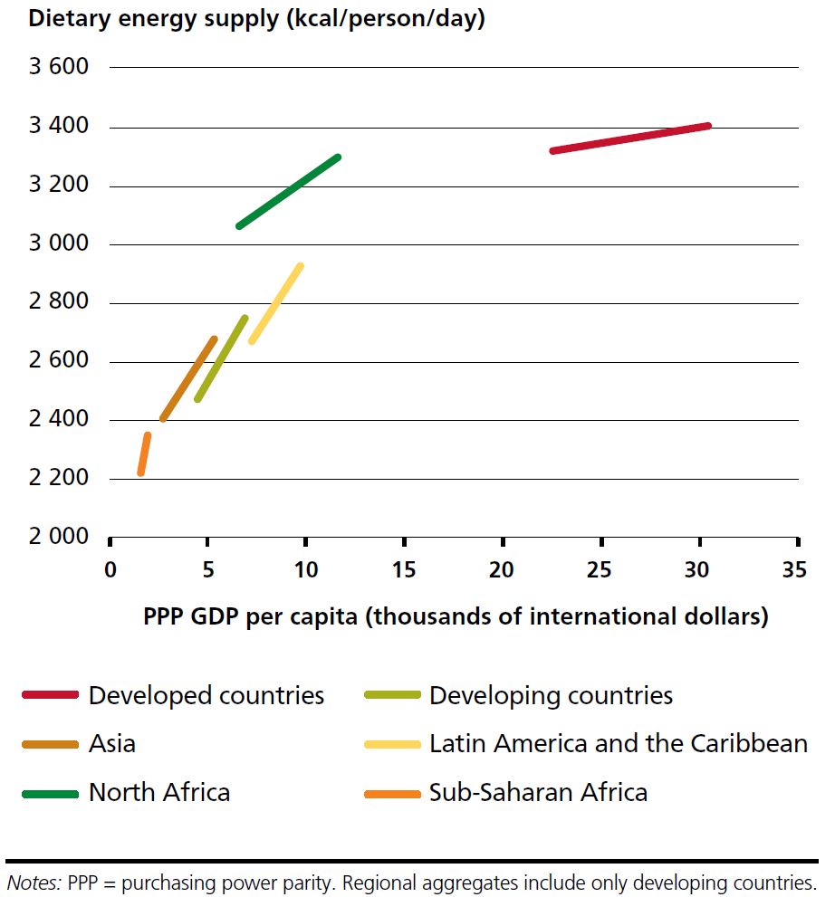
Some regions are still far from abundance
Food supply and real income by region, 1990-2010
Africa has the least food, and is the poorest
Source: FAO, The State of Food Insecurity in the World 2012. Rome: Food and Agriculture Organization.

Slide 8
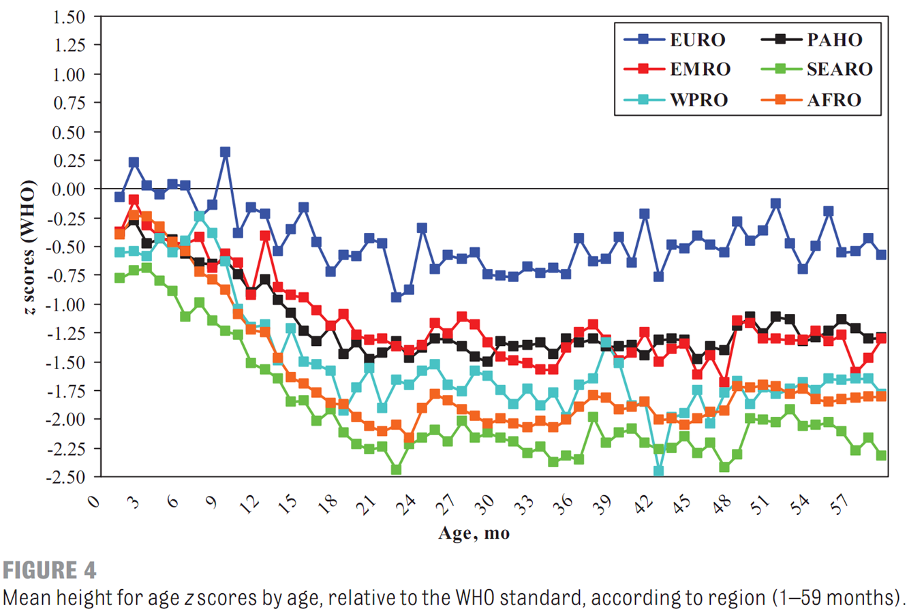
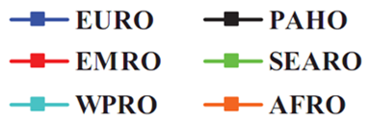
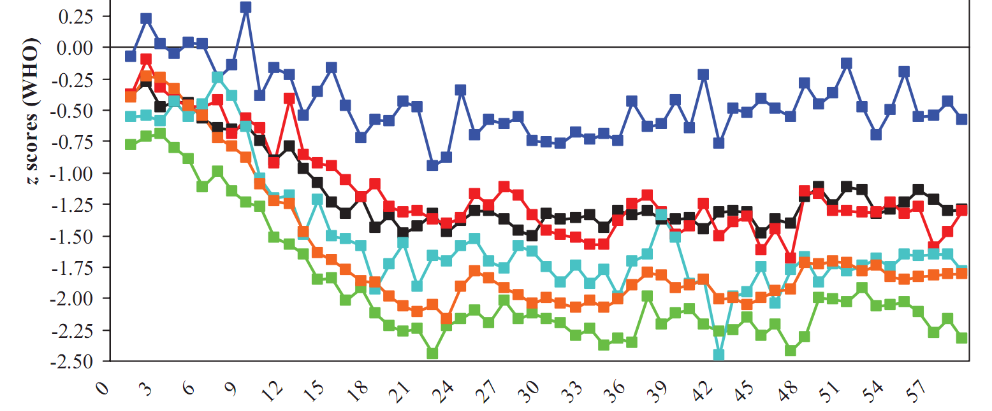
Today’s malnutrition may last forever
Mean height-for-age z scores relative to WHO standards, by region (1-59 months)
EURO: Armenia, Kazkhst., Kyrgyst., Moldova, Mongolia, Montenegro, Turkey (1997-2005)
EMRO: Egypt, Jordan, Morocco, Yemen (1997-2007)
PAHO: Boliv., Brazil, Colomb., Dom.Rep., Guatem., Haiti, Hondur., Nicarag., Peru (1999-2006)
WPRO: Cambodia, Mongolia (2005)
AFRO: Thirty countries (1994-2006)
SEARO: Bangladesh, India, Nepal (2004-2006)
Much of the lifelong burden of undernutrition is experienced in infancy
Source: CG Victora, M de Onis, PC Hallal, M Blössner and R Shrimpton, “Worldwide timing of growth faltering: revisiting implications for interventions.” Pediatrics, 125(3, Mar. 2010):e473-80.

Slide 9
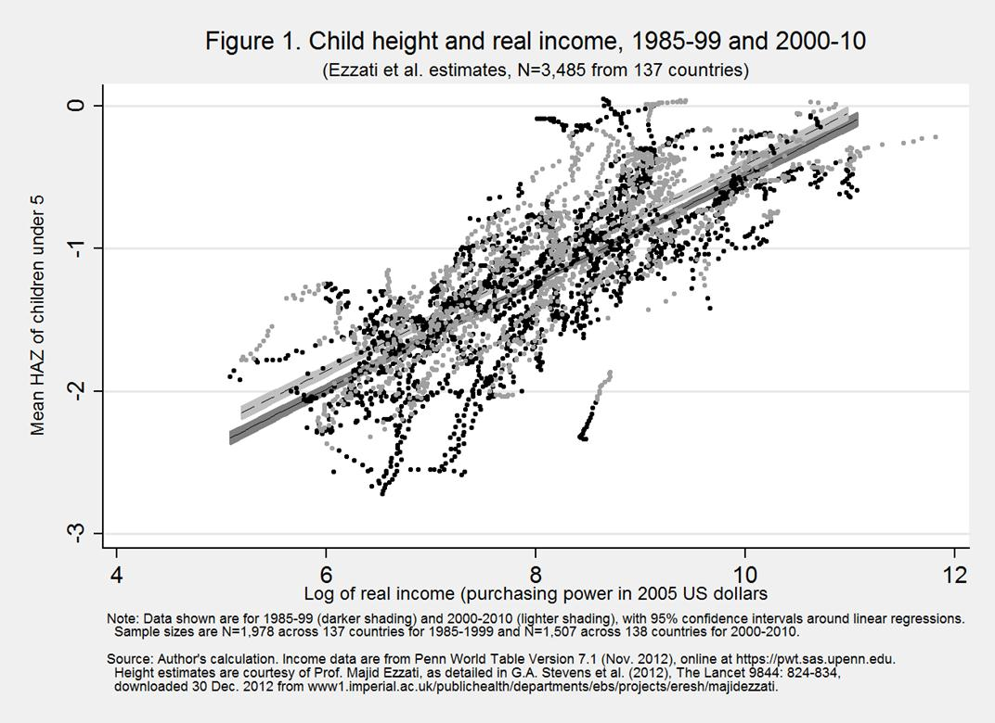
Higher-income countries grow taller children
…and at each income level, children are slightly
taller
now
Source: W.A. Masters, 2013. “Child Nutrition and Economic Development”, Nutrition in Pediatrics, 5th ed. (chapter 44), edited by C.P. Duggan, J.B. Watkins, B. Koletzko and W.A. Walke, Shelton, CT: PMPH-USA.

Slide 10
…and have more overweight children too
…and at each income level, children are slightly more
likely to be
overweight
Source: Author’s calculation.

Slide 11
Overall, malnutrition is a disease of poverty
Source: Author’s calculation.

Slide 12
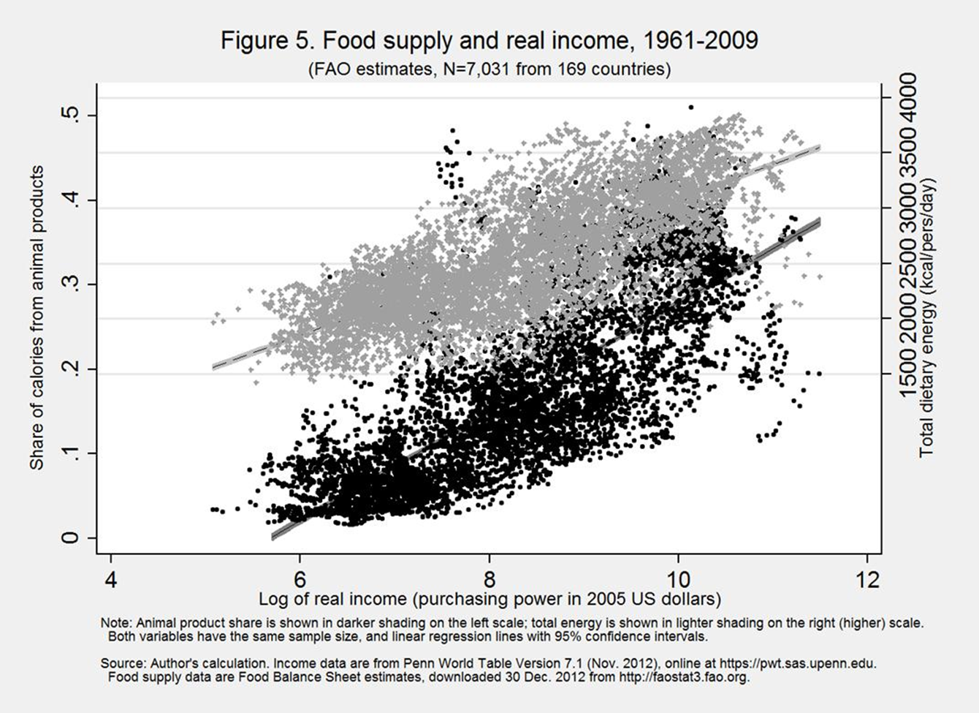
Higher income changes diet quality as well as quantity
Share of calories from animal sources, total food supply and income, 1961-2009
Total calories available rise from under 2000
to over 3500
per person/day
Animal-sourced foods rise from about 5% to about 40% of calories
Source: W.A. Masters, 2013. “Child Nutrition and Economic Development”, Nutrition in Pediatrics, 5th ed. (chapter 44), edited by C.P. Duggan, J.B. Watkins, B. Koletzko and W.A. Walke, Shelton, CT: PMPH-USA.

Slide 13
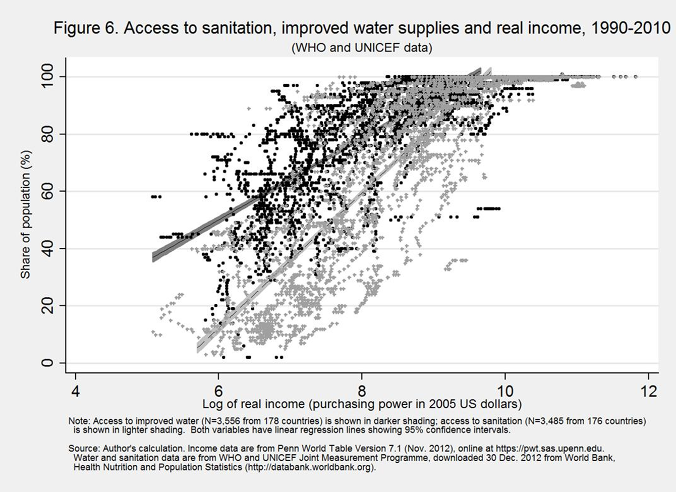
Higher income also buys sanitation and
clean water (among other things)
Access to sanitation, improved water and income, 1990-2010
Access to improved water rises from under 40% to 100% of households
Access to sanitation rises from under 5% to 100%
of households
Source: W.A. Masters, 2013. “Child Nutrition and Economic Development”, Nutrition in Pediatrics, 5th ed. (chapter 44), edited by C.P. Duggan, J.B. Watkins, B. Koletzko and W.A. Walke, Shelton, CT: PMPH-USA.

Slide 14
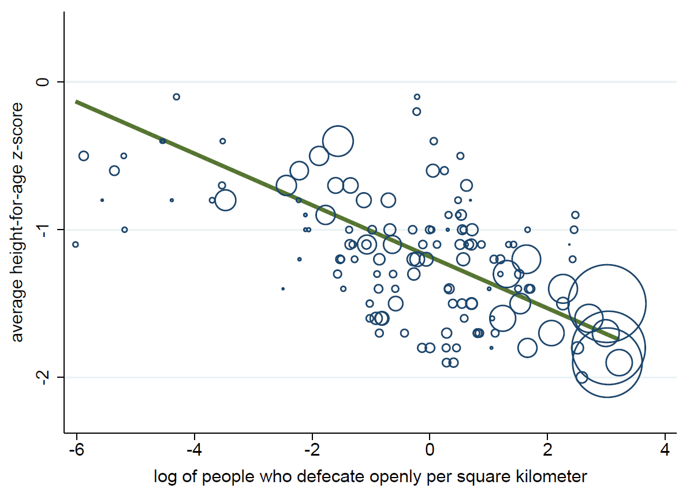
Sanitation may be especially important
for stunting in high-density areas
India
Note: Observations are nationally representative country totals from 130 DHS surveys in 65 countries, 1990-2010, with circles are proportional to population.
Source: Dean Spears (2013), http://riceinstitute.org.

Slide 15
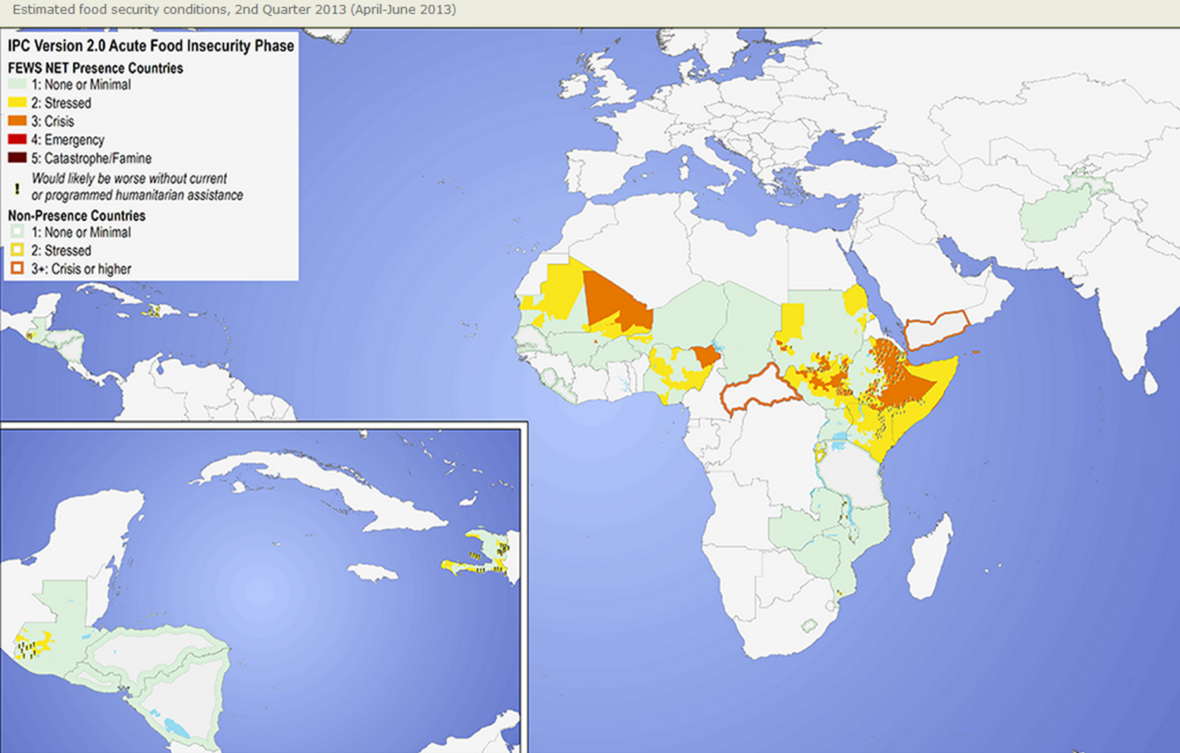
Africa has almost all of the world’s
most extreme poverty and hunger
Mali
Yemen
Nigeria
(at border with Chad)
Ethiopia
South Sudan
Central African Republic
Source: USAID Famine Early Warning Systems Network, 3/27/2013 (http://www.fews.net)

Slide 16
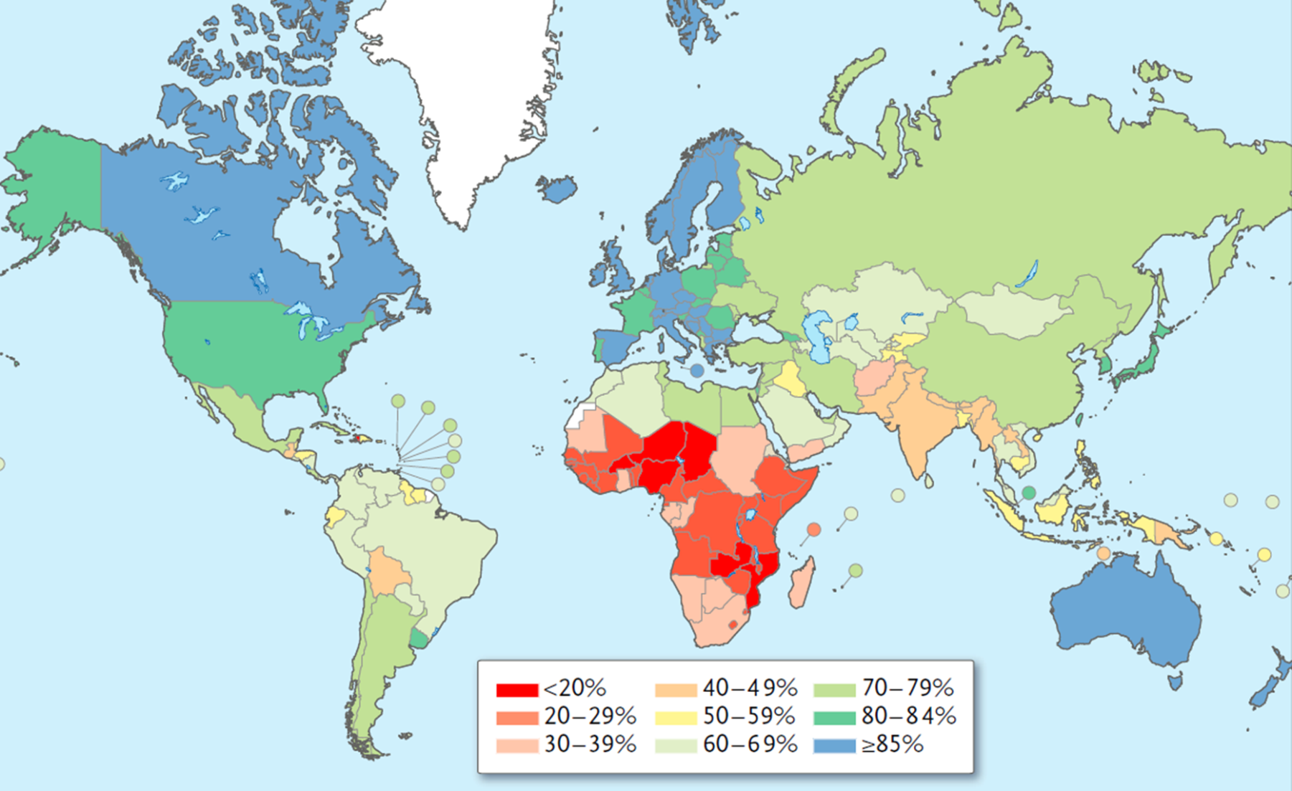
Africa’s burden of disease is still principally infectious, rather than NCDs
Percentage of total Disability-Adjusted Life-Years lost
attributable to non-communicable diseases (NCDs), 2010
Source: C.J.L. Murray and A.D. Lopez, Measuring the Global Burden of Disease. New England Journal of Medicine, 369 (August, 2013):448-57.

Slide 17
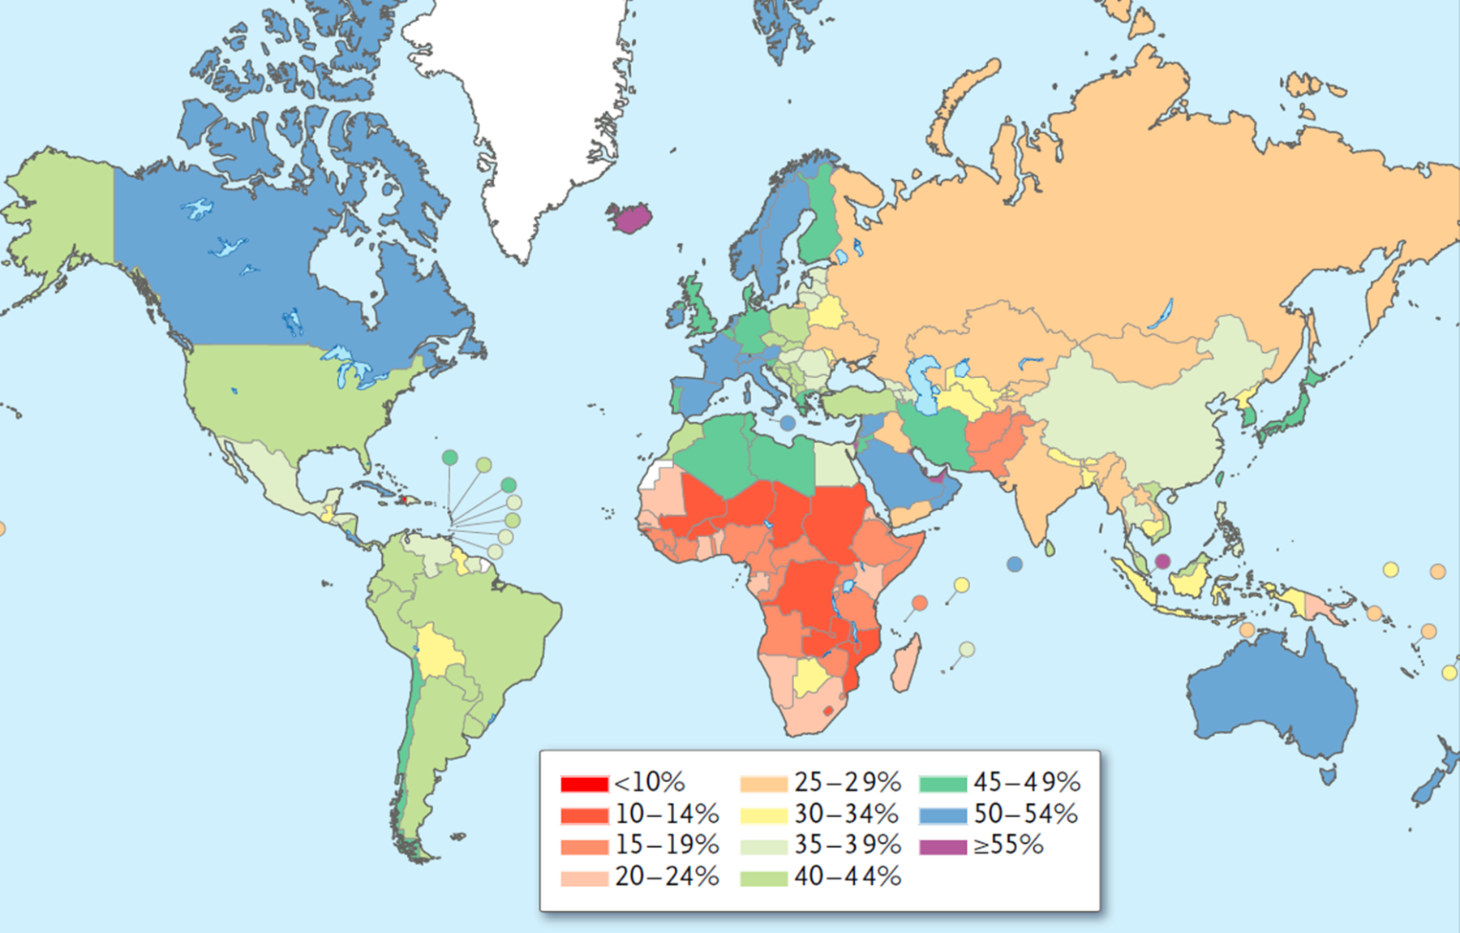
Africa’s burden of disease is still principally mortality, rather than disability
Percentage of total Disability-Adjusted Life-Years (DALYs)
due to years lived with disability, 2010
Source: C.J.L. Murray and A.D. Lopez, Measuring the Global Burden of Disease. New England Journal of Medicine, 369 (August, 2013):448-57.

Slide 18
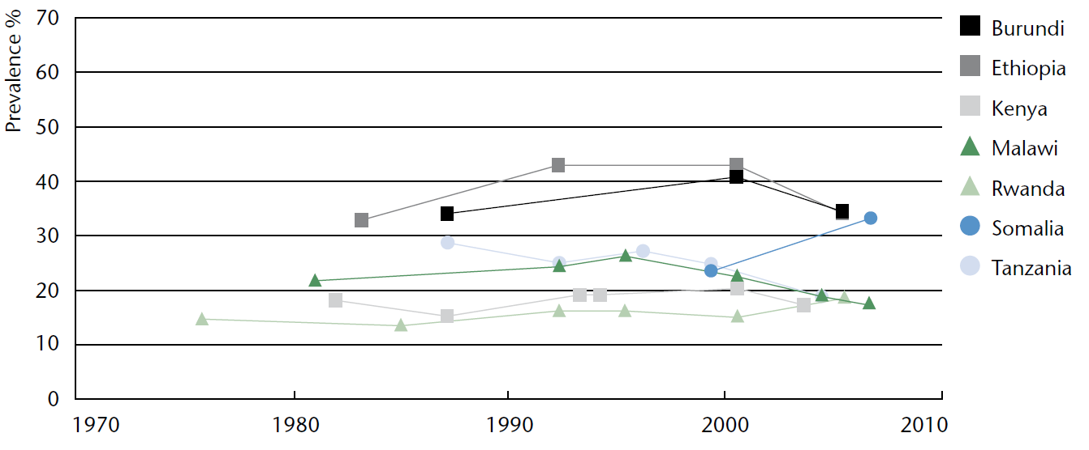
Undernutrition has begun to improve
in some African countries
National trends in prevalence of underweight children (0-5 years)
Selected countries with repeated national surveys
Somalia is an exception, its malnutrition worsened before the 2011 famine
Source: UN SCN. Sixth Report on the World Nutrition Situation. Released October 2010, at http://www.unscn.org.

Slide 19
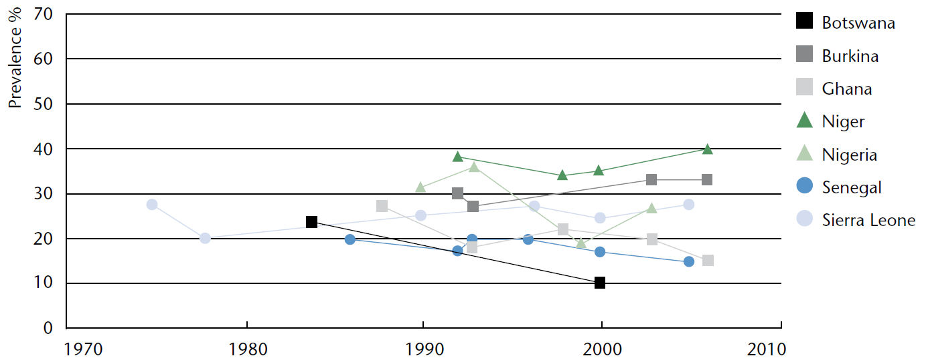
Undernutrition levels and trends
vary widely across Africa
National trends in prevalence of underweight children (0-5 years)
Selected countries with repeated national surveys
Conditions in the Sahel are among the worst in Africa
Source: UN SCN. Sixth Report on the World Nutrition Situation. Released October 2010, at http://www.unscn.org.

Slide 20
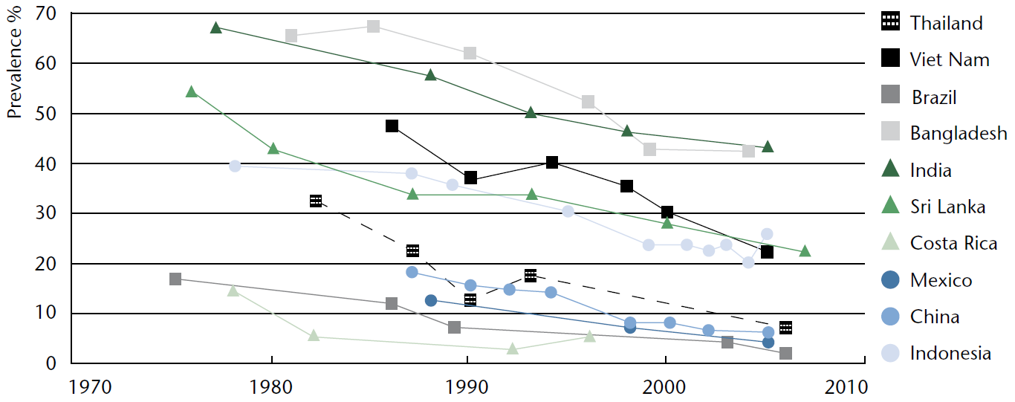
In Asia, where undernutrition was worst, we’ve seen >20 years of improvement
National trends in prevalence of underweight children (0-5 years)
Selected countries with repeated national surveys
Source: UN SCN. Sixth Report on the World Nutrition Situation. Released October 2010, at http://www.unscn.org.

Slide 21
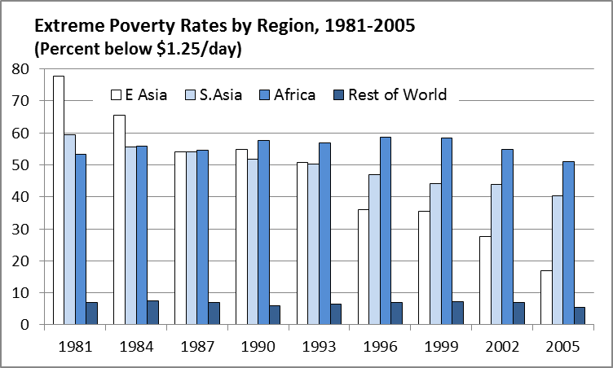
Africa’s impoverishment is relatively recent and may already be ending
Since 2000, African poverty has declined as it did earlier in Asia
In the 1980s & ‘90s, Africa became the world’s most impoverished region
Source: Calculated from World Bank (2011), PovcalNet (http://iresearch.worldbank.org/PovcalNet/), updated 11 April 2011. Estimates are based on over 700 household surveys from more than 120 countries, and refer to per-capita expenditure at purchasing-power parity prices for 2005.

Slide 22
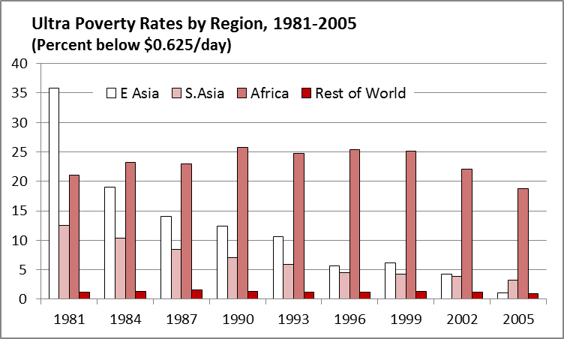
Despite the recent turnaround,
Africa is the last frontier of ultra poverty (<$0.625/day)
Source: Author’s calculation from World Bank (2011), PovcalNet (http://iresearch.worldbank.org/PovcalNet/), updated 11 April 2011. Estimates are based on over 700 household surveys from more than 120 countries, and refer to per-capita expenditure at purchasing-power parity prices for 2005.

Slide 23
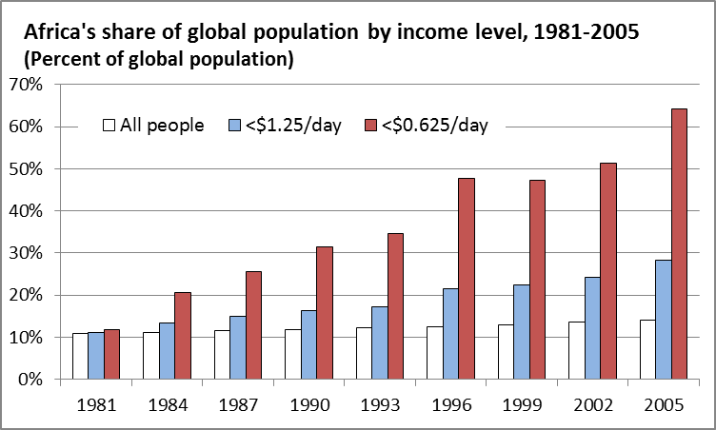
Africa now has 1/8th of the world’s people, but 2/3^{rds} of the ultra-poor
Source: Author’s calculation from World Bank (2011), PovcalNet (http://iresearch.worldbank.org/PovcalNet/), updated 11 April 2011. Estimates are based on over 700 household surveys from more than 120 countries, and refer to per-capita expenditure at purchasing-power parity prices for 2005.

Slide 24
An underlying cause of Africa’s impoverishment has been its child-survival baby boom, roughly 20 years behind Asia’s
Child and elderly dependency rates by region (0-15 and 65+), 1950-2055
Africa had the world’s most severe demographic burden (>90 children per 100 adults)
Africa is now experiencing Asia’s earlier ‘demographic gift’,
but more slowly
2013
Source: Calculated from UN Population Division, World Population Projections (http://esa.un.org/unpd/wpp), accessed 11 Aug 2012, based on UN Population Prospects: The 2010 Revision (April 2011).

Slide 25
A related cause of Africa’s impoverishment is fast, sustained rural population growth
Rural population growth rates by region, 1950-2055
Africa had over 2% annual growth in the rural population, for over 30 years!
Africa is now experiencing Asia’s earlier slowdown in rural population growth,
but more slowly
2013
Rural population growth eventually falls below zero;
land per farmer can then expand with mechanization
Source: Calculated from UN Population Division, World Population Projections (http://esa.un.org/unpd/wpp), accessed 11 Aug 2012, based on UN Population Prospects: The 2010 Revision (April 2011).

Slide 26
The rural population stops growing and farm sizes can rise when urbanization employs all new workers
…in Africa that won’t happen until the 2050s
Population by principal residence, 1950-2050
World (total)
Sub-Saharan Africa
2013
2013
Worldwide, rural population growth has almost stopped
Africa still has both
rural & urban growth
Source: Calculated from UN World Urbanization Prospects, 2011 Revision , released October 2012 at http://esa.un.org/unpd/wup. Downloaded 18 April 2013.

Slide 27
Africa’s continued rising rural population is in sharp contrast to the rest of the world
Population by principal residence, 1950-2050
World outside Africa
Sub-Saharan Africa
2013
2013
Outside Africa, the rural population is falling sharply
Africa still has both
rural & urban growth
Source: Calculated from UN World Urbanization Prospects, 2011 Revision , released October 2012 at http://esa.un.org/unpd/wup. Downloaded 18 April 2013.

Slide 28
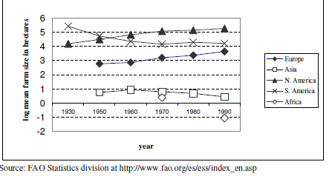
Africa’s burst of rural population growth drove a sharp fall in land per farmer
Land available per farm household (hectares)
Reprinted from Robert Eastwood, Michael Lipton and Andrew Newell (2010), “Farm Size”, chapter 65 in Prabhu Pingali and Robert Evenson, eds., Handbook of Agricultural Economics, Volume 4, Pages 3323-3397. Elsevier.

Slide 29
Africa’s green revolution has just begun
USDA estimates of average cereal grain yields (mt/ha), 1960-2013
Source: Calculated from USDA , PS&D data (www.fas.usda.gov/psdonline), downloaded 2 Aug 2013. Results shown are each region’s total production per harvested area in barley, corn, millet, mixed grains, oats, rice, rye, sorghum and wheat.

Slide 30
So the new face of global malnutrition is diverse and rapidly changing

Slide 32
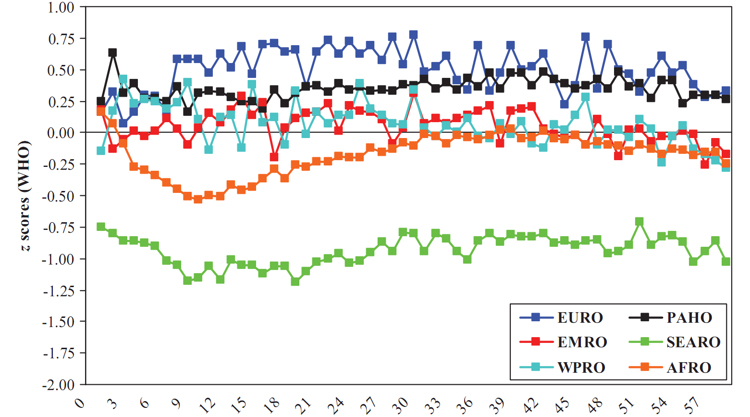
In poorest regions, mean WHZ falls in 1st year,
then recovers in 2nd and 3rd years
Mean weight-for-height z scores relative to WHO standards, by region (1-59 mo.)
Only in South Asia and Africa is the average infant thin for their height;
In Africa, they are thin only in infancy;
In Asia, they remain thin.
Source: CG Victora, M de Onis, PC Hallal, M Blössner and R Shrimpton, “Worldwide timing of growth faltering: revisiting implications for interventions.” Pediatrics, 125(3, Mar. 2010):e473-80.

Slide 33
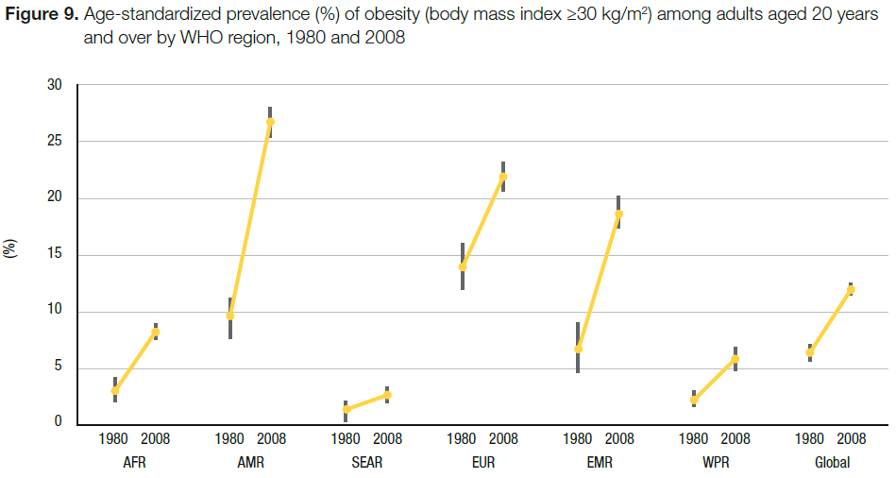
Later in life, obesity rates are rising everywhere
Note: AFR=Africa, AMR=Americas, SEAR=SE Asia, EUR=Europe, EMR=Eastern Medit., WPR=Western Pacific
Source: WHO, World Health Statistics 2012.

Slide 34
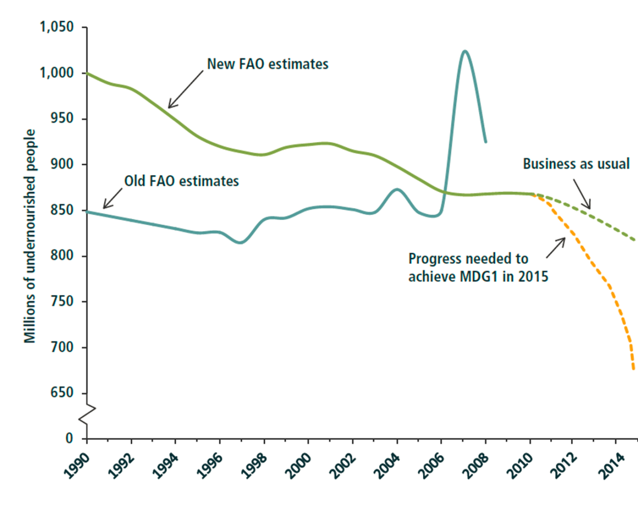
Did we beat Malthus?
The end of food scarcity?
FAO estimates and projections of undernourished people worldwide, 1990–2015
Source: Shenggen Fan (2013), IFPRI Global Food Policy Report, chapter 1. Old FAO estimates are from The State of Food Insecurity in the World (Rome, various years); new estimates are from FAO, The State of Food Insecurity in the World 2012; author’s projections are based on data from FAO and the United Nations..

Slide 35
U.S. aid for agriculture has just begun to recover after being sharply cut in 1980-99
After Asia’s green revolution, 20 years of complacency about agriculture
In the 2000s, donors (re)discovered health
…and then agriculture
Source: Author's calculations from OECD (2013), Official Bilateral Commitments by Sector, updated 15 April 2013 (http://stats.oecd.org/qwids).

Slide 36
Global aid trends have been similar to the U.S. trends, magnified times four
After Asia’s green revolution, 20 years of complacency about agriculture
In the 2000s, donors (re)discovered health
…and then agriculture
Source: Author's calculations from OECD (2013), Official Bilateral Commitments by Sector, updated 15 April 2013 (http://stats.oecd.org/qwids).

Slide 37
The wake-up of external aid for agriculture has been led by the Gates Foundation
Top 15 donors’ foreign aid commitments to African agriculture, 2005-2008
Note: Exact amounts for BMGF have been obscured because methodology differs from that used by the DAC. Source: P. Pingali, G. Traxler and T. Nguyen (2011), “Changing Trends in the Demand and Supply of Aid for Agriculture Development and the Quest for Coordination.” Annual Meetings of the AAEA, July 24–26, 2011.

Slide 38
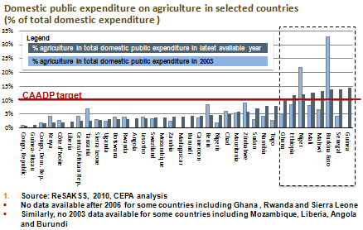
Many African governments are now focusing more on agriculture
Slide is courtesy of Prabhu Pingali, Greg Traxler and Tuu-Van Nguyen (2011), “Changing Trends in the Demand and Supply of Aid for Agriculture Development and the Quest for Coordination,” at the AAEA, July 24–26, 2011.
Notes:
Slide is courtesy of Prabhu Pingali, Greg Traxler and Tuu-Van Nguyen (2011), “Changing Trends in the Demand and Supply of Aid for Agriculture Development and the Quest for Coordination.” Presentation at the Annual Meetings of the AAEA, July 24–26, 2011.

Slide 39
Africa’s green revolution arrived late, roughly 20 years behind Asia’s
Source: Reprinted from W.A. Masters, “Paying for Prosperity: How and Why to Invest in Agricultural Research and Development in Africa” (2005), Journal of International Affairs, 58(2): 35-64.

