Slide 1
Utilization of AI/ML in Obesity Research Targeting African-American Women and Girls: The Mother-Daughter Dyad
Kenya Palmer Emrich, MS, MSN, FNP-BC, CSCS, NBC-HWC
Nutrition Intervention, Communication, Behavior Change (NICBC)
June 17, 2024

Slide 2
The Problem, Objectives & Aims
Problem: Rising prevalence of obesity in AA women and girls, lack of knowledge regarding the mother-daughter dyad.
Objective 1: Predicting obesity in AA women and girls, and the AA-MDD
Aim #1: Utilize AI/ML models to identify and predict risk factors in this population
Objective 2: Apply Behavior Change Interventions
Aim #2: Utilize AI/ML models to develop targeted, culturally specific interventions based on behavior change theory
Objective 3: Measure weight change
Aim #3: Evaluate the effectiveness of AI/ML-informed interventions in improving health behaviors and decreasing obesity in the AA mother-daughter dyad.

Slide 3
Ethical Considerations
ACCEPT-AI
Women4Ethicial AI
Age
Communication
Consent + Assent
Equity
Protection of Data
Technological Considerations—Transparency,
Support the implementation of the Recommendation on the Ethics of Artificial Intelligence,
Share research and contribute to a repository of good practices,
Drive progress on non-discriminatory algorithms and data sources, and
Incentivize girls, women and under-represented groups to participate in AI.
https://www.unesco.org/en/artificial-intelligence/women4ethical-ai

Slide 4
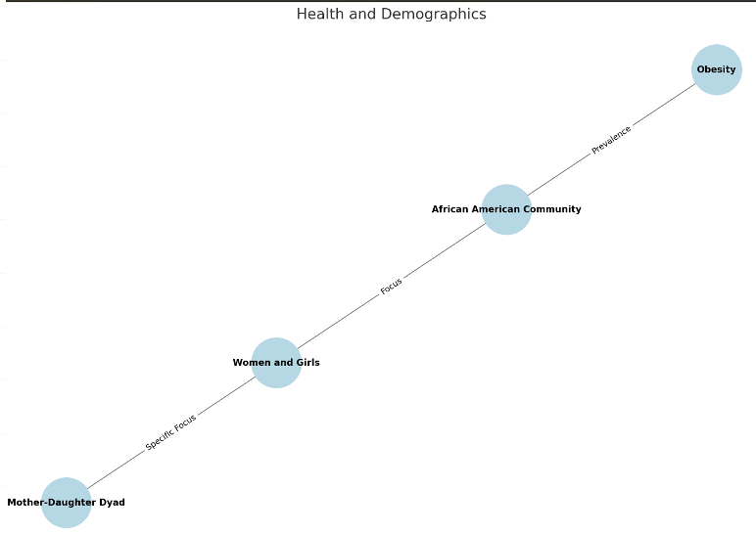
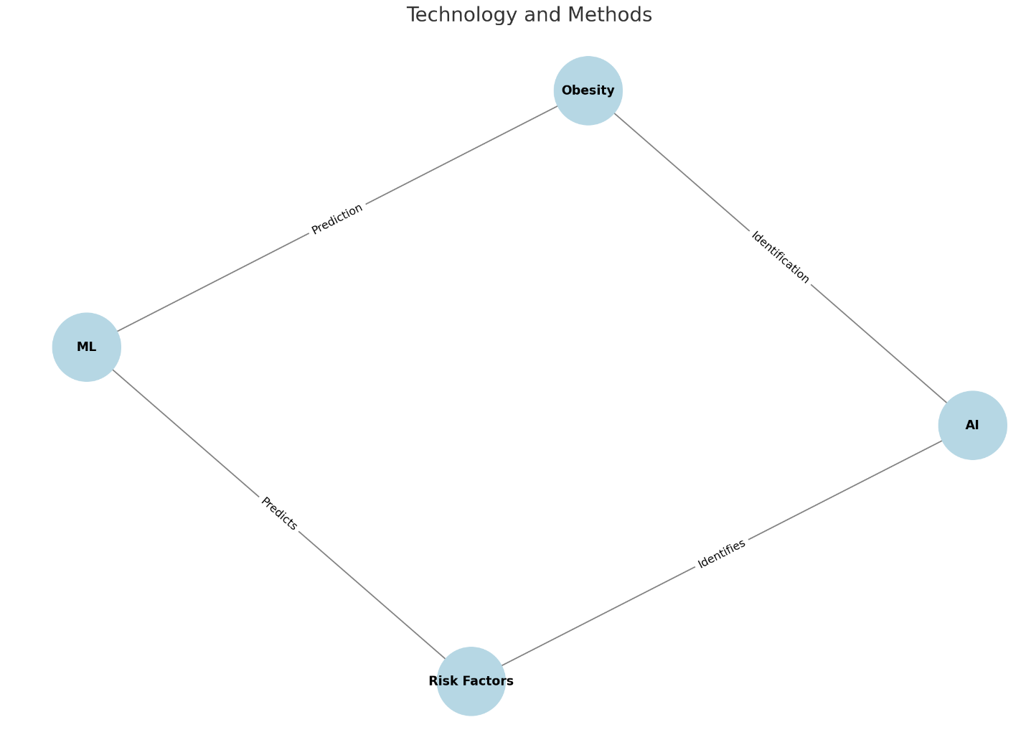
Glossary/Ontology/Knowledge Graphs

Slide 5
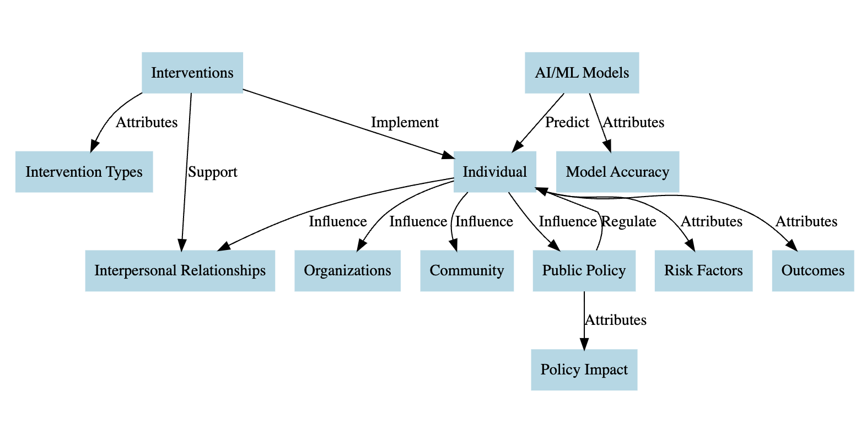
Conceptual Mapping & Policy

Slide 6
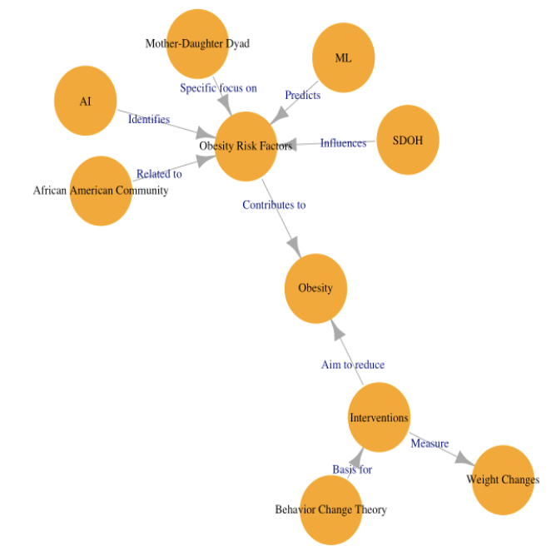
Causal diagrams

Slide 7
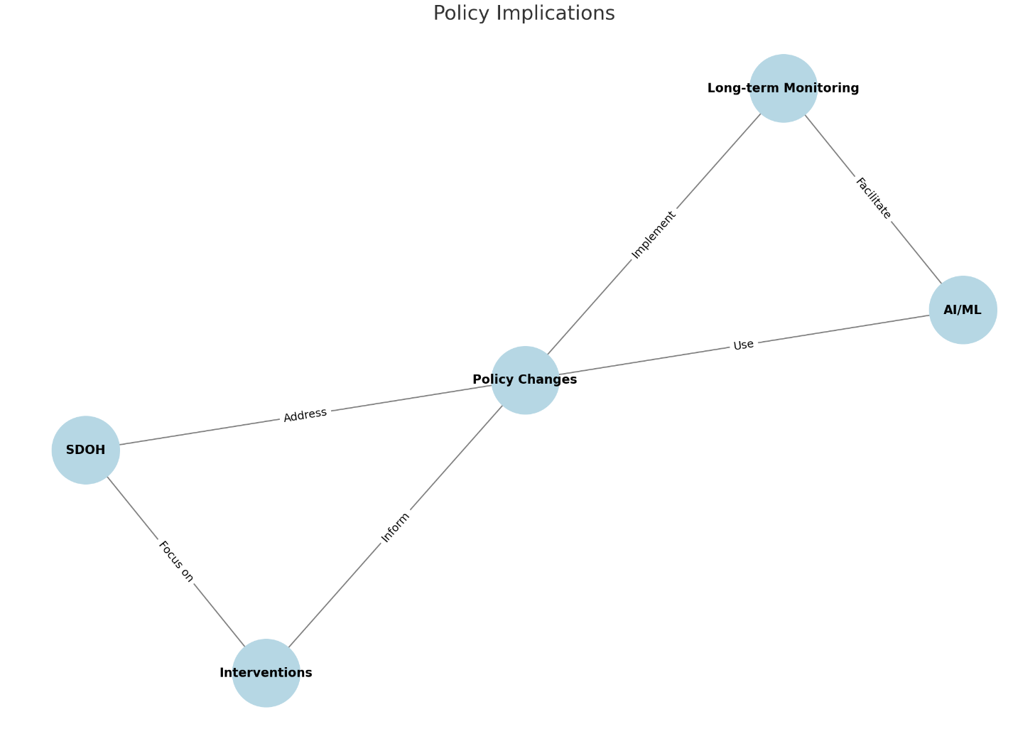
Future Implications
AI/ML-based research
Education and training in Obesity + AI/ML research
Cultural-specific intervention development
Robust longitudinal studies
Enhanced Ethical oversight
Policy Advocacy
Community engagement
Notes:
\

