Slide 1
Web Security Crash Course
Mentee: Aliyah Weiss Mentor: Imaris Loja
11:11PM
Notes:
Hello! My name is Aliyah Weiss and today I am going to be giving a short crash course on websecurity

Slide 2
Introduction • Introduction • Introduction • Introduction • Introduction • Introduction • Introduction
Why should I care about Cybersecurity?
Cyber Facts
Mitigations
Cybersecurity is the protection of computer systems and networks from attacks
Some attacks include:
Malware: malicious software such as spyware, ransomware, viruses etc.
Phishing: fraudulent communications usually via email
Denial-of-Service: flood systems, servers, or networks with traffic to exhaust resources and prevent intended use
In order to protect yourself, family, or company, it’s important to understand:
What a vulnerability & vulnerable system looks like
How to prevent & mitigate these attacks
Introduction
Risks
Notes:
To start, cybersecurity is the protection of computer systems and networks from potential attacks. Some of these attacks could be a malware attack, which is malicious software such as spyware, ransomware, or a virus. Phishing attacks, which are fraudulent communications usually through emails. Or, a denial of service attack, which floods a system, server, or network with traffic to exhaust resources and prevent use of the service. In order to protect yourself, your family, or your business, it's important to understand what these vulnerabilities are and vulnerable systems look like, as well as how to prevent and mitigate these attacks.

Slide 3
CYBER FACTS • CYBER FACTS • CYBER FACTS • CYBER FACTS • CYBER FACTS • CYBER FACTS • CYBER FACTS • CYBER FACTS
3 in 4
39 seconds
480,000
Companies in the US were at risk of a cyber attack in 2023
On average, a cyber attack occurs this often
Number of cyber attacks in 2022
CYBER FACTS • CYBER FACTS • CYBER FACTS • CYBER FACTS • CYBER FACTS • CYBER FACTS • CYBER FACTS • CYBER FACTS
Notes:
Here are some eye opening cybersecurity statistics that really highlight just how important it is to understand and implement cybersecurity. Firstly, 3 in 4 companies in the US were at risk of a cyber attack in 2023! Secondly, on average a cyber attack occurs every 39 seconds. And lastly, there were 480.000 cyber attacks in 2022. Crazy!

Slide 4
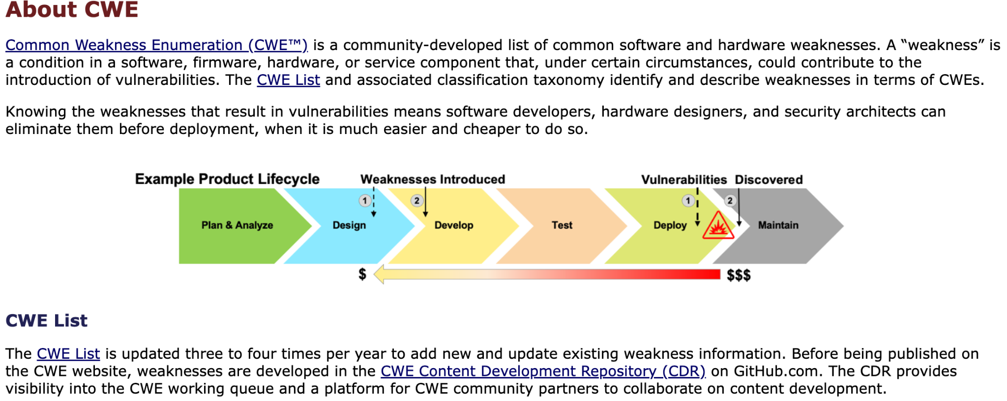
Top 4 2023
Common Weakness Enumeration
What is a CWE?
Weakness that is easy to find and exploit
CWE list is a community developed list of software and hardware weaknesses that can become vulnerabilities
Who is Mitre?
Federally funded research and development center focused on cybersecurity
Back to Agenda Page
Notes:
This brings me to CWEs, also known as common weakness enumerations. A CWE is a weakness that is easy to find and exploit. Every year these CWEs are curated into a list of the top 25, hosted by Mitre who is a federally funded research and development center focused on cyber security

Slide 5
Top 4 2023
Common Weakness Enumeration
Use After Free
referencing memory that has already been freed
Buffer Overflow
places where information is stored can be overwritten
Out-of-Bounds Write
product writes data past the set end or beginning of set location
Improper Input Validation
data received is not confirmed to be in the correct format to be processed safely
If exploited, these weaknesses can cause:
corruption of data
unexpected values
programs crashing
code execution
Back to Agenda Page
Notes:
In 2023, the top three CWEs were, 1. use after free, which is when a certain piece of memory is referenced after it has already been freed. number 2, buffer overflow, which is when information is stored in a location that can be overwritten, number 3: out of bounds write, which is when the product can write data past the beginning or end of the set location, and number 4: improper input validation, which is when data is received but not confirmed or verified to be in the correct format that allows safe processing. All of these CWEs could cause corruption of data, unexpected values, programs crashing, or unintended code execution when exploited.

Slide 6
SQL Injection: CWE-89
User input was not sanitized or validated before being executed, allowing for a string of characters with unmatched quotation marks to overwrite the program and provide access on a login page without the correct credentials.
Username: 1’ or ‘1’=’1
Password: 1’ or ‘1’=’1
Back to Agenda Page
Notes:
Now to really understand some of those vulnerabilities, I have an example from a “capture the flag” competition I participated in during my intro to security class at school. On this purposely vulnerable website, I can demonstrate SQL injection, which is another type of attack. [Play video]
In this video, the user input is not sanitized or validated before it was executed. this allows a specific string of characters with unmatched quotation marks to overwrite the program and provide access on a login page without using the correct credentials.

Slide 7
Mitigations • Mitigations • Mitigations • Mitigations • Mitigations • Mitigations • Mitigations •
Mitigations
Input Validation and Sanitization:
Before processing user input, ensure they conform to expected patterns ex. only allow alphanumeric characters for a username and reject inputs containing other characters.
Sanitize user input by scrubbing data to remove potentially malicious content
Use of Prepared Statements
This allows SQL query logic to be defined first and then user input can be passed as a parameter
So, inputs are handled separately from the SQL not allowing inputs to be executed
Mitigations • Mitigations • Mitigations • Mitigations • Mitigations • Mitigations • Mitigations •
Notes:
What I just demonstrated is extremely dangerous if found and exploited on a real website. So, to mitigate this problem there are two things to implement. 1, always validate and sanitize inputs. This means before the user input is processed, ensure it matches the expected pattern. To sanitize, scrub the user input data to remove anything that could be potentially malicious content such as the payload that was used in the video.
Second, use prepared statements in SQL. These statements allow the SQL query logic to be defined first and then any input is passed as a parameter. This means inputs won't have the ability to be run as SQL code, as they are always handled separately.

Slide 8
Cross-Site Scripting (XSS)
CWE-79
The server reads data directly from the HTTP request and reflects it back in the HTTP response without any checks before executing. This can allow unauthorized access to certain pages, or execution of malicious code through the URL.
Back to Agenda Page
Notes:
Next, I am going to demonstrate cross site scripting, also known as XSS. [video]
In this video, I show a very light version of XSS, where the server reads data directly from the HTTP request and reflects it to the HTTP response without any checks before executing. This allows me to change the message ID on the message board URL and it will redirect me to that message. On a message board this might not seem too scary, but there has been an instance at my school where someone discovered the url of the school health portal could be changed to redirect to other students invoices! This is really bad!

Slide 9
Mitigations • Mitigations • Mitigations • Mitigations • Mitigations • Mitigations • Mitigations •
Mitigations
Data Sanitization and Escaping:
Before displaying user input on web pages, strip out unwanted data such as scripts or SQL code such as [ <, >, “, ‘, &]
Convert these characters to HTML equivalents
Content Security Policy (CSP):
Implement a CSP to define which sources of content are allowed to load. This restricts execution of scripts to only be those coming from specific trusted domains, as well as prevent against inline scripts and eval functions
Mitigations • Mitigations • Mitigations • Mitigations • Mitigations • Mitigations • Mitigations •
Notes:
To mitigate this issue, it is important to sanitize the data. Before a request is processed and user input is displayed, unwanted characters and SQL code should be stripped, as well as converted to safe HTML replacements.
Second, using a content security policy, aka CSP allows the programmer to define which sources of content are allowed to load. This will restrict execution of scripts and dangerous functions by ensuring only trusted domains can execute certain behaviors.

Slide 10
Preventative Actions + Education
Being aware of these security concerns is only the first step
Implement quarterly code reviews
Encourage safe coding practices by reviewing code and using static analysis tools such as Snyk
Implement security awareness meetings
Educate all new employees about CWEs and CVEs
Emphasize coding standards
Safe, Secure, Reliable
Back to Agenda Page
Notes:
Being aware of these security concerns is just the first step to truly preventing these issues. Another shocking fact is that 67% of developers admit to knowingly ship code with vulnerabilities. So, my recommended plan is as follows:
implement quarterly reviews to encourage safe coding practices as well as using static analysis tools which will locate these types of vulnerabilities for you.
implement security awareness meetings to consistently educate new employees about CWEs and CVEs
ALways emphasize coding standards: code should always be safe, secure, and reliable

Slide 11
Thank you!
aliyah.weiss@tufts.edu
https://www.linkedin.com/in/aliyah-weiss/
Notes:
Thank you for your time and I hope you learned a thing or two about cybersecurity! A special thank you to my mentor Imaris for guiding me through these past months and supporting me on my endeavours, as well as a thank you to Ming for providing the CTF! I’ve linked my email; and linkedin as well, so feel free to reach out to me to speak more about my project if you would like! Thank you again!

