Slide 1
To-Do List & Calendar
Aliyah Weiss- EE129 Project 3, Fall 2024

Slide 2
Introduction
Simple Web-Based To-Do List and Calendar View Application
Task Management | User adds tasks with a title, description, and due date
Task List View | Display all tasks by due date
Calendar View | Tasks mapped to their due date on an interactive calendar
Persistent Data | Tasks and account information stores in a database
User Accounts | Personalized task lists and privacy
Visual Appeal | Colorful and cute design to improve user experience

Slide 3
How it Works
Backend Development
Data Persistence
GET/POST
PUT/DELETE
SQLAlchemy used as an Object Relational Mapper (ORM)
app.py interacts with SQLite database file app.db
GET /tasks: retrieves all tasks
POST /tasks: adds a new task
PUT /tasks<id>: updates an existing task
DELETE /tasks<id>: deletes a task

Slide 4
How it Works
Frontend Integration
Jinja2 templates:
Task List
Jinja2 templates:
Calendar View
Task list view uses HTML table dynamically generated from database
Calendar view uses embedded JavaScript (FullCalendar) preloaded via Flask routes
Next

Slide 5
How it Works
Other Features
User Authentication
HTML, CSS, Bootstrap
Generate_password_hash and check_passsword_hash from wekzeug.security module
Bootstrap: CSS framework to make a nice layout for buttons, navigation
Custom CSS: for colors fonts, and images
Flask
Accounts
Routing and server side logic (app.route) and handles HTTP requests
Renders template (Jinja2) to dynamically create HTML pages
Login/signup forms: HTML forms processed by Flask routes for users to create accounts and login, uses session variables

Slide 6
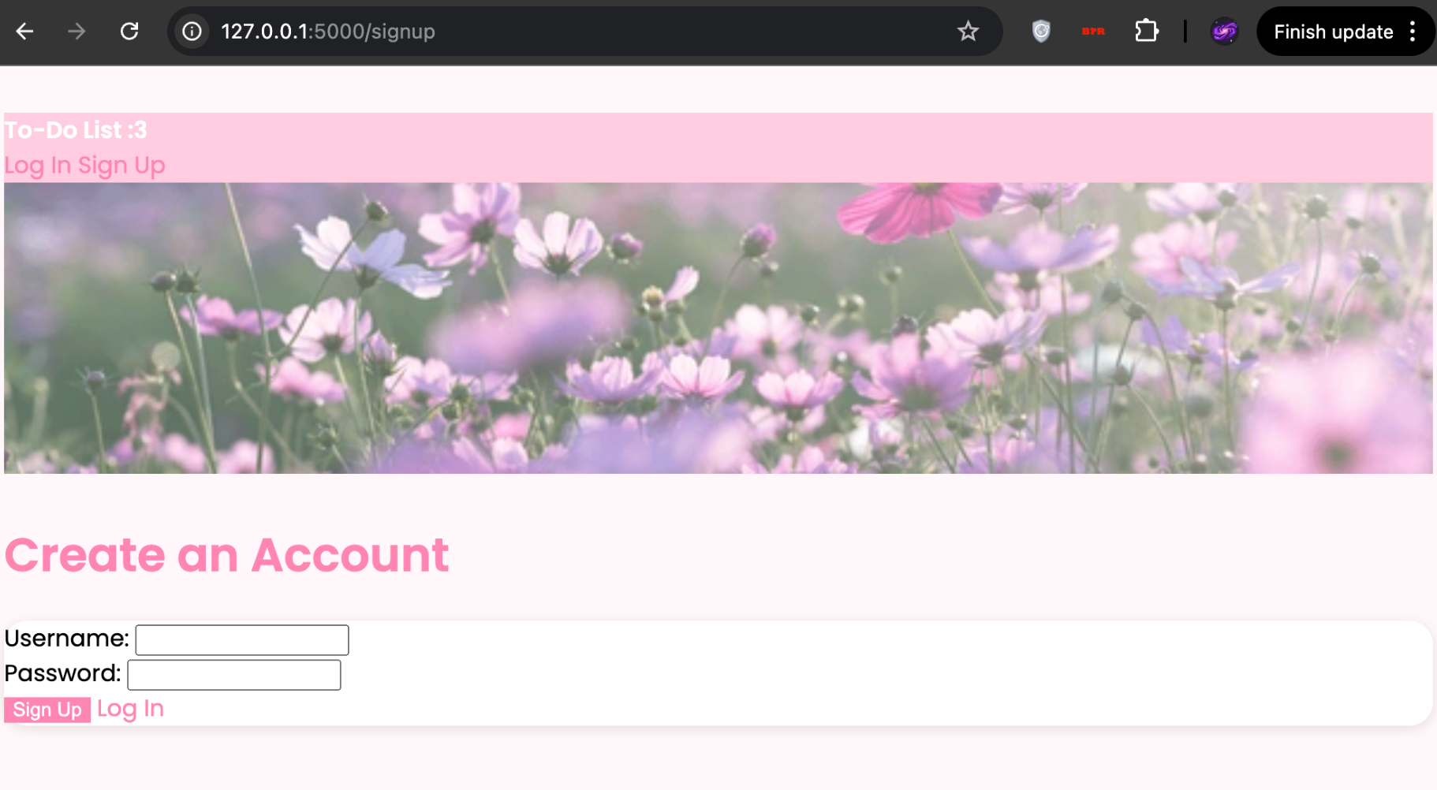
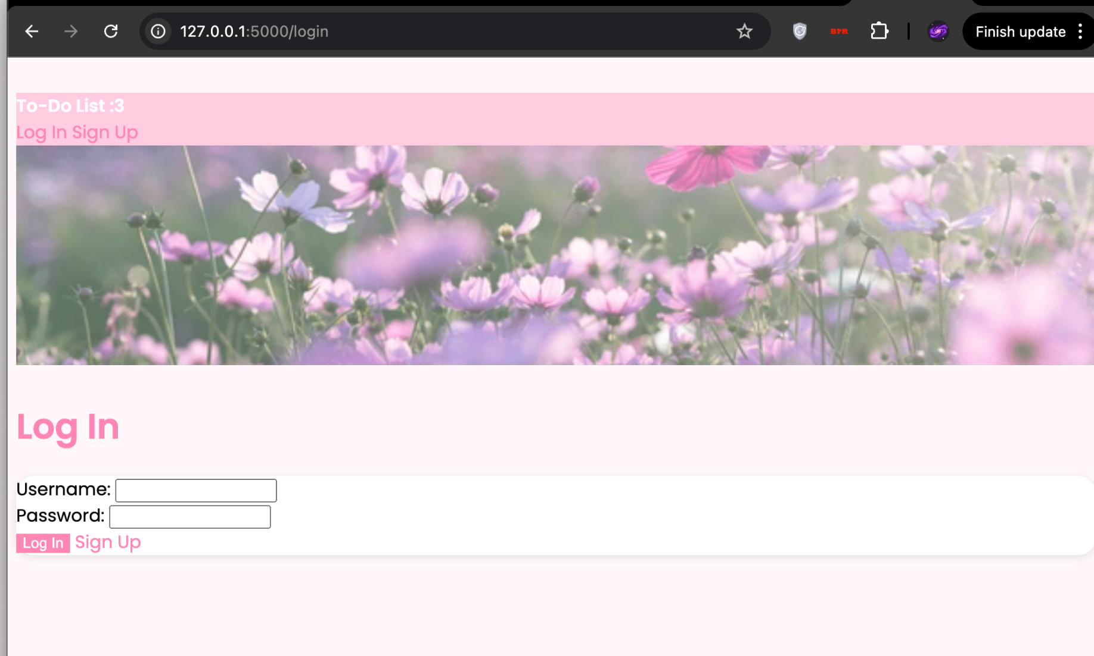
Results
Next

Slide 7
Results
Next

Slide 8
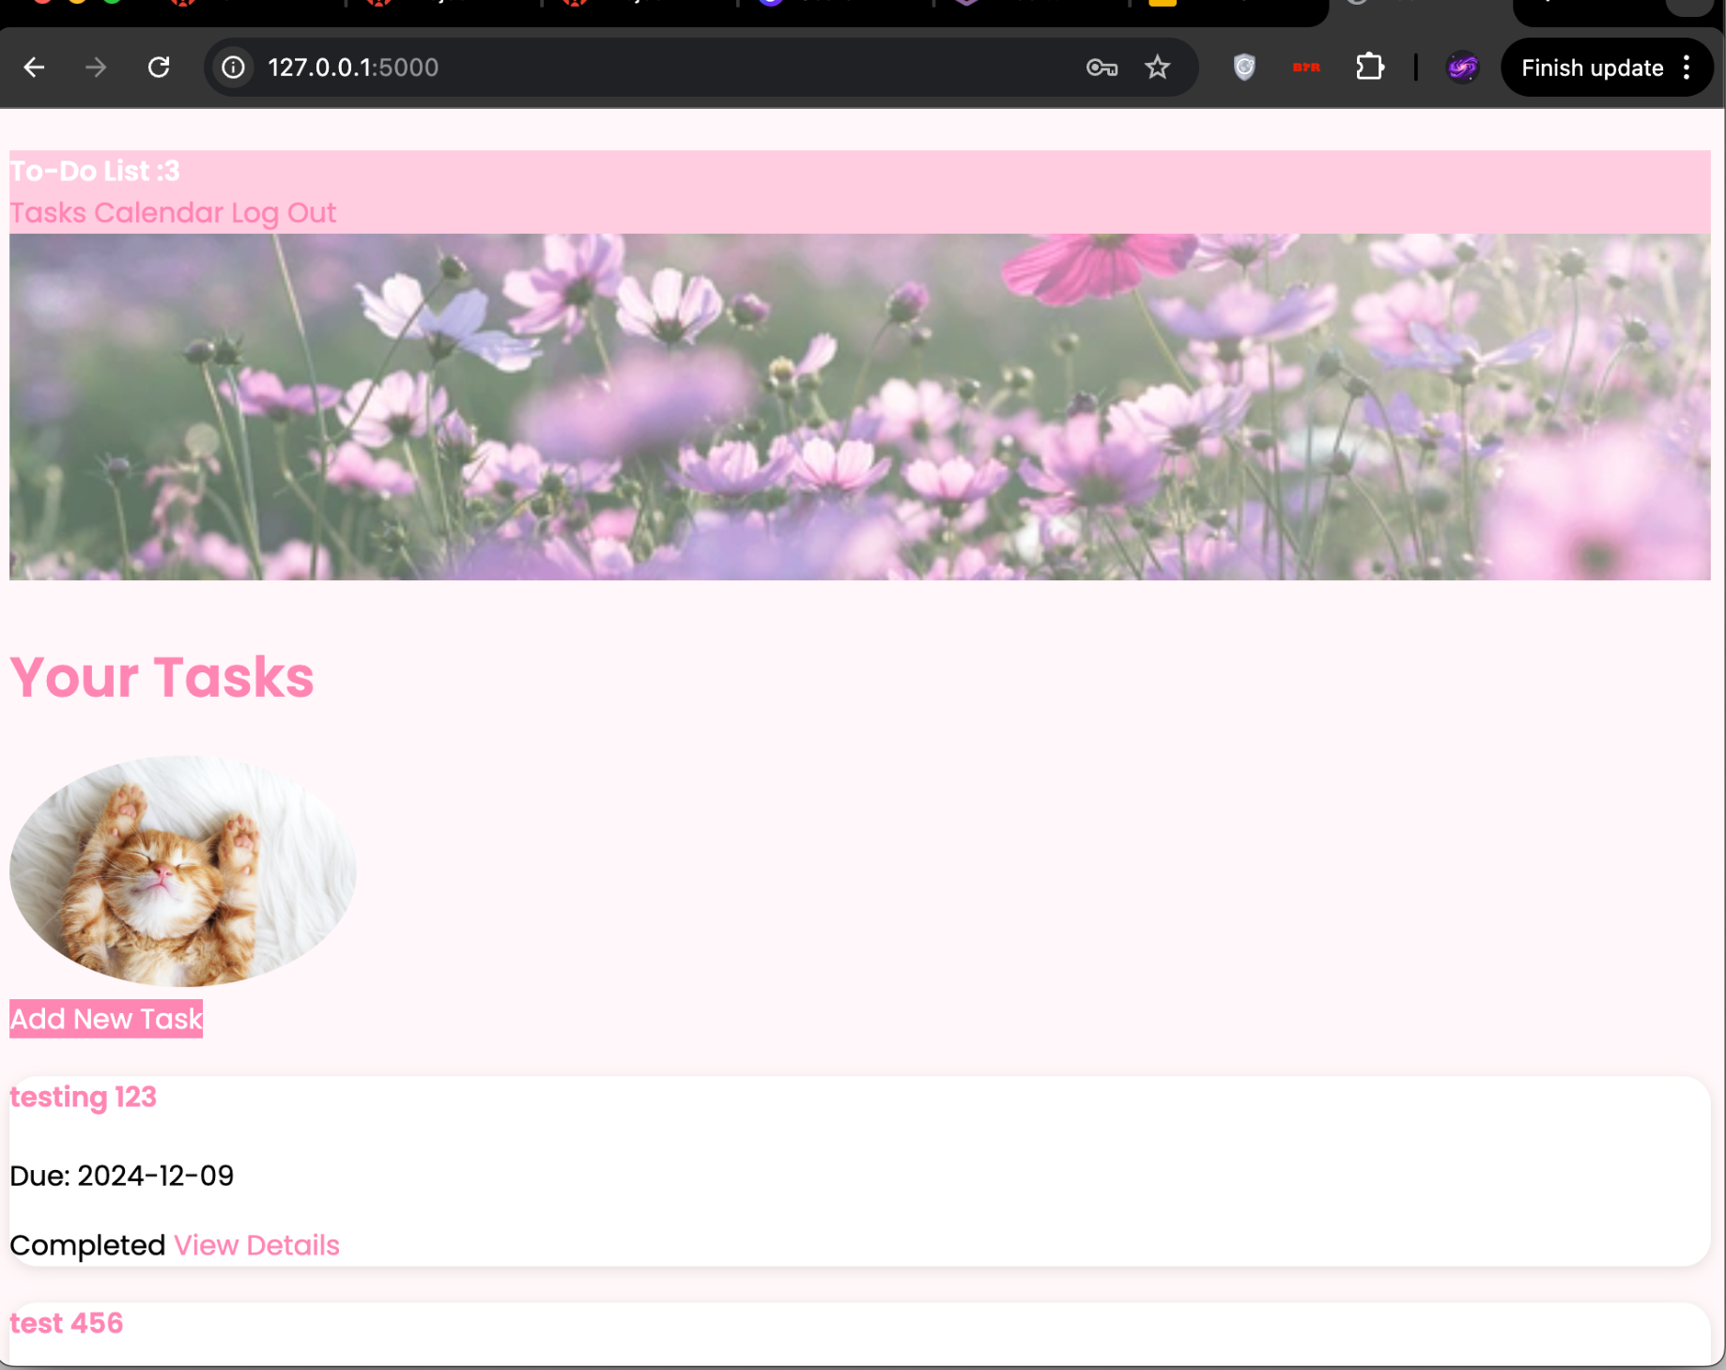
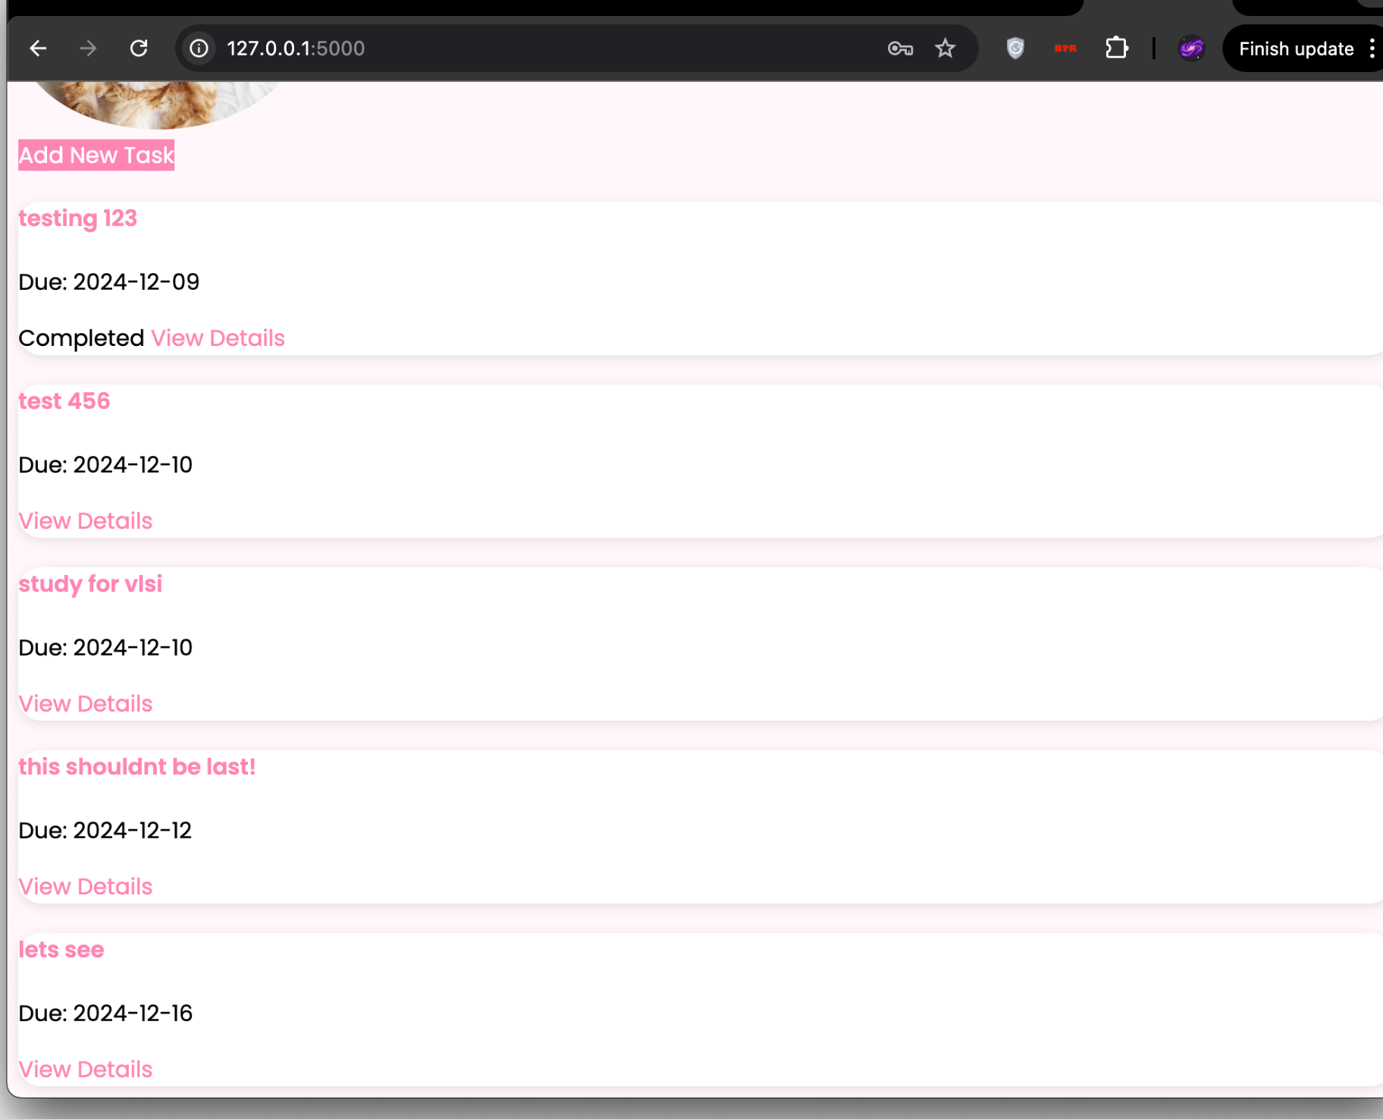
Results
Next

Slide 9
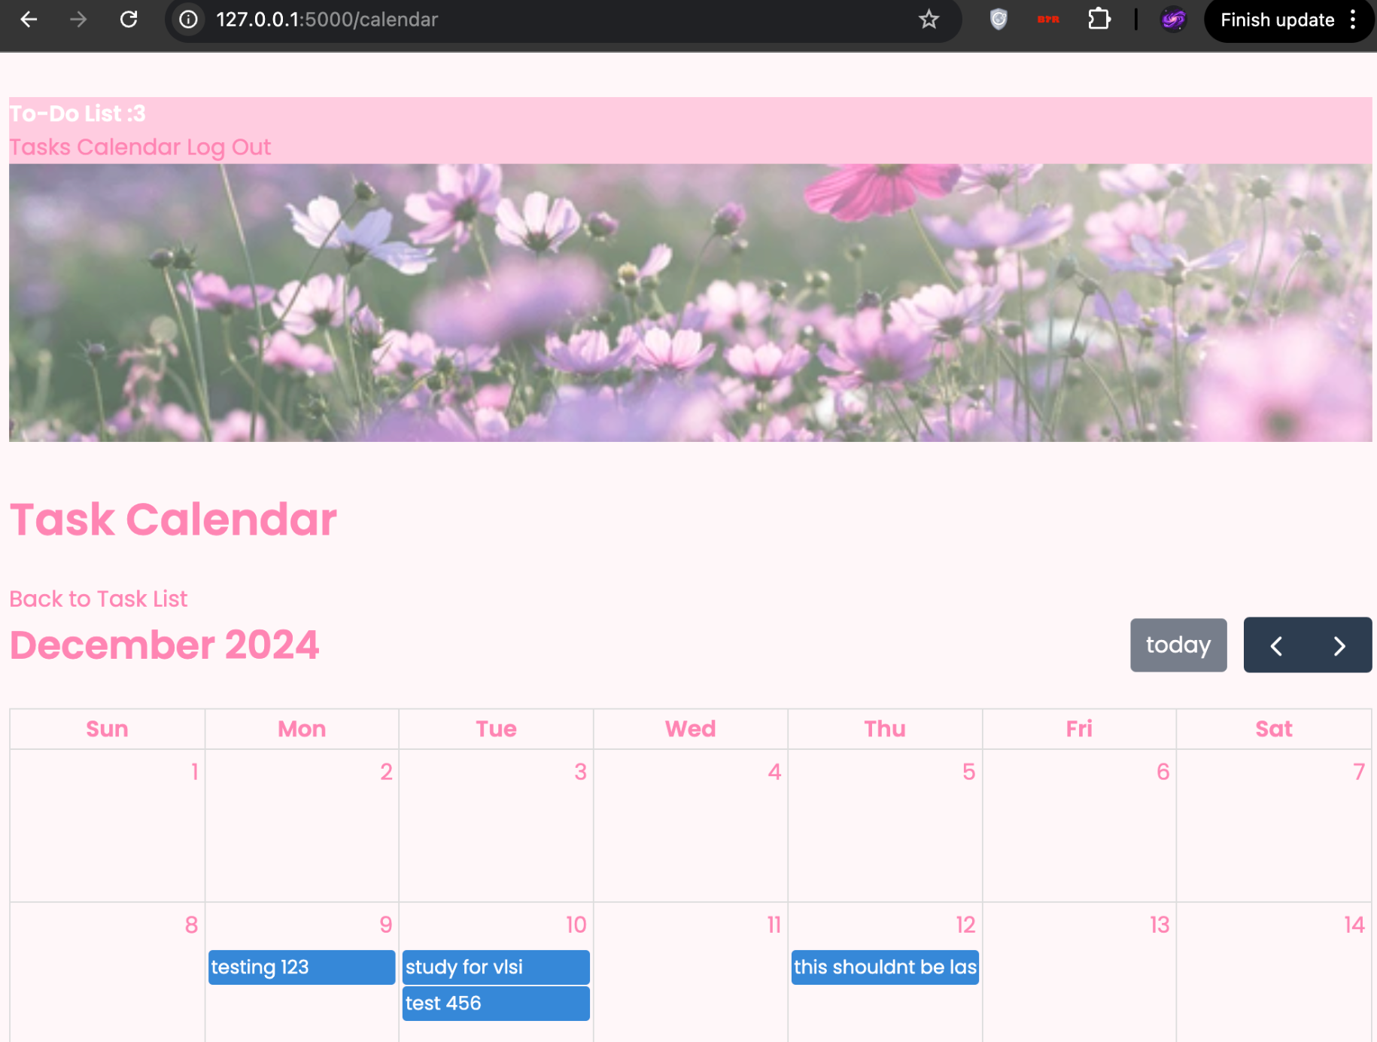
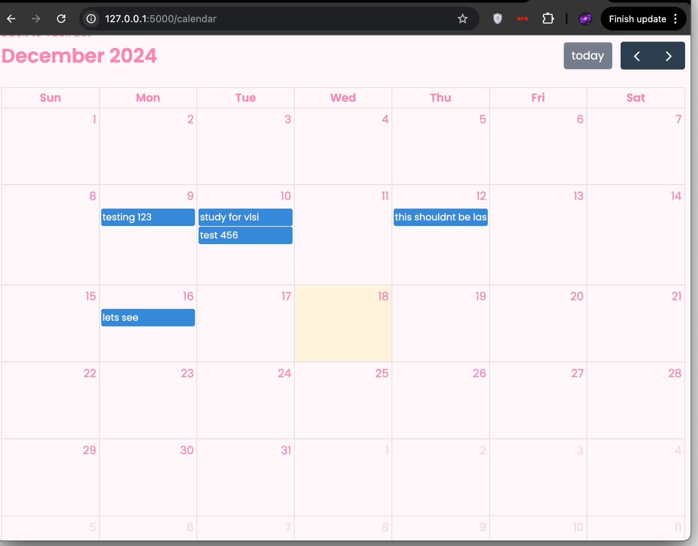
Results
Next

Slide 10
Discussion
Successfully able to implement a To-Do list and Calendar
Adding and removing tasks
Editing tasks
Tasks in due date order
Successfully able to implement accounts
Sign up page
Login with signup credentials
Accounts save previous to-do list information in database
Successfully added user friendly UI
Cute graphics and coloring
Easy to navigate taskbar

Slide 11
Thank you!
Please keep this slide for attribution

