Slide 1
Research Interests
Using epidemiology approach to study diet-disease associations
Integrate molecular epidemiology approach to study potential mechanisms underlying diet-disease associations
Contact info:
jiantao.ma@tufts.edu

Slide 2
Example of Research Projects
Diet-gene interaction in relation to blood pressure change
This project is conducted in the CHARGE consortium
The primary goals of this investigation are:
To test the process of creating and using DASH diet in multiple gene-lifestyle cohorts,
To identify novel genetic loci for blood pressure that may not have been detected previously when interaction was not considered, and
To characterize gene-diet interaction in known and novel blood pressure loci
Similar project has been proposed in the UK Biobank

Slide 3
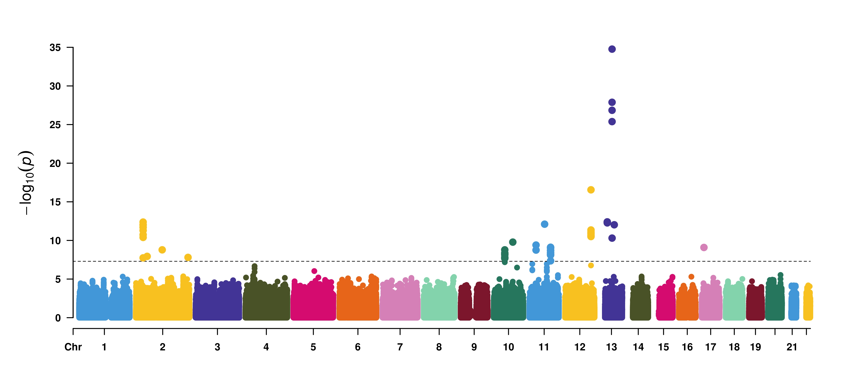
Diet-Gene Interaction on Systolic Blood Pressure

