Slide 1




Fang Fang Zhang, MD, PhD
The Neely Family Professor
Associate Professor
Nutrition Epidemiology and Data Science Program
Email: fang_fang.zhang@tufts.edu
  Research Interests
  Dietary intake patterns of US adults and children
  Role of nutrition in cancer prevention and controls
  Dietary interventions among cancer patients and survivors
  Nutrition policies for reducing cancer burdens and disparities
Tufts-ASA Student Chapter Research “Lightning Talks” August 20, 2020

Slide 2
# 1 and #2: Ultra-Processed Foods (UPFs)
What are the patterns and trends of ultra-processed food consumption among US children?
Does high UPF consumption contribute to obesity risk of children in the Growing Up Today Study (GUTS) cohort?
Does high UPF consumption increase the risk of breast, colorectal and prostate cancer among adults in the Nurses’ Health Study (NHS) and Health Professionals Follow Up Study (HPFS) cohorts?
Does high UPF consumption increase the risk of total mortality, heart disease mortality, and cancer mortality among US adults?
What is the estimated impact of replacing the UPFs in children’s diet with non-UPFs on reducing childhood obesity in the US?
What is the estimated impact of replacing the UPFs in adults’ diet with non-UPFs on reducing obesity-associated cancer burden in the US?

Slide 3

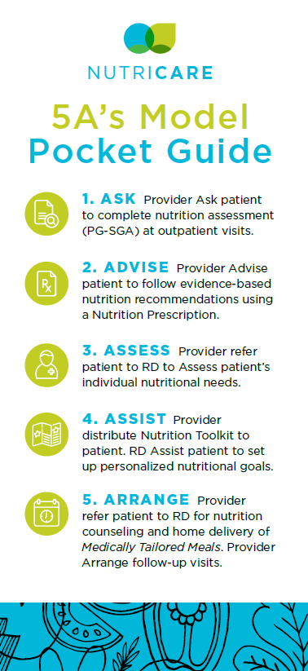
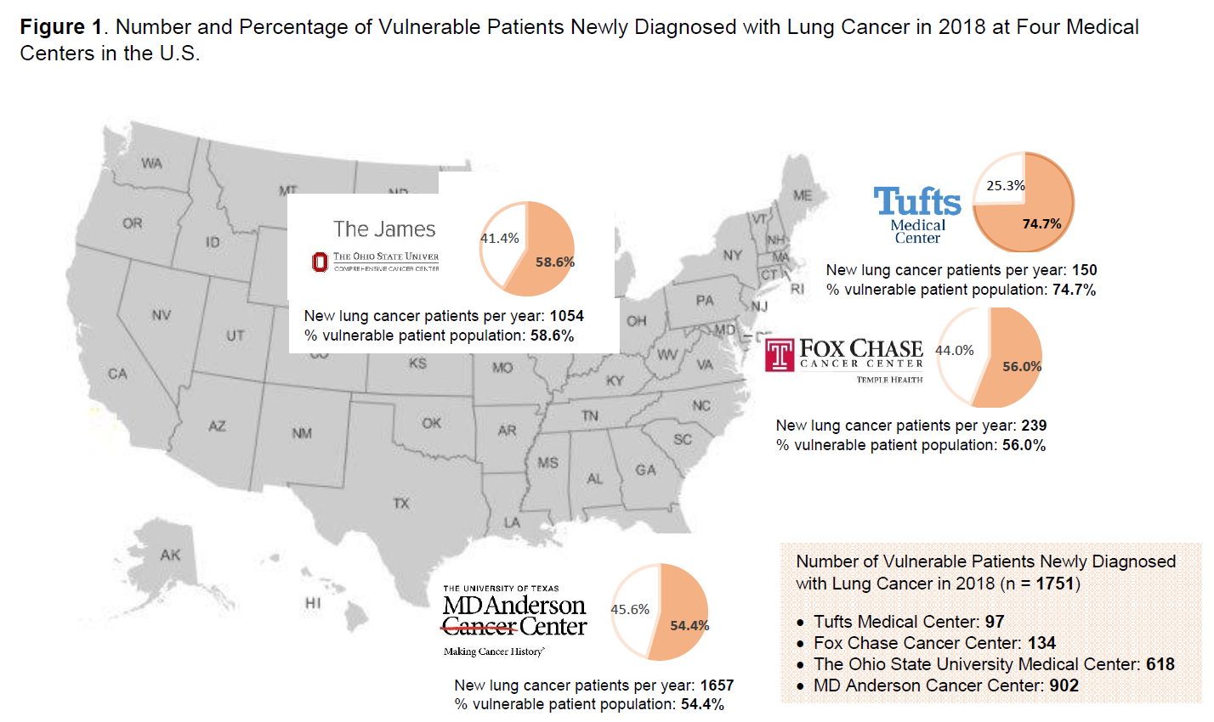
# 3: NutriCare Study
Integrating Nutrition into Oncology Care Using 5As
Using a RCT design, we will enroll 150 vulnerable patients newly diagnosed with stage I-IV lung cancer who will begin systemic therapy, multimodality therapy, or post-surgery adjuvant therapy from four U.S. medical centers

Slide 4
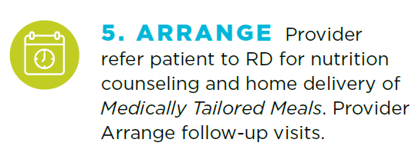




In NutriCare, nutrition counseling will be informed by motivational interviewing and delivered through remote platforms by registered dietitian nutritionists for 8 months.
Notes:
Registered dietitian nutritionist (RDN)-delivered medical nutrition therapy (MNT) significantly improves patients’ nutritional status, treatment response, and quality of life.
Emphasize with patients the importance of nourishment – sell it!
Frame eating as a “part of treatment”
Promote a Food FIRST philosophy
Monitor for unintentional weight loss and signs of malnutrition

Slide 5
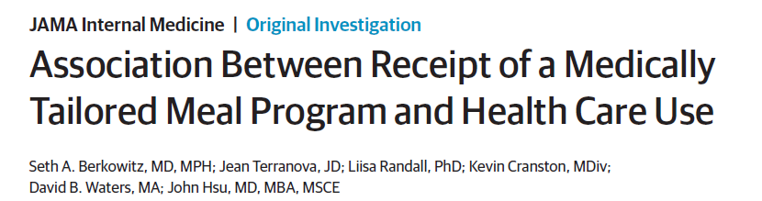
In NutriCare, patients will be prescribed medically tailored meals for 6 months with gradually reduced doses (meals every week for the first 8 weeks, every two weeks for the second 8 weeks, and every four weeks for the last 8 weeks).
Notes:
Provision of medically tailored meals to malnourished and critically-ill patients is emerged as a promising new strategy to improve health outcomes, reduce health care costs, and address disparities.
Receipt of medically tailored meals was associated with:
0.5 fewer hospital admissions per year
49% fewer inpatient admissions
0.9 fewer skilled nursing facility admissions per year
72% fewer skilled nursing facility admissions
net savings of $753 per person per month
16% reduction in health care costs

Slide 6
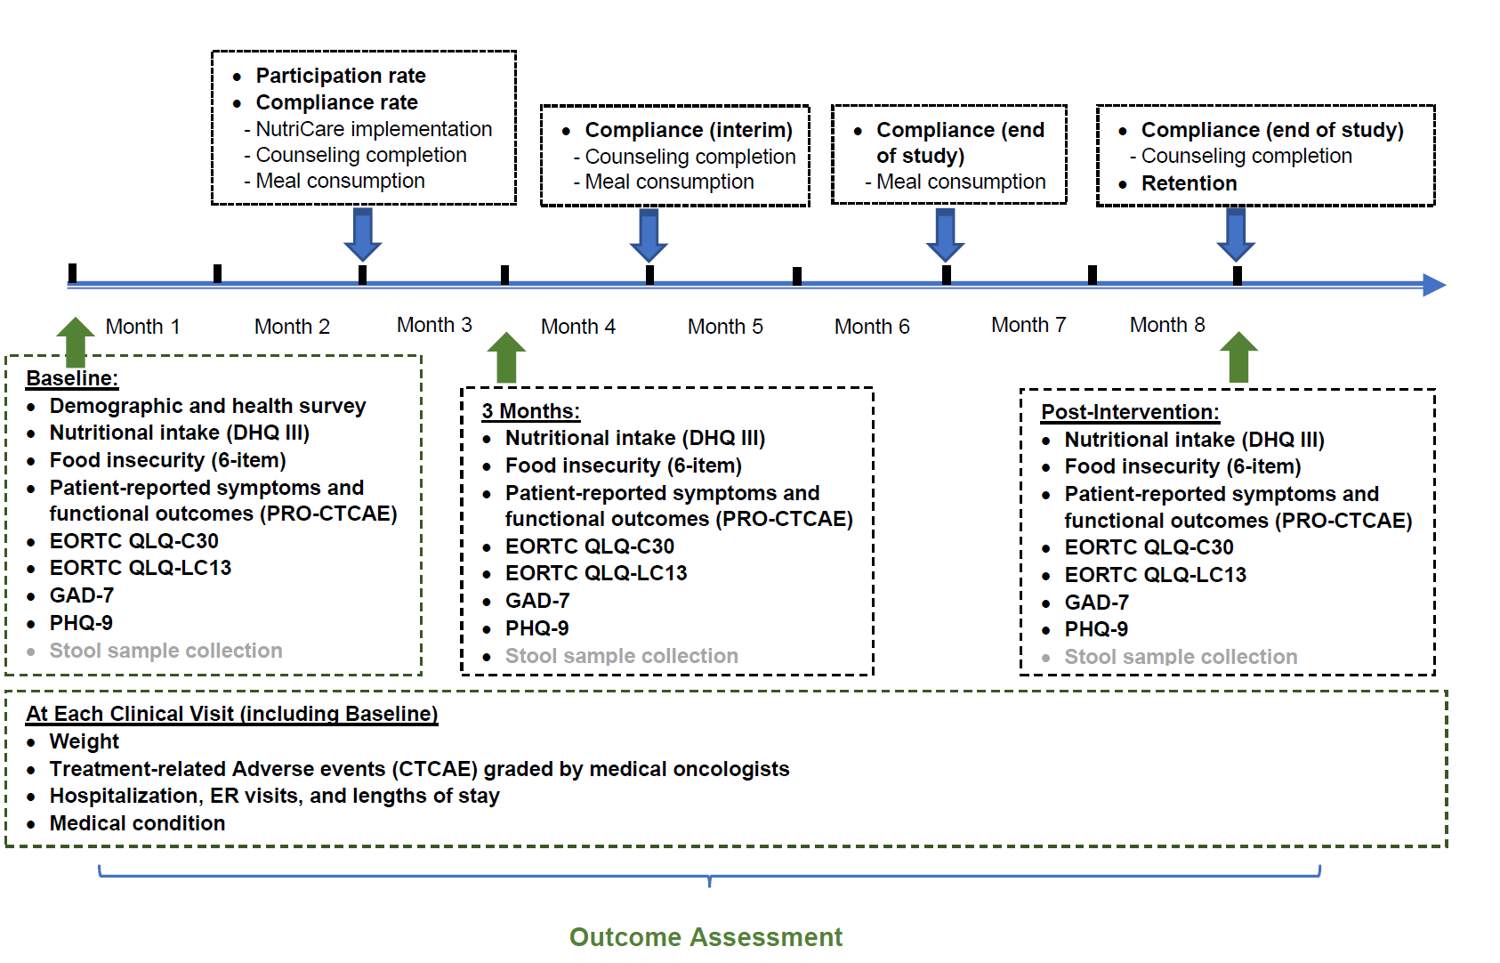
Outcome Assessment
Unintentional weight loss, dietary intake, food security
Treatment-related toxicities, treatment interruptions
Hospitalization, ER visits, lengths of stay
Quality of life, depression, anxiety
Notes:
Study Assessments
Baseline
3-month
8-month
Sociodemographic, Health Behavior Questionnaire, Medical History
X
Diet History Questionnaire (DHQ III) and Healthy Eating Index (HEI)
X
X
X
Food Security (USDA Household Food Security Survey)
X
X
X
Body Weight (Measured at Each Clinical Visit)
X
X
X
Treatment Completion (Dose Reduction; Treatment Delay)
X
X
Treatment-Related Toxicities (CTCAE v.5.0)
X
X
Hospitalization and ER Visits (Discharge Data; Patient Report)
X
X
Patient-Reported Outcomes version of CTCAE (PRO-CTCAE)
X
X
X
Functional Assessment of Cancer Therapy – Lung (FACT-L)
X
X
X

Slide 7
Project Progress
Beta-testing switched to mock enrollment
1st SAG Meeting
2nd SAG Meeting
Development & Testing Electronic Data Capture in REDCap
Clinical Research Coordinator Training
Development of Monitoring Plan
Development of Communication Plan
RD Nutrition Counseling Training
Development of Provider Training Webinar
IRB Submission & Approval
IRB Amendment
Dec. 2019
Jan. 2020
Feb. 2020
Mar. 2020
Apr. 2020
May 2020
Jun. 2020
Jul.2020
Aug.2020
Notes:
For the project progress, in the past nine months, we focused on getting IRB protocol prepared, submitted, and approved, developing the provide training webinar, conducting motivational interviewing training for the RD team who will provide nutrition counseling to the patients (Colleen will update in more details shortly). Together with the clinical team at each of the four cancer centers, we discussed and developed the communication plan and project monitoring plan. We have also conducted various training with the clinical research coordinator at each site, focusing on primarily on research data collection. Because this is a multi-center study, we spent a lot of efforts to develop and test the electronic data capture in REDCap. All these activities are either completed or near the end of completion.
The COVID-19 posed some challenges to us. We planned a beta-testing in May but had to switch to a mock enrollment and research data collection without patient recruitment. As of now, three sites are preparing for face-to-face enrolment in September as originally planned; but one site will not be able to conduct face-to-face enrollment until when the COVID-19 situation gets better. We are in the process of developing a contingency plan for remote screening, consenting, as well as to develop a plan for complete remote research data collection. We felt that a contingency plan is needed given the uncertainty of the COVID-19 this fall but the good news is that our intervention components are largely remote and can be integrated into the telehealth platform.

Slide 8
How and when to get involved?
Skills
  Clinical research experience (patient enrollment; data collection)
  Remote nutrition counseling
  Assisting statistical analysis
Format
  Paid or unpaid internships
    First year or second year (CITI training required)
  Directed study if involved addressing research questions
    Start the summer of the year 1; may last into fall of year 2
  CITI Training required

Slide 9
How and when to get involved?
Skills
  Methods of analyzing dietary intake data collected in the National Health and Nutrition Examination Survey
  Methods of analyzing the association between dietary intake and health outcomes in prospective cohort studies
Format
  Directed study (registered as a course)
  Usually start in the summer of the 1st semester and many last into the fall of the 2nd semester
  Abstract submitted to the annual meeting of the American Society of Nutrition (ASN) and other conferences; some continue into a manuscript

Slide 10
Produce Rx Program Evaluation
Project Title. Advancing the Science on Produce Prescriptions: Impact on Food Security, Health, Health Care Utilization, and Costs
May start this fall (project length: 18 months)
Develop protocols of extracting health care utilization data from medical records
Select matched controls
Analyze health outcomes and health care utilization between participants of the Produce Rx programs and matched controls
Assess program implementation costs
Conduct listening lessons / focus groups to draw inputs from healthcare clinics and patients

Slide 11

Preventable Cancer Burden Associated with Suboptimal Diet in the US
5689
3119
7927
High
Red
Meats
High
SSBs
27763
High SSB
16%
12663
Low Whole Grains
Low Vegetables
More than 80,000 new cancer cases among US adults ages 20 years or older in 2015 could be attributable to suboptimal diet.
High Processed Meats
14524
17962
Zhang et al 2019, JNCI Cancer Spectrum

Slide 12

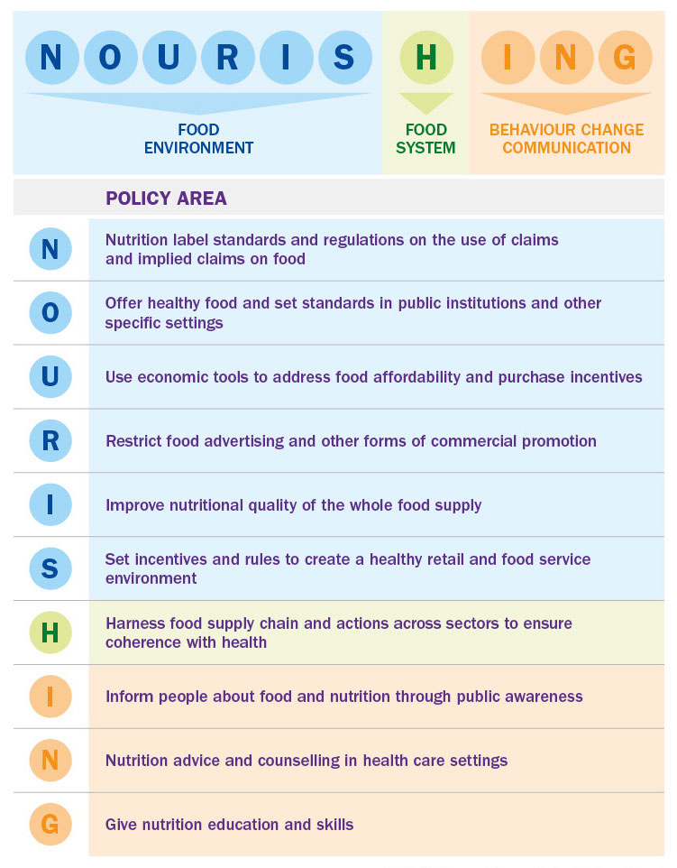
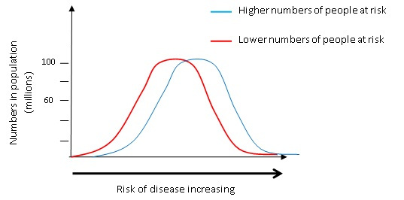
Population-Based Interventions
Sick Populations and Sick Individuals
NOURISHING Framework
Geoffrey Rose (1926 – 1993)

Slide 13


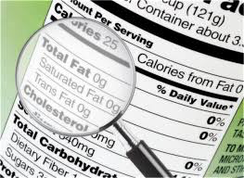
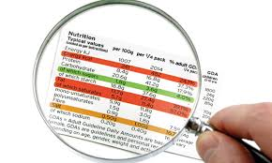
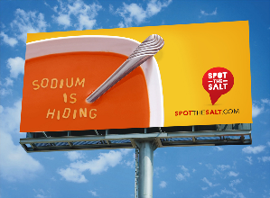


Population-Based Nutrition Interventions
1
2
- Tax
- Subsidy
4
School
Workplace
Quality Standards
Food pricing
2
- Nutrition Facts label
Front of package label
Warning label
- SNAP
- Medicare/Medicaid
5
Labeling
Targeted Intervention
3
Food Policy Review and Intervention Cost-Effectiveness
Education
Restriction
Mass media

Slide 14
Cost-Effectiveness of Nutrition Policies on Processed Meat: Implications for Cancer Burden in the US
Two policy scenarios:
  A 10% federal excise tax
  A warning label informing the public that frequent consumption of processed meat may increase the risk of cancer
Model Input | Data Source
1. Simulated population | NHANES 2013-2016
2. Processed meat intake distribution | NHANES 2013-2016
3. Policy effect size estimates | Meta-analyses; and published literatures
4. Relative risk estimates of processed meat intake on cancer risk | Continuous Update Project (CUP) conducted by the World Cancer Research Fund (WCRF)/American Institute for Cancer Research (AICR)
5. Cancer statistics (incidence and survival) | NCI’s Surveillance, Epidemiology, and End Results Program (SEER) Database CDC’s National Program of Cancer Registries (NPCR) Database
6. Cancer costs (direct medial cost of cancer care, productivity loss, time cost) | NCI’s Cancer Prevalence and Cost of Care Projections; Published literature
7. Policy costs | FDA’s budget report; Nutrition Review Project; and FDA’s RIA
8. Health related quality of life (HRQOL) | Published literature
Kim et al, AJPM 2019

Slide 15
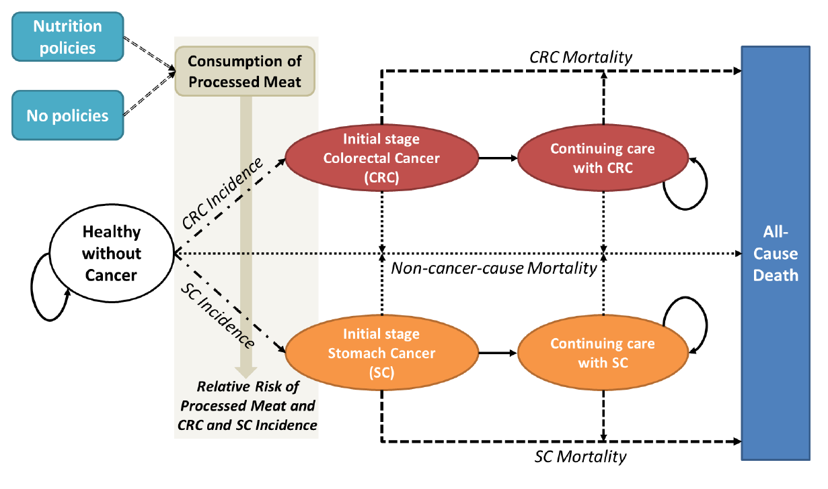
The DIet and Cancer Outcome Model (DiCOM)
A probabilistic cohort-state transition model that projects the population effect of nutrition polices on cancer outcomes.
Kim et al, AJPM 2019

Slide 16
Cost-Effectiveness of Nutrition Policies on Reducing Processed Meat Consumption: Health Benefits
 | Overall Health Benefits |  |  | Cancer-Specific Outcomes
 | Life Years |  | QALYs | Colorectal cancer cases | Colorectal cancer deaths | Stomach cancer cases | Stomach cancer deaths
10% exercise tax
Median | 497,000 | 593,000 |  | 77,000 | 55,000 | 12,500 | 11,100
95% UI | 348,000 – 694,000 | 419,000-827,000 |  | 568,000- 107,000 | 39,500- 77,1000 | 6,880- 23, 900 | 26,500- 116,000
Warning label
Median | 553,000 | 660,000 |  | 85,400 | 61,300 | 15,000 | 13,200
95% UI | 346,000-898,000 | 418,000-1,070,000 |  | 56,600- 100,000 | 39,200- 100,000 | 6,860- 34,500 | 5,930- 30,300
Kim et al, AJPM 2019

Slide 17
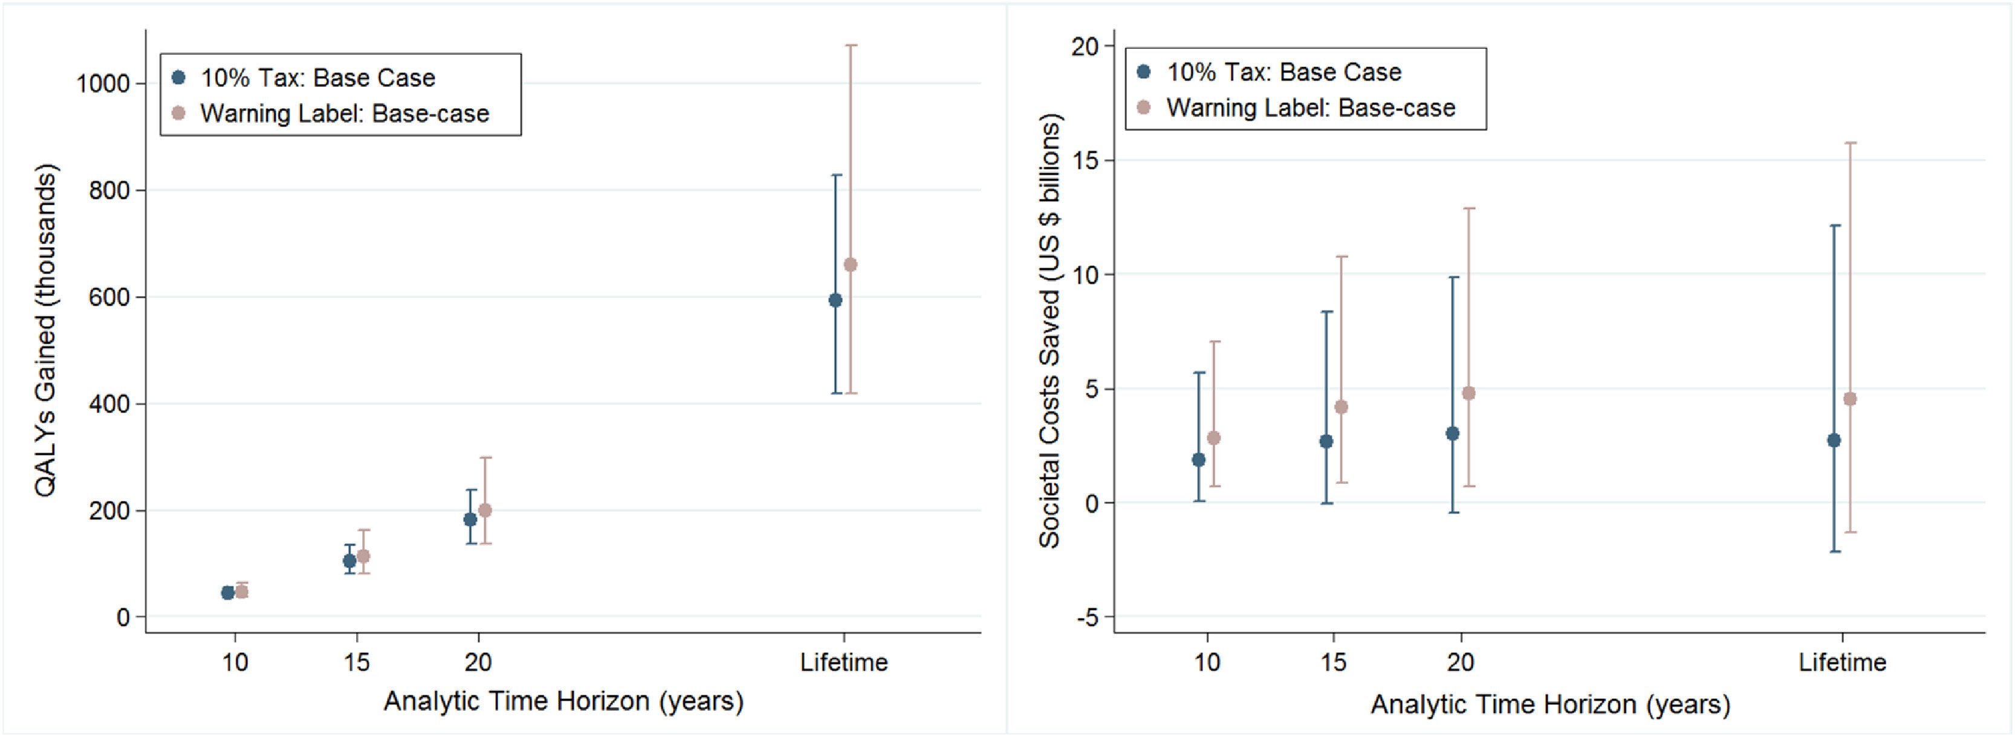
Cost-Effectiveness of Nutrition Policies on Reducing Processed Meat Consumption: Economic Impact
Net Cost = Cost Saved – Cost Spent
At the societal level, the 10% excise tax and the warning label were estimated to generate net savings of $2.7 billion and $4.5 billion, respectively, among US adults over their lifetime.
Both are cost-saving strategies.
Kim et al, AJPM 2019
Notes:
Th estimated economic impact suggested that both policies are cost saving the societal level. Each was estimated to generate net savings of more than $2.7 billion among US adults over a lifetime.

Slide 18

Why Modeling?

