Slide 1

Data science research for the
economics of agriculture, food & nutrition
Will Masters
Lightning talks for the Tufts Student Chapter of the
American Statistical Association, 20 August 2020
Contact info:
william.masters@tufts.edu
https://sites.tufts.edu/willmasters
https://sites.tufts.edu/foodecon

Slide 2
How (my) economics research works
Known methods?
Enough time & money?
Target audience?
Important question?
Available data?
Target outlets?
Future citations?
Actionable news?
Research design
Project funding
Data collection
Data analysis
Abstracts & presentations
Journal publications
Scientific impact
Societal impact
Economics seeks to explain, predict and improve “the ordinary business of life”, through “individual and social action” regarding “the material requisites of well-being” (Marshall, Principles of Economics, 1890)
“Econometrics” is causal inference from observed data, using & adding to economic theories of behavior
  -- We start by seeing all data as the result of past choices, as endogenous to the people & societies we study
  -- For causal inference, we would need random exposure and matched controls in a representative population
    All evidence is provisional
    Most of my work merges multiple datasets, most often household surveys with other data (e.g. climate shocks)
    Many great papers are “just” statistics, to establish new facts
    Sometimes I get funded to conduct my own RCTs
      In India on caregivers’ response to incentives (Gates Foundation)
      In West Africa on citizens’ policy preferences (Columbia University)
      In East Africa on farmers’ demand for crop storage (USAID)
      In the US on weight-loss users’ response to social incentives (LoseIt.com)
    Big new frontier uses retail food prices from all countries

Slide 3
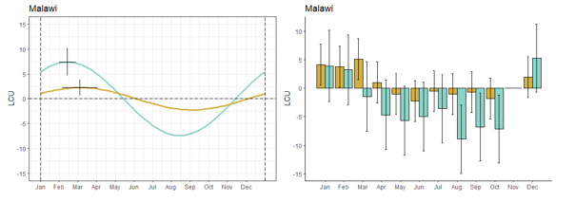
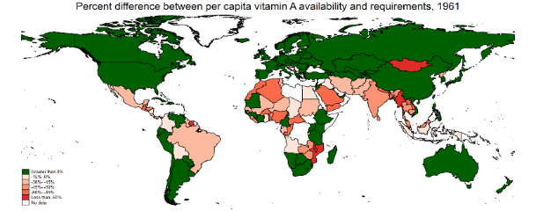
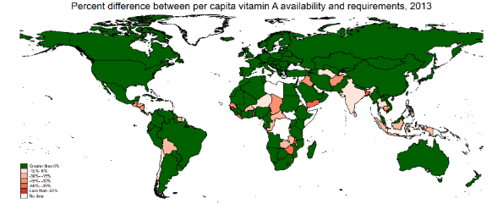
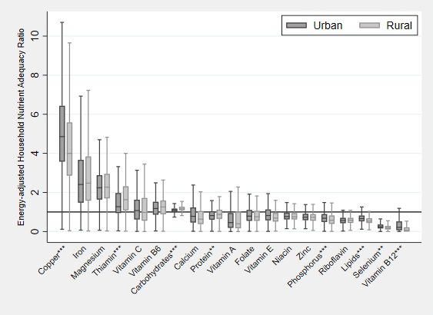
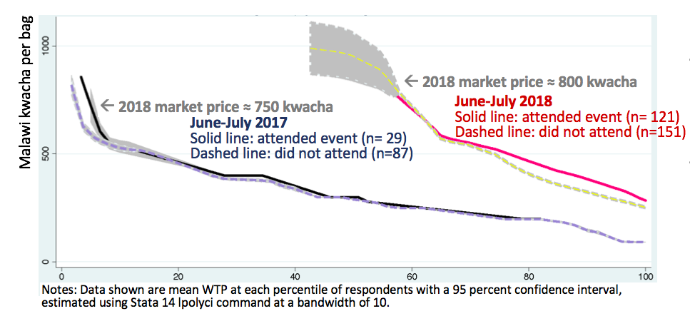

What (my) current students’ research results look like
Winnie Bell: global inequality in ag & nutrition
Yan Bai: seasonality in market prices
Keith Lividini: global production & trade of nutrients
Kate Schneider: diet cost & nutrient adequacy
1961
2013
Vitamin A availability (as % of requirements)
Gloria Guevara: farmers’ demand for crop technology
+ Alissa Ebel, Ash Venkat
and many others via CANDASA and new project on Food Prices for Nutrition

