Slide 1
Design Review 2: Celiac Team
Caroline DePalma, Anna DeCotis, Meira Doherty, Sanjana Vissapragada
Notes:
All of Us

Slide 2
Cover Letter
This design review serves as an update for the current design of our device that reduce incidents of allergic reactions in individuals with celiac due to gluten cross contamination.
We will cover our process of defining a problem statement, seeking user feedback via a survey, identifying user needs, and then iteratively developing our current design.
In this presentation:
Persona
Problem Statement
User + Market definition
Survey Results
User needs
Design Process
Brainstorming
Different Highlighted Ideas
Current Design
Our team experience
Notes:
caroline

Slide 3
User: Julia
Age: 21
Occupation: Student
Lives in: Medford, MA
Traits:
Likes to try new foods and cuisines
Frequent user of technology
Frustrations:
Incorrect gluten-free labelling
Lack of communication/ not enough information given
Goals:
Have more certainty when trying new food
Reduce number of reactions due to unknown cross contamination
Julia is a current junior at Tufts studying economics and entrepreneurship. She is diagnosed with Celiac Disease and is the founder of GlutenFreedomForAll, a company that provides Gluten-Free Snack Packs to hotel gift shops and minibars.
Julia still hopes for a solution to minimizing cross contamination of non-glutenous food.

Slide 4
Problem Statement
A way to address gluten cross-contamination for individuals with Celiac disease to reduce allergic reactions
Notes:
Caroline

Slide 5
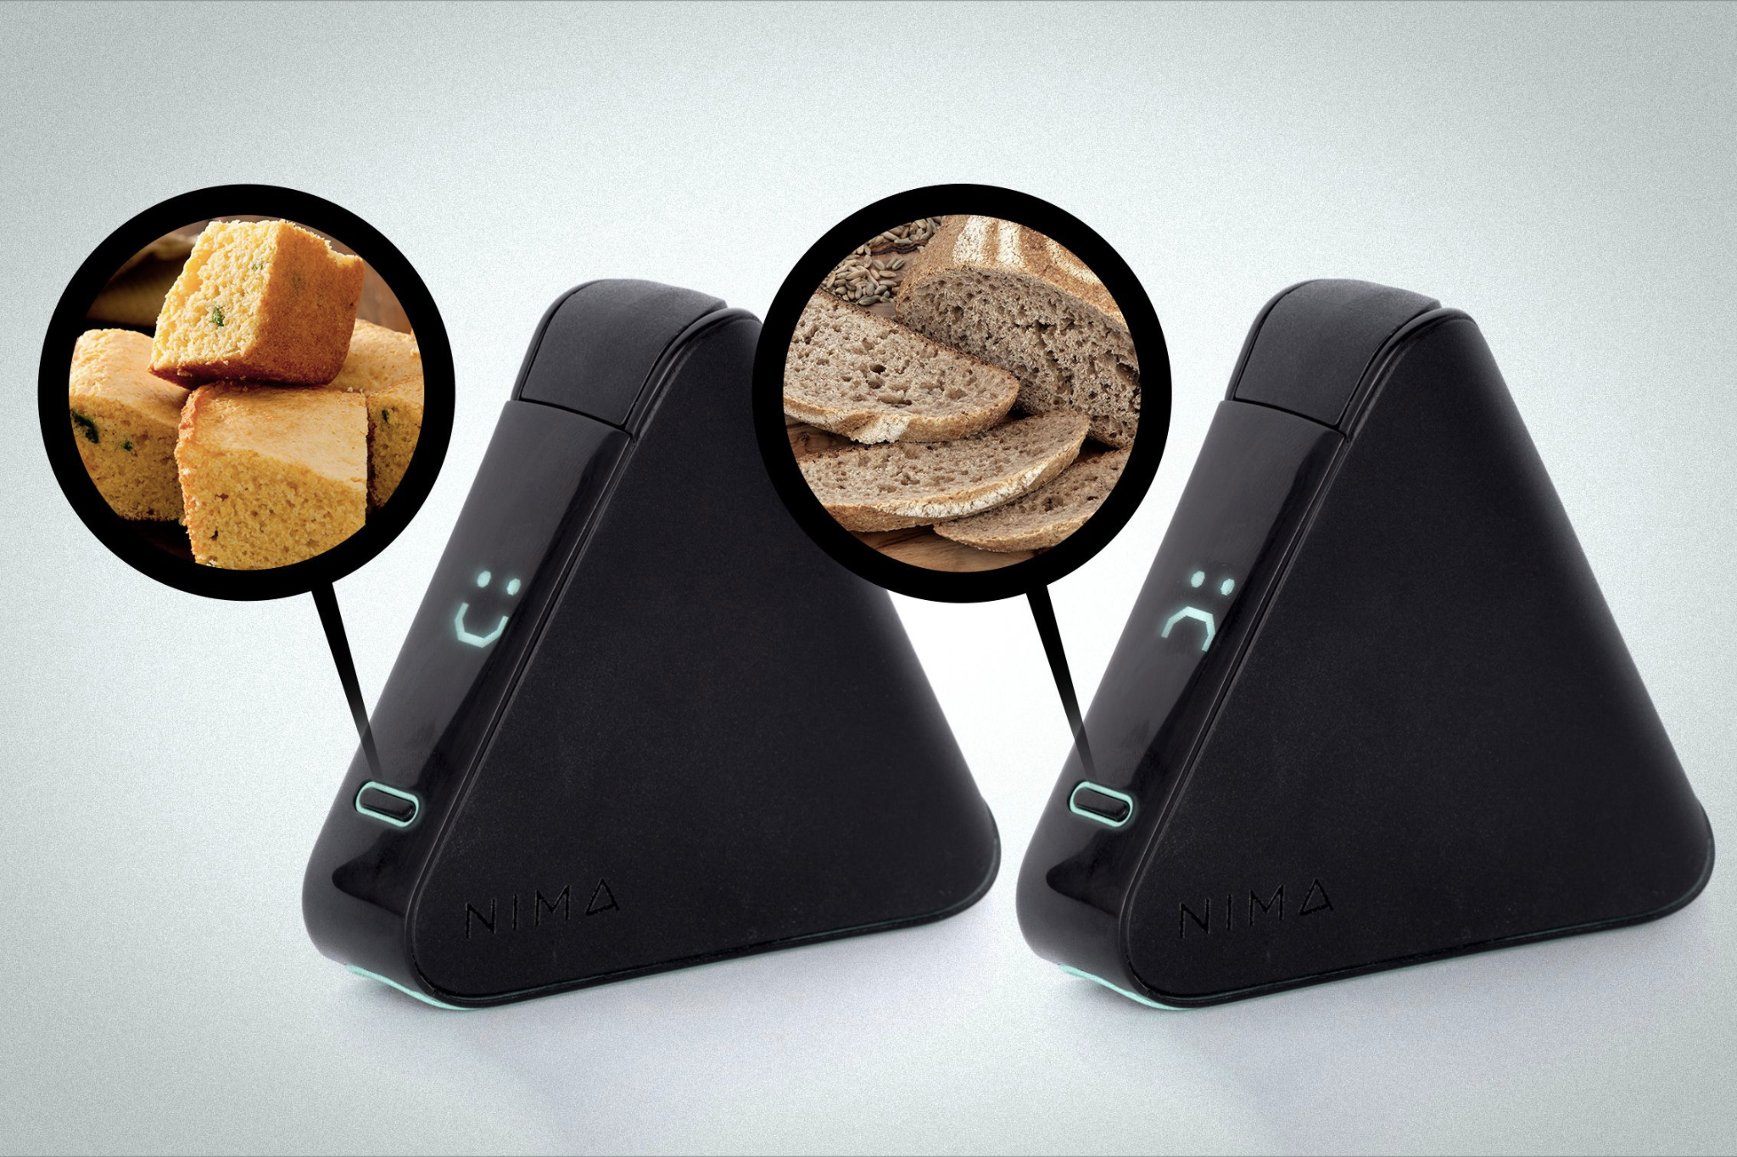
Who is the user + market research
User: people with Celiac Disease, particularly young adults who go out to eat socially
Developed user needs based on this description
Market Research: Nima Gluten Sensor
Disadvantages: high cost, takes several minutes to produce results, reviewers described it as embarrassing, not extensively tested
There is a need for something that is lower cost, proven reliable, and that has higher incentives for teens/young adults to use it
Notes:
Caroline
Not extensively tested means there was no control group, small and homogenous sample size, some users reported inconsistent results within the same meal, it also tested better with the adults than teens

Slide 6
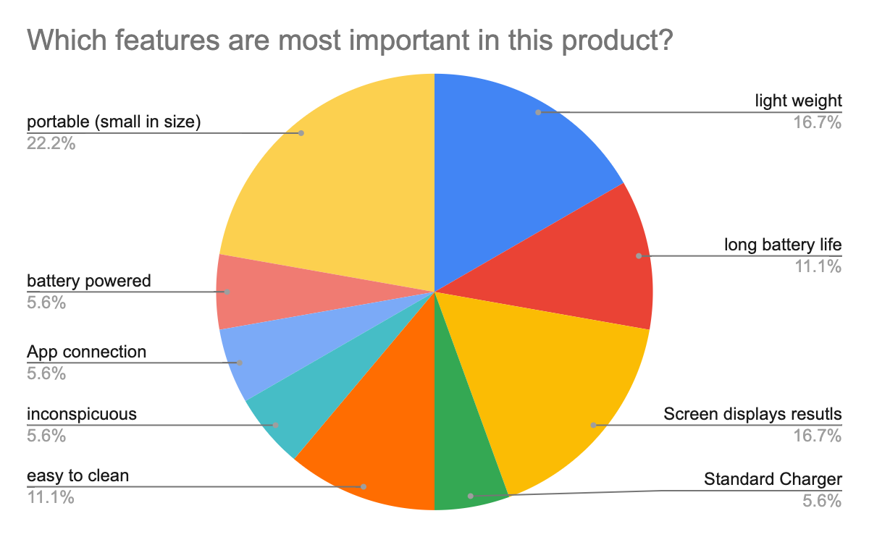
Survey responses pt 2
Top priority among participants is portability
Small in size and lightweight
Generally, ease of use is the main concern
Notes:
Caroline
Cost wasn’t something we had on the survey, could add it and ask for more feedback if needed

Slide 7
User needs + design inputs
Need to have
Easy to use
Fast results
Reading level/easy to understand
Easy to clean
Usable on a variety of food types and temperatures
Reliable
Food-safe
Clinically tested
Nice to have
Physical Design
Long battery life
Lightweight
Can be carried in a small bag
Other design concerns
Low or no waste
Standard charger or batteries
App / popular smartphone connectivity
Inconspicuous
Notes:
Caroline
Say that we developed design inputs for all of these that are measurable (i.e. what range of temperatures it should be used over)
Also say that we used these criteria in our pugh matrix after brainstorming to determine which ideas to pursue further
Fast results: under X seconds
Easy to use: X seconds to input results, weight less than X pounds, buttons pressed in X seconds, cleaned in X seconds, no more than X steps
Reliably detects gluten: able to detect gluten in ppm in X seconds, rate of false negatives X steps
Easy to understand results: up to seventh grade reading level, can be read X feet away
Light weight: weigh less than X pounds
Long battery life: X hours
No contamination: no X change of mass of food
Easy to clean: takes X minutes
Safe for users: radiation less than X
Clinically tested: X studies
Food safe: X amount of chemical and physical byproduct
FDA approved: follows all regulations
App: data found in X seconds
Popular smartphones: fits into apple and android
Standard charger or disposable batteries: of X size
low/no waste: minimal degrading after X use// X grams of waste per use
Carried in small bag: volume less than X^3 and weight less than X lbs
quiet / low profile: noise level X
Tests entire meal: up to X grams of food
Test solid/liquid hot or cold: detect in liquid of X viscosity//function between X-X degrees F

Slide 8
Design Process

Slide 9
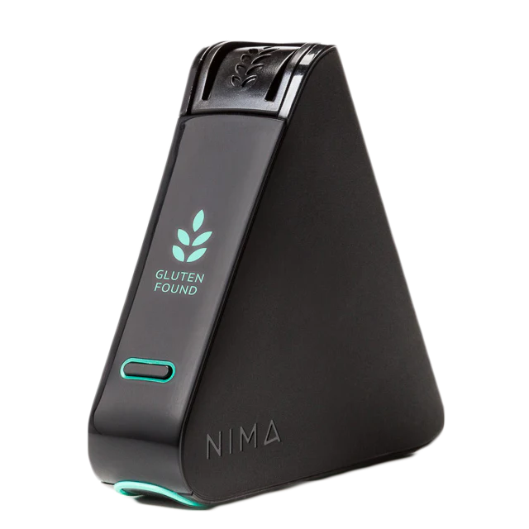
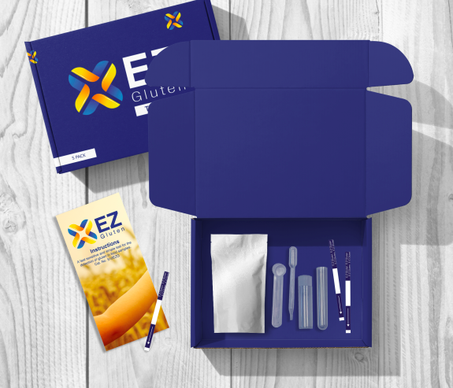
Brainstorming and Pugh Matrix
Used the Pugh Matrix to weight our ideas based on our user needs and design inputs previously specified
Highly ranked ideas:
Gluten test strip
Gluten scanner
Probe
Antibodies
Scanner
Looked at existing products on the market
Notes:
ELISA was found to be the most reliable in detecting gluten–celiac.org

Slide 10
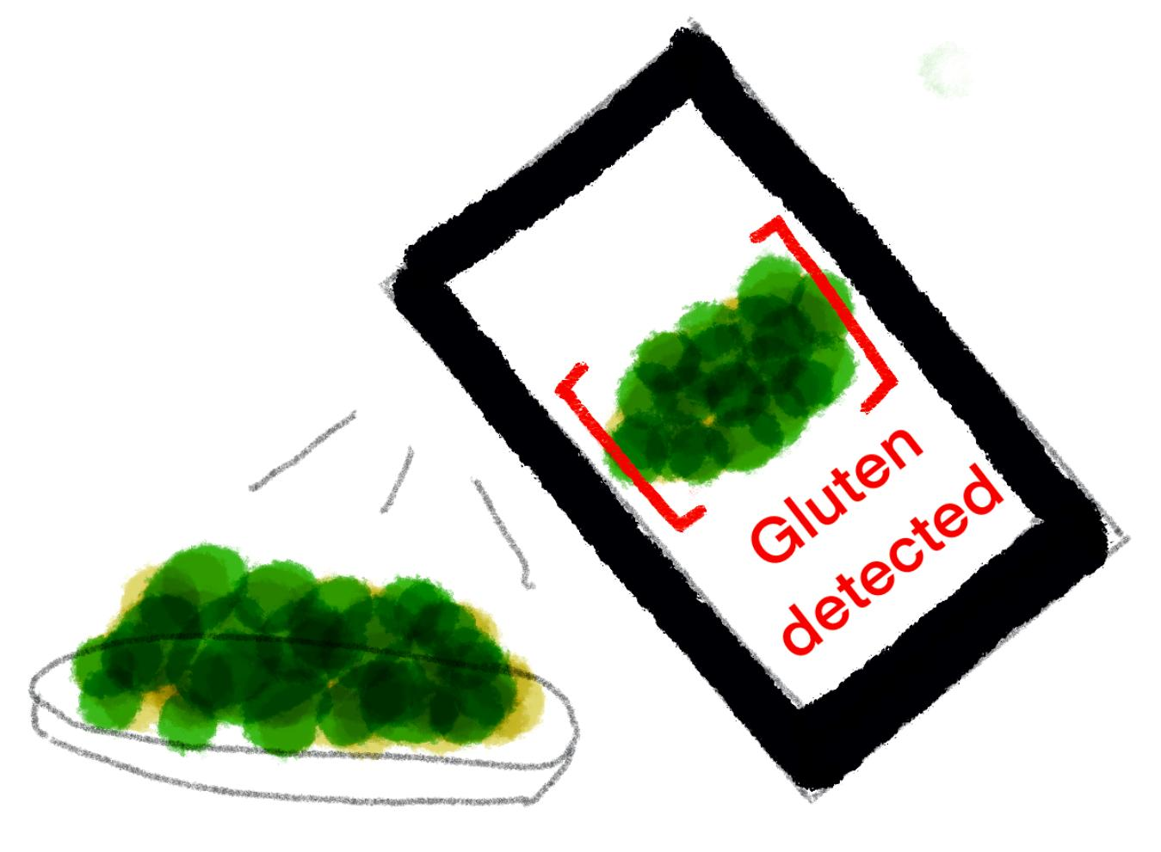
Scanner Idea
Phone app that scans the meal to detect gluten.
Pros:
Would not contaminate food
Cons:
Only the surface would be analyzed
Notes:
This was a highly rated idea from our Pugh Matrix
We though the scanner would look for certain properties of gluten (wavelength, light emission, heat, soundwaves)

Slide 11
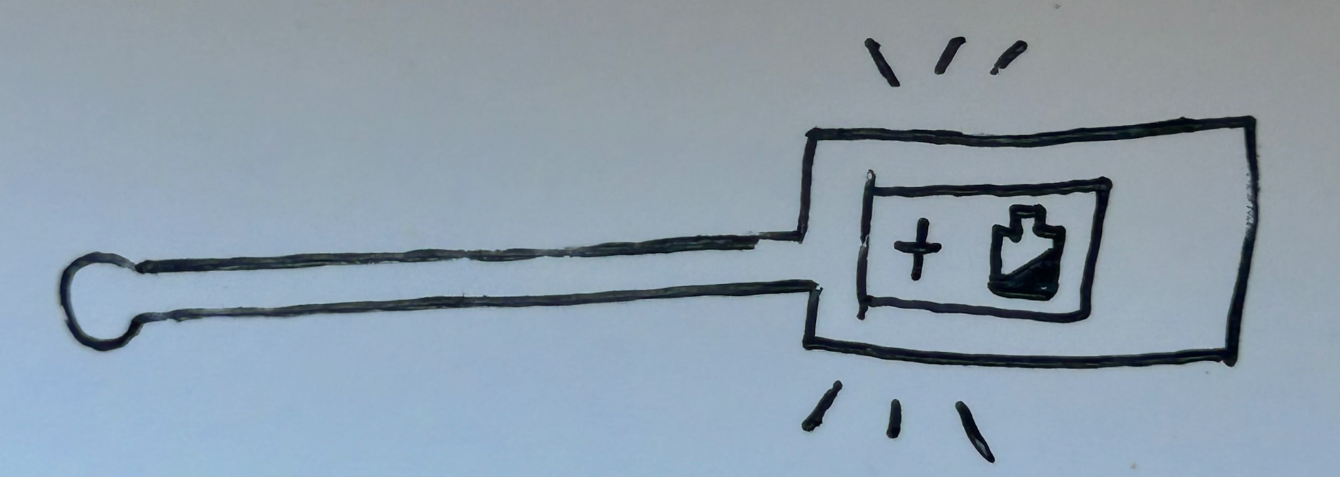
Probe Idea
Users hold handle of the probe and then use the stick part to move through their meal to detect the presence of gluten via antibody reaction.
Pros:
Analyzes entire meal
Can use antibodies
Cons:
Cleaning the device
Being food-safe
Not as discrete
Notes:
After discussing the results of the pugh matrix we thought combining test stripes and probe solution would be a good idea.
We liked using a probe since this meant that entire meal could be analyze for contamination
We found from research online that ELISA was the best method to detect gluten, so we were really attached to the idea of using antibodies
This is why we though test stripe would be the best way to implement the idea. However we realized that it wouldn’t test the entire meal or multiple stripes would need to be used
So we decided to combine the idea of using the antibodies to detect gluten but in the shape of the probe
After a couple of days we realized this initial design might not be feasible since different chemical agents need to used to adhere antibodies to a glass or another material probe. This solution would also not be food safe, which is also a problem
Additionally, the way to clean the device and use it for multiple uses was also an issue since new antibodies needed to be used everytime

Slide 12
Test Strip Idea
Users place a food sample onto the test strip. Result is displayed at the end of the strip indicating whether the sample tests positive for containing gluten.
Pros:
Similar to a COVID test - easy for user to use and discrete
Cons:
Disposable, may not be low coast
Does not analyze the entire meal

Slide 13
Our Current Design
Use a spoon-shaped gathering tool to collect a sample that has particles from all parts of the dish
The spoon is placed into a device that contains the antibody detection system
Food sample is processed by the device
A screen displays whether there is gluten or not
sample
NO Gluten Detected
Notes:
We still wanted to do use antibodies to detect gluten
To collect a sample that encompasses different parts of the meal there is a spoon-shaped device that has spikes on the outside to collect the food sample (Solid or liquid). Using a spoon minimizes the the profile of the device
The antibody detection system is shaped like a thermos. It contains a compartment for the spoon. It has another compartment attached that has the antibody solution that mixes with the sample.
Depending on whether the antibodies bind to the sample or not, the screen displays if there is gluten present
In the future we are planning to make a more finalized prototype of the thermos and spoon devices
We are also going to make a arduino circuit that can display the results
We will most likely not really prototype the antibody chemical system since this requires more in-depth scientific experimentation

Slide 14
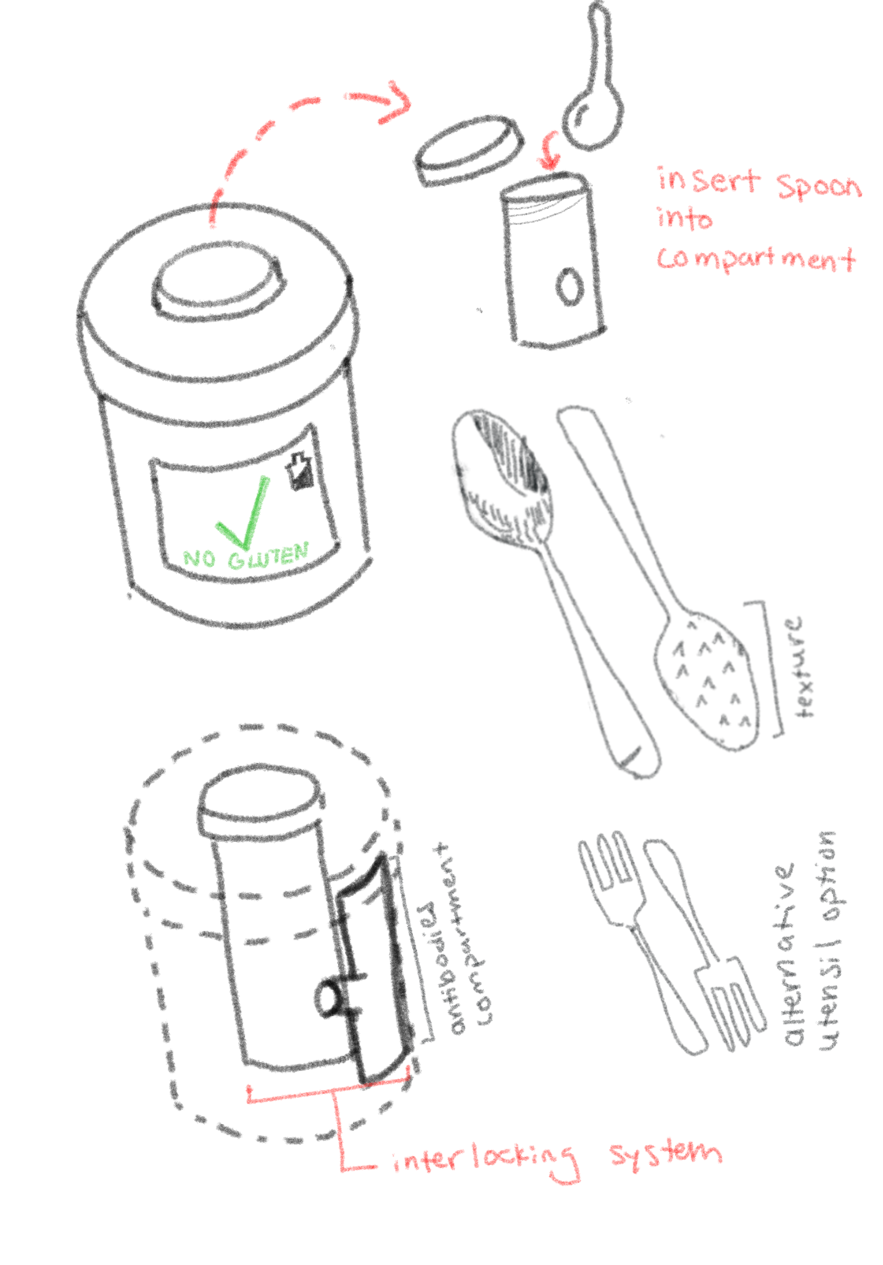
Sketches of Current Design
Fulfillment of User Requirements
Reliably detect gluten in prepared food - antibodies are most reliable
Light weight
Easy to understand results
Easy to clean - removable compartment
Will not contaminate food -
Food-safe
Low/ no waste
Quiet/ low profile - shape of thermos
Tests entire meal for contamination - spoon can scrape over entire meal
Can test both solid and liquid food - spoons can be used for different foods
Notes:
We still wanted to do use antibodies to detect gluten
To collect a sample that encompasses different parts of the meal there is a spoon-shaped device that has spikes on the outside to collect the food sample (Solid or liquid). Using a spoon minimizes the the profile of the device
The antibody detection system is shaped like a thermos. It contains a compartment for the spoon. It has another compartment attached that has the antibody solution that mixes with the sample.
Depending on whether the antibodies bind to the sample or not, the screen displays if there is gluten present
In the future we are planning to make a more finalized prototype of the thermos and spoon devices
We are also going to make a arduino circuit that can display the results
We will most likely not really prototype the antibody chemical system since this requires more in-depth scientific experimentation

Slide 15
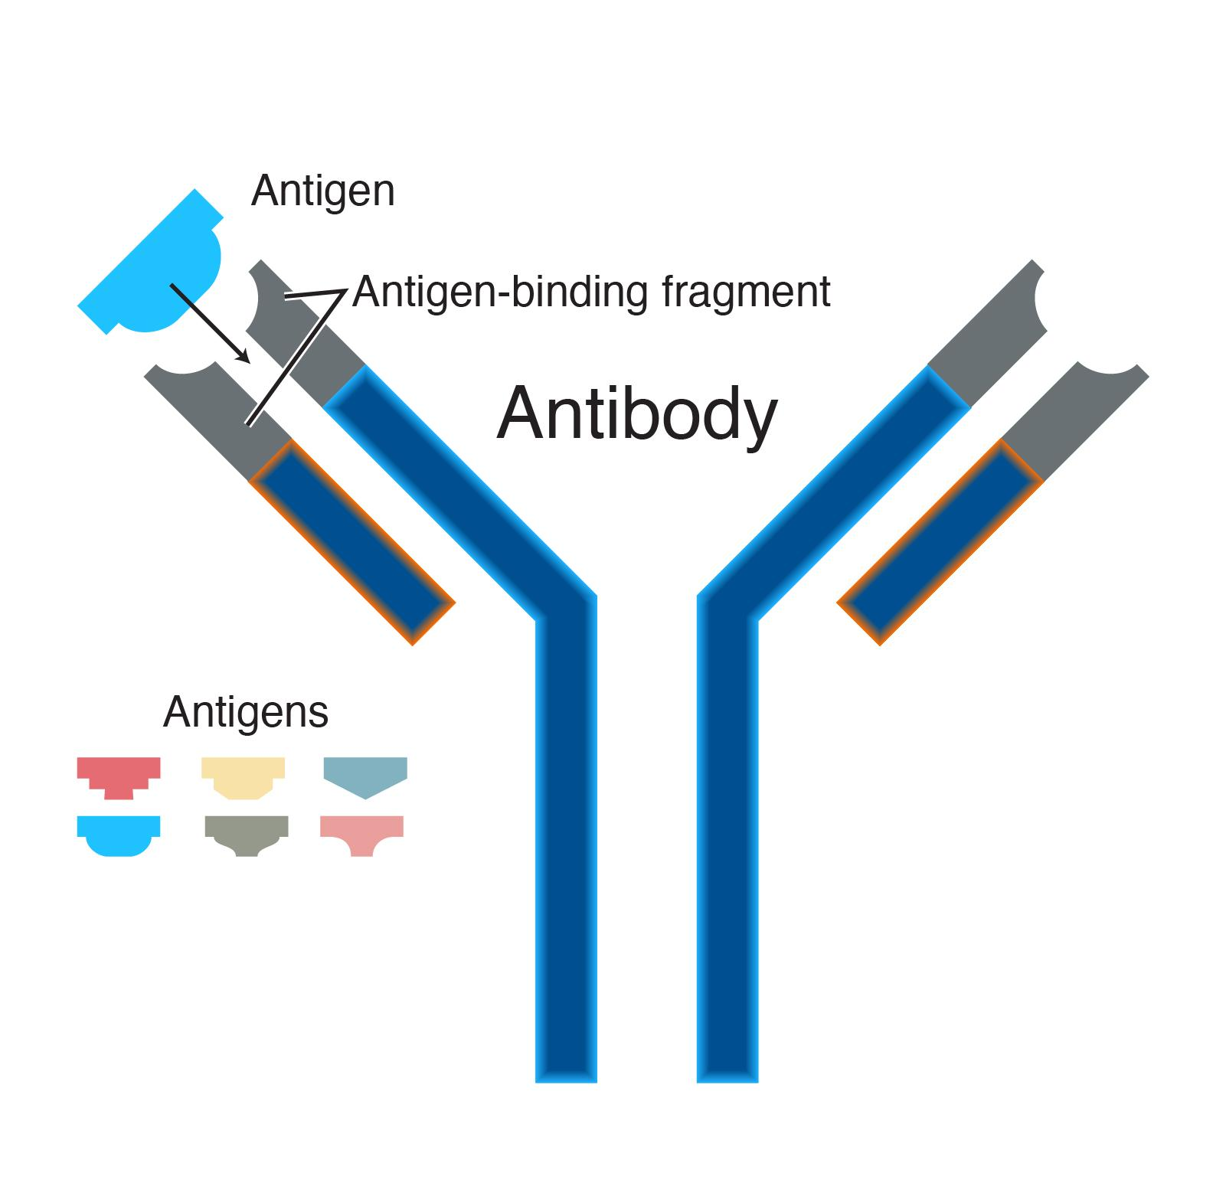
Future Manufacturing Thoughts
Plastic manufacturing
Antibody production
Gluten detection
Notes:
For manufacturing we would need a way to reliably make the detector. This would be through antibodies. These antibodies would go into a machine which can be easily cleaned so that it is not contaminated for future results. Therefore, this would be disposable.
To minimize the cost, the disposable component would be made from plastic which would easily be replicated and bought separately.
The antibodies would get into the device through a separate mechanism which would be imbedded into the detector.
This would therefore allow for easy reuse without the fear of cross contamination of the device itself.

Slide 16
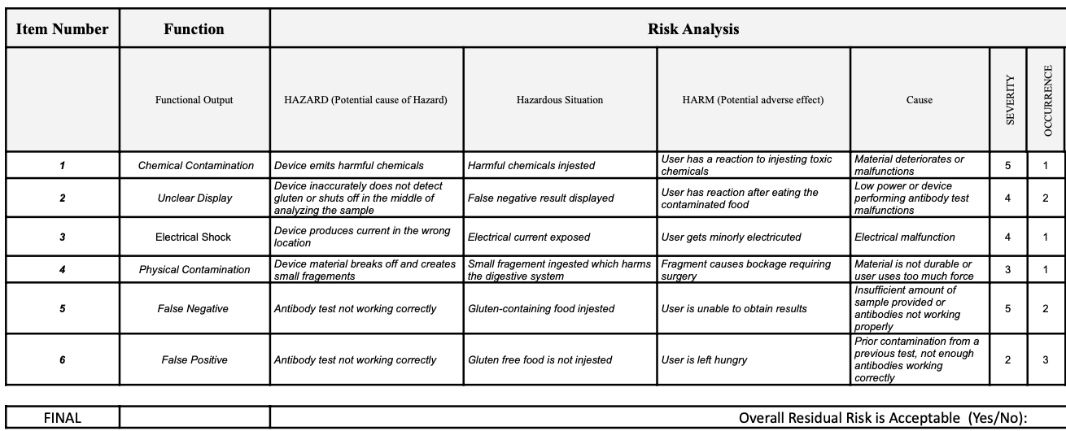
Risk Analysis
chemical contamination, physical contamination, unclear display, electrical shock, false negative, and false positive
Notes:
5 catastrophic severe allergic reaction due to high gluten levels undetected (above X ppm)
4 critical moderate allergic reaction due to moderate gluten undetected (X-X ppm gluten)
3 serious minor allergic reaction due to cross-contamination undetected (0-Xppm)
2 minor unclear results, food not eaten out of caution
1 negligable false positive, food not eaten
5–chemical and false negative

Slide 17
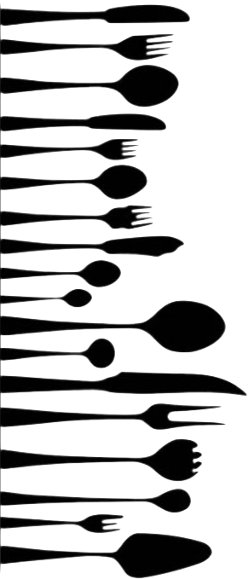
Next Steps in Our Current Design
Designing a spoon/ gathering tool that will be effective with many different food types
Researching the specific antibody interaction with gluten
Cost
Mechanism of detection of antibodies
Designing interlocking mechanisms of removable cartridge to place spoon into and the antibody compartment
Notes:
We still wanted to do use antibodies to detect gluten
To collect a sample that encompasses different parts of the meal there is a spoon-shaped device that has spikes on the outside to collect the food sample (Solid or liquid). Using a spoon minimizes the the profile of the device
The antibody detection system is shaped like a thermos. It contains a compartment for the spoon. It has another compartment attached that has the antibody solution that mixes with the sample.
Depending on whether the antibodies bind to the sample or not, the screen displays if there is gluten present
In the future we are planning to make a more finalized prototype of the thermos and spoon devices
We are also going to make a arduino circuit that can display the results
We will most likely not really prototype the antibody chemical system since this requires more in-depth scientific experimentation

Slide 18
Our Experience
Challenges:
Figuring out which needs are the most critical
How to feasibly design a solution
Understanding what our own design and fabrication limitations will be
Team Dynamics:
Great Communication
Respectful and Supportive
Dividing Work
Bi-weekly meetings

