Slide 1
“The ultimate gluten guardian”

Slide 2
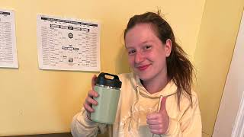
Skit
Imagine …
Notes:
Meira

Slide 3
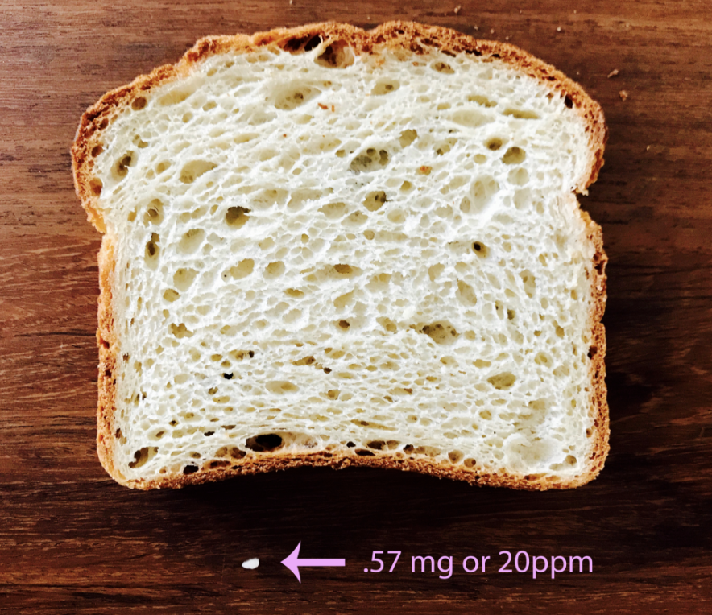
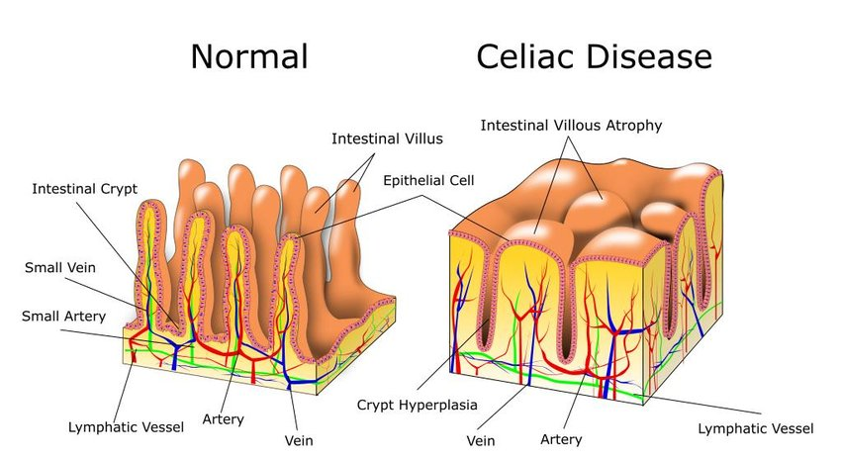
Celiac Disease
Genetically-linked autoimmune disease characterized adverse
response to the consuption of gluten (wheat, barley, rye) products.
Notes:
We are the celiac group presenting our product SCIMA-sense the ultimate gluten guardian
Celiac disease is genetically linked autoimmune disease. When people with celiac disease eat products that contain gluten (wheat, barley, or rye), it sends off an immune response which results in atrophy of the villi in the small intestine.
This causes stomach pain, diarrhea, and more long term osteoporosis, fertility issues, bowel cancer, iron-deficiency, and malnutrition.
The amount of gluten peptides that cause the triggering of this response is not yet known. However, foods can be labeled as gluten free in the united states if they have less than 20 parts per million of gluten.
For reference, this is the what 20 ppm looks like in comparison to a slice of bread.
As you can see, it can be very easy for there to be cross contamination, which is why people with celiac disease have to be very careful when eating food in a restaurant, cafeteria, or even some else's home.

Slide 4
Our Team
Caroline
Sanjana
Why we chose
Celiac Disease
Meira
Anna
Notes:
Therefore, we wanted a way to ease these stresses.
By designing a device that can be discreet, to prevent social anxieties, and effective, to prevent being gluten. We have found a solution to excess stress surrounding food.
Our team designed this product to help our friends with celiac have an easier time navigating eating with others, especially in college when food is a big part of social culture.
We are Caroline, Meira, Sanjana, and Anna.
We hope you like our product.

Slide 5
Problem Statement
A way to address gluten cross-contamination for individuals with Celiac disease to reduce allergic reactions
Notes:
Caroline

Slide 6
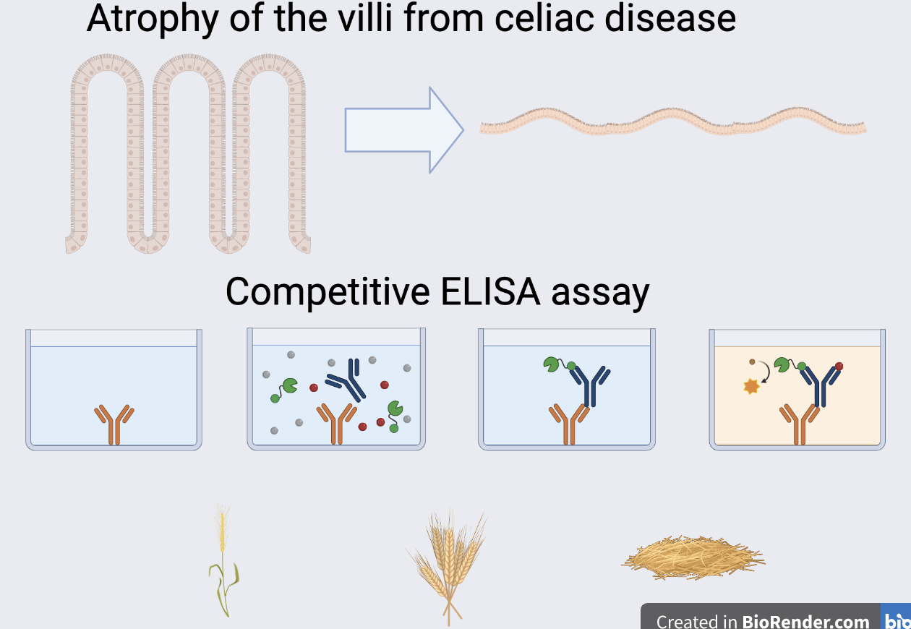
AntiBody Test
Notes:
Meira
It is known that ELIZA testing is the most accurate method for detecting gluten particles
Nima uses a lateral flow strip which automatically tests the sample and performs lateral flow analysis which is analyzed with an optical sensor.
However, it is not able to detect gluten in beer or soy sauce.
Therefore, we propose to do an on the spot ELISA assay.
This would use r5 antibodies which have been proven to be the most successful in detecting gliadin peptides.
The competitive ELISA assay would be used because it is able to detect particles in small portions of the sample vs sandwich which can only detect intact peptides.
Competitive ELISA uses a known quantity of antigen which is immbolized on a microtiter plate and antigen containing sample. The antibodies are added to the well and the immbolized and free antigens compete for the antibody binding sites. Then the excess if washed from the area and the color product is formed which can be detected using signal interference. The absorbance is inversely proportional to the antigen, meaning more antigen in the sample signifies less of the enzyme-labeled antigen that binds to the antibody.

Slide 7
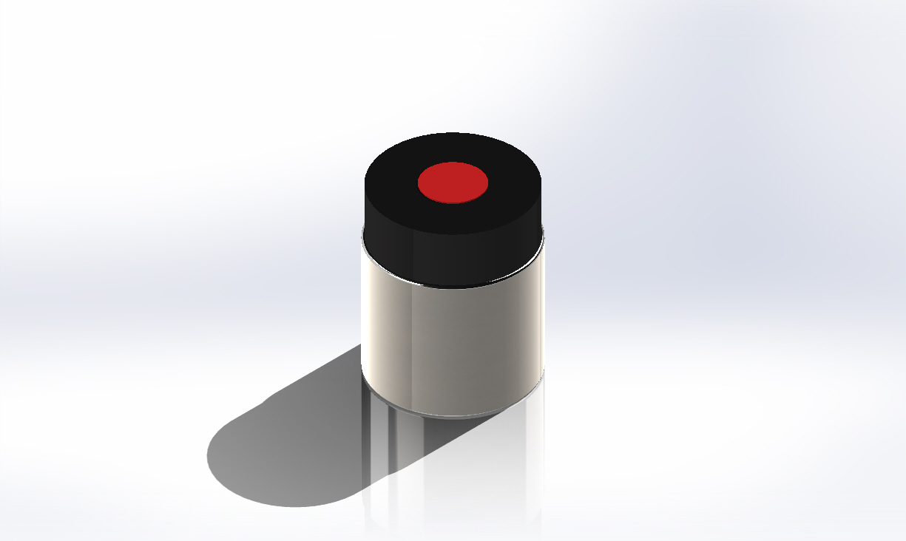
Device Design and Features
Features:
Disposable capsule
Insertable capsule into cap
Removable inner tube for easy cleaning
Screw cap lid
Mechanism of action for release of antibodies from capsule
Notes:
Anna

Slide 8
Prototype Demonstration
Notes:
We used Mold Max 30 for the bread and Smooth Sil for the base of the removable compartment.
We 3D printed the spoon, capsule, compartment, and molds used for molding.
For our prototype we used a distance sensor but for our actual design we would use a optical sensor since the ELISA test will generate a color change based on the amount of antibodies that either bind or don’t bind

Slide 9
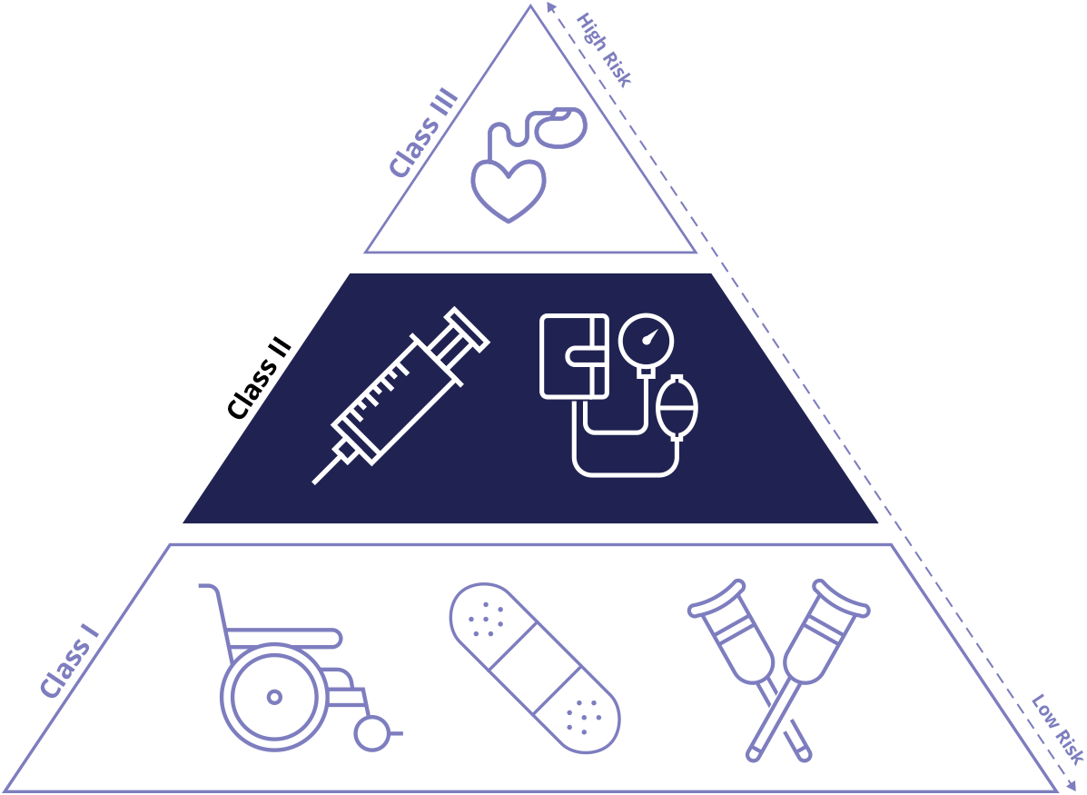
Class II Medical Device
Moderate-risk Device
Will Require Clinical Testing
Notes:
https://www.arenasolutions.com/resources/glossary/class-ii-device/

Slide 10
Why we are better than Nima and what makes our product unique
Nima
Described as “embarrassing” and hard to operate
Reported to make teens feel anxious
Limited testing
Lack of diversity
Some users reported inconsistencies
Not applicable to all foods
Users unaware of device limitations
Results take a few minutes
High cost
Not FDA Approved
Our device
Blends into surroundings
Expanded testing planned
Functional with all food types
Communication with users
Results displayed in 30 seconds
Decreased cost
source
Notes:
Not applicable to fermented foods like soy sauce (concern stated that not all users knew this)
Also concerns that some users found it TOO sensitive for their needs (communication of limits, 20 ppm cutoff)
Embarrassment (from survey and also article – in article it was about having to struggle to close it, now a wrench is provided??)
Results time from nima website

Slide 11
Profit
Sensor: $150
Pods: $30 for a pack of 90 pods (roughly a month supply)
Projected Revenue (in the US): $1,080,000,000

Slide 12
We are seeking 15 million for 15% capital
to start clinical testing and manufacturing operations

Slide 13
Next Steps
Clinical Testing
User Testing
Manufacturing
Commercial
Reliably Tests Gluten
Food Safety
Fast results
Easy to use and understand results
Safe and Comfortable
Manufacturing Plant is running
Units are uniform and reproducible
Sell online
Available at Doctor’s Offices

Slide 14
Thank You!!

