Slide 1


Measuring the (un)affordability of healthy diets: New price indexes for the cost of meeting international nutrition standards
Will Masters
Friedman School of Nutrition Science & Policy, Tufts University (USA)
Seminar at UConn, March 28th 2018
Project website:
http://sites.tufts.edu/candasa

Slide 2
With rapid change in food environments, are nutritious diets becoming easier to buy, or further out of reach?

Slide 3
We introduce four kinds of indicators to add up the cost of foods in terms of their nutritional values
Measuring the affordability of nutritious diet: methods and results
motivation | food scores | diet diversity | recommended diets | nutrient adequacy | conclusion
Unit-free indexes that track change over time
  Nutritious-food Price Index (NPI)
    Weight prices by nutrient scores, instead of spending level as in CPI
  Cost of Diet Diversity (CoDD)
    Uses least-cost food from the lowest-cost food groups to reach MDD-W
Cost-per-day values that specify quantities needed
  Cost of a Recommended Diet (CoRD):
    weights each price by quantities in the recommended diet
  Cost of Nutrient Adequacy (CoNA):
    the least-cost combination of foods to meet nutrient requirements

Slide 4
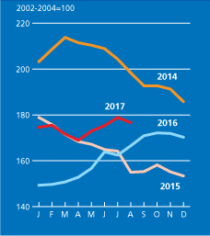
Existing food price indexes are weighted by market value and say little about nutritional value
Measuring the affordability of nutritious diet: methods and results
motivation | food scores | diet diversity | recommended diets | nutrient adequacy | conclusion
World food commodity prices, 2014-2017
For global commodity prices, the FAO Food Price Index consists of five commodity group price indices, weighted with average export shares of each of the groups for 2002-2004.
Total of 23 commodities (73 prices), in 5 groups:
Cereals
-- wheat (11), maize (1), rice (16)
Oils/Fats
-- soybean, sunflower, rapeseed, groundnut, cottonseed, copra, palm kernel, palm, linseed, castor (1 each)
Dairy
-- whole milk powder, skim milk powder, cheese (2 each), cheese (1)
Meat
-- poultry (13), beef (7), pork (6), sheep (1)
Sugar
-- sugar (1)
Source: www.fao.org/worldfoodsituation, 29 Sept. 2017

Slide 5
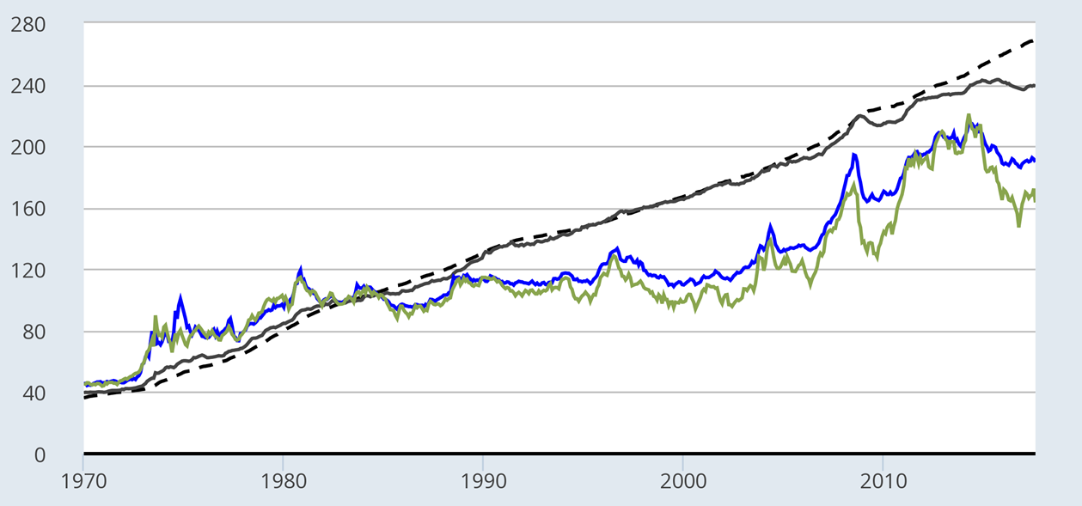
Within a consumer price index, food price trends and fluctuations differ greatly by type of food
Measuring the affordability of nutritious diet: methods and results
motivation | food scores | diet diversity | recommended diets | nutrient adequacy | conclusion
Local food prices in the United States, 1970-2016 (index values, 1982=100)
Retail prices
Food away from home
(restaurants etc.)
Food at home
(groceries)
Wholesale prices
Processed food & feed
Unprocessed food and feed
Source: US. Bureau of Labor Statistics, downloaded 29 Sept. 2017. Definitions and chart data are available at http://myf.red/g/ff6v

Slide 6
How might we measure the cost and affordability of a nutritious diet?
Measuring the affordability of nutritious diet: methods and results
motivation | food scores | diet diversity | recommended diets | nutrient adequacy | conclusion
For foods actually consumed, a very long history
  Fleetwood (1707) food price index = 5 ‘quarters’ of wheat, 4 ‘hogsheads’ of beer
  Lowe (1823) different baskets for different socioeconomic groups
  Jevons (1865), Laspeyres (1871) and many others lead to modern CPI
For affordability of dietary energy, a long history and wide use
  Playfair (1821) chart of wheat prices and wages from 1565 to 1821
  Sukhatme (1961) and FAO’s Prevalence of Undernourishment in calories
  Drewnowski (2004) measure of energy cost ($/kcal) and density (kcal/kg)
For nutrient adequacy, more recent history and many specific uses
  Stigler (1945) linear programming to compute least-cost diets
  USDA Thrifty Food Plan for US nutrition assistance (1975, 1983, 1999, 2006)
  SCUK Cost of Diet tool (2009) and FANTA et al. Optifood (2012) for aid programs
We also introduce three new concepts:
  A nutritionally-weight price index (using nutrient profile scores, from 1 to 100)
  A cost of diet diversity index (at least one from each of at least 5 food groups)
  A cost of recommended diets index (with quantities from local dietary guidelines)

Slide 7
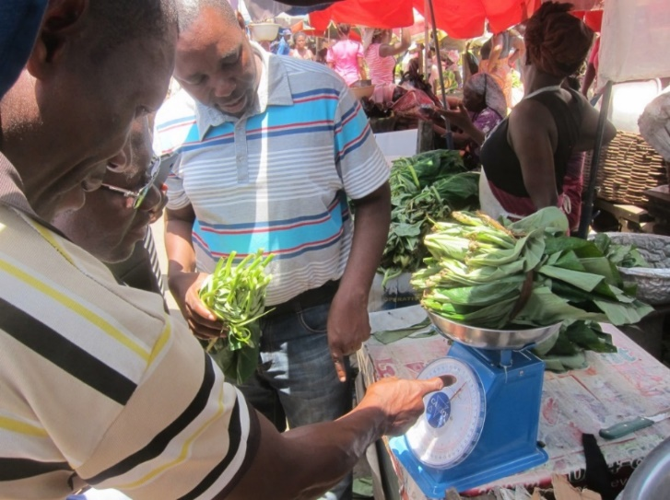
Measuring the affordability of nutritious diet: methods and results
motivation | food scores | diet diversity | recommended diets | nutrient adequacy | conclusion
Food prices can come from many different sources
How are food prices now being collected and used?
 | Market information & price monitoring | National accounts & poverty monitoring
Actor | Agricultural & food agencies | Financial & statistical agencies
Purpose | Inform farmers, traders, distributors | Measure real income, inflation, poverty
Products | Traded commodities, often a few key staple foods and cash crops at wholesale markets | Retail products, often a long list of over 50 standardized items from urban supermarkets
Access | Individual prices may be available upon request; Private sources charge for subscriptions | Aggregate indexes reported annually, quarterly or monthly; Item-level prices are sometimes confidential
Ghana MoFA enumerator collecting food price data
Photo: Anna Herforth, 2017

Slide 8
Measuring the affordability of nutritious diet: methods and results
motivation | food scores | diet diversity | recommended diets | nutrient adequacy | conclusion
The IANDA project helped Ghana MoFA expand price data collection to include more diverse foods
Cereals | White Roots and Tubers | Plantain | Pulses | Nuts and Seeds | Dark Green Leafy Vegetables | Seed Oil
Maize | Yam | Plantain | Cowpea (white) | Groundnut (unsh) | Nkontommire | Coconut oil
Millet | Cocoyam |  | Soya bean | Groundnut (red) | Jute mallow | Palm oil
Sorghum | Cassava |  | Bambara Bean | Melon Seeds | Alefu (Amaranthus) | Groundnut oil
Rice | Gari
 | Sweet potato
 | Cassava dough
 | Dried cassava
Meat, Poultry and Fish | Vegetables | Fruits | Egg | Dairy
Beef | Tomato | Mango | Egg | Fresh Cow Milk
Pork | Garden Egg | Pineapple
Salted dried fish | Okro | Palm fruit
Live chicken bird | Onion | Watermelon
Smoked herring | Ginger | Orange
Anchovy | Pepper | Banana
Fresh fish | Cabbage | Coconut
Chicken meat | Lettuce | Avocado
Snail | Carrot | Pawpaw
Goat meat
Mutton
Ghana’s Weekly Market Price Reports will soon include the additional foods marked in red, for 20 major markets

Slide 9
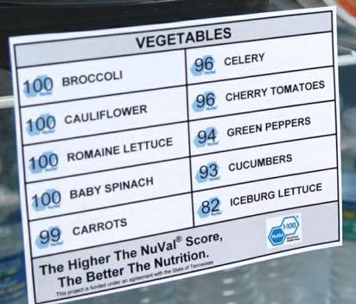
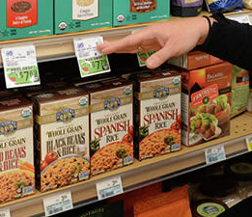
Standard food CPI counts each food in proportion to actual consumption
Measuring the affordability of nutritious diet: methods and results
motivation | food scores | diet diversity | recommended diets | nutrient adequacy | conclusion
We can use nutrition scores instead
Standard food CPI:
  fCPI = ∑_{i}p_{i}w_{i} , where p_{i} and w_{i} are prices and weights in consumer spending
➔ weights each price by quantities actually chosen
Nutritious-food PI (NPI):
  NPI = ∑_{i}p_{i}n_{i}w_{i} , where n_{i} is a nutrient score, eg NuVaL from 1 (worst) to 100 (best)
➔ weighting each expense by its nutritional value
Nutrition scores aim to guide food choices
We use them to measure whether more nutritious foods are becoming
more or less affordable

Slide 10
The Nutritious-food CPI reflects a specific nutrition scoring system
Measuring the affordability of nutritious diet: methods and results
motivation | food scores | diet diversity | recommended diets | nutrient adequacy | conclusion
Ghana Statistical Service CPI weights (food expenditure shares) versus NuVal scores (Nutritional Value index)
 | CPI weights | NuVal weights
Food | 100 | 100
Cereals and cereal products | 25.55 | 19.43
Meat and meat products | 9.10 | 8.55
Fish and sea food | 22.93 | 14.12
Milk, cheese and eggs | 4.33 | 5.50
Fruits | 4.29 | 14.64
Vegetables | 23.36 | 32.67
Oils and fats | 5.19 | 0.86
Sugar, jam, honey, chocolate & confectionery | 2.29 | 0.24
Mineral water, soft drinks, fruit &vegetable juices | 3.57 | 0.45
Food products n.e.c. | 1.95 | 2.45
Non-alcoholic beverages | 5.57 | 2.50
Coffee, tea and cocoa | 2.00 | 2.05
Could use to measure nutritional value
Used to measure real income & poverty
(food as a whole is 42% of CPI)
Nutritional value > consumer spending
Nutritional value < consumer spending
Notes:
Note food as a whole is 42% of CPI

Slide 11
In Ghana, have more nutritious foods become more expensive than other foods?
Measuring the affordability of nutritious diet: methods and results
motivation | food scores | diet diversity | recommended diets | nutrient adequacy | conclusion
Food Price Indexes in Greater Accra, 2012-2017
Prices of more nutritious foods
rose less than prices of other foods
Food Price Indexes in Tamale, 2012-2017
...but in Tamale from 2012 to 2014, the opposite occurred

Slide 12


Measuring the affordability of nutritious diet: methods and results
motivation | food scores | diet diversity | recommended diets | nutrient adequacy | conclusion
A popular metric of diet quality is diversity
We follow the MDD-W
MDD-W is defined as ≥ 5 of these 10 food groups in past 24 hrs
  (1) Starchy staples (Grains, white roots/tubers, plantains)
  (2) Pulses (beans, peas and lentils – includes soybeans)
  (3) Nuts and seeds (higher fat than pulses, includes groundnuts)
  (4) Flesh foods (meat, poultry and fish)
  (5) Dark green leafy vegetables
  (6) Other vitA-rich fruits & vegetables
  (7) Other vegetables; (8) Other fruits; (9) Eggs; (10) Dairy

Slide 13
We can measure the cost of reaching MDD-W with the least-cost food in each group
Measuring the affordability of nutritious diet: methods and results
motivation | food scores | diet diversity | recommended diets | nutrient adequacy | conclusion
MDD-W has a direct economic interpretation
Within groups, all foods are equal substitutes
Each group meets different needs, and also contributes to energy balance
Groups can be ranked by cost towards total daily energy balance
People with at least five groups are likely to reach adequacy thresholds
The cost of reaching MDD-W can be defined as:
Cost of Diet Diversity (CoDD):
  CoDD = Min5{min{p_{i1}}, min{p_{i2}}, …, min{p_{im}}}
    ➔ the least-cost way to include at least one food from at least 5 food groups
  CoDD2 = Ave{min{p_{i1}}, min{p_{i2}}, …, min{p_{im}}}
    ➔ the least-cost way to include at least one food from any 5 of the 10 food groups

Slide 14
1.Maize or cassava
Measuring the affordability of nutritious diet: methods and results
motivation | food scores | diet diversity | recommended diets | nutrient adequacy | conclusion
The least-cost food in each group may vary
  Foods counted for the Cost of Diet Diversity (CoDD) in Ghana, 2009-14
In Ghana, foods in the five lowest-cost groups are:
5.Fish or banana
4.Mangoes
3.Groundnuts
2.Soya
Note: if we ranked foods by weight ($/kg), the least cost starchy staple would always be cassava

Slide 15
1.Maize
Measuring the affordability of nutritious diet: methods and results
motivation | food scores | diet diversity | recommended diets | nutrient adequacy | conclusion
Each food group may have
different trends and fluctuations
  Foods counted for the Cost of Diet Diversity (CoDD) in Tanzania, 2011-15
In Tanzania, each food group varies differently over time
5.Avocado
4.Beef
3.Groundnuts
2.Soya
Note: if we ranked foods by weight ($/kg), the least cost food would often be cabbage

Slide 16
To measure cost levels (e.g. $/day), we can use the Cost of a Recommended Diet (CoRD)
Measuring the affordability of nutritious diet: methods and results
motivation | food scores | diet diversity | recommended diets | nutrient adequacy | conclusion
The previous indexes are unit-free, to measure change over time
Traditional food CPI
Nutritious-food CPI (NPI)
Cost of Diet Diversity (CoDD)
We measure total cost by specifying quantities consumed
Cost of a Recommended Diet (CoRD):
  CoRD = ∑_{j}p_{ij}q_{j} , where p_{ij} = min{p_{ij}} and q_{j} = requirement for j={1,…, m} categories
  ➔ weights each price by quantities in the recommended diet, lowest-cost only
  CoRD2 = ∑_{j}p_{ij}q_{j} , where p_{ij} = median{p_{ij}} and q_{j} = requirement for j={1,…, m} categories
  ➔ weights each price by quantities in the recommended diet, all foods equally

Slide 17
The Cost of a Recommended Diet (CoRD) reflects specific dietary guidelines
Measuring the affordability of nutritious diet: methods and results
motivation | food scores | diet diversity | recommended diets | nutrient adequacy | conclusion
In Africa, the only countries with dietary guidelines are Benin, Sierra Leone, Nigeria, Namibia, and South Africa (+Kenya soon)
Ghana prices not available for dairy
Cost per serving for lowest-cost
item in each food group (Ghana, 2015)
Guidelines specify
the number of servings in
each group
Cost/serving (PPP US$/item)
Notes:
Ghana and Tanzania do not have national food-based dietary guidelines. As a substitute, we used Benin’s guide, because among countries with FBDGs, the food examples are most similar to Ghana. (Only Benin, Sierra Leone, Nigeria, Namibia, and South Africa have FBDGs in Africa. And Seychelles. Kenya coming soon.)
Kenya – not done yet – could use for Kenya
Sierra Leone – no guidance on quantity or servings
Nigeria – Cannot see graphic, no written guidance on quantity or servings
Namibia, South Africa, Seychelles – not close enough regionally

Slide 18
The Cost of a Recommended Diet (CoRD) depends on which foods are used
Measuring the affordability of nutritious diet: methods and results
motivation | food scores | diet diversity | recommended diets | nutrient adequacy | conclusion
With the average of all items in each food group (except dairy), total cost would be US$1.37/day
Ghana price data include several high-cost vegetables and protein foods, so those groups can be very expensive
Cost per day for a recommended diet, median of all items (Ghana, 2015)
Cost per day (2011 US$ in PPP terms)
Notes:
The price data include several high-cost items in the “protein” group (and also vegetables), so including them raises average cost a lot

Slide 19
The Cost of a Recommended Diet (CoRD) depends on price and quantity per day
Measuring the affordability of nutritious diet: methods and results
motivation | food scores | diet diversity | recommended diets | nutrient adequacy | conclusion
With the average of all items in each food group (except dairy), total cost would be US$0.75/day
The required portions from each food group cost between $0.15 and $0.25 per day
Ghana prices not available for dairy
Cost per day for a recommended diet, lowest-cost items only (Ghana, 2015)
Cost per day (2011 US$ in PPP terms)

Slide 20
Measuring the affordability of nutritious diet: methods and results
motivation | food scores | diet diversity | recommended diets | nutrient adequacy | conclusion
The most widely-used nutritional standard is nutrient adequacy
The Cost of Nutrient Adequacy (CoNA) is a “least-cost diet” using foods that reach EARs at lowest cost:
  Minimize C = Σ_{i}p_{i}q_{i}
  Subject to a_{ij} q_{i} > EAR_{j} , for j = 1,…, 17 essential nutrients
  and a_{ie} q_{i} = E , for energy
  where p_{i} is price and q_{i} is quantity of food i, and a_{ij} is its content in nutrient j, for which EAR_{j} is the Estimated Average Requirements for adult women aged 19-30, not pregnant or lactating, at 55 kg with energy use (E) of 2000 kcal/day
  We focus on total cost
    Disaggregated by food groups, to show diet composition
    Disaggregated by nutrients, valued at their shadow prices
Notes:
Note we use only 17 of the 21 essential nutrients, omitting Vit. D and cholesterol because they are naturally synthesized by the body, and omitting iodine and molybdenum due to lack of data in the food composition databases.

Slide 21
Measuring the affordability of nutritious diet: methods and results
motivation | food scores | diet diversity | recommended diets | nutrient adequacy | conclusion
  Cost of Nutrient Adequacy (CoNA) in Ghana, by food group
In Ghana, the cost of buying sufficient nutrients rose from 2010 to 2014, largely because vitamin-A rich F&V (e.g. mango) became more expensive

Slide 22
Measuring the affordability of nutritious diet: methods and results
motivation | food scores | diet diversity | recommended diets | nutrient adequacy | conclusion
  Cost of Nutrient Adequacy (CoNA) in Ghana, by limiting nutrient
In Ghana, the limiting nutrient whose cost has risen is mainly vitamin A, but the cost of meeting calcium requirements has also risen

Slide 23
Measuring the affordability of nutritious diet: methods and results
motivation | food scores | diet diversity | recommended diets | nutrient adequacy | conclusion
  Cost of Nutrient Adequacy (CoNA) in Tanzania, by food group
In Tanzania, there was some rise in CoNA during 2011-12, with many different food groups playing important roles in keeping the cost of nutrients relatively stable

Slide 24
Measuring the affordability of nutritious diet: methods and results
motivation | food scores | diet diversity | recommended diets | nutrient adequacy | conclusion
  Cost of Nutrient Adequacy (CoNA) in Tanzania, by limiting nutrient
In Tanzania, there was some rise in CoNA during 2011-12, with many different nutrients as limiting factors

Slide 25
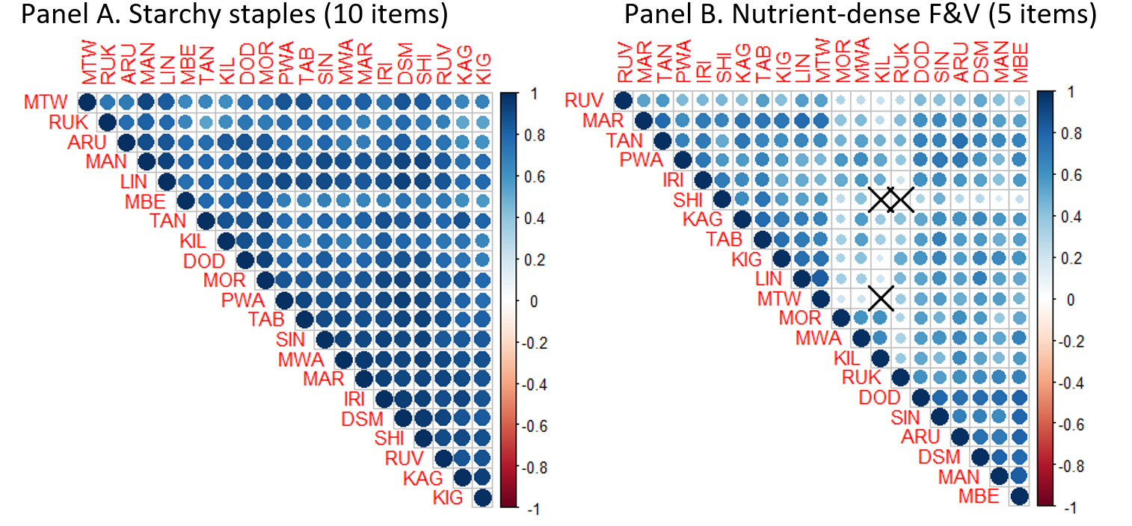
Measuring the affordability of nutritious diet: methods and results
motivation | food scores | diet diversity | recommended diets | nutrient adequacy | conclusion
  More nutritious foods have more spatial variance in price
  Spatial correlation in monthly food prices across 21 locations in Tanzania, 2011-2015
  Note: Darker blue indicates larger positive coefficient, X indicates zero.

Slide 26
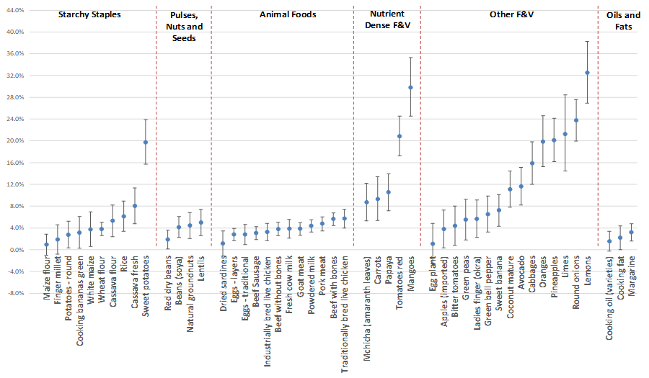
Measuring the affordability of nutritious diet: methods and results
motivation | food scores | diet diversity | recommended diets | nutrient adequacy | conclusion
  More nutritious foods have more seasonal variance too
  Seasonal price variation in monthly food prices at 21 locations in Tanzania, 2011-2015
  Note: Data shown are point estimates and 95% confidence intervals for the amplitude of seasonal fluctuation, as a percent of average prices at the lowest time of year.

Slide 27
Measuring the affordability of nutritious diet: methods and results
motivation | food scores | diet diversity | recommended diets | nutrient adequacy | conclusion
  At each location, the cost of nutritious diets has more significant seasonality than the cost of daily energy
  Seasonal variation in cost of nutrient adequacy vs. daily energy in Tanzania, 2011-2015
  Note: Bars show amplitude of seasonality, with 95 percent confidence intervals, in dark bars for cost of nutrient adequacy and light bars for cost of caloric adequacy

Slide 28
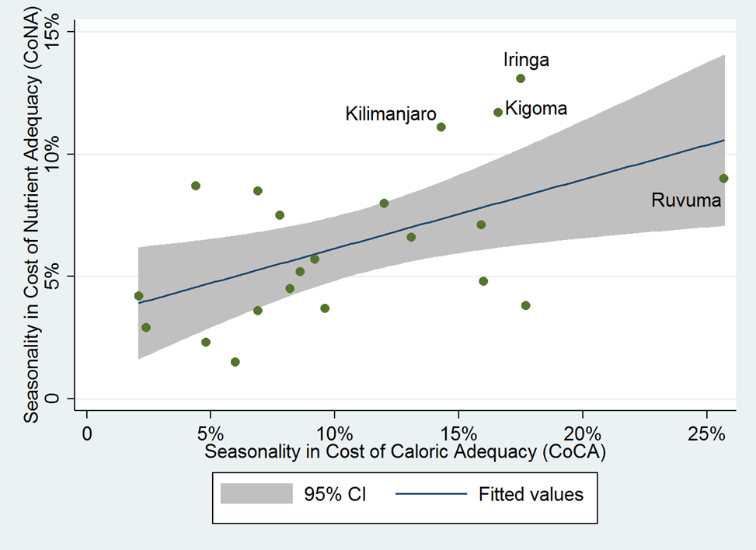
Measuring the affordability of nutritious diet: methods and results
motivation | food scores | diet diversity | recommended diets | nutrient adequacy | conclusion
  Variation in the cost of nutritious diets is driven partly by cost of energy, with additional seasonality
  Seasonal variation in cost of nutrient adequacy vs. daily energy in Tanzania, 2011-2015
  Note: Bars show amplitude of seasonality, with 95 percent confidence intervals, in dark bars for cost of nutrient adequacy and light bars for cost of caloric adequacy

Slide 29
Conclusions and next steps
Measuring the affordability of nutritious diet: methods and results
motivation | food scores | diet diversity | recommended diets | nutrient adequacy | conclusion
Calculating the cost of a nutritious diet is challenging
  Need clear definition of “nutritious”. We use:
    Food scores for nutritional value, modifying standard CPI to calculate NPI
    Recommended diets, using dietary guidelines to calculate CoRD
    Dietary diversity, using MDD-W to calculate CoDD
    Nutrient adequacy, using use EARs for 17 nutrients to calculate CoNA

Slide 30
Measuring the affordability of nutritious diet: methods and results
motivation | food scores | diet diversity | recommended diets | nutrient adequacy | conclusion
Conclusions and next steps
Summary of formulas
Index values: unit-free, no quantities specified
Nutritious-food CPI (NPI)
  NPI = ∑_{i}p_{i}n_{i} , where n_{i} is a food’s health score, eg NuVaL from 1 (worst) to 100 (best)
➔ weighting each price by its nutritional value, instead of expenditure shares in CPI
Cost of Diet Diversity (CoDD)
  CoDD = Min5{min{p_{i1}}, min{p_{i2}}, …, min{p_{im}}}
    ➔ the least-cost way to include at least one food from at least 5 food groups
  CoDD2 = Ave{min{p_{i1}}, min{p_{i2}}, …, min{p_{im}}}
    ➔ the least-cost way to include at least one food from any 5 of the 10 food groups
Cost per day: specifies quantities needed
Cost of a Recommended Diet (CoRD)
  CoRD = ∑_{j}p_{ij}q_{j} , where p_{ij} = min{p_{ij}} and q_{j} = requirement for j={1,…, m} categories
  ➔ weights each price by quantities in the recommended diet, lowest-cost only
Cost of Nutrient Adequacy (CoNA)
  CoNA = Min_{i}Σ_{i}p_{i}q_{i}, where a_{ij} q _{i} > EAR_{j} and a_{ie} q _{i} = E
  a_{ij} is nutrient content of foods, EAR_{j} is nutrient requirement of people
  ➔ the least-cost combination of m foods to meet n nutrient needs

Slide 31
Conclusions and next steps
Measuring the affordability of nutritious diet: methods and results
motivation | food scores | diet diversity | recommended diets | nutrient adequacy | conclusion
Calculating the cost of a nutritious diet is challenging
  Need clear definition of “nutritious”. We use:
    Food scores for nutritional value, modifying standard CPI to calculate NPI
    Recommended diets, using dietary guidelines to calculate CoRD
    Dietary diversity, using MDD-W to calculate CoDD
    Nutrient adequacy, using use EARs for 17 nutrients to calculate CoNA
Underlying data remain limiting
  Here, we use prices from MoFA in Ghana, NBS in Tanzania
  For Ghana, future studies will include prices for expanded food list
  In Tanzania and other countries, need more rural market prices
In follow-on projects, we will:
  Continue working with stakeholders for use and uptake
  Assemble prices from additional countries
  Test link to prices from climate fluctuations, infrastructure & markets
  Test link from prices to diet quality, heights & weights

Slide 32
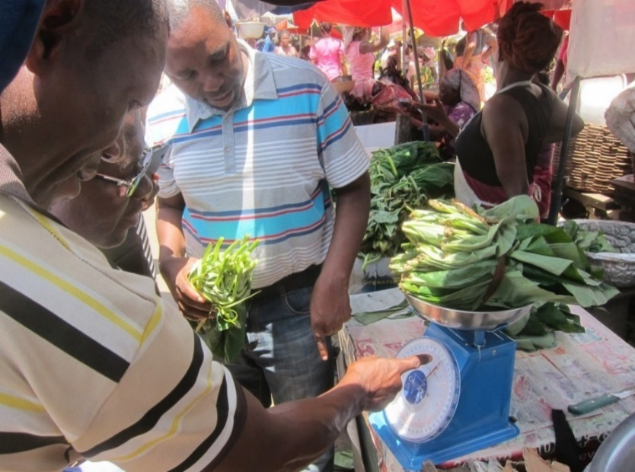
Thank you!
Measuring the affordability of nutritious diet: methods and results
motivation | formulas | data | nutrient adequacy | diet diversity | next steps
This work is funded by UKAid and the Bill & Melinda Gates Foundation (OPP1182628)
Model code and data for replication of results will be available on that project’s website at http://sites.tufts.edu/candasa
Special thanks to all price enumerators
Photo: Anna Herforth, 2017

Slide 33
Other slides

Slide 34
Measuring the affordability of nutritious diet: methods and results
motivation | food scores | diet diversity | recommended diets | nutrient adequacy | conclusion
In Ghana, most food groups have had similar trends and fluctuations
  Cost of Diet Diversity (CoDD) price index in Ghana, 2009-14
  Index value
  (2009=100)
CoDD2 = avg. of least cost foods in all groups
CoDD1 = least cost food in 5th lowest-cost group

Slide 35
Measuring the affordability of nutritious diet: methods and results
motivation | food scores | diet diversity | recommended diets | nutrient adequacy | conclusion
In Tanzania, the cost of the cheapest 5 groups has declined, while other groups have risen
  Cost of Diet Diversity (CoDD) price index in Tanzania, 2011-15
  Index value
  (2009=100)
CoDD2 = avg. of least cost foods in all groups
CoDD1 = least cost food in 5th lowest-cost group

Slide 36
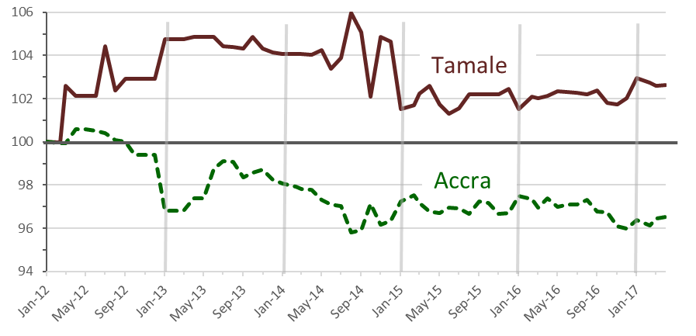
Nutritious-food price index (NPI) relative to food CPI in two regions of Ghana, Jan. 2012-April 2017
...but in Tamale from 2012 to 2014, the opposite occurred
Prices of more nutritious foods
rose less than prices of other foods
Notes:
In Accra, maybe BCC and education is helpful for better food choices
-Keeping in mind that for poorer groups, affordability is going to be an issue – can compare prices of other indicators to incomes for an index of affordability
In Tamale, attention needs to be paid to affordability, and probably availability as well

Slide 37
Measuring the affordability of nutritious diet: methods and results
motivation | food scores | diet diversity | recommended diets | nutrient adequacy | conclusion
Estimated Average Requirements for dietary energy and
17 essential nutrients, for Cost of Nutrient Adequacy (CoNA)
Category | Nutrients | EARs ¹ | Units
Dietary Energy | Energy | 2,000 | kcal/day
Macronutrient | Protein | 36.3 | g/day
Minerals | Calcium | 800 | mg/day
 | Iron | 8.1 | mg/day
 | Magnesium | 255 | mg/day
 | Phosphorus | 580 | mg/day
 | Zinc | 6.8 | mg/day
 | Copper | 0.7 | mcg/day
 | Selenium | 45 | mcg/day
Vitamins | Vitamin C | 60 | mg/day
 | Thiamin | 0.9 | mg/day
 | Riboflavin | 0.9 | mg/day
 | Niacin | 11 | mg/day
 | Vitamin B6 | 1.1 | mg/day
 | Folate | 320 | mg/day
 | Vitamin B12 | 2 | mcg/day
 | Vitamin A | 500 | mcg/day
 | Vitamin E | 12 | mg/day
Note: Data shown are Estimated Average Requirements (EARs) for adult women aged 19-30, not pregnant or lactating, at 55 kg with energy use (E) of 2000 kcal/day, from U.S. Institute of Medicine

Slide 38
Measuring the affordability of nutritious diet: methods and results
motivation | food scores | diet diversity | recommended diets | nutrient adequacy | conclusion
Average intake (mean g/day) and frequency of intake (percent of days)
  Foods selected for least-cost (CoNA) diet plans in Ghana
Food Item | 2009-2014 |  | 2009 |  | 2010 |  | 2011 |  | 2012 |  | 2013 |  | 2014
 | Avg. | Pct. | Avg. | Pct. | Avg. | Pct. | Avg. | Pct. | Avg. | Pct. | Avg. | Pct. | Avg. | Pct.
Cassava | 21 | 11% | 18 | 10% | -- | -- | 47 | 25% | 63 | 33% | -- | -- | -- | --
Maize | 50 | 69% | 14 | 20% | 48 | 67% | 55 | 75% | 36 | 50% | 66 | 92% | 74 | 100%
Mango | 900 | 100% | 910 | 100% | 904 | 100% | 902 | 100% | 905 | 100% | 881 | 100% | 899 | 100%
Paddy Rice | 14 | 49% | -- | -- | 6 | 25% | 18 | 67% | 13 | 50% | 15 | 42% | 27 | 100%
Palm Oil | 4 | 51% | 7 | 100% | 6 | 75% | 3 | 33% | 4 | 50% | 5 | 58% | -- | --
Plantain | 3 | 1% | -- | -- | -- | -- | -- | -- | -- | -- | 19 | 8% | -- | --
Smoked Herring | 15 | 100% | 15 | 100% | 15 | 100% | 15 | 100% | 15 | 100% | 15 | 100% | 15 | 100%
Soya Beans | 256 | 100% | 289 | 100% | 267 | 100% | 242 | 100% | 252 | 100% | 246 | 100% | 243 | 100%
In Ghana, achieving nutrient adequacy at lowest cost would require eating a ton of mango (900 g/day) and soya beans (250 g/day)!

Slide 39
Measuring the affordability of nutritious diet: methods and results
motivation | food scores | diet diversity | recommended diets | nutrient adequacy | conclusion
Average intake (mean g/day) and frequency of intake (percent of days)
  Foods selected for least-cost (CoNA) diet plans in Tanzania
Food Item | 2011-2015 |  | 2011 |  | 2012 |  | 2013 |  | 2014 |  | 2015
 | Avg. | Pct. | Avg. | Pct. | Avg. | Pct. | Avg. | Pct. | Avg. | Pct. | Avg. | Pct.
Cassava Flour | 22 | 10% | 36 | 17% | 73 | 33% | -- | -- | -- | -- | -- | --
Cassava Fresh | 36 | 42% | 20 | 25% | 7 | 8% | 58 | 67% | 44 | 50% | 49 | 58%
Cooking Oil | 6 | 32% | 18 | 100% | 7 | 42% | -- | -- | -- | -- | 3 | 17%
Dried Sardines | 14 | 100% | 14 | 100% | 14 | 100% | 14 | 100% | 14 | 100% | 14 | 100%
Mchicha (spinach) | 135 | 100% | 150 | 100% | 162 | 100% | 122 | 100% | 133 | 100% | 111 | 100%
Groundnuts | 61 | 68% | -- | -- | 48 | 58% | 90 | 100% | 88 | 100% | 77 | 83%
Oranges | 3 | 7% | -- | -- | -- | -- | -- | -- | -- | -- | 14 | 33%
Papaya | 1 | 3% | -- | -- | -- | -- | 3 | 8% | 3 | 8% | -- | --
Soya Beans | 198 | 100% | 206 | 100% | 169 | 100% | 203 | 100% | 201 | 100% | 210 | 100%
White Maize Grains | 147 | 100% | 196 | 100% | 163 | 100% | 120 | 100% | 132 | 100% | 127 | 100%
In Tanzania, achieving nutrient adequacy at lowest cost involves a lot of spinach (>100 g/day) and also soya beans (200 g/day)

Slide 40
  Food prices in 10 regions of Ghana, March 2009 – Dec. 2014
(2011 PPP USD per 1000 kcal)
Food Groups | No | Foodstuffs | Obs. | Mean | Std. Dev.
Grains, white roots and tubers, and plantains | 1 | Cassava | 70 | 0.33 | 0.07
 | 2 | Cocoyam | 70 | 1.07 | 0.24
 | 3 | Kokonte | 70 | 0.38 | 0.06
 | 4 | Gari | 70 | 0.44 | 0.07
 | 5 | Imported Rice | 70 | 0.73 | 0.12
 | 6 | Local Rice | 70 | 0.52 | 0.06
 | 7 | Maize | 70 | 0.26 | 0.05
 | 8 | Millet | 70 | 0.39 | 0.05
 | 9 | Paddy Rice | 56 | 0.40 | 0.13
 | 10 | Plantains | 70 | 1.47 | 0.49
 | 11 | Sorghum | 70 | 0.37 | 0.04
 | 12 | Yam | 70 | 1.04 | 0.17
Pulses | 13 | Cowpea | 70 | 0.61 | 0.10
 | 14 | Soya Beans | 70 | 0.29 | 0.07
Nuts & seeds | 15 | Groundnut⁴ | 70 | 0.58 | 0.11
Meat, poultry and fish | 16 | Anchovies | 70 | 4.83 | 1.04
 | 17 | Salted Dried Tilapia Fish | 70 | 2.53 | 0.61
 | 18 | Smoked Herrings | 70 | 1.99 | 0.45
Eggs | 19 | Eggs | 70 | 6.23 | 0.44
Vitamin A-rich vegetables and fruits | 20 | Mangoes | 70 | 1.41 | 0.51
 | 21 | Tomatoes | 70 | 20.77 | 6.88
Other vegetables | 22 | Garden Eggs (egg plants) | 70 | 9.16 | 2.37
 | 23 | Large Onions | 70 | 8.95 | 2.90
Other fruits | 24 | Bananas | 70 | 1.90 | 0.37
 | 25 | Oranges | 70 | 2.94 | 0.90
 | 26 | Pineapples | 70 | 2.94 | 0.32

Slide 41
  Food prices in 21 regions of Tanzania, Jan. 2011-Dec. 2015
(2011 PPP USD per 1000 kcal)
(1 of 2)
Food Group | No | Foodstuff | Obs. | Mean | Std. Dev.
Grains, white roots and tubers, and plantains | 1 | Cassava flour | 60 | 0.60 | 0.07
 | 2 | Cassava fresh | 60 | 0.77 | 0.07
 | 3 | Cooking Bananas Green | 60 | 1.64 | 0.09
 | 4 | Finger millet | 60 | 0.68 | 0.11
 | 5 | Maize Flour | 60 | 0.47 | 0.06
 | 6 | Potatoes – round | 60 | 2.25 | 0.13
 | 7 | Rice | 60 | 0.74 | 0.12
 | 8 | Sweet Potatoes | 60 | 1.70 | 0.14
 | 9 | Wheat Flour | 60 | 0.62 | 0.04
 | 10 | White Maize | 60 | 0.31 | 0.04
Pulses | 11 | Beans (soya) | 60 | 0.65 | 0.03
 | 12 | Lentils | 60 | 1.28 | 0.12
 | 13 | Red dry beans | 60 | 0.78 | 0.04
Nuts & seeds | 14 | Natural Groundnuts | 60 | 0.66 | 0.05
Dairy | 15 | Fresh cow milk | 60 | 2.89 | 0.16
 | 16 | Powdered milk | 60 | 7.99 | 0.38
Meat, poultry and fish | 17 | Beef sausage | 60 | 4.32 | 0.08
 | 18 | Beef with bones | 60 | 3.92 | 0.19
 | 19 | Beef without bones | 60 | 1.11 | 0.04
 | 20 | Dried sardines | 60 | 5.99 | 0.46
 | 21 | Goat meat | 60 | 9.51 | 0.38
 | 22 | Industrially bred live chicken | 60 | 6.57 | 0.31
 | 23 | Pork meat | 60 | 3.17 | 0.28
 | 24 | Traditionally bred live chicken | 60 | 11.9 | 0.79
Eggs | 25 | Eggs-layers | 60 | 8.42 | 0.28
 | 26 | Eggs-traditional | 60 | 11.81 | 0.69
Tanzania’s food list is already more diverse than Ghana’s

Slide 42
  Food prices in 21 regions of Tanzania, Jan. 2011-Dec. 2015
(2011 PPP USD per 1000 kcal)
(2 of 2)
Food Group | No | Foodstuff | Obs. | Mean | Std. Dev.
Dark green leafy vegetables | 27 | Mchicha (spinach) | 60 | 7.49 | 0.74
Vitamin A-rich vegetables and fruits | 28 | Carrots | 60 | 7.05 | 0.69
 | 29 | Mangoes | 60 | 4.46 | 0.63
 | 30 | Papaya | 60 | 5.63 | 0.50
 | 31 | Tomatoes red | 60 | 10.44 | 1.19
Other vegetables | 32 | Bitter tomatoes | 60 | 8.86 | 0.46
 | 33 | Egg plant | 60 | 9.44 | 0.49
 | 34 | Cabbages | 60 | 2.80 | 0.27
 | 35 | Green peas | 60 | 24.78 | 1.74
 | 36 | Green bell pepper | 60 | 16.46 | 0.92
 | 37 | Ladies finger (okra) | 60 | 11.28 | 0.75
 | 38 | Onions | 60 | 6.43 | 0.77
Other fruits | 39 | Apples (Imported) | 60 | 19.58 | 1.62
 | 40 | Avocado | 60 | 1.91 | 0.12
 | 41 | Coconut mature | 60 | 5.52 | 0.51
 | 42 | Lemons | 60 | 11.75 | 2.03
 | 43 | Limes | 60 | 15.62 | 2.87
 | 44 | Oranges | 60 | 4.43 | 0.46
 | 45 | Pineapples | 60 | 6.66 | 0.65
 | 46 | Sweet banana | 60 | 3.35 | 0.28
Tanzania’s food list is already more diverse than Ghana’s

Slide 43
With rapid change in food environments, are nutritious diets becoming easier to buy, or further out of reach?
The IANDA project (2016-17) developed a set of metrics
to answer this question
  Pilot in Ghana and Tanzania, with academic partners
  Local stakeholder workshops with government & NGO officials
    project inception in April 2016 (Accra) and June 2016 (Dar-es-Salaam)
    validation & dissemination of results in July 2017 (Accra and Dar-es-Salaam)
  International meeting presentations for feedback and dissemination
    14 including at FAO (Rome), CFS, AAEA (2017), AERC (2017, Nairobi), etc
Results show clear potential for policy & program impact
  Dialogue around metrics brought key parties together
    Ag. (commodity markets), Min of Finance (retail prices), Health & NGOs
  In Ghana, led to expansion of MoFA data collection to additional foods
    Improved metrics can spur demand for data, and availability/access to information
  For ag-nutrition researchers, offer specific formulas & results

