Slide 1
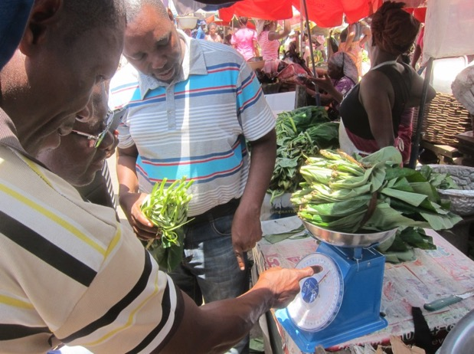
New Tools for Monitoring Food and Diet Globally
Anna Herforth
Researcher, Harvard T.H. Chan School of Public Health
Oct 17, 2019
USAID
Notes:
USAID has been at the vanguard of connecting nutrition and ag
FTF
SPRING
Principles and pathways
Participating in the process to develop and adopting the Ag2Nut Key Recommendations as part of the nutrition strategy
Therefore very pleased and excited to share with USAID about these two tools, which I think are so relevant to priorities in country

Slide 2
Nutrition and ag linkages: Ensuring access to nutritious diets
Agriculture & Food Systems
Food Access
Diet Quality
Nutrition
Access to adequate food
Diversified, balanced and healthy diets
Notes:
The focus of most ag-nutrition projects
Our brief outlines other pathways too, but the huge fundamental one with the biggest impact is this.

Slide 3
Need to mainstream data collection on these links
Strengthen capacity in-country to have nutrition-sensitive information systems, to inform programs and policies
Information needed on what is available, affordable, and consumed – and what the gaps are
Need to use data where it exists
Need to collect data where it doesn’t exist

Slide 4
Why prioritize these areas?
Some tools exist for food affordability
Very limited diet data across countries
Existing tools and data are not sufficient for easy, low cost data collection by countries, in order to understand and address gaps in food access and diet quality.

Slide 5
Affordability of nutritious diets: Using existing data better

Slide 6
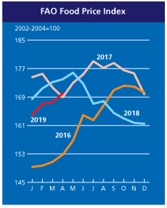
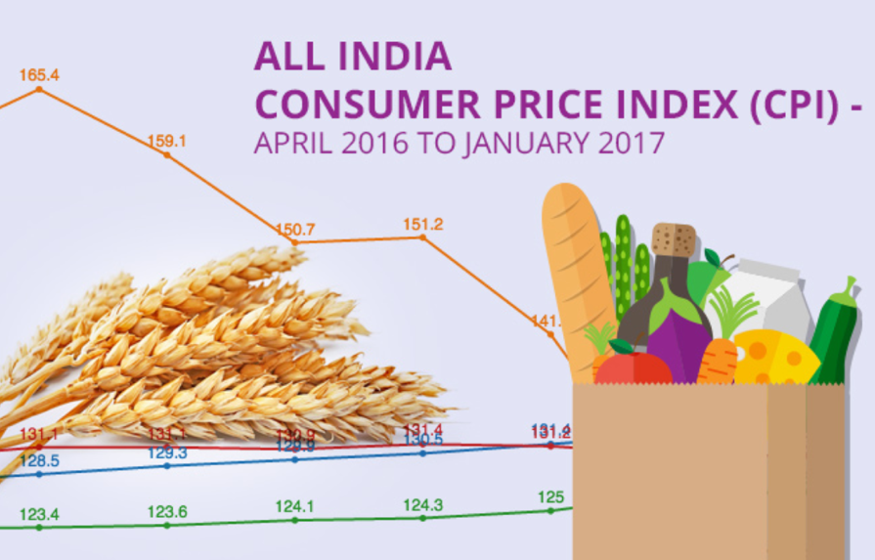
Food price data are abundant but underutilized
World food prices
(traded commodities only)
National food prices
(weighted by share of total expenditure)
Components:
Cereals
Vegetable oils
Sugar
Meat
Dairy
Vulnerability monitoring
(most commonly consumed staples)
Source: www.fao.org/worldfoodsituation, April 2019
Notes:
National statistics organizations collect data on all the items most often purchased, to track inflation
Food is a large part of what is purchased
This does not serve the purpose of understanding the price of food people need to thrive…but the data can be repurposed for that
Food prices as typically measured by governments usually reflect a basket of foods based on economic importance
In inflation monitoring (done by national bureaus of statistics)

Slide 7
Inadequate information for decision-making
Agriculture and food systems can make nutritious diets more available and affordable.
But, governments and projects have no information system that tracks prices of a nutritious food basket.
Countries can use existing food price monitoring systems better to understand availability and prices of nutritious foods.
Notes:
Fortunately, there is a LOT of food price data out there.
Let’s see what’s there, and how it can be used with a nutrition lens.

Slide 8
New, simplified metrics of cost and affordability
New metrics of the cost of nutritious diets re-analyze existing food price data with a nutrition lens.
Uniquely, these metrics are designed to be used within food price monitoring systems, so that governments and programs can adopt them for nutrition-sensitive decision-making.
http://sites.tufts.edu/candasa/
ianda.nutrition.tufts.edu
Notes:
New metrics of the cost of nutritious diets show whether it is economically feasible for people to consume high quality diets.

Slide 9
How does this differ from other initiatives?
Cost of Diet
Primary purpose to estimate the lowest cost of consuming adequate energy, macronutrients, and micronutrients, within a typical diet pattern
Fill the Nutrient Gap
Primary purpose to engage national stakeholders in a dialogue for actions that can be taken to improve economic access to nutritious diets
Optifood
Primary purpose to develop locally specific dietary recommendations
New metrics
Primary purpose to easily integrate into existing monitoring systems; and, to move beyond nutrients and into the cost of healthy diet patterns.

Slide 10
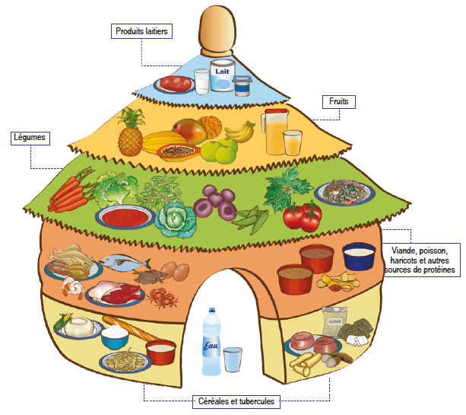
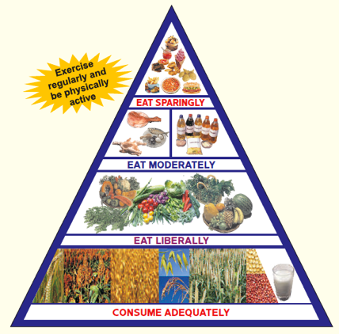
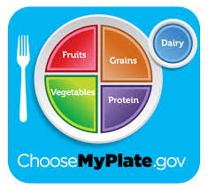
New price indexes account for nutritional needs
Cost of Recommended Diets
Based on food-based dietary guidelines
Food groups & servings (g) per day
Choose foods that meet recommendations at lowest total cost
Benin Food Guide
India Food Guide
Cost of Nutrient Adequacy
Lowest cost of meeting calorie, macronutrient, and micronutrient needs
Specify quantity of each nutrient
Choose foods that meet needs at lowest total cost
Compare to Cost of Caloric Adequacy
U.S. Food Guide
Notes:
The cost of a nutritious diet starts by defining “nutritious”
The cost of a nutritious diet depends on how it is defined

Slide 12
Cost of Recommended Diets (CoRD) in Ghana: Vegetables are the most costly food group
For Ghana, with the average of all items in each food group (except dairy), total cost would be US$0.75/day
The required portions from each food group cost between $0.15 and $0.25 per day (Ghana 2015)
Cost per day (Ghana 2017): lowest-cost items
Notes:
When we break down the cost of meeting dietary recs by food group, here in Ghana we see that the most expensive food group is vegetables. This will impact consumption behavior – perhaps add less vegetables to the sauce, because demand for vegetables is elastic, or responsive to prices.

Slide 13
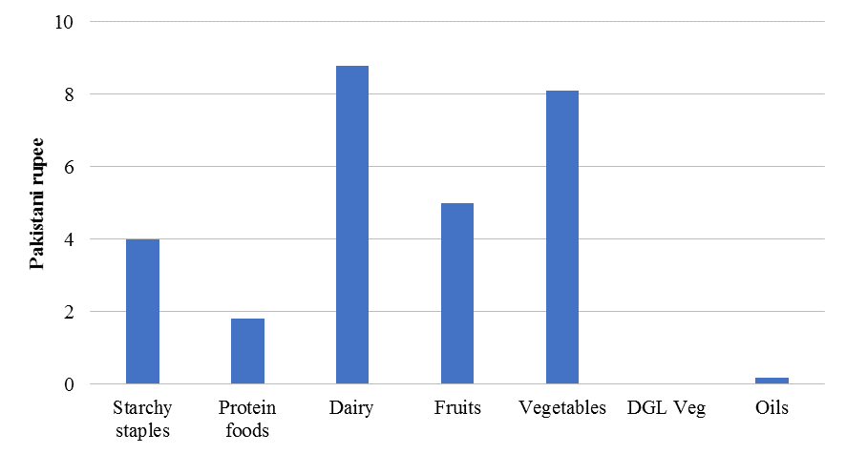
Variation across space: Cost of Recommended Diets in Pakistan
Dizon and Herforth 2018, World Bank
Notes:
Typically, don’t have to totally update the national monitoring system! Pakistan used data from the NSO.
Another thing we can do with food price data from national monitoring systems (systems already in place) is to look at variation across space. This map shows the nominal price (not adjusted for income) of achieving FBDGs – which are recommendations determined by the national govt on what people should eat - is highly variable (red most expensive, green least expensive). The food groups most responsible for the disparities across region are veg, dairy, and fruit.
These are foods that are perishable- not as easily transported as oils, starchy staples, or lentils.
We found that veg and dairy prices were the most variable geographically in Pakistan, Afghanistan, and Sri Lanka.
From our paper (Dizon and Herforth, WB, July 2018):
To gauge the spatial differences in CoRD within each country, we calculate CoRD for each of the 40 cities in Pakistan. We use nominal food prices to demonstrate that CoRD varies across space in each of the countries. The differences in CoRD can be considerable. In Pakistan, CoRD is under 70 PKR in Dera Ismail Khan, Dera Ghazi Khan, and Sahiwal divisions, while it is over 90 PKR in Rawalpindi, Makran, and Islamabad divisions.
Note that CoRD calculates the cost of nutritious diets. This is not exactly a measure of the affordability of nutritious diets in each province or division. Such a measure would entail looking at incomes alongside the cost of nutritious diets. Nonetheless, our initial calculations demonstrate that the cost of nutritious diets, based on nominal food prices, varies within a country.
Quite similarly, in Pakistan and Afghanistan the cost of dairy and vegetables are also higher than other food groups, about double the variance of starchy staples in Pakistan, for example. Combined with the fact that the share of dairy and vegetables to CoRD is large in each of these countries (i.e. over 50 percent of CoRD for Sri Lanka), we deduce that much of the CoRD variability across districts or cities is determined by dairy and vegetable prices. This is consistent with the idea that such highly perishable products are difficult and costly to transport. Across countries, the variance of protein food prices is relatively low. This could be driven by easy tradability of non-animal sources of proteins (i.e. legumes). The price of DGL vegetables in Pakistan are unavailable for the city-wise calculations. As such, they are excluded from the city-wise CoRD calculations.
Note: We find that prices a for dark green leafy vegetables, a required part of the vegetable recommendations in FBDGs, are seasonally missing in Pakistan. Missing data points suggest that either the food items measured (in this case a single food item, “spinach”) may be missing from the market, or that the food group (dark green leafy vegetables more generically) is missing from the market. Further information on national CPI methodology is needed to draw clear conclusions on (a) whether the item is specific to a single food, or reflects any dark green leafy vegetables available in the market, and (b) how missing data points are handled. We expect that in many such cases, national statistics organizations impute the price of missing items. Therefore, CPI data may not be a reliable source of availability of certain foods in markets.
In Pakistan, the lowest cost items (per serving edible portion, June 2017) for starchy staples were wheat and rice, for protein foods red lentils (masoor) and black gram, for dairy curd and fresh unboiled milk, for fruits watermelon (turbooz) and muskmelon (kharbooza), for vegetables onion and eggplant (brinjal), for DGLV only spinach is available (in the data), for oils cooking oil (pakwan) and mustard oil

Slide 14
Data by region and food group reveal specific challenges
Variation across space:
Cost of Recommended Diets in India
LOTS of variation in trends for the cost of a recommended diet relative to wages
LOTS of variation in seasonality by food group, especially fruits and vegetables
Source: CANDASA results, from Raghunathan et al. (2019)

Slide 15
How costly is the recommended diet relative to wages?
Trends in the cost of the recommend diet as a percent of wages for rural unskilled labor
Diet costs are a larger fraction of wages for women
70-80% of women’s wage
50-60% of men’s wage
Highly unaffordable:
Costs for non-food expenses and other family members?
Volatile!
But some improvement:
wages ↑ & diet cost ↓ since 2007, but more so for men
Women
Men
No data
Source: CANDASA results, from Raghunathan et al. (2019)

Slide 16
New price indexes account for nutritional needs (cont’d)
Nutritious food Price Index (NPI)
Directly comparable to Consumer Price Index (CPI)
Uses same data as CPI, collected by national statistical organizations
While CPI weights food items by economic share, NPI re-weights items by share in a nutritious diet
Weights based on food groups in dietary recommendations, and most popular items within food groups

Slide 17
Difference between NPI and CPI weights (Afghanistan)
Dizon and Herforth 2018, World Bank

Slide 18
Nutritious Food Price Index (NPI) Minus Food Consumer Price Index (Food CPI)
Dizon and Herforth 2018, World Bank

Slide 19
Market Information System: Expanding the MoFA food list
In 2016, MoFA collaborated with IANDA to review their food price monitoring list. The list lacked sufficient diversity of nutrient-rich foods to calculate nutritious food price indexes.
22 foods added in all
Including several dark green leafy vegetables; some fruits; two additional beans/seeds; meat and fish in the form typically bought by consumers
Piloted over 7 weeks (Nov 2016-Jan 2017) in 4 geographically disparate regions (Accra, Central, Northern, Brong Ahafo)
MoFA-SRID piloted the expanded list and made the decision to institutionalize it nationwide
Weekly Market Price Reports are now generated for the expanded food list since July 2017
Usefulness: when businesses request availability and price data for decisions on agricultural ventures or investments, vegetables are no longer invisible
Notes:
This slide is about the potential for working with other data collectors, outside of NSOs…ministries of ag can also use these methods and engage in the conversation about food prices.
Their data is just even less standardized and may be harder to obtain than CPI data.

Slide 20
Ghana as a pioneer
Demonstrated that existing food price monitoring systems can be used, with very little added cost, to provide better information for nutrition
Tracking the price of nutritious food can be used for decision-making toward a more nutritious food system
Most expensive (limiting) food groups can be prioritized in programs and policies.
Ghana (GSS) has announced its intent to calculate and report CoRD and NPI routinely as national statistics
This process could be replicated in other countries.
Notes:
Note that Nortey has spoken about this at international fora
Use of SRID data: 1. For making quality informed decisions, 2. Planning, 3. Calculating real prices, 4. To compare prices across countries, 5. Research purposes,
6. Food security analysis, 7. Policy formulation, project implementation, monitoring and evaluation
Note that quality of data matters
The new indicators would be less realistic and informative without the expanded food list
Advantage: Ghana has a longstanding, well-functioning food price monitoring system which provides high-quality data and allows for adjustments to improve data.

Slide 21
Policy dialogue for use of new price indexes in Ghana
Since 2016 IANDA/CANDASA has worked with Ghanaian authorities (GSS, MoFA) to help officials use the new price indexes within their routine food price monitoring
There is government interest, but support is needed
To help introduce new metrics, an informal “Nutritious Food Prices Analysis Support Group” to be hosted at the University of Ghana’s Institute for Statistical, Social & Economic Research (ISSER)
This is to allow government statistical officers to meet regularly with local economists and other stakeholders, before and after release of new data, to discuss the significance and interpretation of each indicator
Meetings will begin later this year
POLICY OBJECTIVE Measuring access to nutritious diets to guide intervention

Slide 22
What we will accomplish in the current phase
Phase 1 (IANDA) 2015-2017
Developed the new metrics, in collaboration with governments of Ghana and Tanzania
Govt of Ghana updated MoFA food price monitoring system
Phase 2 (CANDASA) 2018-2020
Streamlined and honed methods, methods papers and protocols
Demonstrated results in Malawi, Tanzania, Ghana, India, Myanmar, Bangladesh, Pakistan, Sri Lanka (many publications in press)
Demonstrated use in international dataset (ICP) (Alemu et al. 2019)
In process 2019-2020: Adoption of the metrics as national statistics in Ghana
Planned for 2020: Use of the metric in Ethiopia to assess the cost of meeting its new FBDGs, to help formulate a BCC strategy around them

Slide 23
Seeking another phase: Scaling up
Working with other countries (e.g. Nigeria) to use their food price data to report these metrics of the cost of nutritious diets
Working with international agencies (e.g. World Bank ICP, FAO) to institutionalize use of the metrics
Introducing the metrics across countries in the Food Systems Dashboard; would fill a gap in metrics about food prices and food affordability
Ideally: existing food price data analyzed with a nutrition lens will be
reported across countries by relevant international agencies, and
used within countries by governments, so that
It will be possible to track Food prices in a way that reflects what people need to eat.
Notes:
Any interest in USAID partnership?

Slide 24
Agriculture & Food Systems
Food Access
Diet Quality
Nutrition
Access to adequate food
Diversified, balanced and healthy diets
Notes:
Maybe we’re making some headway on this part of the chain between agriculture and nutrition…we have ministries of ag starting to measure food prices with a nutrition lens; the World Bank is starting to calculate the Cost of Recommended Diets in some countries…

Slide 25
…but there is still a data gap
Agriculture & Food Systems
Food Access
Diet Quality
Nutrition

Slide 26
Diet Quality slides
(deleted from this version)

Slide 27
Summary
Main goal to strengthen capacity and commitment in country for nutrition-sensitive investments
Food prices: Provide metrics, software tools, and protocols
Diet: Provide first round of data, and country-adapted translated tools; and in-country dissemination to build awareness, enthusiasm, and capacity.

Slide 28
Ultimately, both of these efforts provide tools that can be applied in countries
The aim is to provide simple, parsimonious tools for application by practitioners
Very low cost (designed for pragmatic utility)
Food prices: does not need any new data.
Publishing software tools and protocols now
Will have a test case in Ghana, on how much capacity it takes to integrate the new metrics
Seeking support to continue mainstreaming the new metrics in countries
Diet quality tools and data:
Country-adapted tools
Data across countries to jump start the country process of collecting diet data at national level in own information systems
Seeking support to adapt survey tools and build country capacity for data collection
Notes:
This work was motivated by my time consulting for USAID, WB, FAO, CGIAR, and understanding that program managers want to measure

