Slide 1
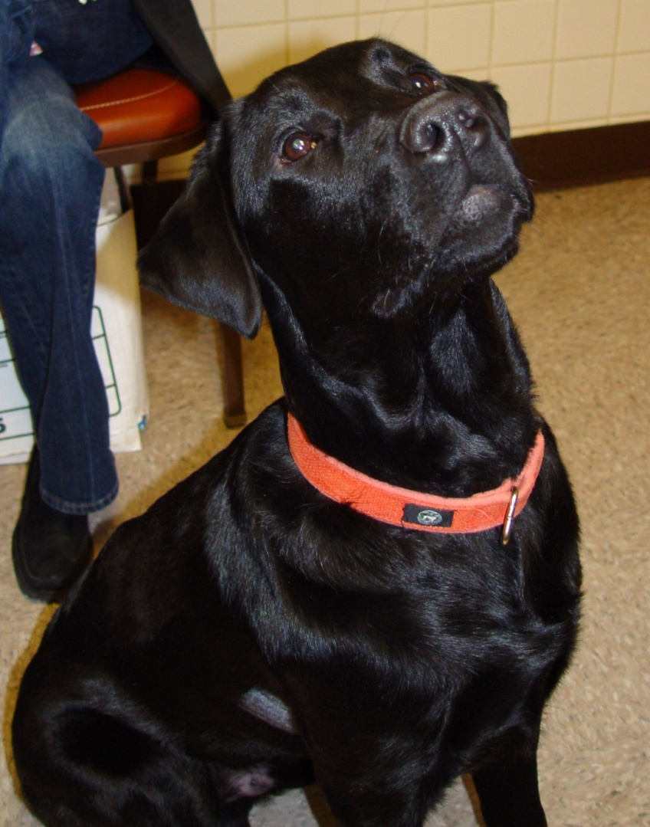
Rudy the Labrador

Slide 2
Presentation
4 month old male Lab
Complaint: Owner noted a markedly increased heart rate. Rudy is quieter than normal and has mild shortness of breath with an occasional cough. There is no known heart disease in his littermates.

Slide 3
Physical Exam
Heart
Murmur: When HR is slow, a 4/6 holosystolic plateau-shaped murmur is heard at the left heart apex; a 3/6 murmur is also heard at the right mid-cardiac region
Gallop: S3
HR= 300 to 140/min
Arterial pulses-weak with pulsus alternans during fast HR
Respiratory
Mild increase in RR +/- effort; normal BV sounds

Slide 4
ECG at 25mm/sec

Slide 5
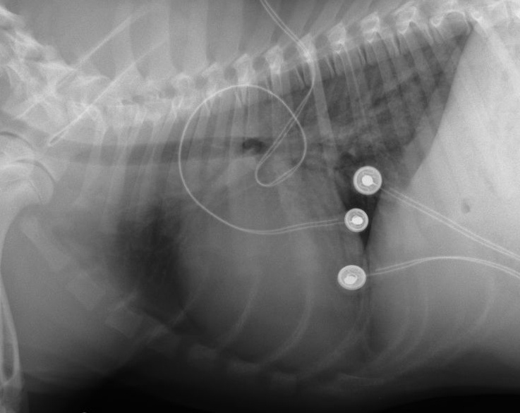
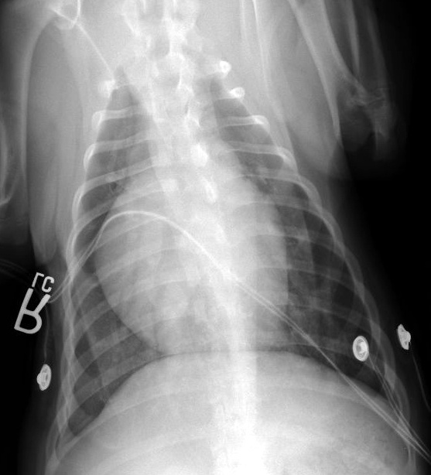
Thoracic Radiographs

Slide 6
Assessment
What is this patient’s heart rate and rhythm based on the ECG?
What is your radiographic interpretation?
Answers on next page

Slide 7
Assessment
What is this patient’s heart rate and rhythm based on the ECG?
About 320bpm, supraventricular tachycardia
What is your radiographic interpretation?
There is cardiomegaly with a perihilar interstitial pattern, LA enlargement, and ECG leads on the chest.

Slide 8
Echocardiogram

Slide 9
Diagnosis
What type of heart disease does Rudy have?
What is the cause of Rudy’s tachycardia?
Does the murmur location and timing fit with this disease process?
Answers on next page

Slide 10
Diagnosis
What type of heart disease does Rudy have?
Supraventricular tachycardia (SVT), mitral regurgitation with left ventricular and left atrial enlargement
What is the cause of Rudy’s tachycardia?
SVT can develop as a result of significant underlying heart disease, or it can result from a congenital problem, such as a bypass pathway (Wolf-Parkinson-White, or WPW syndrome). Labrador retrievers are know to have an inherited tendency to have these bypass pathways.
Does the murmur location and timing fit with this disease process?
Yes, a holosystolic left apical murmur is typical for mitral regurgitation, which was also present in this case.

Slide 11
What is your treatment plan?

Slide 12
Some Possible Treatment Options
Calcium channel blockers (diltiazem or verapamil)
Beta-blockers
Digoxin
Amiodarone
Ablation of the suspected accessory pathway

