Slide 1
Precious the Miniature Donkey

Slide 2
Presentation
11 month old Miniature Donkey Mare
History: Precious had seizures noted 3 months ago, and was placed on phenobarbital with a partial response. Her liver values were increased, and a CSF tap and liver biopsy were unremarkable.
Presentation: Precious had her seizures return, and was referred for an MRI of her brain.

Slide 3
Physical Exam
Heart
HR= 48 bpm
Murmur: 3-4/6 systolic murmur with a PMI at the left apex and an occasional arrhythmia
Arterial pulses-good
Mucous membranes: pink with a CRT of under 2 seconds
Respiratory
RR= 40/ minute
Slightly harsh lung sounds bilaterally, nares flaring at times.

Slide 4
Laboratory Testing
Hematocrit = 25% (normal 30-51%)
Fibrinogen = 500 mg/dl (normal 100-400 mg/dl)
Normal WBC (9.500 x10³/ul) and normal WBC distribution
Phosphorous = 6.1 mg/dl (normal 1.9-6.0 mg/dl)
Chloride = 89 mEq/L (normal 99-105 mEq/L)
Triglycerides = 139 mg/dl (normal 9-52 mg/dl)
Fecal float – Large number of strongyle eggs

Slide 5
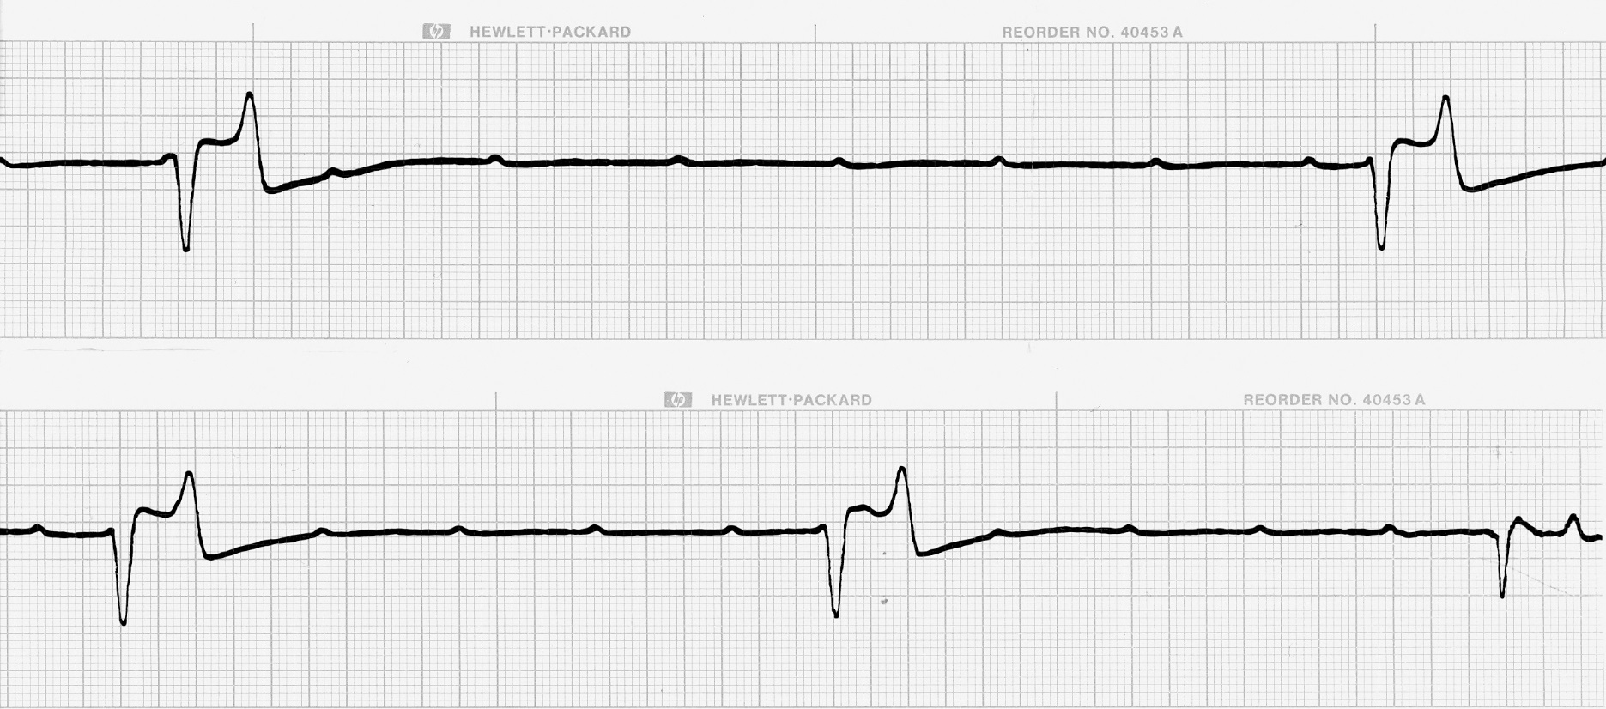
ECG at 25mm/sec

Slide 6
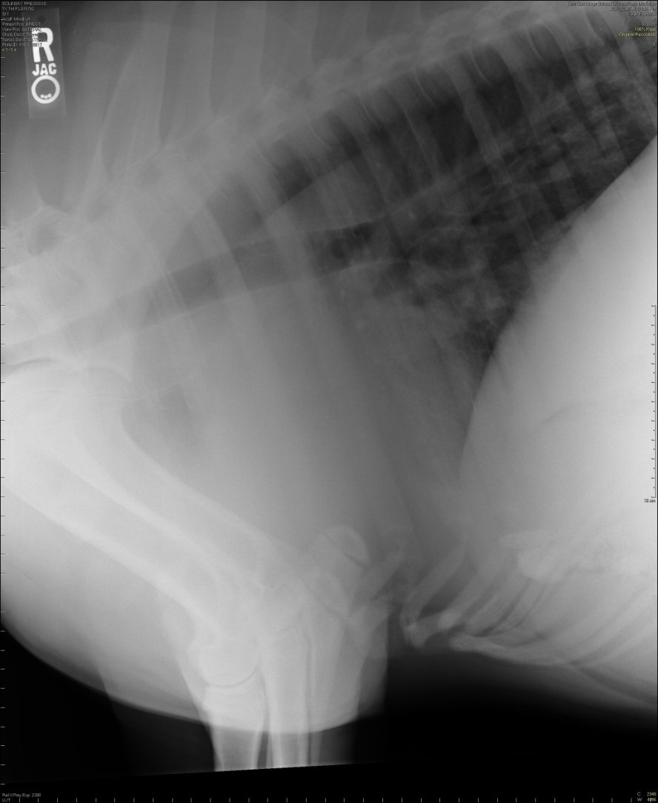
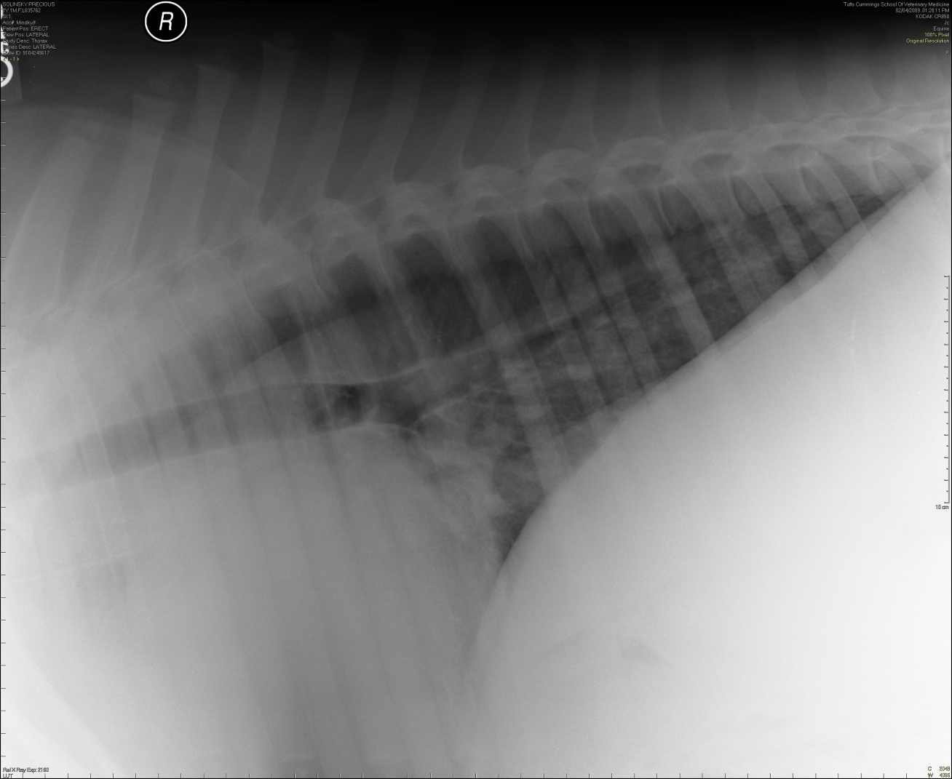
Thoracic Radiographs

Slide 7
Assessment
What is this patient’s heart rate and rhythm based on the ECG?
What is your ECG interpretation?
Answers on next page

Slide 8
Assessment
What is this patient’s heart rate and rhythm based on the ECG?
The atrial rate is 70 bpm, and the ventricular rate is 20 bpm; Sinus rhythm with 3rd degree AV black and a ventricular escape rhythm
What is your ECG interpretation?
Mild cardiomegaly. Diffuse interstitial pattern in the caudodorsal lung fields, which could result from congestive heart failure or could be neurogenic pulmonary edema resulting from seizures.

Slide 9
Echocardiogram

Slide 10
Diagnosis
What is the ECG diagnosis?
What type of heart disease does Precious have?
What is the cause for the collapse?
Answers on next page

Slide 11
Diagnosis
What is the ECG diagnosis?
Third degree AV block
What type of heart disease does Precious have?
The primary arrhythmia (AV block) is likely congenital in origin. She also had mitral regurgitation, which might be a concurrent defect or might be a result of cardiac enlargement secondary to bradycardia.
What is the cause for the collapse?
Third degree AV block with failure of an escape rhythm to fire (pauses in ventricular activity > 10 seconds duration caused collapse in this case).

Slide 12
What is your treatment plan?

Slide 13
One Treatment Option
Pacemaker implantation
Moderate exercise limitation
Slowly taper off the phenobarbital (over many weeks)

