Slide 1
BME 194 - Cellular Agriculture Fall, 2022
https://new-harvest.org/

Slide 2
Week 1
Part 1 (~1.5 hours)
Course overview & logistics
Cell Ag 101
Break (~10 minutes)
Part 2 (~1.5 hours)
Cell Ag Trivia!

Slide 3
Course overview
Goal: Introduce students to the key concepts of cellular agriculture, including:
Muscle and fat biology
Large-scale cell culture for food production
3D tissue engineering within a food context
Food & Meat science
Consumer and regulatory considerations
Research & entrepreneurship landscape
Format: Lectures, journal clubs, student discussions, and student projects
Instructors: Michael Saad, Sophie Letcher
Teaching Assistant: Kirsten Trinidad
Notes:
- this course is listed in BME department so a lot of content will be BME-focused, but we also want to give a holistic approach to the field which will bring in lots of guest lectures and we hope the discussions will think outside of just BME
- refer to syllabus for more info

Slide 4
Course overview
Assignments
Infographic (next week)
Journal club & lecture preparation (reading / summary / Q’s)
Discussion participation
Midterm project (Technical proposal)
Final project (“pitch”)
Grading
Misc reflections & Questions. – 25%
1-page summary of midterm approach – 5%
2-page response to midterm questions – 5%
Midterm – 15%
Class engagement – 25%
Final project pitch – 25%
Notes:
- syllabus will always be updated on canvas, we'll try to send out an announcement after every class summarizing where to submit assignments/where to find readings for next week
- bulk of assignments are: preparation for the next class and semester-long project where you start with a problem facing the cell ag field, review the current research to solve this problem, and then come up with your own solution that you'll turn into a "start-up pitch" at the end of the class

Slide 5
Course expectations
Expectations for students:
Arrive on time
Attentive
Participate, ask questions, etc.
Expectations for instructors:
Arrive on time
10-minute break guaranteed
End early if appropriate
Contact information (please contact everyone if you have a question):
Michael Saad (Michael.saad@tufts.edu)
Sophie Letcher (Sophia.letcher@tufts.edu)
Kirsten Trinidad (Kirsten.Trinidad@tufts.edu)
Office:
SciTech 124c
Office hours & questions
By appointment (email)
Notes:
- if it's time for break you can tell us it's break

Slide 6
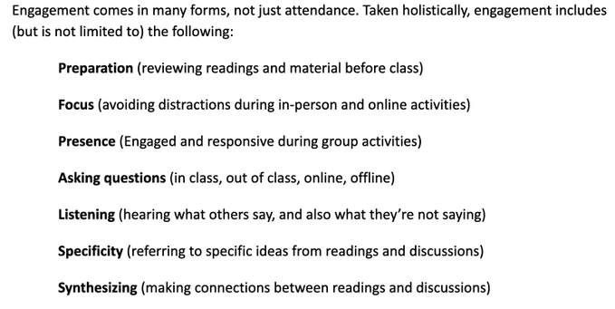
Class engagement

Slide 7
Main projects
Midterm (groups of ~4)
Select a scientific problem facing Cell Ag (list provided, or can pick your own with instructor approval)
Research current solutions/state-of-the-art surrounding that problem
Writeup and presentation of your problem & current research
Final (same groups of ~4)
Develop a startup company idea based on a technical solution based off your midterm research
Prepare a writeup and presentation of your company, expanding beyond the technical to market, regulatory, and other considerations.
Present to investors & “Pork Tank”

Slide 8
Questions?

Slide 9
Getting to know the class!
Notes:
Since there’s such a large group, we wanted to get a sense for what people know so far, what backgrounds you come from, etc…to do this, we’re taking an interactive aproach so everyone please stand up →
Have you heard of cell ag? (one side of the room know it very well, have done some research on it/taken class before and other side of the room just heard the term for the first time today)
Knowledge of alt proteins in general (plant based proteins, cell ag, entomophagy)
What department are you from? (BME one side, others on the other side?)
How comfortable do you feel with cell biology (concept of stem cells, proliferation vs. differentiation, ect)? (love it one side, hate it and makes me uncomfortable the other side)
How comfortable do you feel with engineering concepts (concept of biomaterials, bioreactors) (love it one side, hate it and makes me uncomfortable on the other side) [if opposite from question before, point out that maybe it’s best for you to choose people to work with on the other side of the spectrum]
What is your background? (major if you’re an undergrad, specialization now if you’re a graduate student → BME, chem eng, mech eng, biology, other?
[optional???] → undergrad vs. grad student vs. other

Slide 10
Cellular Agriculture 101
“Cellular agriculture focuses on the production of agriculture products from cell cultures using a combination of biotechnology, tissue engineering, molecular biology, and synthetic biology to create and design new methods of producing proteins, fats, and tissues that would otherwise come from traditional agriculture”
- Wikipedia entry
Agriculture
Cell Ag
Food
Science
Bioengineering

Slide 11
Cellular Agriculture 101
“Cellular agriculture focuses on the production of agriculture products from cell cultures using a combination of biotechnology, tissue engineering, molecular biology, and synthetic biology to create and design new methods of producing proteins, fats, and tissues that would otherwise come from traditional agriculture”
- Wikipedia entry
Agriculture
Cell Ag
Food
Science
Bioengineering

Slide 12
Caveats
This will be a bit of a crash course
We’re starting at the beginning on some of the topics
If you’re familiar with the material, try to view it from a new, food-focused perspective
Feel free to ask questions throughout
In the group brainstorming sessions, try to speak 1/nth of the time

Slide 13
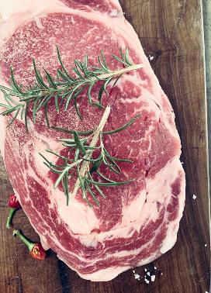
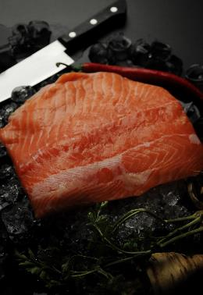
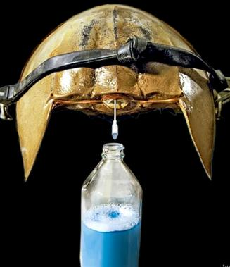
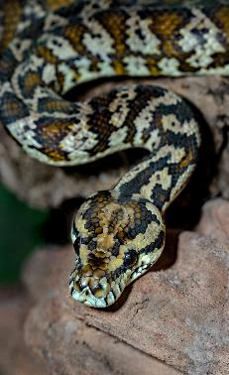
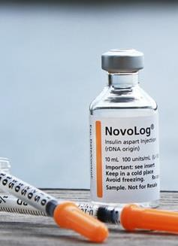
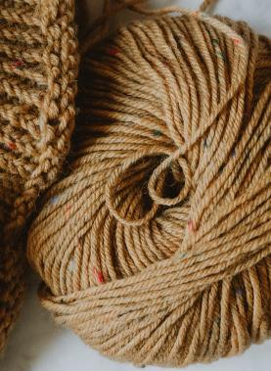
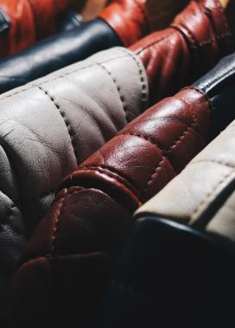
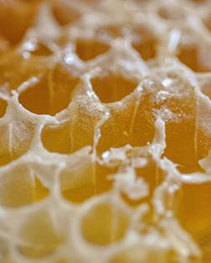
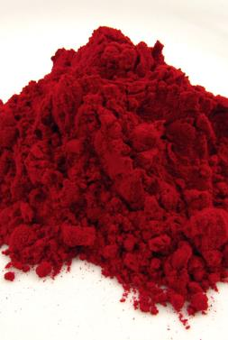
Animals provide valuable products.
Food
Medicine
Materials
Chemicals
Notes:
Medicine for things like insulin
Materials for clothes, fur, leather
Chemicals like beeswax, glues, dyes

Slide 14
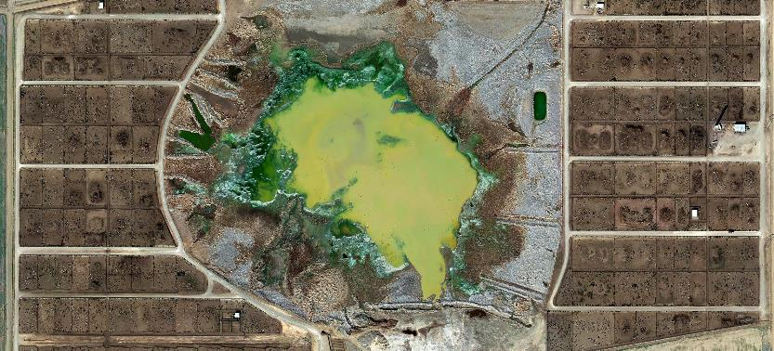
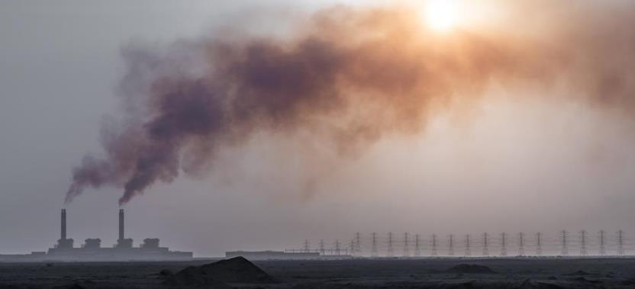
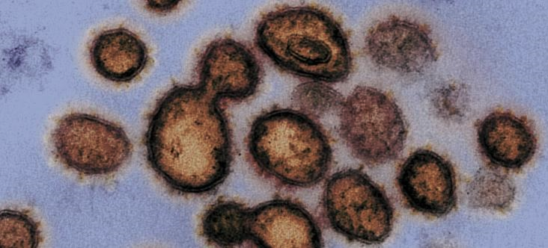
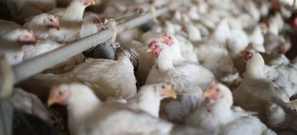
Animal production has a host of issues
Pollution
Resources
Miska Henner
Eric Lafforgue
Health
Welfare
NIH
Scott Olson

Slide 15
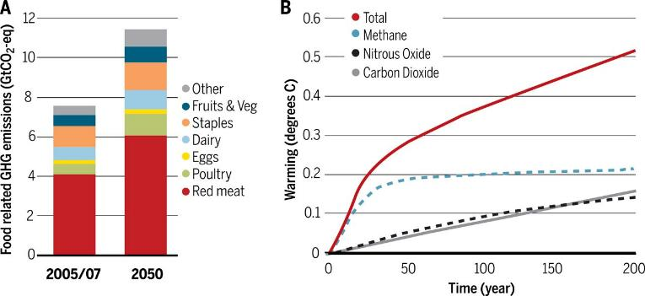
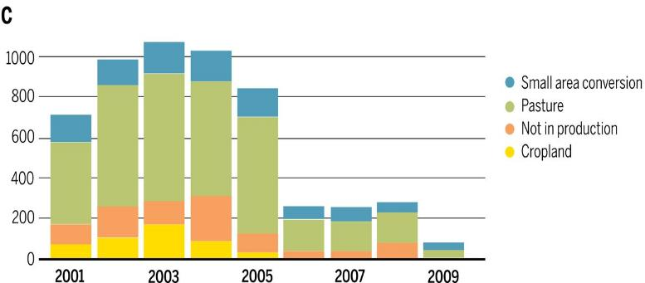
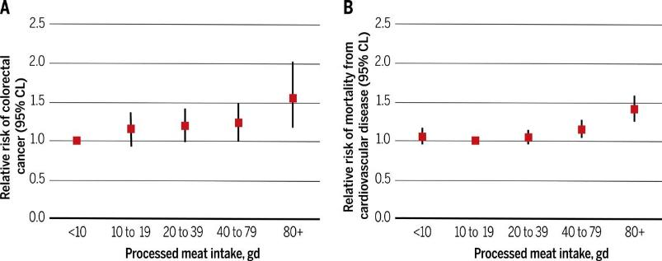
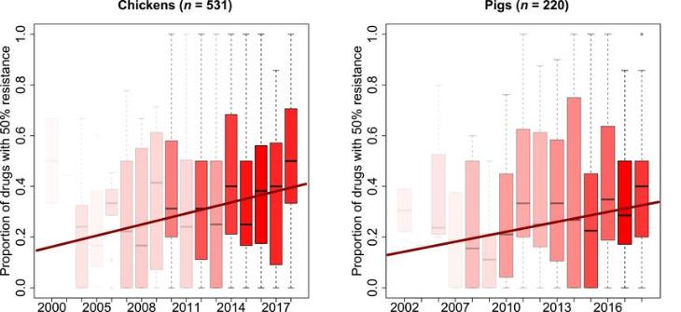
Animal production has a host of issues
Pollution
Resources
Fate of deforested land in Mato Grosso, Brazil
Health
Welfare
Welfare
Godfray, et al. 2018 Science 361(6399); Van Boeckel, et al. 2019. Science 365(6459)

Slide 16
Animals production has a host of issues
Resources
Fate of deforested land in Mato Grosso, Brazil
Health
Welfare
Welfare
Godfray, et al. 2018 Science 361(6399); Van Boeckel, et al. 2019. Science 365(6459)

Slide 17
Animals production has a host of issues
Pollution
Fate of deforested land in Mato Grosso, Brazil
Health
Welfare
Welfare
Godfray, et al. 2018 Science 361(6399); Van Boeckel, et al. 2019. Science 365(6459)

Slide 18
Animals production has a host of issues
Pollution
Resources
Fate of deforested land in Mato Grosso, Brazil
Welfare
Welfare
Godfray, et al. 2018 Science 361(6399); Van Boeckel, et al. 2019. Science 365(6459)

Slide 19
Animals production has a host of issues
Pollution
Resources
Fate of deforested land in Mato Grosso, Brazil
Health
Welfare
Godfray, et al. 2018 Science 361(6399); Van Boeckel, et al. 2019. Science 365(6459)

Slide 20
Key issues with animal agriculture
Inefficient
For every 10 calories of feed a cow eats, 1 calorie of beef is produced
Gaseous
Animal agriculture generates 44% of anthropogenic methane annually
“Dirty”
Intensive operations are bad for animals and can encourage disease

Slide 21
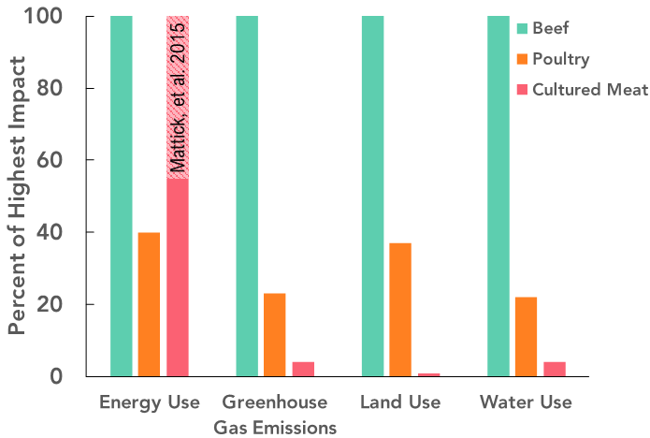
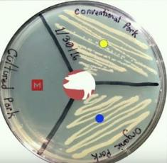
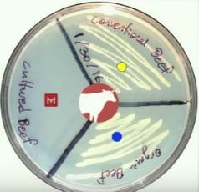
The potential presented by cellular agriculture
Efficient
<Land, <Water, <GHG, <?>Energy
Humane
Slaughter-free cell sourcing
“Clean”
Sterile production
Pork
Beef
Conventional sore-bought meat
Organic sore-bought meat (no Ab)
Cultured meat (no Ab)
Tuomisto, et al. 2014; Mattick, et al., 2015; Memphis Meats/Youtube

Slide 22
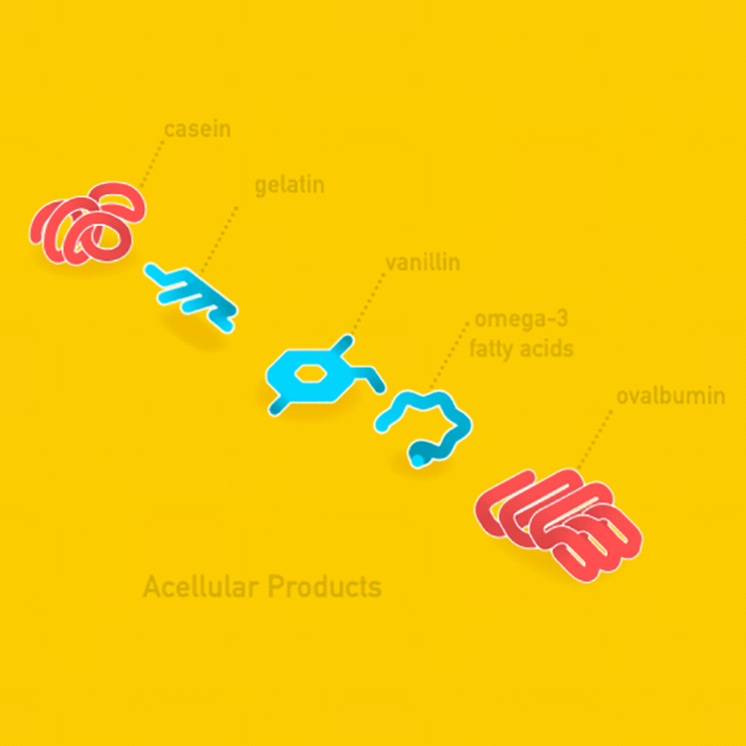
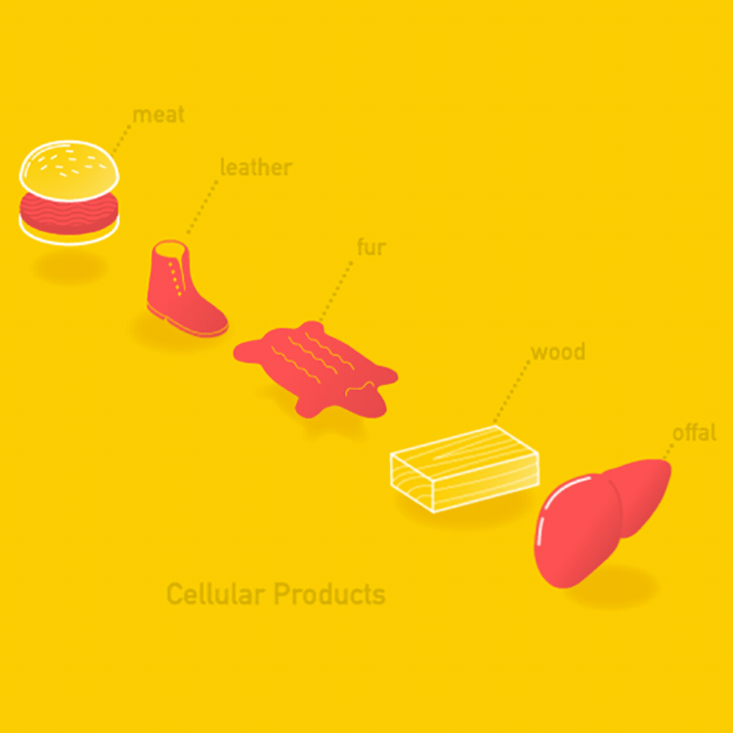
Two types of product
(Myocytes & adipocytes)
(Protein)
(Protein)
(Fibroblasts)
(Small molecule)
(Keratinocytes)
(Lipid)
(Tracheids)
(Protein)
(Hepatocytes)
Acellular products
Cellular products
https://new-harvest.org/
https://new-harvest.org/

Slide 23
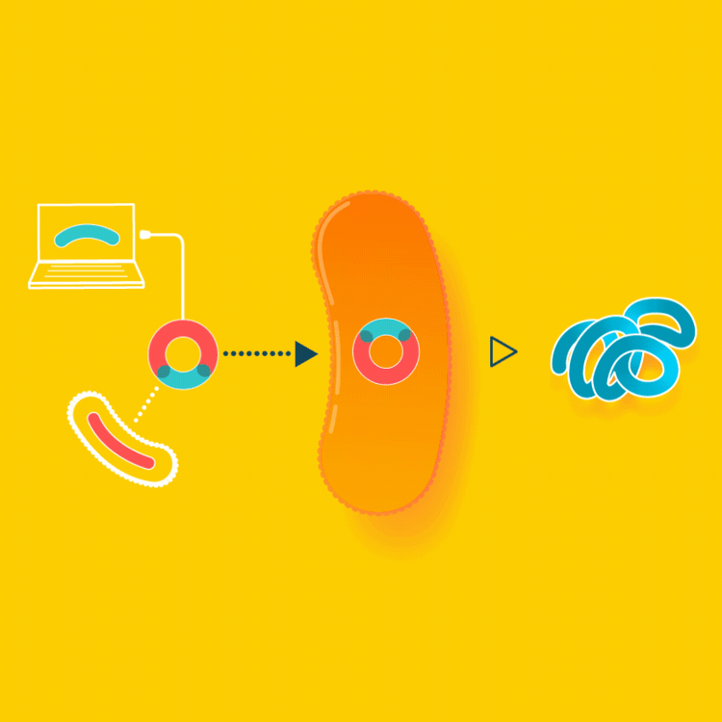
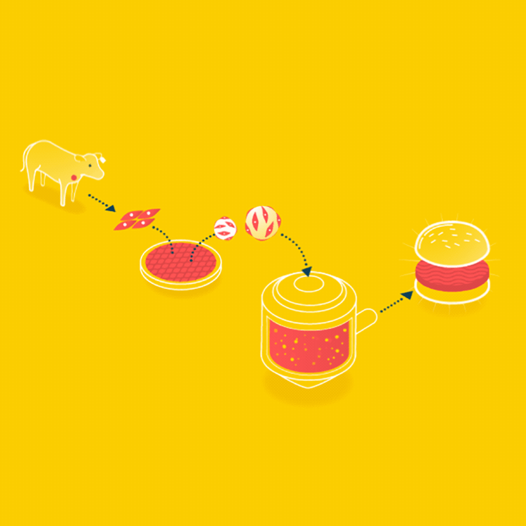
Two types of production
Acellular products – Fermentation
Cellular products – Tissue engineering
https://new-harvest.org/
https://new-harvest.org/

Slide 24
Many companies

Slide 25
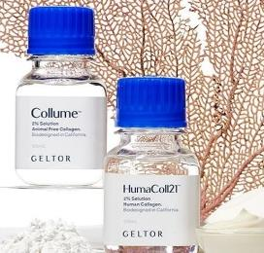
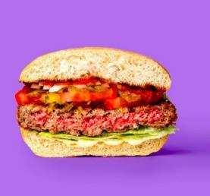
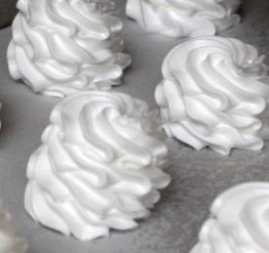
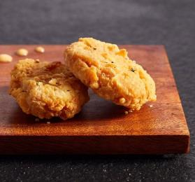
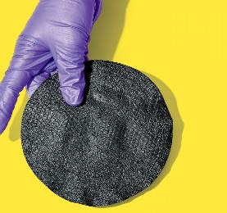
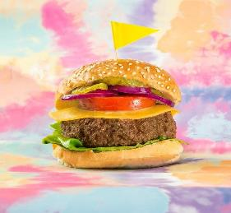
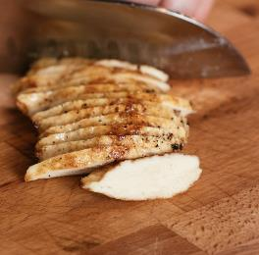
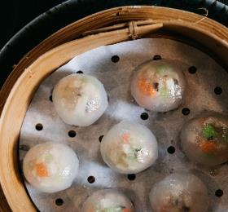
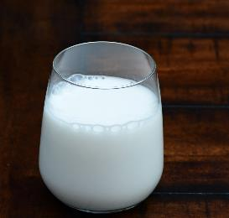
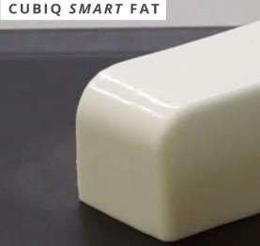
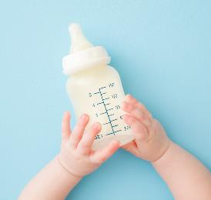
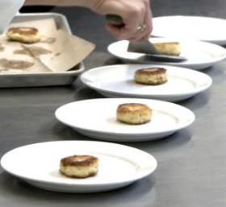
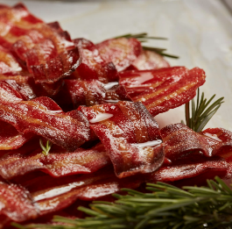
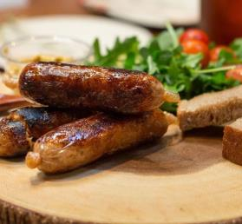
Many products (or prototypes)
*
* Image from Impossible Foods (no specific Motif products disclosed to-date)

Slide 26
Acellular production: key processes

Slide 27
Acellular production: key processes
Yeast
Recombinant DNA
Bacteria
Fungi
Building the production platform
Recombinant DNA / Cloning
Transformation & selection
Microbial host optimization

Slide 28
Acellular production: key processes
Yeast
Stirred-tank bioreactor
Recombinant DNA
Bacteria
Fungi
Building the production platform
Recombinant DNA / Cloning
Transformation & selection
Microbial host optimization
Large scale cell culture
Media optimization for cells
Seed train / bioreactor cultures
Induction systems for production

Slide 29
Acellular production: key processes
Yeast
Purification
column
Products
Stirred-tank bioreactor
Recombinant DNA
Bacteria
Fungi
Building the production platform
Recombinant DNA / Cloning
Transformation & selection
Microbial host optimization
Large scale cell culture
Media optimization for cells
Seed train / bioreactor cultures
Induction systems for production
Product isolation and formulation
Protein extraction and purification
Quality control
Formulation into foodstuffs

Slide 30
Acellular production: key considerations
Breakout into groups to brainstorm what might be key considerations (challenges, questions, etc.) for acellular production – 5 minutes.

Slide 31
Acellular production: key considerations
Breakout into groups to brainstorm what might be key considerations (challenges, questions, etc.) for acellular production – 5 minutes.
What did your group come up with?

Slide 32
Acellular production: key considerations
Breakout into groups to brainstorm what might be key considerations (challenges, questions, etc.) for acellular production – 5 minutes.
What did your group come up with?
My brainstorming:
Cellular growth rate in vitro (affects cost)
Organism precedent (affects regulation)
Purification requirements (affects cost)
Post-translational modifications (affects food function)
Folding, crosslinking, other
E. Coli ~ 20-minute doubling time.
Vibrio Natriegens ~10-minute doubling time.

Slide 33
Cellular production: key processes

Slide 34
Cellular production: key processes
Muscle
Cell
sourcing
Fat
Others?
Establishing cell populations
Species / tissue considerations
Cell acquisition techniques
Cell type & cell engineering

Slide 35
Cellular production: key processes
Muscle
Stirred tank
Cell
sourcing
Fat
Hollow fiber
Rocking bed
Others?
Establishing cell populations
Species / tissue considerations
Cell acquisition techniques
Cell type & cell engineering
Large scale cell culture
Media optimization for cells
Seed train / bioreactor cultures
High density, low cost

Slide 36
Cellular production: key processes
Muscle
Stirred tank
Fibrous scaffolds
Products
Cell
sourcing
Fat
Porous sponges
Hollow fiber
Rocking bed
Patterned surfaces
Others?
Establishing cell populations
Species / tissue considerations
Cell acquisition techniques
Cell type & cell engineering
Large scale cell culture
Media optimization for cells
Seed train / bioreactor cultures
High density, low cost
Tissue maturation and harvest
Scaffolding and differentiation
Transition from muscle → meat
Harvesting and processing

Slide 37
Cellular production: key considerations
Breakout into groups to brainstorm what might be key considerations (challenges, questions, etc.) for cellular production – 5 minutes.
What did your group come up with?

Slide 38
Cellular production: key considerations
Breakout into groups to brainstorm what might be key considerations (challenges, questions, etc.) for cellular production – 5 minutes.
What did your group come up with?
My brainstorming:
Cellular growth rate in vitro (affects cost)
Genetic engineering (affects regulation)
Differentiation requirements (affects taste/texture?)
Media requirements & metabolic efficiency (affects cost)
Achievable cell density (affects cost)
CHO cells ~14-17 hour doubling time.
Muscle stem cells ~24-48 hour doubling time.

