Slide 1


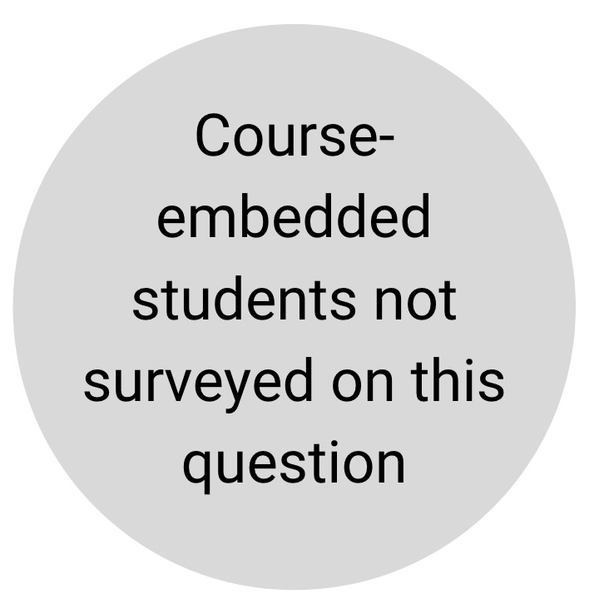
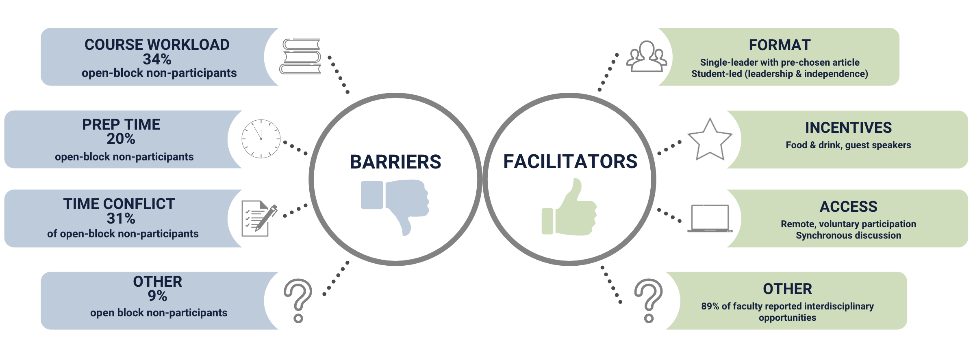
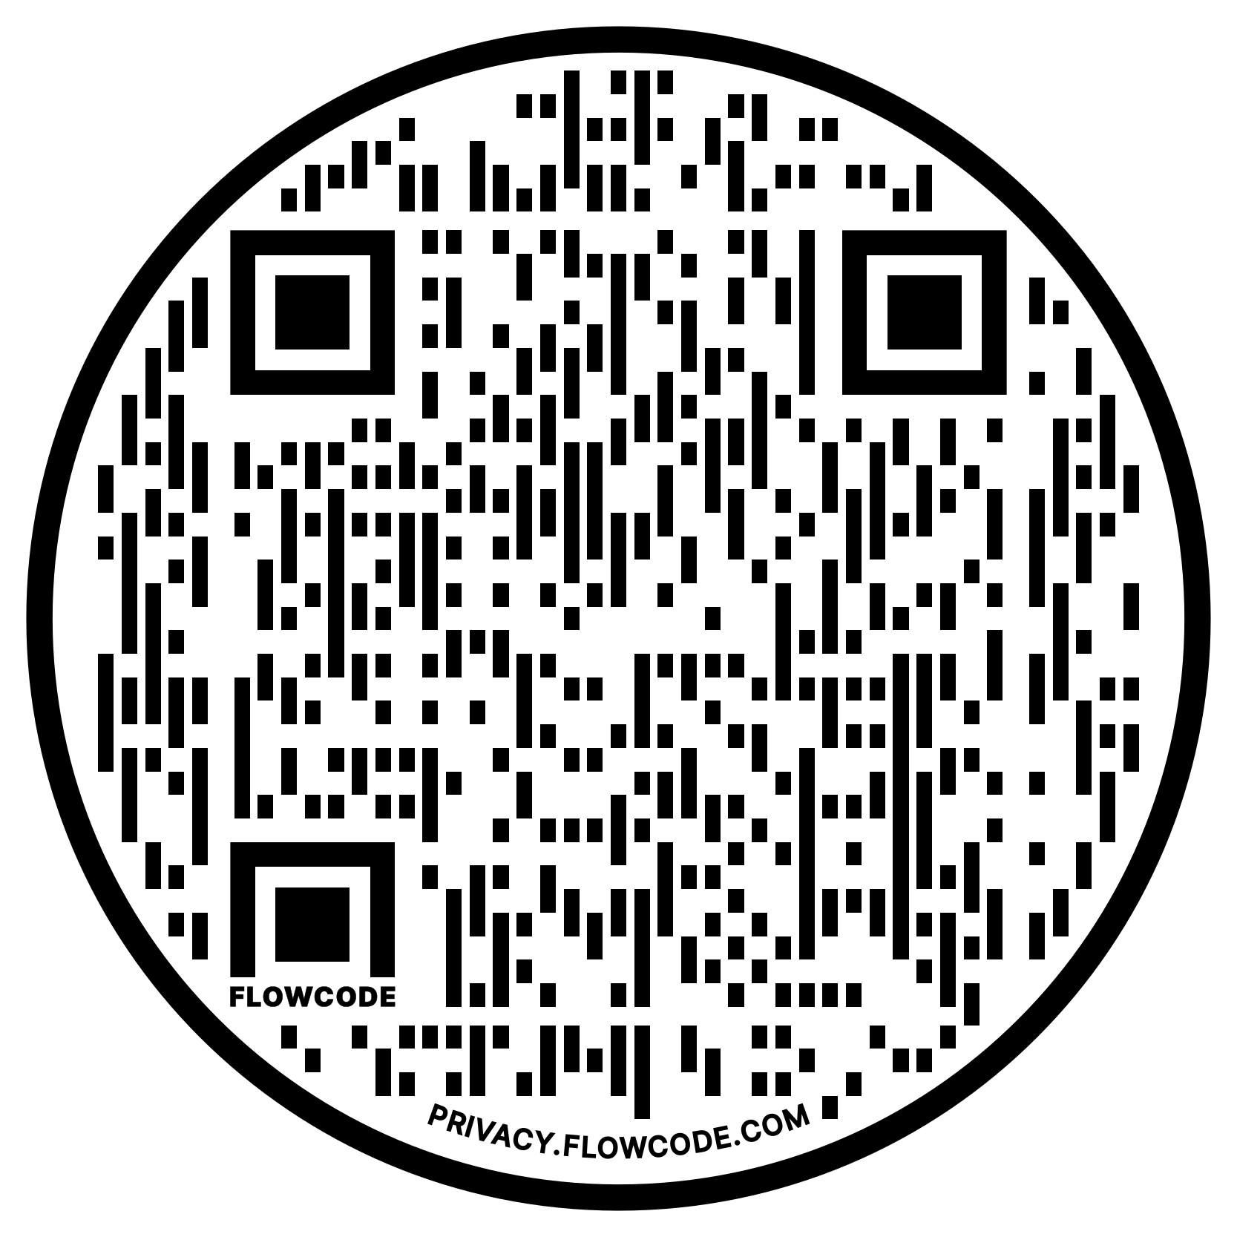
Feasibility Study: Journal Clubs in Entry Level OTD Curriculum
Jenna K. Becker OT/s
Peer Collaborators: Emma Haan Opsina OT/s & Sarah Lubic OT/s
Mentored by Dr. Elizabeth Marfeo PhD, MPH, OTR/L
Department of
Occupational Therapy
Background & Objective
Results
Results (cont.)
Journal Club: an organized series of meetings where individuals read, appraise and discuss scientific literature and its practical implications.
It is a form of knowledge translation and supports evidence-based practice (Stern, 2021).
A form of knowledge translation, “the process of integrating research findings into routine practice” (Juckett, 2022, p. 1)
Supports evidence-based practice (Stern, 2021)
Journal Club Variations
Currently no standard journal club format recommended for use
  New virtual capacities introduce further variation
  Differ in mission, format, organizational needs, frequency/duration, incentivization, and participation requirements (Deenadayalan et. al., 2008).
Variations can increase successful participation, engagement, and relevancy to applied educational and practice contexts.
Critical Appraisal
Post-survey: students critical appraisal skills are positively correlated with their academic year
  Report that journal clubs are a good way to use the skills acquired during the program
    Course-embedded (1st year) - 84%
    Post-didactic (3rd year) – 86%
Knowledge translation
Pre-survey: Students reported knowledge translation lowest confidence when compared to other skills
  ability to interpret results and draw evidence-based conclusions for use in practice (3.39/5)
Post-didactic students reported the highest ranked skills across all categories within a 5-point scale
  Engagement & Depth of discussion 4.67
  Use of Critical Appraisal Skills and Knowledge Translation 4.17
Q: Would Tufts EL-OTD program benefit from a Journal Club?
Survey says…“Yes”
Post-Survey: 92% of first year students reported they will use these skills in practice with 40% (11/27) reporting to promote evidence-based practice
Purpose: To evaluate the feasibility of implementing a journal club within an Entry-Level OTD curriculum. Specific aims:
Describe both faculty and student perceptions of journal club placement
Pilot and assess feasibility of various journal club modalities
Identify potential barriers to journal club engagement among students
Faculty expectations met for each journal club format:
  Develop independent critical appraisal process
  Learn new occupational therapy concepts outside of required lectures
  Guide students in forming their own OT identity through journal exploration
Barriers and Facilitators to Journal Club Participation
Methods
Discussion & Conclusion
Stakeholder surveys: (faculty and students) assessed perspectives on journal club utility, feasibility, and curriculum placement
Literature review: conducted to develop protocols journal club modalities:
  Post-didactic (3rd year DEC students)
  Open Block (entire OT cohort)
  Course-embedded (1st year students)
Data: collected via semi-structured interviews with both Likert-based and open-ended questions collected via anonymous Qualtrics surveys
Journal clubs nested within an EL-OTD curriculum can be a useful tool to support students in habituating critical appraisal and knowledge translation processes.
Journal clubs provide a space for students to practice these important skills in a low-stakes environment that builds a sense of community and support through journal article exploration.
Limitations
Possible researcher bias due to participation in program and singular review of data points during coding process
Possible selection bias (participants motivation in journal club and surveys may differ given the small sample size and proportion of entire cohort represented)
Lack of generalizability to other settings
n = number participants per journal club type
Student and Faculty Perspectives on Journal Club Curriculum Placement
Concluding Recommendations:
Tufts would benefit from an extra-curricular, student-led journal club with voluntary participation
Curriculum placement: an addition to course work during the 3rd year of the program, during DEC Seminar III or Level II Fieldwork placements
Participation should be voluntary with incentives
Traditional format: preassigned articles and one leader
Student-led with preference to topics, time, frequency, and duration
Participants should be of the same academic year to foster community-building and meet academic needs regarding critical appraisal and knowledge translation
4
References

