Slide 1

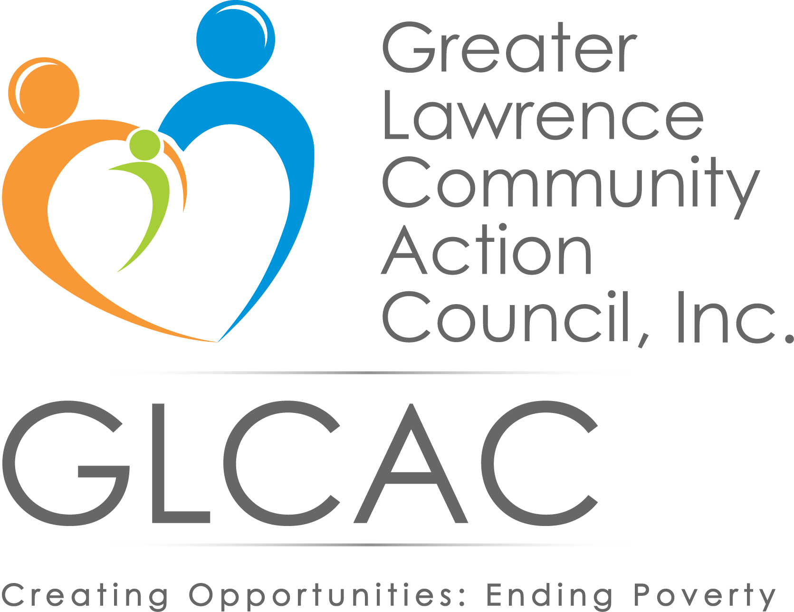
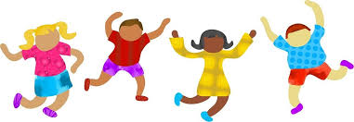




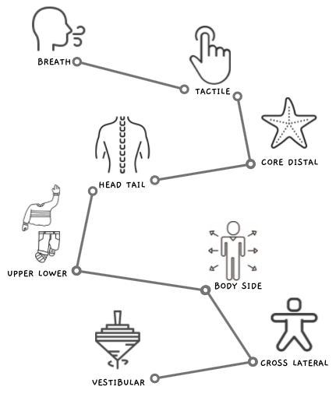
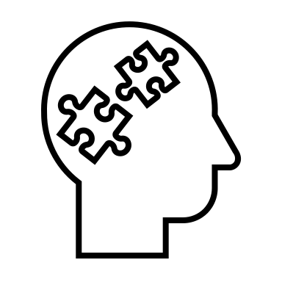



Development of a Dance and Creative Movement Curriculum to Support Social and Emotional Skills for Children Enrolled in a Head Start Program
Department of
Occupational
Therapy
Daniela Chavez Hernandez, OT/s, Justine Donovan, MSM, & Margaret Morris, OTD, OT, BCP
Site Description
Curriculum Development
Themes of Findings
Head Start (HS) & Early Head Start (EHS): federally funded programs that provide free learning and development services to children 0-5 from low-income families.
The HS and EHS programs aim to promote school readiness services through a nurturing and stimulating environment.
Constructs
Significance
Family Development Coordinator
Supported efforts to improve classroom behavior
Social and Emotional Development
Establish secure relationships with peers and adults
Experience, regulate, & express emotions appropriately
Effectively respond to challenging situations
Demonstrate understanding of social & cultural norms
Dance and Creative Movement (D&CM): children can use their bodies to communicate ideas, thoughts, and emotions [4].
Through the development of body awareness, personal identity and control, D&CM can improve young children’s cognitive function, motor skills, and overall social and emotional well-being [5].
Children sense and respond to the environment within the context of movement, therefore, a dance-based intervention can help them recognize and respond to strong emotions [5].
Parents
Reported
D&CM helps to promote cultural identity
Children
Utilized self regulation strategies
Early Learning Division
Appreciated additional support with SEL
Greater Lawrence Community Action Council (GLCAC): non-profit institution that provides various programs & services to families across the greater Lawrence area.
GLCAC administers 5 Head Start programs located in Lawrence and Methuen, MA. Their mission is to serve low income, high need, high risk children and families through high quality services.
Teachers Interested in curriculum & felt comfortable implementing lesson plans
Mental Health Consultant Underpinned benefits for overall well-being of HS children
Variables
Education Supervisor Acknowledged the project aligns with PeaceWorks®
curriculum
Special Needs Facilitator
Hopes curriculum will reduce referrals to E.I. and Public School
Population & Stakeholders
The program adhered to the following social and emotional learning standards (SELS), developed by the Department of Early Education and Care for the Massachusetts Curriculum Frameworks
Standard SEL 1
Recognize, identify, and express emotions.
Standard SEL 2 Demonstrate accurate self-perception
Standard SEL 5 Display empathetic characteristics
Statistics based on cumulative enrollment of 710 children (2020-2021 Fiscal Year Annual Report):
39% Received public assistance (e.g., TANF and SSI)
44% Received emergency or crisis intervention
28% Income ≤ 100% of federal poverty line
18% Received mental health services
12% Experienced homelessness
90% Hispanic/Latino origin
2% Foster care
Dance and Creative Movement Curriculum
Future Steps
BrainDance®
Expand across all GLCAC classrooms
Teacher training
Introduce curriculum to EHS
Long-term partnership between GLCAC and BSOT
Opportunities for consultant services
The curriculum was developed using the principals of Brain-Compatible Dance Education [3] a structured methodology for teaching dance using strategies that create an environment in which the brain is ready, willing and able to learn. It consists of:
6 single-page lesson plans
Visual supports (e.g., posters, word wall)
Music and props suggestions
Instruction on curriculum implementation
Lesson plans adapted into 3 parts:
Warming Up: A BrainDance® pattern to the tune of a popular children’s song. The pattern is inspired by primitive reflexes integrated during infancy that initiate brain growth.
Exploring the Concept: D&CM activities to learn about a concept (e.g., self space/general space, size, speed, body parts, emotions and balance). To accommodate different learning styles, the activities include opportunities to see, say, and do.
Cooling down: activities that foster self regulation skills such as, mindfulness practices, breathing techniques, yoga, and relaxation exercises.
Stakeholders
Head Start Children
Parents Guardians
Head Start Teachers
Special Needs Facilitator
Family Dev. Coord.
Early Learning Division
Mental Health Consultant
Gap, Aims, & OT Role
Acknowledgements
Critical Issue:
Children living in poverty are more likely to experience Adverse Childhood Experiences (ACEs) and consequently to develop behavioral issues during childhood and adolescence [1].
ACEs can cause changes in brain architecture that leads to difficulties with planning, self-regulation, and adapting to unexpected events [2].
The COVID-19 pandemic has undermined children’s social and emotional well-being. The GLCAC mental health, special needs, and the FDC specialists report an alarming increase in referrals compared to pre-pandemic numbers.
Aim:
To develop a group-based dance and creative movement curriculum for children enrolled in the GLCAC Head Start programs to promote social and emotional development.
Occupational Therapy (OT) Role:
Based on a public health model, this pilot program uses a tier one OT model as a preventive approach to support children’s occupational performance in play, leisure, and social participation.
This project was possible thanks to the support and contribution of:
My DEC mentors and coauthors, Margaret “Peggy” Morris and Justine Donovan
Renata Celichowska, Tufts Dance Program Director
Mary Barnes, OTD, BSOT DEC Coordinator and DEC Seminar Facilitator
Tina Vakilynejad, MS. Ed., ME. Ed. GLCAC Head Start - Education Supervisor
Marta Torres, LMHC, GLCAC Head Start - Mental Health Consultant
Mercedes Vasquez, GLCAC Head Start – Disability and Special Needs Facilitator
Lucy Nuñez, GLCAC Head Start - Family Development Coordinator
Example Lesson Plan
References
Methods
[1] Cho Choi, J., Wang, D., & Jackson, A. P. (2019). Adverse experiences in early childhood and their longitudinal impact on later behavioral problems of children living in poverty. Child Abuse & Neglect, 98(1). https://doi.org/10.1016/j.chiabu.2019.104181
[2] Fabrizi, S. E. & Ponsolle-Mays, M. (2018). Enriching kid’s lives: Addressing the effects of poverty on the health and wellbeing of school-aged children and their families. OT Practice Magazine, (9), 8-12.
[3] Gilbert, A. G. (2018). Brain compatible dance education (2nd ed.). Society of Health and Physical Educators.
[4] Leight, J. (2017). Experiencing emotion: Children’s perceptions, reflections and self-regulation. Body, movement and dance in psychotherapy, 12(2), 128-144.https://doi.org/10.1080/17432979.2017.1303544
[5]Lorenzo-Lasa, R., Ideishi, R. I. & Ideishi, S. K. (2007). Facilitating preschool learning and movement through dance. Early Childhood Education Journal, 35(1), 25–31. https://doi.org/10.1007/s10643-007-0172-9
Classroom
Lesson plan implementation
Classroom observations
Teachers
Informal interviews
Feedback exchange
Parents
Sharing testimonials
Mental Health Team
Case collaboration
Consult services
Lesson plan revisions
Information session
Project presentation
Teacher training
Contact: Daniela.Chavez_Hernandez@Tufts.edu

