Slide 1
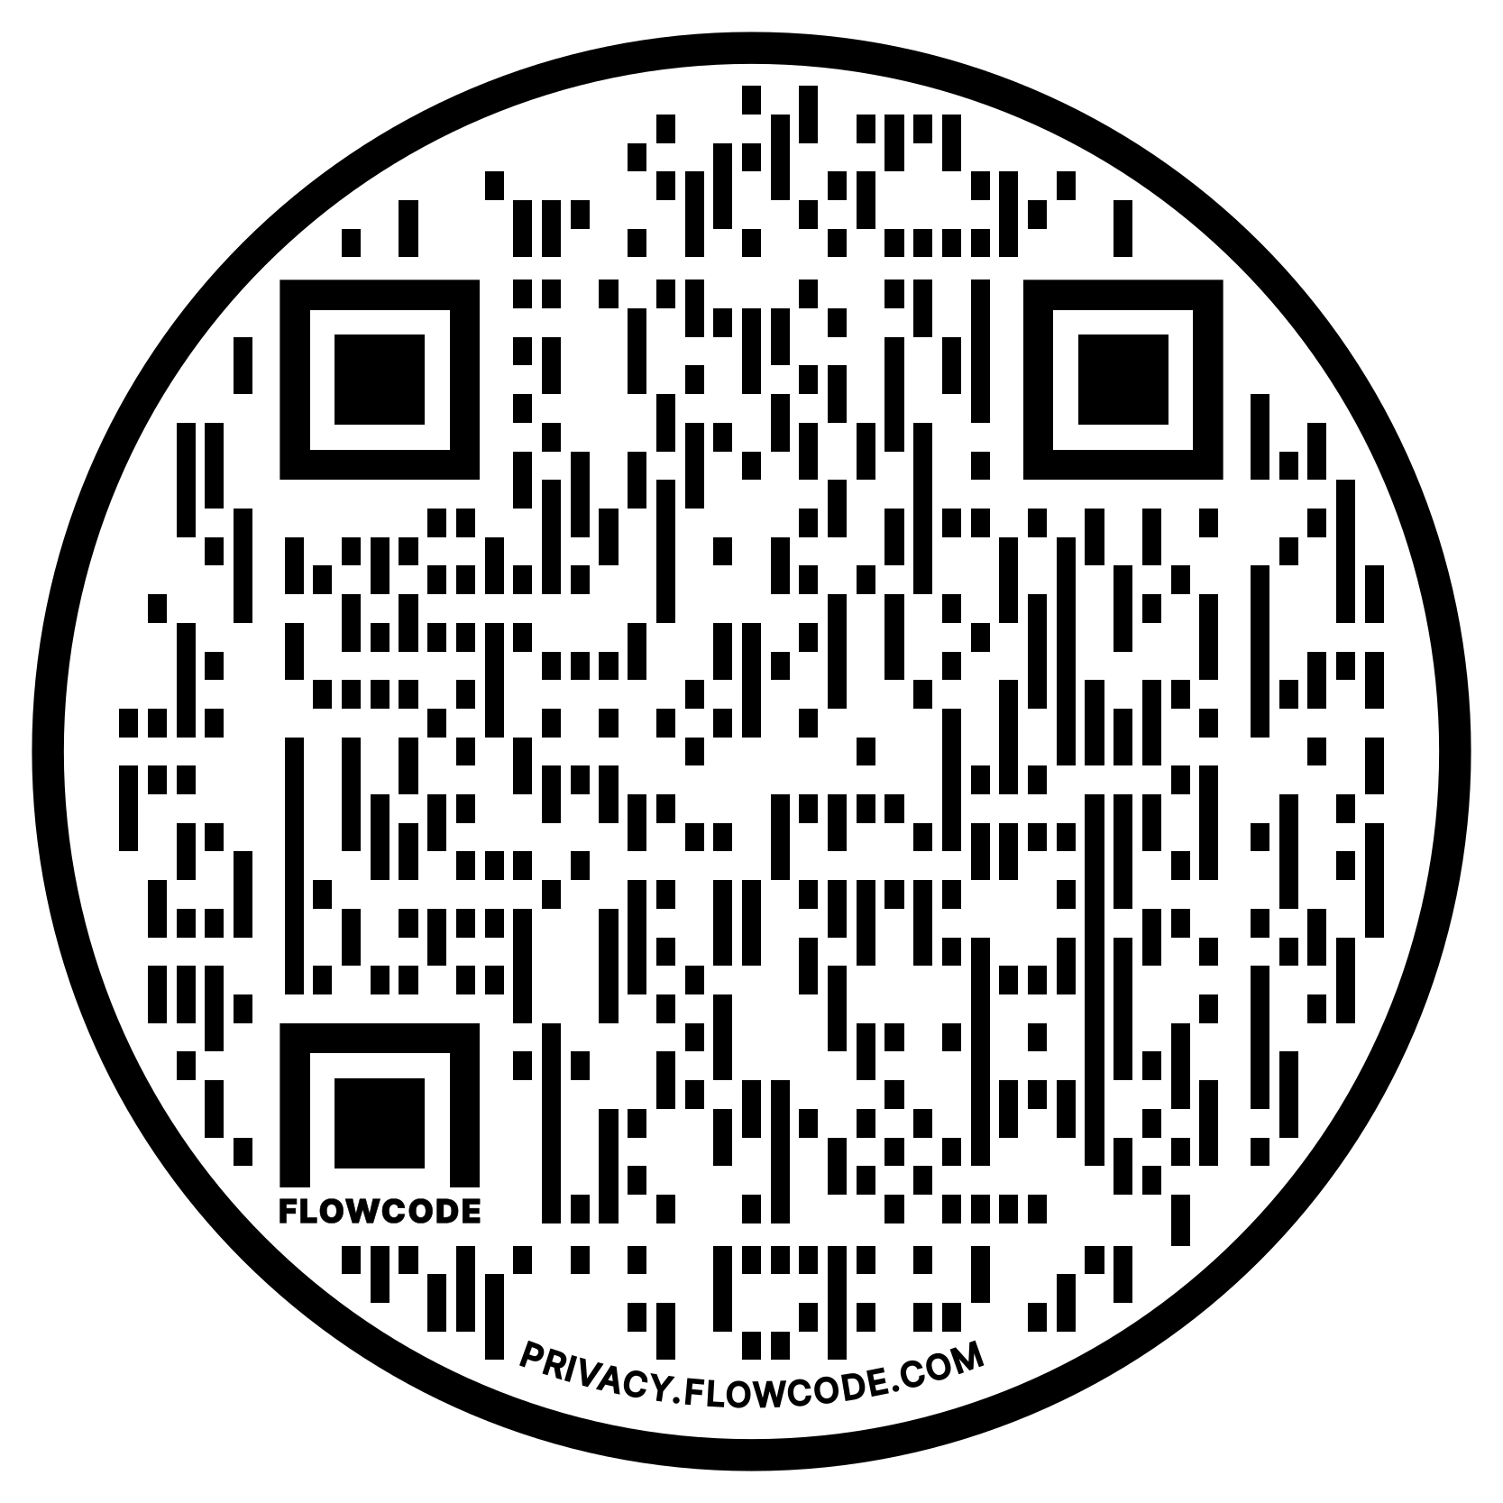
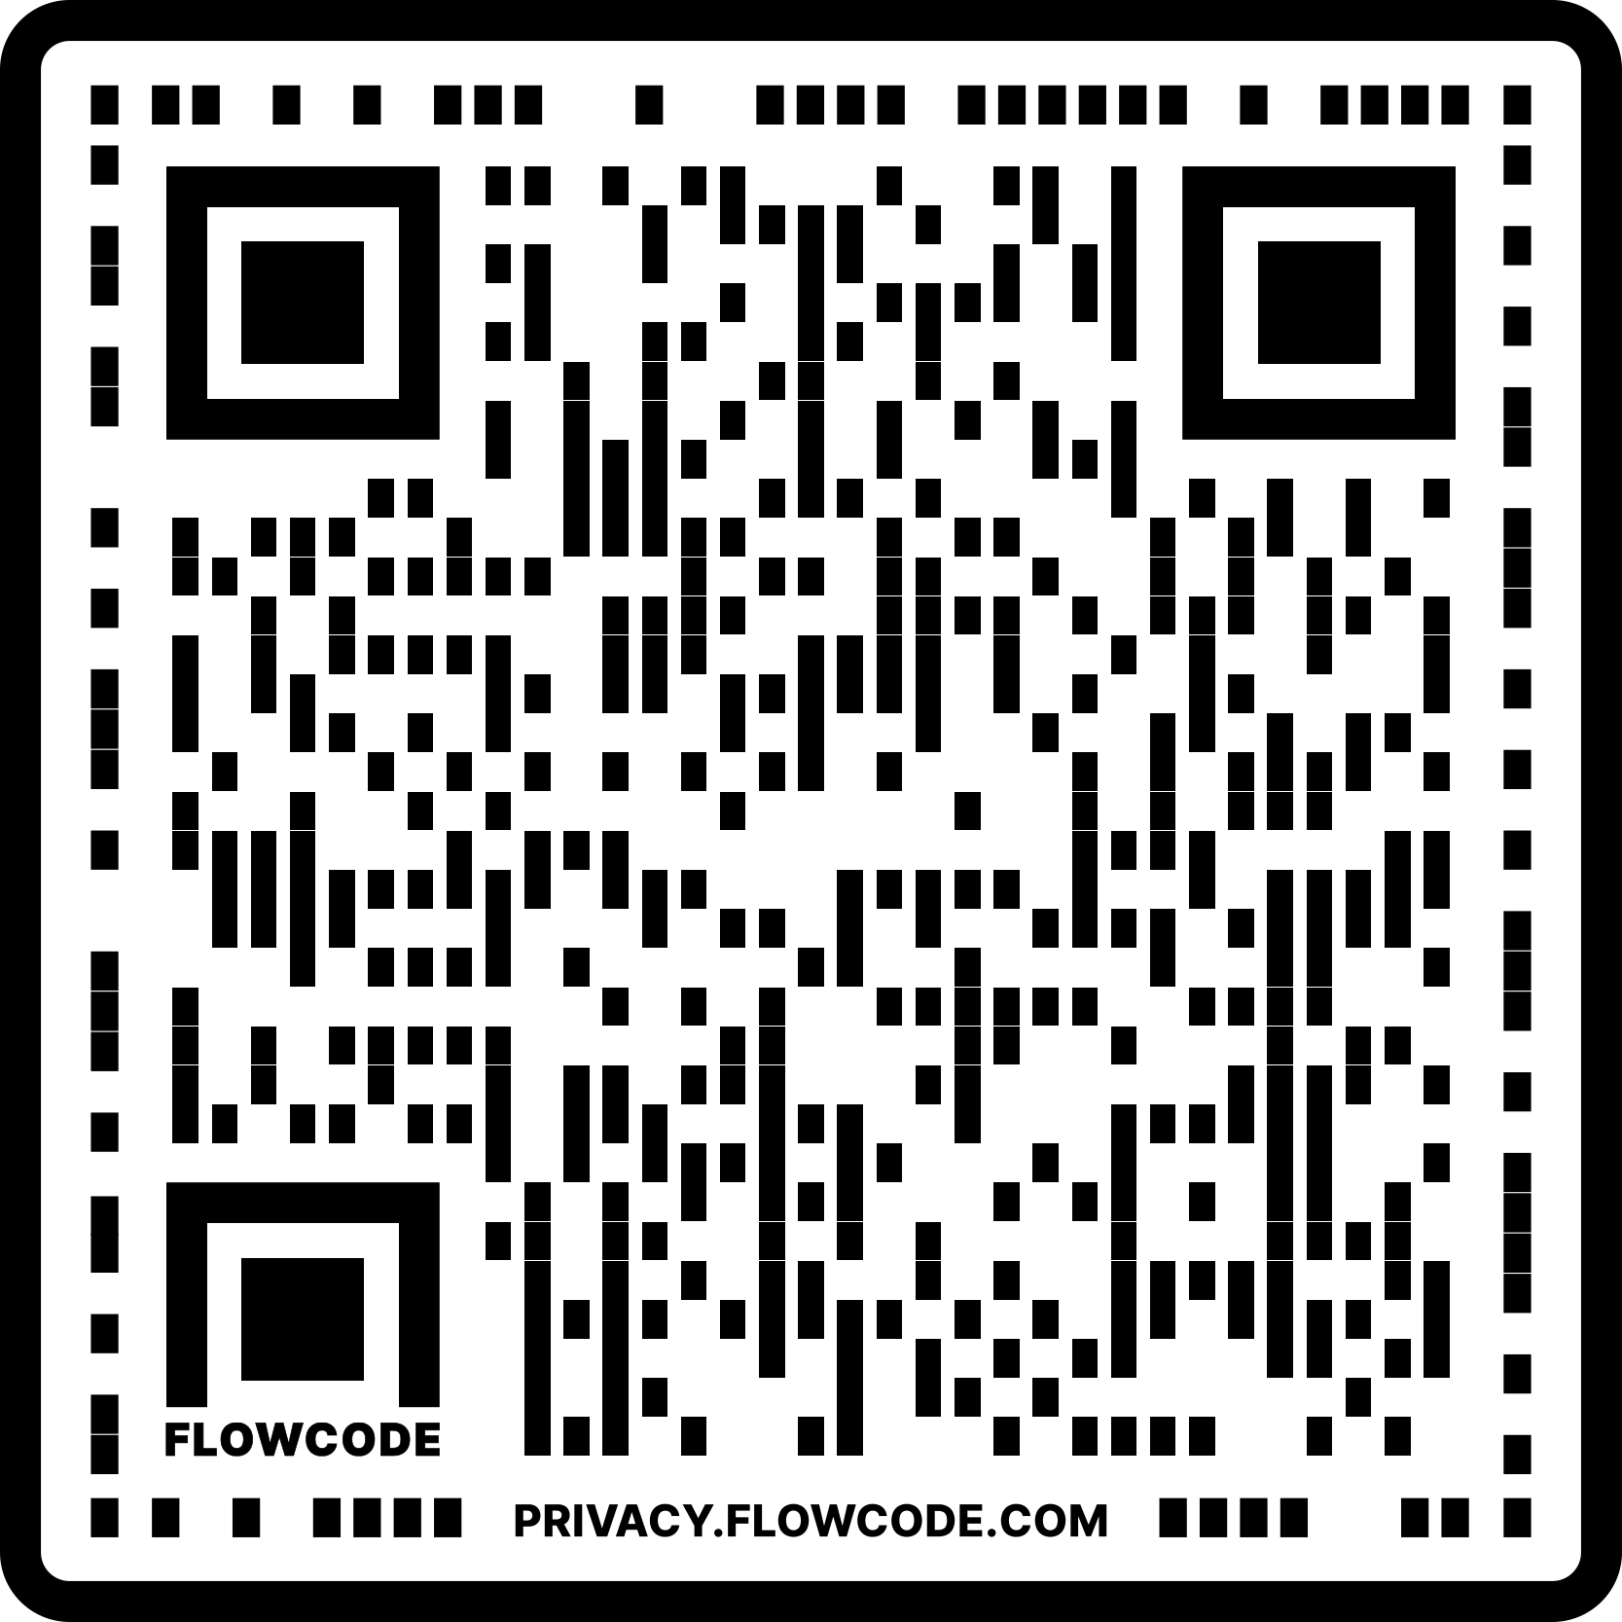
Developing a Universal Design for Learning and Inclusion Toolkit:
Supporting Young Children in the Classroom
Department of
Occupational Therapy
Kaitlyn Irwin, OT/s; Gary Bedell, Ph.D., OT; Hanna Gebretensae, Ph.D.;
Lynne May Lim, M.A.T.
Introduction
Initial observations of all classrooms to understand school culture.
Meeting with Head Teachers and administration to introduce project.
Observation of two classrooms on alternating weeks (8 weeks total).
Review of literature and existing tools to inform tool creation.
Weekly meetings and informal conversations with Head Teachers and classroom teams to inform tool.
Education on UDL to increase common understanding.
Creation of first draft of tool using observations, the literature, and information gathered from members of the EPCS community.
Meeting with stakeholders to discuss tool, feedback, and potential strategies.
Refinement of initial tool based on feedback.
Iterative Development Process and Deliverables
Discussion
Scan for an audio version of this poster.
Need for tool development to directly involve the stakeholders for whom tools are being designed.
Importance of flexibility in use of tools.
Provide and design multiple ways that the tool can be used depending on individual preferences and needs.
Limited resources and tools focused on UDL in early childhood education and preschool/kindergarten/first grade classrooms.
Many focus on high school and higher education.
Incorporate other identities in UDL to address their relationship with learner variability.
Highlight children, environment, and teacher’s impact.
Background:
Eliot-Pearson Children’s School (EPCS) is a laboratory and demonstration school at Tufts University in Medford, Massachusetts for children ages 2.9 to 7 that works closely with departments across campus.
Impacts of Early Childhood Education
Decreases involvement in special education and grade retention⁷ | Increases high school graduation rates⁷
Young children with [dis]abilities have been found to be less involved in preschool activities and the environments often do not meet their needs³.
EPCS has identified a need to address its current programing related to universal design for learning and inclusion in line with its mission¹.
Key Terminology:
Universal design for learning (UDL) is a framework that involves providing various options to meet the learning needs of all children through the lens of 3 principles⁴:
References
Additional DEC Experiences
Support of classroom teachers during activities
Social skills groups focused on self-regulation and social thinking with use of Zones of Regulation™⁶ and We Thinkers! ⁵ curricula
Application for interdisciplinary grant focused on UDL
Attendance of staff meetings and professional development
Principle | Meaning
Multiple means of engagement | Motivation and interest in learning⁴
Multiple means of representation | How information is presented (e.g., multisensory presentation) and whether a child understands information presented⁸
Multiple means of action and expression | How learning is demonstrated by students and whether a child can do what is being asked⁸
Future Directions
Final refinement of tool based on feedback and provision of toolkit to site.
Refinement of tool based on feedback; final presentation of tool to classroom teams and administration for feedback.
Discussion, implementation, and modeling of strategies related to UDLI.
Use of tool to design classroom prior to start of school year and/or evaluate throughout the year
Apply the tool to afterschool programming (Extended Day, Life Project) and summer programming
Incorporate UDLI into Eliot-Pearson Fellows training and staff professional development.
Expand UDLI tool to include more of a focus on inclusion (e.g., direct connection to program’s special rights program, expansion of inclusion principles and strategies)
Importance of interdisciplinary collaboration in education.
Occupational therapy practitioners can support through strengths-based and participation-focused approach.
Project may inform future occupational therapy doctoral projects at EPCS (e.g., evaluating use of tool and training for teachers and Eliot-Pearson Fellows) to further increase collaboration between EPCS and Department of Occupational Therapy.
References
Each principle has corresponding guidelines and checkpoints with the goal of creating expert learners⁴.
Inclusion is the involvement of all children, in consideration and in celebration of race, ethnicity, gender, sexual orientation, [dis]ability, and other personal and social identities.
Aims
Deliverables | Key Features | Key Feedback
Universal Design for Learning and Inclusion (UDLI) Toolkit | Background Information 72-item tool with corresponding questions for each UDL checkpoint and inclusion principles Alternate Use Guide (time of year) Strategies to increase UDLI focused on environment/materials, choice time, transitions, academic time, and general strategies Action Plan and Lesson Plan Documents Additional Resources | Need for tool to incorporate different ways of using it, with anticipated use at beginning of school year, throughout the year, and/or at end of year, depending on preference. Explicit connection to the environment. “Most of the time”/”Some of the time”/”Not often/Never” vs. “Yes”/”Sometimes”/”No” One tool for both classrooms Examples to clarify questions Provision of details and clarification of jargon
Implementation and modeling of strategies related to UDLI | Self-regulation Wiggles, Stomps and Squeezes Calm My Jitters Down⁹- Book on sensory differences Classroom proprioceptive movement/heavy work | Importance of written infographic of proprioceptive movement/heavy work for teachers to use Normalization of sensory differences
Education on UDL | Explanation of three principles and history of UDL | Breaking down UDL concepts without jargon to increase understanding
Develop and refine a Universal Design for Learning and Inclusion (UDLI) Toolkit at EPCS for 2 older student classrooms serving children ages 4 to 7.
Support teachers in utilizing co-developed UDLI toolkit in their classrooms.
Engage in interdisciplinary collaboration to co-develop strategies with teachers on how to improve UDLI in the classroom.
Methods
The methodology was as follows:
Integration into classroom as member of teaching staff, spending alternating weeks in two classrooms over course of 14-week doctoral experiential component (DEC).
Observations of both classrooms’ cultures, organizations, activities, physical spaces, social environments, and educational materials through lens of UDLI, with corresponding observation notes.
Meetings with head teachers, teaching teams, and administration to collaborate, refine project, and co-develop strategies.
Education regarding UDL.
Review of literature and related tools to inform toolkit development.
Contact and Acknowledgements
Kaitlyn Irwin, OT/s: kaitlyn.irwin@tufts.edu
A special thank you to the administration, teaching staff, and children of the EPCS community for their support in the completion of this project!

