Slide 1
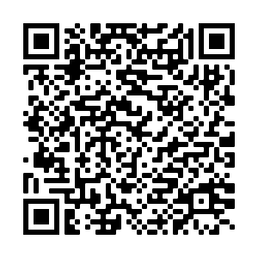
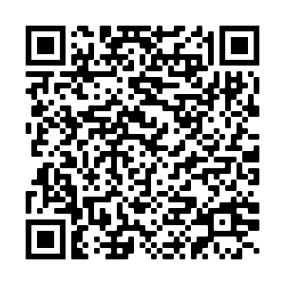
Aging in Place: Rethinking the Role of Occupational Therapy (OT)
Sienna M. Carpenter OT/s
Peer Collaborators: Hailey Pister OT/s & Sami Basnet OT/s
Mentored by Dr. Beth Marfeo PhD, MPH, OTR/L
Department of
Occupational Therapy
Introduction
Key Concepts
Findings
Acknowledgement
Key Concepts | Definition
Aging in Place (AIP) | One’s ability to live in residence of their choice for as long as they are able as they move through the aging process & as their needs change, while maintaining QoL (What is aging in place, 2018)
Quality of Life (QoL) | An individual's perception of their position in life in the context of the culture and value systems in which they live and in relation to their goals, expectations, standards and concerns (WHO, 2022)
Occupational Deprivation | Prolonged restriction from participation in necessary or meaningful activities due to circumstances outside of individual’s control (Abson, 2021)
Social Participation | Activities that involve social interaction with others, including family, friends, peers, and community members, and that support independence (OTPF, 2020)
Start
It is important to note that everyone's experience is different, with marginalization, discrimination, and oppressive systems serving as major drivers of reduced access to resources throughout the lifespan. Therefore, it is imperative to acknowledge how the systems discussed on this poster have harsher impacts on different communities.
How are OTs currently supporting older adults?
Most common OT interventions for older adults based on evidence:
1. Home safety
2. Fall prevention
3. ADLs/IADLs
Project Goals & Aims
Project Goal: Gain insight into the experiences and desires of older adults in the community, basic knowledge of relevant legislation, and gaps in OT services that support successful aging in place for older adults.
1. Report of loneliness and isolation, without finding this in OT literature
2. Functional deficits not deemed medically necessary do not receive services in traditional settings
Aim 1: Identify structural gaps that impact older adults’ ability to age in place.
Where are there gaps?
Aim 2: Identify role of OTs to further support older adults in the community & make aging in place more accessible.
Methods
Literature Search Process
How can OTs address these gaps?
More emphasis on community-based practice when working with older adults
Aging in Place Overview
A combination of different sources were reviewed to answer the string of research questions relevant to this project. These sources included:
What does it mean to age in place?
What are the preferences of older adults?
What are barriers/facilitators to aging in place?
Of those factors, what is role of Occupational Therapy?
What are the gaps?
How can those gaps be filled?
What is the role of OT in aging in place?
How are OTs currently supporting older adults?
Where are there gaps in OT services for this population?
How can OTs address these gaps?
What influences someone’s
ability to age in place?
Finances
Personal finances/assets
Government support
Familial support
Discussion
Finances
Home
Safety
Final Recommendation: To address barriers to aging in place for community-dwelling older adults, OT practitioners should partner with their local councils on aging.
Access to
Care/Health
Home Safety
Next Step: Contract between MCOA and Tufts OT Dept. for level II fieldwork placement.
Social
Participation
Community
Access
Fall prevention
Safe completion of ADLs/IADLs
Home accessibility
Articles & Websites
Why?
Serve as 12-week pilot
Cost-effective way to test utility of OT services at MCOA
Opportunity to provide evidence to support funding for licensed practitioner in the future
Access to Care/Health
Social Participation
Community Access
Setting: Home, outpatient, inpatient, ALF, SNF, nursing home
Health insurance
Proximity to providers
Complexity of medical
Informal/family caregiver
Proximity & access to family, friends, peers, desired activities, community center
Intergenerational social participation
Proximity to supports
Universal Design
Assistive technology
Community mobility (driving & public transit)
Attitudes & community policies
Final Recommendation:
Podcasts
Videos
Local Councils on Aging
OT
Practitioners
Stakeholder Interviews
Using the PEO Model to Understand Value of OT in Aging in Place
Occupational therapist with experience working in inpatient, outpatient, home-health, & community-based settings
Family member of older adult living in greater Boston Area who has experience helping a parent age in their home
Director of Elder Affairs at Medford Council on Aging regarding perceptions of facilitators/barriers to aging in place
Older adults (ages 60+) who utilize services at Medford Council on Aging and have varying experiences aging in the community
Opportunity to fill gaps in community needs!
Reality – nuanced examples
of misalignment
GOAL – all 3 in alignment
Person
Environment
Occupation
Person
Environment
Occupation
Person
Environment
Occupation
Acknowledgements
References
OT Intervention
Thank you to the MCOA community for offering your time and insights, the HPAL lab for data and resource access, my peer mentors for their support and input, and to Dr. Beth Marfeo for her guidance and mentorship.
Person
Environment
Occupation
Person
Environment
Occupation
Contact:
Sienna Carpenter sienna.carpenter@tufts.edu
Dr. Beth Marfeo elizabeth.marfeo@tufts.edu

