Slide 1
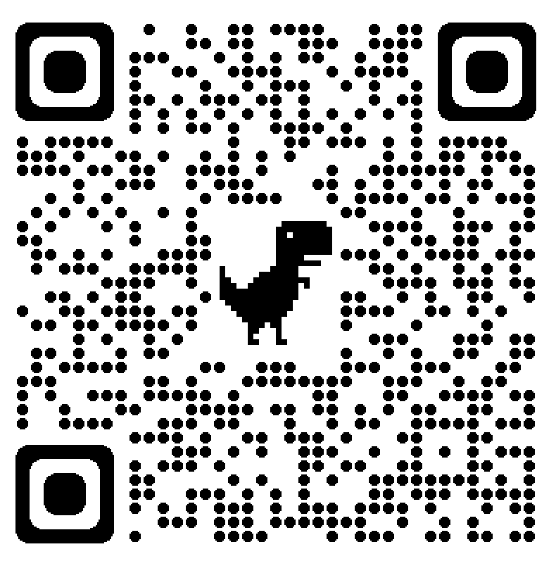
Creating a More Inclusive and Culturally Sensitive Professional Development Monitor (PDM)
Department of
Occupational Therapy
Authors: Emma O’Malley OT/s, Meredith Grinnell OT, OTD, & Mary Alicia Barnes OT, OTD
Introduction
Professional Development Monitor
Professional Development Monitor created to explore transition from student to professional (Barnes & Evenson, 1995)
Underwent several revisions [1996, 1997, 2004, 2010, & 2020] (Barnes, 2022)
Professionalism as construct difficult to define (Nesbit & Fitzsimmons, 2021)
Debate on whether professionalism is a culturally inclusive term (Mackenzie et al., 2020)
Professionalism used to oppress and regulate people of color in various ways including hair, tone, and food scents. Professionalism based on set of beliefs grounded in racial subordination and white supremacy, ultimately making term racial construct (Goodridge, 2022).
Certain hair styles (ex: dreadlocks) have been viewed as “unprofessional” when actually culturally appropriative to other communities (Mackenzie et al., 2020)
New Categories
Cultural and Client Sensitivity
Patient Safety
AOTA Code of Ethics
Communication with clients
Professional appearance / presentation
Shows tolerance toward a variety of opinions & viewpoints in all environments (Nesbit et al., 2021)
Demonstrates sensitivity & respect toward individual needs, values, beliefs, cultural factors, language barriers, cognitive abilities, & socioeconomic status (Tanzer & Dintzner, 2017)
Gauges client understanding of safety concern(s) before close of session (Havig et al., 2020)
Examples:
Uses probing questions to gather further information (Havig et al., 2020)
Validates client experiences & concerns (Havig et al., 2020)
Receives information with care & concern (Havig et al., 2020)
Engages with client & peers in an ethical & safe manner (MacKenzie et al., 2020)
Application of Knowledge
Uses language that meets audience expectations (Mackenzie et al., 2020)
Demonstrates awareness of one’s knowledge/skill level with humility and growth mindset (Nesbit et al., 2021)
Takes a strengths-based approach, highlighting client’s abilities & strengths in addition to concerns (Havig et al., 2020)
Abides by AOTA’s Code of Ethics & Ethics Standards
Examples:
Respects confidentiality of client in accordance with AOTA code of ethics
Delivers patient-centered care in a manner that is legal, ethical, & compassionate
Shows respect & dignity for others (MacKenzie et al., 2020)
Wears professional attire as defined by the site (Tanzer & Dintzner, 2017)
Example:
Well groomed
Follows dress code
Cleanliness
Verbal Examples
Non-verbal Examples
Addresses client using preferred designation (name, title, pronouns) (Havig et al., 2020)
Demonstrates empathy (accurately reflects back feelings/perspective of client) (Havig et al., 2020)
Expresses concern (Havig et al., 2020)
Body language is suitable to context & audience (MacKenzie et al., 2020)
Methods
Steps One & Two: Literature Search & Scoping Review
Categories Expanded
Identification
Records identified though data base searches (Web of Science, CINAHL, PubMed, ERIC, & Psychinfo) using search terms
“rubrics for professionalism” AND “simulation” AND “rubric” (n=502)
Screening
Records remaining after duplicates were removed (n=334)
Records screened for rubrics grading professionalism (n=114)
Records screened for rubrics grading
professionalism
in healthcare students (n=49)
Eligibility
Full text articles excluded (n=31)
Published after 2010 (n=19)
Not peer reviewed (n=12)
Categories with Minimal Editing
Included
Studies included in scoping review (n=18)
Initiative
Generates relevant questions & potential solutions
Self-directed; seeks out necessary learning materials or opportunities
Organization
Manages materials safely & efficiently
Arrives on time with all necessary materials & forms
Addresses any delays or absences proactively with supervisor (Tanzer & Dintzner, 2017)
Dependability & Timeliness
Responsive; modifies behavior according to demands of situation
Demonstrates time management skills (MacKenzie et al., 2020)
Step Three: Professional Development Monitor Revision
Revise PDM
Collaborate with mentor
Revise PDM
Collaborate with research assistant
Collaborate with original author
Revise PDM
Collaborate with peers
Final PDM draft
Revise PDM
1. Gather expert feedback
2. Test constructs
3. Evaluate reliability & validity
References & Relevant Literature
Next Steps
Pilot test assessment and data collection to:
Special thanks to Meredith Grinnell OTD, Mary Alicia Barnes OTD, Jackson Miller OT/s, Elizabeth Perrone OT/s, Rachel Cohen OT/s, & Angie Velasquez OT/s

