Slide 1
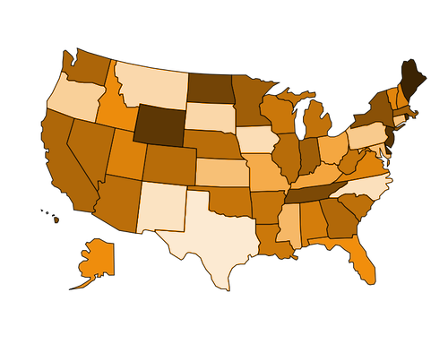
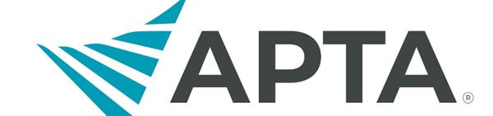
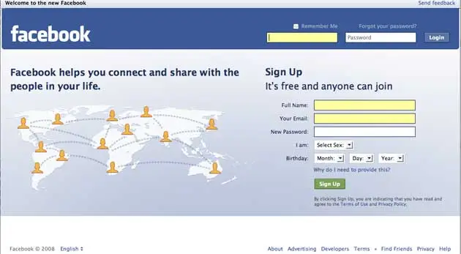
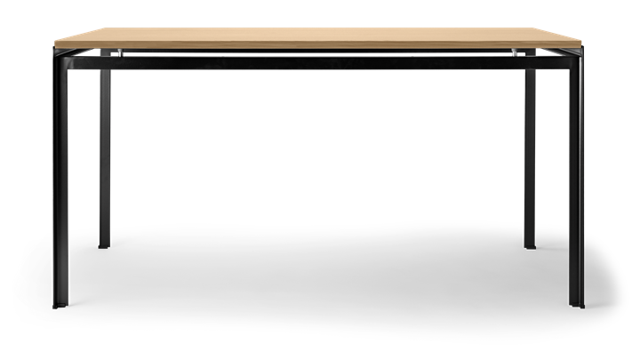
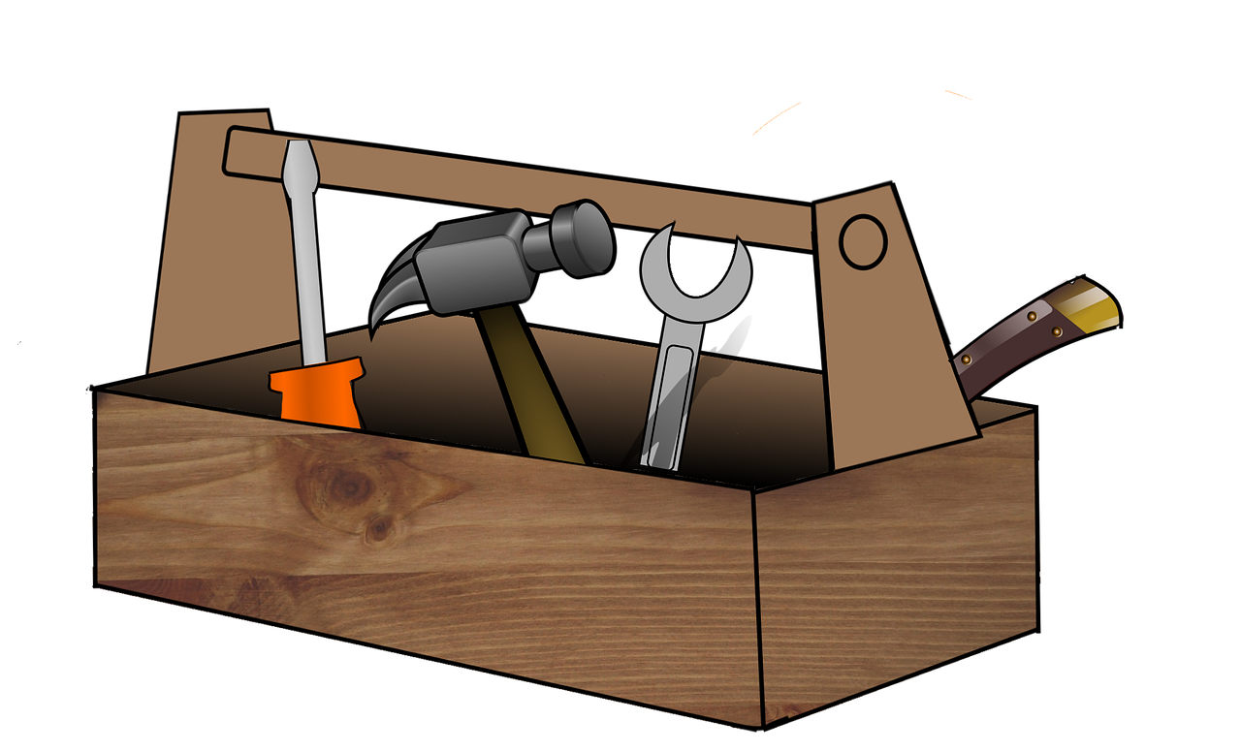
x

Slide 2
Legend
OT Schoolhouse Podcast Episode 81 and 86
20-minute Yoga for Beginners (Stress Management)
State-by-State Legislative Workload Guide (Seruya & Garfinkel, 2020)
NC DPI Workload Calculator from a Time Study Resource
Garfinkel & Seruya (2017) Time Study Excel Sheet
Garfinkel & Seruya Workload Toolbox Powerpoint
School-based OTs & PTs Facebook Group
Watt et al. (2021) Integrated vs. Pull-out Services Article
Build Your Advocacy Skills (NAEYC)
BOX Folder of Additional Literature/Resources [Living Resource]
x
AOTA, APTA, ASHA Joint Statement on Workload and Caseload Models in School-based Practice
Stephenson (2019) Resilience & Burnout in School-based OTs

Slide 3
References
American Occupational Therapy Association, American Physical Therapy Association, American Speech-Language-Hearing Association. (2014). Workload approach: A paradigm shift for positive impact on student outcomes. American Occupat A Paradigm Shift for Positive Impact on Student Outcomes. https://prep.asha.org/siteassets/practice-portal/caseloadworkload/apta-asha-aota-joint-doc-workload-approach-schools.pdf
Davies, J. (Host). (2021, November). OTSH 86: Journal Club - The Problem with Caseloads [Audio Podcast Episode]. OT Schoolhouse. https://www.otschoolhouse.com/single-post/otsh-86
Davies, J. & Corley, A. (Hosts). (2021, August). OTSH 81: School-Based OT Workloads with Alexa Corley (No. 443). [Audio Podcast Episode]. OT Schoolhouse. https://www.otschoolhouse.com/single-post/otsh-81
Garfinkel, M., & Seruya, F. M. (2017, April 1). The Workload Toolbox: Practical Tools to Help You Build a Case for and Maintain a Workload Model in Your School-Based Practice [Conference Presentation]. https://tufts.app.box.com/file/1325837653557?s=9trmuj9yg7fkdcgnevcl2cwxyj1mgea6

Slide 4
References
Garfinkel, M., & Seruya, F. M. (2020a). Workload categories. GARFINKEL & SERUYA CASELOAD TO WORKLOAD RESOURCES. https://www.garfinkelseruya.com/excel-template.html
Garfinkel, M., & Seruya, F. M. (2020b, February). State-by-state guide. GARFINKEL & SERUYA CASELOAD TO WORKLOAD RESOURCES. https://www.garfinkelseruya.com/state-by-state-guide.html
Mischler, A. (2022, May 2). 20-minute yoga for beginners | start yoga here... YouTube. https://www.youtube.com/watch?v=vNyJuQuuMC8
Purpose updated workload tool for OT, PT, and SLP practitioners - NC DPI. DPI NC Workload Tool Answers. (n.d.). https://www.dpi.nc.gov/workload-tool-answers/download?attachment
Stephenson, P. (2019). Building resilience and minimizing burnout in school-based practice. Journal of Occupational Therapy, Schools, &amp; Early Intervention, 12(3), 354–364. https://doi.org/10.1080/19411243.2019.1590754
Watt, H., Richards, L. G., Woolley, H., Price, P., & Gray, S. (2021). Integrated Services or pullout? factors influencing school-based Occupational Therapy Service Delivery Models. Journal of Occupational Therapy, Schools, & Early Intervention, 1–15. https://doi.org/10.1080/19411243.2021.1934226
Ziembowicz, Megan. (2023. Bitmoji Classroom Workload Caseload Literature Bookcase [BOX Folder].
(n.d.). Build Your Advocacy Skills. NAEYC. https://www.naeyc.org/our-work/public-policy-advocacy/build-your-advocacy-skills-and-knowledge

Slide 5
References
Watt, H., Richards, L. G., Woolley, H., Price, P., & Gray, S. (2021). Integrated Services or pullout? factors influencing school-based Occupational Therapy Service Delivery Models. Journal of Occupational Therapy, Schools, & Early Intervention, 1–15. https://doi.org/10.1080/19411243.2021.1934226
Ziembowicz, Megan. (2023. Bitmoji Classroom Workload Caseload Literature Bookcase [BOX Folder].
(n.d.). Build Your Advocacy Skills. NAEYC. https://www.naeyc.org/our-work/public-policy-advocacy/build-your-advocacy-skills-and-knowledge

