Slide 1
COVID-19 Pandemic, Food Systems, and Interaction with Malnutrition
Ag2Nut Community of Practice Discussion
April 2, 2020
Tesfaye Hailu Bekele, Researcher, Ethiopian Public Health Institute
Stineke Oenema, Coordinator, UN SCN
William Masters, Professor, Tufts Friedman School
Selena Ahmed, Associate Professor, Montana State University
Namukolo Covic, Senior Research Coordinator, A4NH, IFPRI, Addis Ababa, Ethiopia
Moderator: Anna Herforth, Ag2Nut

Slide 2
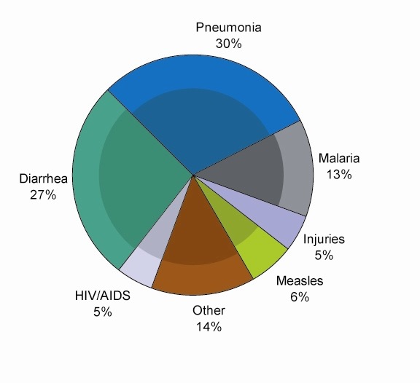
Major causes of death among children <5 years
(2000-2003)
The shaded regions are deaths due to malnutrition
Pelletier et al. 1995 and Bryce et al 2005
Notes:
Bryce J, Boschi-Pinto C, Shibuya K, Black RE,
“WHO estimates of the causes of death in children.” Lancet 2005; 365:1147-52.
Pelletier, D. L., Frongillo, Jr., E. A., Schroeder, D. and Habicht, J-P.: The effects of malnutrition on child mortality in developing countries. Bulletin of the World Health Organization, 1995, 73 (4): 443-448.

Slide 3
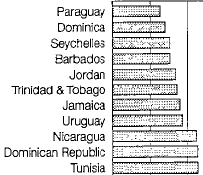
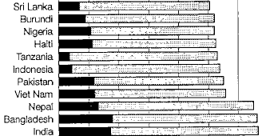

Total and relative proportions of death due to severe vs. mild-moderate malnutrition
Mild+moderate MN
Severe MN
World
Percent of child deaths due to Malnutrition
Pelletier et al. 1995
Notes:
Information in 53 countries : 11with highest and 11with lowest death rates
Total proportion of mortality due to malnutrition. And black = proportion of total due to severe malnutrition
Bottom is the information for the world
The important item to notice is that severe malnutrition accounts for many less deaths than does mild to moderate, in the world overall and in each of the countries
The other item to note is that 53% of all deaths are due malnutrition, in the sense that the they would not have occurred if the children had been well-nourished with exactly the same amount of infectious disease rates.
Figure 1 from :136 Pelletier, D. L., Frongillo, Jr., E. A., Schroeder, D. and Habicht, J-P.: The effects of malnutrition on child mortality in developing countries. Bulletin of the World Health Organization, 1995, 73 (4): 443-448.

Slide 4
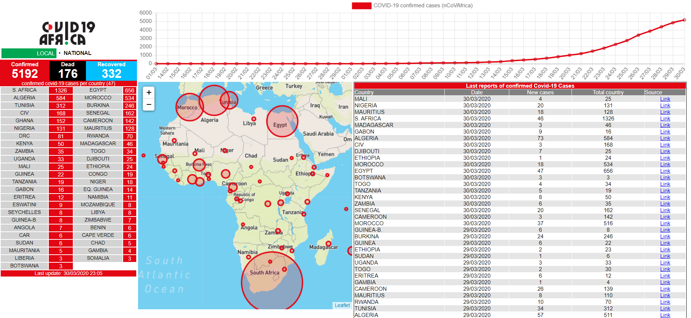

Slide 5
Special challenges for COVID-19 in Africa ?
What needs to be done ?
Nutrition programs and role of sectors to support the anticipated crises on food system and malnutrition due to COVID-19

Slide 6

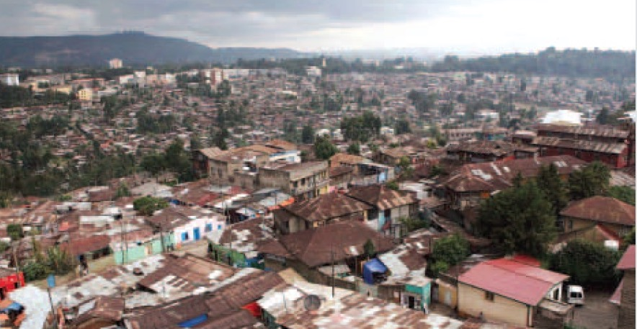
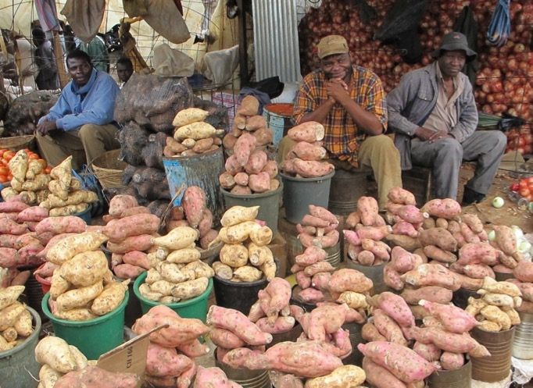
Living condition very challenging for physical distancing

Slide 7
What should be done differently in nutrition at this critical time?
  Are we able to do current programs as planned? If not, what can we do differently?
Where is the current resource allocation for nutrition?
  What resources are currently available for nutrition?
  What additional resources are needed for nutrition? How can we get these additional resources?
  What can we do differently with the available resources to reduce the effect of COVID 19 on the burden of malnutrition?

Slide 8

Resilience in food systems due to COVID-19? How?
Health
Agriculture
Education
Water and energy
Business/private sector
Social SafetyNet
Civil society
Academia
Research institutes
Development partners
Humanitarian organization
Community

Slide 9
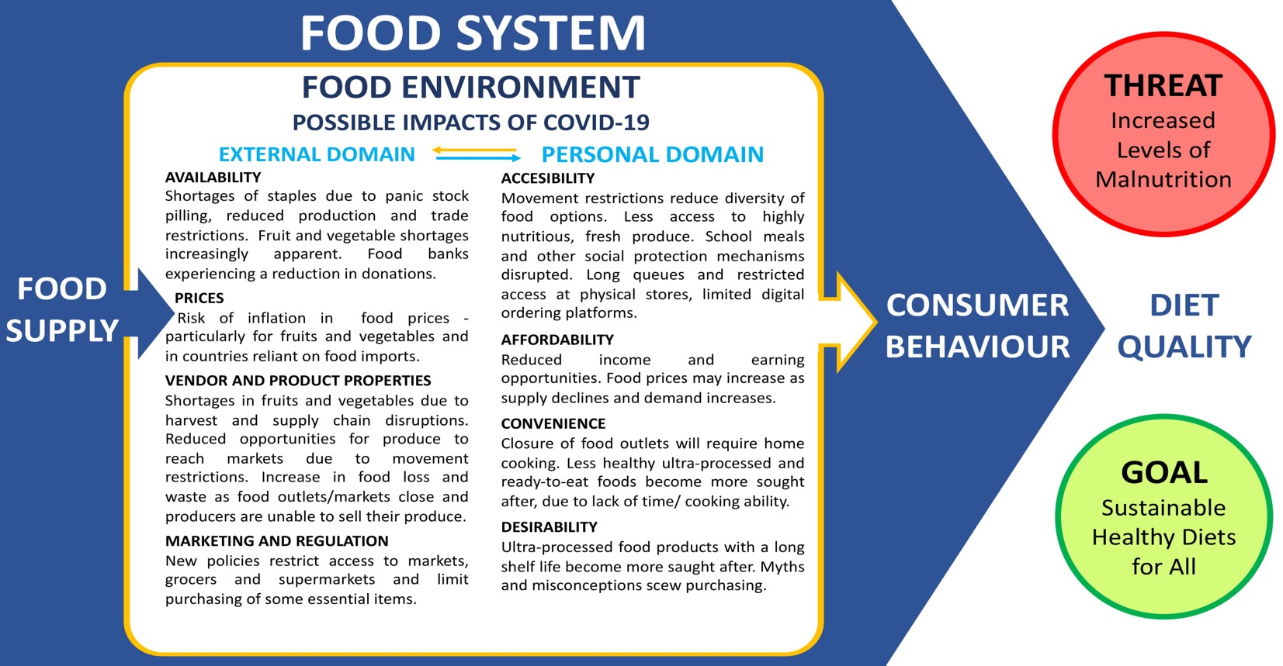
Figure 1. Possible impacts of the COVID-19 pandemic on food environments
Source: adapted from Turner et al, Concepts and critical perspectives for food environment research: A global framework with implications for action in low- and middle-income countries, available at https://www.sciencedirect.com/science/article/pii/S2211912418300154?via%3Dihub
Source: adapted from Turner et al, Concepts and critical perspectives for food environment research: A global framework with implications for action in low- and middle-income countries, available at https://www.sciencedirect.com/science/article/pii/S2211912418300154?via%3Dihub

Slide 10
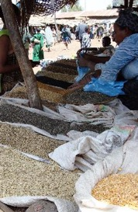
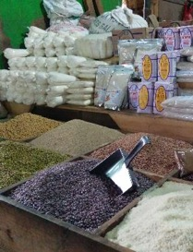
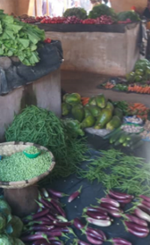


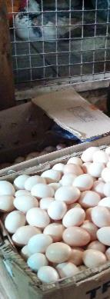

Economics of Covid-19 impacts on agriculture, food & nutrition
Will Masters (Tufts University)
Risks to farm production and food supply chains
  Transmission via close contact, in group workspaces and face-to-face transactions
  Most farms and food supply activity is already dispersed, but vulnerable at some locations
  Big immediate risk is stopped movement of migrant workers, transport & marketplaces
Impact of shift to reliance on food at home
  Loss of school meals and other safety nets that rely on face-to-face contact
  Huge disparities in capacity to acquire and prepare food at home
Effects of widespread loss of employment and livelihoods
  Cost of shutdown is largest income decline in history (uncontrolled disease would be even worse)
  Sharp decline in demand for many goods & services, shift to basic necessities including food
Need real-time monitoring of food prices and quantities
  Price spikes will reveal supply chain disruption for specific food groups
  Price declines will reveal loss of purchasing power by local populations

Slide 11
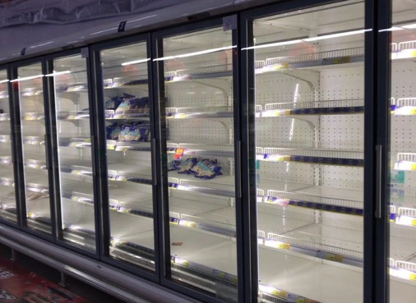
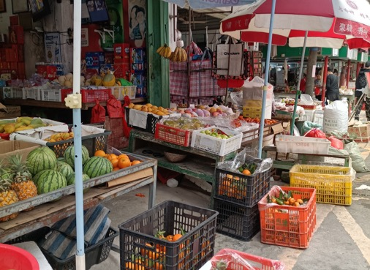
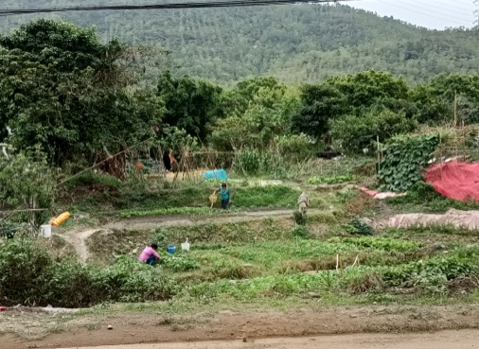

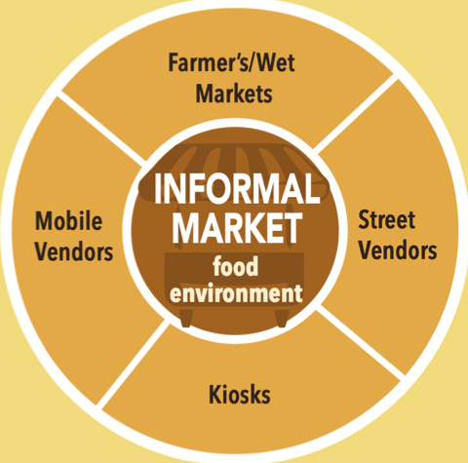
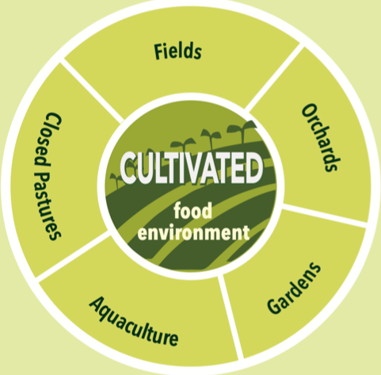
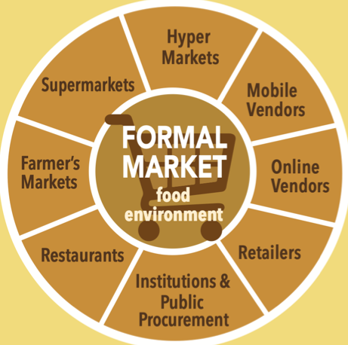

Slide 12
Downs et al. Forthcoming

Slide 13
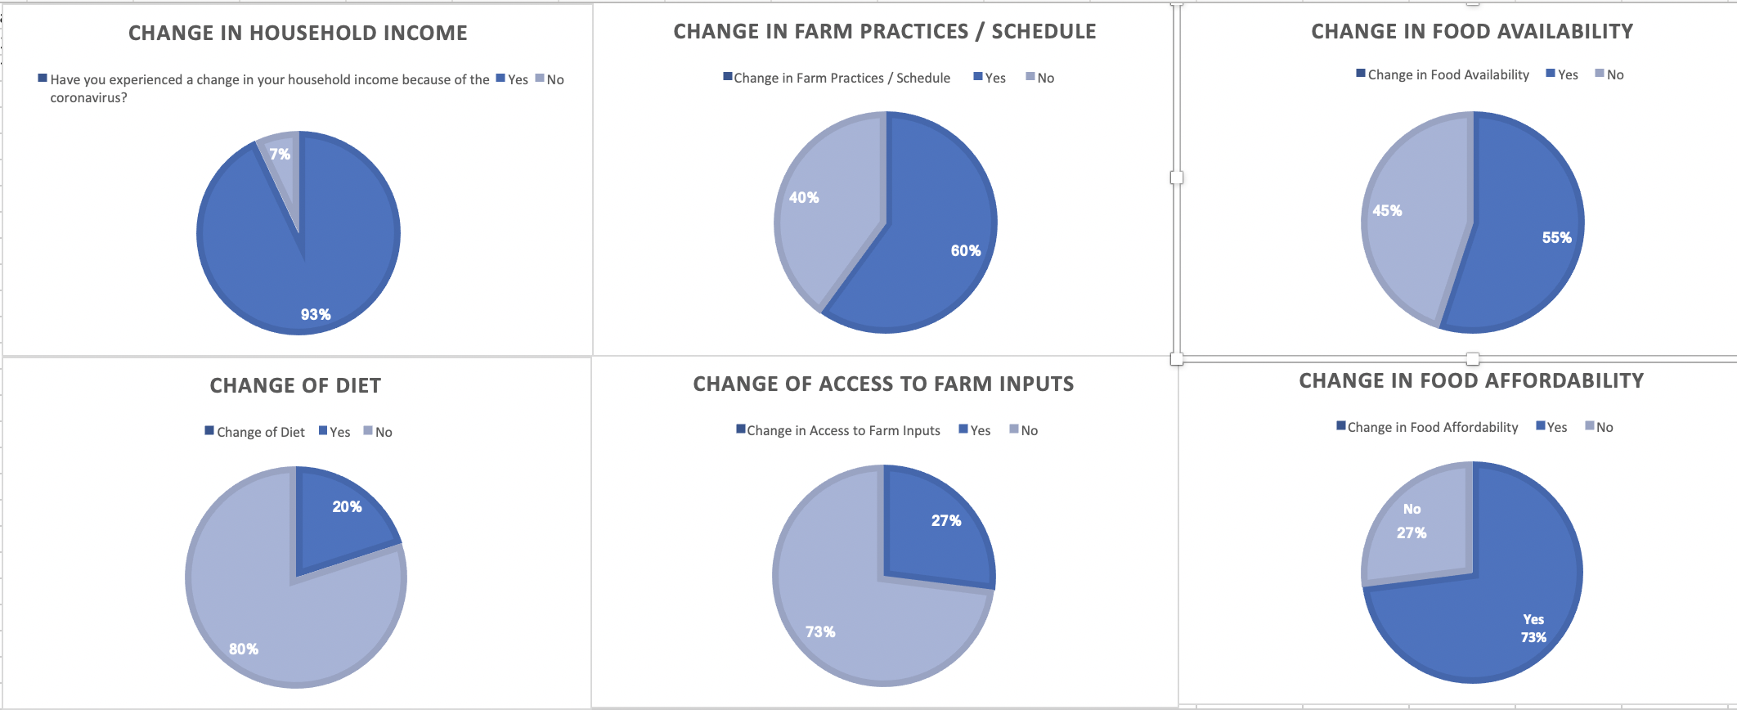

Slide 14
