Slide 1
Covid-19 impacts on agriculture, food & nutrition
Will Masters
Friedman School of Nutrition, Tufts University
http://sites.tufts.edu/willmasters
http://sites.tufts.edu/foodecon
Friedman speaker series, 22 April 2020

Slide 2
Covid-19 impacts on agriculture, food & nutrition
Four points:
Economic analysis starts with epidemiology
Disease hit richer cities first, then spreads and hits poorer people harder
2. Supply chains are vulnerable wherever people gather or move
Farmers & farm owners already distanced; food system is what’s disrupted
3. Massive job loss in food service, sudden shift to food at home
Income collapse, shift to packaged foods and basic necessities
Loss of school meals and other supports reveals disparities at home
4. Need real-time monitoring of food prices by food group
Impact and response reveals both weaknesses and strengths

Slide 3
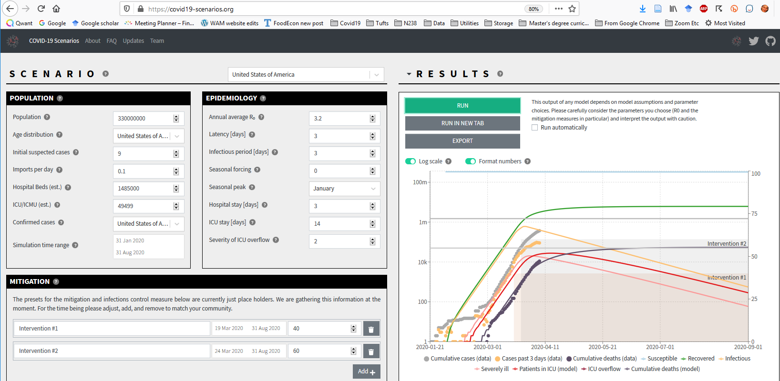
The economics of COVID starts with epidemiology
We are all Susceptible and easily Infected, with unknown immunity if Recovered
SIR model parameters are uncertain and can change
Epi forecasts are warnings, meant to be updated
Source: https://covid19-scenarios.org

Slide 4
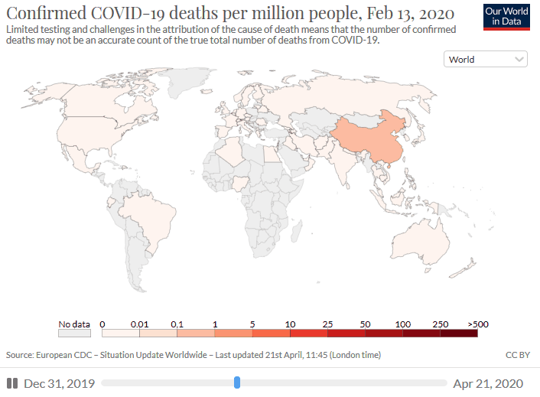
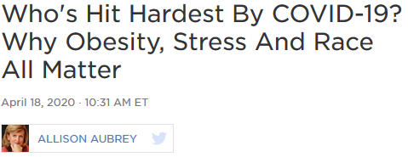
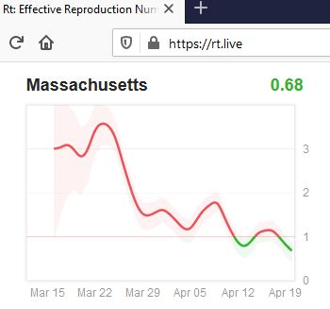
COVID spreads internationally by air travel to big cities
then spreads to the most vulnerable places and people
Community spread hits those who cannot escape, and for whom disease is most severe
So far the only way to slow
the virus’ reproduction rate (Rt) is physical distancing
Poorer places cannot do this!
Source: https://ourworldindata.org/coronavirus

Slide 5
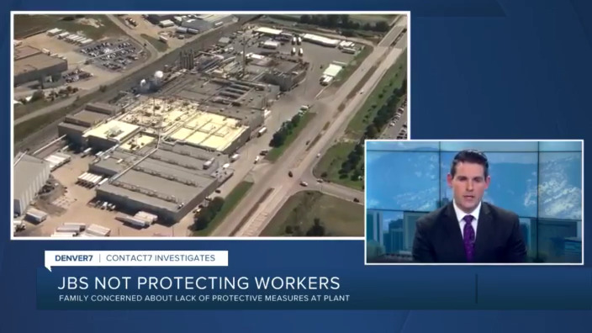
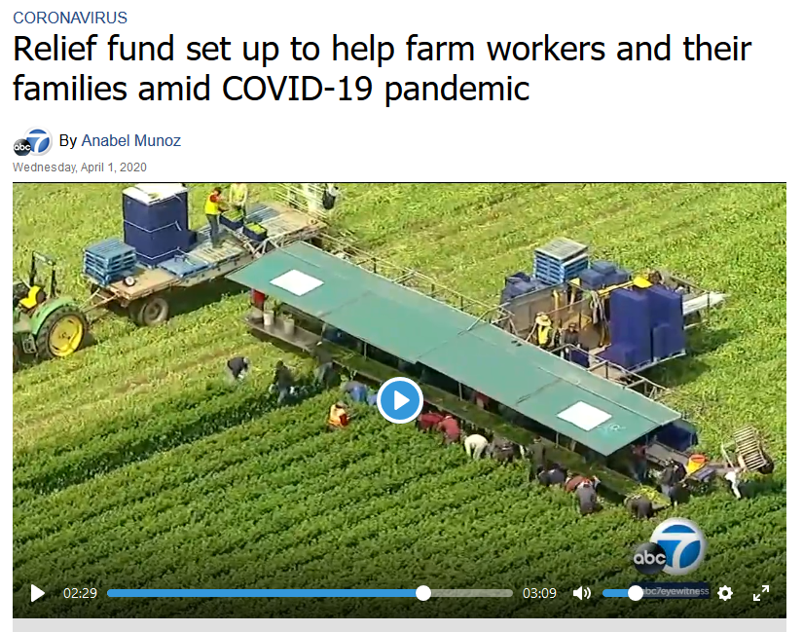
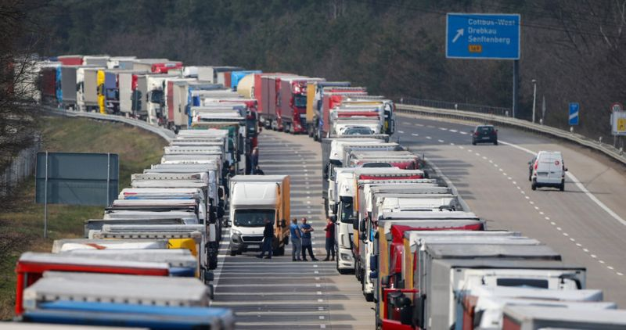
Supply chains can break wherever people gather or move
Meatpacking plants pose big risks
Harvest workers labor side-by-side and often migrate long distances
Governments may block borders

Slide 6
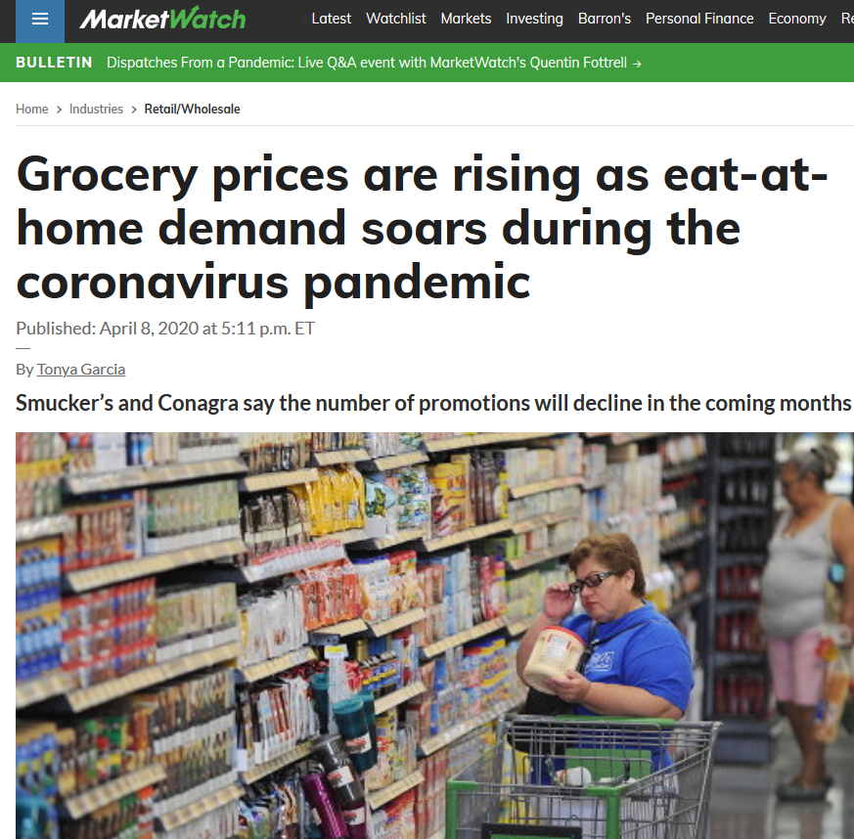
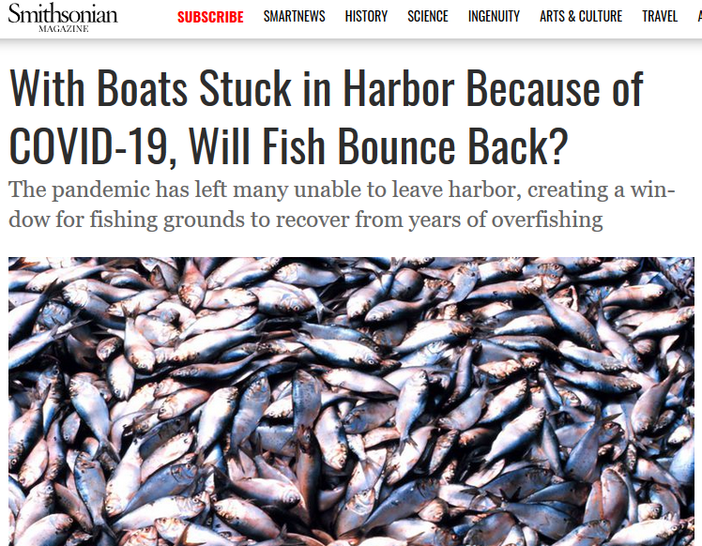
Massive job loss and switch to food at home

Slide 7
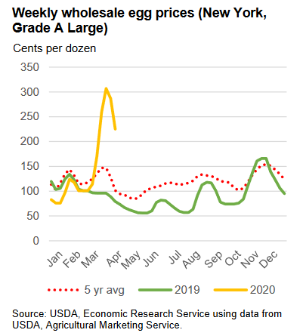
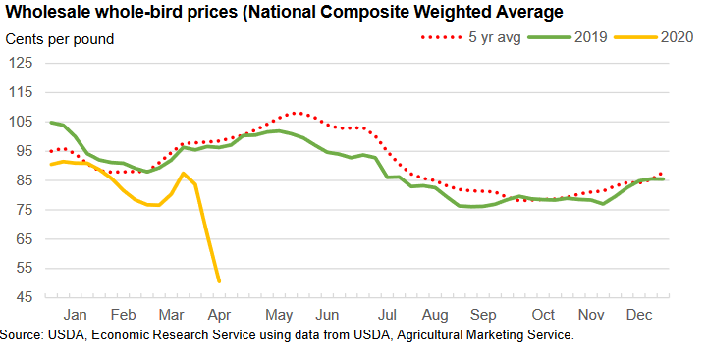
Wholesale prices reveal supply failures & demand shocks
Price spike for eggs in retail packs
Price collapse for whole chickens
Wholesale egg prices (New York, grade A large)
Cents per dozen
Wholesale chicken prices (national average, whole birds)
Cents per pound
Source: USDA, Livestock, Dairy, and Poultry Outlook (15 April 2020), using data from USDA Agricultural Marketing Service

Slide 8
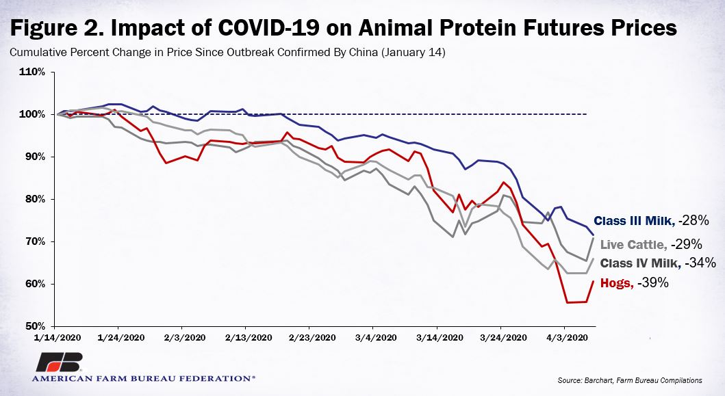
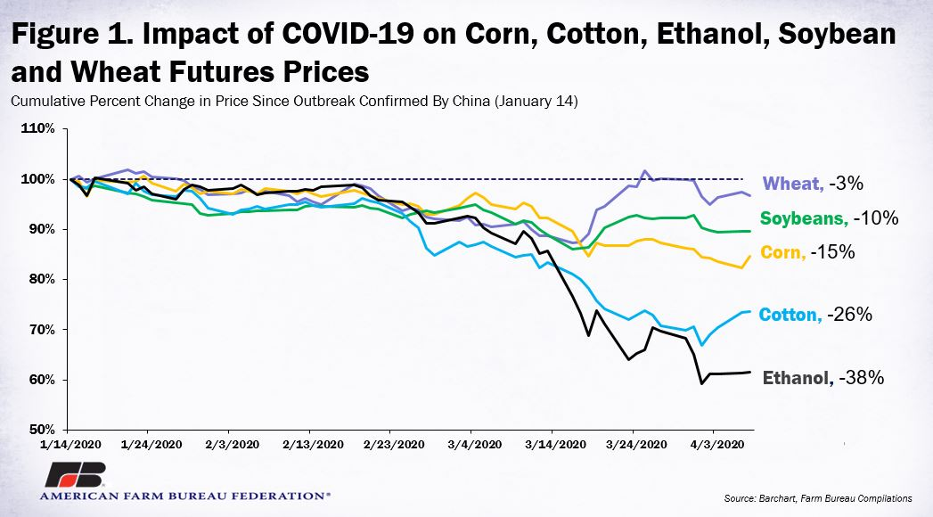
Lower incomes and shift to food at home drives down prices for feed & animals
Source: Farm Bureau, Apr. 7th 2020: https://www.fb.org/market-intel/coronavirus-sends-crop-and-livestock-prices-into-a-tailspin

Slide 9
Food company valuations show shift to grocery sector
Packaged food and food retail is seen as safe
Food service companies that provision cafeterias etc. are down 50%
Jan 2nd
=100
Source: Calculated from NYSE daily closing values

Slide 10
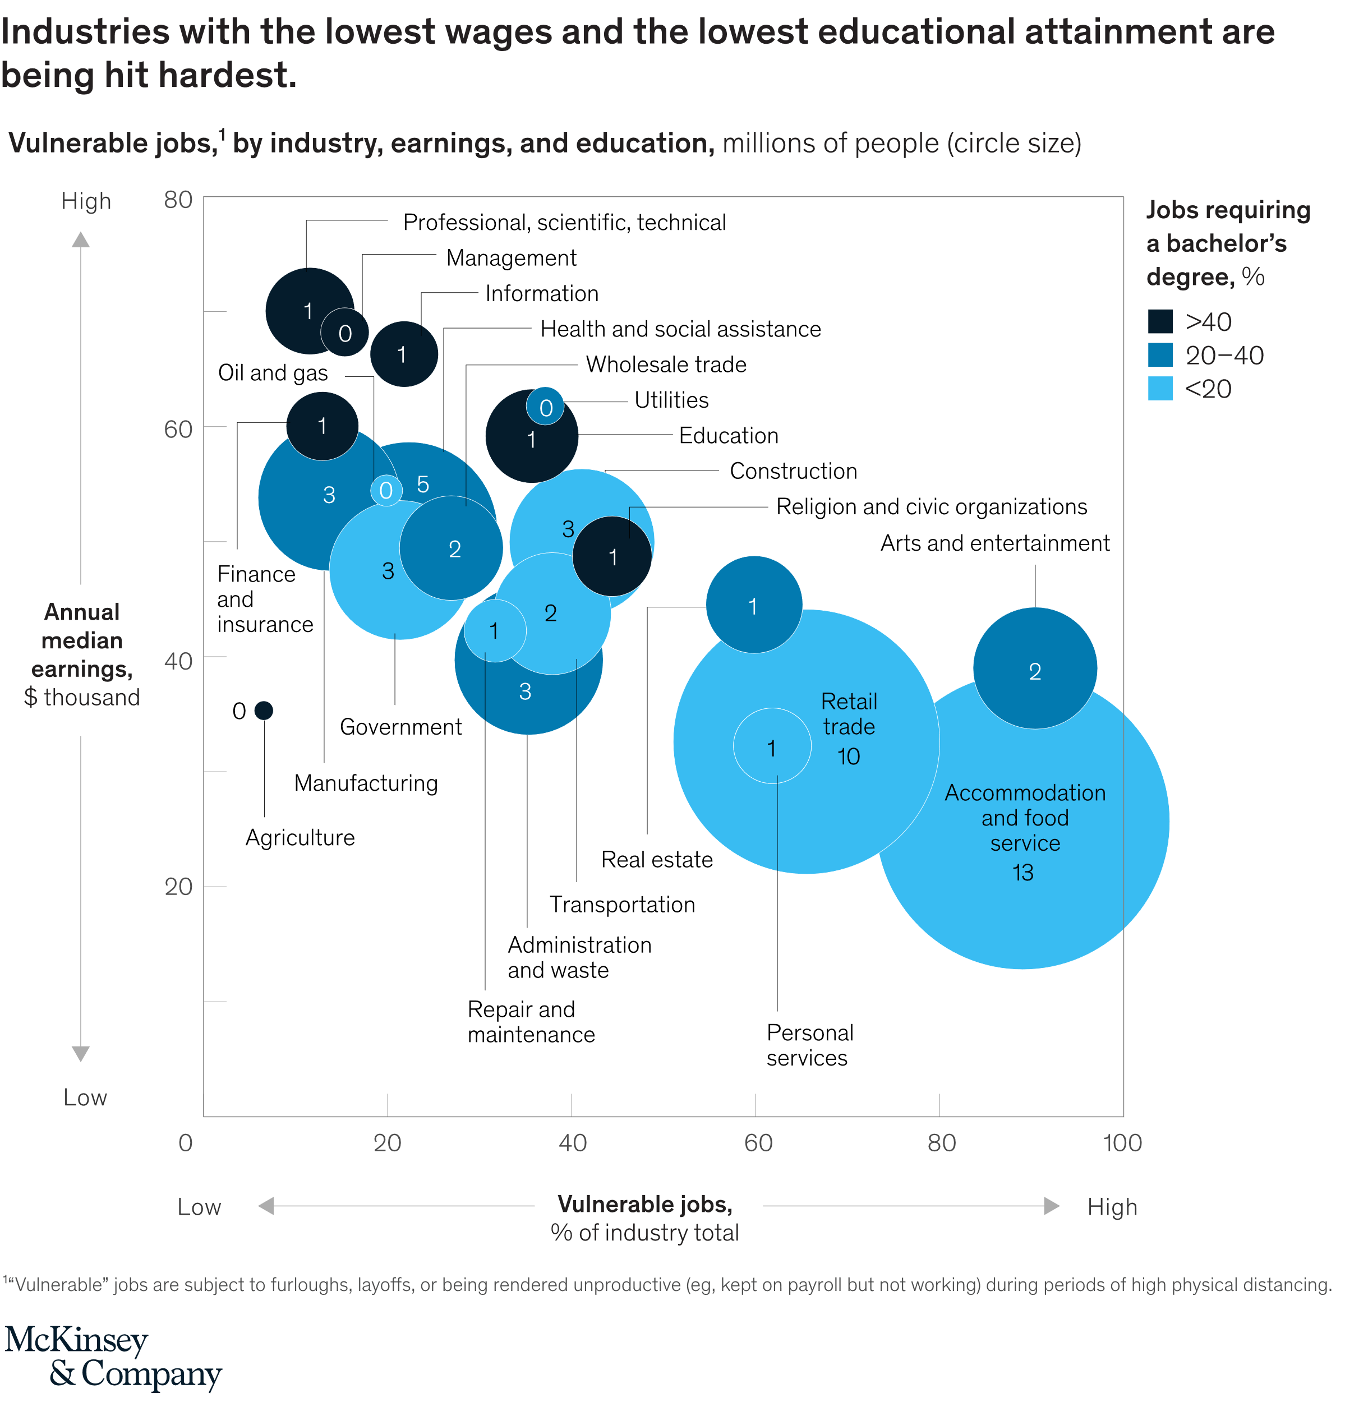
The food system workers most at risk of job loss are at the base of the U.S. employment ladder
Roughly 90% of food service jobs at risk, totaling 13 m. workers!
Source: Susan Lund, Kweilin Ellingrud, Bryan Hancock, James Manyika & André Dua. Lives and livelihoods: Assessing the near-term impact of COVID-19 on US workers. McKinsey Global Institute, April 2020.

Slide 11
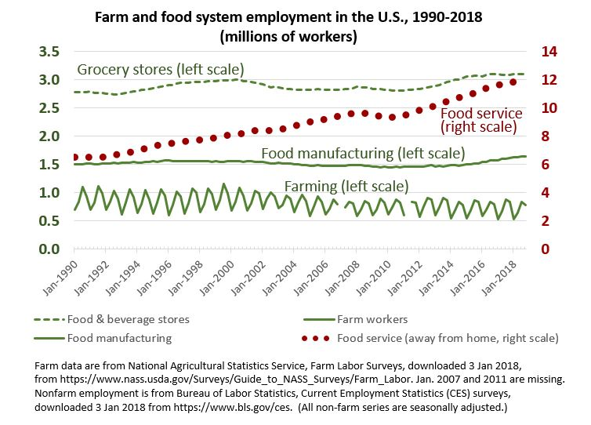
Over the past 30 years, food service has grown to be by far the largest employer in the food system
http://sites.tufts.edu/foodecon/2019/01/employment-in-the-food-system

Slide 12
To monitor diet costs, we will need retail price indexes that track differences by food group
Storable grains and oils have 1-2 year spikes when pipeline stocks near depletion
Other food group prices are sensitive measures of trends, seasonality and hotspots
Average prices by food group for 92 items at 120 markets in Ethiopia, monthly from 2001 to 2017
Prices in US$ at 2011 PPP
Source: CANDASA project results, from F. Bachewe et al. (2019)

Slide 13
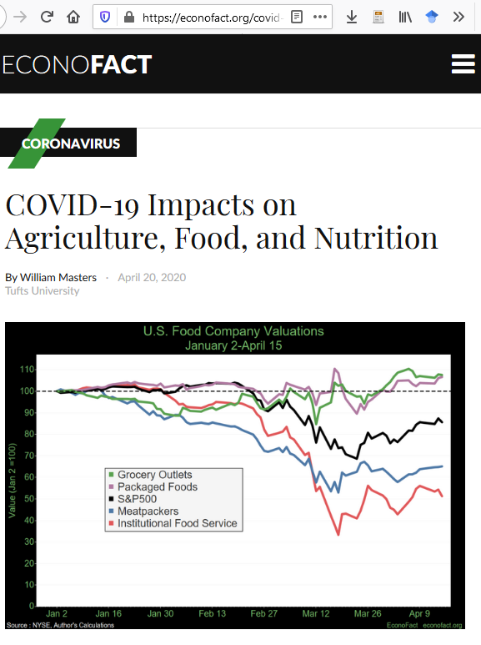
…and so much more!
Selected links to online resources
https://sites.tufts.edu/foodecon/2020/03/covid19links
EconoFact memo
https://econofact.org
1. Boston-area volunteering — Public health students supporting local public health agencies — Health science students supporting medical staff at BMC & HMS — Neighbor-to-neighbor mutual aid compiled by Boston Public Library
2. The basics — Our indispensable U.S. CDC & Massachusetts Dept of Public Health — Announcements and info for Tufts University & the Friedman School — Covid-related nutrition advice from dieticians in the US and UK
3. Data on impacts and responses – Epidemiological forecasts – for the U.S. and individual states, from IHME – for the U.S., UK and Europe, from Imperial College MRC – Global monitoring from Our World in Data – Daily situation reports from the WHO – Africa-specific info from Amref, AfricaCDC, and WHO-Africa
4. Agriculture, food and nutrition –UN Standing Committee on Nutrition list of resources –UN system agency responses from FAO, WFP & UNICEF –Research from the Center for Global Development & IFPRI –Global impacts on school meals: https://gcnf.org/covid
6. The great migration to online learning — AAUP on Coronavirus impacts & response in higher education

Slide 15
Covid-19 impacts on agriculture, food & nutrition
1. Economic impacts & response start with epidemiology
Everyone is Susceptible and easily gets Infected, variable severity & unknown immunity if Recovered
Like other pandemics, spread internationally through air travel then locally through close contact
Most farmers are already distanced, working from home… but the food system is extremely vulnerable
2. Wherever people gather or move, supply chains could break
All food supply chains rely on movement of goods and people, across and within countries
Seasonal harvests done in groups, with up to 1 m. migrant workers in the U.S.
Meatpacking & food manufacturing, about 1.5 m. food industry workers in the U.S.
Grocery stores & distributors, with over 3 m. retail workers in the U.S.
Institutions and restaurants, with over 12 m. food service workers in the U.S.
3. Massive job loss especially in food service, shift to food at home
Largest income decline in human history, shift to packaged foods and basic necessities
Loss of school meals and other support services, huge disparities at home and worsening of diet quality?
4. Need real-time monitoring of food prices by food group
Price spikes to reveal shortages, price declines to see loss of purchasing power

