Slide 1
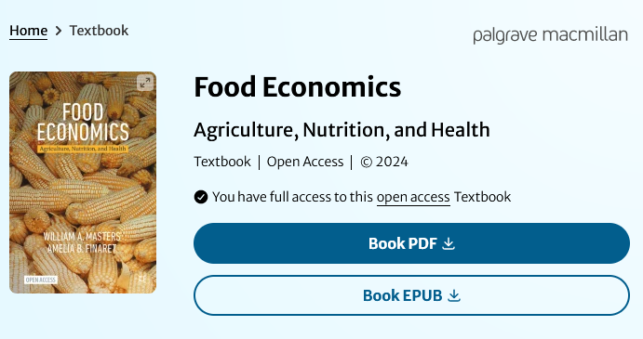
Teaching Food Economics: New approaches and materials to reach students from diverse backgrounds
Organized Symposium at ICAE 11:00-12:30, August 6th 2024 New Delhi, India
https://www.anh-academy.org
https://bit.ly/FoodEconBook

Slide 2
Goals for today
Meet each other
Use ICAE to build the community of instructors teaching food economics
Share new materials and exchange best practices for new and existing courses
Use our classes to reach more diverse students
Through new and existing courses, serving students with different backgrounds and skill levels
Bring in diverse instructors and teaching methods, with easier course prep linked to current events
Leverage changes in student backgrounds and interests
A declining fraction of students (and instructors) grew up on farms
A rising fraction of jobs are in food-related services, providing high-value attributes
Leverage changes in student beliefs about how the food system works
When the actual value of attributes is unobservable, price is a signal of value (more expensive=better)
Personal experience, media stories and marketing efforts lead to strongly held beliefs
… but student beliefs might be wrong, leading to teachable moments!
Teach food economics in new ways
Provide a gentle introduction for newcomers, using a standardized graphical approach (no math!)
Offer in-depth analyses of many topics, explained briefly with examples

Slide 3
Our new textbook could help
Food Economics: Agriculture, Nutrition and Health aims to serve advanced undergrads and grad students from diverse backgrounds, providing introductory but high-level content
Textbook is open access thanks to Gates funding for the UK-based Agriculture, Nutrition & Health Academy
First half of book is graphical principles of economics, taught through agrifood examples
Motivation -- why study economics about food?
Individual choices -- optimization to points of tangency
Market outcomes -- individuals move to points of intersection
Social welfare and externalities -- economic surplus areas
Market power and strategy -- monopoly and game theory
Collective action and policy -- public goods and social choice
Second half of book adds charts of data, exploring patterns and trends in the U.S. and globally
Poverty and risk -- social protection and insurance
Food and health -- diet quality and diet-related disease
Food and agriculture in the circular flow of macroeconomics
Food and agriculture in international development and growth
Food and agriculture in international trade and value chains
The future of food: Induced innovation for agriculture and health
Teaching materials available
Warm-up exercise finding errors in ChatGPT
Excel exercise on nutrient adequacy of real diets
Weekly exercises to draw analytical diagrams matched to current news stories
Midterm or course project (partial draft)
Weekly exercises to make data visualizations with downloaded data from official sources
Final or course project (report + slides)

Slide 4
Agenda for today
Presentation and panel discussion
Will Masters -- What’s in the new book? How might it be useful in different settings?
Anna Lartey -- Professor of Nutrition, University of Ghana; former Director of Nutrition, FAO
Bharat Ramaswami -- Prof. of Economics, Ashoka Univ.; formerly at Indian Statistical Institute, Delhi
Jonathan Nzuma -- Head, Department of Agricultural Economics, University of Nairobi, Kenya
Liesbeth Colen -- Professor of Nutrition and Agriculture, University of Göttingen, Germany
Participatory workshop on current and potential courses in the economics of food
What courses do we now teach?
Program context, prerequisites and academic background/skill level of the students
Course objectives and student needs, for subsequent courses and career paths
How do we teach these courses?
Course content: classroom lectures & discussion, textbooks or other readings, online resources and software tools
Student activities: class discussion, exercises, quizzes, tests and project assignments
Where and how could we reach more or different students, more effectively?
Opportunities for new courses
Opportunities for new instructors
Ways forward, linking agricultural economics to other disciplines in the food system
Partnerships with ANH Academy, African Nutrition Society, etc.?
Back to the panel!

Slide 5
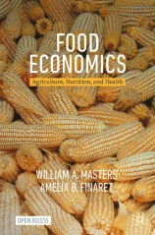
What’s in the book?
Principles of Economics (Chapters 1-6)
Data about the food system (Chapters 7-12)
1. Introduction Motivating food economics
2. Individual Choices Consumption and production theory
3. Societal Outcomes Supply, demand, trade, elasticity
4. Social Welfare Economic surplus, externalities
5. Market Power Imperfect competition, game theory
6. Collective Action Public goods, non-market goals
7. Poverty and Risk Inequality, safety nets, vulnerability
8. Food and Health Behavioral economics, interventions
9. Food in the Macroeconomy Recessions, unemployment, inflation
10. International Development Ag. transformation, diet transition, urbanization
11. From Local to Global International trade, globalization, value chains
12. The Future of Food Agribusiness and agroecology, food environments

Slide 6
The book could be used to teach introductory economics
Principles of Economics (Chapters 1-6)
Data about the food system (Chapters 7-12)
1. Introduction Motivating food economics
2. Individual Choices Consumption and production theory
3. Societal Outcomes Supply, demand, trade, elasticity
4. Social Welfare Consumer and producer surplus, externalities
5. Market Power Imperfect competition, game theory
6. Collective Action Public goods, non-market goals
7. Poverty and Risk Measuring poverty, inequity, disparities, safety nets, vulnerability
8. Food and Health Behavioral economics, interventions
9. Food in the Macroeconomy Circular flow, recessions, unemployment, inflation
10. International Development Ag. transformation, diet transition, urbanization
11. From Local to Global International trade, globalization, value chains
12. The Future of Food Agribusiness and agroecology, food environments

Slide 7
The book could support a course on food systems
Principles of Economics (Chapters 1-6)
Data about the food system (Chapters 7-12)
1. Introduction Motivating food economics
2. Individual Choices Consumption and production theory
3. Societal Outcomes Supply, demand, trade, elasticity
4. Social Welfare Consumer and producer surplus, externalities
5. Market Power Imperfect competition, game theory
6. Collective Action Public goods, non-market goals
7. Poverty and Risk Measuring poverty, inequity, disparities, safety nets, vulnerability
8. Food and Health Behavioral economics, interventions
9. Food in the Macroeconomy Circular flow, recessions, unemployment, inflation
10. International Development Ag. transformation, diet transition, urbanization
11. From Local to Global International trade, globalization, value chains
12. The Future of Food Agribusiness and agroecology, food environments

Slide 8
The book could support a course on food and health
Principles of Economics (Chapters 1-6)
Data about the food system (Chapters 7-12)
1. Introduction Motivating food economics
2. Individual Choices Consumption and production theory
3. Societal Outcomes Supply, demand, trade, elasticity
4. Social Welfare Consumer and producer surplus, externalities
5. Market Power Imperfect competition, game theory
6. Collective Action Public goods, non-market goals
7. Poverty and Risk Measuring poverty, inequity, disparities, safety nets, vulnerability
8. Food and Health Behavioral economics, interventions
9. Food in the Macroeconomy Circular flow, recessions, unemployment, inflation
10. International Development Ag. transformation, diet transition, urbanization
11. From Local to Global International trade, globalization, value chains
12. The Future of Food Agribusiness and agroecology, food environments

Slide 9
The book could support a course on agribusiness
Principles of Economics (Chapters 1-6)
Data about the food system (Chapters 7-12)
1. Introduction Motivating food economics
2. Individual Choices Consumption and production theory
3. Societal Outcomes Supply, demand, trade, elasticity
4. Social Welfare Consumer and producer surplus, externalities
5. Market Power Imperfect competition, game theory
6. Collective Action Public goods, non-market goals
7. Poverty and Risk Measuring poverty, inequity, disparities, safety nets, vulnerability
8. Food and Health Behavioral economics, interventions
9. Food in the Macroeconomy Circular flow, recessions, unemployment, inflation
10. International Development Ag. transformation, diet transition, urbanization
11. From Local to Global International trade, globalization, value chains
12. The Future of Food Agribusiness and agroecology, food environments

Slide 10
Figure 5.1 Scale economies in agrifood systems
The book is about how the modern food system actually works
We need to teach about both harms and benefits of innovation and investment in new technologies
that often drives consolidation in ag & food businesses
A small number of large agribusinesses supplying farm inputs & credit
Scale economies and investment, induced innovation, intellectual property
Most of us wish we could have more food go directly from farmers to consumers
Many farms, almost all of which are self-employed households
Demography and land use, geographic specialization and risk
A small number of product trade, processing and marketing firms
Scale economies and specialization, market power, value added
Many consumer households
Income, prices, and preferences as drivers of food choice, dietary diversification, consumption smoothing & wellbeing
There is so much new data about value chains, farm production, and consumer behavior!

Slide 11
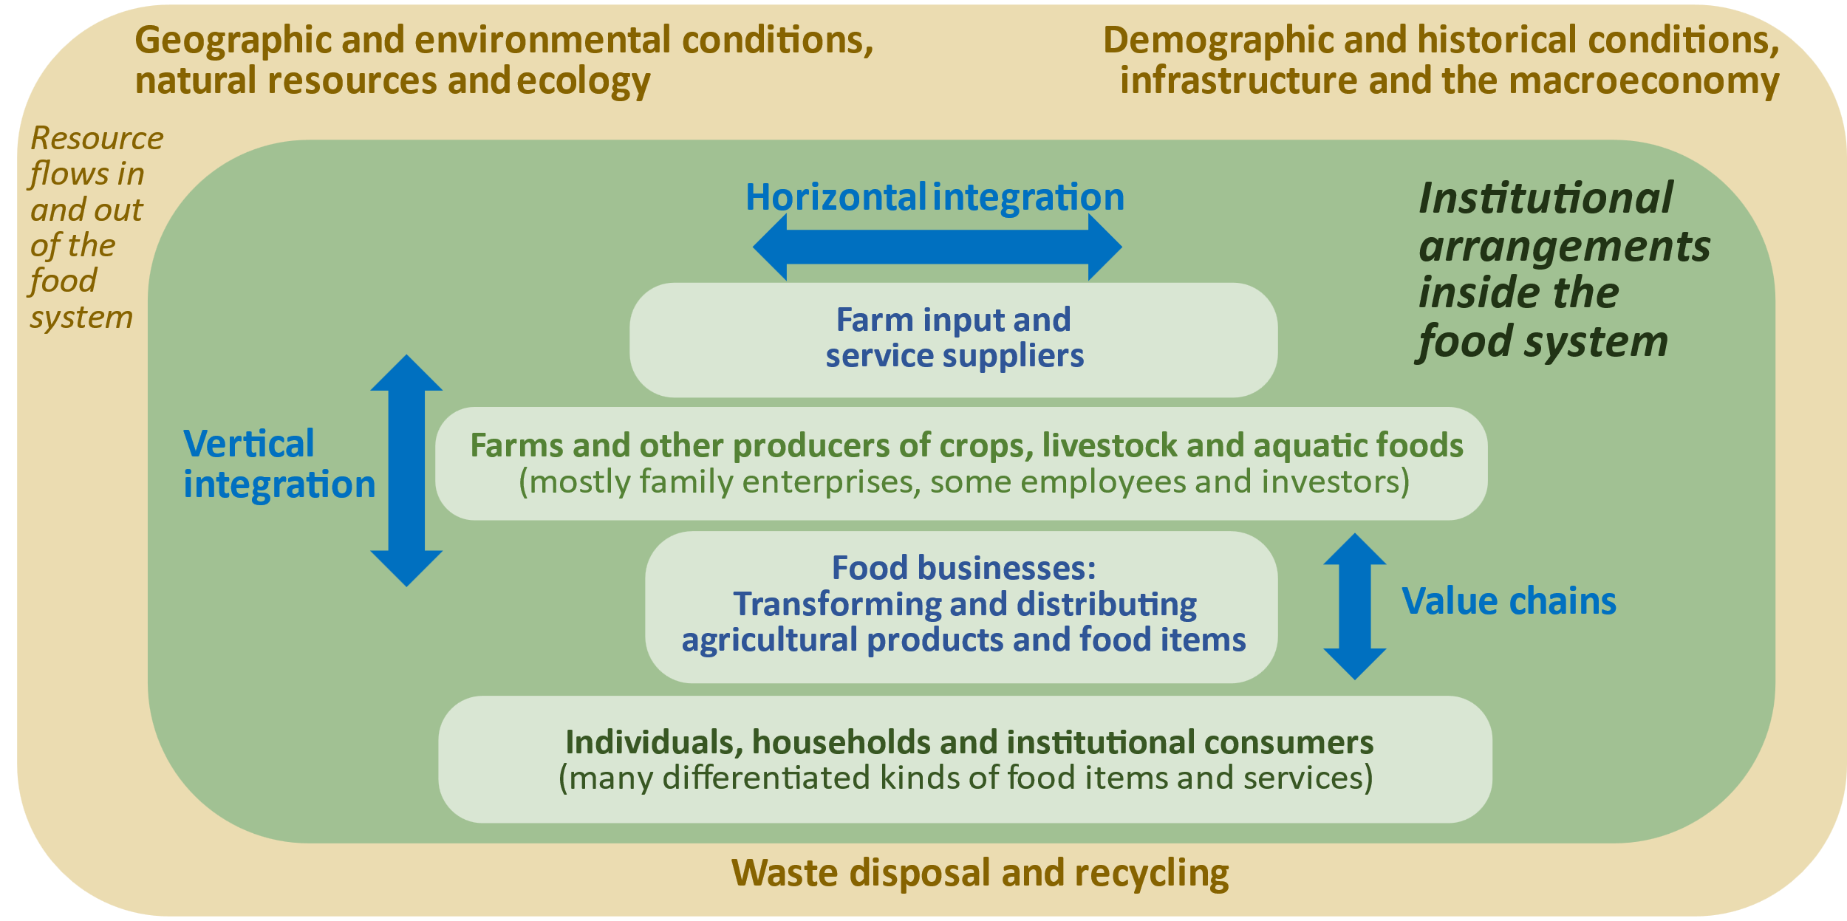
Our story is about market linkages over space and time
Figure 11.8 Institutional arrangements and value chains in the food system
Notes:
Source: Authors’ infographic, adapted from the nested framework of a social-ecological model showing each entity within its larger context.

Slide 12
Chapter 2: Individual choices – optimization to a point of tangency
From the start, we teach that farmers’ choices link production to own consumption through net sales
Production
Possibilities
allow for scale effects
Indifference curves may not reflect true impacts on health
Price lines for revenue and expenditure reflect markets and policies
The thing of interest is always on the X axis, and “all other things” (in local currency units) are on the Y axis, so slopes are the price of X
Figure 2.20 Production and consumption for the farming household

Slide 13
Chapter 3: Market outcomes – moving to points of intersection
We teach that populations at each place can be autarkic (e.g. for hot meals), or exporting the things in which they specialize, and importing many other foods
Figure 3.7 Interactions between supply, demand, and trade

Slide 14
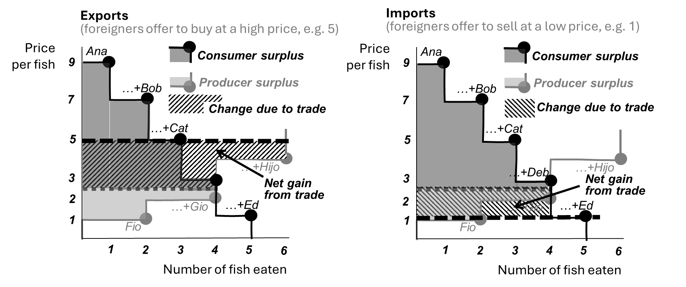
Figure 4.4 Gains and losses from trade at Alphabet Beach, with exports and imports
Chapter 4: Social welfare – how groups of people can get richer
Ch. 4.1 introduces economic surplus, in a toy model called Alphabet Beach Village where five consumers could buy fish from two producers, showing effects of trade
Notes:
Figure 4.1.4. Gains and losses from trade at Alphabet Beach, with exports and imports

Slide 15
Chapter 4: Social welfare (continued)
Ch. 4.2 introduces externalities, as all kinds of nonmarket side-effects, with three kinds of potential remedy: Pigovian taxes, Coasian rights, or direct regulation
Figure 4.12 Externalities can cause inequity as well as inefficiency

Slide 16
Chapter 5: Market power and strategic behavior
Part 1 covers economies of scale, monopoly/monopsony, anti-trust policy
Part 2 covers strategic behavior and incentives in a 2x2 prisoner’s dilemma
Payoffs from a price-fixing conspiracy |  | Company Y (e.g. Ajinomoto)
 |  | Compete | Cut supply
Company X (e.g. ADM) | Compete | 50/50 | 200/0
 | Cut supply | 0/200 | 150/150
Figure 5.6 Market power alters income distribution and reduces total economic surplus
Table 5.3 A hypothetical payoff matrix
for two participants in a
price-fixing conspiracy

Slide 17
Chapter 6: Collective action and nonmarket valuation
This chapter introduces public economics as role of government and nonprofits, measurement of their cost-effectiveness and elicitation of societal preferences
Figure 6.1 Definition of four types of goods and services, from private to public

Slide 18
Chapter 7: Poverty and risk
Part 1 is on poverty lines, inequality among individuals, inequity between groups
GINI coefficients by region and national income level
Figure 7.9 Income inequality at each level of national income per person, 1967-2018

Slide 19
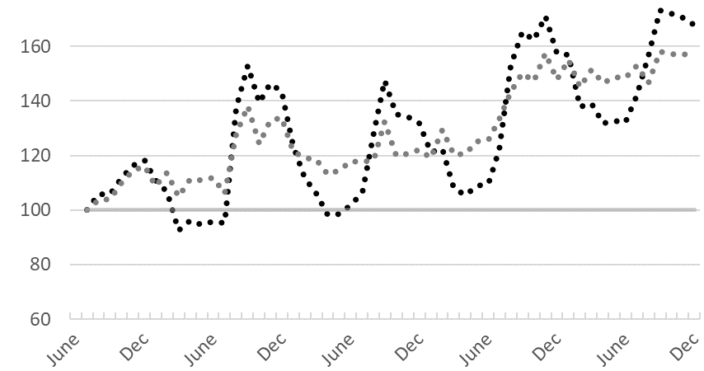
Chapter 7: Poverty and risk (continued)
Part 2 is on wellbeing over time, falling into and rising out of poverty
Poverty traps pull those who rise back below the poverty line
Resilience is protection against a decline into poverty
Growth is rise out of poverty, with more or less stability
Figure 7.11 Hypothetical trajectories in and out of poverty over time

Slide 20
Chapter 7: Poverty and risk (nutritional aspects)
Part 2 includes new data on how poverty and risk relate to food choice and nutrition
Economic and psychosocial factors: Perception, cognition, and intentional efforts
Biological and physiological processes: Hormones, neurotransmitters and autonomous regulation
Energy balance
Figure 7.15 Interaction of conscious and unconscious mechanisms for energy balance

Slide 21
Chapter 8: Behavioral economics and response to intervention
Part 1 is on mistaken beliefs and systematic biases in food choice
We emphasize informational as well as behavioral causes of preference reversals and regretted choices
Figure 8.3 Differences between long-term goals and actual behavior

Slide 22
Chapter 8: Behavioral economics and response to intervention
Part 2 is on differences among interventions in their mechanism of action
We describe how policies and programs use each kind of mechanism
to alter food choice: income, prices, and preferences
Fig. 8.6 Interventions can alter food choice towards more healthful items

Slide 23
Chapter 8: Behavioral economics and response to intervention
Part 2 is on differences among interventions in their mechanism of action
We emphasize how in-kind transfers can be like cash assistance, as long as the recipient spends some of their own money on what is transferred
Fig. 8.7 The effect of a transfer depends on peoples’ preferences

Slide 24
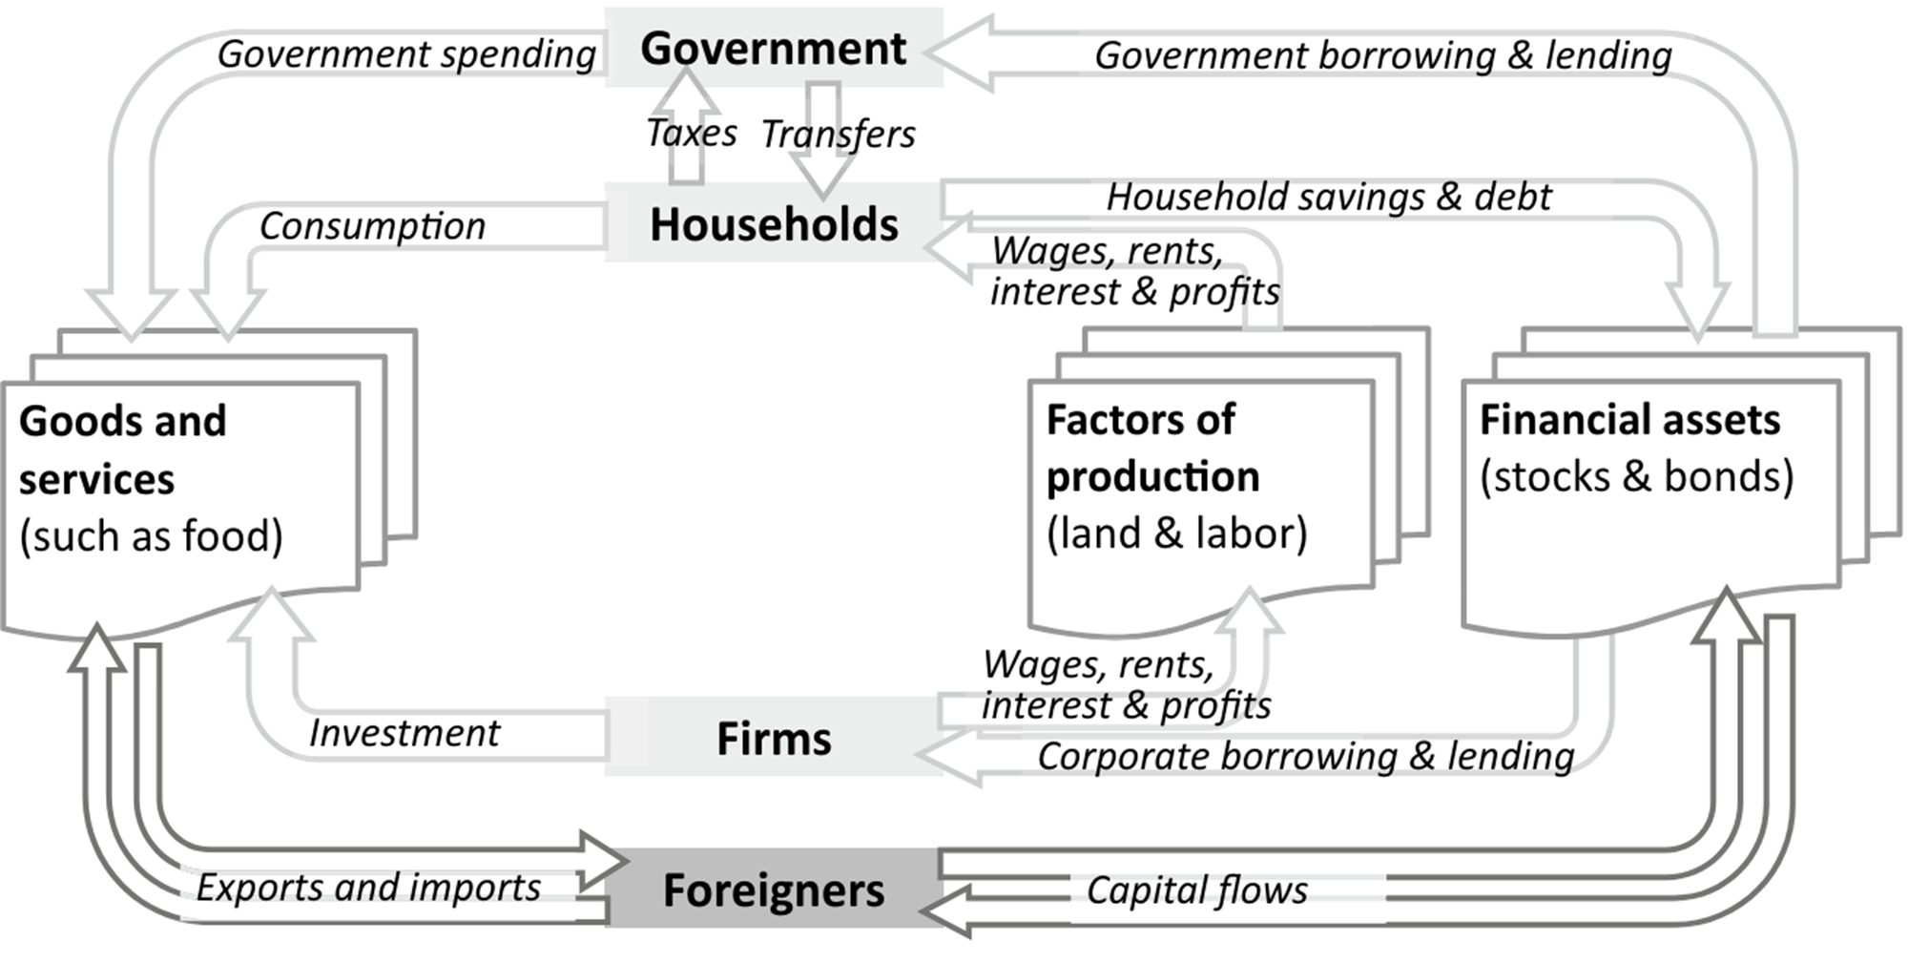
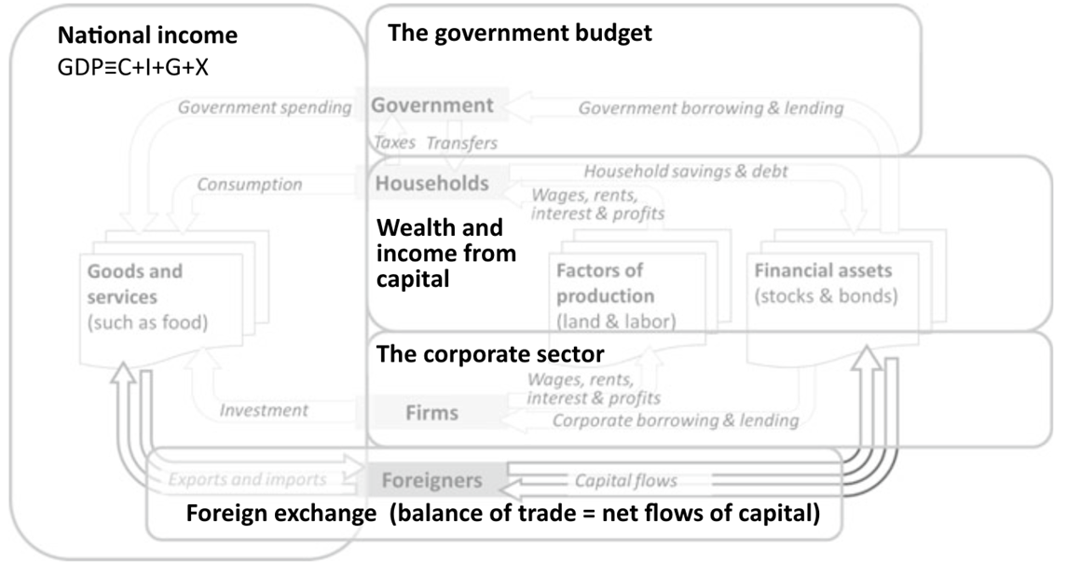
Chapter 9: Food in the macroeconomy
Part 1 is accounting definitions, emphasizing circular flows from stocks of assets
Figure 9.1 The macroeconomy is a circular flow of income and expenditure
Figure 9.2 The macroeconomy can be described and measured in multiple ways

Slide 25
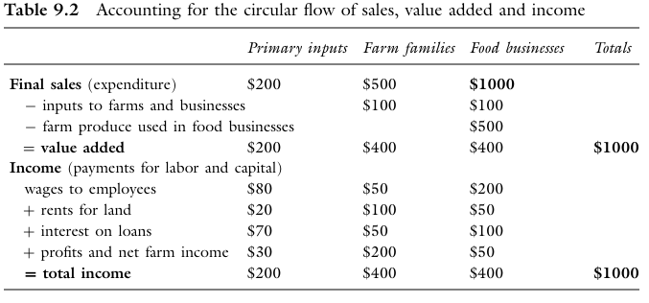
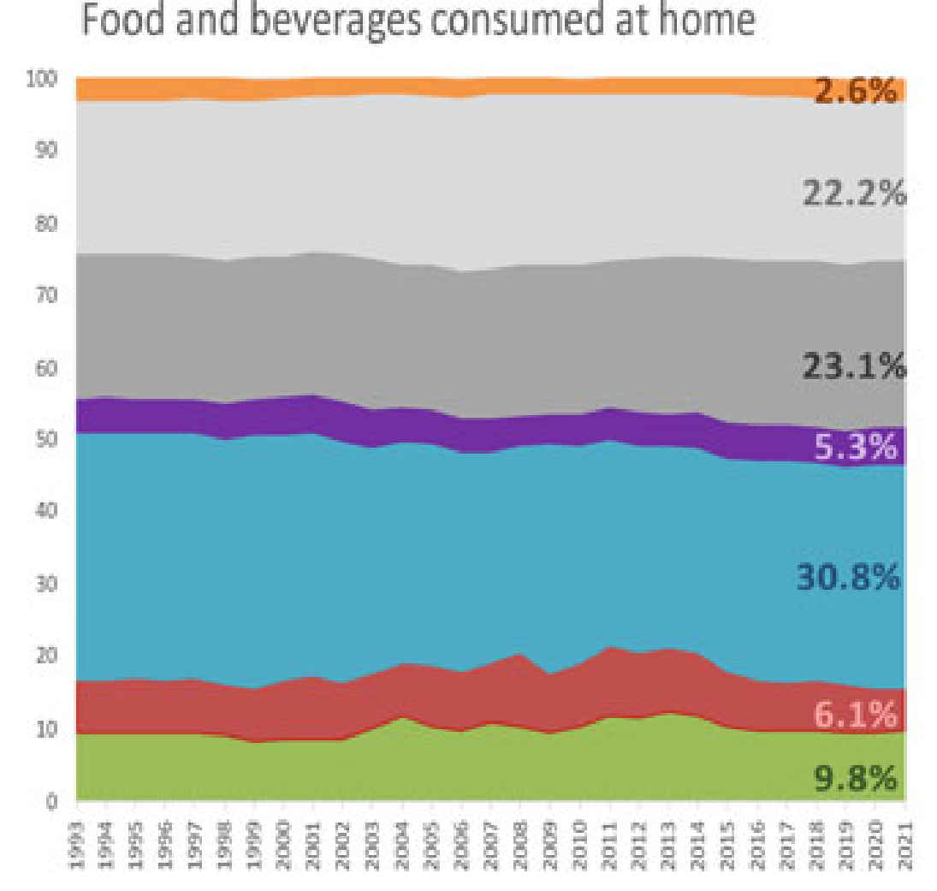
Chapter 9: Food in the macroeconomy
The circular flow of value added is shown using toy examples and also real data
Fig. 9.4 Value added in the U.S. food system, 1993–2021
An example with round numbers
Actual USDA “food dollar” data

Slide 26
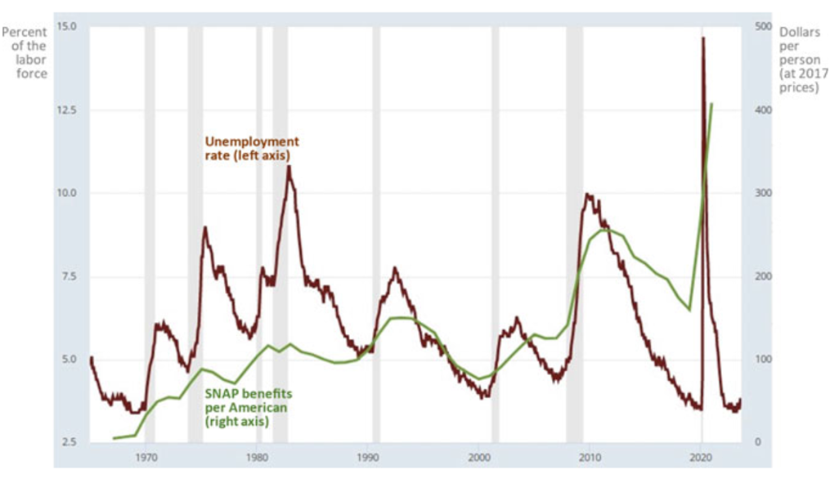
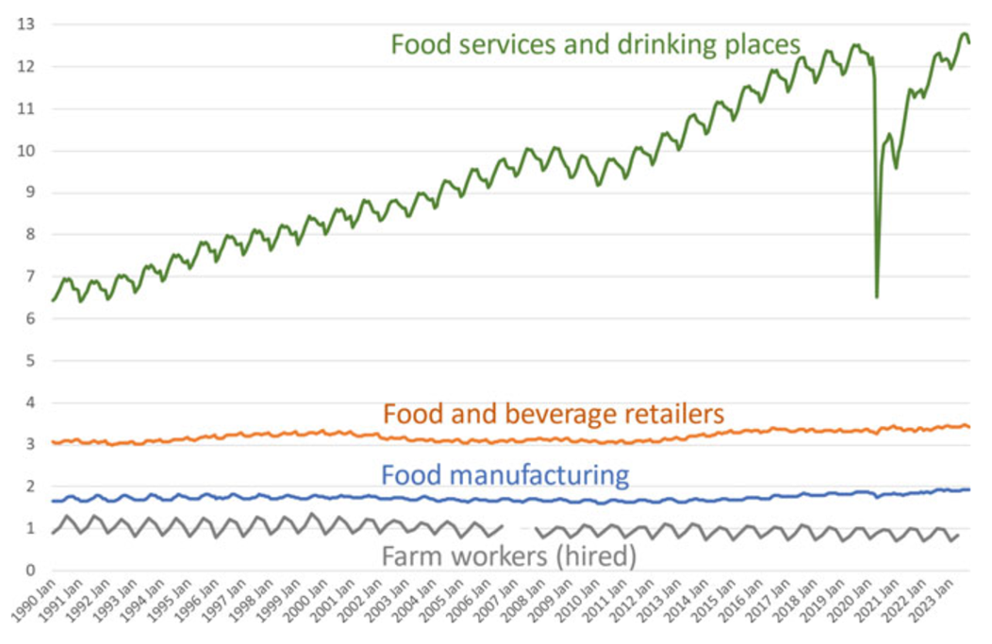
Chapter 9: Food in the macroeconomy
Part 2 shows how the food system changes with fluctuations and growth
Fig. 9.9 Unemployment and SNAP benefits in the U.S., 1967–2021
Fig. 9.11 Farm and food system employment in the U.S., Jan. 1990–Sept. 2023

Slide 27
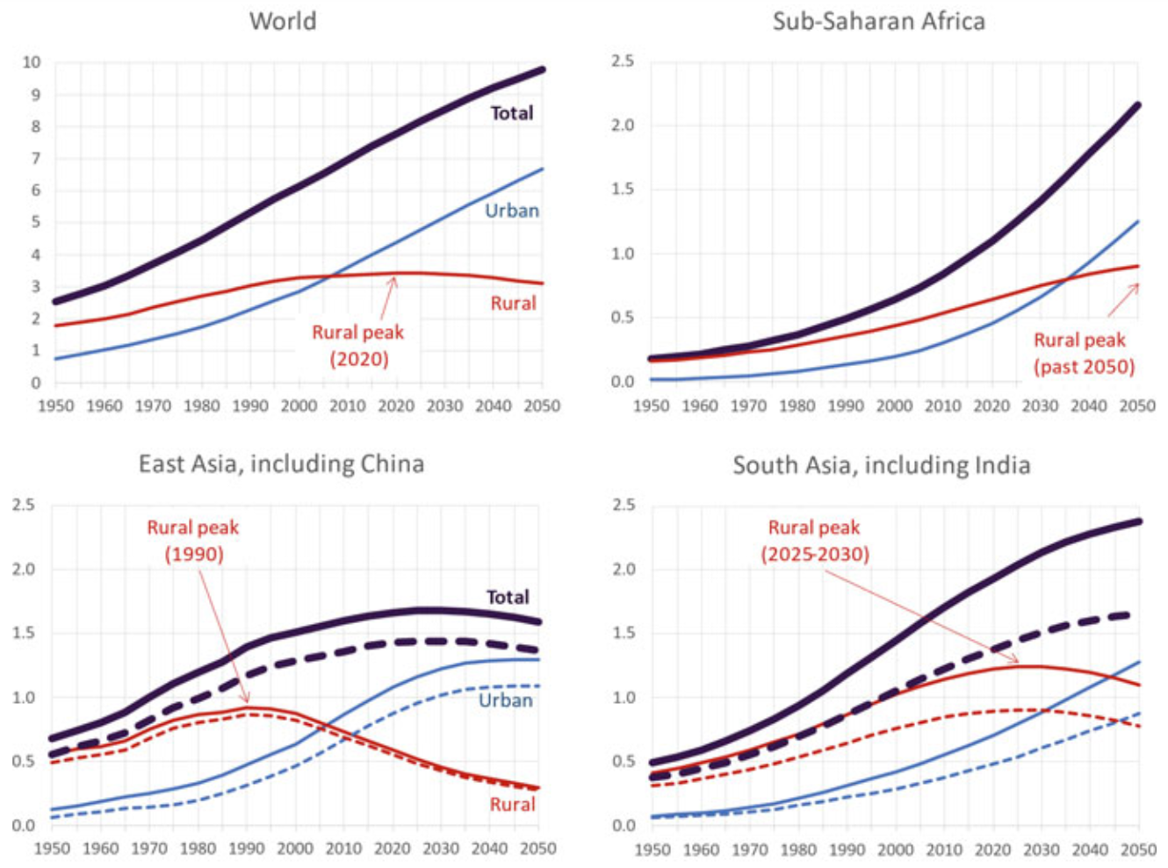
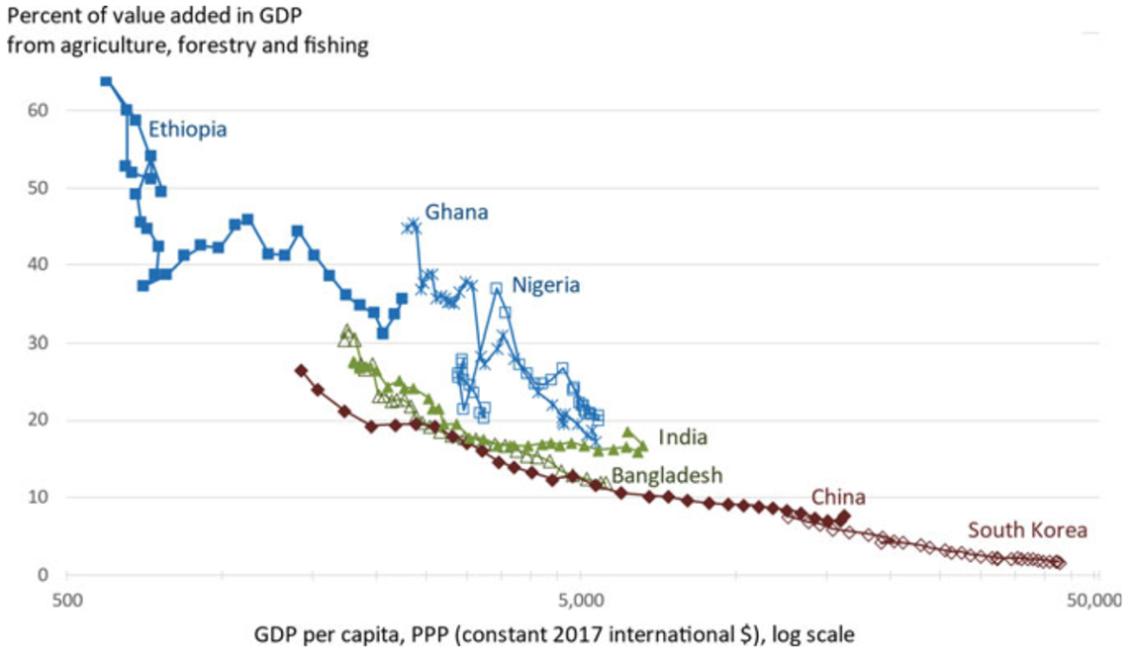
Chapter 10: International development
We emphasize differences in the speed and smoothness of exit from agriculture
…and how demographic transition plus urbanization drives rural population size
Fig. 10.11 Selected trajectories of growth and structural transformation, 1990–2020
Fig. 10.13 Rural and urban population in selected regions and countries, 1950–2050

Slide 28
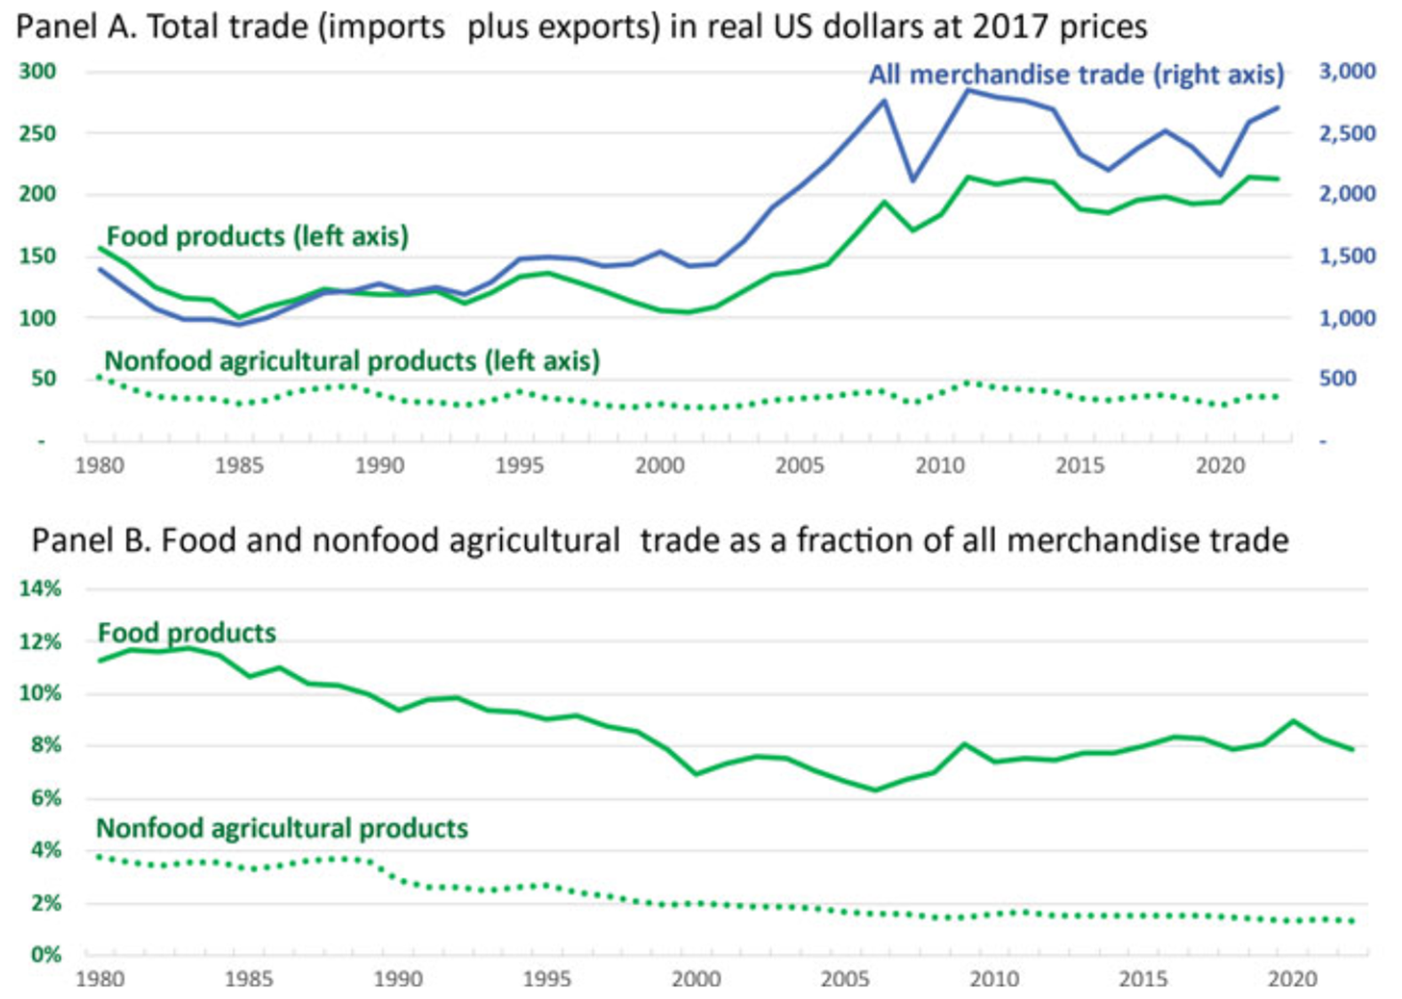
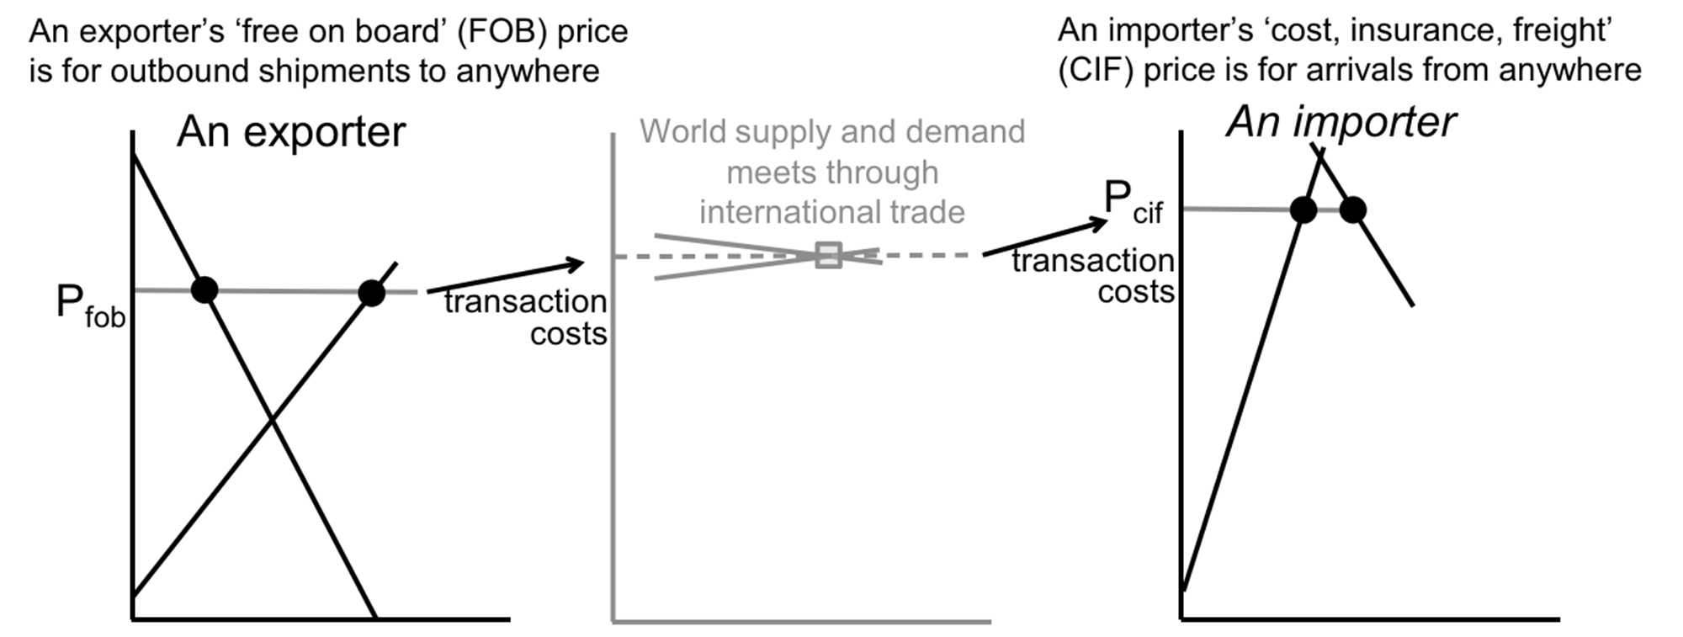
Chapter 11: International trade and value chains
We emphasize the role of transaction costs between and within countries
…and describe changes in globalization
Fig. 11.2 Transactions costs make exporters’ price received lower than importers’ price paid
Fig. 11.4 Food and nonfood agricultural trade during the 1980s–2000s wave of globalization

Slide 29
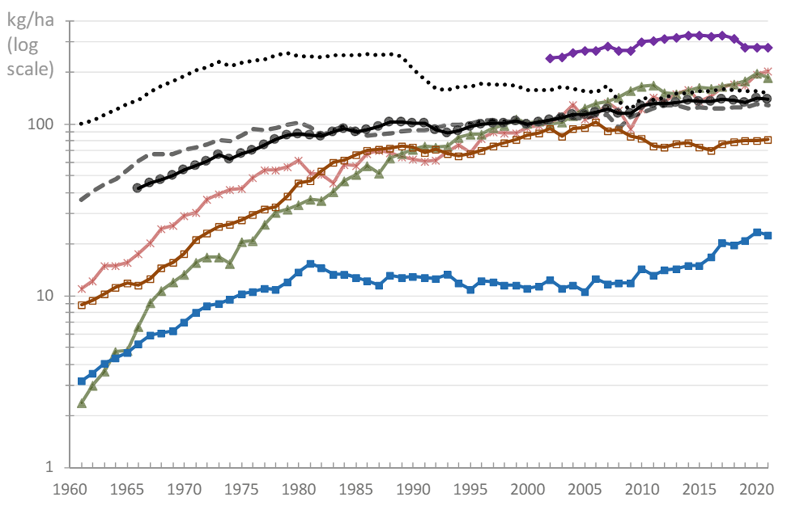
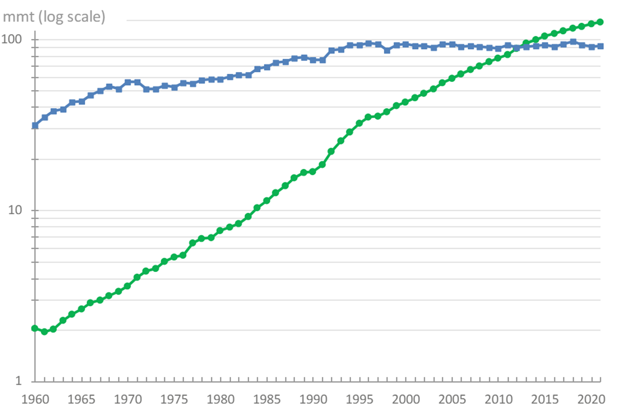
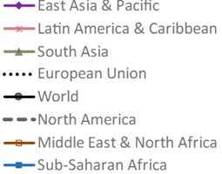
Chapter 12: The future of food
We emphasize induced innovation and choices for the speed and direction of productivity and decarbonization
…and describe how agribusiness and agroecology can work together for sustainability and health
Figure 12.1 Crop intensification as measured by fertilizer use, 1961–2021
Figure 12.4 The global transition from capture fisheries to aquaculture, 1960–2021

Slide 30
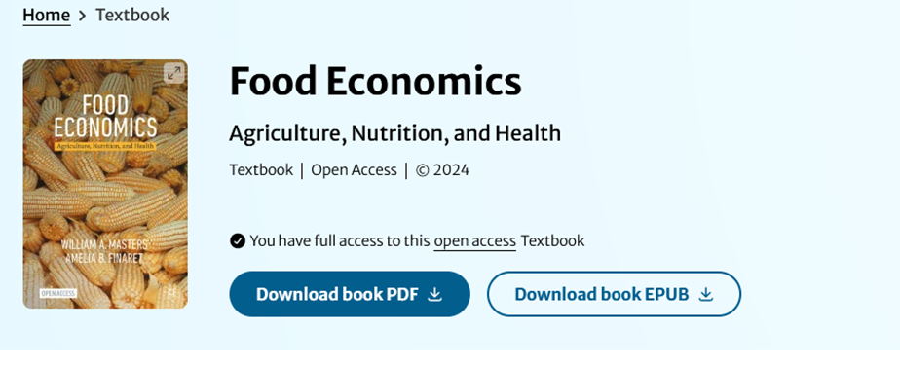
Conclusions about the book
Can use the book via any device, or in print
Features of the online version
• Syllabus can link to specific pages online
• Students can share comments on the text itself
• All figures are available as powerpoint slides
• Analytical diagrams can be edited
• Data visualizations can be updated
Other teaching materials coming soon
Class materials developed for and with Tufts students
https://sites.tufts.edu/foodecon
• Warm-up exercise finding errors in ChatGPT
• Excel exercise on nutrient adequacy of real diets
• Weekly exercises to draw analytical diagrams matched to current news stories
Welcome to our resource page for the new open-access textbook on Food Economics: Agriculture, Nutrition and Health, published in May 2024 from Palgrave MacMillan.
This site will soon have password-protected links to course materials (slides, exercise prompts, past exams and answer keys). For now we invite you to subscribe to our elist so that you can receive and share teaching material and updates related to the book.
• Midterm or course project (partial draft)
• Weekly exercises to make data visualizations with downloaded data from official sources
• Final or course project (report + slides)

Slide 31
Panel discussion
Anna Lartey
Professor of Nutrition, University of Ghana; former Director of Nutrition, FAO
Bharat Ramaswami
Prof. of Economics, Ashoka Univ.; formerly at Indian Statistical Institute, Delhi
Jonathan Nzuma
Head, Department of Agricultural Economics, University of Nairobi, Kenya
Liesbeth Colen
Professor of Nutrition and Agriculture, University of Göttingen, Germany

Slide 32
Workshop and ways forward
Group discussion of current and potential new courses relating to food economics
What courses do we now teach?
Program context, prerequisites and academic background/skill level of the students
Course objectives and student needs, for subsequent courses and career paths
How do we teach these courses?
Course content: classroom lectures & discussion, textbooks or other readings, online resources and software tools
Student activities: class discussion, exercises, quizzes, tests and project assignments
Where and how could we reach more or different students, more effectively?
Opportunities for new courses
Opportunities for new instructors
Ways forward, linking agricultural economics to other disciplines in the food system
Partnerships with ANH Academy, African Nutrition Society, etc.?
Back to the panel!

