Slide 1
`
The Food Environment: Menus of Change
Greg Drescher
Vice President, Strategic Initiatives and Industry Leadership

Slide 2
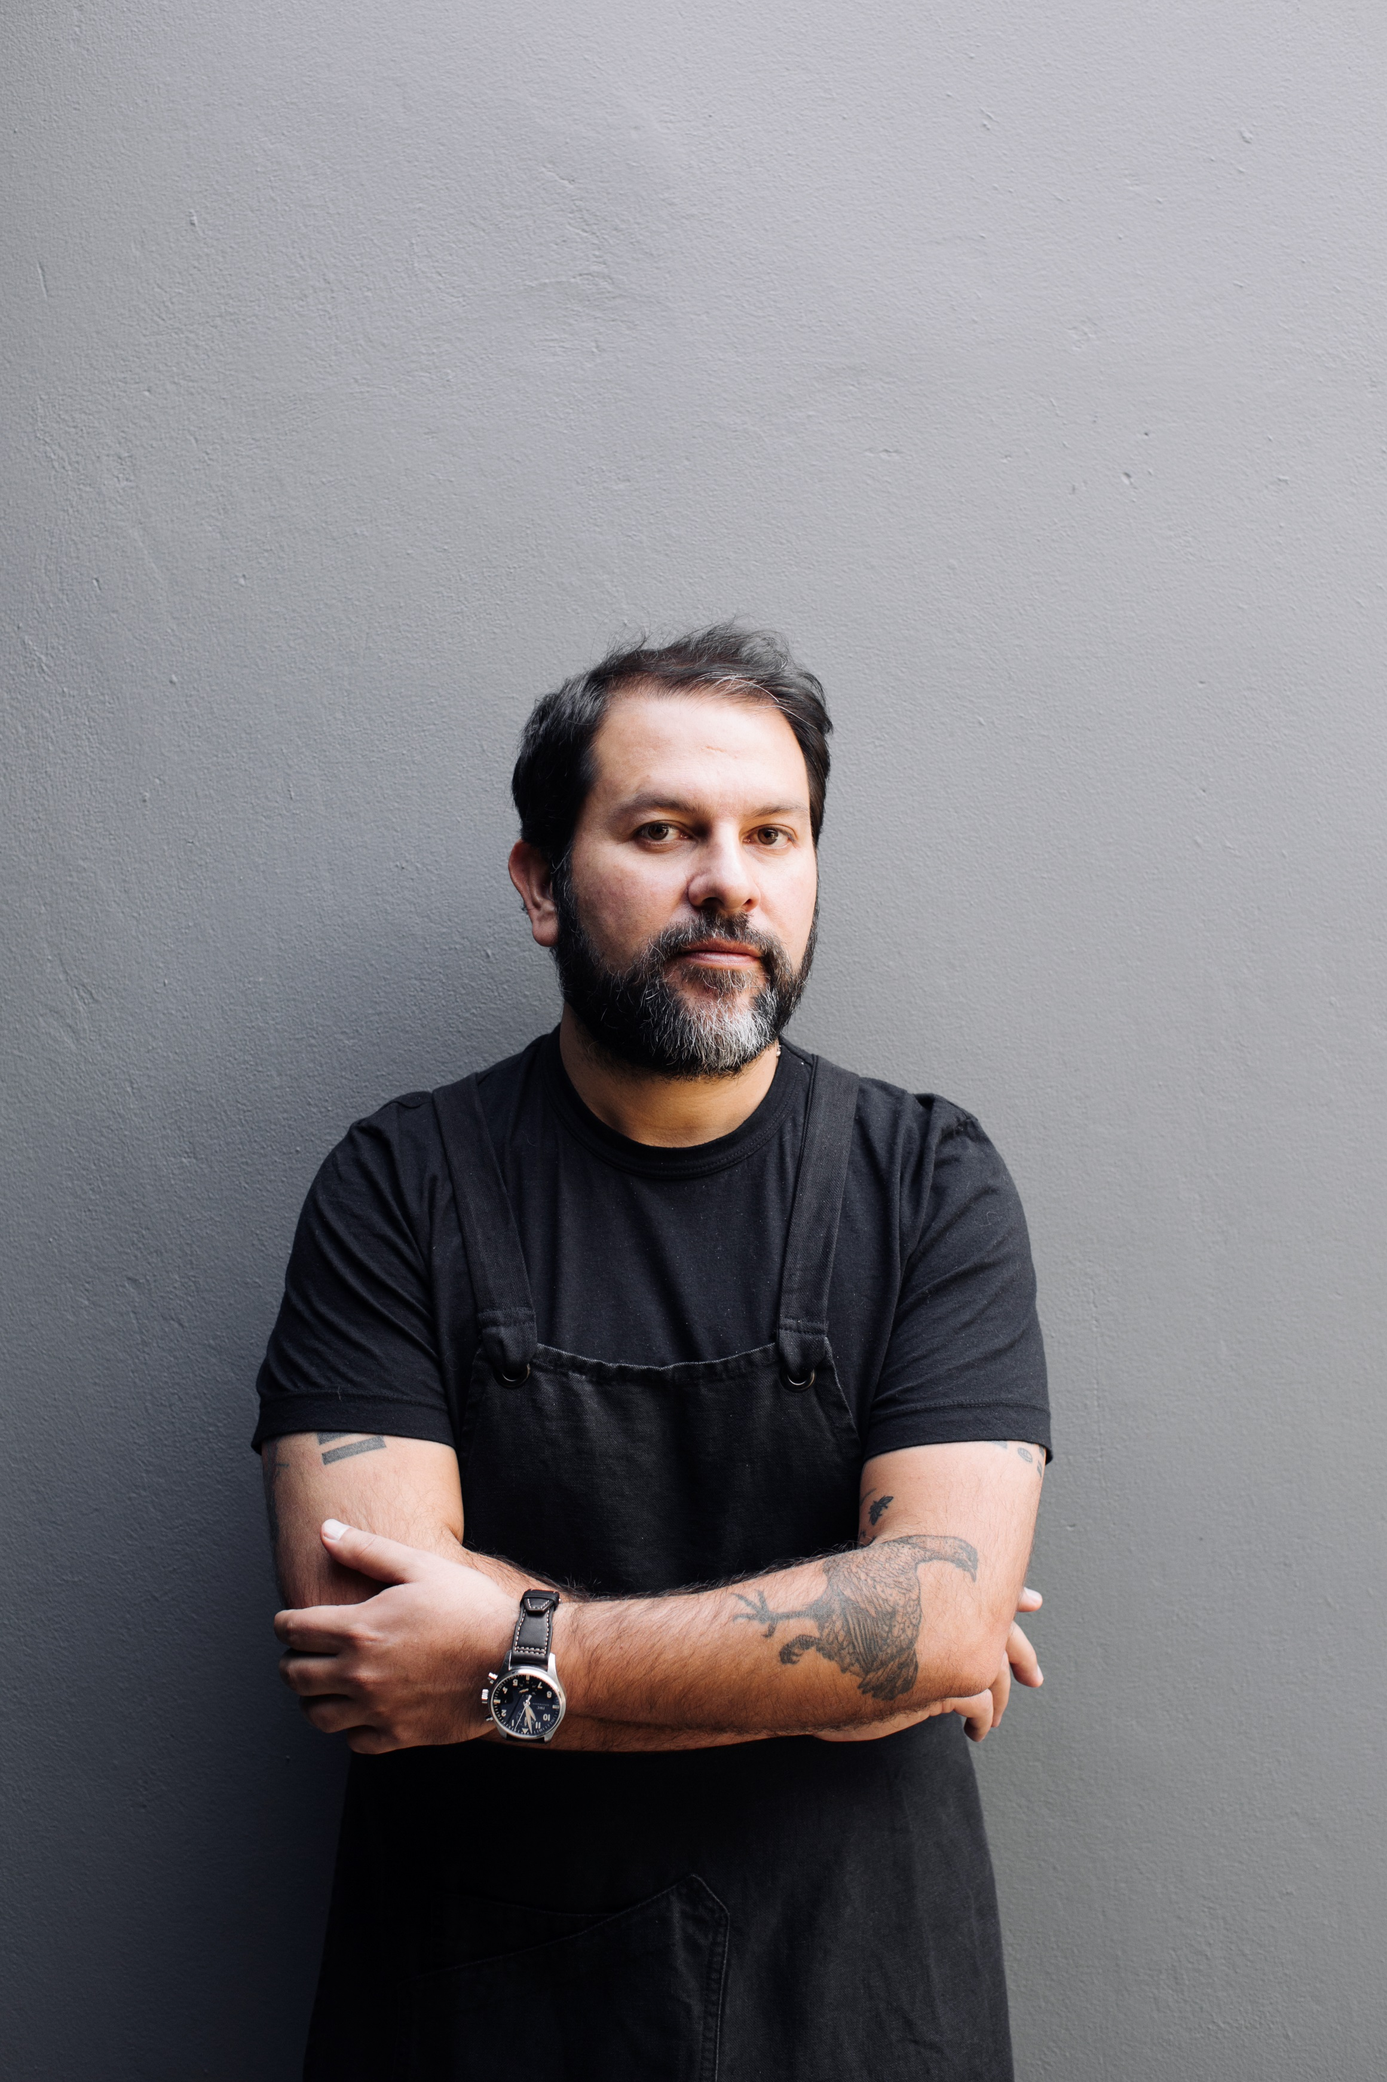
CHEFS
can inspire us
to pursue
healthier,
sustainable
food choices.
Enrique Olvera ’99
Pujol, Cosme, Atla

Slide 4
We can no longer frame a nutrition and public health agenda without considering planetary health imperatives.

Slide 5
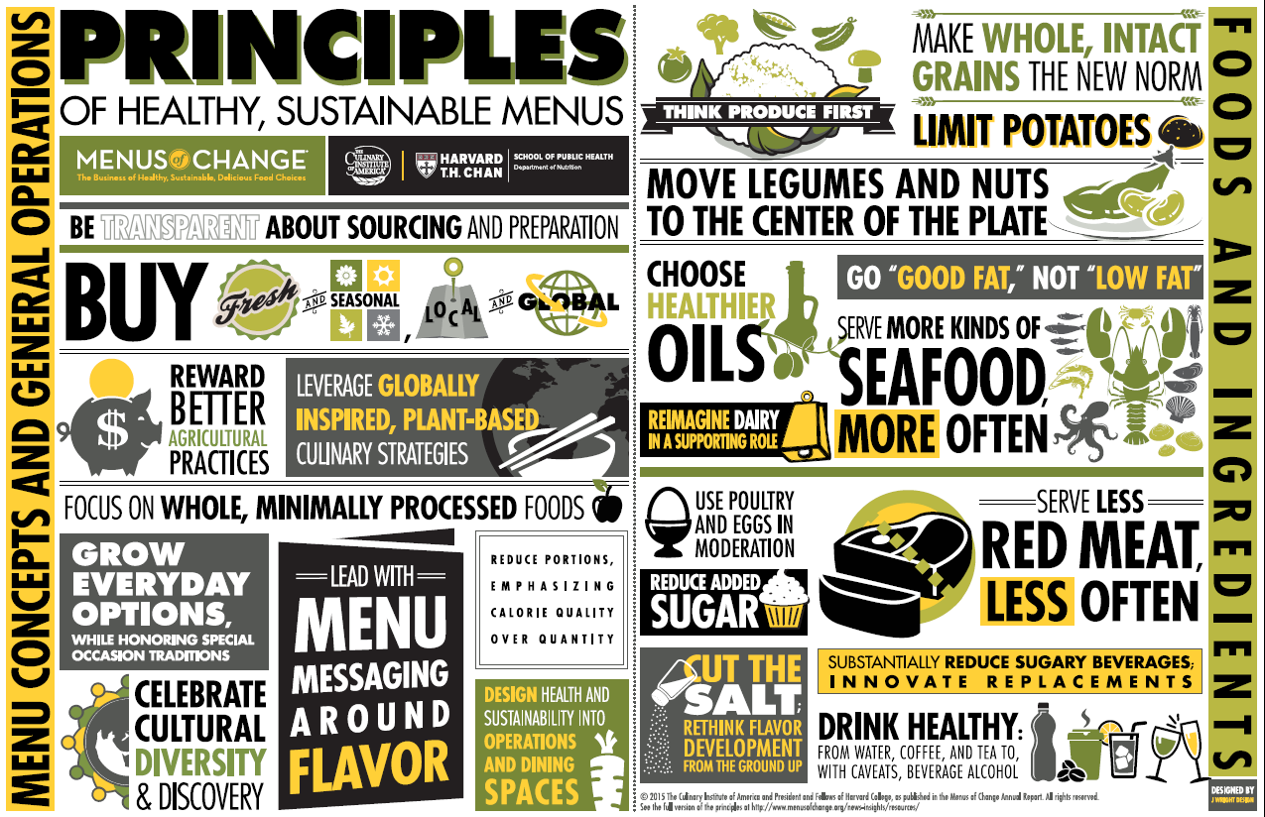

Slide 6
Culinary Strategy
It’s not just about menus and recipes

Slide 7
What is optimal?
< PLANT-FORWARD >
A style of cooking and eating that emphasizes and celebrates, but is not limited to, plant-based foods—including fruits and vegetables (produce); whole grains; beans, other legumes (pulses), and soy foods; nuts and seeds; plant oils; and herbs and spices—and that reflects evidence-based principles of health and sustainability.

Slide 8
Plant-Forward*
Healthy flexitarian, vegetarian, and vegan diets
can all fit under this broad umbrella.
*Intended largely as a B2B term, not a menu descriptor

Slide 9
What can we learn from traditional,
plant-forward food cultures?

Slide 11
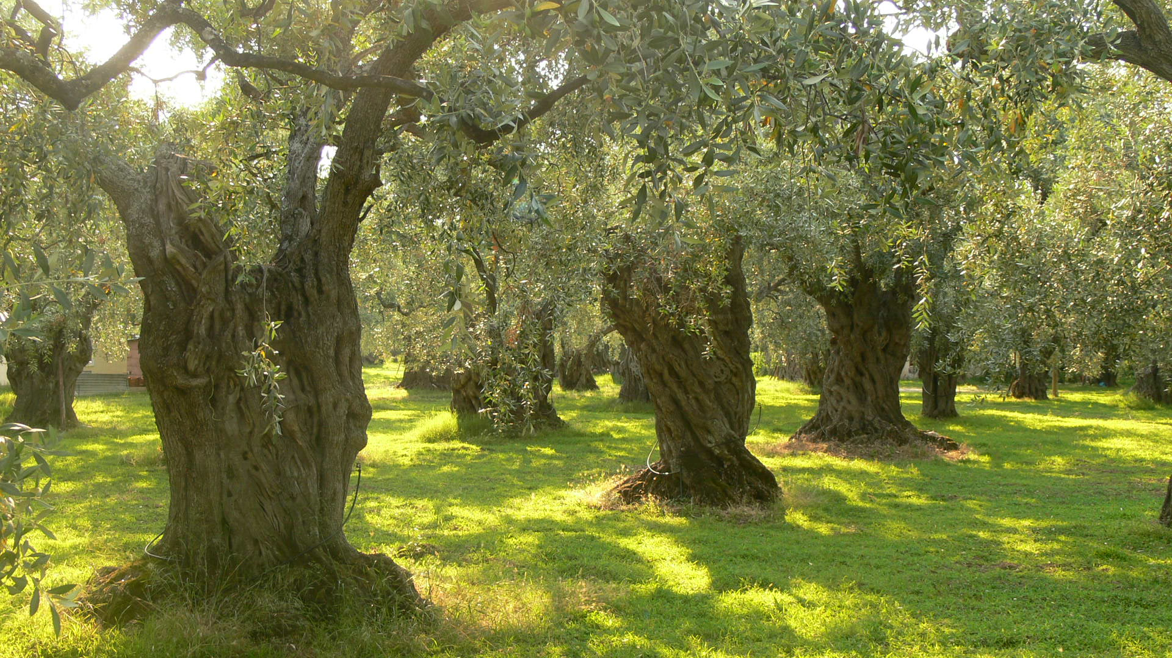
Tomorrow Tastes Mediterranean

Slide 12
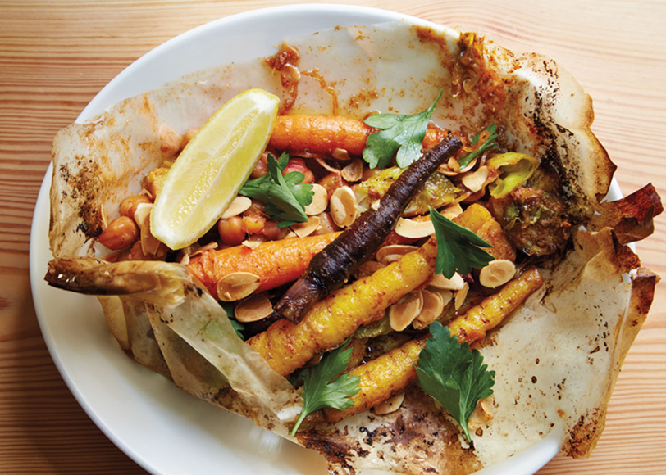
Leveraging Sector Potential
In the $860 billion American restaurant/foodservice industry, what sectors are best positioned to drive meaningful innovation around health and sustainability?

Slide 13
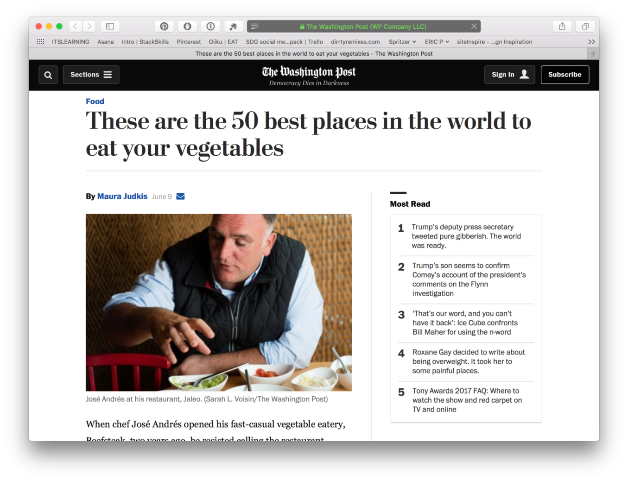
PlantForward50.com
Independent restaurants lead change

Slide 14
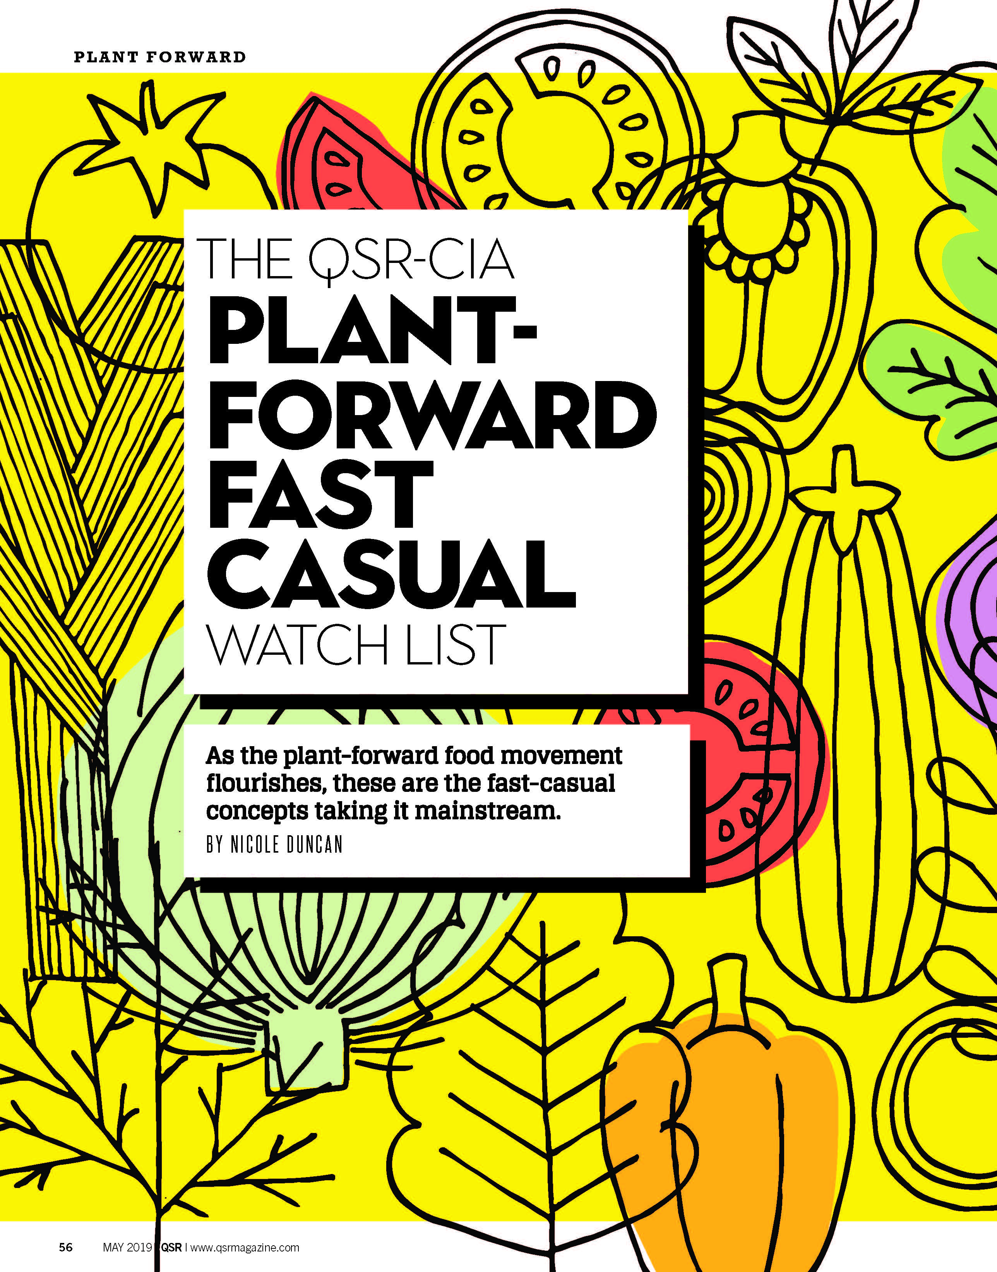

Slide 17
The Culinary Institute of America
Plant-Forward Culinary Arts Education
and Certification Initiative
In collaboration with Food@Google

