Slide 1
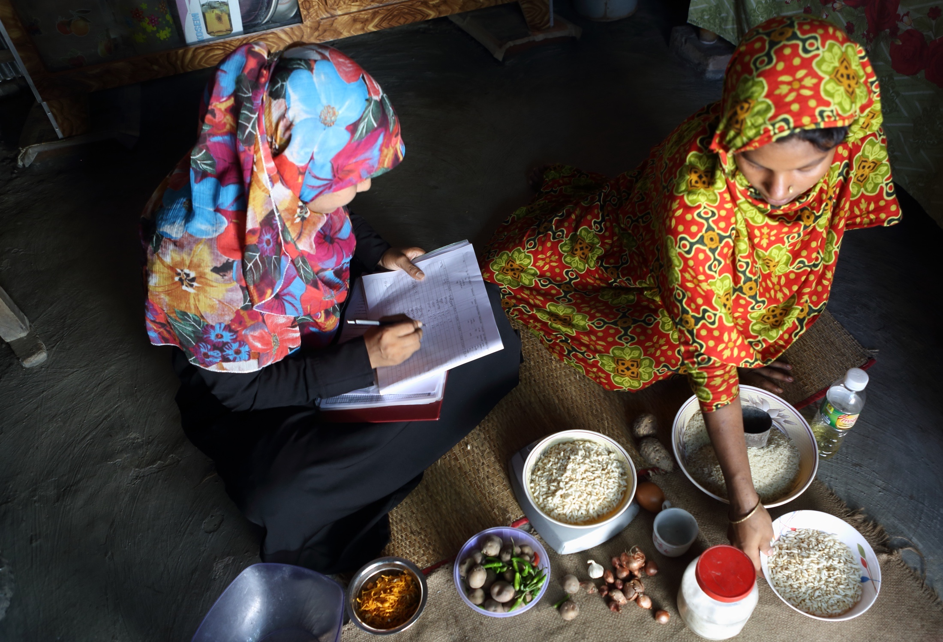

THE COST OF NUTRITION IN ASIA
Photo by Shafiqul Alam Kiron,/Data Analysis and Technical Assistance Limited
Derek D. Headey (d.headey@cgiar.org)
The International Food Policy Research Institute (IFPRI)

Slide 2
WHY SHOULD WE CARE ABOUT DIET COSTS?
Dietary quality
Cost of healthy diet
(fuzzy, especially in rural areas!)
Healthy dietary level
Affordability the
binding constraint
Knowledge the
binding constraint
Diet affordability
(ratio of income to diet cost)

Slide 3
HOW EXPENSIVE ARE (UN)HEALTHY FOODS?
Can answer this question with relative caloric prices
  e.g. cost of 1 egg calorie relative to 1 starchy staple calorie
Why price foods in caloric terms?
  Calories essential for survival, activity & averting hunger
Why measure prices relative to staples?
  Measures cost of diet diversification in a comparable way
Data: 2011 International Comparison Program (ICP)
  Prices for 657 standardized food products in 176 countries
Series of maps:
    light = cheap relative to cereals
    dark = expensive relative to cereals

Slide 4
WHAT KINDS OF FOODS ARE CHEAP IN ASIA?
Cheapest Vitamin-A rich fruit/veg
Relatively cheap in most of Asia, especially China

Slide 5
WHAT KINDS OF FOODS ARE CHEAP IN ASIA?
Fortified infant cereals (well known brand)
Very expensive in most of Asia

Slide 6
WHAT KINDS OF FOODS ARE CHEAP IN ASIA?
Chicken eggs
Large variation in Asian egg prices:
Cheap in India, expensive in SE Asia

Slide 7
WHAT KINDS OF FOODS ARE CHEAP IN ASIA?
Fresh cow’s milk
Very expensive in
South-East Asia!

Slide 8
WHAT KINDS OF FOODS ARE CHEAP IN ASIA?
Cheapest fish
Only moderately expensive; cheaper in China & Thailand

Slide 9
WHAT KINDS OF FOODS ARE CHEAP IN ASIA?
Sugar
Cheap everywhere

Slide 10
WHAT KINDS OF FOODS ARE CHEAP IN ASIA?
Oils
Cheap everywhere

Slide 11
WHAT KINDS OF FOODS ARE CHEAP IN ASIA?
Soft drinks (Coca-Cola)
Cheaper in China, moderately expensive elsewhere

Slide 12
WHAT KINDS OF FOODS ARE CHEAP IN ASIA?
Potato chips
Cheap everywhere

Slide 13
HOW EXPENSIVE ARE HEALTHY DIETS?
We estimated:
1.5 billion people cannot afford EAT-Lancet diet even if they spent 100% of their budget on food (Hirvonen et al. 2019)
2/3 of rural India could not afford healthy Indian diet (Raghunathan et al. 2020)
In Myanmar, 99% could of poorest could not afford healthy diet (Mahrt et al)

Slide 14
POLICY IMPLICATIONS
Affordability interventions
Income growth is essential for the poor
Safety nets can reduce dietary gaps in the short run
Investment in nutritious agriculture & infrastructure
  Improve access & affordability & quality
Knowledge/preference interventions
For the poor, focus on combined cash+knowledge interventions
For emerging middle classes, with rising incomes
  Nutrition education critical for obesity/NCD prevention
  Focus on school-age populations
  Support with proactive legislation: e.g. food labelling
Major challenge: improve nutritional knowledge at scale!

