Slide 1
Cost and affordability of a nutritious diet: New data for policymaking by national governments and international development agencies
William A. Masters & Aishwarya Venkat
Tufts University
Feed the Future Policy Research Consortium
2-3 November 2021

Slide 2
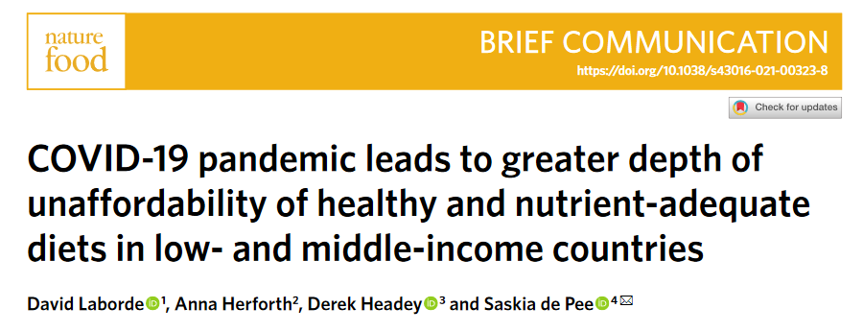
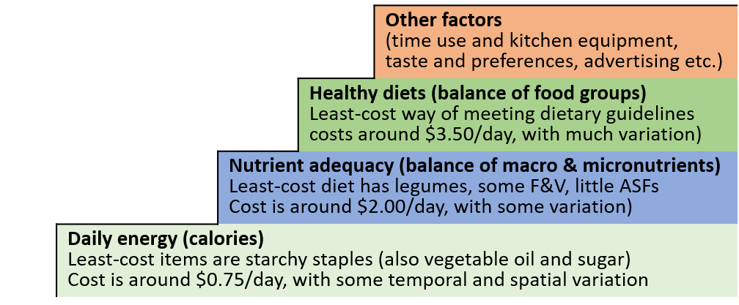
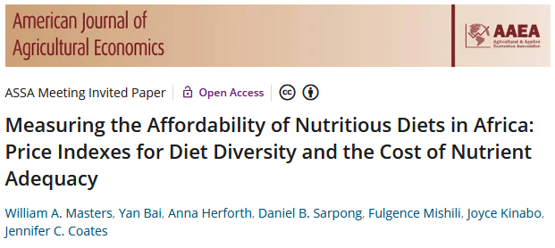
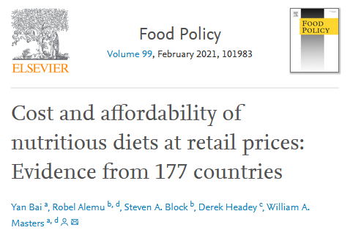
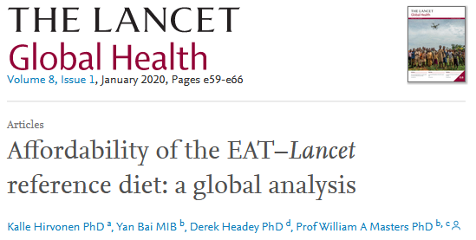
New data on retail prices, food composition and human requirements can guide policy to improve food systems
We find that foods with healthy attributes are too costly for the poorest, and affordable but often not chosen
by richer people
Diet costs vary in many policy-relevant ways

Slide 3
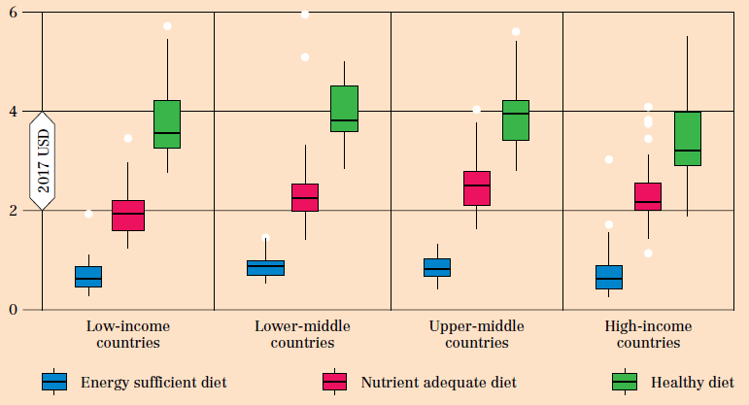
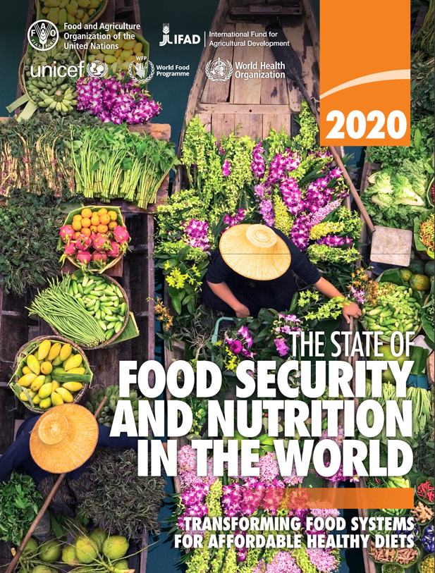
The least-cost items needed for each level of diet quality
have similar prices for different people
Daily cost of the most affordable diets for energy, essential nutrients and overall health in 2017
The least-cost items in each place vary,
but have similar prices for low- and high-income people
Smaller step up,
due primarily to
lower prices for dairy
Cost of recommended diets > $3.50/day
Cost of nutrient adequacy ≈ $2.00/day
Cost of survival ≈ $0.75/day
Source: Figure 2 of Herforth et al. (2020). Cost and affordability of healthy diets across and within countries. Background paper for The State of Food Security and Nutrition in the World 2020. FAO Agricultural Development Economics Technical Study No. 9. Rome, FAO. https://doi.org/10.4060/cb2431en

Slide 4
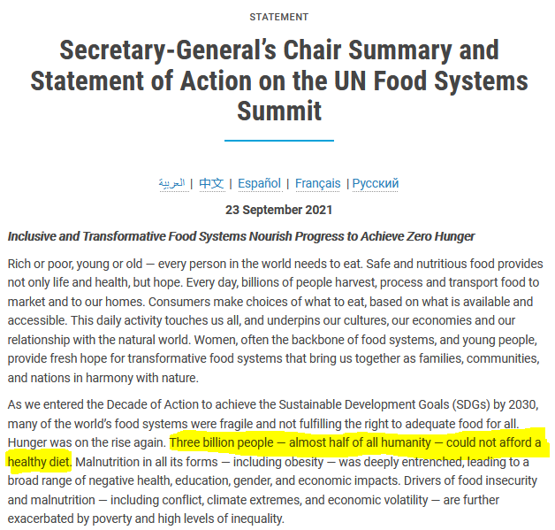
Differences in affordability are mainly due to income distribution
Cannot afford sufficient daily energy
(global total ≈ 185 million, ave. cost = PPP$0.79)
(September 2021): cost and affordability estimates included in outcomes of UNFSS
Percent of population, by country in 2017
Cannot afford a nutrient-adequate diet
(global total ≈ 1.5 billion, ave. cost=PPP$2.33)
Africa: 596 million
Cannot afford a healthy diet
(global total ≈ 3.0 billion, ave. cost=PPP$3.75)
S. Asia: 1.3 billion
SE Asia: 326 million
Africa: 829 million
Source: FAO, IFAD, UNICEF, WFP and WHO (2020). The State of Food Security and Nutrition in the World 2020, FAO, Rome. Details at https://sites.tufts.edu/foodpricesfornutrition

Slide 5
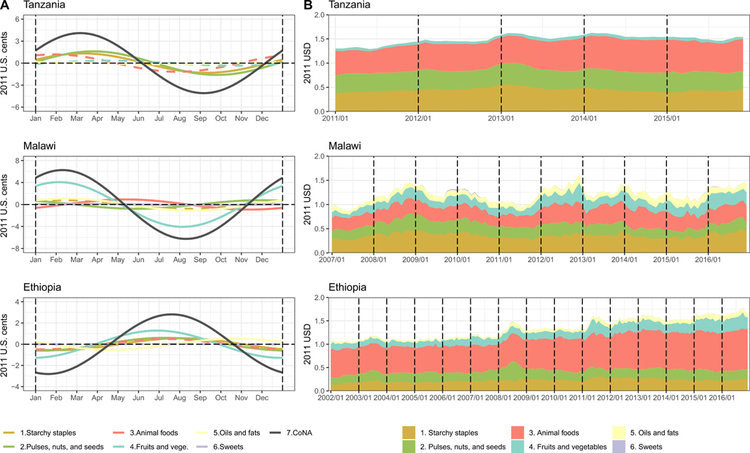
Diet cost data can guide national policy towards resilient food markets
Energy shares of least-cost diets
Seasonality of diet costs and cost by food group in Tanzania, Malawi and Ethiopia
Source: Bai, Y., E. Naumova and W.A. Masters (2020). Seasonality in diet costs reveals food system performance in East Africa. Science Advances, eabc2162.

Slide 6
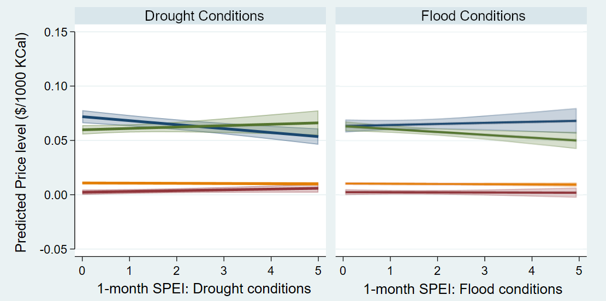
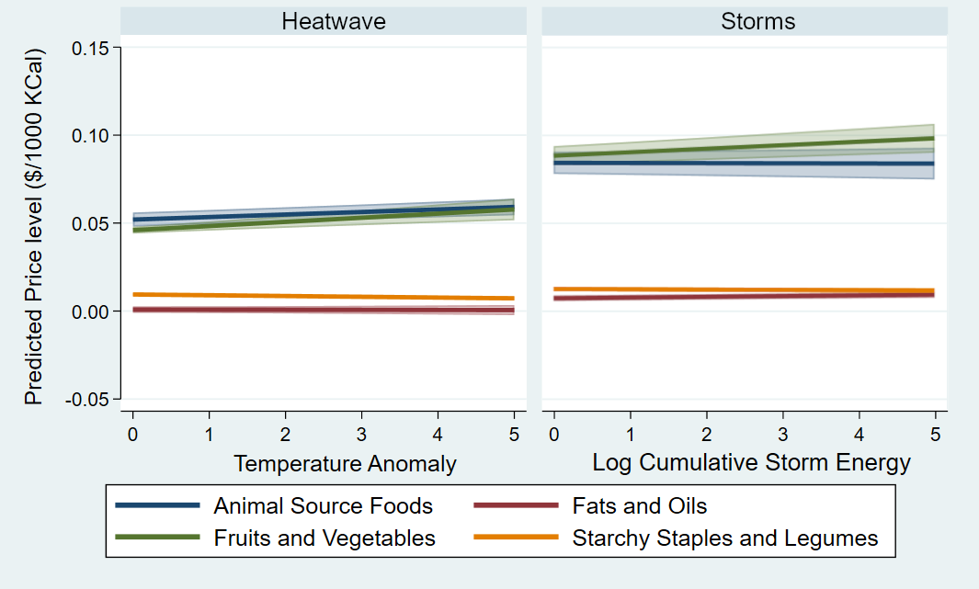
Extreme weather events impact retail prices of perishable vs.
non-perishable foods
Droughts and floods have opposite effects on animal source foods vs. fruits and vegetables
Most hazards lead to demand reduction of ASFs, except droughts which lead to supply reduction
Positive slopes indicate supply reduction from greater spoilage, ineffective storage, or impeded access to markets for wholesale traders
Negative slopes indicate demand reduction from wage losses or impeded access to markets for consumers

Slide 7
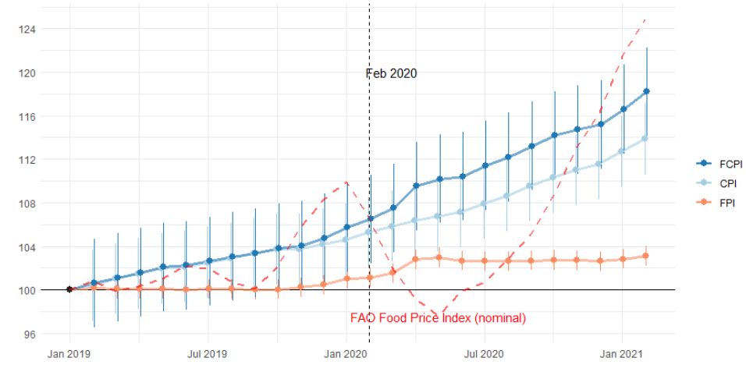
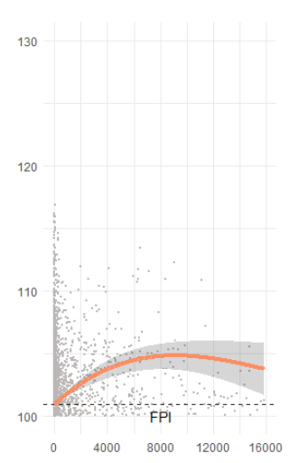
COVID brought higher food prices due to higher farm-to-retail margins
Monthly change in global consumer price indexes for food versus other items
(180 countries, Jan. 2019 – Feb. 2021)
Association with
cumulative COVID case counts
Larger (5%)
rise in countries
with higher case counts
3% rise in real food CPI since March 2020
(and does not follow commodity prices)
Source: Bai, Y. et al., Food prices in a pandemic: Global data show higher costs for nutritious food groups (2021). https://doi.org/10.21203/rs.3.rs-710555/v1.

Slide 8
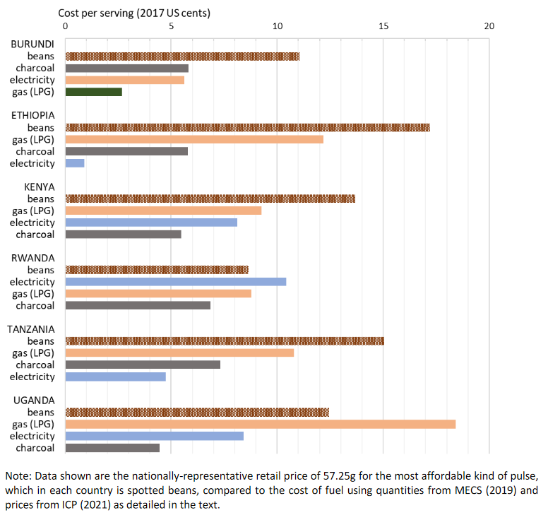
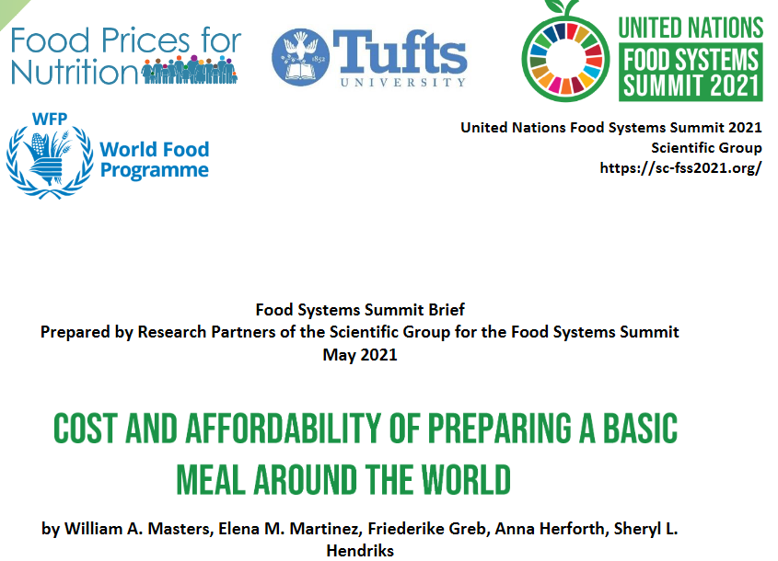
New work for UNFSS includes households’ cost of meal preparation
Cost per serving of cooking fuel, relative to the cost of dried beans in East Africa
Source: Masters WA, Martinez EM, Greb F, Herforth A, Hendriks SL (2021). Cost and Affordability of Preparing a Basic Meal around the World. UN Food System Summit Scientific Group Partners’ Brief (23 pages), available online at https://sc-fss2021.org/materials/fss-briefs-by-partners-of-scientific-group

Slide 9
Conclusions:
New data on diet costs & affordability can help guide policy
For the poorest 3 billion (38% of world), healthy diets remain beyond reach
Link production to markets for more stable, lower prices of locally-appropriate items in each food group
Affordability requires income growth and safety nets, especially for more remote rural households
At higher incomes, healthy diets are affordable but often not chosen
Factors beyond affordability drive food choice
meal preparation (time, fuel, water, equipment)
preferences (food culture, taste and satiation)
marketing of packaged foods (availability and advertising)
FAO, WFP, World Bank, Gates Foundation and other development agencies have started using diet cost and affordability as a metric of access to healthy diets
National governments may follow, as computation becomes easier and more familiar
Results guide investment to reduce and stabilize food prices, and target safety nets for affordability

Slide 10
U.S. Government Partners

