Slide 1
The global food and nutrition crisis:
What we’ve learned about the cost of healthy diets
and its implications for social protection worldwide
William A. Masters
Friedman School of Nutrition Science and Policy
Tufts University
william.masters@tufts.edu
https://sites.tufts.edu/foodpricesfornutrition
USP2030 Working Group on Social Protection and Food Systems Transformation
17 October 2022

Slide 2
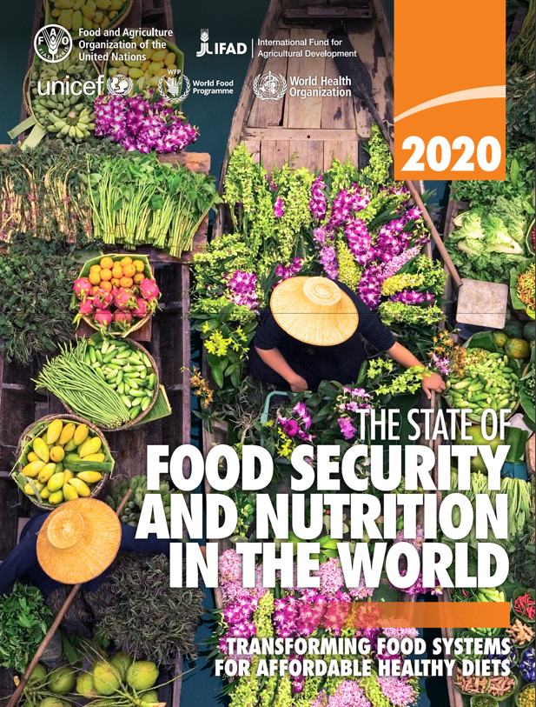
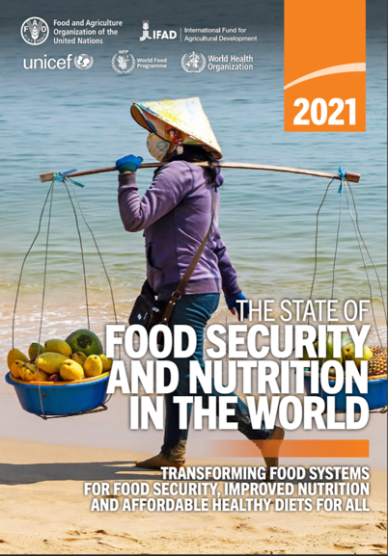
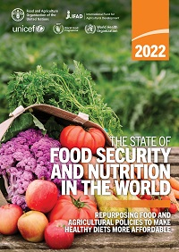
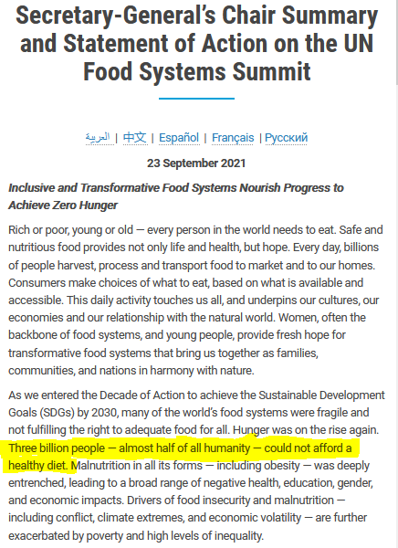
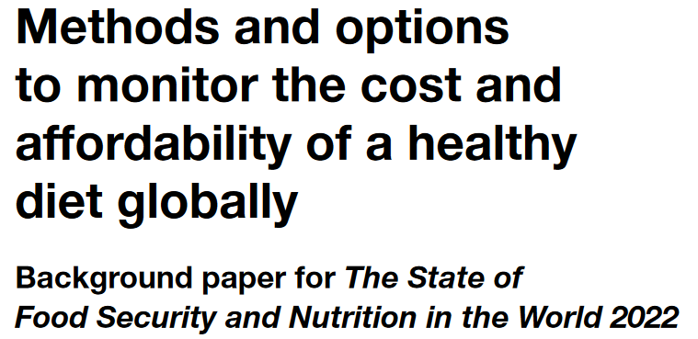
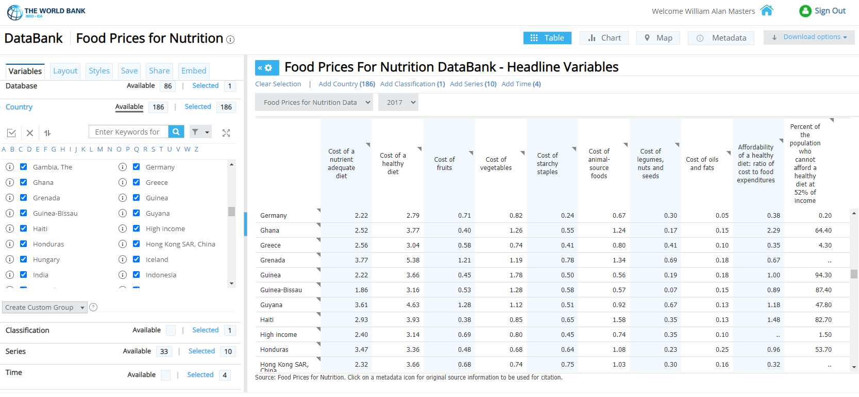
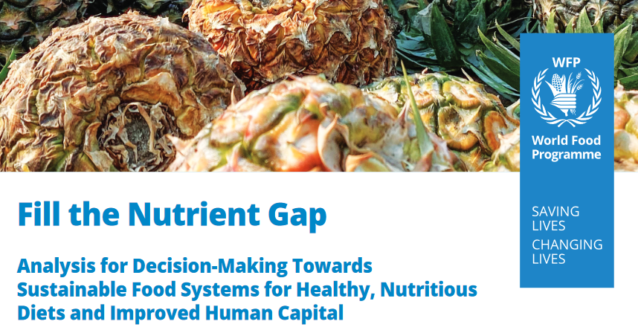
New data on cost & affordability of healthy diets can help guide social protection efforts
The FAO, IFAD, UNICEF, WFP and WHO (2020, 2021, 2022) introduced a new operational metric of global food security,
tracking physical and economic access to healthy diets
Affordability of least-cost diets
is now an actionable global goal
The World Bank now reports this for all countries
Similar methods are used to target WFP aid
Source: UN Food System Summit (New York: United Nations): https://www.un.org/en/food-systems-summit/news/making-food-systems-work-people-planet-and-prosperity
Source: https://www.wfp.org/fillthenutrientgap
Source: https://databank.worldbank.org/Food-Prices-For-Nutrition-DataBank---Headline-Variables/id/4608e28f

Slide 3
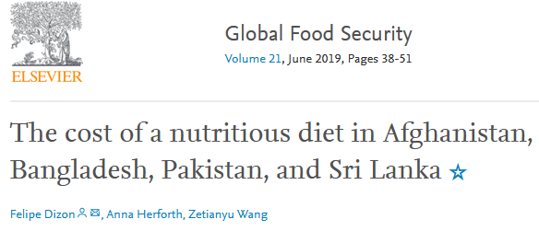
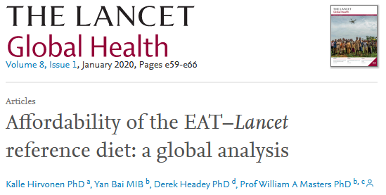
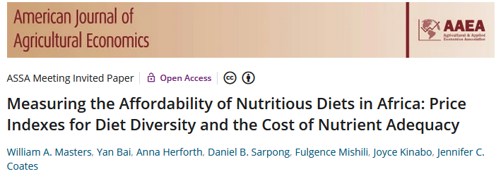
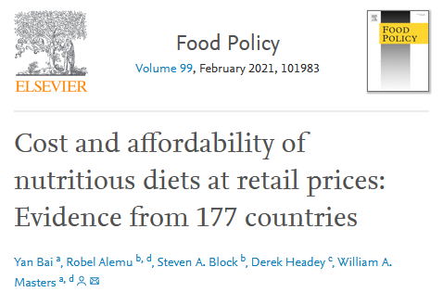
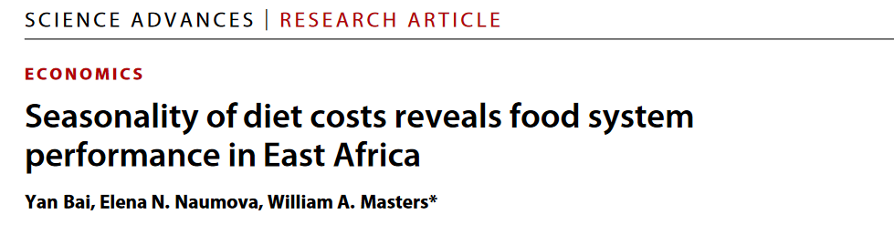
How can new methods & data inform social protection?
We use least-cost diets as a new kind of food price index, counting the cost of food as an input to health
Both nutrients and food groups are important for healthy diets
Results help guide policies and programs by
-- distinguishing unaffordability from other barriers to healthy eating
-- guiding intervention to universal access via lower costs and safety nets
 |  |  | Food preferences, convenience and other goals (including food security, diet diversity, sustainability, equity and inclusion)
 | Caloric adequacy (short-term subsistence)
For actual food choice among affordable options, observed demand systems often displace healthy items with other foods
 |  |  | Healthy diets Meets national dietary guidelines by food group
 |  | Nutrient adequacy Avoids deficiency or excess of essential macro- and micronutrients
 | Daily energy Meets only calorie needs, for short-term survival and physical work
For SOFI 2022, the updated standard for the Cost of a Healthy Diet (CoHD) is a “Healthy Diet Basket” of 11 items in 6 food groups
For SOFI 2020, we used dietary guidelines for the Cost of Recommended Diets (CoRD)
Our AJAE 2018 article introduced a Cost of Diet Diversity (CoDD) metric
for comparison to cost of nutrients
Source: Food Prices for Nutrition (2022). https://sites.tufts.edu/foodpricesfornutrition

Slide 4
What are least-cost items for healthy diets, in practice?
Examples of actual least-cost healthy diet baskets in selected countries, using item prices from 2017 ICP data
Senegal |  |  |  | Pakistan |  |  |  | Italy
Item name | Qty (g/day) | Cost (USD/day) |  | Item name | Qty (g/day) | Cost (USD/day) |  | Item name | Qty (g/day) | Cost (USD/day)
Maize grains, white | 161 | 0.19 |  | Wheat flour | 161 | 0.19 |  | Wheat flour | 161 | 0.08
Rice, 25% broken | 164 | 0.22 |  | Maize | 161 | 0.22 |  | Pasta, short | 158 | 0.15
Onions, fresh | 108 | 0.23 |  | Onions, fresh | 108 | 0.19 |  | Carrots, fresh | 106 | 0.20
Carrots, fresh | 106 | 0.24 |  | Carrots, fresh | 106 | 0.21 |  | Onions, fresh | 108 | 0.21
Aubergine, fresh | 173 | 0.33 |  | Water spinach | 103 | 0.23 |  | Cabbage, fresh | 173 | 0.48
Dates, dried | 29 | 0.17 |  | Bananas | 89 | 0.39 |  | Bananas | 89 | 0.30
Mangoes, fresh | 132 | 0.25 |  | Coconut, green | 49 | 0.52 |  | Apples, fresh | 152 | 0.51
Sardines, dried | 36 | 0.12 |  | Buffalo milk, raw | 149 | 0.41 |  | Milk, whole UHT | 227 | 0.34
Small fish, dried | 36 | 0.25 |  | Chicken, live | 68 | 0.58 |  | Chicken, whole froz. | 68 | 0.43
Groundnuts, whole | 51 | 0.12 |  | Dhal, musur | 82 | 0.33 |  | Beans, dry white | 86 | 0.26
Palm oil | 33 | 0.19 |  | Vegetable oil | 34 | 0.19 |  | Sunflower oil | 33 | 0.06
Total cost (USD/day) |  | 2.29 |  | Total cost (USD/day) |  | 3.44 |  | Total cost (USD/day) |  | 3.02
Starchy staples
Starchy staples
Starchy staples
Vegetables
Vegetables
Vegetables
Fruits
Fruits
Fruits
Animal-sourced foods
Animal-sourced foods
Animal-sourced foods
Pulses, nuts and seeds
Pulses, nuts and seeds
Pulses, nuts and seeds
Oils and fats
Oils and fats
Oils and fats

Slide 5
Diet costs vary but are
not linked to national income

Slide 6
Diet costs vary but are
not linked to national income
and rose in 2020 (+ 2021-2022)
2017 (dots)
2017

Slide 7
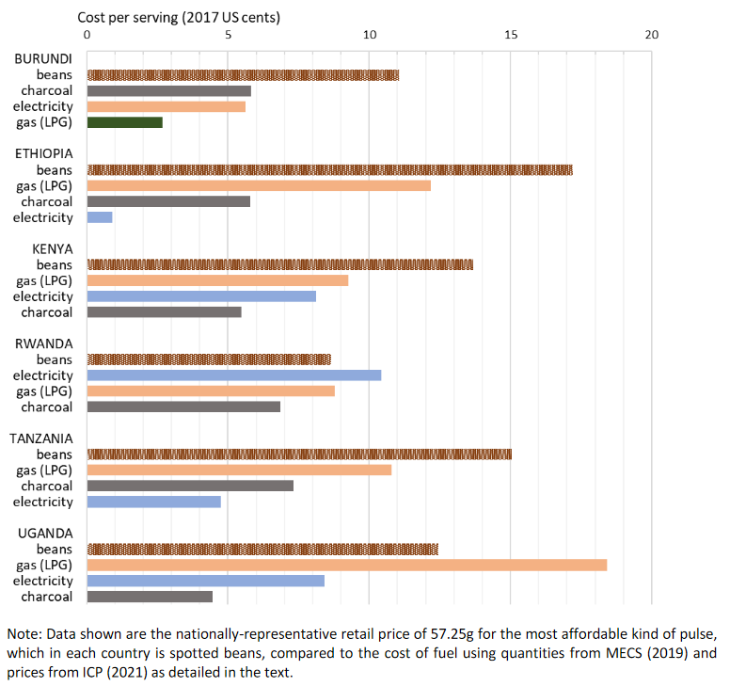
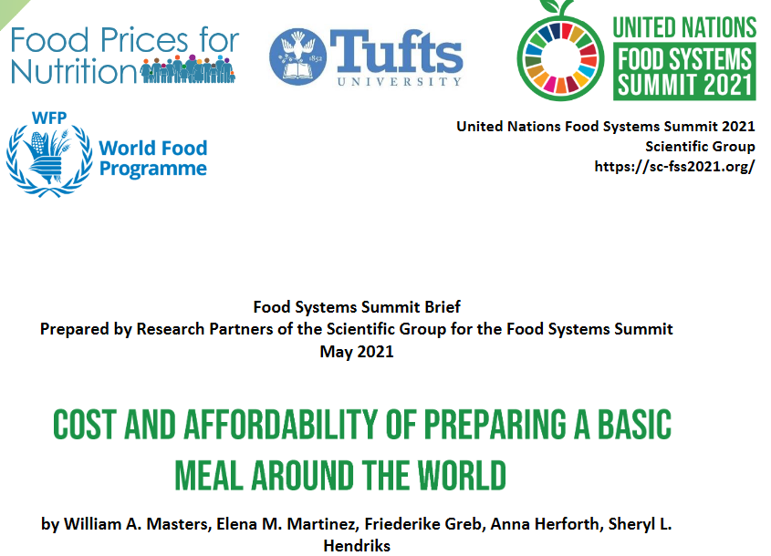
The food-energy crisis has a direct impact on the cost of meal preparation and cooking
Cost per serving of cooking fuel, relative to the cost of dried beans in E. Africa
Source: Masters WA, Martinez EM, Greb F, Herforth A, Hendriks SL (2021). Cost and Affordability of Preparing a Basic Meal around the World. UN Food System Summit Scientific Group Partners’ Brief (23 pages), available online at https://sc-fss2021.org/materials/fss-briefs-by-partners-of-scientific-group

Slide 8
Conclusion: How can new data on least-cost healthy diets
inform social protection efforts?
Social protection can be guided by diet costs at each place and time
Resource mobilization based on affordability of a universal human need
Least-cost healthy diets operationally useful for targeting and adequacy
For many people (3 billion, 40% of world) healthy diets remain beyond reach
Vegetables and fruits, other nutrient-rich foods are costly to grow and distribute
Seasonality and other price volatility limits year-round access
Social protection builds resilience to shocks of all kinds
For most people (4.9 billion, 60% of world) healthy diets are affordable but not used
Food choice among affordable items is driven by many factors other than health
Cost of cooking, time and space for meal preparation are key factors in diet quality
Social protection can alleviate meal-preparation constraints even in high-income countries

Slide 9
Omitted slides

Slide 10
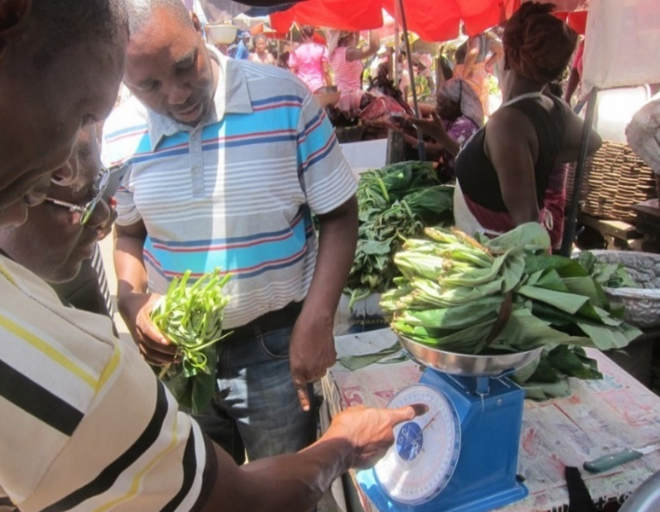
https://sites.tufts.edu/foodpricesfornutrition
Thank you!
The Food Prices for Nutrition project (https://sites.tufts.edu/foodpricesfornutrition) is conducted at Tufts University jointly with Anna Herforth, and with IFPRI (led by Derek Headey) and the World Bank (led by Nada Hamadeh, with Yan Bai and Marko Rissanen), with numerous Tufts students and staff including Robel Alemu, Leah Costlow, Rachel Gilbert, Elena Martinez, Julia Matteson, Kate Schneider, Kristina Sokourenko, Aishwarya Venkat, Jessica Wallingford, and faculty collaborators Steve Block, Shibani Ghosh, Elena Naumova and Patrick Webb. In-country studies have been led by Stevier Kaiyatsa (Ministry of Finance, Malawi), Fulgence Mishili (Sokoine University, Tanzania), Daniel Sarpong (University of Ghana), Fantu Bachewe (IFPRI-Addis) and Kalyani Ragunathan (IFPRI-Delhi) among others.
We thank the many price collectors and contributors to other databases on which we rely and are grateful for funding to the Bill & Melinda Gates Foundation and UKAid, as well as complementary funding from FAO and USAID through the Feed the Future Nutrition Innovation Lab.
Photo by Anna Herforth
at Agbogbloshi market, Ghana

Slide 11
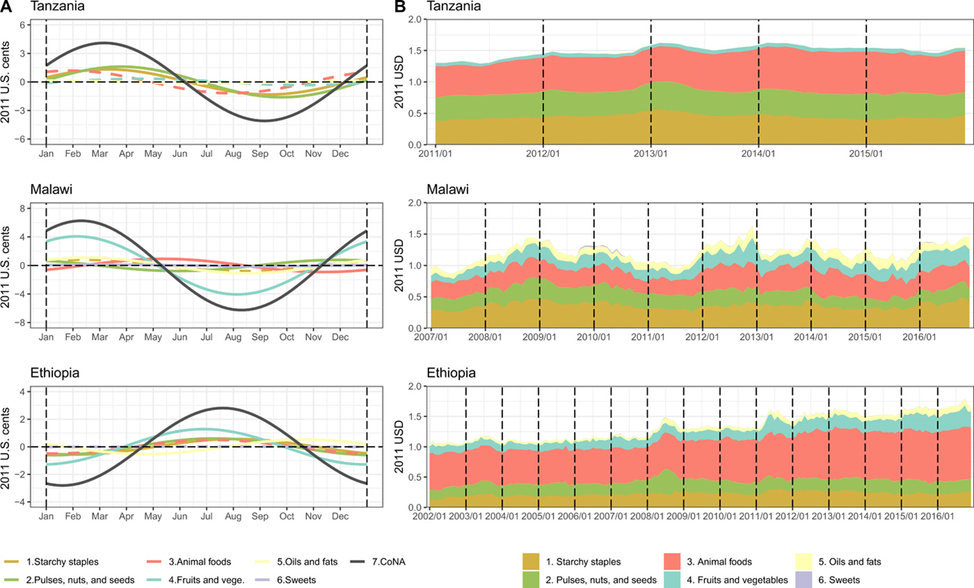
Seasonality and remoteness are the principal drivers of differences in diet costs
Energy shares of least-cost diets
Seasonality of diet costs and cost by food group in Tanzania, Malawi and Ethiopia
Source: Bai, Y., E. Naumova and W.A. Masters (2020). Seasonality in diet costs reveals food system performance in East Africa. Science Advances, eabc2162.

Slide 12
The cost of nutrient adequacy varies by demographic group, due to different requirements
Variation in least-cost diets by age, sex and reproductive status across 172 countries in 2017
Cost per day is highest for adolescents or during lactation, due to high needs for total energy and nutrients
Cost per calorie is highest for girls and women, due to high nutrient needs per unit of dietary energy
Source: Bai, Herforth and Masters, 2022. Global variation in the cost of a nutrient-adequate diet by population group. Lancet Planetary Health 6(1): 19-28.

Slide 13
What did the SOFI work reveal about affordability?
About 3 billion people (38% of world) could not afford a healthy diet in 2017
Monitoring diet cost and affordability complements other ways of measuring poverty and food insecurity:
≈ 690 m. below $1.90/day (World Bank)
≈ 653 m. undernourished (PoU, from 1960s)
≈ 1.9 b. experience food insecurity (FIES)
Cannot afford sufficient daily energy
(global total ≈ 185 million,
ave. cost = PPP$0.79)
Percent of population, by country in 2017
Cannot afford a nutrient-adequate diet
(global total ≈ 1.5 billion, ave. cost=PPP$2.33)
Africa: 596 million
Updated method and results (through 2020) here:
S Asia: 1.3 billion
Cannot afford a healthy diet
(global total ≈ 3.0 billion, ave. cost=PPP$3.75)
SE Asia: 326 million
Africa: 829 million
Source: FAO, IFAD, UNICEF, WFP and WHO (2020). The State of Food Security and Nutrition in the World 2020, FAO, Rome.

Slide 14
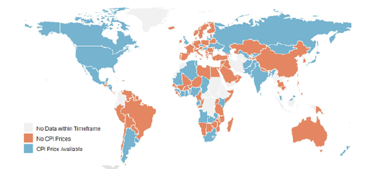
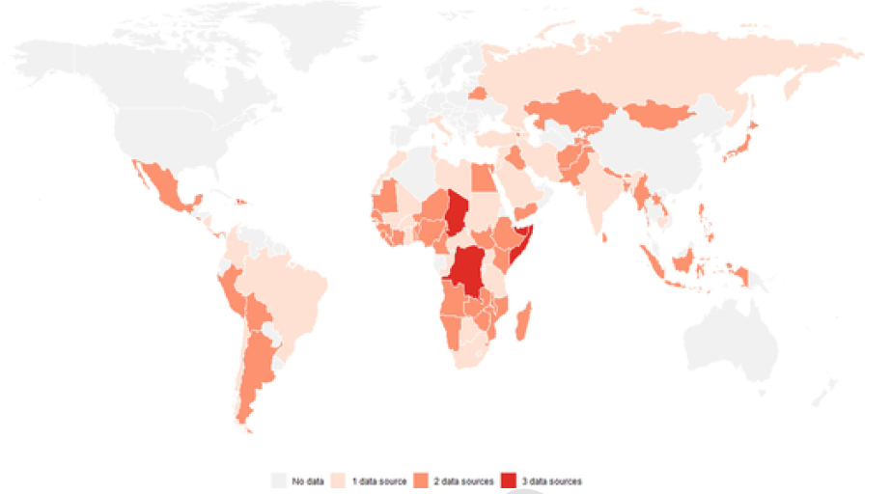
The innovation is linking retail price data to nutritional needs
Availability of food item prices from national governments’ Consumer Price Index (CPI) data in 2019-2020
Availability of food item prices from international agencies’
Early Warning System (EWS) data in 2019-2020

Slide 15
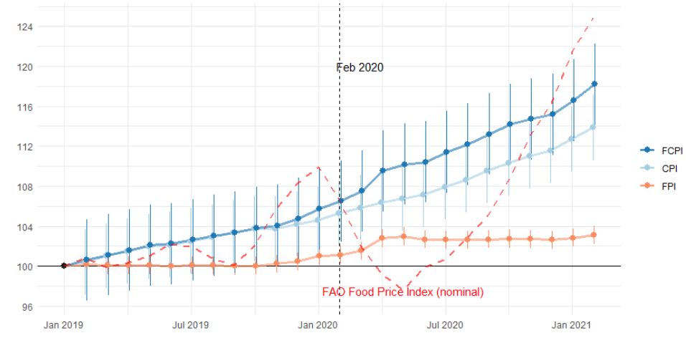
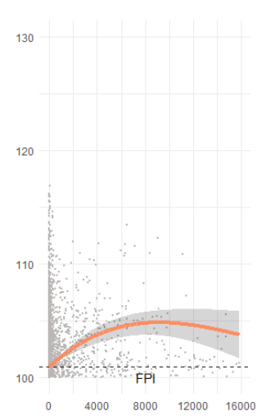
COVID impacts are mostly on income, but may include higher food prices
Monthly change in global consumer price indexes for food versus other items
(180 countries, Jan. 2019 – Feb. 2021)
Association with
cumulative COVID case counts
Larger (5%)
rise in countries
with higher case counts
3% rise in real food CPI since March 2020
(and does not follow commodity prices)
Source: Bai, Y. et al. (2022), Retail prices of nutritious food rose more in countries with higher COVID-19 case counts. Nature Food, 3: 325–330. (May 19, 2022)

Slide 16
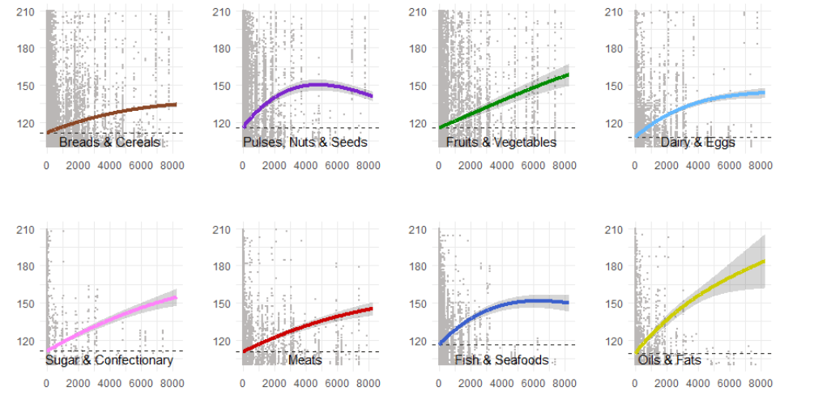
COVID impacts include
higher food prices,
especially for certain foods
Average nominal prices by food group vs. cumulative COVID case counts
(n=1,309 items from 86 countries, Jan. 2019 – Feb. 2021)
Source: Bai, Y. et al. (2022), Retail prices of nutritious food rose more in countries with higher COVID-19 case counts. Nature Food, forthcoming.

Slide 17
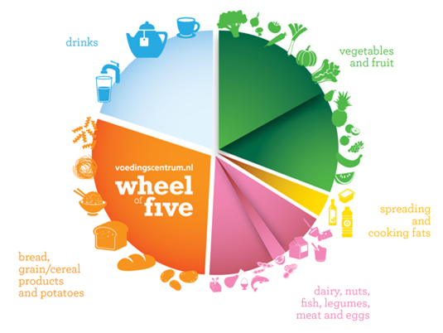
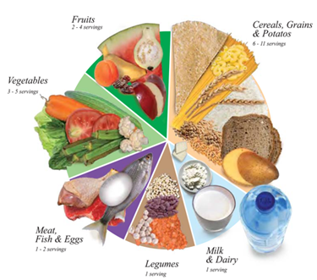
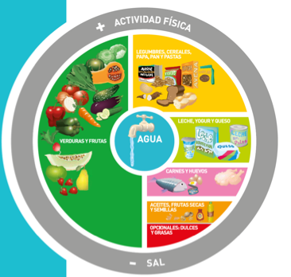
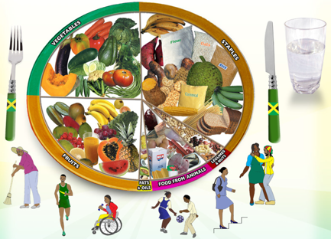
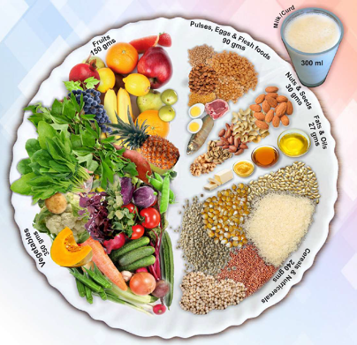
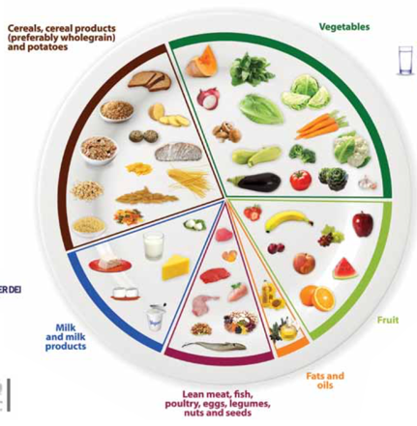
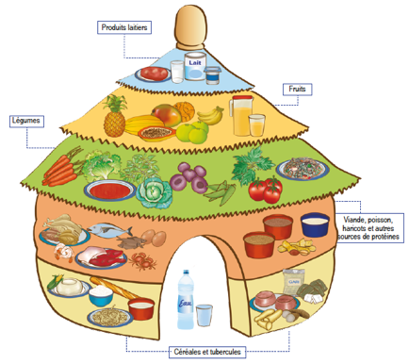
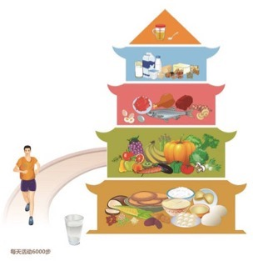
How do we define healthy diets to measure their cost
and affordability?
Use national dietary guidelines, in terms of food groups
Meet target quantities of each food group needed for a healthy diet
Allow substitution within energy balance, by converting volume and weight to calories
Guidelines differ in details, but food group requirements are similar
For SOFI 2020, used median cost of meeting 10 quantified guidelines from all UN regions
Now we use a single Healthy Diet Basket derived from 31 guidelines with food guides
Meeting targets for 6 food groups leads to nutrient-adequate diets within most guidelines
Quantities of food in the healthy diet
Typical weight (grams) | Typical volume (plate share)
322g dry rice | 25%
270-400g veg. | 25%
230-300g fruits | 25%
210g egg | 25%
85g dry bean
34g oil
Definition of the Healthy Diet Basket
Food group | Number of items | Total energy (kcal)
Starchy staples | 2 | 1,160
Vegetables | 3 | 110
Fruits | 2 | 160
Animal-source foods | 2 | 300
Legumes, nuts & seeds | 1 | 300
Oils and fats | 1 | 300
Total: 2,330

Slide 18
How does the healthy diet basket relate to food demand and revealed preferences?
Shortfalls below healthy diet basket targets by income level in a global demand system (kcal/person/day)
No deficit, all HDB targets met
Lipids use reaches HDB target around $7k/yr
ASF use reaches HDB target around $3k/yr
Dietary transition displaces healthy diet basket foods after $15k/yr
Global deficit for the poorest is 580 kcal/day of healthy foods, that they now get from cheaper starchy staples
Adequacy of actual intake rises to just 300 kcal/day below target, then falls due to displacement by less healthy foods at higher incomes
Income per person ($US2022 /year )
Note: Adapted from W.Martin and W.A. Masters (2022), “Consumer demand for healthy diets: Modeling the impact of food access on consumption in low-, middle- and high-income countries”.
Food Prices for Nutrition project working paper, in progess. Data shown are projections using a MAIDADS demand system, originally estimated from FAO Food Balance Sheet data by Gouel and Guimbard (2019).

Slide 19
Use of healthy diet basket foods is influenced by displacement across the dietary transition
Excesses and deficiencies relative to healthy diet basket targets by income level (kcal/person/day)
Bennett’s law: starchy staple use shrinks rapidly
ASFs + oils & fats overshoot and displace healthy foods
Everyone loves sugar, but use changes little
Actual intake of healthy diet basket foods rises towards adequacy, then falls with dietary transition
Note: Adapted from W.Martin and W.A. Masters (2022), “Consumer demand for healthy diets: Modeling the impact of food access on consumption in low-, middle- and high-income countries”.
Food Prices for Nutrition project working paper, in progess. Data shown are projections using a MAIDADS demand system, originally estimated from FAO Food Balance Sheet data by Gouel and Guimbard (2019).

