Slide 1
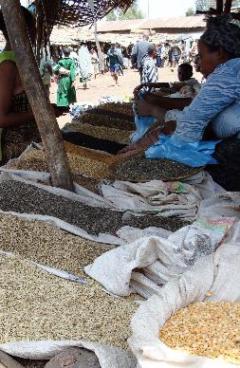
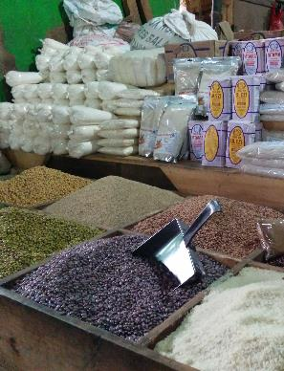
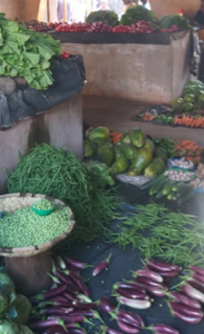
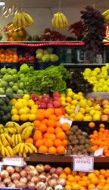
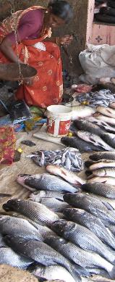
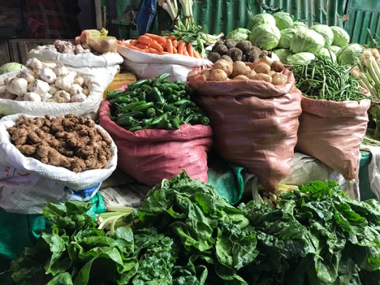
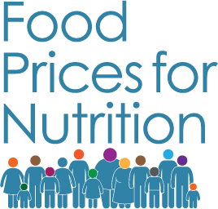
Measuring Cost and Affordability of Healthy Diets
September 20, 2022
Dr. Anna Herforth
Co-Director, Food Prices for Nutrition
#FoodPricesforNutrition
sites.tufts.edu/foodpricesfornutrition

Slide 2
Purpose
Explain the rationale and methods for Cost and Affordability of a Healthy Diet (CoAHD)
Cost of a Healthy diet: the cost of the least expensive locally-available foods to meet requirements for FBDG, per capita, per day
FAO institutionalized the indicators for annual monitoring globally this year
Review where conversation left off in Ghana
Discuss a roadmap for the regular calculation of these indicators in Ghana
Uses data already collected; does not require further data collection
Now would align with global indicator published annually by FAO
Roles of GSS and MoFA
Notes:
for a representative person within energy balance at 2330 kcal/day.

Slide 3
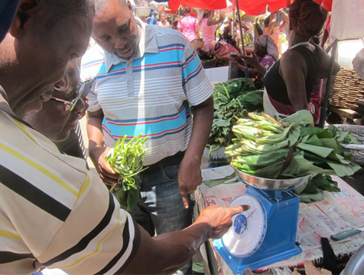
Review of what has been done
Collaboration in Ghana since 2016
2016: Kickoff meeting for Indicators of Affordability for Nutritious Diets in Africa (IANDA)
2016 MoFA piloted longer food list
Scaled up since Aug 2017
2017 meeting in Accra
2018 meeting in Accra → intention to monitor indicators
Notes:
We set out to answer these questions 6 years ago, with the IANDA project..
Indictors of Affordability of Nutritious Diets in Africa (IANDA)
Changing Access to Nutritious Diets in Africa and South Asia (CANDASA) project (2017-2020) scaled up the use of indicators developed in IANDA
Especially Daniel Sarpong (University of Ghana), Joyce Kinabo and Fulgence Mishili (Sokoine University of Agriculture), and govt data collectors (John Nortey, Ghana MoFA)
Fulgence Mishili At IFPRI, CANDASA seminar, 29 May 2019

Slide 4
Expansion of
Project purpose: Scale up monitoring and analysis of food prices, to guide agricultural production and food markets for improved nutrition
Support use of new metrics in high-priority countries
Build a global system to monitor change in food prices for nutrition
Analyze change in cost and affordability of healthy diets
Actively disseminate tools and results on food prices, diet costs, and affordability
Funded by:
In collaboration with:
Notes:
Now, finally, before we wrap up and go to the question-and-answer session, I want to talk briefly about the forthcoming work of the Food Prices for Nutrition project.
This project continues to build on work done in previous projects, now working with the World Bank and IFPRI to promote the use of food prices to measure diet costs and affordability and to scale up monitoring and analysis of the metrics we’ve been talking about today. The Food Prices for Nutrition project has four inter-linked aims
In order to do this, we will focus on….
And model impacts of policies and programs to influence food prices, for example –
By investing in research and development of vegetable, fruit, and legume seeds: increase diversity in the food supply, and viable opportunities for farmers
By investing in environmentally and socially sustainable ways to produce animal source foods targeted to the poor
Innovations for cold chains and other means of preservation
Market infrastructure to allow movement of products

Slide 5
Vision: Food price measurement to match this aspiration
Food security is…
when all people, at all times, have physical and economic access to sufficient, safe, nutritious food to meet dietary needs and food preferences for an active and healthy life.
- World Food Summit, 1996
Notes:
The Food Prices for Nutrition Project arose out of this vision: That food price measurement should match the globally held aspiration toward food security, adopted over 25 years ago.
Until now, food security measurement has not reflected this definition in full. It has centered on availability and access to calories, and more recently reported experience.
The cost and affordability of a healthy diet add the dimension of economic access to nutritious food to meet dietary needs.
Prevalence of Undernourishment
hunger – how many people cannot access sufficient calories
Food Insecurity Experience Scale
how many people experience moderate or severe food insecurity
Affordability of a Healthy Diet
how many people cannot afford the minimum cost of a healthy diet following dietary guidelines

Slide 6
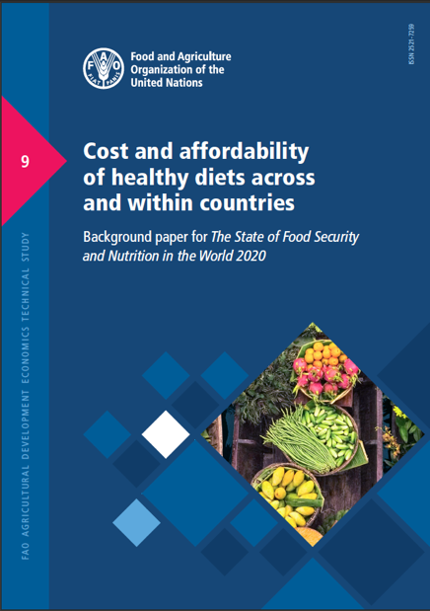
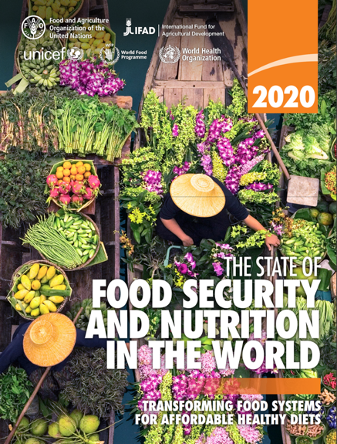
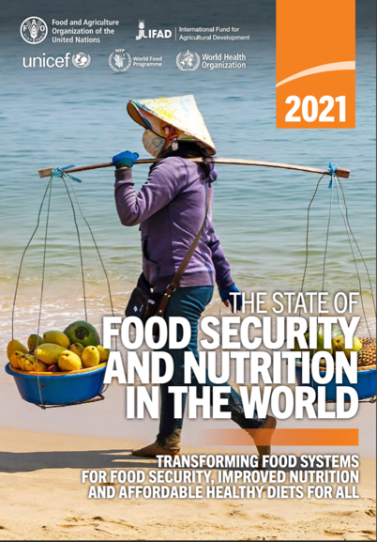
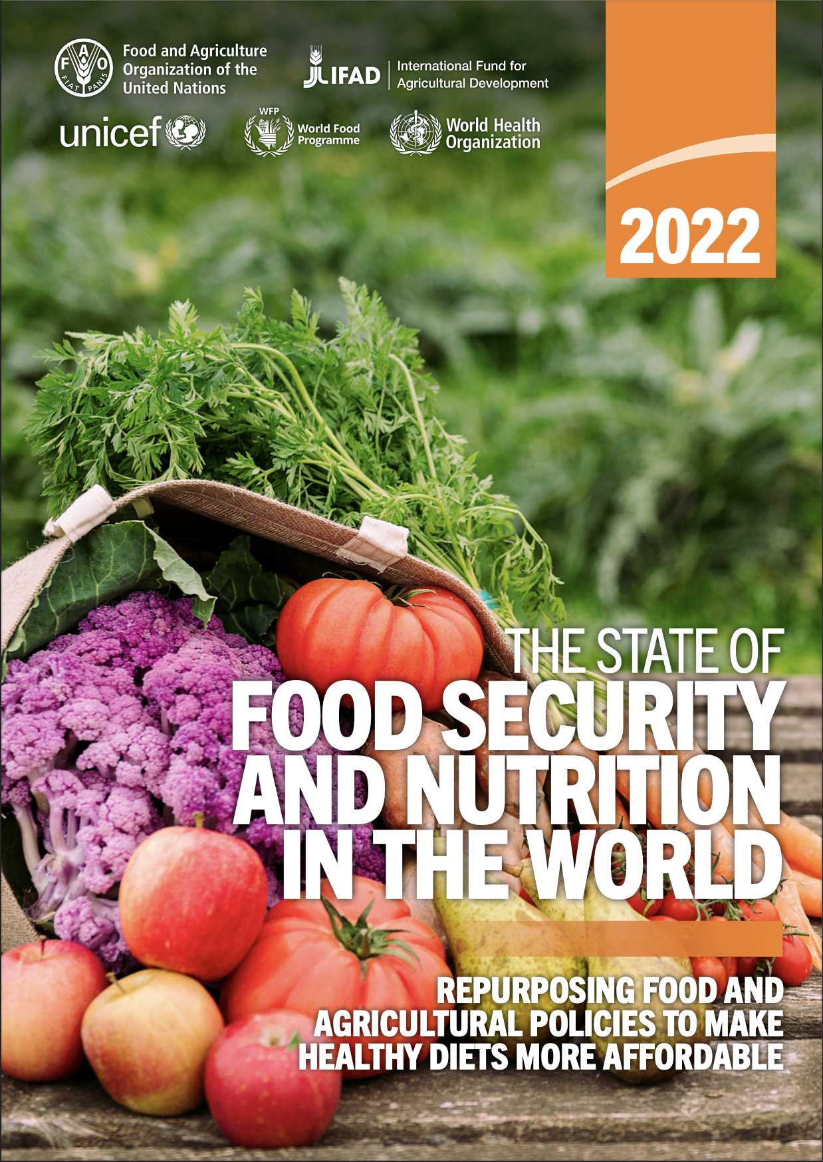
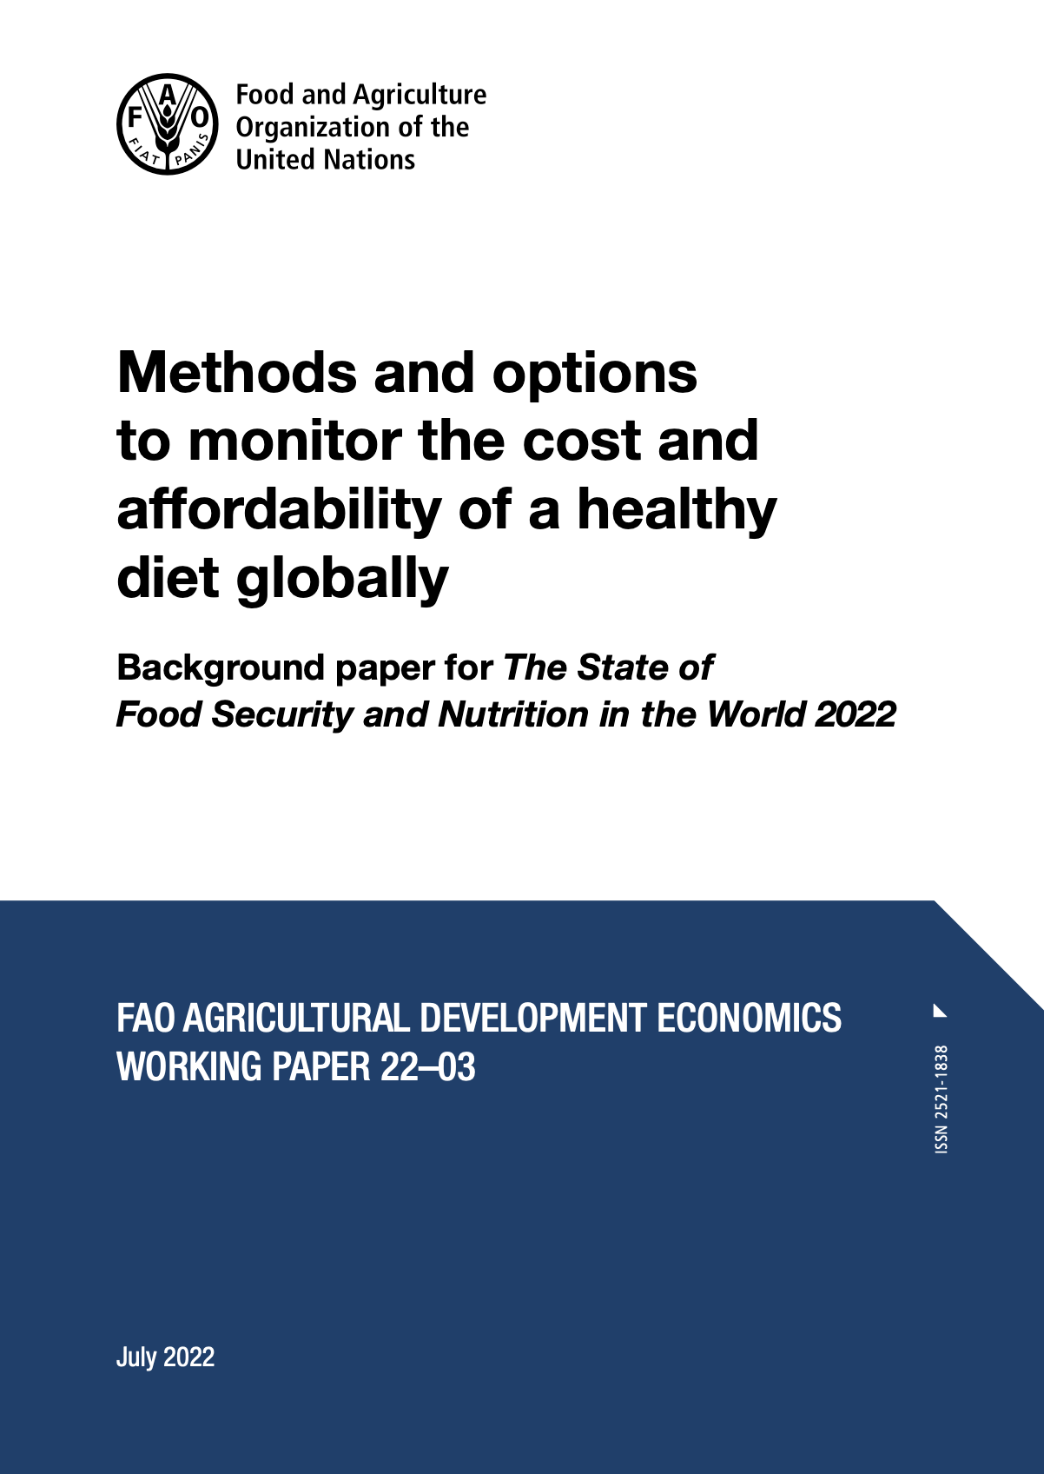
Cost and Affordability of a Healthy Diet: indicators to understand food access
Used in the UN State of Food Security and Nutrition in the World (2020, 2021, 2022), joining other food security metrics
​Herforth, A., Bai, Y., Venkat, A., Mahrt, K., Ebel, A. & Masters, W.A. 2020. https://doi.org/10.4060/cb2431en
Herforth, A., Venkat, A., Bai, Y., Costlow, L., Holleman, C. & Masters, W.A. (2022). Methods and options to monitor globally the cost and affordability of a healthy diet. Background paper to The State of Food Security and Nutrition in the World 2022.
FAO Agricultural Development Economics Working Paper 22-03. Rome, FAO.
https://www.fao.org/publications/sofi/en/
Notes:
Cindy will speak more to this. It has been a pleasure to partner with FAO, which supported our background paper to define the methods for the cost and affordability of a healthy diet. This paper is coming out soon. I will spend the rest of my presentation today introducing these methods.
“Estimates of the cost and affordability of healthy diets will be updated annually and disseminated in this report, reflecting the most recent data as they become available.”
-SOFI 2021, p29
http://www.fao.org/publications/sofi/2020/en/
https://www.fao.org/publications/sofi/2021/en/
P29 “Estimates of the cost and affordability of healthy diets will be updated annually and disseminated n this report, reflecting the most recent data as they become available. Once new data for 2020 are available, it will be possible to estimate he overall economic impact of the COVID-19 pandemic on the cost and affordability of healthy diets. Regional, subregional, national and even subnational differences are expected, given the different timing, duration and intensity of lockdowns, as well as differential impacts of economic shocks on countries.”

Slide 7
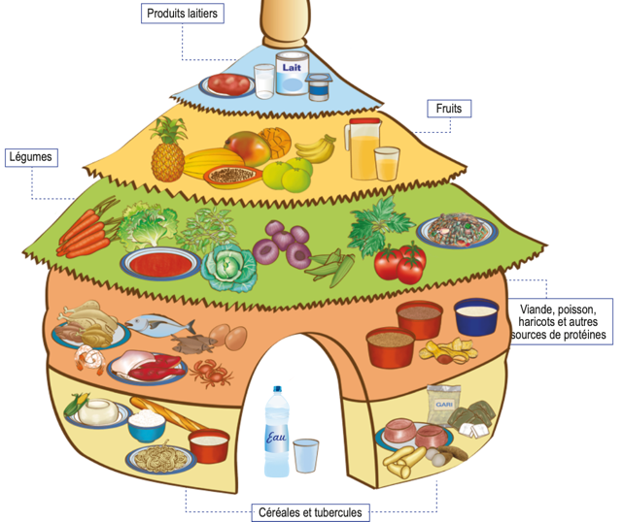
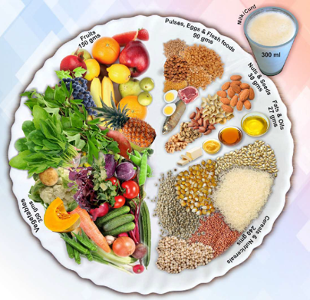
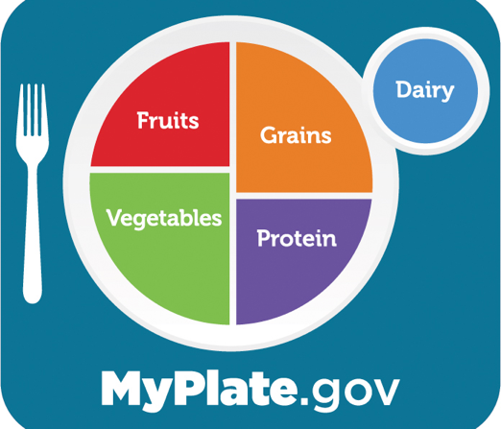
What is a healthy diet?
“…sufficient, safe, nutritious food to meet dietary needs and food preferences for an active and healthy life”
Based on food-based dietary guidelines (FBDG), which represent:
a realistic way for regular people to select nutrient-adequate diets
diets that protect health against NCDs
diets that are dignified and culturally appropriate
In nations where FBDG have been elaborated, they are the official policy standard for what constitutes dietary needs
social safety nets and nutrition education based on FBDG
Notes:
The method for finding the cost of a healthy diet starts with the question: What is a healthy diet?
Many countries have answered this question as a matter of national policy. The handiest definitions of a healthy diet are from food-based dietary guidelines,

Slide 8
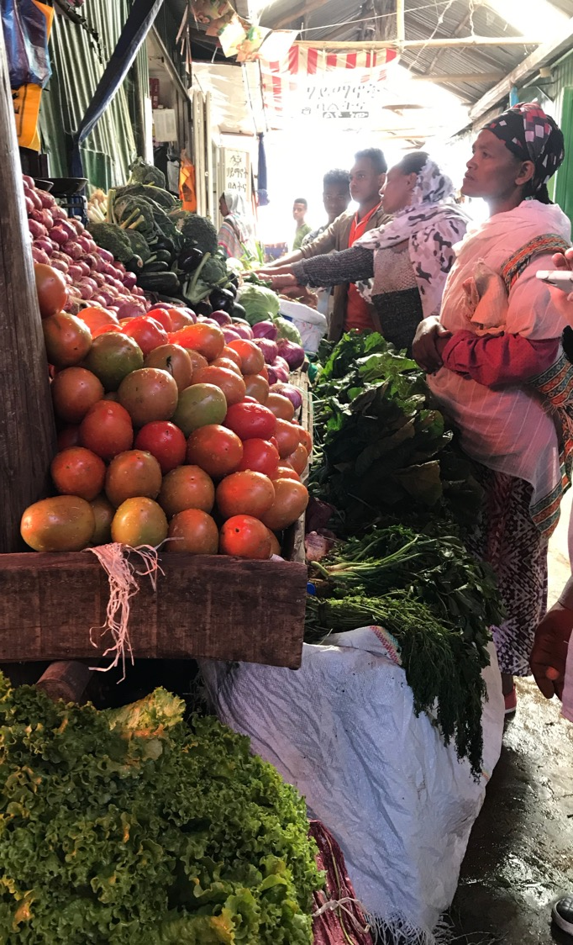
Aim
If you went to an average market in any country, how much would it cost to obtain a diet that satisfies dietary guidelines?
How many people could not afford this cost?
Photo: A Herforth, market in Ethiopia
Notes:
Taking as a standard that many nations have already defined what a healthy diet is, what we aim to do is then to find out…
This takes a consumer perspective of food prices and uses retail costs, as the costs people find in the market.
First, I want to talk about how we quantify the healthy diet.

Slide 9
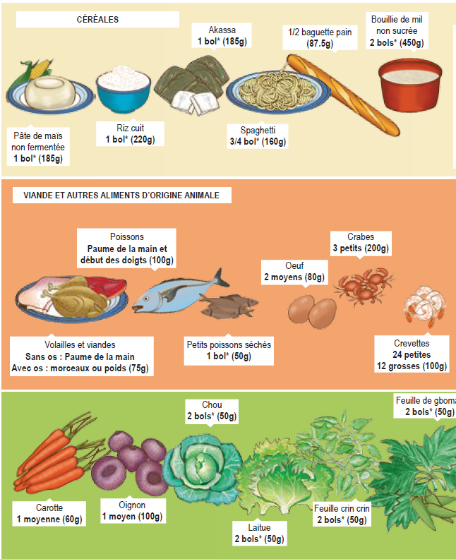
Benin’s quantitative food-based dietary guidelines
Food groups
Number of portions per day
Grams or calories per portion
Notes:
Dietary guidelines typically identify a number of required food groups, and the portions per day required of each, and then define the grams or calories per portion of each food group recommended. So the task is then to find out how much the recommended amount of each food group costs at retail prices in the market.

Slide 10
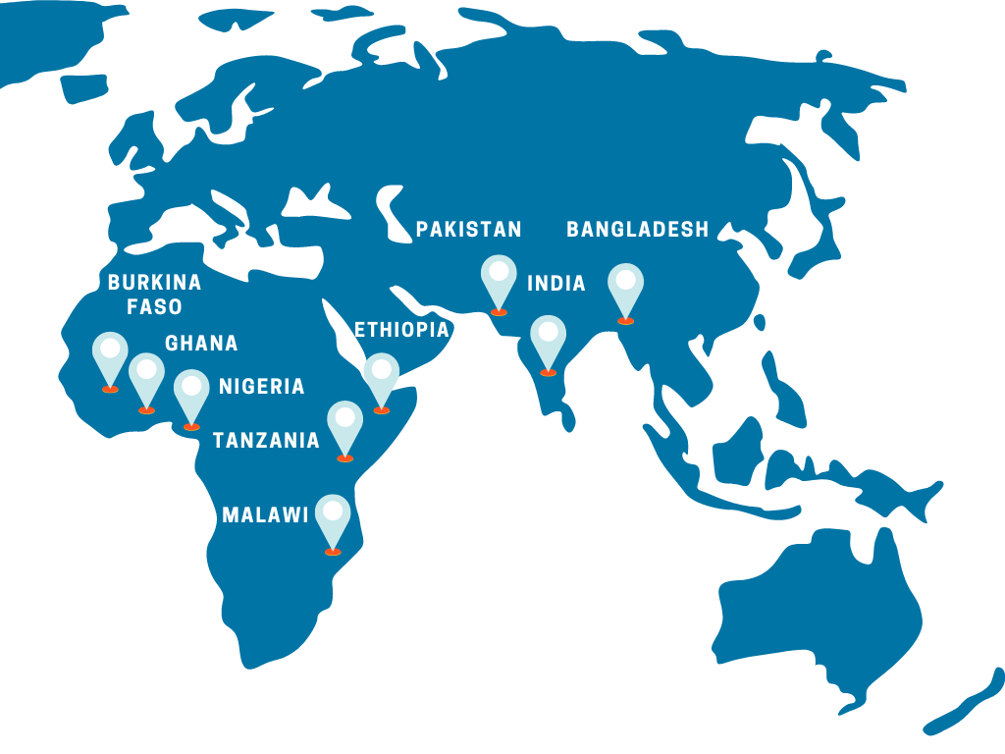
Cost of a Healthy Diet can be calculated in two ways
National: adherence to national FBDG
Meets specific countries’ guidelines, if quantified, to achieve policy coherence within countries.
Global: Healthy Diet Basket
Meets commonalities among national guidelines, to enable global comparability.
Used for annual updates to The State of Food Security and Nutrition in the World reports, as a standard of “access to nutritious food to meet dietary needs.”
Purpose is to help inform:
“What actions in the food system and agriculture need to be taken to improve access to healthy diets?”
Notes:
Food Prices for Nutrition project is working with several national governments. For example we’re working with Ethiopia right now to mainstream the costing of their first ever FBDGs, just released this year.
But at global level, we need a consistent standard to apply to all countries. Developing this standard was what we did to support FAO and reporting the indicator in the SOFI. We call this standard the Healthy Diet Basket.

Slide 11
A global standard set of criteria that represents commonalities across most national food based dietary guidelines, created for the purpose of calculating and comparing the cost and affordability of healthy diets across countries.
How do we build a Healthy Diet Basket?
Notes:
How do we build a healthy diet basket?
a global standard set of criteria that represents commonalities across most food based dietary guidelines globally, created for the purpose of calculating and comparing the cost and affordability of healthy diets across countries.
Six food groups make up the basket, which were the most universally recommended food groups. How did we identify the amounts of each?
Starchy staples contribute around half the calories for the basket
Oils and fats; animal source foods; legumes, nuts, and seeds all contribute around 13% each
Fruits contribute 7% of calories
Vegetables contribute around 5% of calories.

Slide 12
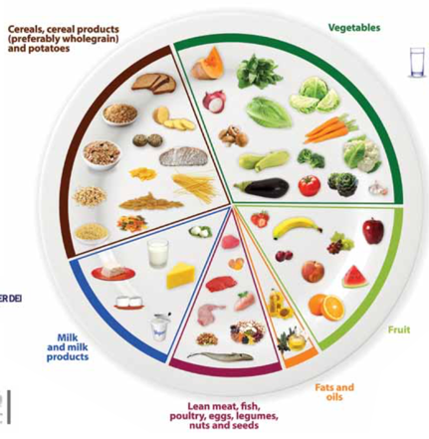
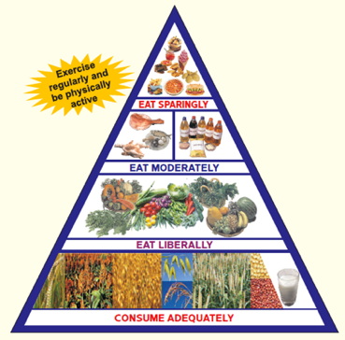
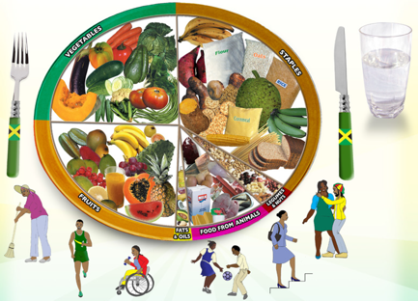
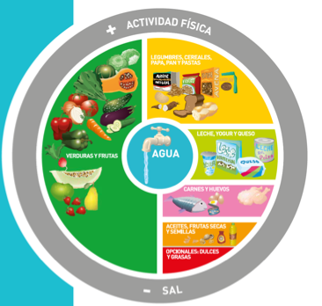
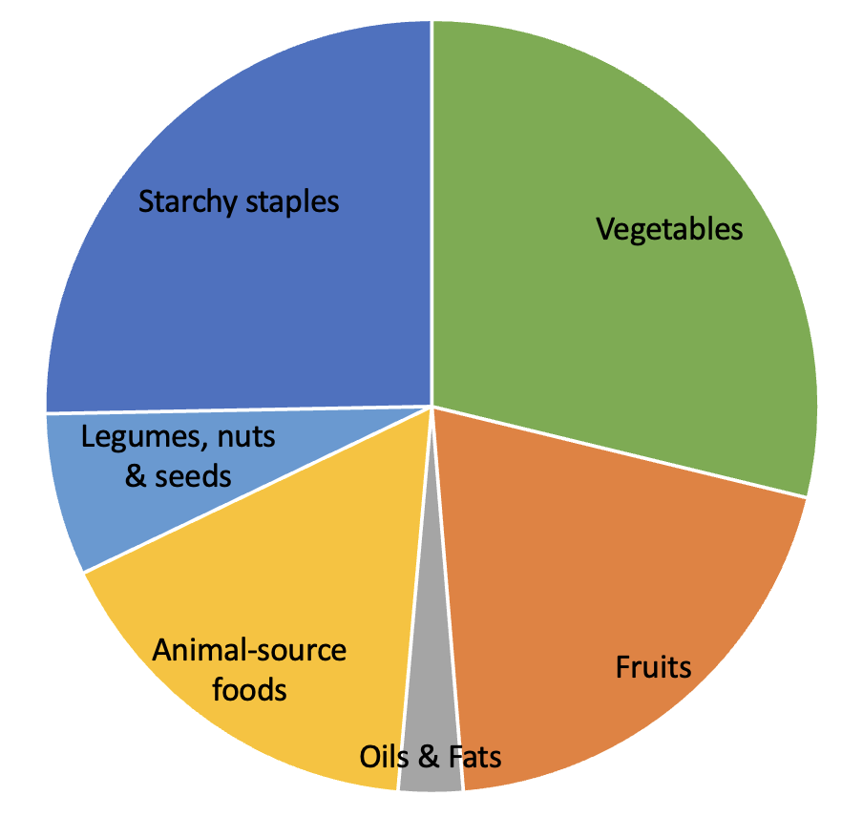
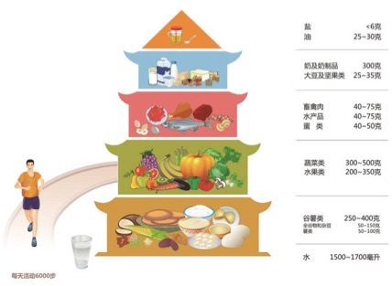
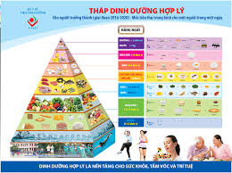
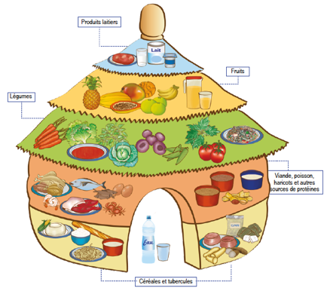
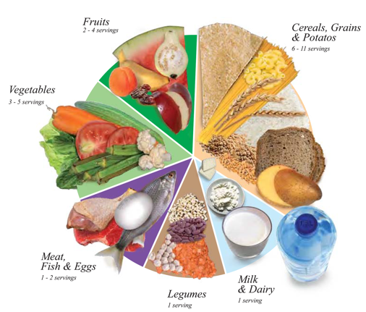
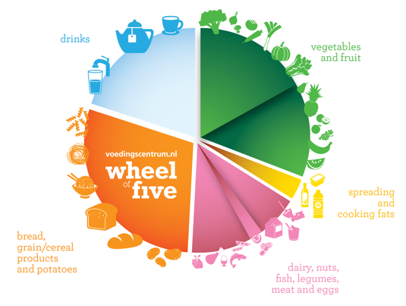
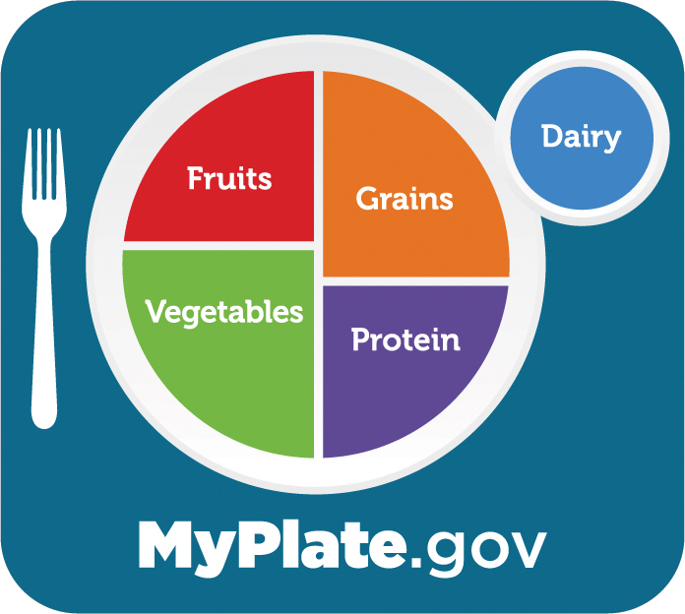
Jamaica
Argentina
India
Malta
China
Vietnam
Benin
U.S.A.
Oman
Netherlands
Notes:
We looked across a number of quantified guidelines, and found the average amounts recommended in each food group. Imagine overlaying each one on top of the other, and what you would see emerge is the average proportions of each food group, that make up the Healthy Diet Basket.
Why these 10 were selected: clearly quantified, recent, representing diverse regions.
They represent guidance given to a high % of the world’s population
HDB represents the median recommendations across 10 quantified FBDG, and is consistent with other non-quantified FBDG in terms of identity and proportionality of food groups.

Slide 13
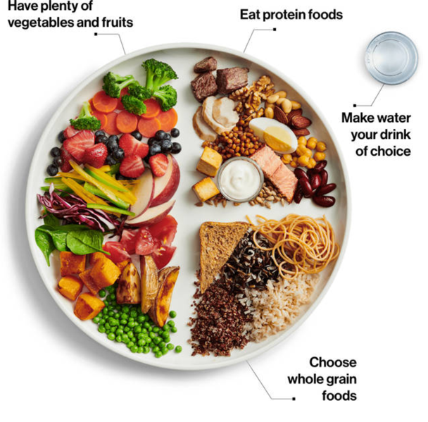
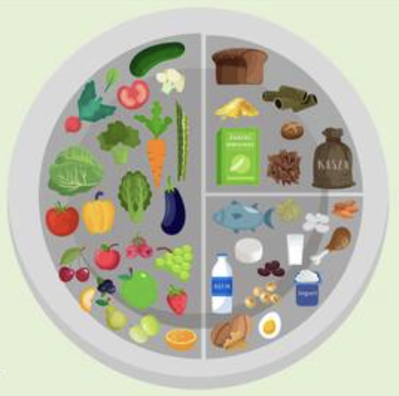
Healthy Diet Basket reflects the commonalities across guidelines in terms of food group proportions
About ¼ starchy staples by volume
About ½ fruits and vegetables by volume
About ¼ protein-rich foods by volume
Notes:
This is what the Healthy Diet Basket looks like. It’s about half fruits and veg by volume, a quarter each of starchy staples and protein rich foods by volume, and a small amount in starchy staples.
This grouping is the most common distribution of food groups seen in food guides in many countries, a couple of which are pictured here, Poland and Canada.
This is what the proportions look like in terms of volume on a plate. However, to calculate cost…

Slide 14
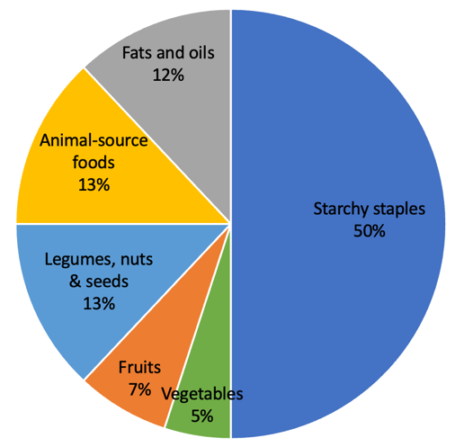
To calculate cost, items are selected in proportion to their share of dietary energy
1 oil or fat, totaling 300 kcal
2 starchy staples, totaling 1160 kcal
2 animal-source foods, totaling 300 kcal
11 items,
totaling 2330 kcal
1 legume, nut or seed, totaling 300 kcal
2 fruits, totaling 160 kcal
3 vegetables, totaling 110 kcal
Notes:
While fruits and veg account for about half by volume, Starchy staples account for half of dietary energy.
2330 kcal in total = energy needs of an average active woman
To calculate the cost of a healthy diet, we select a specified number of least-cost items in each food group, in amounts corresponding to their calorie share. 2 starchy staples…5 fruits and veg, to satisfy diversity requirements…1 legume nut or seed, 2 animal source foods, and 1 oil or fat. In all, 11 items are selected.
Note: dairy is included in animal-source foods. It often comes up as one of the cheapest items, but not always, in countries where dairy is not part of the food culture.
So why am I mentioning least cost?

Slide 15
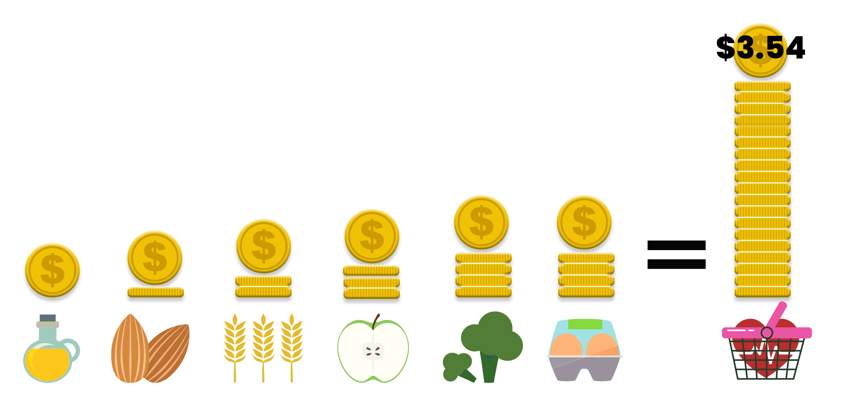
What is a least-cost healthy diet?
Food group proportions stay constant (share of kcal)
Food items are substitutable
Within food groups, what are the cheapest items?
The answer varies by season and market.
Least-cost diets set a lower bound.
Taste, preferences, and convenience add to the cost, and would raise the number of people who cannot afford the diet.
Notes:
A LEAST-COST healthy diet used by Food Prices for Nutrition uses the least expensive locally available foods at each time and place to fulfill each food group contribution to the healthy diet basket.
The food group proportions stay constant in the Healthy Diet Basket. The food items within each food group are substitutable. So within food groups, the cheapest items vary by season and place.
----
On average globally, in 2020 we find that the cost of a healthy diet using this method was $3.54. However, this varies by country. What stays constant is
There are eleven food items selected in each country to make up the basket, covering the six food groups:
Here you can see the average relative costs of each food group that form part of the total diet. Animal-source foods and vegetables each account for around 25% of the total cost, and fruits 20%. The costs of starchy staples and legumes, nuts, and seeds in the basket are lower around 15% and 11% respectively, with oils and fats typically accounting for around just 4%. Of course, these are global averages and relative costs are different in each country,.
Most marketplaces offer a variety of items meeting other needs, such as taste and convenience, which consumers with higher incomes can afford to buy.
CoRD-FP (food preferences) is a variant which is the cost of a diet meeting food-based dietary guidelines that accounts for local food preferences within each food group

Slide 16
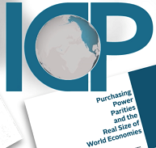
Food price dataset
For global analysis, we have used the World Bank’s International Comparison Program (ICP) dataset from 2017
Unique dataset of retail prices
Global and regional lists for 2017 include 680 foods & non-alcoholic beverages in 173 countries
Can use other retail food price data
Consumer Price Index data
Market research data
Notes:
All of these cost data have come from the single comprehensive global food price dataset in existence, from the WB ICP.
This is what we used for the global analysis. You can use…
We have developed tools to calculate the CoHD using your own data, will be available on our website, and are using these tools to help governments calculate the metrics from their own national data.
Income in low- and middle-income countries is measured as total household expenditure, meaning the value of all goods and services reported to have been consumed. (WB)
Prices are measured at retail marketplaces, defined as the locations where people typically acquire their food.
To compare prices across and within countries, national statistical agencies identify representative items at widely-used marketplaces, and observe their price at regular intervals. We use all prices reported by those national agencies, compiled by the WB ICP.

Slide 17
Example of least-cost items in Ghana, 2017, national data from ICP dataset
$3.77 (2017 PPP)
$0.15
Peanut oil
$0.17
Groundnuts
$0.55
Maize grains
Wheat flour
$0.40
Bananas
Coconut
$1.26
Onions
Carrots
Eggplants
$1.24
Chicken legs
Minced beef
Least-cost diets set a lower bound.
Taste, preferences, and convenience add to the cost, and would raise the number of people who cannot afford the diet.
This is a snapshot from 2017 – items and prices change over time
Notes:
A LEAST-COST healthy diet used by Food Prices for Nutrition uses the least expensive locally available foods at each time and place to fulfill each food group contribution to the healthy diet basket.
The food group proportions stay constant in the Healthy Diet Basket. The food items within each food group are substitutable. So within food groups, the cheapest items vary by season and place.
----
On average globally, in 2020 we find that the cost of a healthy diet using this method was $3.54. However, this varies by country. What stays constant is
There are eleven food items selected in each country to make up the basket, covering the six food groups:
Here you can see the average relative costs of each food group that form part of the total diet. Animal-source foods and vegetables each account for around 25% of the total cost, and fruits 20%. The costs of starchy staples and legumes, nuts, and seeds in the basket are lower around 15% and 11% respectively, with oils and fats typically accounting for around just 4%. Of course, these are global averages and relative costs are different in each country,.
Most marketplaces offer a variety of items meeting other needs, such as taste and convenience, which consumers with higher incomes can afford to buy.
CoRD-FP (food preferences) is a variant which is the cost of a diet meeting food-based dietary guidelines that accounts for local food preferences within each food group

Slide 18
Share of dietary energy
(Healthy Diet Basket standard)
Share of cost
(2017 ICP data for Ghana)

Slide 19
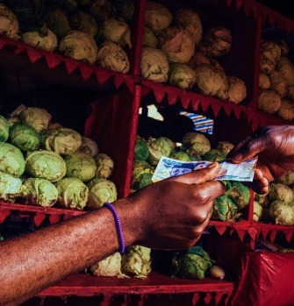
How many people cannot afford healthy diets?
In low-income countries, people spend an average of 52% of expenditures on food
Calculated from national accounts data compiled by the World Bank ICP
So, we compare the cost of each diet to 52% of income
Using World Bank estimated 2018 income distributions across 164 countries
In Ghana, the figure would be about 16% on average
Notes:
To find out how many people cannot afford healthy diets, we used World Bank income distribution data, and set the proportion of income available for food at 52%, which is the average % of expenditures on food in low-income countries.

Slide 20
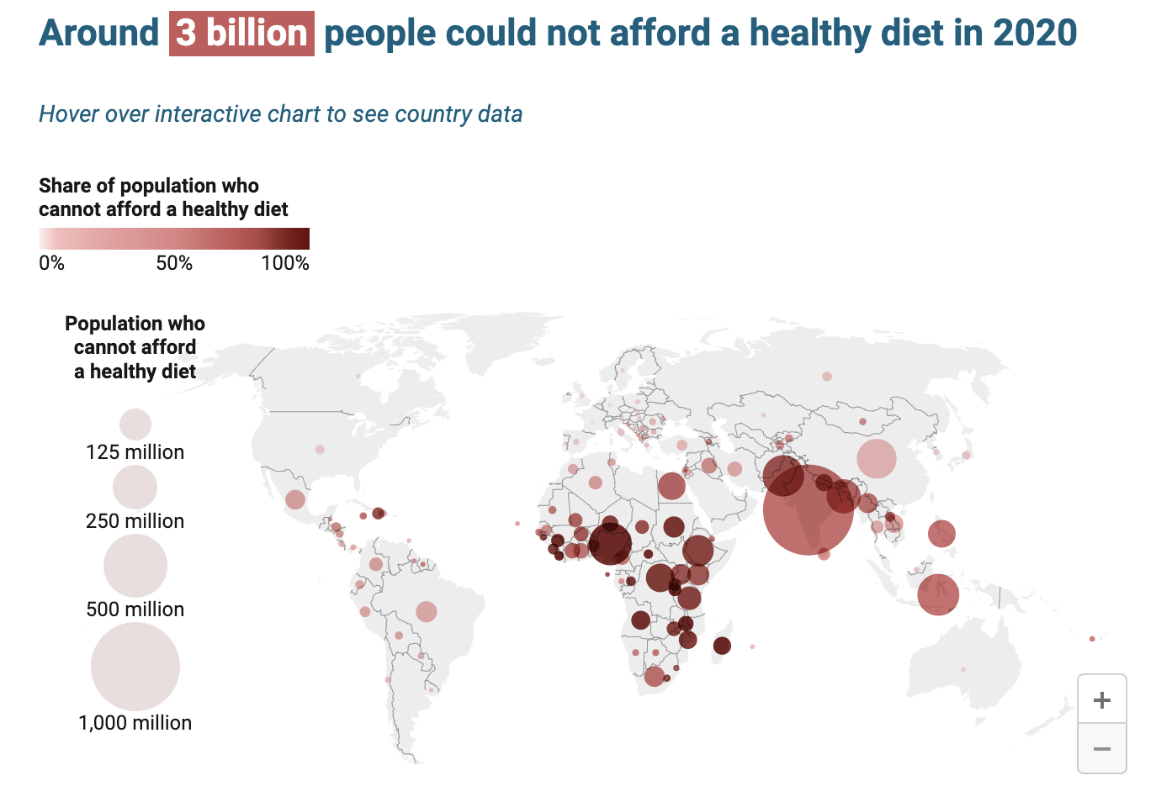
Est. 64% of people in Ghana
Source: FAO, 2022.
Map source: Food Prices for Nutrition DataHub
https://www.worldbank.org/en/programs/icp/brief/foodpricesfornutrition
Notes:
Using this method, we find that…
This statistic was published by FAO et al. last week, and you can now find the information here on our [FPN] DataHub hosted at the World Bank.

Slide 21
These indicators are available on the Food Prices for Nutrition DataHub
data.worldbank.org
Notes:
And if you go to data.worldbank.org, you can select the Food Prices for Nutrition series and download the data.

Slide 22
A lot more could be done with Ghana’s food price data
Updated prices – rather than extrapolating from an annual average for 2017
Longer food list – may lead to more accurate identification of least-cost items
Monthly prices – ability to see changes over seasons
Sub-national prices – ability to see differences between regions in cost and affordability

Slide 23
What is happening in other countries?
Nigeria: incorporating CoAHD into national food systems dashboard
Ethiopia: using the indicators to find the cost and affordability of new FBDGs, to bring implementation of FBDG into the agriculture sector, and serve the purpose of the food systems transformation plan and roadmap (from the UN Food Systems Summit process)
Pakistan: FAO Pakistan is producing a national report (State of Food Security and Nutrition in Pakistan) aligned with the global SOFI report
All efforts are in partnership with statistics offices

Slide 24
Affordability of a healthy diet across States
Unaffordability: % of households with food exp. below the cost of healthy diet
Ebonyi (with 77%) ranks as the least-affordable and Lagos (with 5%) as most-affordable.
A healthy diet is relatively affordable in:
Southern states:
Lagos (SW)
Oyo (SW)
Ondo (SW)
Delta (SS)
Northern states
Benue (NC)
Kwara (NC)
Kebbi (NW)
Source: Daniel Mekonnen
Analysis of Nigeria Living Standards Survey 2018/19

Slide 25
Suggestions from IANDA stakeholder workshop in Ghana (2017)
To enhance monitoring of and advocacy for improved food and nutrition security.
district-, regional-, national- and internal level programming and policymaking
Useful for intersectoral decision-making, such as agriculture, nutrition, and linkages between the two
To inform important social programmes in Ghana
for example, school feeding programmes could use the indicators for provision of low-cost, nutritious meals
Visualize using spatial mapping and link to nutritional outcomes
Use as a next step after Cost of Hunger analysis in SUN

Slide 26
Monitoring the Price of Nutritious Diets in Ghana
John Nortey and Eunice Arhin
MSU, SRID/MoFA – Ghana

Slide 27
Agriculture and Food Systems
Food Access
Diet Quality
Nutrition
Improving availability and affordability of nutritious food is a way that Agriculture can improve nutrition.
MoFA aims to help ensure economic viability for farming in Ghana, and also food and nutrition security for Ghana.

Slide 28
Some missing information...
…to know if what we are doing is positive for nutrition;
…to support decision-making about what we can do to better improve nutrition.

Slide 29
MoFA has a mandate to ensure food security.
This includes access to nutritious foods.
MoFA-SRID supports this mandate, provides information for decision-making in agriculture, by tracking production and food price data.
Collects prices on a weekly basis in 164 markets nationwide.
This provides a powerful structure to track access to nutritious food.

Slide 30
Current Uses of Food Price Data
For making quality informed decisions
Planning
Calculating real prices
To compare prices across countries
Research purposes
Food security analysis
Policy formulation, project implementation, monitoring and evaluation

Slide 31
Need to fill an information gap
Previously, the food list for food price data collection was missing some nutritious foods.
Could be used for many basic commodities, but could not very well track the cost of nutritious diets.
Difficult to formulate informed policies and programs toward food and nutrition security without data showing the problem areas

Slide 32
Partnership with IANDA: Updating MoFA food list
IANDA reviewed current MoFA-SRID food list and suggested commonly-consumed nutritious foods to be added;
22 foods added in all; most worked well
Such as: several dark green leafy vegetables; some fruits; two additional beans/seeds; meat and fish in the form typically bought by consumers
MoFA-SRID piloted the expanded list and made the decision to institutionalize it

Slide 33
State of Institutionalization
Expanded Food list Questionnaire sent to all 10 regional offices and 20 major selected markets have started using it
Weekly Market Price Reports are now generated for the expanded food list since July 2017

Slide 34
Partnership with IANDA: Tracking indicators
IANDA developed new indicators
Cost of Recommended Diet (CoRD)
Nutritious food price Index (NPI)
Using the recently-expanded food list, MoFA-SRID can track these indicators using food price monitoring data

Slide 35
Better Information for decision-making for Nutrition Impact
MoFA can use these indicators for decision-making toward a more nutritious food system
Could see where, and when, nutritious diets are too expensive
MoFA-SRID is continuing to roll out the expanded food list nationwide
Ghana Statistical Service is exploring reporting the new indicators as national statistics
Notes:
Use of SRID data: 1. For making quality informed decisions, 2. Planning, 3. Calculating real prices, 4. To compare prices across countries, 5. Research purposes,
6. Food security analysis, 7. Policy formulation, project implementation, monitoring and evaluation
Note that quality of data matters
The new indicators would be less realistic and informative without the expanded food list
Advantage: Ghana has a longstanding, well-functioning food price monitoring system which provides high-quality data and allows for adjustments to improve data.

Slide 36
Conclusion
Existing food price data monitoring system can be used, with very little added cost, to provide better information for nutrition impact
Ghana would like to commit to monitoring the cost of nutritious diets
This can be a model for how food price monitoring can reflect nutritious food, and how it can better inform policy, production, and program decisions to promote healthy diets

Slide 37
Deciding on Next Steps
#1 PRODUCE the indicator
#2 PUBLISH the indicator
#3 USE the indicator

Slide 38
Food Price Data Sources / Uses
GSS: national monitoring
MoFA: informing market opportunities for less accessible food groups
Esoko: who are the data users?
Notes:
[Question for Institutions]

Slide 39
Could also use as a unit-free index
Previously discussed as the “NPI”
Uses all items in the CPI food list, but reweighted according to nutritional need and preference
weighted by their expenditure shares, instead of only least-cost items.
Reflects food preferences, while holding fixed the proportions of food groups to meet dietary guidelines.
In contrast to “least cost”
Notes:
Can be useful to understand the cost of a more culturally preferable diet – and how much of a premium it has compared to least-cost.

Slide 40
Least-cost healthy diet
Minimum cost needed to meet dietary guidelines.
It always provides a balanced diet, but might not be the most preferred foods.
Food group | Least-cost items in Ghana in 2017
Starchy staples | Maize grains, wheat flour
Protein-rich foods | Groundnuts
Dairy | Chicken legs, minced beef
Fruits | Banana, coconut
Vegetables | Onion, carrot, eggplant
Oils | Peanut oil

Slide 41
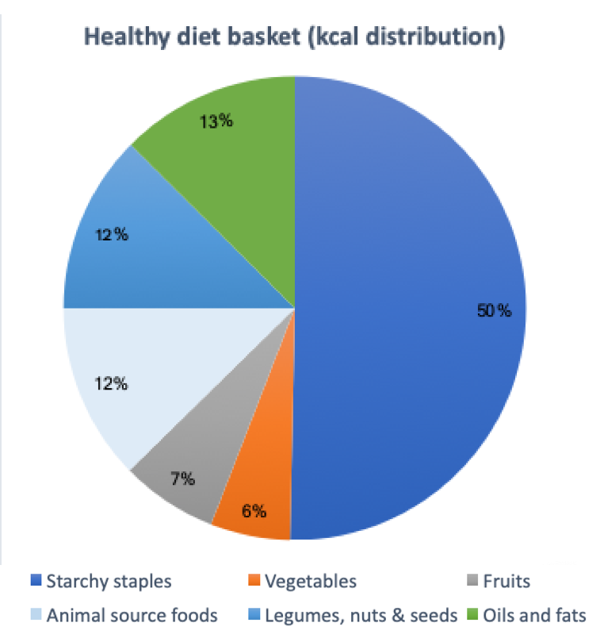
NPI weights
Hold food group proportions fixed
Each food group gets a weight
Within food group:
Least-cost: selects only 1-3 least-cost items weighted equally
NPI: select all items, weighted by expenditure share within the food group

Slide 42
Demonstration: how a least-cost healthy diet differs from one incorporating preference weights
Source: ​Herforth, A., Bai, Y., Venkat, A., Mahrt, K., Ebel, A. & Masters, W.A. 2020. Cost and affordability of healthy diets across and within countries. Background paper for The State of Food Security and Nutrition in the World 2020. FAO Agricultural Development Economics Technical Study No. 9. Rome, FAO. https://doi.org/10.4060/cb2431en
Notes:
We did demonstrate this diet in the FAO SOFI Background paper – but only in 1 country case study. We cannot apply it across countries because we don’t have expenditure weights for all countries.

