Slide 1
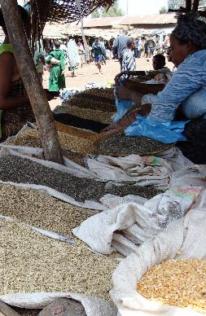
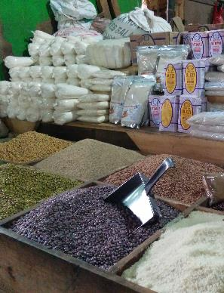
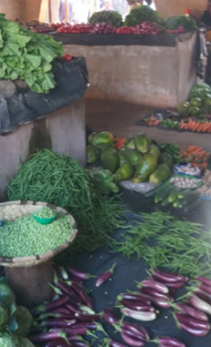
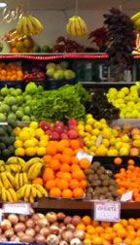
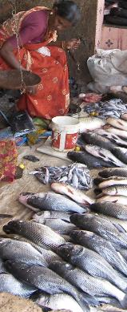
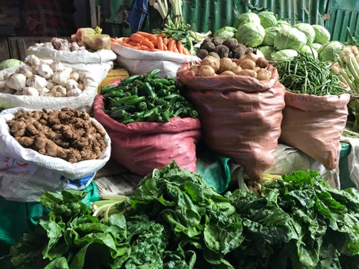
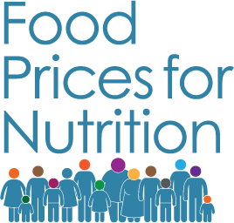
Cost and Affordability of Healthy Diets and implications for sustainability
November 16, 2022
Dr. Anna Herforth
Co-Director, Food Prices for Nutrition
#FoodPricesforNutrition
sites.tufts.edu/foodpricesfornutrition
www.worldbank.org/foodpricesfornutrition

Slide 2
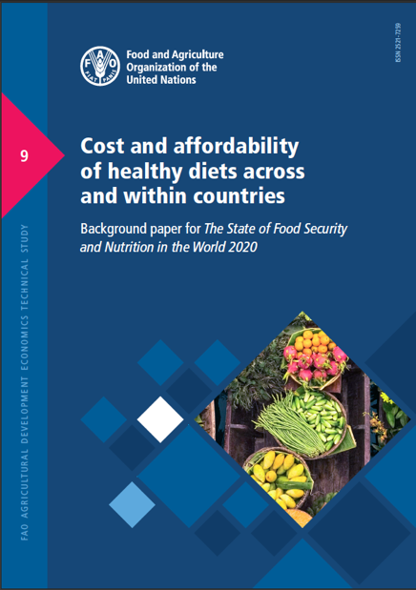
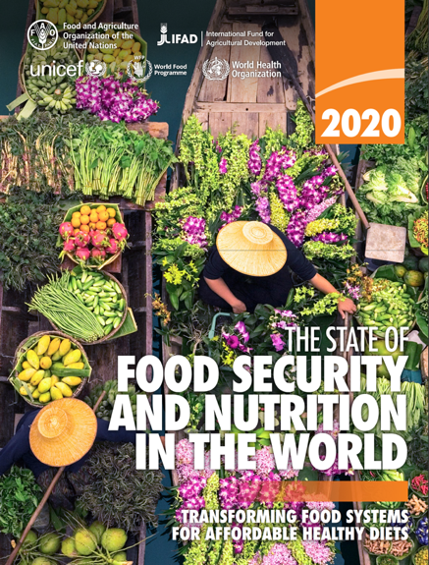
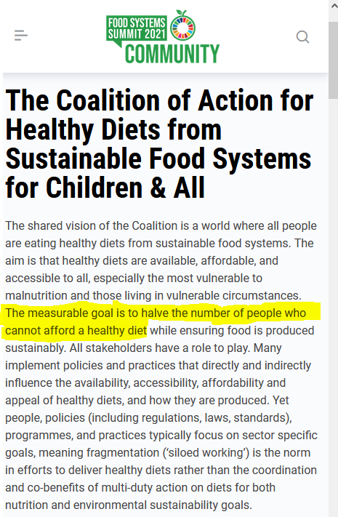
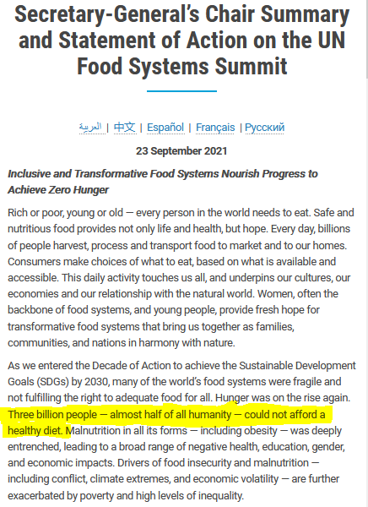
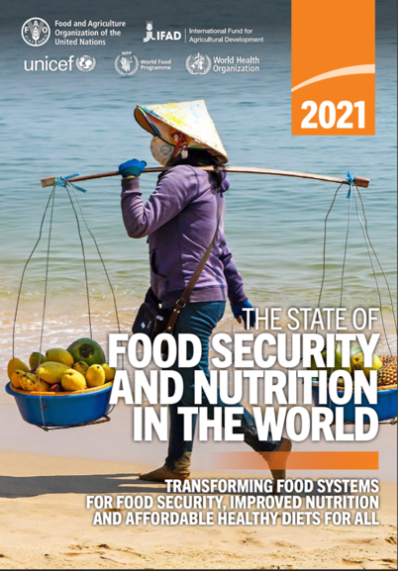
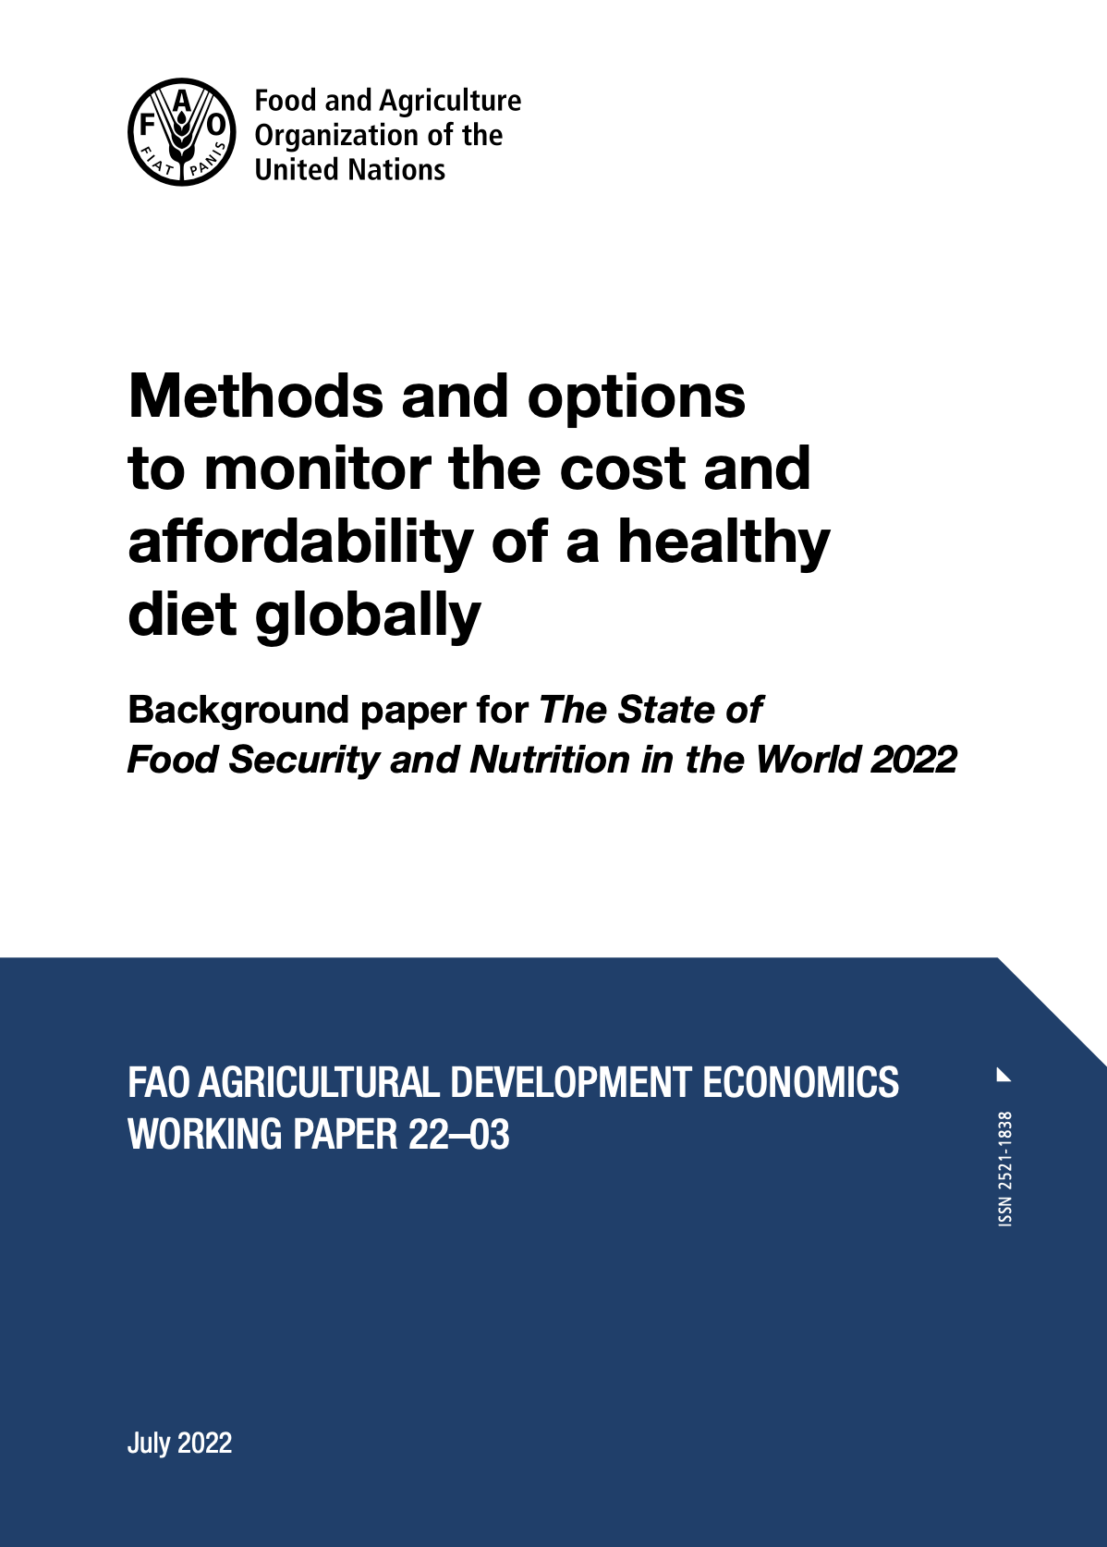
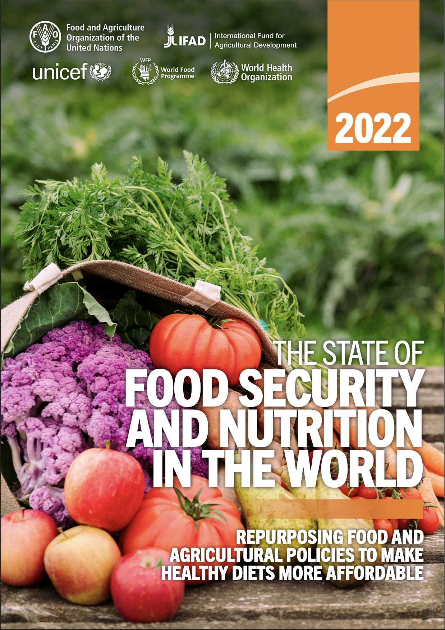
Cost and Affordability of a Healthy Diet: indicators to understand food access
Used in the UN State of Food Security and Nutrition in the World (2020, 2021, 2022), joining other food security metrics
These data provide actionable new targets, as in the UN Food Systems Summit of 2021
Herforth et al. 2020, 2022
Notes:
https://www.fao.org/publications/sofi/en/
Source: UN Food System Summit (New York: United Nations): https://www.un.org/en/food-systems-summit/news/making-food-systems-work-people-planet-and-prosperity; https://foodsystems.community/coalitions/the-coalition-of-action-for-healthy-diets-from-sustainable-food-systems-for-children-all

Slide 3
Vision: Food price measurement to match this aspiration
Food security is…
when all people, at all times, have physical and economic access to sufficient, safe, nutritious food to meet dietary needs and food preferences for an active and healthy life.
- World Food Summit, 1996
Notes:
The Food Prices for Nutrition Project arose out of this vision: That food price measurement should match the globally held aspiration toward food security, adopted over 25 years ago.
Until now, food security measurement has not reflected this definition in full. It has centered on availability and access to calories, and more recently reported experience.
The cost and affordability of a healthy diet add the dimension of economic access to nutritious food to meet dietary needs.
Prevalence of Undernourishment
hunger – how many people cannot access sufficient calories
Food Insecurity Experience Scale
how many people experience moderate or severe food insecurity
Affordability of a Healthy Diet
how many people cannot afford the minimum cost of a healthy diet following dietary guidelines

Slide 4
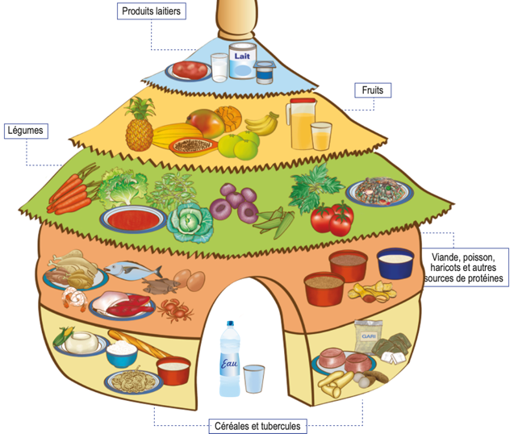
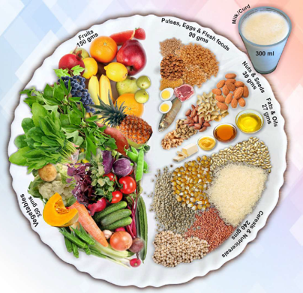
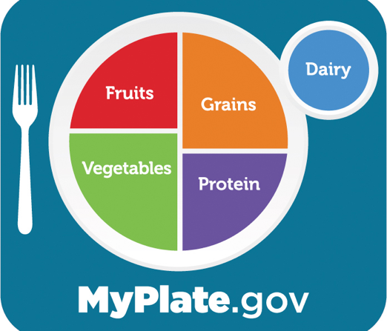
What is a healthy diet?
“…sufficient, safe, nutritious food to meet dietary needs and food preferences for an active and healthy life”
Based on food-based dietary guidelines (FBDG), which represent:
a realistic way for regular people to select nutrient-adequate diets
diets that protect health against NCDs
diets that are dignified and culturally appropriate
In nations where FBDG have been elaborated, they are the official policy standard for what constitutes dietary needs
social safety nets and nutrition education based on FBDG
Notes:
The method for finding the cost of a healthy diet starts with the question: What is a healthy diet?
Many countries have answered this question as a matter of national policy. The handiest definitions of a healthy diet are from food-based dietary guidelines,

Slide 5
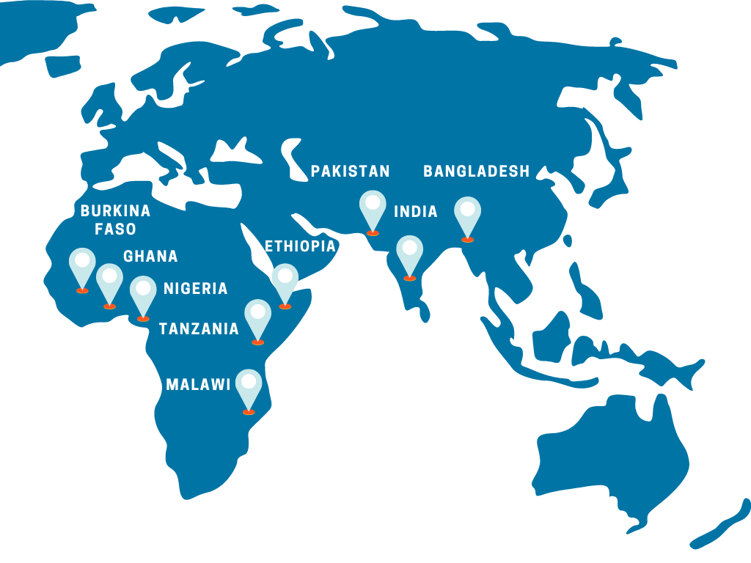
Cost of a Healthy Diet can be calculated in two ways
National: adherence to national FBDG
Meets specific countries’ guidelines, to achieve policy coherence within countries.
Global: Healthy Diet Basket
Meets commonalities among national guidelines, to enable global comparability.
Used for annual updates to The State of Food Security and Nutrition in the World reports, as a standard of “access to nutritious food to meet dietary needs.”
Notes:
Food Prices for Nutrition project is working with several national governments. For example we’re working with Ethiopia right now to mainstream the costing of their first ever FBDGs, just released this year.
But at global level, we need a consistent standard to apply to all countries. Developing this standard was what we did to support FAO and reporting the indicator in the SOFI. We call this standard the Healthy Diet Basket.

Slide 6
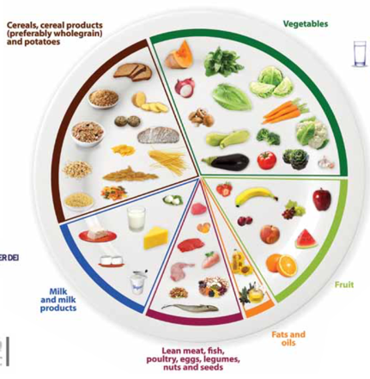
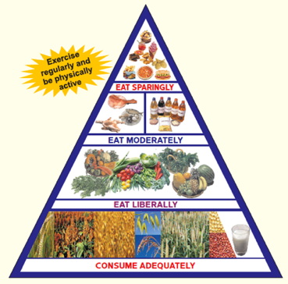
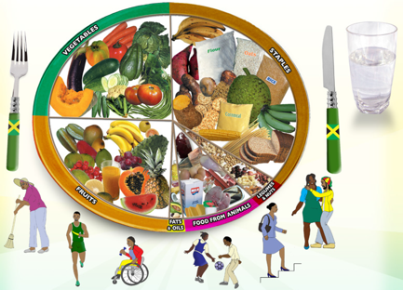
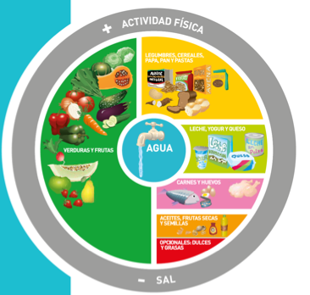
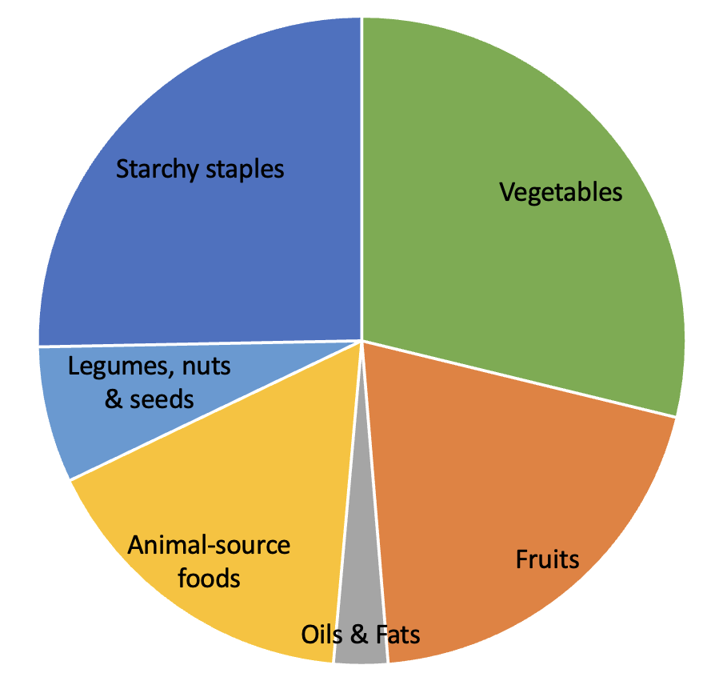
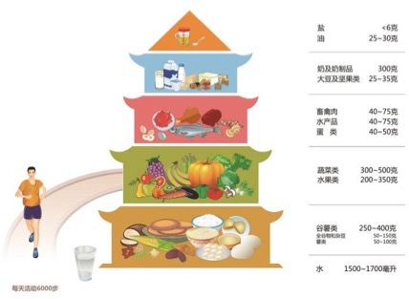
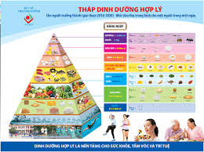
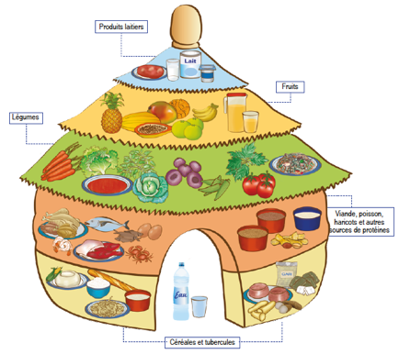
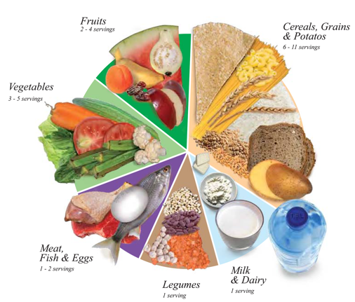
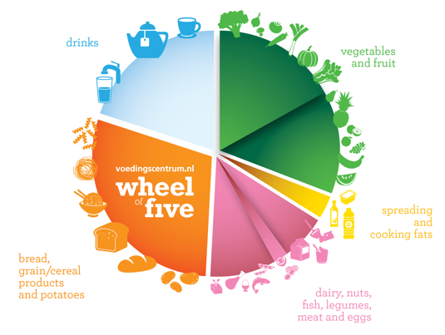
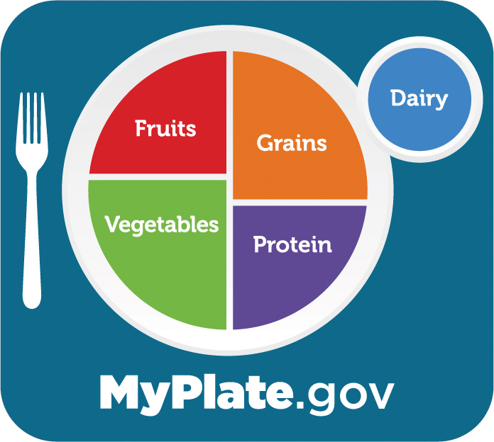
Jamaica
Argentina
India
Malta
China
Vietnam
Benin
U.S.A.
Oman
Netherlands
Notes:
We looked across a number of quantified guidelines, and found the average amounts recommended in each food group. Imagine overlaying each one on top of the other, and what you would see emerge is the average proportions of each food group, that make up the Healthy Diet Basket.
Why these 10 were selected: clearly quantified, recent, representing diverse regions.
They represent guidance given to a high % of the world’s population
HDB represents the median recommendations across 10 quantified FBDG, and is consistent with other non-quantified FBDG in terms of identity and proportionality of food groups.

Slide 7
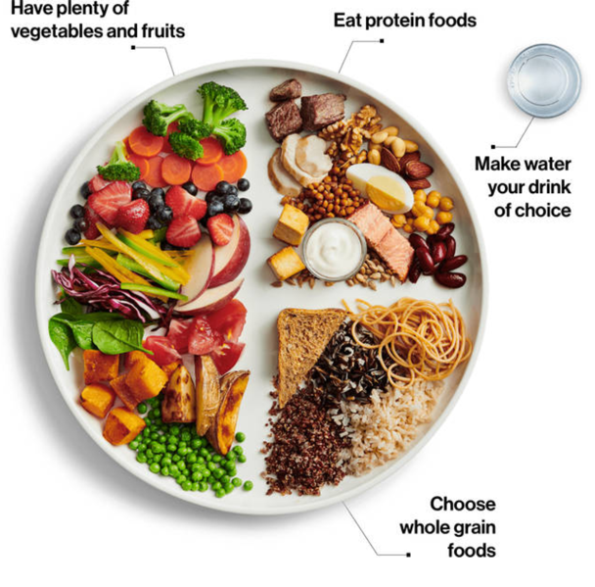
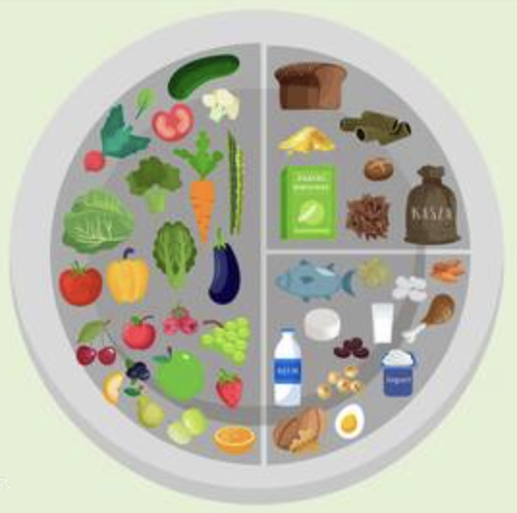
Healthy Diet Basket reflects the commonalities across guidelines in terms of food group proportions
About ¼ starchy staples by volume
About ½ fruits and vegetables by volume
About ¼ protein-rich foods by volume
Notes:
This is what the Healthy Diet Basket looks like. It’s about half fruits and veg by volume, a quarter each of starchy staples and protein rich foods by volume, and a small amount in starchy staples.
This grouping is the most common distribution of food groups seen in food guides in many countries, a couple of which are pictured here, Poland and Canada.
This is what the proportions look like in terms of volume on a plate. However, to calculate cost…

Slide 8
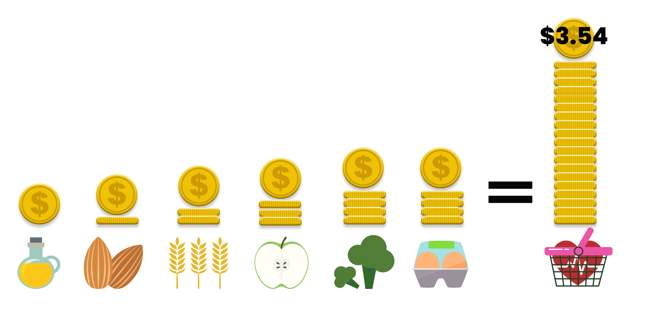
What is a least-cost healthy diet?
Food group proportions stay constant (share of kcal)
Food items are substitutable
Within food groups, what are the cheapest items?
The answer varies by season and market.
Least-cost diets set a lower bound.
Taste, preferences, and convenience add to the cost, and would raise the number of people who cannot afford the diet.
Notes:
A LEAST-COST healthy diet used by Food Prices for Nutrition uses the least expensive locally available foods at each time and place to fulfill each food group contribution to the healthy diet basket.
The food group proportions stay constant in the Healthy Diet Basket. The food items within each food group are substitutable. So within food groups, the cheapest items vary by season and place.
----
On average globally, in 2020 we find that the cost of a healthy diet using this method was $3.54. However, this varies by country. What stays constant is
There are eleven food items selected in each country to make up the basket, covering the six food groups:
Here you can see the average relative costs of each food group that form part of the total diet. Animal-source foods and vegetables each account for around 25% of the total cost, and fruits 20%. The costs of starchy staples and legumes, nuts, and seeds in the basket are lower around 15% and 11% respectively, with oils and fats typically accounting for around just 4%. Of course, these are global averages and relative costs are different in each country,.
Most marketplaces offer a variety of items meeting other needs, such as taste and convenience, which consumers with higher incomes can afford to buy.
CoRD-FP (food preferences) is a variant which is the cost of a diet meeting food-based dietary guidelines that accounts for local food preferences within each food group

Slide 9
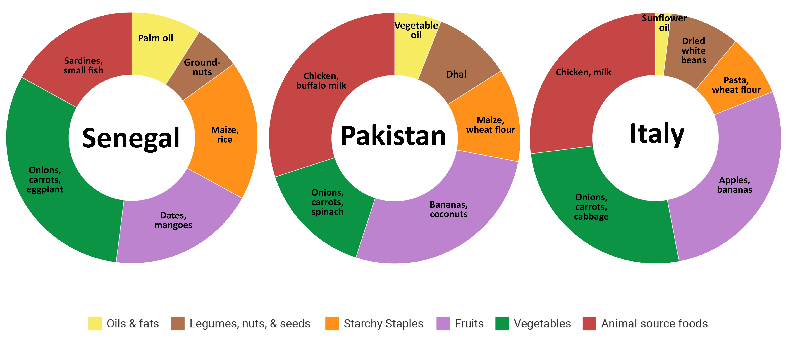
Least-cost items and cost share, 2017
Notes:
As the basket is based on locally available foods, the healthy diet basket in one country will look different in each time and place.
For example, at the time the ICP data were collected, in Senegal sardines form part of the animal-source group, whereas in Pakistan and Italy chicken and milk are included. Dates and mangoes are chosen for the fruits group in Senegal, whilst bananas and coconuts are the fruit inputs in Pakistan, and Italy has apples and bananas. Onions, and carrots feature in the healthy basket of all three countries.
You can also see here that the relative cost of each food group varies, while the calories of each food group is constant, using the Healthy Diet Basket method.
Note that starchy staples account for a small cost share, even though they are 50% of the calorie share. Nutrient-dense non-staples are more expensive, so clearly you can see why people who cannot afford the diet have starch-heavy diets.
Now I would like to turn to the food price data we have used to identify these costs for each country.

Slide 10
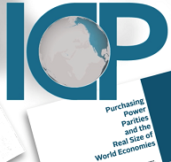
Food price dataset
For global analysis, we have used the World Bank’s International Comparison Program (ICP) dataset from 2017
Unique dataset of retail prices
Global and regional lists for 2017 include 680 foods & non-alcoholic beverages in 173 countries
Notes:
All of these cost data have come from the single comprehensive global food price dataset in existence, from the WB ICP.
This is what we used for the global analysis. You can use…
We have developed tools to calculate the CoHD using your own data, will be available on our website, and are using these tools to help governments calculate the metrics from their own national data.
Income in low- and middle-income countries is measured as total household expenditure, meaning the value of all goods and services reported to have been consumed. (WB)
Prices are measured at retail marketplaces, defined as the locations where people typically acquire their food.
To compare prices across and within countries, national statistical agencies identify representative items at widely-used marketplaces, and observe their price at regular intervals. We use all prices reported by those national agencies, compiled by the WB ICP.

Slide 11
Diet costs vary but are
not linked to national income

Slide 12
Diet costs vary but are
not linked to national income
and rose in 2020 (+ 2021-2022)
2017 (dots)
2017

Slide 13
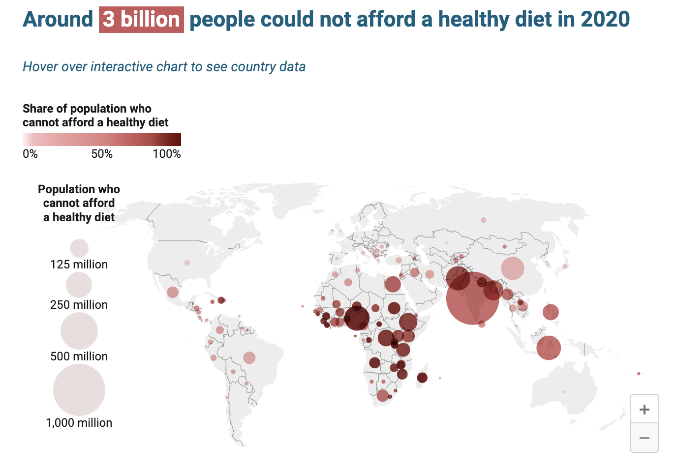
Source: FAO, 2022.
Map source: Food Prices for Nutrition DataHub
www.worldbank.org/foodpricesfornutrition
Notes:
This statistic was published by FAO, and you can now find the information here on our [FPN] DataHub hosted at the World Bank.

Slide 14
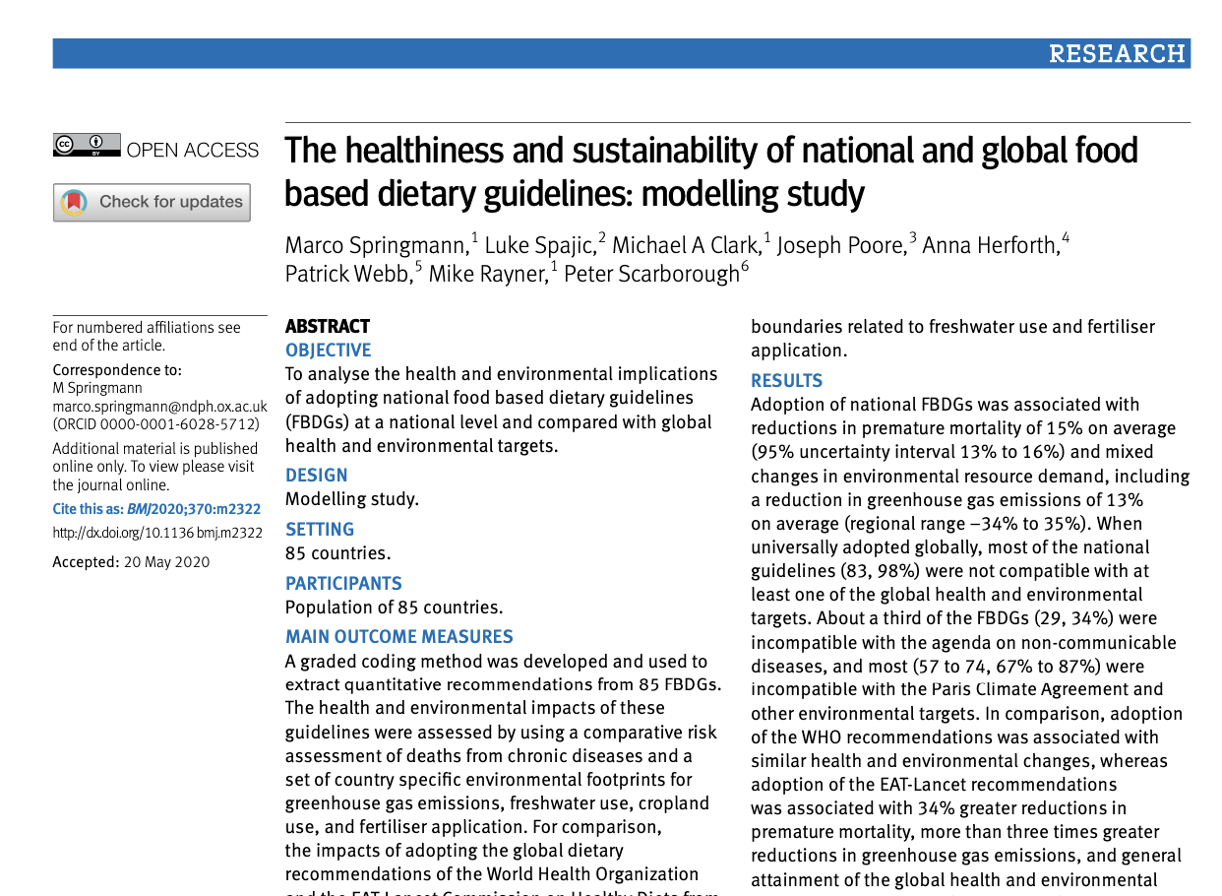
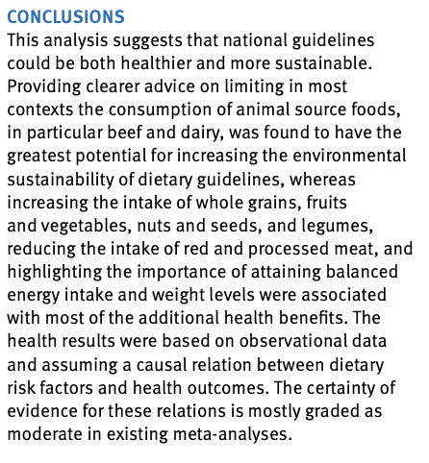
But are dietary guidelines sustainable?
Notes:
This is true on a case by case basis for individual guidelines; and it is certainly an important principle for countries to incorporate into their dietary guidelines – both for reasons of sustainability, and cost! Because ASF tend to be the most expensive food group, as it should be with regard to basic ecological principles.
But when looking at the average amounts recommended across FBDGs – and the foods that are least cost in each food group – we find an interesting result:

Slide 15
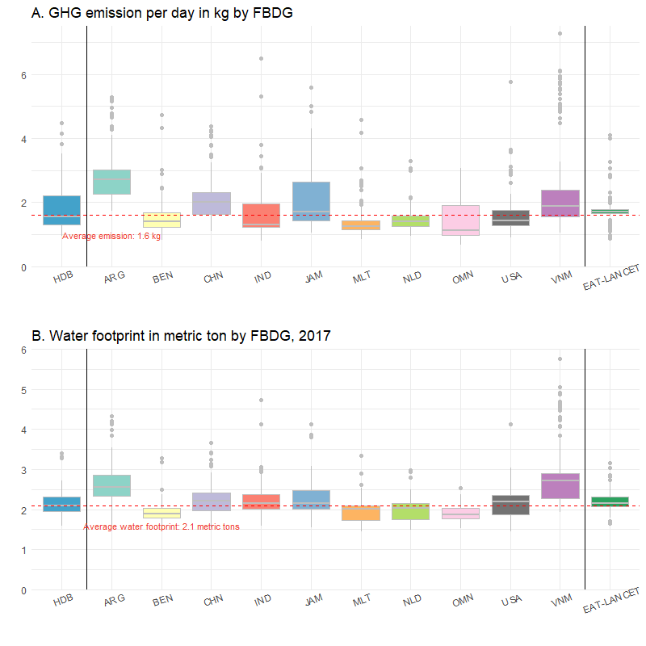
Least-cost diets following the HDB have about the same environmental impact as the EAT-Lancet Diet
Why?
Amount of ASF in HDB is the same as in EAT
Implication: no need to calculate a separate least-cost diet to get to “healthy AND sustainable”
Source: Herforth, Bai and Masters, in preparation
Notes:
What does it cost to eat a healthy and sustainable diet?
No more than the least-cost healthy diet.
Arg is higher because they have no legumes in the protein rich group.

Slide 16
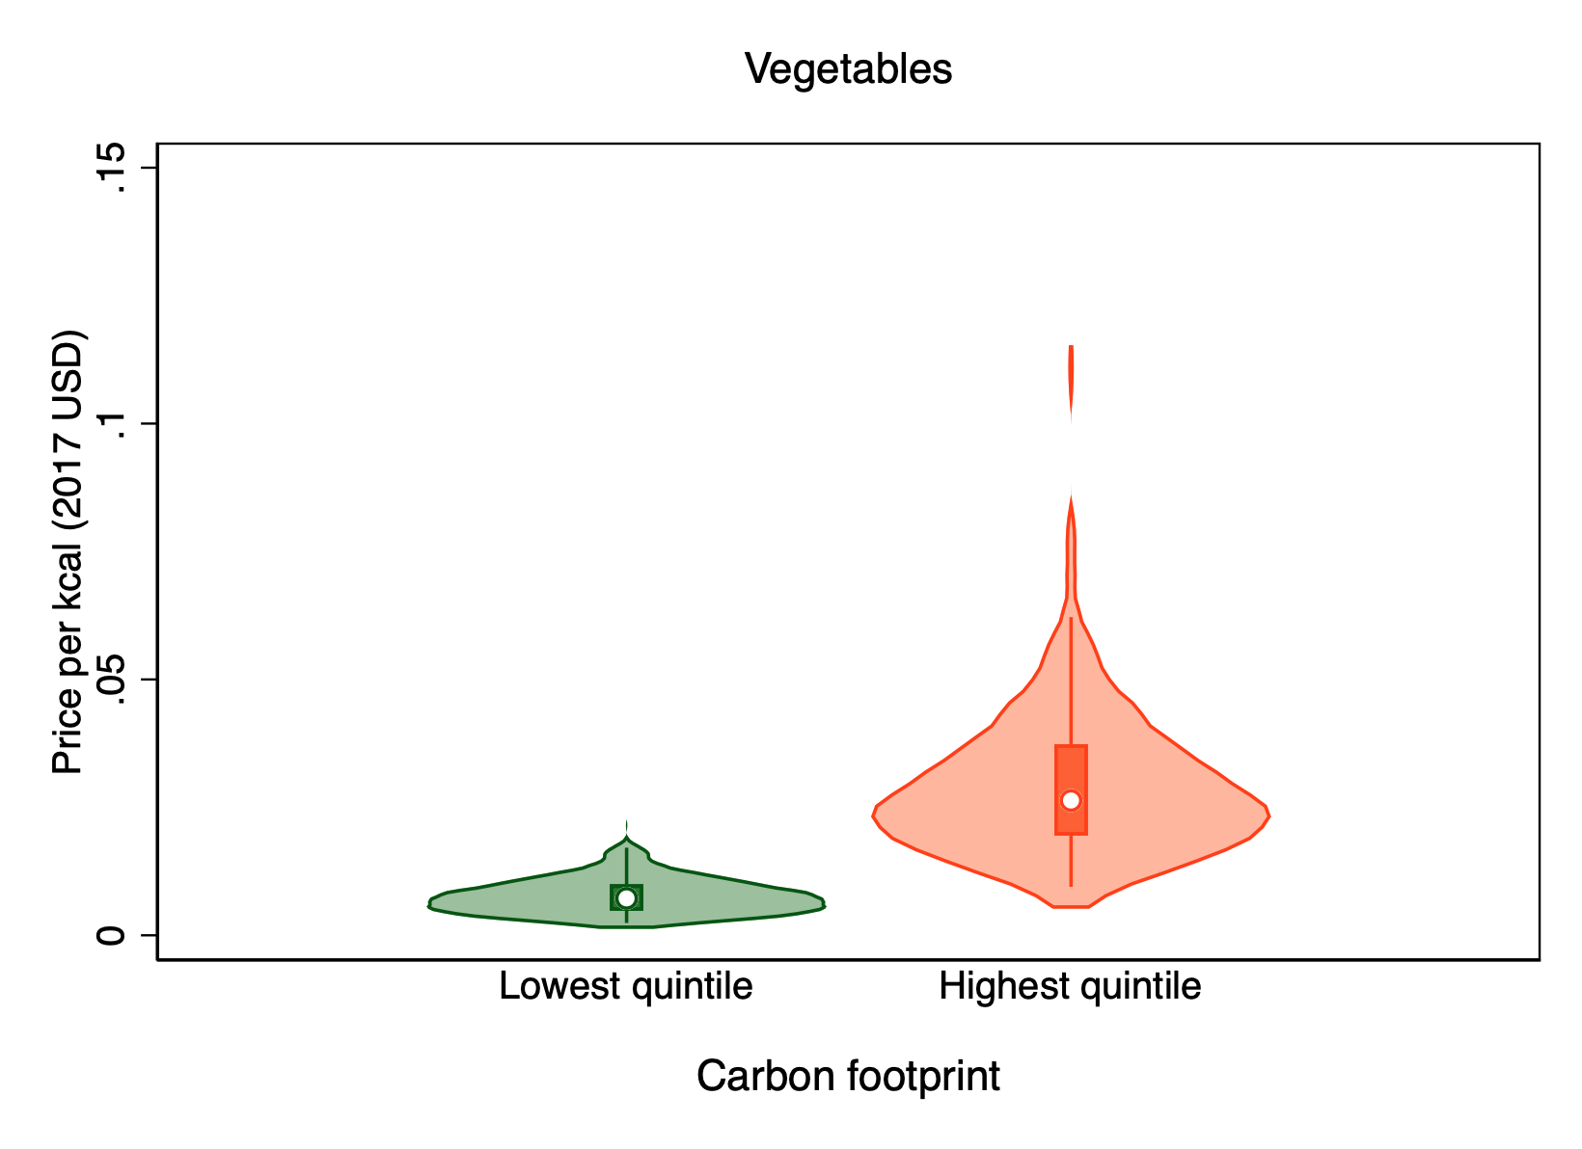
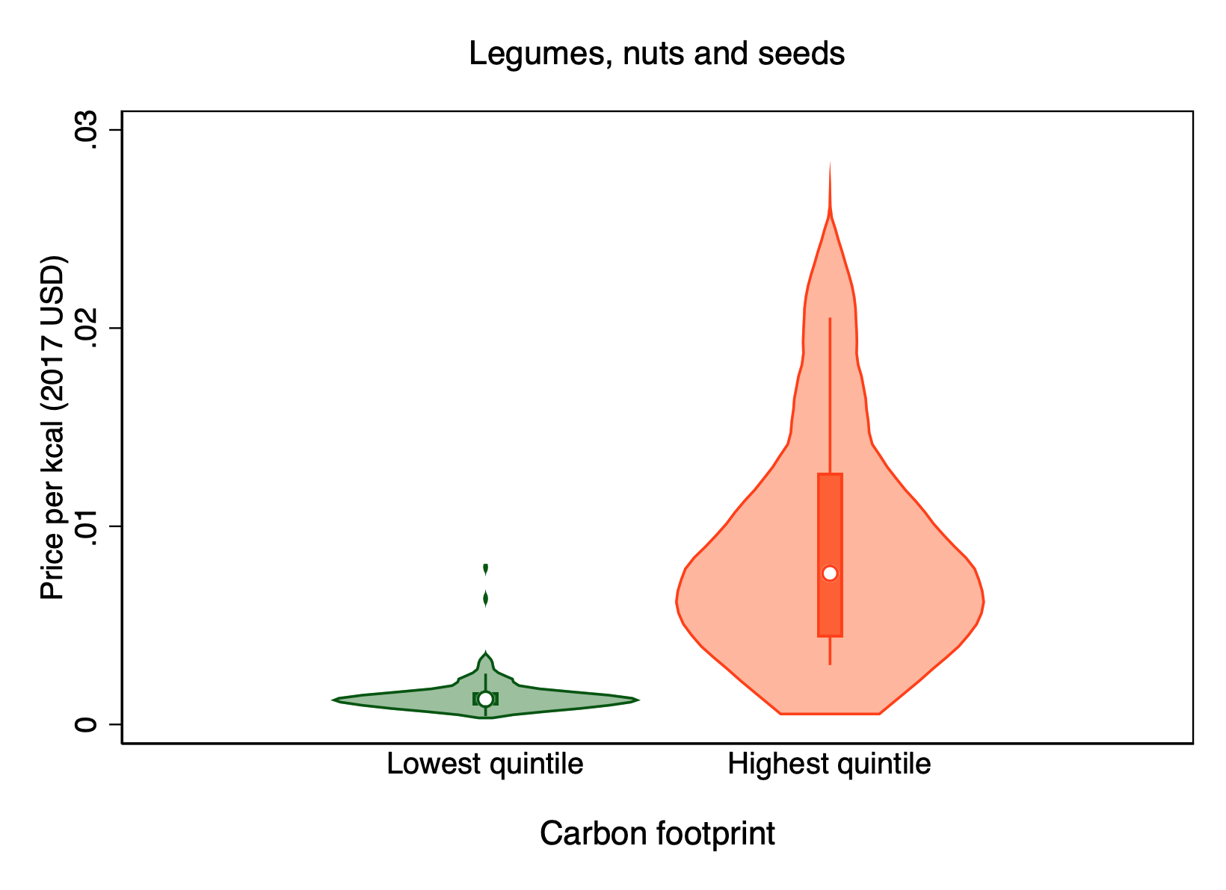
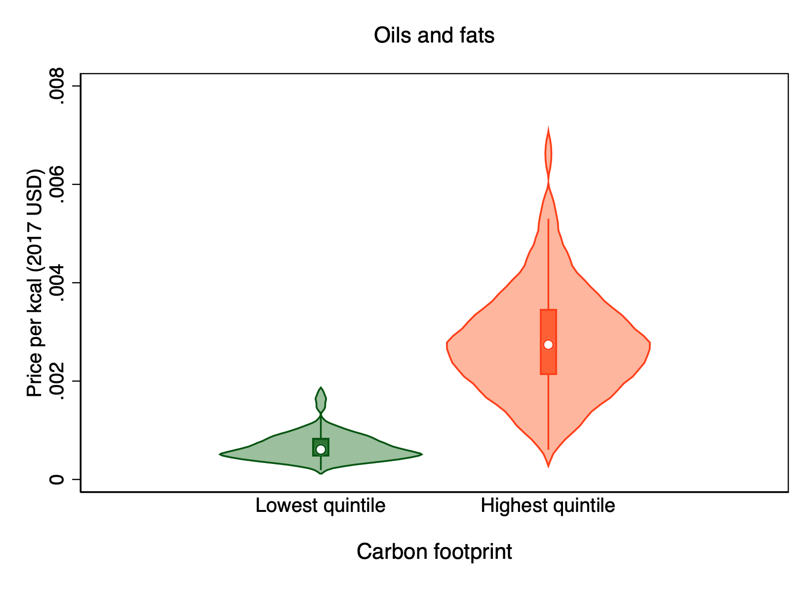
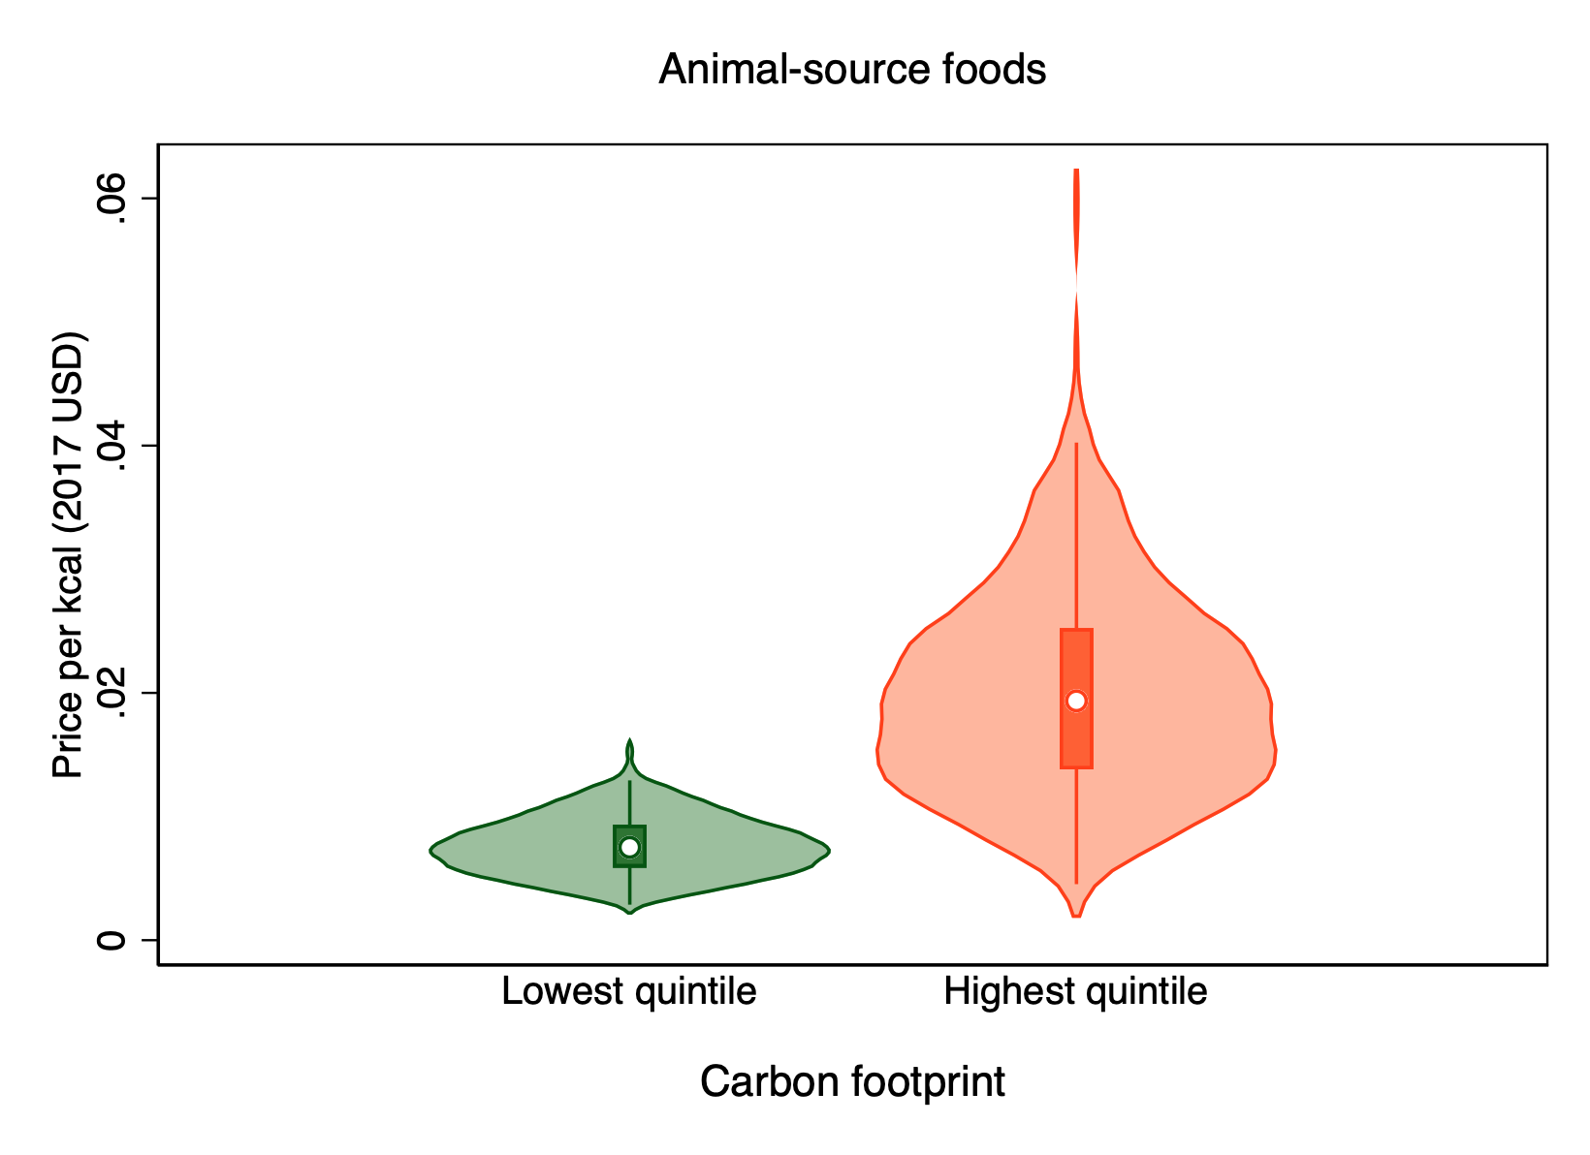
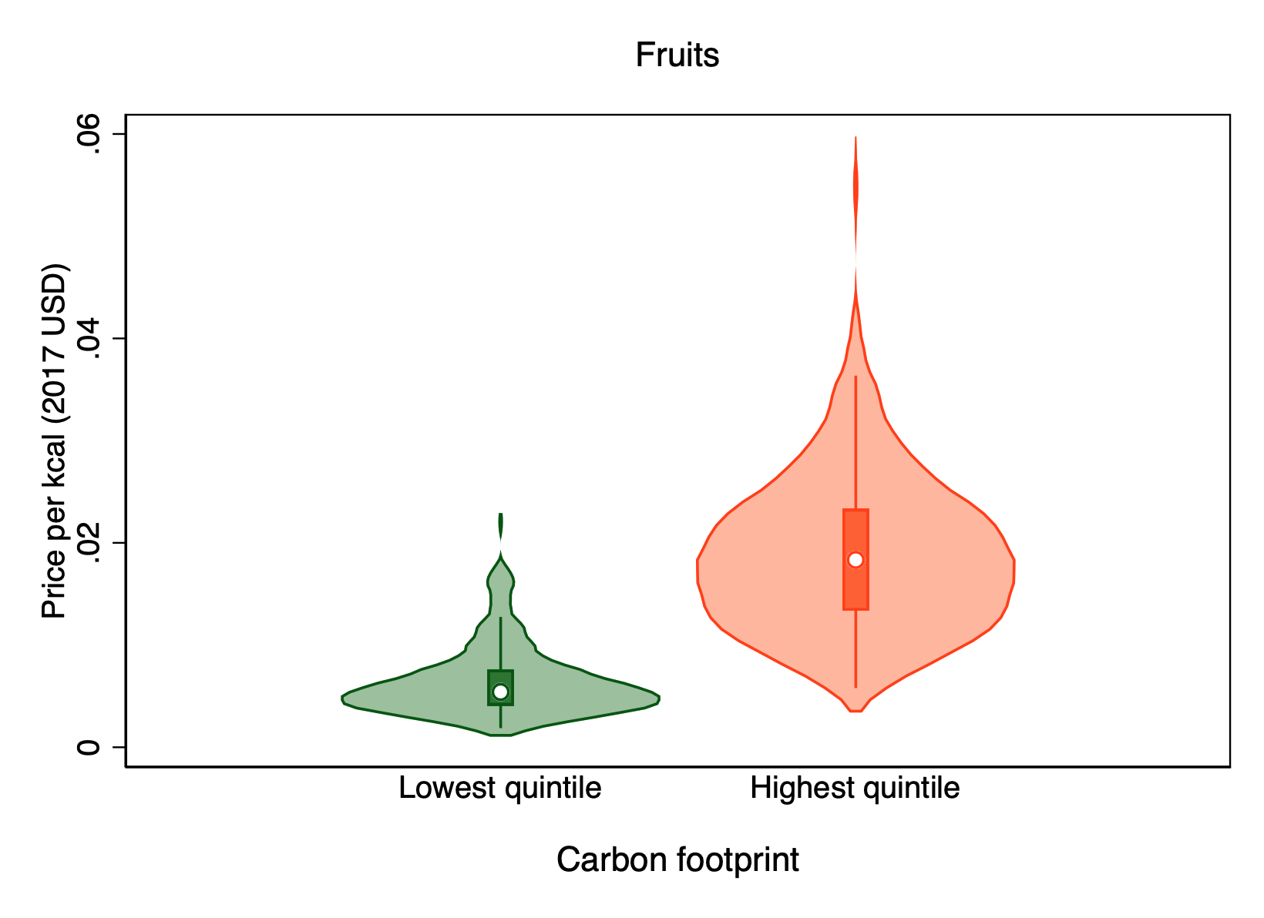
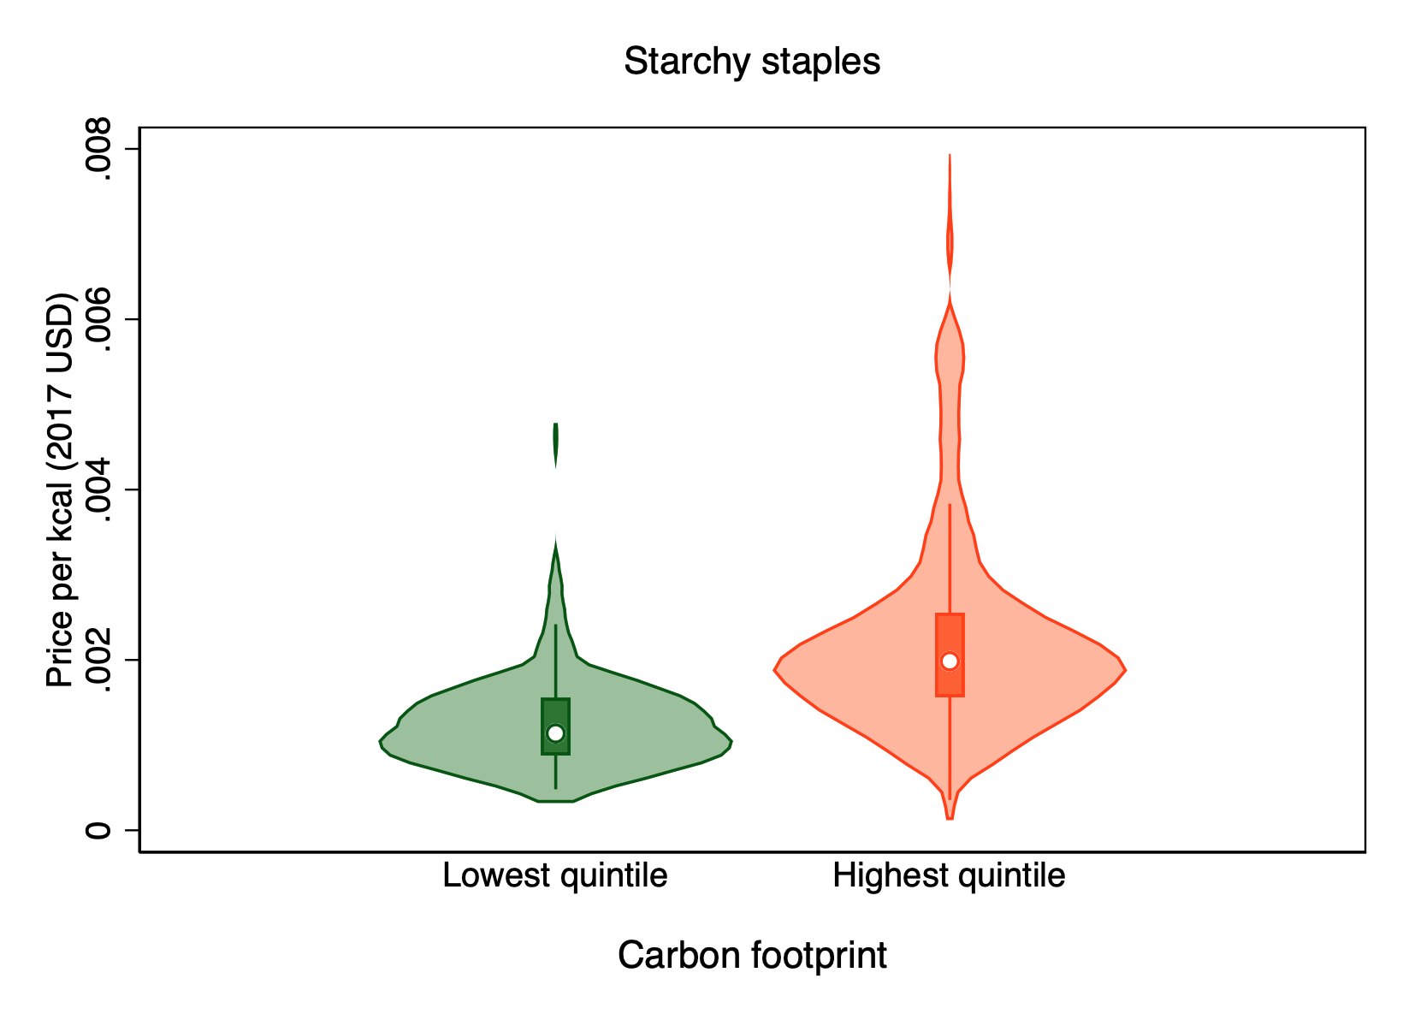
More expensive foods tend to have higher carbon footprints
Vegetables
Legumes, nuts & seeds
Oils & fats
Source: Martinez et al., in preparation
Animal-source foods
Starchy staples
Fruits
Notes:
Evidence that more affordable items tend to also be more sustainable. BUT…this is only the cost of the item itself, and the environmental impact of the item itself. Does not factor in cooking time

Slide 17
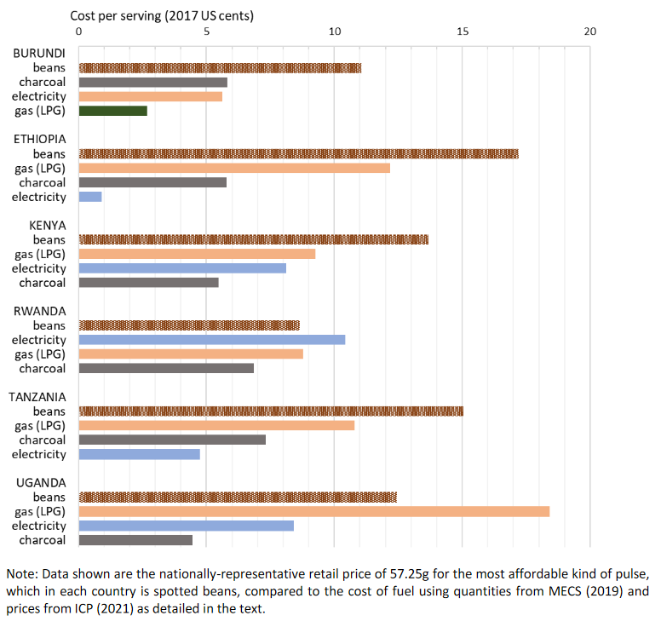
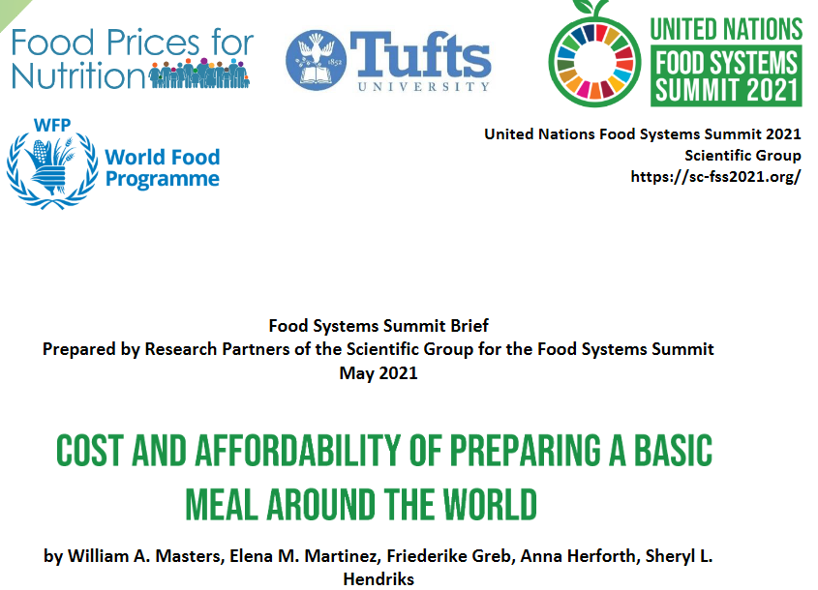
Cost (and environmental impact) of meal preparation and cooking is not trivial!
Cost per serving of cooking fuel, relative to the cost of dried beans in E. Africa
Source: Masters WA, Martinez EM, Greb F, Herforth A, Hendriks SL (2021). Cost and Affordability of Preparing a Basic Meal around the World. UN Food System Summit Scientific Group Partners’ Brief (23 pages), available online at https://sc-fss2021.org/materials/fss-briefs-by-partners-of-scientific-group
Notes:
Need low-cost sustainable cooking; and inclusive diets would benefit from reduced cooking time.

Slide 18
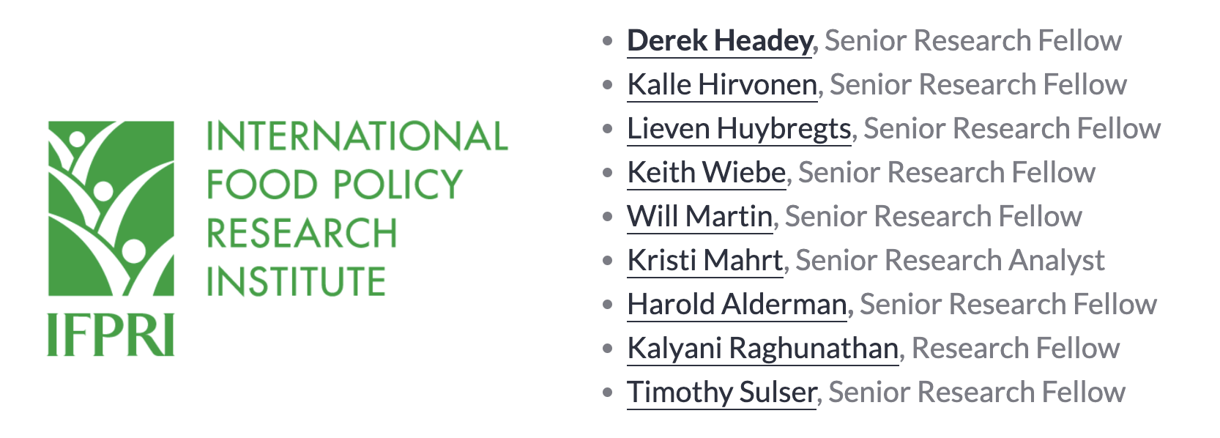
Funded by:
In collaboration with:
Notes:
Next I’d like to hand over to my long-time colleague on this project, Yan Bai, at the World Bank – and before that, just briefly acknowledge the whole [FPN] team, as well as our donors and the collaboration with FAO.

Slide 19
Cost and Affordability of Healthy Diets and implications for sustainability
November 16, 2022
Dr. Anna Herforth
Co-Director, Food Prices for Nutrition
#FoodPricesforNutrition
sites.tufts.edu/foodpricesfornutrition
www.worldbank.org/foodpricesfornutrition

