Slide 1
Food prices, diet costs and the affordability crisis: Needs and opportunities for social protection
William Masters
Professor of Food Economics and Policy, Friedman School of Nutrition and Department of Economics, Tufts University
Project site: https://sites.tufts.edu/foodpricesfornutrition
USP2030 webinar on Addressing the Global Food, Energy and Cost of Living Crises, 6 Apr 2023
Notes:
Frame the need for SP, opportunity to use price and income data
Addressing the Global Food, Energy and Cost of Living Crises: The role of social protection in strengthening food systems’ resilience

Slide 2
The ongoing world food crisis is as bad as previous spikes in the cost of food
2022-23
(recovery from COVID)
Recent world food crises:
2008-09
2020-21
(onset of COVID)
Food and non-food inflation is now easing in most countries, but real costs remain high
2011-12
Note: Author's calculations, from IMF data. The values shown are the global average for up to 138 countries reporting monthly consumer price indexes (CPI) for food and for all goods and services, from January 200 through December 2022. Each observation is the average monthly rise over the previous 12 months, multiplied by 12 to obtain an annualized value. Number of countries rises from 51 in Jan 2000 to 95 in 2005 and then 138 from 2015 onwards.

Slide 3
Food prices can now be used for targeting of social assistance and guiding food system change
Food security was initially seen in terms of calories for survival
Since the 1960s, the FAO has used its “Prevalence of Undernourishment” metric for the number of hungry people in the world, based on total food consumption relative to target levels of dietary energy
Food security was later seen in terms of access to desired foods
More recently, the FAO and others use “Experience of Food Insecurity” scores for the number of people who went to bed hungry, skipped meals, ate less or fewer items, due to lack of money to buy their usual foods
Now we can monitor nutrition security, as affordability of healthy diets
Since 2020, the FAO, IFAD, UNICEF, WFP and WHO flagship annual reports on the State of Food Security and Nutrition in the World (SOFI 2020, 2021 and 2022) use retail prices of the least-cost locally available foods for a balanced diet that would meet dietary guidelines in each country of the world
Methods and results are at https://WorldBank.org/FoodPricesforNutrition, and on FAOSTAT
Using least-cost locally available foods to track affordability of a healthy diet provides a diagnosis to distinguish between causes of malnutrition, guiding action in each country
Where and when foods are unusually expensive, need better farm production and food distribution to lower prices
For people with insufficient income, need higher earnings or assistance

Slide 4
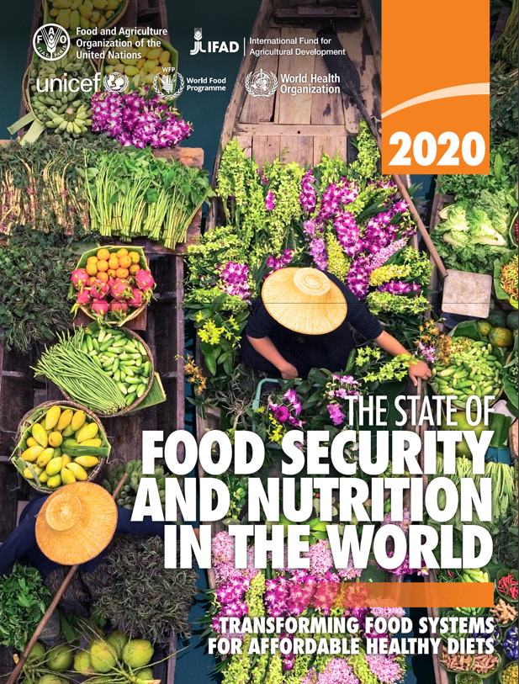
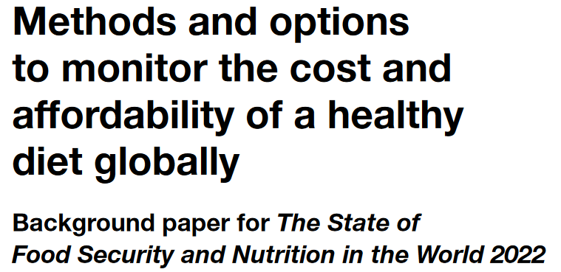
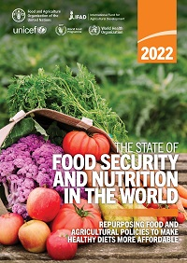
Policies and programs pursue what is measured
Since 2020, the FAO has published the cost of each country’s least expensive foods needed for health
-- a first step up from calories is vitamins & minerals, like the WFP’s “Fill the Nutrient Gap” programs in humanitarian settings
-- the next step up meets food group targets to meet nutrient needs and also avoid hypertension, diabetes etc., as specified in national dietary guidelines
For SOFI 2020, we used ten countries’ national dietary guidelines for an average Cost of Recommended Diets (CoRD)
 |  |  | Food preferences, convenience and other goals (including food security, diet diversity, sustainability, equity and inclusion)
 | Caloric adequacy (short-term subsistence)
By 2020, global average minimum cost of a healthy diet had risen to $3.54 (SOFI 2023 will update this)
Actual food spending was $5.64
 |  |  | Healthy diets Meets national dietary guidelines by food group
 |  | Nutrient adequacy Avoids deficiency or excess of essential macro- and micronutrients
 | Daily energy Meets only calorie needs, for short-term survival and physical work
Global average cost in 2017:
$3.31
For SOFI 2022, we developed a single global Healthy Diet Basket of 11 items in 6 food groups for a simpler Cost of a Healthy Diet (CoHD)
$2.46
$0.83
Source: Food Prices for Nutrition (2022). https://sites.tufts.edu/foodpricesfornutrition

Slide 5
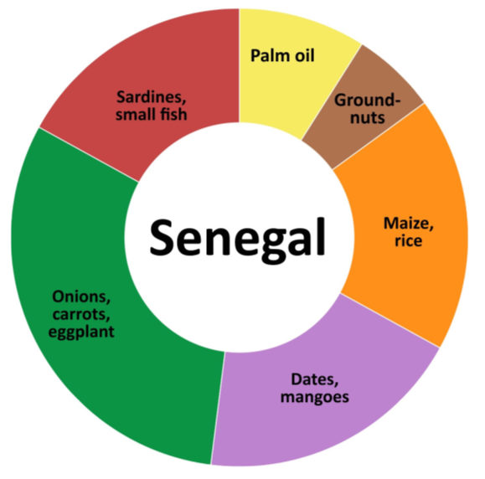
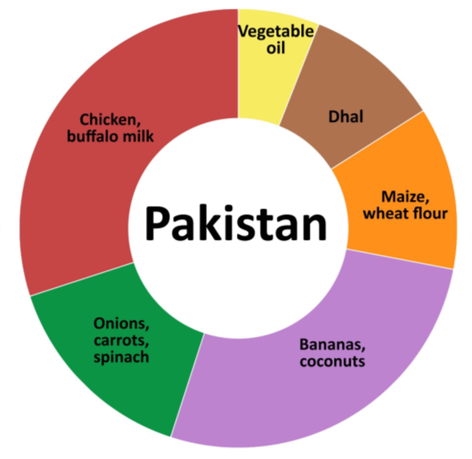
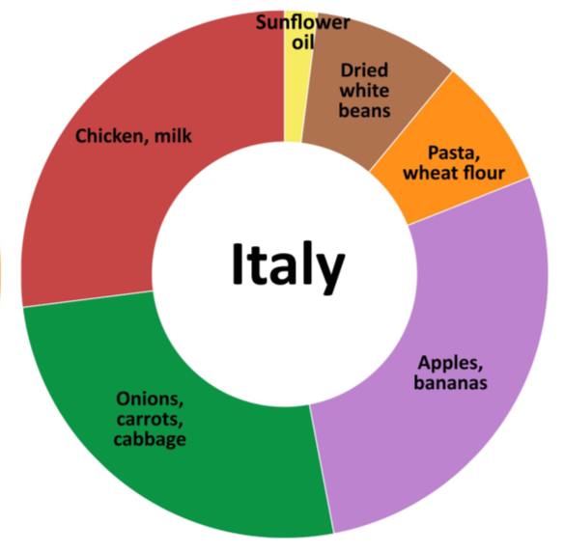
What foods are included in a least-cost healthy diet?
Foods selected are the least expensive items being sold at the time and place of measurement
Animal-source foods (2 items x 150 kcal each)
Edible oil (1 x 300 kcal)
Pulses, nuts or seeds (1 x 300 kcal)
$2.29/day
$3.44/day
$3.02/day
Vegetables (3 at 30 kcal each)
Starchy staples (2 at 580 kcal each)
Fruits (2 at 80 kcal each)
Note: Data shown are each food group’s share of cost per day using ICP 2017 items and prices.
Source: Food Prices for Nutrition (2022). https://sites.tufts.edu/foodpricesfornutrition

Slide 6
What have we discovered about the cost and affordability of healthy diets?
Food costs differ but are not lower in low-income countries when measured in real terms, compared to other goods & services
Least-cost healthy diets are unaffordable for the very poor, about 3 billion people
Based on overall food price inflation relative to incomes, real costs rose to $3.54 in 2020, higher in 2021 and 2022
Global average costs in 2017
$3.31
(meets dietary guidelines for overall health)
$2.46
(within upper & lower bounds for nutrients)
$0.83
(sufficient calories for work each day)
Diet cost data are from FAO and the Food Prices for Nutrition project, using item prices reported by national statistical organizations through the International Comparison Program (ICP), downloaded from https://databank.worldbank.org/source/food-prices-for-nutrition, and national income (GNI) is from the World Development Indicators https://databank.worldbank.org/source/world-development-indicators. Guidelines are linear in the logarithm of income shown on the horizontal axis.

Slide 7
How does actual spending on food compare to the cost of healthy diets?
Average food spending is much greater than least-cost healthy diets in middle- and high-income countries
…but that is the national average, many households in these countries cannot afford healthy diets, especially now.
Global average costs in 2017
$5.64
(pursues many goals other than health)
Actual food spending is less than healthy diet costs in low-income countries
$3.31
(meets dietary guidelines for overall health)
$2.46
(within upper & lower bounds for nutrients)
$0.83
(sufficient calories for work each day)
Diet cost data are from FAO and the Food Prices for Nutrition project, using item prices reported by national statistical organizations through the International Comparison Program (ICP), downloaded from https://databank.worldbank.org/source/food-prices-for-nutrition. Food expenditures are derived from those data, and national income (GNI) is from the World Development Indicators https://databank.worldbank.org/source/world-development-indicators. Guidelines are linear in the logarithm of income shown on the horizontal axis.

Slide 8
How does affordability of healthy diets relate to food insecurity?
Here, “food insecurity” is a person’s answers to whether they ate less, skipped meals, went hungry etc. for lack of money to buy food
Unaffordability is much more prevalent than food insecurity in LMICs
Food insecurity measures access to a person’s usual foods, which are similar from week to week so what it measures is financial precarity
Data shown are FAO estimates, downloaded from https://databank.worldbank.org/source/food-prices-for-nutrition for affordability of healthy diets, and from https://databank.worldbank.org/source/world-development-indicators for experience of food insecurity and national income (GNI).

Slide 9
Diet costs could be used for targeting and adequacy of social assistance
Food spending per person per day
(in local currency or US$ at PPP exchange rates)
Observed expenditure or income available for food
Example assistance program targeted to the lowest-income 25% of people, at an adequacy level sufficient for some to afford a healthy diet
Min. cost of healthy diets (typically 6-8 food groups)
Min. cost of nutrient adequacy (typically 4-5 food groups)
Min. cost of caloric adequacy (from starchy staples only)
Targeting and coverage could be based on needs to reach nutritional standards for health
0
0
25
100
Cumulative share of the population
Source: Adapted from graphic introduced by Saskia de Pee (WFP).

Slide 10
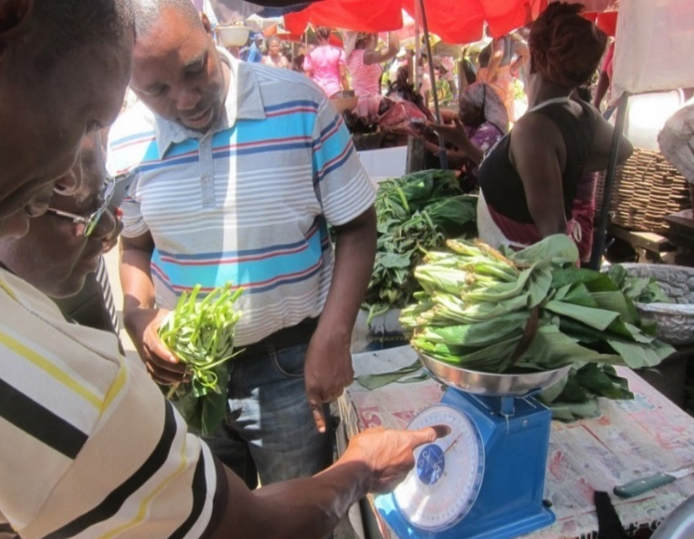
https://sites.tufts.edu/foodpricesfornutrition
Thank you!
We thank the many price collectors and contributors to the diverse databases used in this work and are grateful for funding to the Bill & Melinda Gates Foundation and UKAid, as well as complementary funding from FAO.
Photo by Anna Herforth
at Agbogbloshi market, Ghana

