Slide 1
Using least-cost diets to measure food access globally: Results and implications
24 July 2023
AAEA Track Session
Bridging U.S. and international research on food security, food prices and access to healthy, sustainable diets
Leah Costlow
Tufts Friedman School

Slide 2
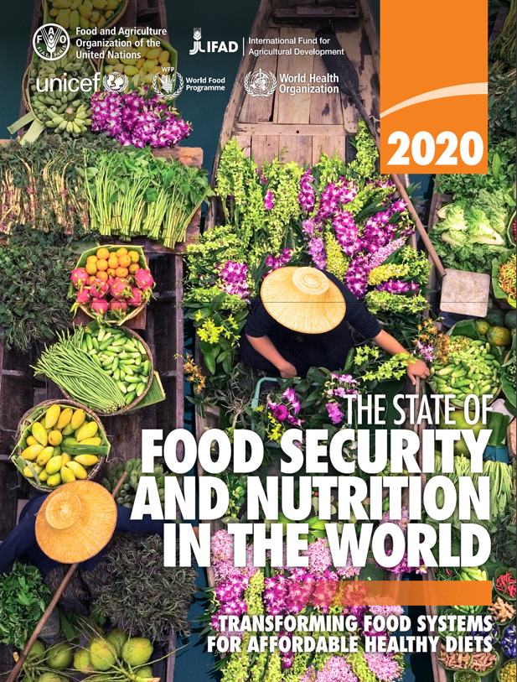
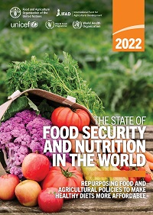
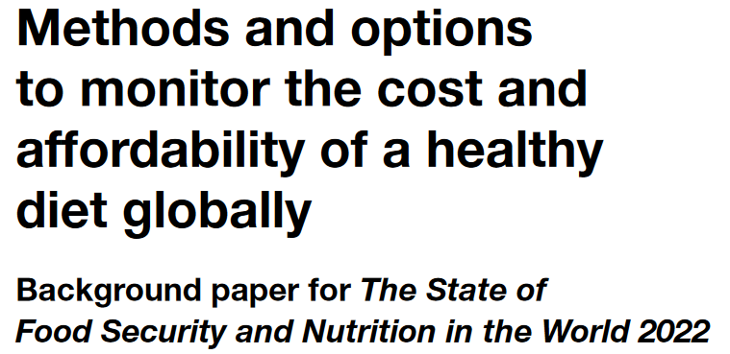
Measuring the cost and affordability of healthy diets
The Cost and Affordability of Healthy Diets (CoAHD) are new indicators of access to healthy diets
Retail food prices let us identify the least expensive combinations of locally available foods needed for health
Global monitoring of CoAHD is now hosted by UN-FAO and World Bank as part of a suite of food security indicators

Slide 3
Why monitor the cost and affordability of healthy diets?
Moving up each tier of access involves higher costs at each step
Reveals barriers to access and opportunities for improvement
Foods with the potential to improve affordability
People who need higher incomes or safety nets
Displacement from other foods
 |  | a
 |  |  | Food preferences, convenience and other goals (including food security, diet diversity, sustainability, equity and inclusion)
 | Caloric adequacy (short-term subsistence)
 |  |  | Healthy diets (meet food group recommendations)
 |  | Nutrient adequacy (avoid deficiencies and excesses of essential nutrients )
 | Caloric adequacy (short-term subsistence)
Distinguish unaffordability from other causes of poor diet quality

Slide 4
Calculating CoAHD using the Healthy Diet Basket
Begin with retail food prices
Match retail items to food groups, food composition, and quantities required for health
Within the least-cost healthy diet:
Food group proportions stay constant (share of energy)
Food items are substitutable within food groups
Least-cost items may vary at each time and place
Healthy Diet Basket Food Group | No. of items | Energy (kcal) | Weights of example foods (g)
Starchy Staples | 2 | 1,160 | 322 g dry rice
Vegetables | 3 | 110 | 270-400 g
Fruits | 2 | 160 | 230-300 g
Animal-source foods | 2 | 300 | 210 g egg
Legumes, nuts & seeds | 1 | 300 | 85 g dry bean
Oils & fats | 1 | 300 | 34 g oil
Total | 11 | 2,330
Source: Herforth et al, 2022. Methods and options to monitor the cost and affordability of a healthy diet globally.

Slide 5
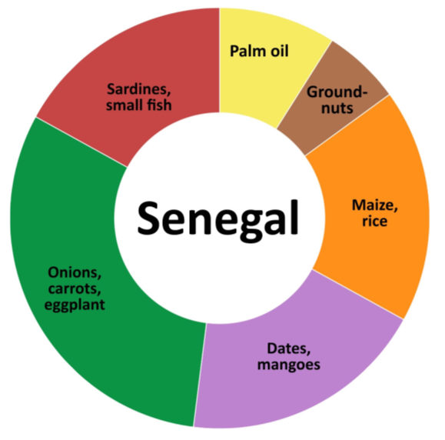
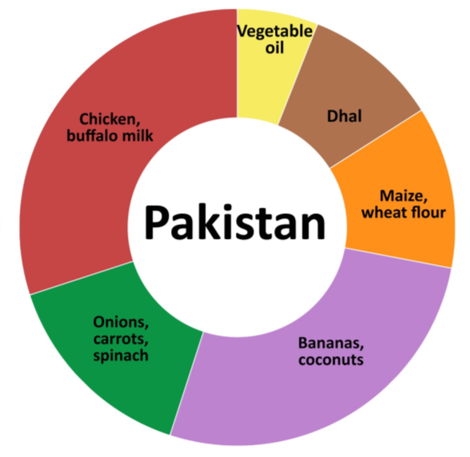
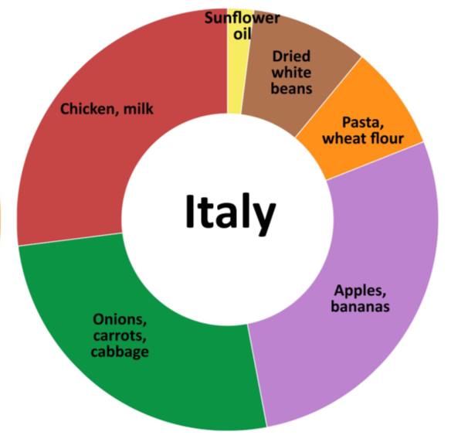
Which foods are included in a least-cost healthy diet?
This method identifies the least expensive items
within each food group sold in each time and place.
Animal-source foods (2 items x 150 kcal each)
Edible oil (1 x 300 kcal)
Pulses, nuts or seeds (1 x 300 kcal)
$2.29/day in 2017
$3.44/day
in 2017
$3.02/day
in 2017
Vegetables (3 at 30 kcal each)
Starchy staples (2 at 580 kcal each)
Fruits (2 at 80 kcal each)
Note: Data shown are each food group’s share of cost per day using ICP 2017 items and prices.
Source: Food Prices for Nutrition (2022). https://sites.tufts.edu/foodpricesfornutrition

Slide 6
What have we discovered about the cost and affordability of healthy diets?
Food costs differ but are not lower in low-income countries when measured in real terms, compared to other goods & services
Least-cost healthy diets are unaffordable for the very poor, about 3 billion people
Based on overall food price inflation relative to incomes, real costs rose to $3.54 in 2020, higher in 2021 and 2022
Global average costs in 2017
$3.31
(meets dietary guidelines for overall health)
$2.46
(within upper & lower bounds for nutrients)
$0.83
(sufficient calories for work each day)
Diet cost data are from FAO and the Food Prices for Nutrition project, using item prices reported by national statistical organizations through the International Comparison Program (ICP), downloaded from https://databank.worldbank.org/source/food-prices-for-nutrition, and national income (GNI) is from the World Development Indicators https://databank.worldbank.org/source/world-development-indicators. Guidelines are linear in the logarithm of income shown on the horizontal axis.

Slide 7
How does actual spending on food compare to the cost of healthy diets?
Average food spending is much greater than least-cost healthy diets in middle- and high-income countries
…but that is the national average, many households in these countries cannot afford healthy diets
Global average costs in 2017
$5.64
(pursues many goals other than health)
Actual food spending is less than healthy diet costs in low-income countries
$3.31
(meets dietary guidelines for overall health)
$2.46
(within upper & lower bounds for nutrients)
$0.83
(sufficient calories for work each day)
Diet cost data are from FAO and the Food Prices for Nutrition project, using item prices reported by national statistical organizations through the International Comparison Program (ICP), downloaded from https://databank.worldbank.org/source/food-prices-for-nutrition. Food expenditures are derived from those data, and national income (GNI) is from the World Development Indicators https://databank.worldbank.org/source/world-development-indicators. Guidelines are linear in the logarithm of income shown on the horizontal axis.

Slide 8
How does affordability of healthy diets relate to food insecurity?
Here, “food insecurity” is a person’s answers to whether they ate less, skipped meals, went hungry etc. due to lack of money to buy food
Food insecurity measures access to a person’s usual foods which are often not healthy, and have similar cost from week to week; most variation in food insecurity comes from fluctuations in income or non-food expenses
Data shown are FAO estimates, downloaded from https://databank.worldbank.org/source/food-prices-for-nutrition for affordability of healthy diets, and from https://databank.worldbank.org/source/world-development-indicators for experience of food insecurity and national income (GNI).

Slide 9
Conclusions
Healthy diets remain unaffordable for about 3 of the world’s 8 billion people
Nutrient-rich foods are more costly to produce
Supply and distribution improvements can lower cost
But most unaffordability is due to low incomes
For the remaining 5 billion people, healthy diets could be purchased but are often not chosen
Many factors drive food choice other than health
Other FPN work explores diverse applications of CoAHD:
Seasonal, spatial and demographic differences in food access
Non-market externalities and sustainability
Vulnerability and resilience to climate risks
Contribution of trade policy to diet costs

Slide 10
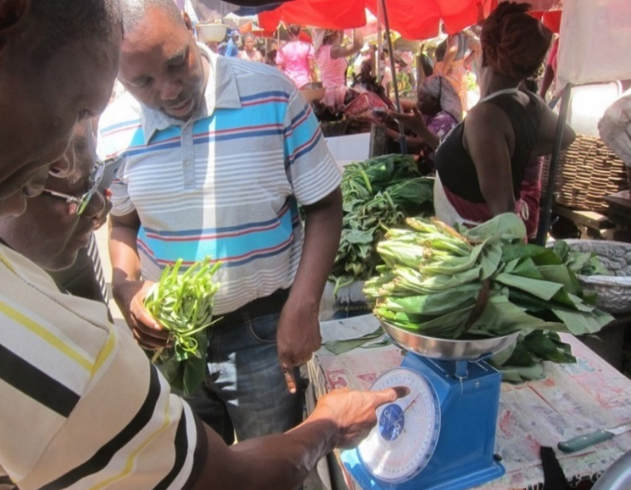
Find links to papers, data, presentations, and events on our website: https://sites.tufts.edu/foodpricesfornutrition
We thank the many price collectors and contributors to the diverse databases used in this work and are grateful for funding to the Bill & Melinda Gates Foundation and UKAid, as well as complementary funding from FAO.
Photo by Anna Herforth
at Agbogbloshi market, Ghana

