Slide 1
https://sites.tufts.edu/foodpricesfornutrition
Food Prices and Nutrition: Using Least-Cost Healthy Diets to Monitor and Improve Global Food Security
William Masters
Friedman School of Nutrition, Tufts University
25 July 2023 AAEA track session on Export Policies, Staple Commodity Prices, and Global Food Security

Slide 2
We can now use access to healthy diets in retail markets as a new metric of global food security
For decades, food security was defined and measured as calories for survival
Since the 1960s, the FAO has used its “Prevalence of Undernourishment” metric for the number of hungry people in the world, based on total food consumption relative to estimated level of dietary energy requirements
More recently, food security is defined and measured as access to desired foods
Since the 1990s, the USDA and then FAO have used “Experience of Food Insecurity” scores for the number of people who went to bed hungry, skipped meals, ate less or other foods etc. due to lack of resources to buy their usual foods
Now we can use data on retail prices, to track the cost and affordability of healthy diets
Since 2016, a series of Tufts projects have developed new metrics of food and nutrition security, designed to measure whether a population has access to foods that meet international criteria for a healthy diet
Our goal is to guide intervention, matching items to needs and distinguishing among three causes of unhealthy diets:
High prices: if healthy foods are unusually expensive, need to invest in production and distribution to lower cost
Low incomes: if people lack enough money to buy a healthy diet, need higher earnings or assistance
Food choice: if people could buy a healthy diet but choose unhealthy foods instead, need other changes
Pilot study on cost of diet diversity in Ghana & Tanzania (Masters et al. 2018), then cost of healthy diets globally for FAO (Herforth et al. 2020, 2022), scaled up with over 16 journal articles and adoption on FAOSTAT and the World Bank for international comparison, and for analysis within countries for example by the government of Ethiopia.

Slide 3
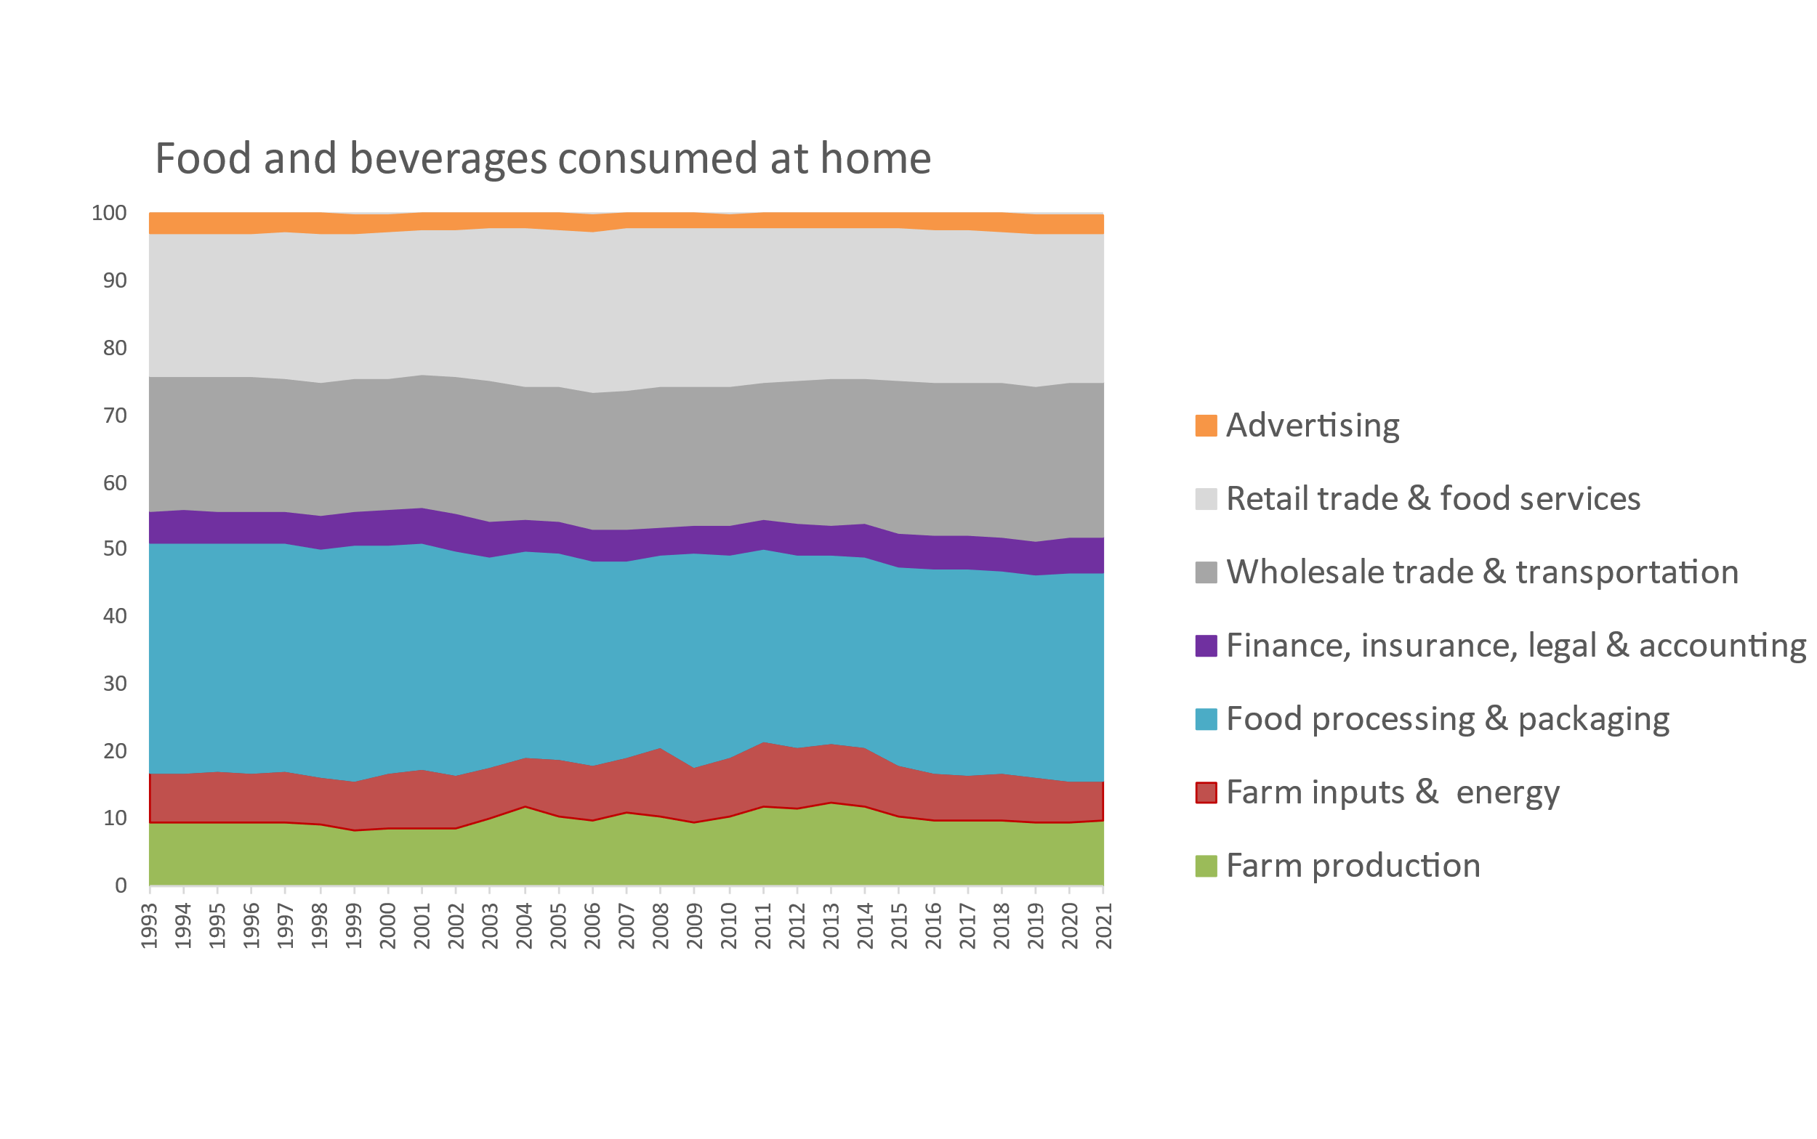
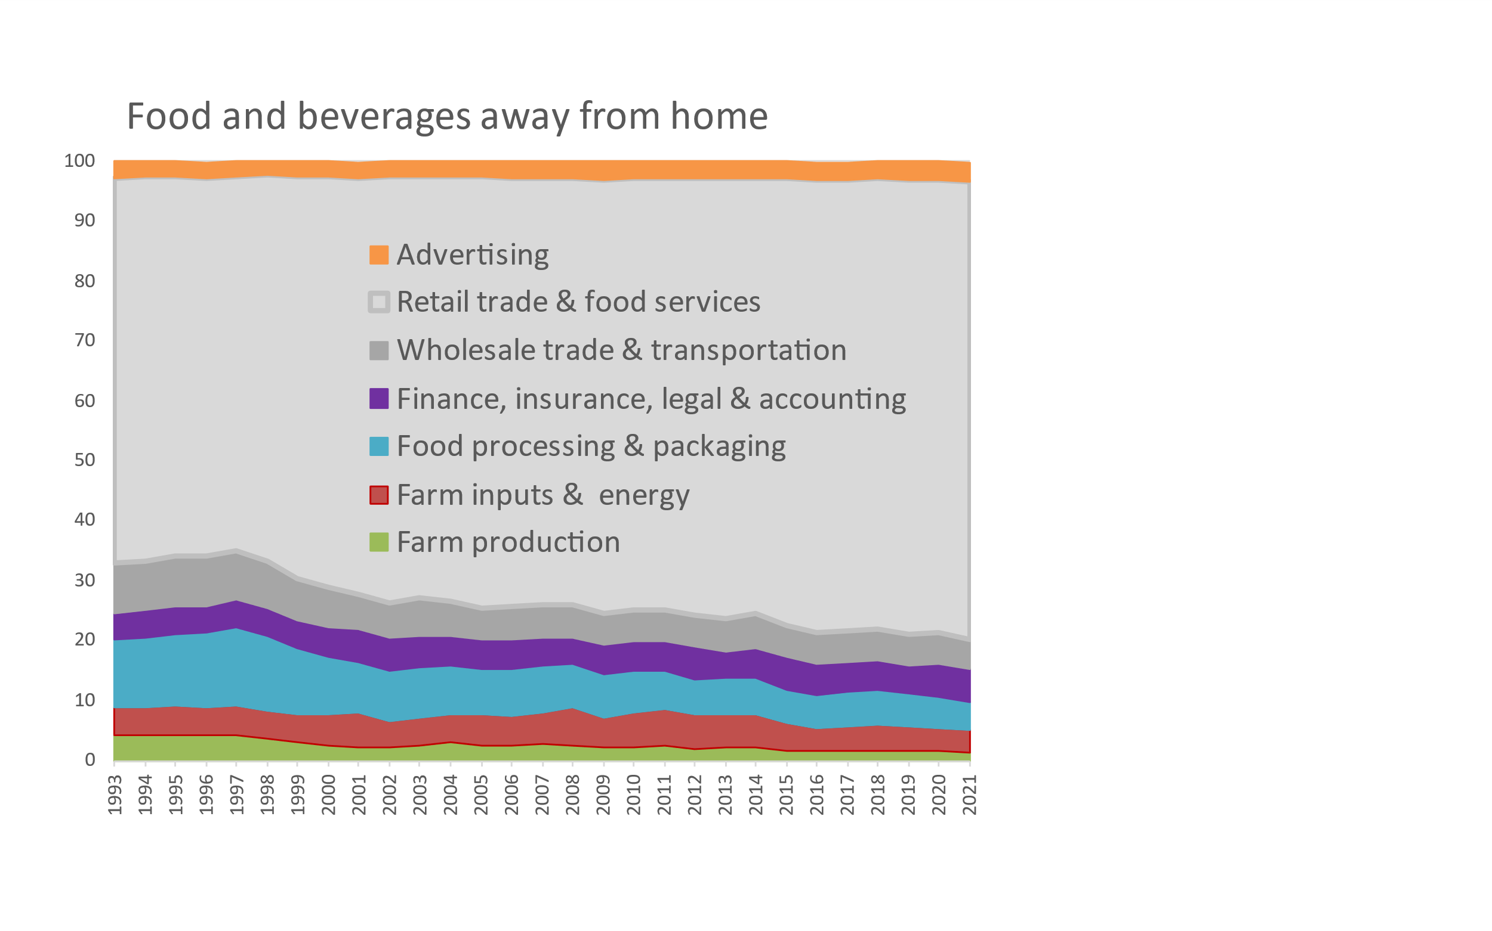
Retail food prices are mostly value added after harvest
Cost of food by stage of value added in the United States, 1993 – 2021
When we buy food, we pay a lot for brands & services!
Cumulative percent of consumer price
2.6%
3.4%
22.2%
76.2%
23.1%
5.3%
30.8%
5.0%
6.1%
5.5%
9.8%
4.8%
3.7%
1.3%
Note: Author’s calculations. Data shown are from the USDA Economic Research Service (2023), Food Dollar Series. Last updated Feb. 15, 2023, available at https://www.ers.usda.gov/data-products/food-dollar-series. Implied total spending on food advertising is roughly $60 billion per year, more than the NIH and CDC budgets combined. (Overall food spending is about $6,200 per person, about half our total health-care spending.) The FAO has piloted a global version of these data based on Yi et al. (2021) “Post-farmgate food value chains make up most of consumer food expenditures globally” in Nature Food, with downloadable data for a few countries available in FAOSTAT at https://www.fao.org/faostat/en/#data/GFDI.

Slide 4
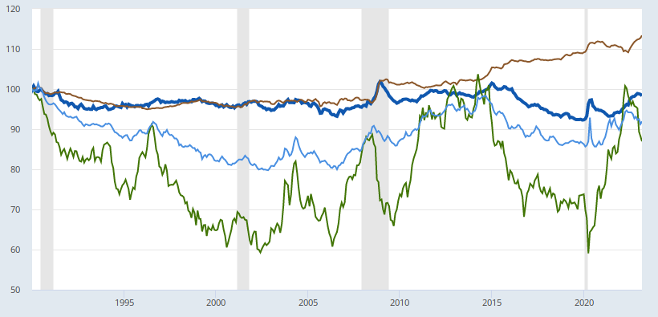
Price variation differs by stage of the value chain
Consumer prices for groceries and restaurants vs. wholesale costs, Jan 1990 – Mar 2023
Restaurant prices are relatively stable, rising with wages and rents
Restaurant prices (food away from home)
Index value (January 1990=100)
Grocery prices (food at home)
Grocery prices fluctuate around overall inflation
Fruits & vegetables
Wholesale producer prices for processed foods
Wholesale prices for unprocessed commodities are more volatile than prices for processed foods
All food at home
Wholesale producer prices for unprocessed foods
Note: Author’s calculations. Data shown are from the US Bureau of Labor Statistics, as the average for each category relative to the overall U.S. consumer price index for all goods and services. Fruits and vegetables may be fresh, frozen or canned. Updated values can be obtained from https://fred.stlouisfed.org/graph/?g=12MMl.

Slide 5
Globally, most foods have an importable main ingredient, but that import costs only a fraction of the item’s retail price
Role of imported product costs in retail item prices (n=680 foods in 144 countries)
 |  | All foods
 | Pct of retail food items that could be matched to an actively imported primary ingredient | Pct of the retail price that is the cost of the item’s actively imported primary ingredient |  | Total number of retail food price observations in the global ICP database
Starchy staples | 72 | 10 |  | 3,473
Vegetables | 56 | 20 |  | 1,420
Fruits | 63 | 16 |  | 1,477
Animal-source foods | 37 | 26 |  | 5,726
Legumes, nut, and seeds | 75 | 14 |  | 826
Oils and fats | 72 | 17 |  | 990
All foods | 55 | 17 |  | 13,912
Source: W.A. Masters, S. Block, R. Gilbert, L. Costlow, J. Matteson, E. Krivonos and J. Rauschendorfer (2022), “Trade policy and the cost of healthy diets in Africa and worldwide”. Draft report for FAO, last revised 22 Feb. 2023
Notes:
Notes: Data shown are global averages for all retail items on the left, and only items selected in least-cost diets on the right. Column details are (a) Percentage of all country-retail food combinations for which the retail item was successfully matched to a primary ingredient from the FAO Commodity List, where that country is a net importer of the commodity and the commodity has a non-missing unit value; (b) percentage of the final product’s retail price that is accounted for by the trade unit value of the corresponding imported commodity ; (c) percentage of those imported commodities that have any tariffs; (d) average tariff for all items in column c; (e) total country-retail food item observations.

Slide 6
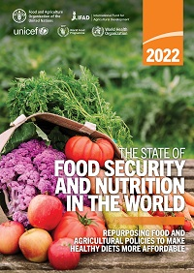
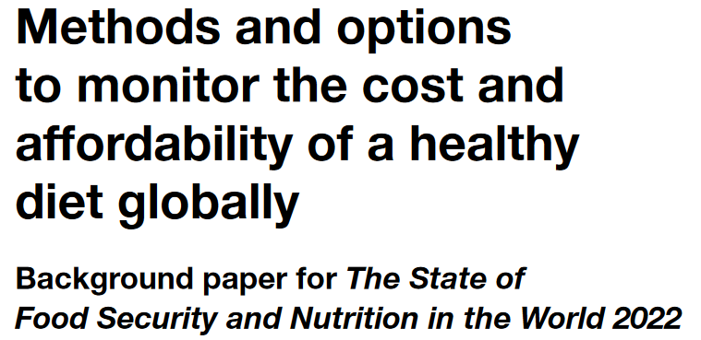
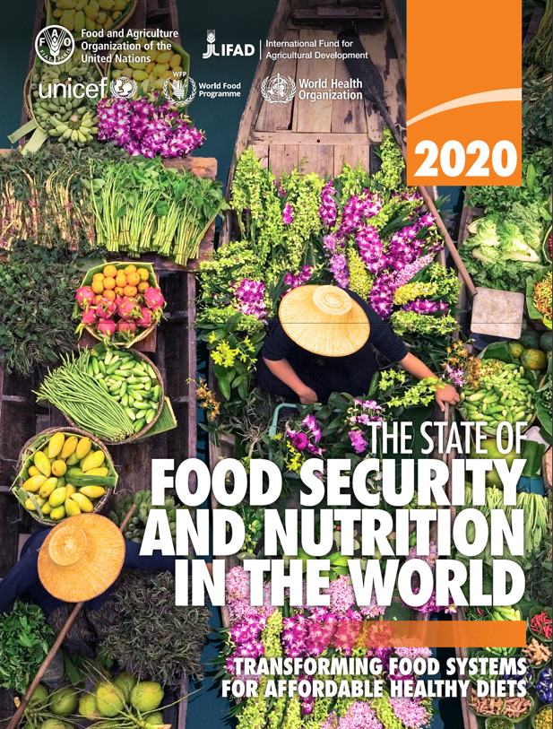
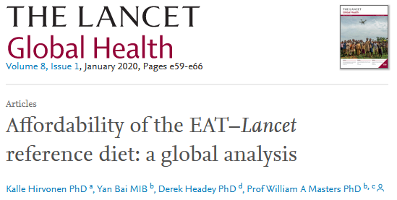
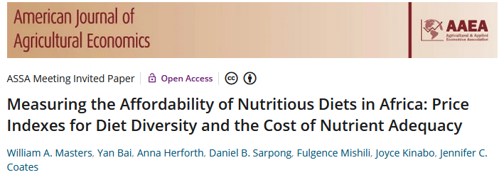
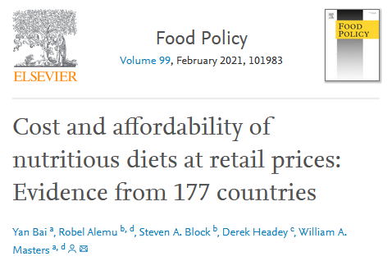
The Food Prices for Nutrition project in one slide
We measure access to healthy diets using the least expensive locally available foods as a new kind of price index, measuring the cost of food as an input to health
A key step is to quantify needs for both nutrients and food groups
 |  |  | Food preferences, convenience and other goals (including food security, diet diversity, sustainability, equity and inclusion)
 | Caloric adequacy (short-term subsistence)
For actual food choice among affordable options, observed consumption often displaces healthy items with other foods
Herforth, A., Venkat, A., Bai, Y., Costlow, L., Holleman, C. & Masters, W.A. 2022.
Actual global food spending =
$5.46/day
For SOFI 2022, the updated standard for the Cost of a Healthy Diet (CoHD) is a “Healthy Diet Basket” of the 11 least-cost items from 6 food groups
 |  |  | Healthy diets Meets national dietary guidelines by food group
 |  | Nutrient adequacy Avoids deficiency or excess of essential macro- and micronutrients
 | Daily energy Meets only calorie needs, for short-term survival and physical work
Herforth, A., Bai, Y., Venkat, A., Mahrt, K., Ebel, A. & Masters, W.A. 2020.
For SOFI 2020, we used 10 countries’ guidelines for the Cost of Recommended Diets (CoRD)
Our AJAE 2018 article introduced a Cost of Diet Diversity (CoDD) metric
Global ave. in 2017 = $3.31/day
and many other studies analyze the cost of nutrients
Global average in 2017 = $2.46/day
Global average in 2017 = $0.83/day
Source: Food Prices for Nutrition (2023). https://sites.tufts.edu/foodpricesfornutrition

Slide 7
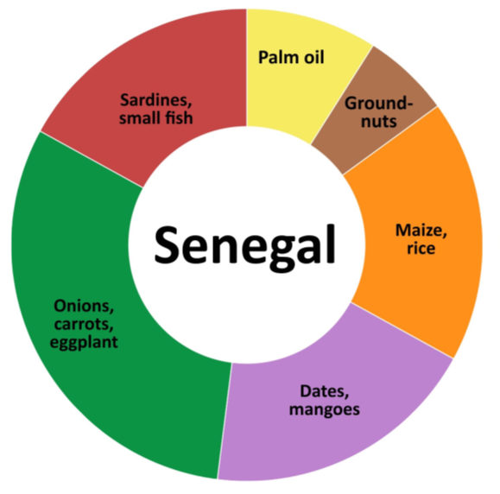
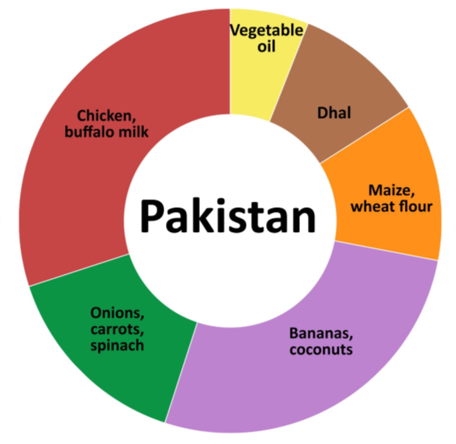
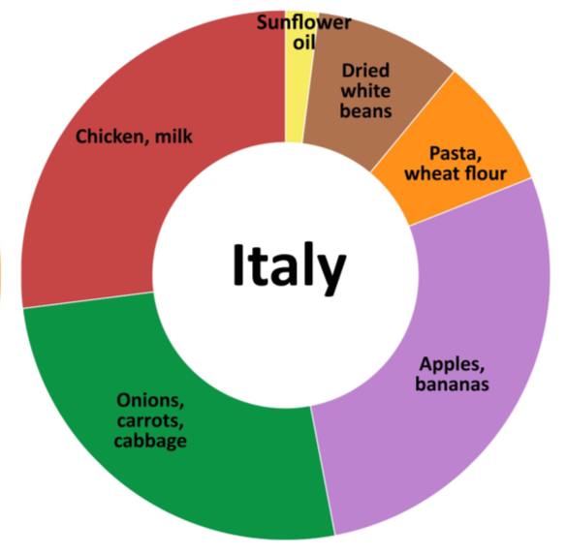
What foods are included in a least-cost healthy diet?
Foods selected are the least expensive items being sold at the time and place of measurement
Animal-source foods (2 items x 150 kcal each)
Edible oil (1 x 300 kcal)
Pulses, nuts or seeds (1 x 300 kcal)
$2.29/day in 2017
$3.44/day
in 2017
$3.02/day
in 2017
Vegetables (3 at 30 kcal each)
Starchy staples (2 at 580 kcal each)
Fruits (2 at 80 kcal each)
Note: Data shown are each food group’s share of cost per day using ICP 2017 items and prices.
Source: Food Prices for Nutrition (2022). https://sites.tufts.edu/foodpricesfornutrition

Slide 8
What have we discovered about the cost and affordability of healthy diets?
Food costs differ but are not lower in low-income countries when measured in real terms, compared to other goods & services
Least-cost healthy diets are unaffordable for the very poor, about 3 billion people
Based on overall food price inflation relative to incomes, real costs rose to $3.54 in 2020, higher in 2021 and 2022
Global average costs in 2017
$3.31
(meets dietary guidelines for overall health)
$2.46
(within upper & lower bounds for nutrients)
$0.83
(sufficient calories for work each day)
Diet cost data are from FAO and the Food Prices for Nutrition project, using item prices reported by national statistical organizations through the International Comparison Program (ICP), downloaded from https://databank.worldbank.org/source/food-prices-for-nutrition, and national income (GNI) is from the World Development Indicators https://databank.worldbank.org/source/world-development-indicators. Guidelines are linear in the logarithm of income shown on the horizontal axis.

Slide 9
How does actual spending on food compare to the cost of healthy diets?
Average food spending is much greater than least-cost healthy diets in middle- and high-income countries
…but that is the national average, many households in these countries cannot afford healthy diets
Global average costs in 2017
$5.64
(pursues many goals other than health)
Actual food spending is less than healthy diet costs in low-income countries
$3.31
(meets dietary guidelines for overall health)
$2.46
(within upper & lower bounds for nutrients)
$0.83
(sufficient calories for work each day)
Diet cost data are from FAO and the Food Prices for Nutrition project, using item prices reported by national statistical organizations through the International Comparison Program (ICP), downloaded from https://databank.worldbank.org/source/food-prices-for-nutrition. Food expenditures are derived from those data, and national income (GNI) is from the World Development Indicators https://databank.worldbank.org/source/world-development-indicators. Guidelines are linear in the logarithm of income shown on the horizontal axis.

Slide 10
How does affordability of healthy diets relate to food insecurity?
Here, “food insecurity” is a person’s answers to whether they ate less, skipped meals, went hungry etc. due to lack of money to buy food
Food insecurity measures access to a person’s usual foods which are often not healthy, and have similar cost from week to week; most variation in food insecurity comes from fluctuations in income or non-food expenses
Data shown are FAO estimates, downloaded from https://databank.worldbank.org/source/food-prices-for-nutrition for affordability of healthy diets, and from https://databank.worldbank.org/source/world-development-indicators for experience of food insecurity and national income (GNI).

Slide 11
Conclusion: we can distinguish access to a healthy diet from actual intake,
and use that to guide intervention
For about 3 of the world’s 8 billion people, healthy diets remain unaffordable
Nutrient-rich foods are more costly to grow and distribute than starchy staples, vegetable oil & sugar
At times and places where prices are unusually high, supply improvements can lower cost
Most unaffordability is due to low incomes, so healthier diets will require higher earnings or safety nets
For most people (5 of the world’s 8 billion), healthy diets could be purchased but are often not chosen
Many factors beyond health drive food choice, as people transition from inadequacy to excess
overshooting on animal-source foods, sweeteners and oils, even for home-cooked meals
switching to food away from home and packaged items, leading to excess salt, refined grains etc.
Identifying least-cost items and diet costs helps guide intervention
Which items have the most potential to improve affordability of healthy diets
Which people would need higher incomes or safety nets to afford healthy diets
Which other foods enter to displace least-cost healthy diets, due to preferences and market failures
once affordability is assured, maintaining a balanced diet is very challenging!
many different interventions are likely needed, as discussed by others in this session

Slide 12
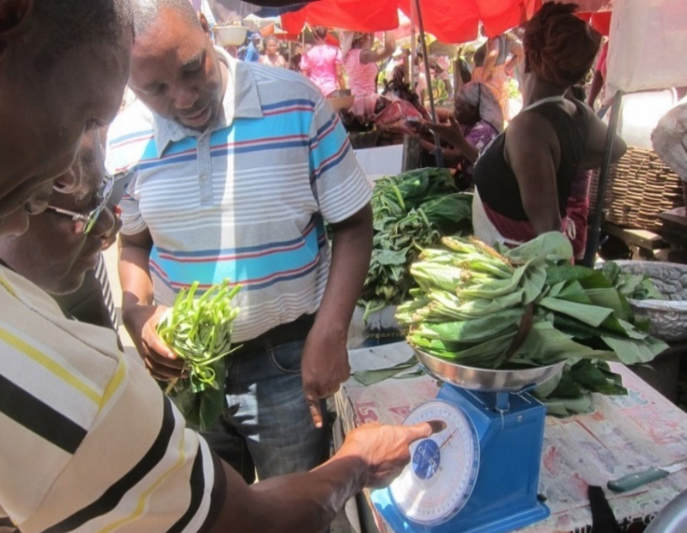
https://sites.tufts.edu/foodpricesfornutrition
Thank you!
We thank the many price collectors and contributors to the diverse databases used in this work and are grateful for funding to the Bill & Melinda Gates Foundation and UKAid, as well as complementary funding from FAO.
Photo by Anna Herforth
at Agbogbloshi market, Ghana

Slide 13
Other slides
Notes:
Source: U.S. Bureau of Labor Statistics Release: Consumer Price Index Units: Index 1982-1984=100, Seasonally Adjusted Frequency: Monthly U.S. Bureau of Labor Statistics, Consumer Price Index for All Urban Consumers: Food Away from Home in U.S. City Average [CUSR0000SEFV], retrieved from FRED, Federal Reserve Bank of St. Louis; https://fred.stlouisfed.org/series/CUSR0000SEFV, May 25, 2023. Source: U.S. Bureau of Labor Statistics Release: Consumer Price Index Units: Index 1982-1984=100, Seasonally Adjusted Frequency: Monthly U.S. Bureau of Labor Statistics, Consumer Price Index for All Urban Consumers: Food at Home in U.S. City Average [CUSR0000SAF11], retrieved from FRED, Federal Reserve Bank of St. Louis; https://fred.stlouisfed.org/series/CUSR0000SAF11, May 25, 2023. Source: U.S. Bureau of Labor Statistics Release: Producer Price Index Units: Index 1982=100, Seasonally Adjusted Frequency: Monthly U.S. Bureau of Labor Statistics, Producer Price Index by Commodity: Intermediate Demand by Commodity Type: Processed Foods and Feeds [WPSID69112], retrieved from FRED, Federal Reserve Bank of St. Louis; https://fred.stlouisfed.org/series/WPSID69112, May 25, 2023. Source: U.S. Bureau of Labor Statistics Release: Producer Price Index Units: Index 1982=100, Seasonally Adjusted Frequency: Monthly U.S. Bureau of Labor Statistics, Producer Price Index by Commodity: Intermediate Demand by Commodity Type: Unprocessed Foodstuffs and Feedstuffs [WPSID621], retrieved from FRED, Federal Reserve Bank of St. Louis; https://fred.stlouisfed.org/series/WPSID621, May 25, 2023.

Slide 14
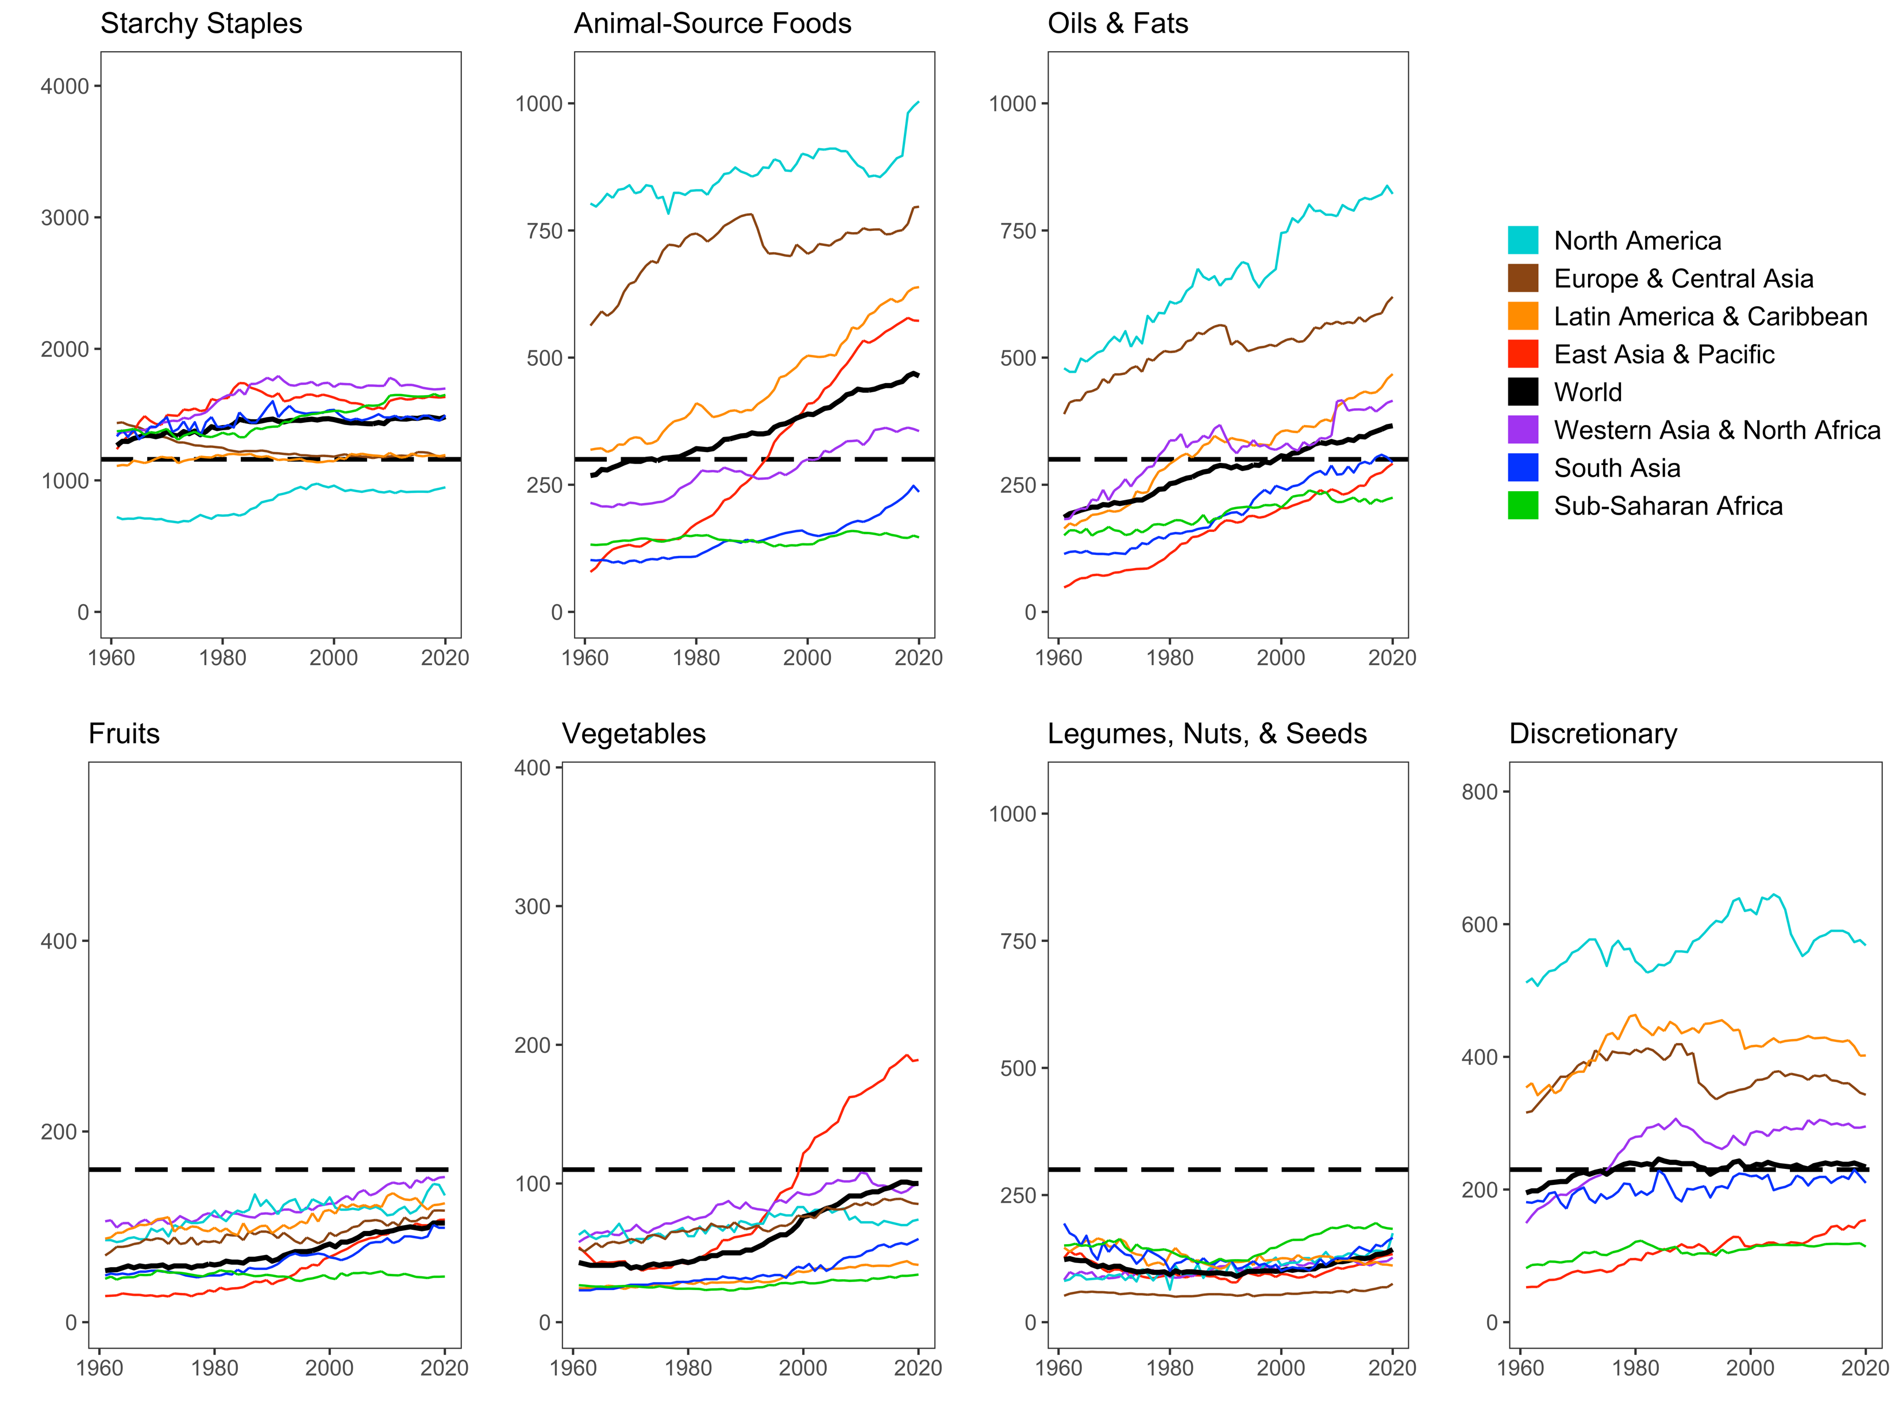
Are the foods required for a healthy diet always available in the food supply?
Food supply data are from FAO Food Balance Sheets and show total daily kilocalories available per capita for food consumption in each geographic region, aggregated by HDB food group.

Slide 15
For consumers, what matters are retail food prices
Average rise in retail food prices relative to all other goods and services over previous 12 months in the U.S. and worldwide, Jan. 1998 - Mar 2023
8%
2022-23
(COVID recovery)
Recent food price spikes:
2008-09
6%
2020-21
(COVID onset)
4%
2015-16
2011-12
2%
month moving average, times 12)
United
States
Annual percent change in real food prices
0%
-2%
Global average
-
(up to 138 countries)
(12
-4%
-6%
1998-01
1999-01
2000-01
2001-01
2002-01
2003-01
2004-01
2005-01
2006-01
2007-01
2008-01
2009-01
2010-01
2011-01
2012-01
2013-01
2014-01
2015-01
2016-01
2017-01
2018-01
2019-01
2020-01
2021-01
2022-01
2023-01
Note: Author's calculations. U.S. data are from the Bureau of Labor Statistics (updates: https://fred.stlouisfed.org/graph/?g=12Myr). Global data are from the IMF, averaging up to 138 countries reporting monthly consumer price indexes (CPI) for food and for all goods and services, Jan. 2000 through Dec. 2022. Each observation is the average monthly rise over the previous 12 months, times 12 to obtain an annualized value. Number of countries rises from 51 in Jan 2000 to 95 in 2005 and then 138 from 2015 onwards. Raw data for all countries are at https://data.imf.org.

Slide 16
When we buy food, what are we paying for?
Cost of food by stage of value added in the United States, 1993 – 2021
When we buy food, we pay a lot for brands & services!
Cumulative percent of consumer price
2.6%
3.4%
22.2%
76.2%
23.1%
5.3%
30.8%
5.0%
6.1%
5.5%
9.8%
4.8%
3.7%
1.3%
Note: Author’s calculations. Data shown are from the USDA Economic Research Service (2023), Food Dollar Series. Last updated Feb. 15, 2023, available at https://www.ers.usda.gov/data-products/food-dollar-series. Implied total spending on food advertising is roughly $60 billion per year, more than the NIH and CDC budgets combined. (Overall food spending is about $6,200 per person, about half our total health-care spending.)

Slide 17
Price variation differs by stage of the value chain
Consumer prices for groceries and restaurants vs. wholesale costs, Jan 1990 – Mar 2023
Restaurant prices are relatively stable, rising with wages and rents
Restaurant prices (food away from home)
Index value (January 1990=100)
Grocery prices (food at home)
Grocery prices fluctuate around overall inflation
Fruits & vegetables
Wholesale producer prices for processed foods
Wholesale prices for unprocessed commodities are more volatile than prices for processed foods
All food at home
Wholesale producer prices for unprocessed foods
Note: Author’s calculations. Data shown are from the US Bureau of Labor Statistics, as the average for each category relative to the overall U.S. consumer price index for all goods and services. Fruits and vegetables may be fresh, frozen or canned. Updated values can be obtained from https://fred.stlouisfed.org/graph/?g=12MMl.

Slide 18
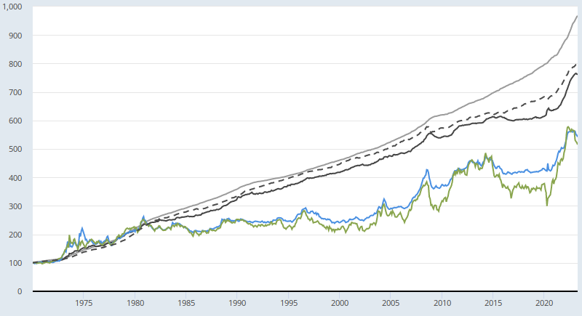
Price variation differs by stage of the value chain
Consumer and producer price indexes for foods in the US, Jan.1970 – Mar. 2023
Index value (January 1970=100)
Consumer price indexes:
Food away from home
All goods & services
Food at home
Processed food and feed
Producer price indexes:
Unprocessed food and feed
Note: Author’s calculations. Data shown are from the US Bureau of Labor Statistics, as the average for each category. A continuously updated version of this chart can be obtained from https://fred.stlouisfed.org/graph/?g=15rA3.

Slide 19
Agricultural products are ingredients in retail food items
Price
($/kcal)
Demand for retail item
(e.g. bread)
Retail item
(e.g. bread)
P_{r}
P’_{r}
Retail price without tariffs
or non-tariff measures [P’_{r} = P_{r} - (t × P_{t})]
Traded
commodity
(e.g. wheat)
P_{d}
Cost of tariffs or
non-tariff measures (t × Pt)
P_{t}
Supply from domestic farms (if any)
Demand for tradable commodity
(bulk wheat)
Quantity (kcal/year)
Source: W.A. Masters, S. Block, R. Gilbert, L. Costlow, J. Matteson, E. Krivonos and J. Rauschendorfer (2022), “Trade policy and the cost of healthy diets in Africa and worldwide”. Draft report for FAO, last revised 22 Feb. 2023

Slide 20
Most retail foods are based on importable ingredients, and the cost of those ingredients averages 10-26% of retail price
Role of imported product costs and tariffs in retail item prices (n=680 foods in 144 countries)
 |  | All foods
 | Pct of retail food items with an imported primary ingredient | Pct of retail price for imported foods that is its import cost (CIF) | Pct of imported products that face an import tariff | Average tariff, where present (percent ad-valorem) |  | Total number of retail food items in the global ICP database
Starchy staples | 72 | 10 | 36 | 7.10 |  | 3,473
Vegetables | 56 | 20 | 50 | 6.65 |  | 1,420
Fruits | 63 | 16 | 50 | 6.53 |  | 1,477
Animal-source foods | 37 | 26 | 26 | 7.59 |  | 5,726
Legumes, nut, and seeds | 75 | 14 | 57 | 6.11 |  | 826
Oils and fats | 72 | 17 | 62 | 7.87 |  | 990
All foods | 55 | 17 | 38 | 7.10 |  | 13,912
Source: W.A. Masters, S. Block, R. Gilbert, L. Costlow, J. Matteson, E. Krivonos and J. Rauschendorfer (2022), “Trade policy and the cost of healthy diets in Africa and worldwide”. Draft report for FAO, last revised 22 Feb. 2023
Notes:
Notes: Data shown are global averages for all retail items on the left, and only items selected in least-cost diets on the right. Column details are (a) Percentage of all country-retail food combinations for which the retail item was successfully matched to a primary ingredient from the FAO Commodity List, where that country is a net importer of the commodity and the commodity has a non-missing unit value; (b) percentage of the final product’s retail price that is accounted for by the trade unit value of the corresponding imported commodity ; (c) percentage of those imported commodities that have any tariffs; (d) average tariff for all items in column c; (e) total country-retail food item observations.

