Slide 1
Can all people access healthy and sustainable diets?
Dr. Anna Herforth – Harvard T.H. Chan School of Public Health, USA
P.I. Global Diet Quality Project
Co-Director, Food Prices for Nutrition
20-22 SEPTEMBER 2023-BARCELONA

Slide 2
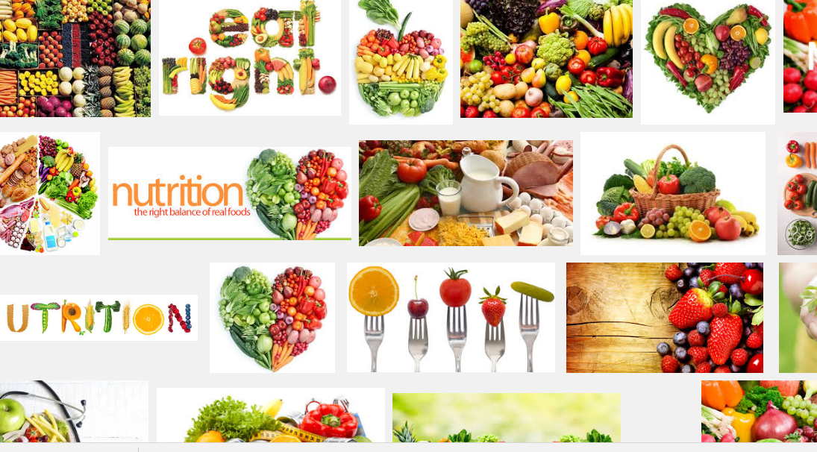
Background: Recommendations vs reality
Notes:
Background image – googled nutrition

Slide 3
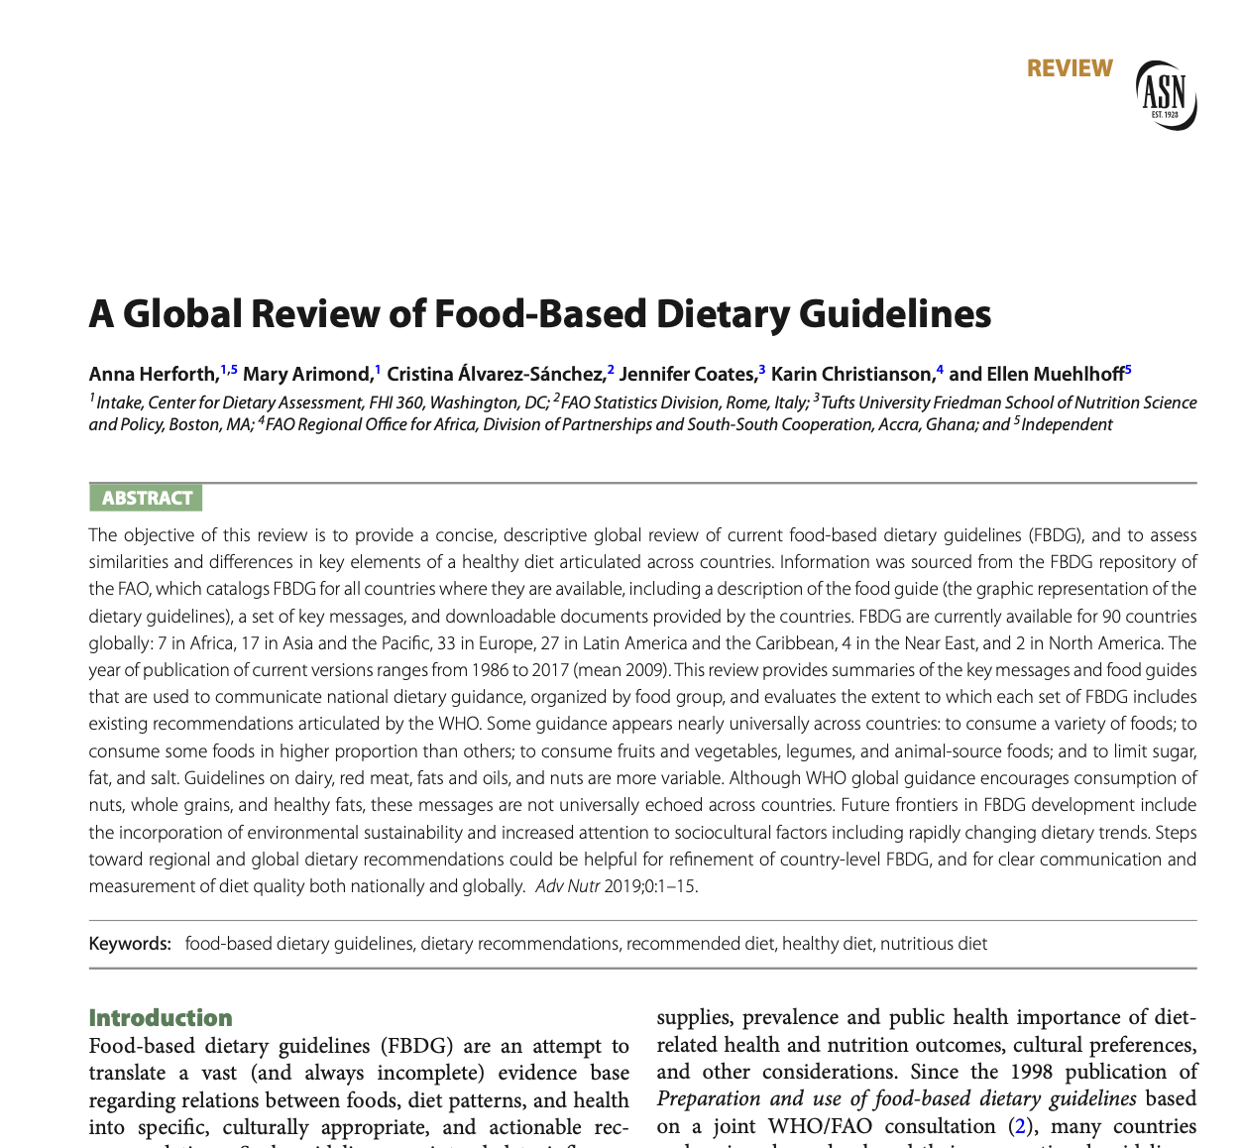
Advances in Nutrition 2019

Slide 4
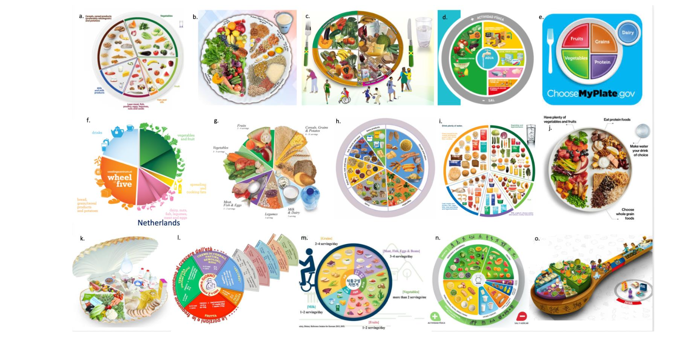
Abundant consumption of fruits and vegetables is the most universal recommendation for healthy diets

Slide 5
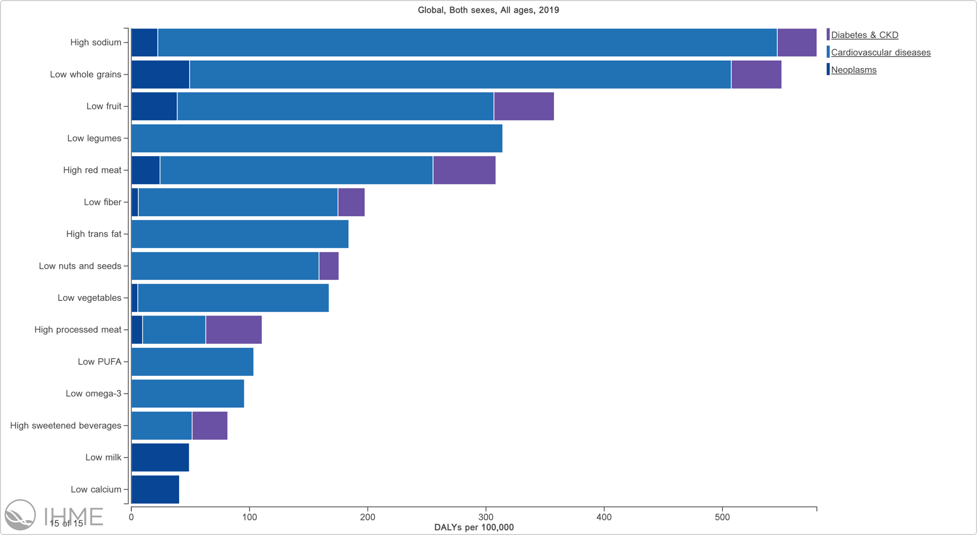
Low fruit, vegetables, legumes, nuts, seeds in the global burden of disease
Why are some risk factors attributable for a larger burden of disease?
Strong causal link (has been discussed)
High prevalence of deficiency in diets
Notes:
The health consequences of low fruit and vegetable consumption include higher risk of diet-related noncommunicable diseases and certain nutrient deficiencies.

Slide 6
What do we know about what people eat?
Are people following dietary guidance?
How many people are eating fruits and vegetables daily?
New survey data, and other modeling efforts, can help answer this question

Slide 7
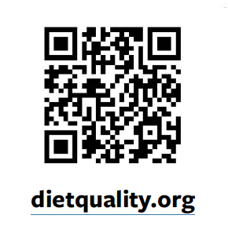

Slide 8
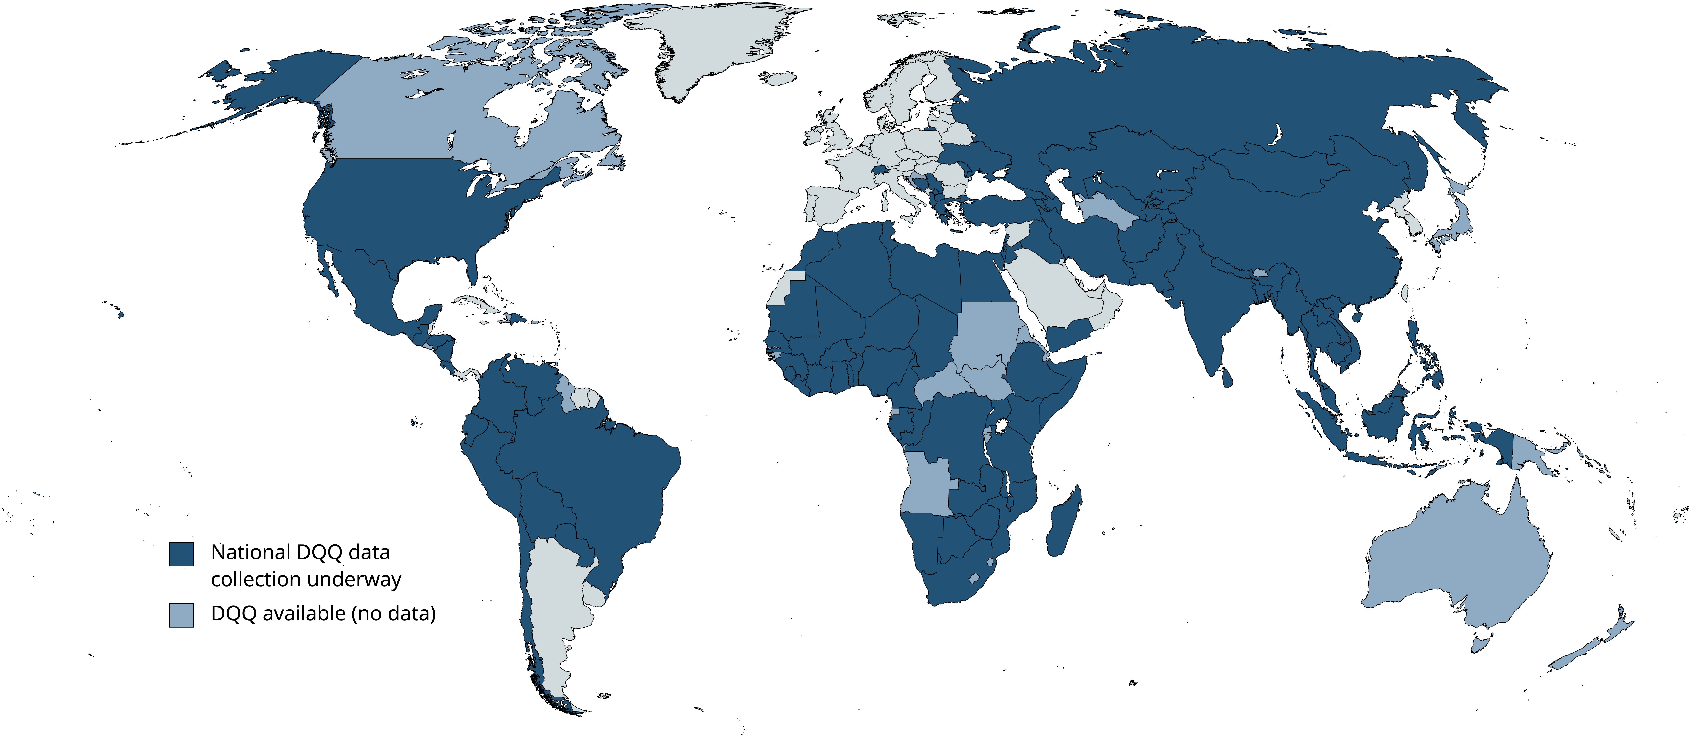
Nationally representative data now collected in 85 countries (>90 by 2024)
5-minute module implemented in the Gallup World Poll, following the model of the Food Insecurity Experience Scale (FIES)
DHS is implementing the same question adaptations for women and children
Data collected so far represents 85% of the global population
Notes:
The DQQ has now been implemented in 85 countries in the GWP, and results are available and posted for the 56 covered in 2021-2022.
This follows in the footsteps of the successful scale up of food insecurity measurement through Gallup, as it is the only survey in the world that covers essentially all countries. DHS is also a large multitopic survey covering many countries, and we have partnered with DHS: we have provided the diet questions to DHS, and incorporated feedback from DHS.
The dark blue countries are where the DQQ has already been implemented, and the medium blue are this year and next.
All the results are publicly available, less than 6 months after data collection is completed, on the Global Diet Quality Project Website: dietquality.org

Slide 9
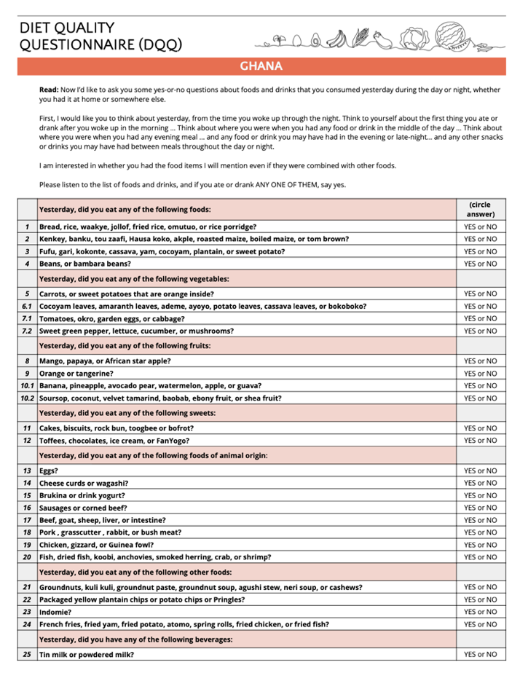
DQQ approach:
“Yes or No” questions about foods consumed in the previous day.
29 universal food groups, country-adapted items
Read aloud the same way each time in person or by phone
Takes 5 minutes to administer
Diet Quality Questionnaire (DQQ) was developed as a tool to rapidly assess diet quality at population level.
Notes:
The DQQ does not gather information on all aspects of diet.

Slide 10
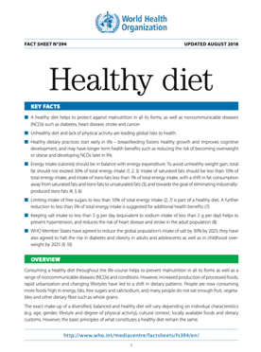
Moderation and Protection against NCDs
NCD-Protect
NCD-Risk
New indicators allow tracking of trends related to public health risk from diet-related NCDs
Validated against WHO recommendations
NCD-Protect reflects diverse plant food consumption
NCD-Risk is also correlated with ultraprocessed food intake
Notes:
Protective food groups: diverse vegetables, fruits, whole grains, pulses, nuts and seeds
Food groups associated with excess sugar, salt, fat and saturated fat, processed meat

Slide 11
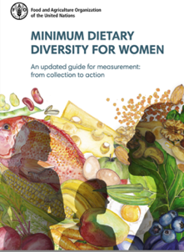
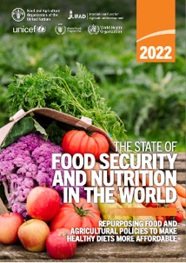
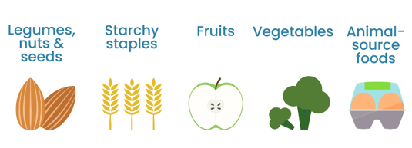
Dietary diversity and adequacy
Nutrient Adequacy is proxied by the Minimum Dietary Diversity for Women (MDD-W) aged 15-49
Dietary diversity scores are measured in both women and men
Food group adequacy is measured as diversity aligned with dietary guidelines: the proportion of people who consumed All-5 recommended food groups
Notes:
Then share what we know about dietary consumption
Current data (Gallup)
-All-5
-percent of people consuming any fruits
-percent of people consuming any veg
-percent of people consuming at least 3 types of fruit and veg
From Gallup data:
(In all but 8 of the countries surveyed, the majority of people are missing at least one recommended food group on any given day.)
Vegetable consumption is a bit better, with the majority of people consuming at least some amount of vegetables in all countries.
In half the countries surveyed, 10% or more of the population is consuming ZERO vegetables or fruits on any given day.

Slide 12
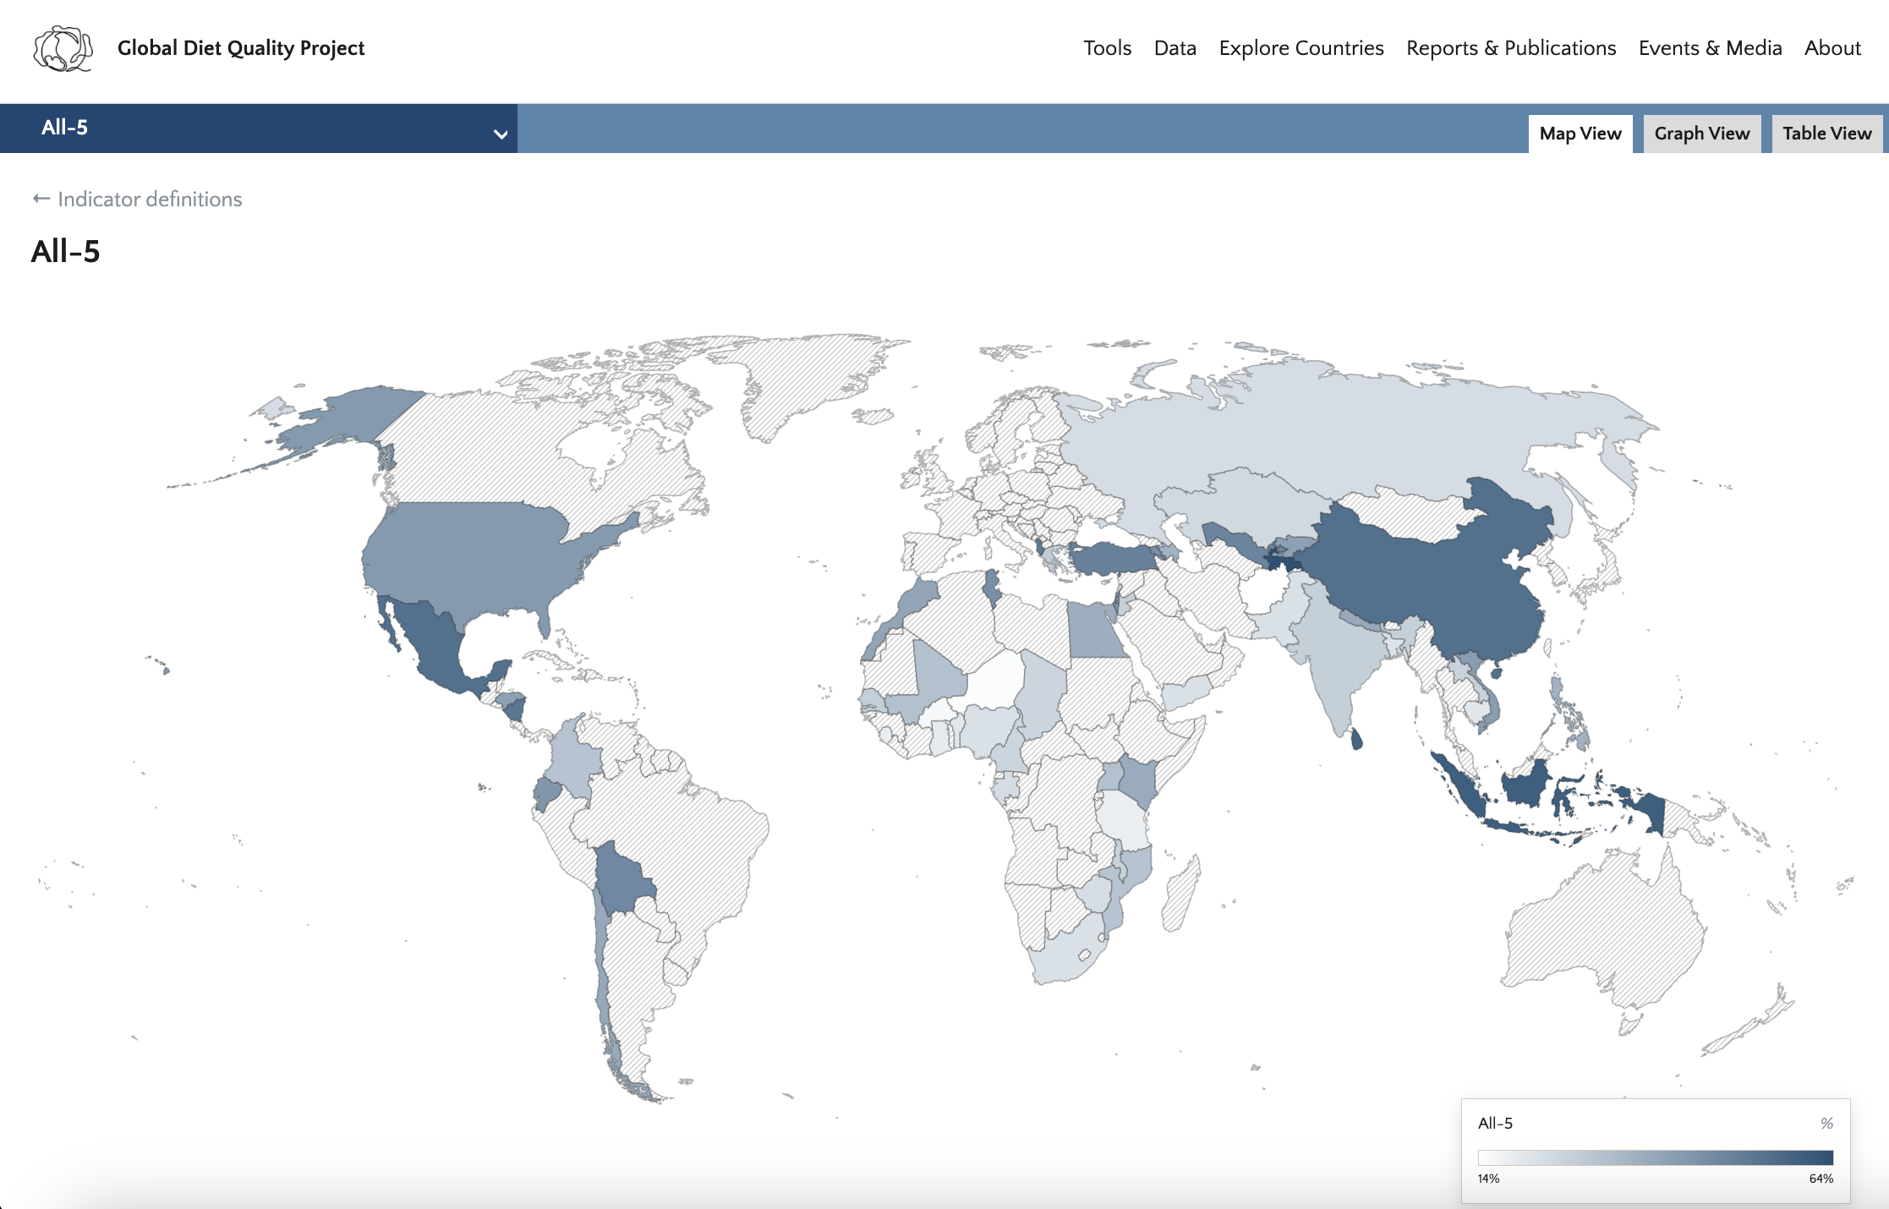
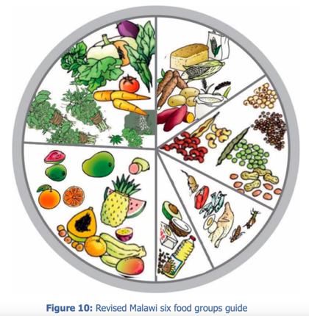
Most people are missing at least one recommended food group on any given day
1 Vegetables
2 Fruits
3 Pulses, nuts and seeds
4 Animal-source foods
5 Starchy staples
>50% are consuming All-5 in only 7 of 56 countries.
Darker color = more people aged 15 years and older are consuming all 5 recommended food groups
Source: Global Diet Quality Project dietquality.org

Slide 13
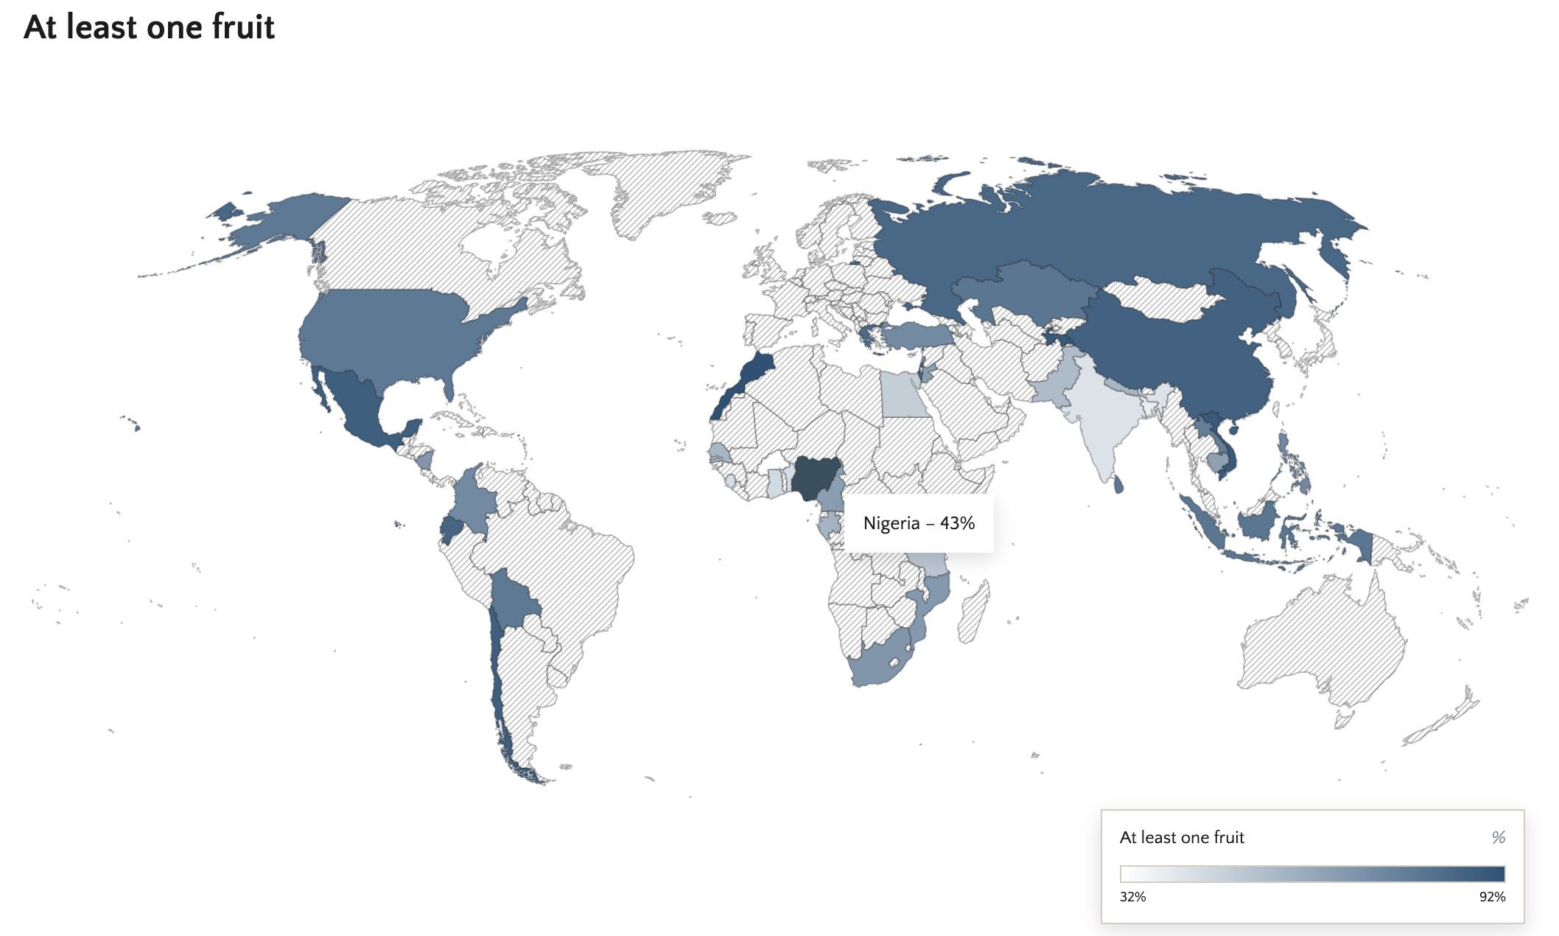
Most people consume at least some amount of vegetables, but fruits are commonly absent
In one quarter of the countries surveyed, the majority of people are missing fruit on any given day.
Source: Global Diet Quality Project dietquality.org
Notes:
While most people consume at least some amount of vegetables, fruits are commonly absent: in one quarter of the countries surveyed, a majority of people are missing fruit on any given day.

Slide 14
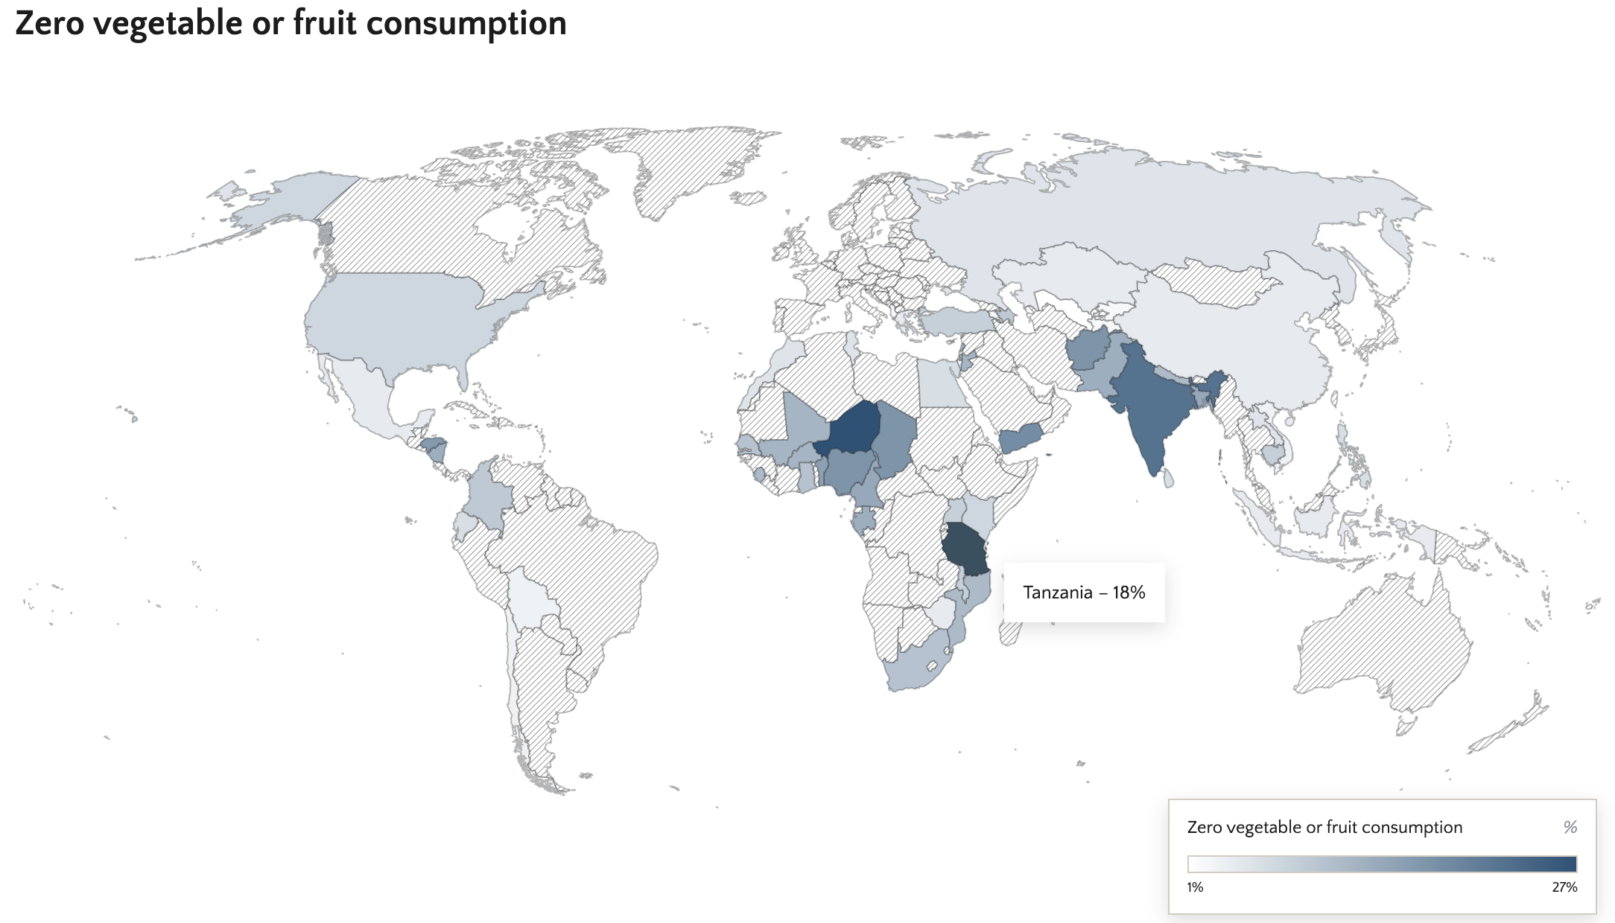
In several countries up to 1/5 of people are consuming zero veg or fruit on a given day
Source: Global Diet Quality Project dietquality.org

Slide 15
Other data suggest that the amount of fruits and vegetables consumed is far below recommendations
400 grams or more per day recommended by the World Health Organization
From WHO STEPS surveys in 28 countries:
Mean intake of fruits was 1.15 servings per day, and for vegetables 2.46 servings/d.
Over 80% of individuals aged ≥15 y living in these 28 LMICs consumed lower amounts of fruits and vegetables than recommended by the WHO. (Frank et al. 2019, J Nutr)
Corroboration:
GWP data found that in 56 countries, mostly LMIC, on average respondents consumed 1.01 of 3 fruit groups, and 1.52 of 3 vegetable groups
Notes:
Frank SM, Webster J, McKenzie B,† Geldsetzer P,† Manne-Goehler J, Andall-Brereton G, Houehanou C, Houinato D, Gurung MS, Bicaba BW, McClure RW, Supiyev A, Zhumadilov Z, Stokes A, Labadarios D, Sibai AM, Norov B, Aryal KK, Kagaruki GB, Mayige MT, Martins JS, Atun R, Bärnighausen T, Vollmer S, Jaacks LM. Consumption of fruits and vegetables among individuals 15 years and older in 28 low- and middle-income countries. J Nutr. 2019 Jun 1. pii: nxz040.
Modeling on amount of fruit and veg consumed
Micha R, Khatibzadeh S, Shi P on behalf of the Global Burden of Diseases Nutrition and Chronic Diseases Expert Group (NutriCoDE), et al
Global, regional and national consumption of major food groups in 1990 and 2010: a systematic analysis including 266 country-specific nutrition surveys worldwide
BMJ Open 2015;5:e008705. doi: 10.1136/bmjopen-2015-008705

Slide 16
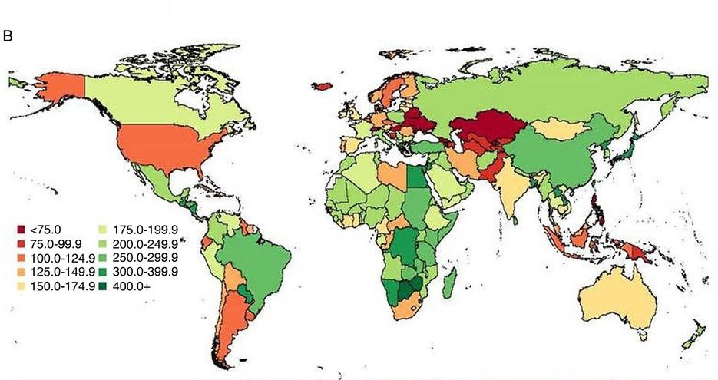
Modeled (estimated) consumption of fruits -green shades are >150g and vegetables + legumes -green shades are >175g
Source: Micha et al. 2015 BMJ Open
Modeled estimates from the Global Dietary Database (GDD)
Notes:
Micha R, Khatibzadeh S, Shi P on behalf of the Global Burden of Diseases Nutrition and Chronic Diseases Expert Group (NutriCoDE), et al
Global, regional and national consumption of major food groups in 1990 and 2010: a systematic analysis including 266 country-specific nutrition surveys worldwide
BMJ Open 2015;5:e008705. doi: 10.1136/bmjopen-2015-008705
“In 2010, mean global fruit consumption in adults was 81.3 g/day (95% UI 78.9–83.7; table 3 and figure 2), yet with 6-fold variation across 21 world regions (from 27.6 to 169.9 g/day; figure 5) and 17-fold variation across 187 countries (from 19.2 to 325.1 g/day). Highest intakes were identified in Jamaica, Malaysia, Jordan, Greece and New Zealand (see eTable 3); and lowest intakes in Ethiopia, Nepal, India, Vanuatu and Pakistan. Only 2 of 187 countries, Jamaica and Malaysia, representing roughly 19 million adults (0.4% of the global adult population), had mean consumption ≥300 g/day.”
“Worldwide, mean vegetable consumption (including legumes) was 208.8 g/day (table 3 and figure 2), with less variation (approximately 3.4-fold) compared with fruits across highest (294.4 g/day) to lowest (86.1 g/day) regions (figure 5). Among individual nations, intake ranged from 34.6 to 493.1 g/day: highest in Zimbabwe, other South Sub-Saharan African nations (Botswana and Swaziland) and Greece; and lowest in Vanuatu, the Philippines, Hungary, Switzerland, Armenia and Georgia (see eTable 3). High vegetable intake was primarily due to high consumption of legumes in Southern Sub-Saharan Africa and Tropical Latin America; due to both legumes and other vegetables in Central and Eastern Sub-Saharan Africa; and due to vegetables alone in Greece, high-income Asia Pacific and East Asia. Only 4 of 187 countries had intake levels ≥400 g/day, representing 17 million adults and 0.4% of the world adult population.”

Slide 17
Lack of access to healthy diets
including
adequate fruits and vegetables
Notes:
Lack of access is one culprit underlying low consumption of healthy diets, and fruits and vegetables
Fruits and vegetables are unaffordable for many

Slide 18
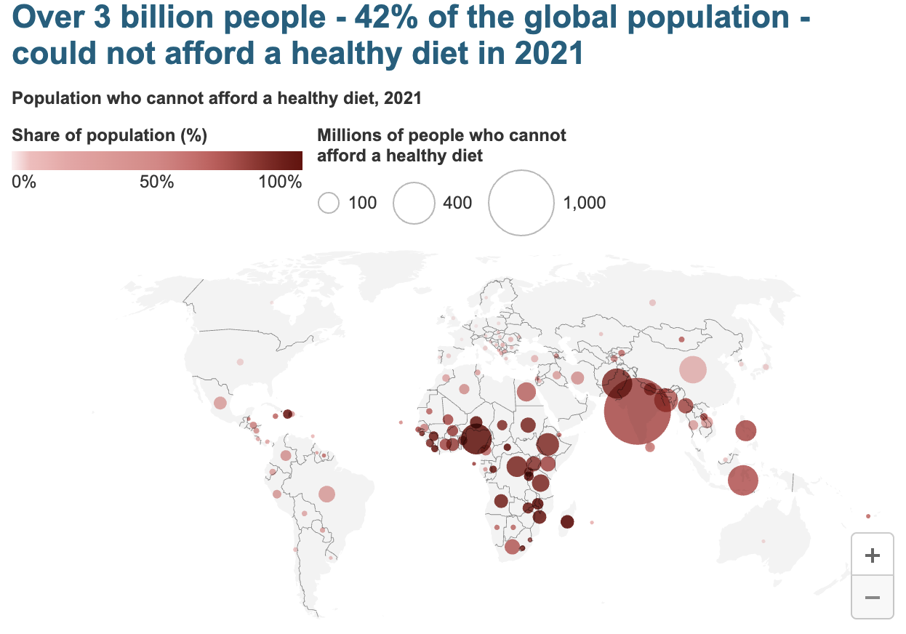
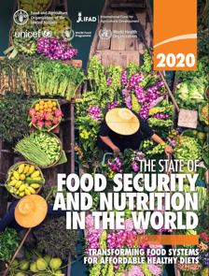
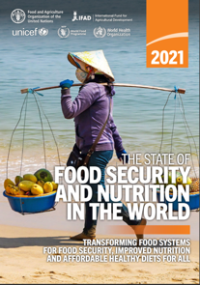
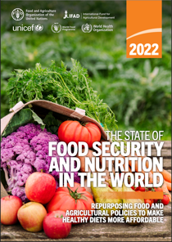
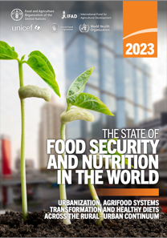
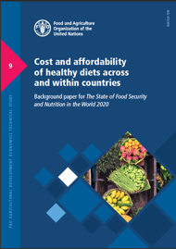
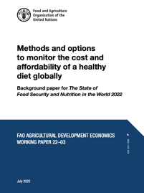
https://www.fao.org/faostat/en/#data/CAHD/
Herforth et al. 2020 and 2022
Map source: Food Prices for Nutrition DataHub
https://www.worldbank.org/foodpricesfornutrition
Notes:
This statistic was published by FAO et al., and you can find the information on FAOSTAT and our [FPN] DataHub hosted at the World Bank.
The Cost and Affordability of a Healthy Diet is an indicator recently adopted by FAO as a global food security indicator to complement the Prevalence of Undernourishment and Food Insecurity Experience Scale. This indicator has revealed that approximately three billion people cannot afford a healthy diet, meaning a least-cost diet that satisfies dietary guidelines. The majority of those who cannot afford a healthy diet are living in sub-Saharan Africa and South Asia.
Reference:
Herforth, A., Venkat, A., Bai, Y., Costlow, L., Holleman, C. & Masters, W.A. 2022. Methods and options to monitor the cost and affordability of a healthy diet globally. Background paper for The State of Food Security and Nutrition in the World 2022. FAO Agricultural Development Economics Working Paper 22-03. Rome, FAO.

Slide 19
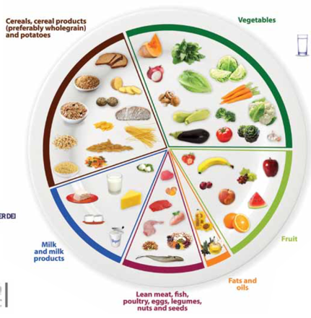
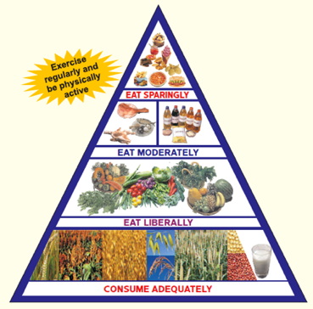
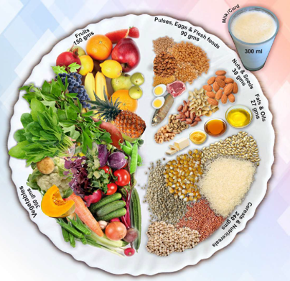
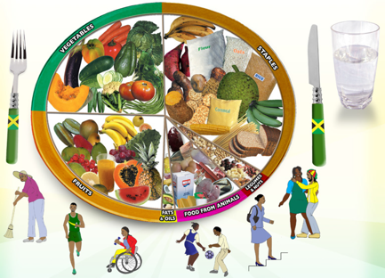
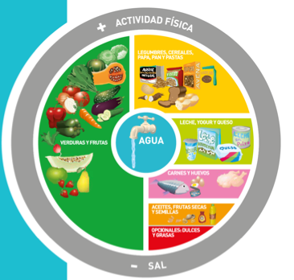
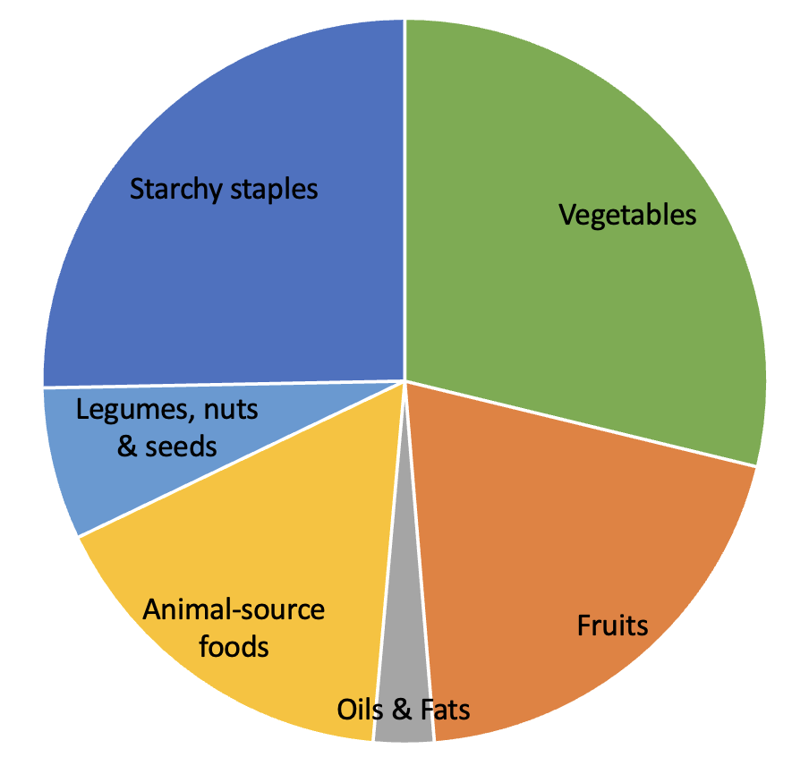
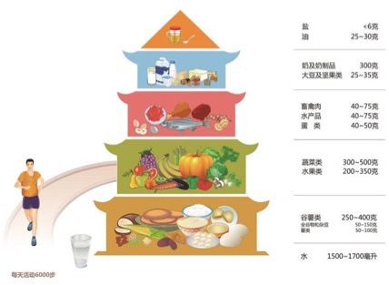
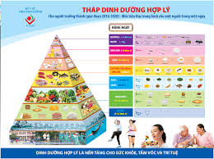
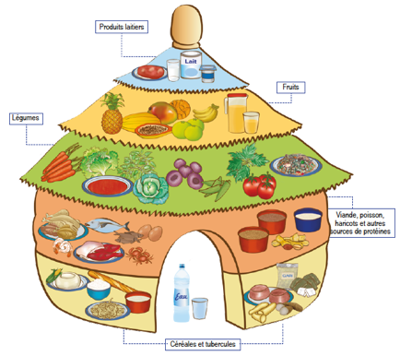
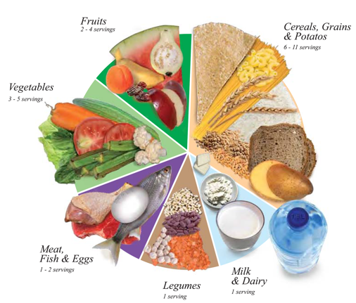
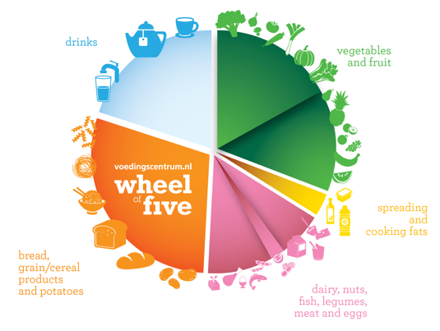
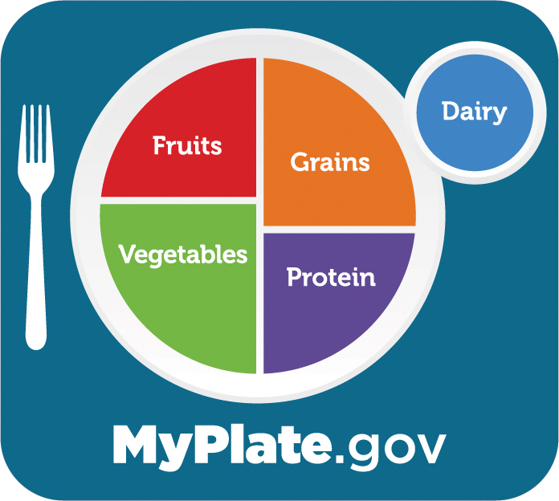
Jamaica
Argentina
India
Malta
China
Vietnam
Benin
U.S.A.
Oman
Netherlands
Notes:
We looked across a number of quantified guidelines, and found the average amounts recommended in each food group. Imagine overlaying each one on top of the other, and what you would see emerge is the average proportions of each food group, that make up the Healthy Diet Basket.
Why these 10 were selected: clearly quantified, recent, representing diverse regions.
Also looked at 31 food guides that were not necessarily
HDB represents the median recommendations across 10 quantified FBDG, and is consistent with other non-quantified FBDG in terms of identity and proportionality of food groups.

Slide 20
Healthy Diet Basket reflects the commonalities across guidelines in terms of food group proportions
About ¼ starchy staples by volume
About ½ fruits and vegetables by volume
Healthy Diet Basket
A global standard set of criteria that represents commonalities across most national food based dietary guidelines, created for the purpose of calculating and comparing the cost and affordability of healthy diets across countries.
About ¼ protein-rich foods by volume
Source: Herforth et al. 2022
Notes:
This is what the Healthy Diet Basket looks like. It’s about half fruits and veg by volume, a quarter each of starchy staples and protein rich foods by volume, and a small amount in starchy staples.
This grouping is the most common distribution of food groups seen in food guides in many countries, a couple of which are pictured here, Poland and Canada.
This is what the proportions look like in terms of volume on a plate. However, to calculate cost…

Slide 21
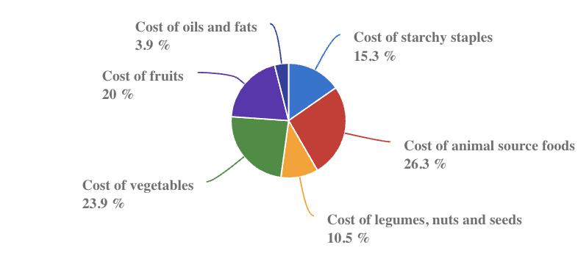
On average globally, fruits and vegetables command 44% of the cost of a healthy diet, which puts them out of reach for many
Source: FAOSTAT

Slide 22
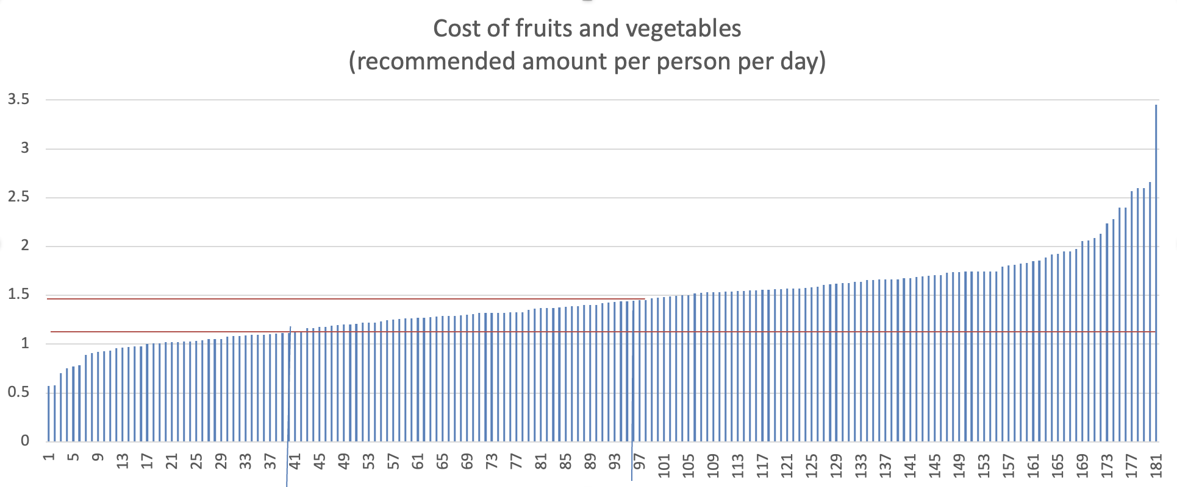
The cost of adequate fruits and veg exceeds the total food poverty line in most countries
2017 USD (PPP)
Average cost $1.45 (PPP)
Food poverty line $1.12
Source: Food Prices for Nutrition DataHub (World Bank DataBank)
Notes:
In 141 countries (of 181), average cost of adequate F&V exceeds the food poverty line

Slide 23
Disconnect between per capita supply and recommendations
Food balance sheet data show that availability of fruits and vegetables is lower than recommended amounts in most regions of the world.
Notes:
Food balance sheet data show that availability of fruits and vegetables is lower than recommended amounts in most regions of the world.

Slide 24
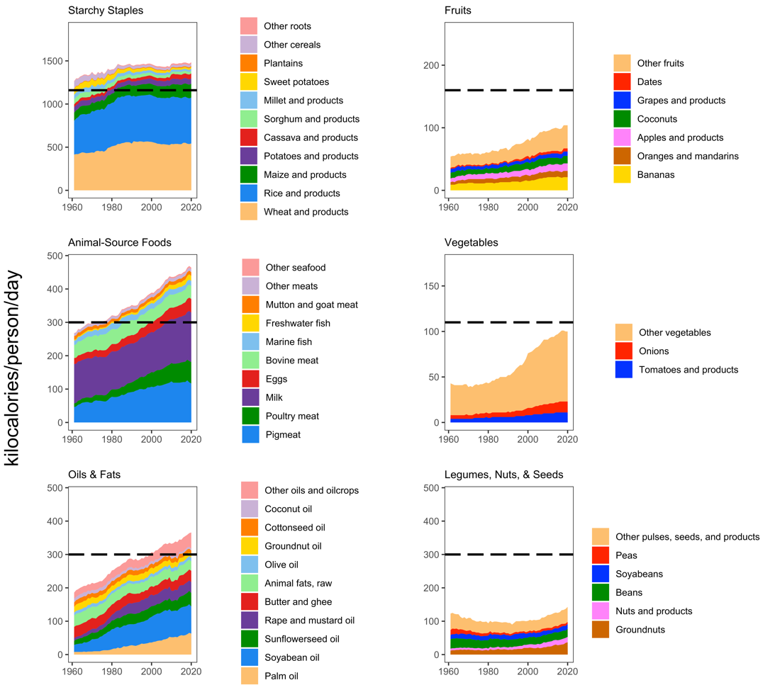
Figure 1. Global food supply relative to healthy diet basket targets by food group, 1961-2020.
Source: Costlow L, Herforth AW, and Masters WA, forthcoming.
Note: Data shown are worldwide totals available for food consumption, based on production minus non-food use and supply-chain losses estimated in national food balance sheets.

Slide 25
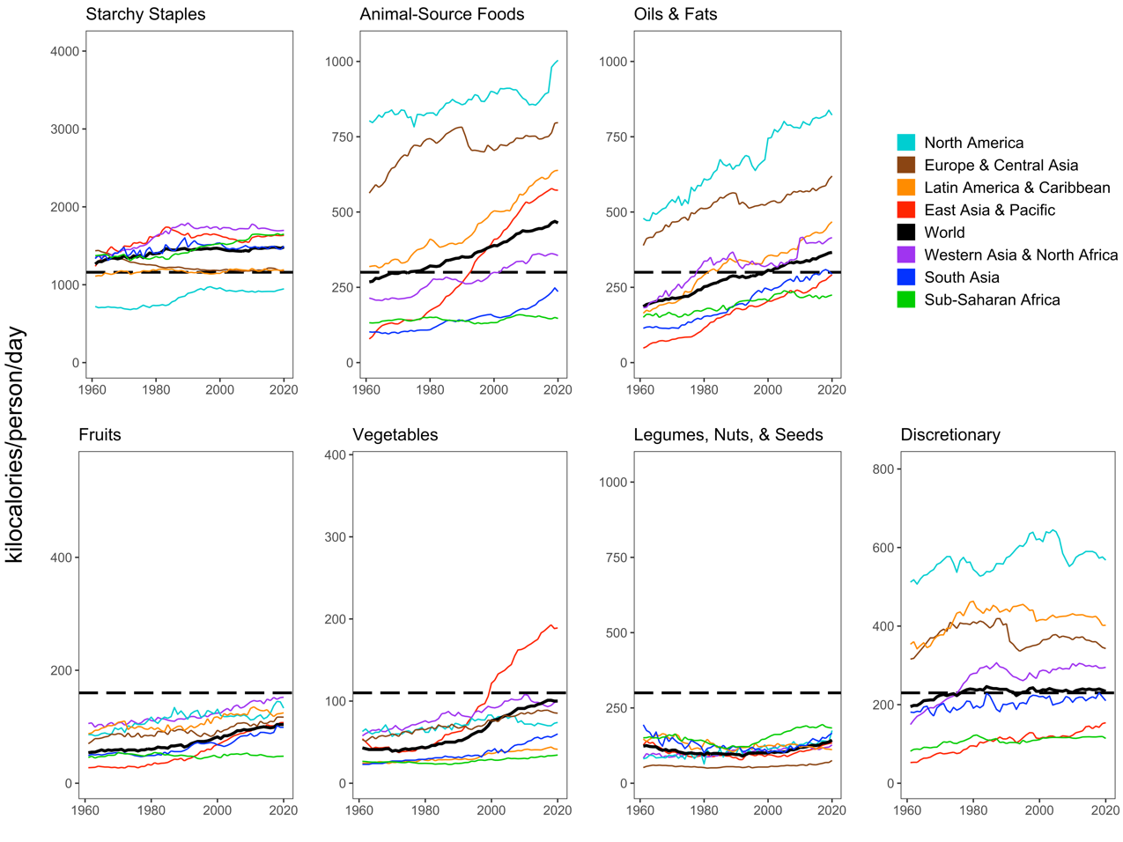
Figure 2. Regional food supplies relative to healthy diet basket targets by food group, 1961-2020
Source: Costlow L, Herforth AW, and Masters WA, forthcoming.
Note: Data shown are worldwide totals available for food consumption, based on production minus non-food use and supply-chain losses estimated in national food balance sheets.

Slide 26
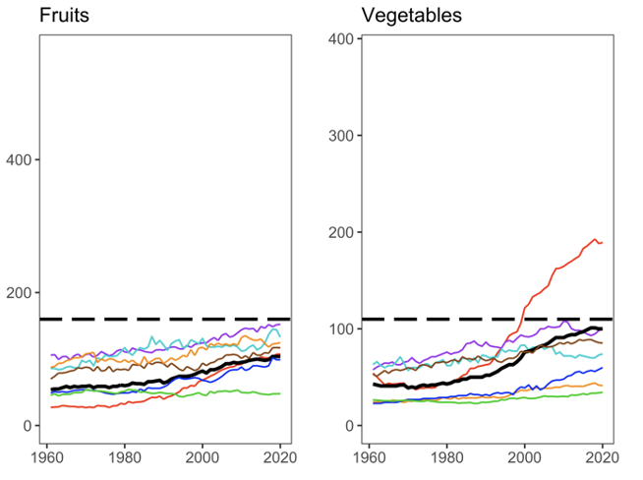
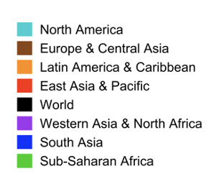
Source: Costlow L, Herforth AW, and Masters WA, forthcoming.
Note: Data shown are worldwide totals available for food consumption, based on production minus non-food use and supply-chain losses estimated in national food balance sheets.

Slide 27
Possible actions

Slide 28
Improving access to healthy diets
What to do about low availability? Systemic, long term:
investment in seed systems, gene banks, cold chains
and other research and development for improved, locally-adapted and resilient production
What to do about low affordability? More immediate:
social protection efforts to help people purchase or grow vegetables and fruits for themselves
conservation of wild areas which may provide access when markets and cultivation do not.
Better measurement of availability of fruits and vegetables
to ensure that progress and gaps in fruit and vegetable production are accurately captured, including minor and underutilized species
Efforts to reinforce cultural preferences for traditional species and preparations are essential to sustaining recognition and demand
Notes:
When people cannot access adequate fruits and vegetables, what can be done? Now and over the long term, investment in seed systems, gene banks, cold chains, and other research and development for improved, locally-adapted and resilient production is needed.
Other more immediate actions to improve physical and economic access include social protection efforts to help people purchase or grow vegetables and fruits for themselves, and conservation of wild areas which may provide access when markets and cultivation do not.
Finally, efforts to reinforce cultural preferences for traditional species and preparations of vegetables and fruits are essential to sustaining recognition and demand.
In tandem with these efforts, greater attention needs to be paid to estimating the availability of fruits and vegetables to ensure that progress and gaps in fruit and vegetable production are accurately captured, including minor and underutilized species.

Slide 29
Thank you!
Gracias
Merci
20-22 SEPTEMBER 2023-BARCELONA
sites.tufts.edu/foodpricesfornutrition
worldbank.org/foodpricesfornutrition

