Slide 1

Nutrition as a Basic Need
A new method for utility-consistent and nutritionally adequate food poverty lines
Kristi Mahrt,¹ Anna W. Herforth,² Sherman Robinson, ¹ Channing Arndt, ¹ Derek Headey¹
1 – IFPRI; 2 – Co-Director of the Food Prices for Nutrition project

Slide 2
Motivation
The cost of basic needs (CBN) poverty metrics, as currently applied, poorly reflect nutritional needs.
Most poor countries use the CBN approach for national poverty lines, estimating food baskets that satisfy a dietary energy standard while reflecting consumption patterns of near poor households.
But poorer households consume poor diets. Lots of starchy staples, few nutrient-dense food … a circular logic: cost of basic “nutritional” needs estimated from nutritionally inadequate diets.
Poverty measurement is still in a past paradigm in terms of nutrition.
How to get beyond energy…
  Linear programming
    → nutrients are not enough (Allen 2017)
  Dietary guidelines (Herforth et al. 2020). Least-cost healthy diets (SOFI 2020 onward)
    → do not account for tastes and norms (preferences)
  Can this be done using the cost of basic needs welfaristic approach?

Slide 3
Contributions
We argue that:
  A healthy diet is a basic need
  A healthy diet can be defined from dietary guidelines (national policy documents or international healthy diet standards), and adjusted to to reflect cultural food norms
  Energy-based food baskets are associated with significant micronutrient deficiencies
  Poverty estimates resulting from poverty lines that use energy-based food baskets are typically substantially lower than poverty based on a healthy-diet food baskets
We apply these arguments to Myanmar (2015) but expect that our results generalize to all LMICs.
In short, nutrition as a basic need implies a reset of the utility level defining the poverty threshold. With this reset, many more people in the world are mired in poverty-- energy poor versus nutritionally poor.

Slide 4
What do we mean by poverty?
Absolute vs
Relative
National vs
Global
Welfaristic vs Objective
Notes:
Global
$2.15 international measure of extreme poverty
median of the national poverty lines of 28 of the world’s poorest countries – in in 2017 PPPs

Slide 5
What do we mean by poverty?
Absolute vs
Relative
National vs
Global
Welfaristic vs Objective
Decerf (2023) distinguishes welfaristic vs objective:
Welfaristic approach → poverty line tied to a fixed level of utility
e.g., cost of basic needs approach, Ravallion 1998
Objective approach → poverty line tied to a fixed level of achievements
e.g., linear programming/least cost diet approaches Allen 2017, Herforth 2020
Our primary focus is how to expand the nutrition requirement in national cost of basic needs poverty lines
Notes:
Text from Decerf
Under the “welfaristic” approach, an absolute poverty line aims at capturing a fixed value in the utility space. Its nominal monetary amount corresponds to the minimal cost of reaching the reference utility level given prevailing prices.
Under the “objective” approach, an absolute poverty line aims at capturing a fixed list of achievements. Its nominal monetary amount corresponds to the minimal cost of satisfying a fixed list of basic needs given prevailing prices.

Slide 6
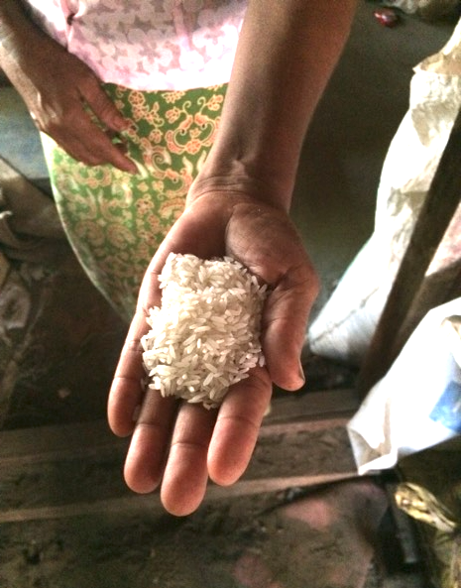
Context and Background

Slide 7
Nutrition, food security, and poverty
50 years ago
The available data were used to define the problem.
Prevalence of malnutrition was estimated from food supply data
  No anthropometry yet
  Low calorie supply = malnutrition
Food security
  availability at all times of adequate world food supplies. (World Food Summit, 1974)
1973: formation of CGIAR
  Structure: centers focused on improved productivity of the major staple crops
1973: World Bank shifts mission to poverty reduction
  Main vehicle is rural development / farm productivity
Notes:
Paradigm of the early 70s: nutrition was sufficiency of energy and proteins.
There was a lot of hunger and famine! Could see why the view of malnutrition would be overwhelmed by hunger, or lack of calories. PEM was visible, kwashiorkor.
Also, there was no clear statement by countries, nor by the nutrition community, of what a basic healthy diet was, nor any dietary guidelines in low-income countries.
Zambia food pyramid, 1980s. Following the US example.
Calories were the problem. Increasing the supply of calories, most efficiently through staple crops, was the solution.
“Although deficiency of vitamins and minerals may cause serious health problems, especially among children, the therapy is now well known and relatively easy to apply so that the magnitude of this problem is almost negligible in relation to the one created by lack of calories and proteins.”
-Chafkin et al., 1972 Possible World Bank Actions on Malnutrition Problems
1990s
DHS began to collect anthropometry data across countries
The new data enabled research showing the extent of the problem; and the dire consequences of even mild and moderate malnutrition (Pelletier et al. 1995)
Cost of Basic Needs approach

Slide 8
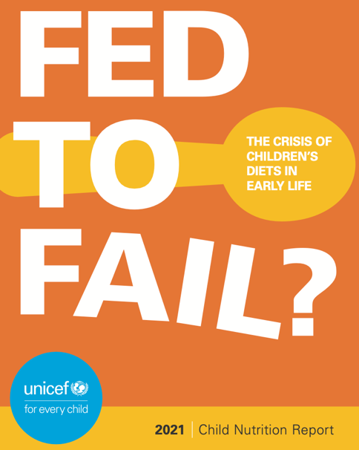
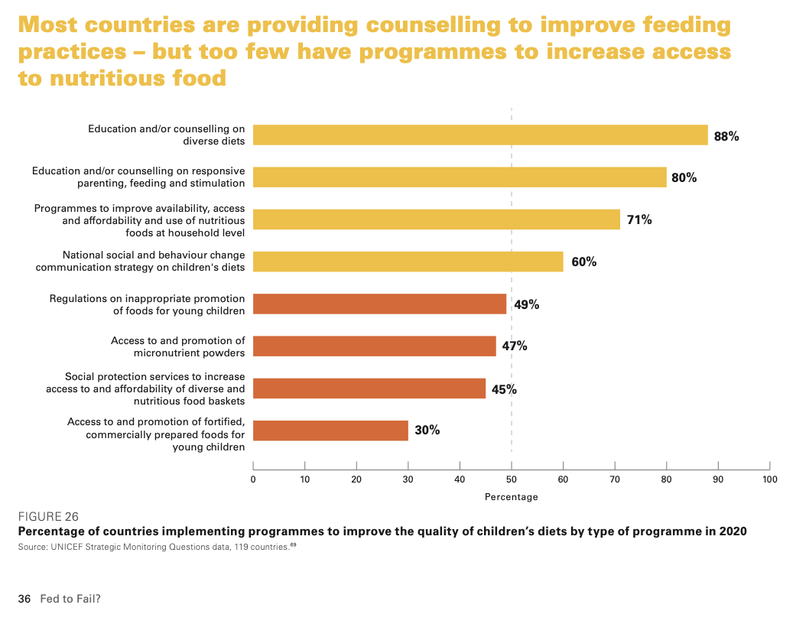
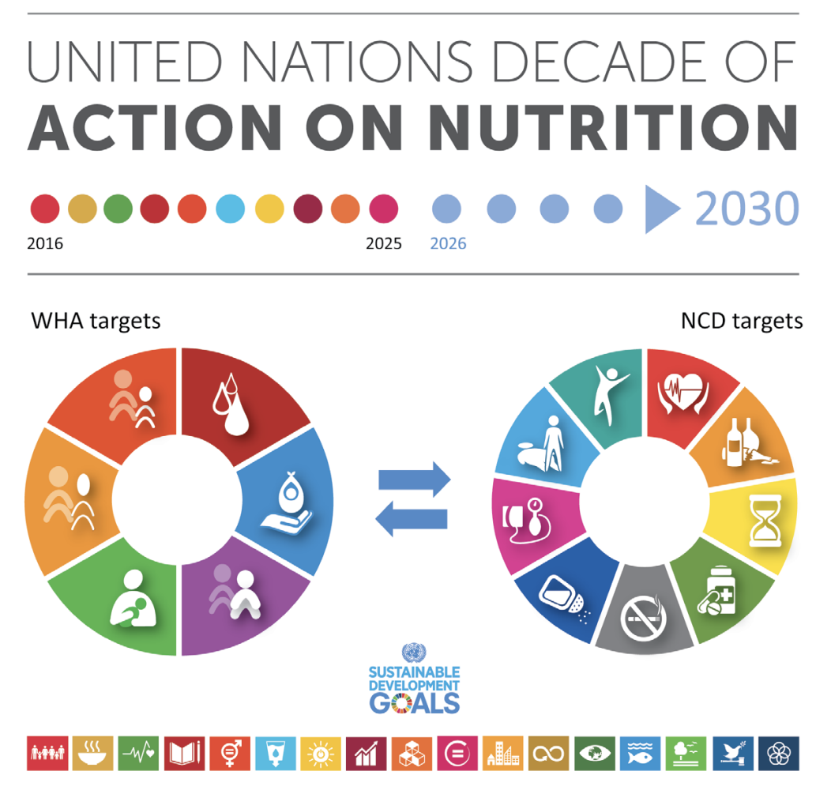
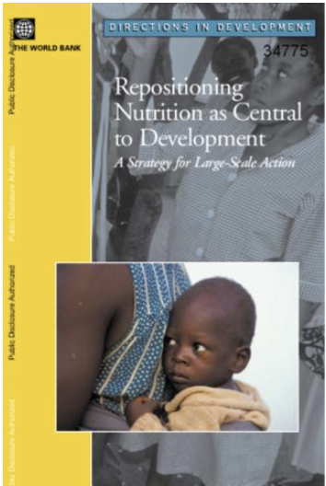
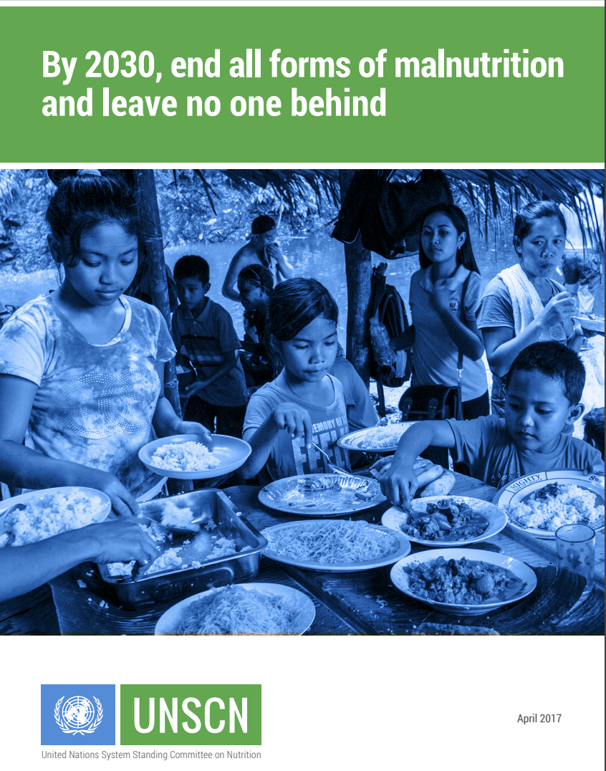
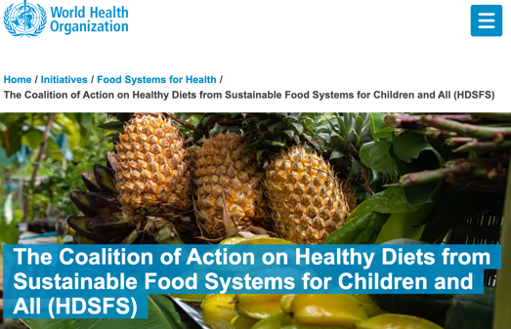
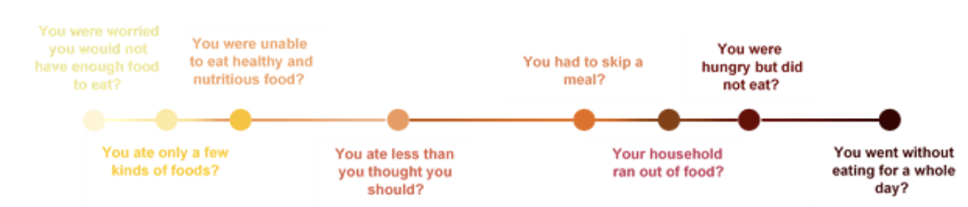
Things have changed!
Notes:
We now have anthropometry data, collected across countries in DHS since the 1990s, and WHO child growth standards in 2006 for the measurement of malnutrition with child anthropometry
We now have a wide recognition that poor diets are a critical factor driving malnutrition, and now also increasing recognition that lack of access to healthy diets is a major problem for nutrition – this graph is UNICEF, not FAO!
Channing…now “Senior Director for Systems Transformation Strategies” in CGIAR…Efforts at transforming systems (beyond single crops)

Slide 9
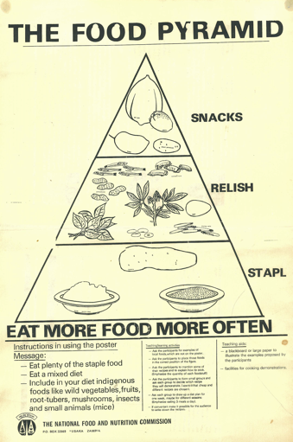
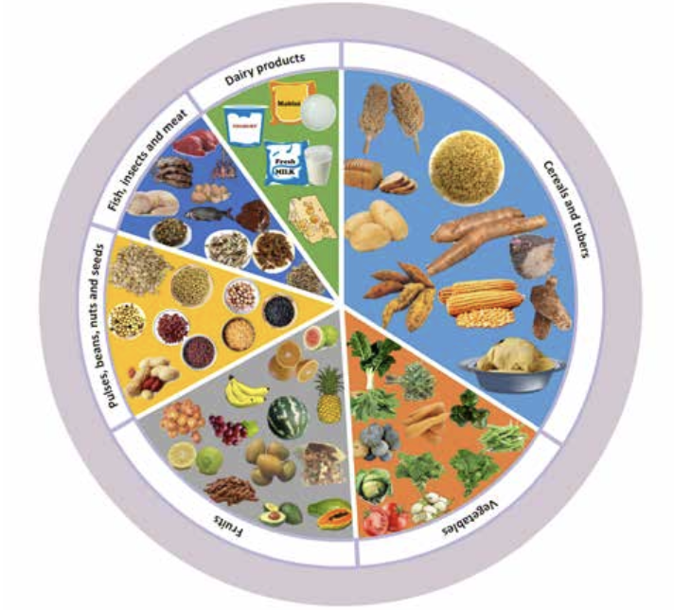
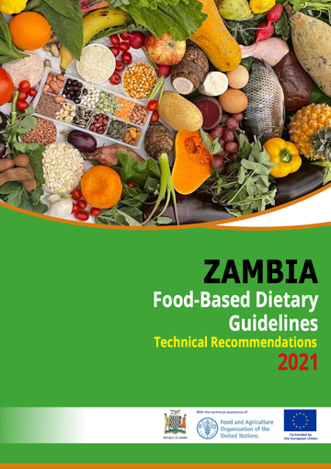
What kind of diet is recommended for all people, for active and healthy lives?
Zambia FBDG 1980s
Zambia FBDG 2021
Notes:
You can see the paradigm shift reflected in these food guides from Zambia.
Is the 1980s guide still the kind of diet that we want to be the standard for poor people? Is that equitable?
Or do we want the standard to be what is currently recommended for all people, for healthy and active lives?

Slide 10
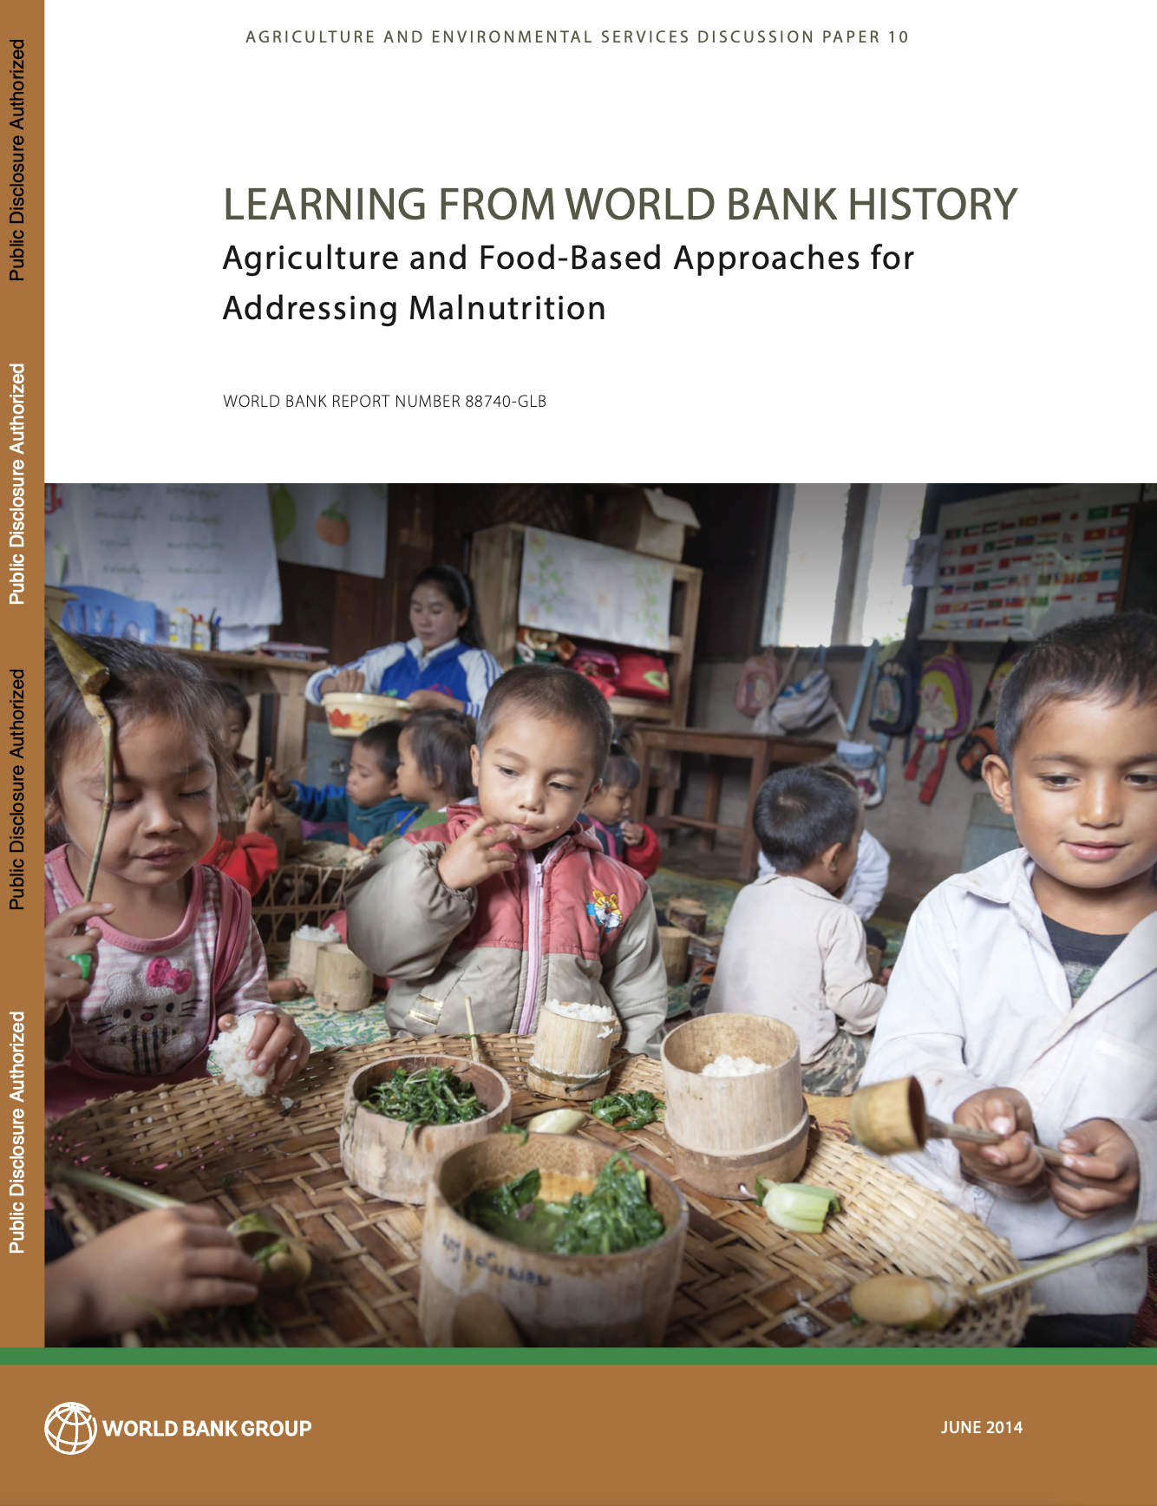
Change in paradigm calls for different thinking about food security and poverty
1970s: Food shortage paradigm
Lack of calories was the major problem
Now: Nutritious food shortage paradigm
  Multiple forms of malnutrition in all regions
  Diabetes and child overweight rising fastest in Africa
  Availability: Theoretically possible for everyone to eat enough, but impossible for everyone to eat healthy diets
  How many lack access to healthy diets?
Herforth and Tanimichi-Hoberg et al., 2014. http://hdl.handle.net/10986/20029
Notes:
A decade ago, Yurie and I were working on this study – of how WB investments in food and agriculture approached nutrition.
Conclusion was that essentially, the indicators and solutions had not evolved alongside the evolution of the problem and our understanding of the problem
Co-authored with Yurie Tanimichi Hoberg of the ag GP
Gathered information from the World Bank Archives as well as interviews with agriculture and nutrition WB staff from 1973-2013.
In doing this review, we looked at what had been done within the Bank, but also the broader context in the field of international nutrition and agriculture, and where emphasis was placed, and where it was not.
Lots more detail in this report but a big take-home was that there has been a paradigm shift in how the problem is defined, and what needs to be done.
In 2014 we were calling for the need to build a new evidence base on:
Where (and for whom) are food access and diets inadequate?
What are the consequences of poor diets on health, productivity, and environment?
What policies underpin access to nutritious food and dietary quality of populations?
(Similar to where we were in 80s with basic nutrition, need new “nutrition-sensitive” data and indicators now)

Slide 11
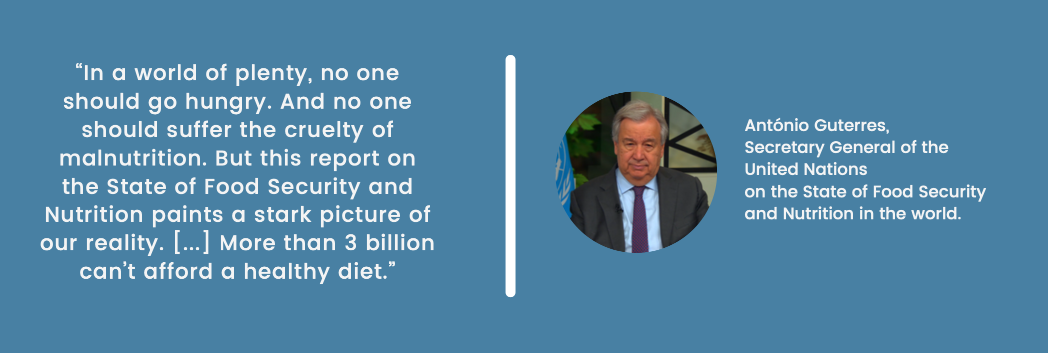

Slide 12
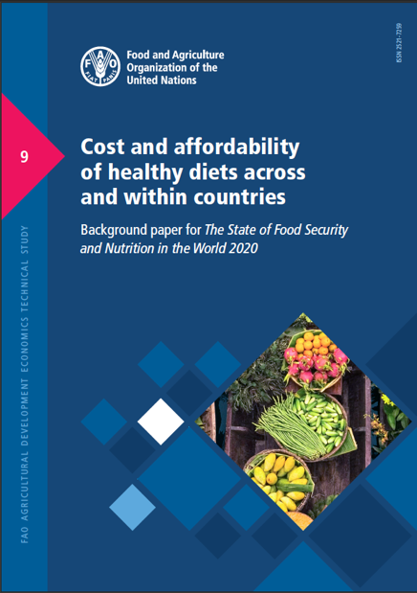
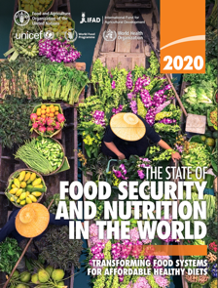
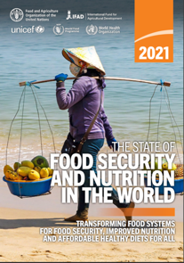
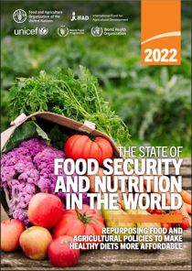
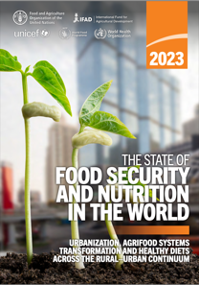
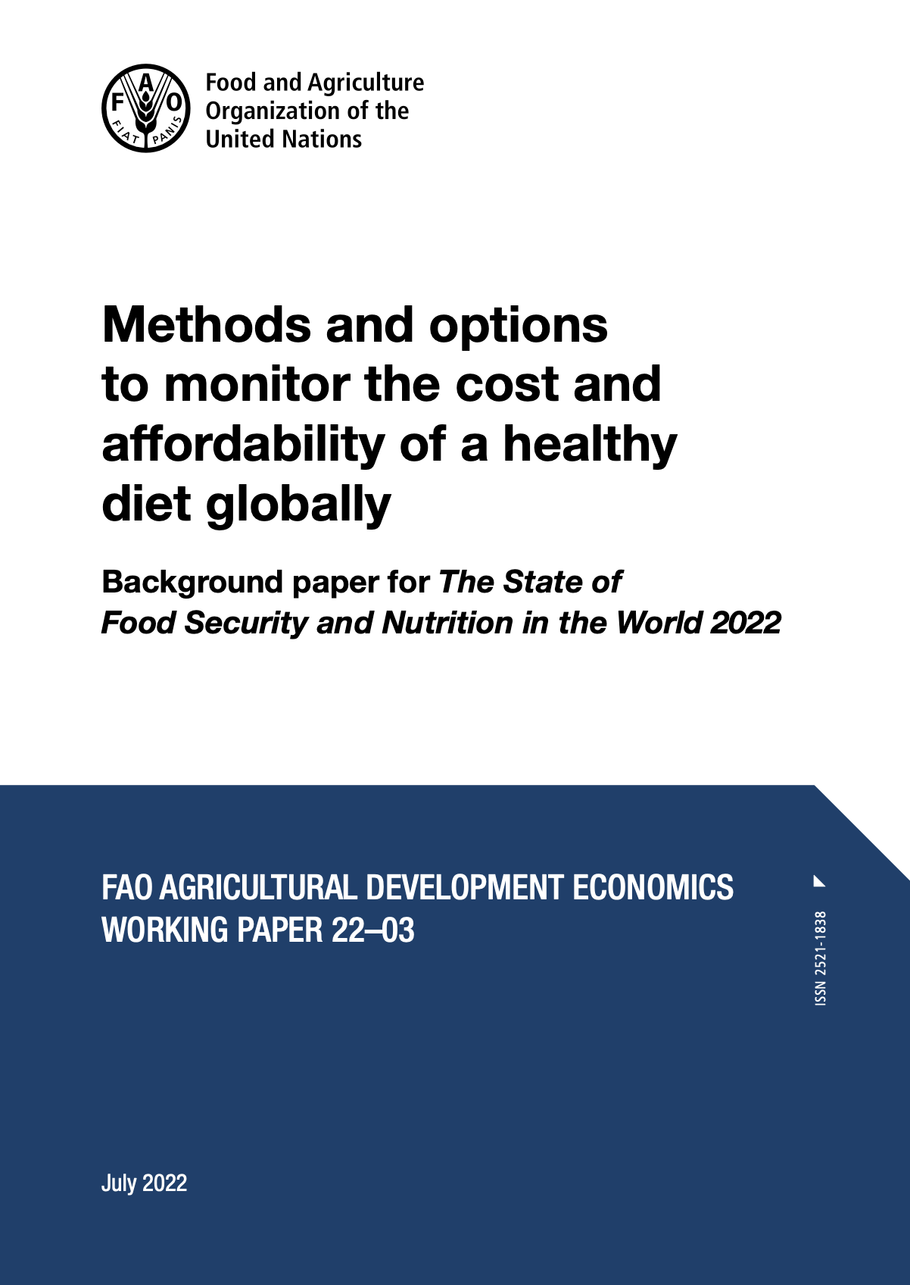
Cost and Affordability of a Healthy Diet: indicators to understand food access
Used in the UN State of Food Security and Nutrition in the World (2020-2023), joining other food security indicators
https://www.fao.org/faostat/en/#data/CAHD/
​Herforth, A., Bai, Y., Venkat, A., Mahrt, K., Ebel, A. & Masters, W.A. 2020. https://doi.org/10.4060/cb2431en
https://databank.worldbank.org/source/food-prices-for-nutrition
Herforth, A., Venkat, A., Bai, Y., Costlow, L., Holleman, C. &
Masters, W.A. 2022. https://doi.org/10.4060/cc1169en
Notes:
We do now have an indicator of access to nutritious diets to meet dietary needs, as a new food security indicator.
Soon to be incorporated into FAOSTAT and monitored annually in the SOFI reports.
CoHD can be thought of a as an achievement poverty line – access to healthy foods
This indicator rests on a clear set of criteria for what it means to meet dietary needs – beyond calories.
“Estimates of the cost and affordability of healthy diets will be updated annually and disseminated in this report, reflecting the most recent data as they become available.”
-SOFI 2021, p29
http://www.fao.org/publications/sofi/2020/en/
https://www.fao.org/publications/sofi/2021/en/

Slide 13
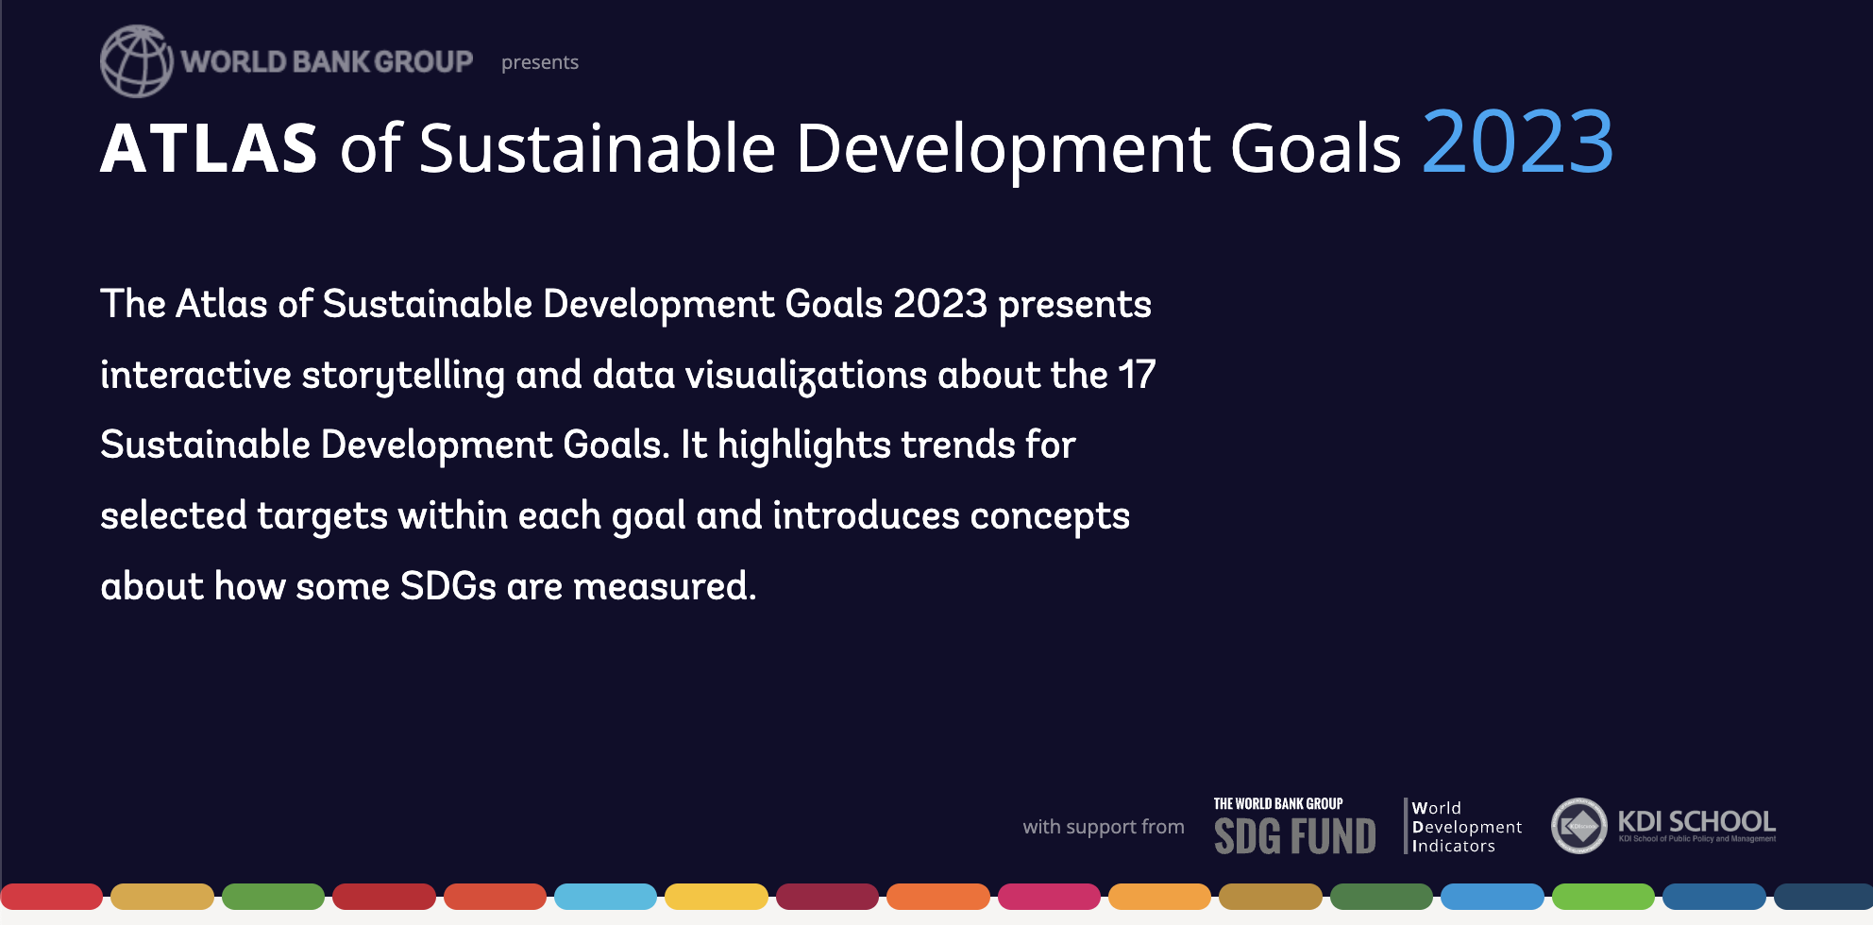
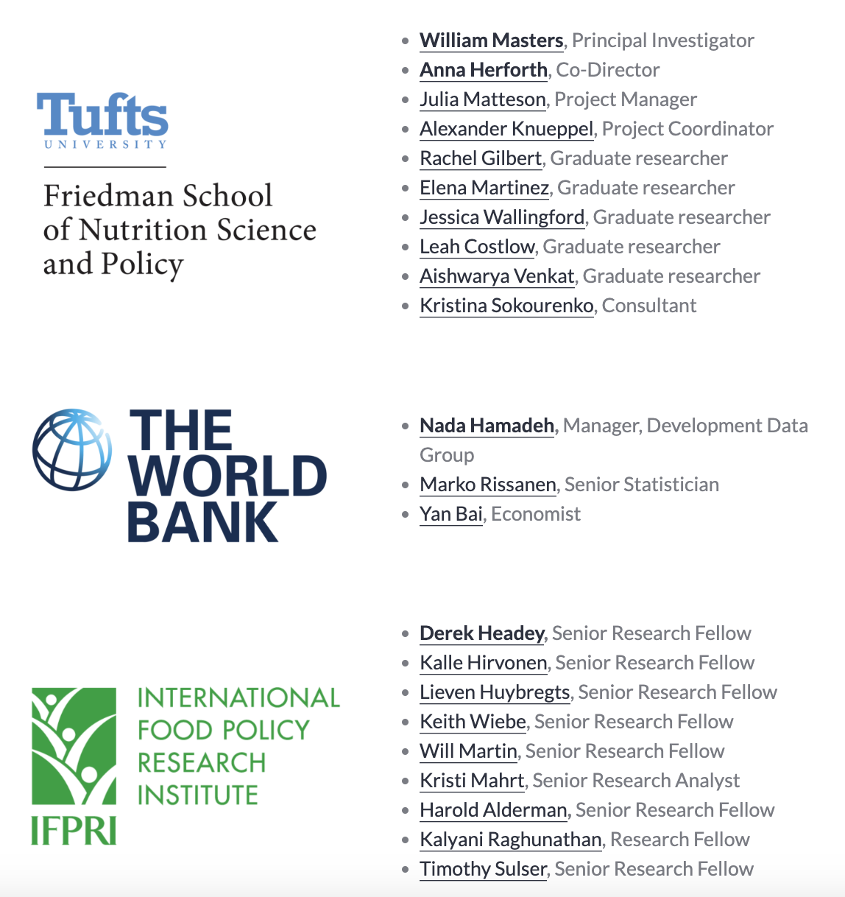
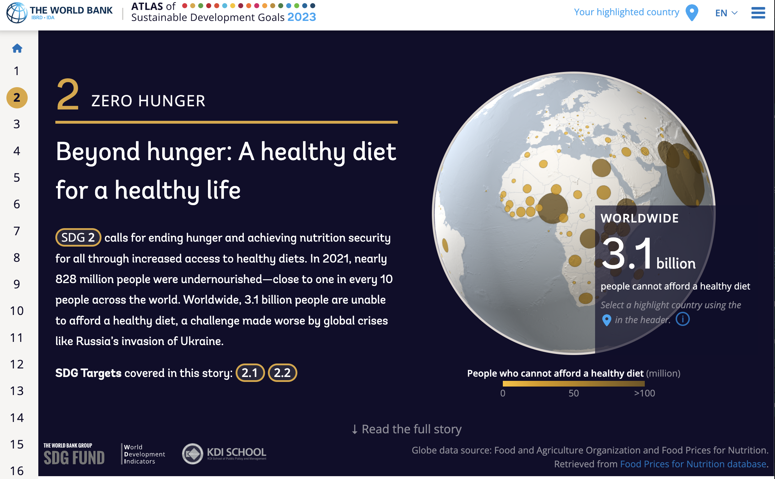

Slide 14
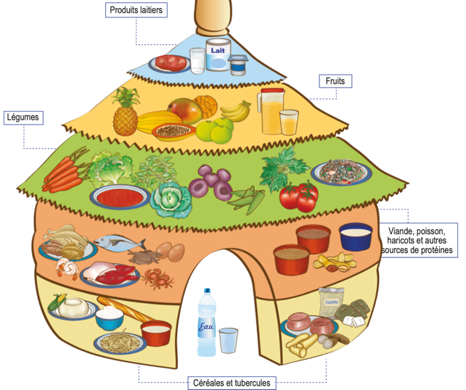
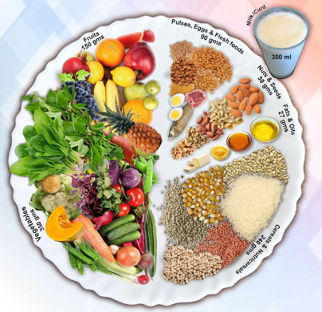

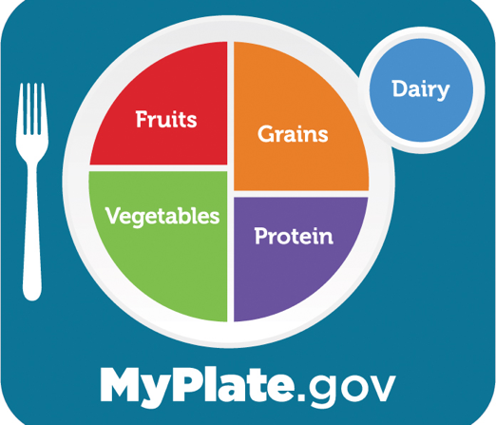
What is a healthy diet?
“…sufficient, safe, nutritious food to meet dietary needs and food preferences for an active and healthy life”
Based on food-based dietary guidelines (FBDG), which represent:
a realistic way for regular people to select nutrient-adequate diets
diets that protect health against NCDs
diets that are dignified and culturally appropriate
In nations where FBDG have been elaborated, they are the official policy standard for what constitutes dietary needs
social safety nets and nutrition education based on FBDG
Notes:
The method for finding the cost of a healthy diet starts with the question: What is a healthy diet?
Many countries have answered this question as a matter of national policy. The handiest definitions of a healthy diet are from food-based dietary guidelines,

Slide 15
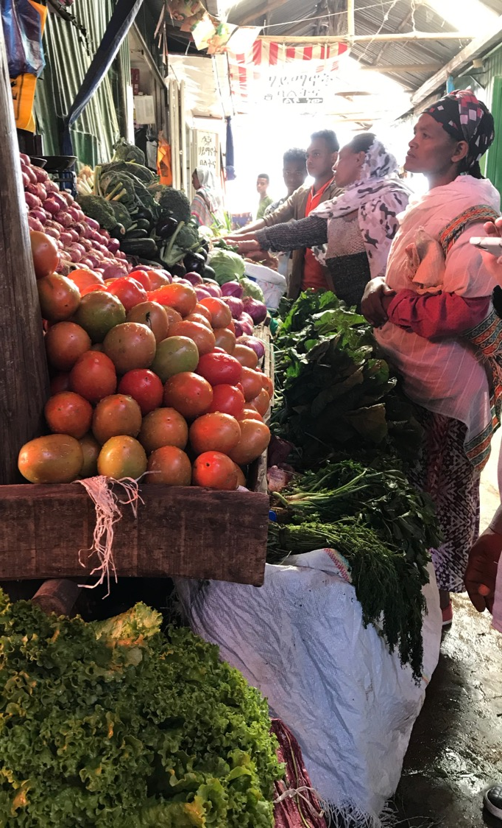
Cost of a Healthy Diet
If you went to an average market in any country, how much would it cost to obtain a diet that satisfies dietary guidelines?
How many people could not afford this cost?
Photo: A Herforth, market in Ethiopia
Notes:
Taking as a standard that many nations have already defined what a healthy diet is, what we aim to do is then to find out…
This takes a consumer perspective of food prices and uses retail costs, as the costs people find in the market.
Next is an example of how we quantify the healthy diet.

Slide 16
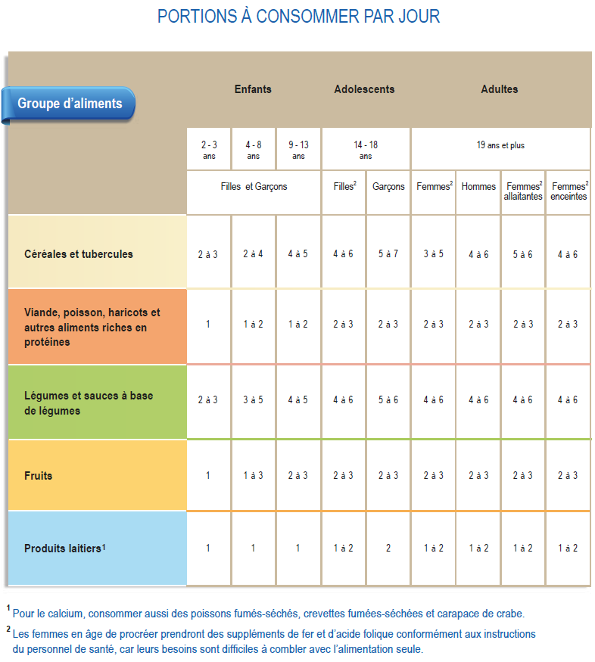

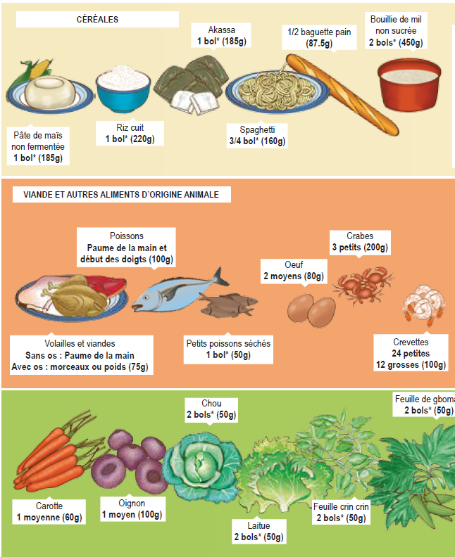
Benin’s quantitative food-based dietary guidelines
Food groups
Number of portions per day
Grams or calories per portion
Notes:
Dietary guidelines typically identify a number of required food groups, and the portions per day required of each, and then define the grams or calories per portion of each food group recommended. So the task is then to find out how much the recommended amount of each food group costs at retail prices in the market.

Slide 17
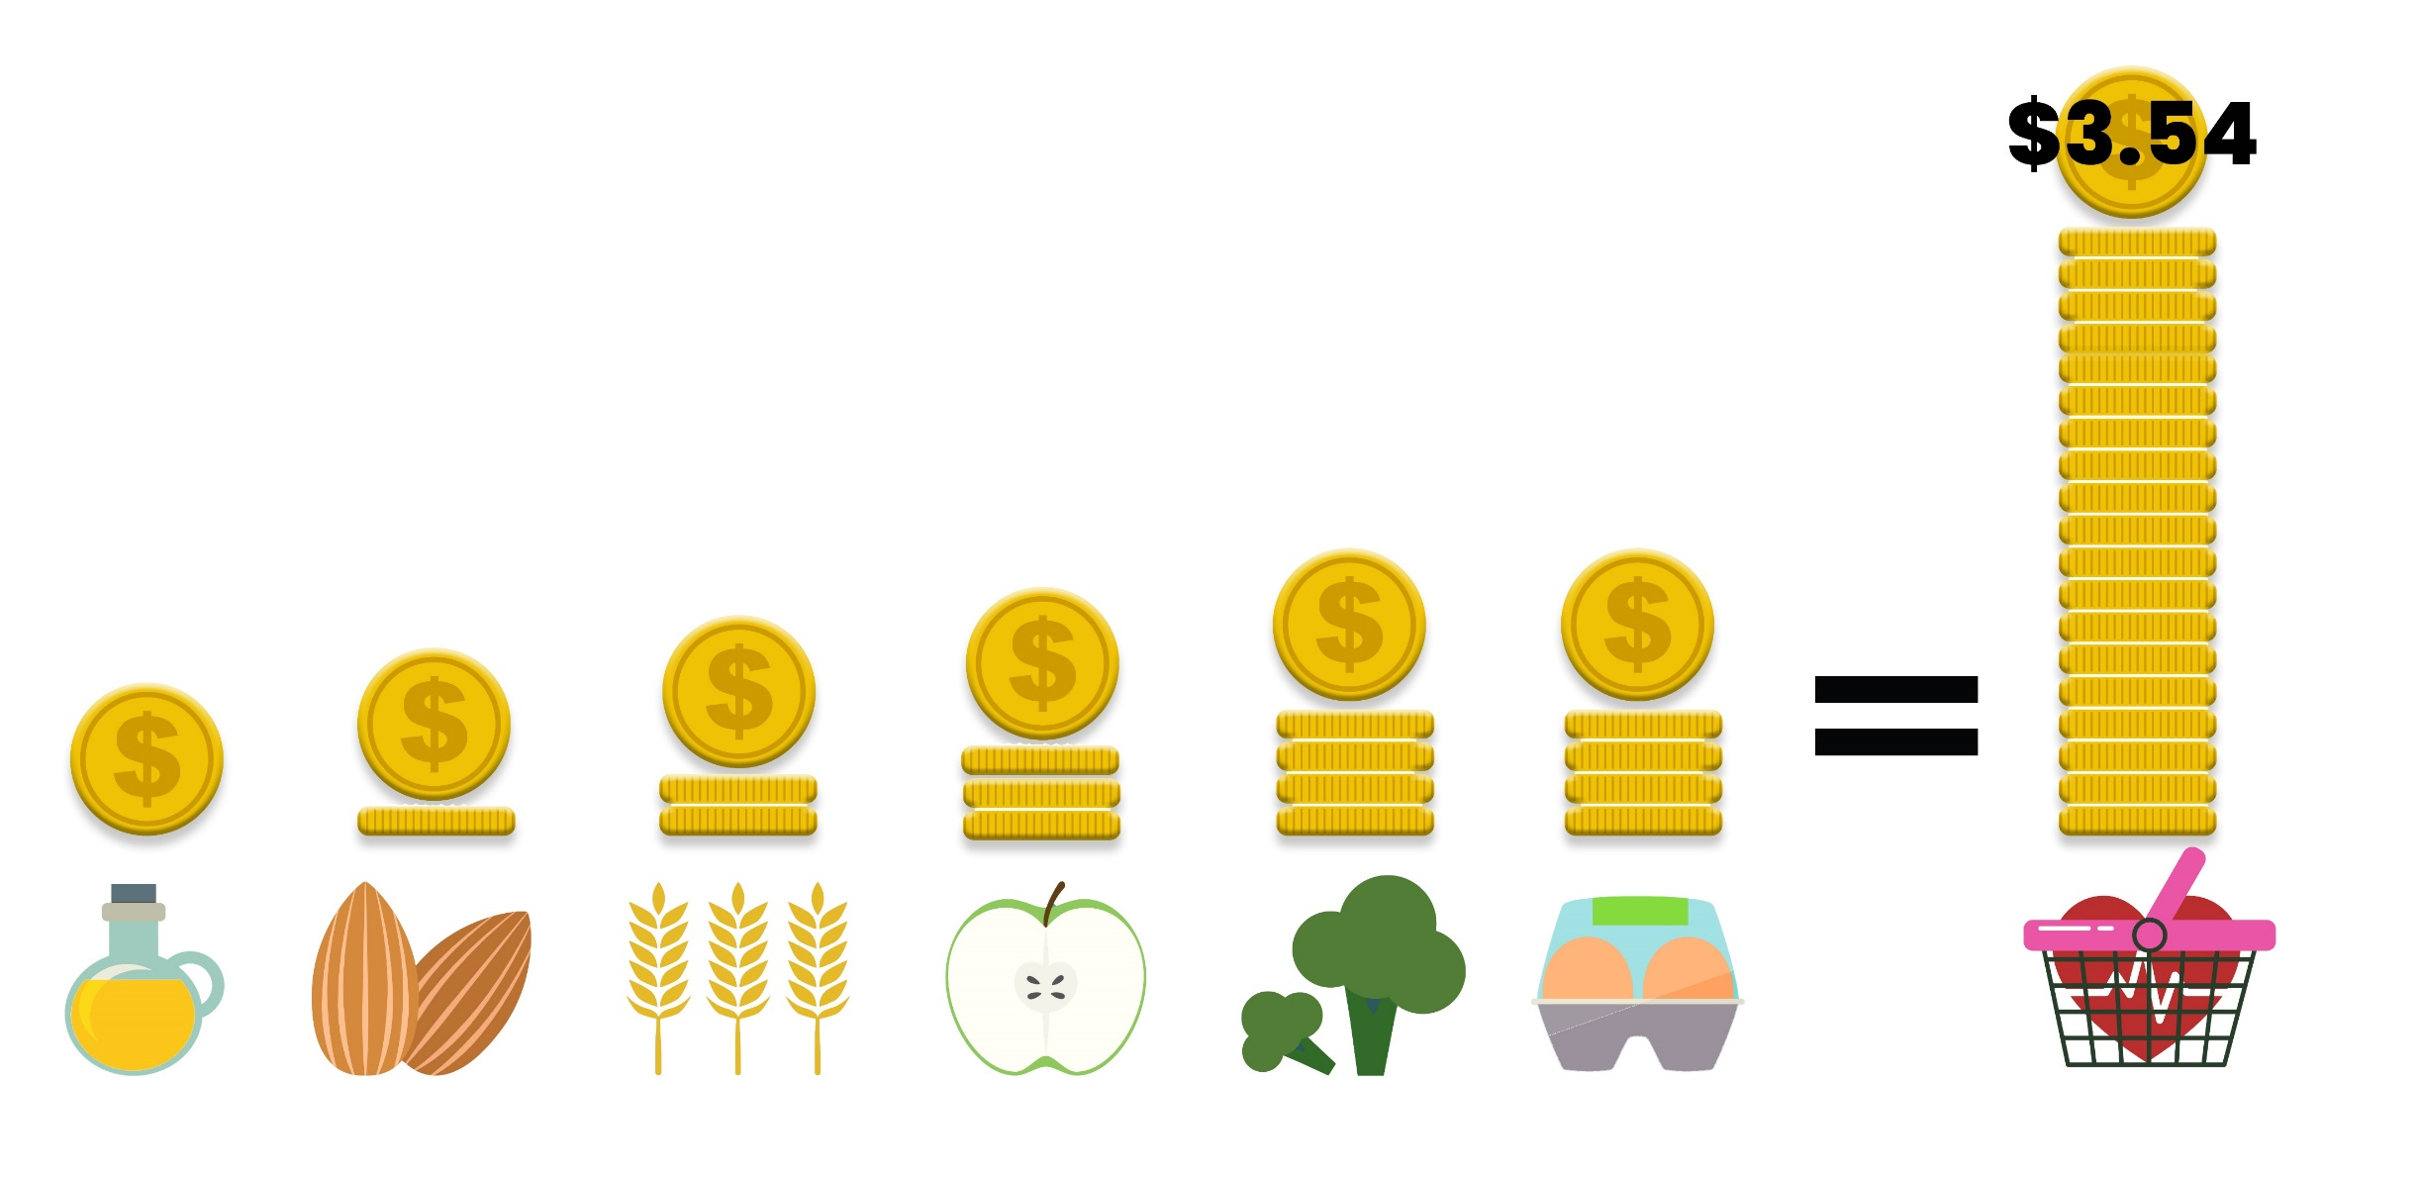
Least-cost healthy diets
Food group proportions stay constant (share of kcal)
Food items are substitutable
Within food groups, what are the cheapest items?
  The answer varies by season and market.
Least-cost diets set a lower bound.
Does not necessarily select food items that are culturally essential (social inclusion)
Notes:
A LEAST-COST healthy diet used by Food Prices for Nutrition uses the least expensive locally available foods at each time and place to fulfill each food group contribution to the healthy diet basket.
The food group proportions stay constant in the Healthy Diet Basket. The food items within each food group are substitutable. So within food groups, the cheapest items vary by season and place.
----
On average globally, in 2020 we find that the cost of a healthy diet using this method was $3.54. However, this varies by country.

Slide 18
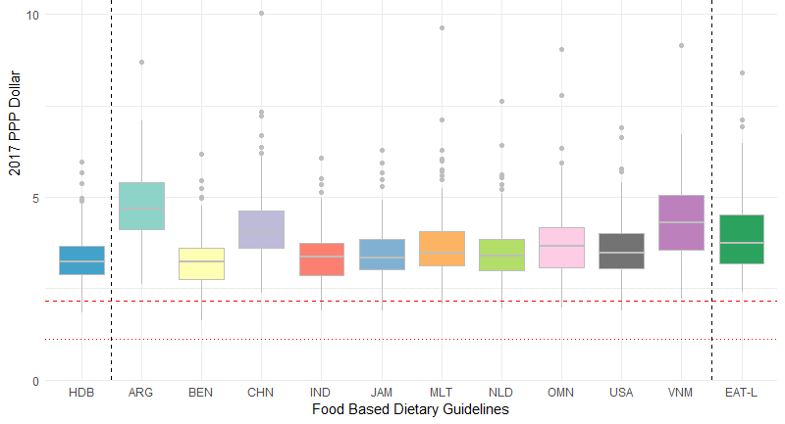
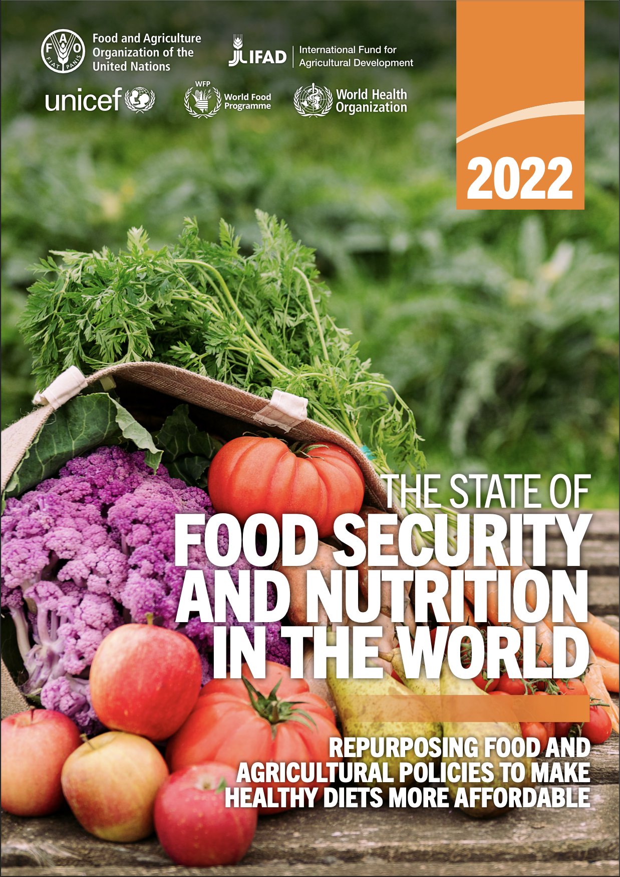

Least-cost healthy diets cost more than the global poverty line
National Food Based Dietary Guidelines
Healthy Diet Basket
$3.54 in 2020
$2.15
$1.12
52% of int’l poverty line
Source: Herforth, Bai, et al. in preparation
Notes:
Using the global data, we find that the HDB cost $3.54 in 2020. Each national FBDG we analyzed had a slightly different cost, but they are all in the same range. Also EAT-Lancet.
What we find is that Healthy Diets, by any definition, cost more than the poverty line.
There is no country in the world where you can purchase a diet that meets FBDG for $1.12. Results from global dataset show that in the least expensive countries, still more than $2.15.
This calls into question where the poverty line is set.

Slide 19
Global headcounts, 2021
Poverty (<$2.15/day): 648 million (2019)
  Uses an energy-based food poverty line
PoU / Hunger: 725 million
Moderate or severe food insecurity based on FIES: 2.3 billion
Unable to afford a healthy diet: 3.1 billion
Currently, the nutrition standard used to define food poverty lines is conceptually similar to the Prevalence of Undernourishment – both indicators measure the construct in terms of adequate dietary energy
Notes:
Note: CoHD-FP was not possible to consider for global application because there is no global dataset of food expenditures at item level; these are sourced from national HCES individually.
Food insecurity measurement using experience-based measures (i.e. FIES-based) captures a broader construct, but does not include a normative standard of basic nutritional needs
individual interpretation of what "healthy and nutritious food" means
During the last 12 months, was there a time when, because of lack of money or other resources:
1. You were worried you would not have enough food to eat?
2. You were unable to eat healthy and nutritious food?
3. You ate only a few kinds of foods?...

Slide 20
Methods
Absolute vs
Relative
National vs
Global
Welfaristic vs Objective

Slide 21
Poverty measurement: Do households achieve a minimum level of wellbeing?
Welfare → utility defined over commodities, reflecting the preferences of poorer households
Cost of Basic Needs reference utility: a consumption bundle that allows individuals to
“lead a healthy and active life, including fully participating in the society”
(Ravallion, 1998)
Food poverty line = reference utility consumption bundles evaluated at prices faced poorer HHs
Notes:
Now focusing on national, welfaristic poverty lines estimated using the cost of basic needs approach.
Poverty estimation strives to identify whether households achieve a minimum level of wellbeing
Ravallion’s reference welfare level as one that allows individuals to
Beyond mere survival, this reference welfare level stipulates two conditions
achieving good health and
achieving social inclusion, where social inclusion can have many dimensions
important to the food poverty line is the ability to acquire a diet consistent with local food cultures and norms.
In practice to define cost of basic needs food poverty lines, we identify food bundles associated with this reference welfare level using consumption patterns of poor and near poor households observed in household survey data.
Consumption patterns reveal bundles of foods that poor and near poor households choose to consume given their limited resources, relative prices, and food access and availability. Importantly, even for poor households these bundles are not likely to be bundles of the cheapest foods. Rather the chosen bundles incorporate food preferences associated with cultural tastes and norms. And as such, in tying the food poverty line to bundles of foods that capture tastes and norms, the cost of basic needs food poverty line by design accounts for social inclusion.
Ignoring food consumption patterns, risks estimating a food poverty line that is insufficient to cover the costs of what people are actually willing to eat and undercounting who we consider poor.
In order to satisfy the second condition of good health, food bundles are adjusted to meet a nutrition standard – traditionally a dietary energy target. However, a calorically adequate diet based on the consumption patterns of relatively poor households, is likely to be heavy in starchy staples and therefore unlikely to reflect a diet needed to achieve good health
Proposing a method for incorporating a more comprehensive healthy diet nutrition standard into food poverty line estimation while maintaining some consistency with observed food consumption patterns.

Slide 22
Rethinking the nutrition standard
Energy-based food poverty line
  Food consumption by poorer households evaluated at median prices and scaled to meet a dietary energy target (traditional cost of basic needs poverty line)
Cost of a Healthy Diet – provides the framework for a new nutrition standard
  Reflects “economic access to nutritious food to meet dietary needs for an active and healthy life”
  Aligned with food based dietary guidelines – policy documents defining diets that meet nutritional needs
  Does not incorporate consumption patterns that reflect preferences [rather, it selects least cost foods to determine a minimum standard of access]
Healthy diet food poverty line
  New method for incorporating a more comprehensive healthy diet nutrition standard into food poverty line estimation
Notes:
For clarity:
Energy-based poverty lines to refer to poverty lines calculated using only an energy target as the nutrition standard –traditional cost of basic needs approach
Healthy diet poverty lines refers to our proposed poverty lines that incorporate a more comprehensive healthy diet nutrition standard
What to use as a nutrition standard?
The economic commission of Latin America and the Caribbean align the % of calories derived from each macronutrient (protein, fat, and carbohydrates) with guidelines.
Method used in a standardized approach to poverty estimation in 18 LAC countries
Preserves consumption patterns of reference households within food groups
Scales the staple, protein-rich, and fat foods groups to meet the macronutrient targets
Potentially small adjustments (in the Myanmar case study the energy-based basket nearly met the criteria without any adjustments (table showing this at the end of the presentation)
Does not address micronutrients
The indicator of the Cost of a Healthy Diet (described by Anna) an FAO indicator of global food security: Reflects “economic access to nutritious food to meet dietary needs for an active and healthy life”
Uses recommended healthy diets such as those found in food based dietary guidelines as the nutrition standard.
The indicator takes a least costs approach and estimates the cost of acquiring the cheapest foods in each food group in quantities outlined in guidelines
Does not account for tastes and preferences for foods, beyond a preference for consuming foods from a variety of food groups
→ likely underestimates the costs of diets that poor households would actually want to eat

Slide 23
Energy-based poverty
Cost of the healthy diet
Nutrition standard
Food selection
Nutrition standard
Food selection
Consumption patterns of poorer HHs
Energy threshold
Food group guidelines
Least cost foods
Between food groups: recommended proportions stay constant (normative)
Within food groups: items reflect behavior (descriptive)
Consumption patterns of poorer households
Food group guidelines
Food selection
Nutrition standard
Healthy diet food poverty line basket
Notes:
on the one hand we have the Cost of a Healthy Diet indicator which incorporates a comprehensive nutrition standard but does not adequately capture social inclusion
on the other hand, we have the energy-based food poverty line that incorporates household consumption patterns but does not adequately meet comprehensive nutrition needs.
What we propose is essentially to merge these two different approaches, to form an approach that uses healthy diet guidelines together with household consumption patterns.
→ Achieve a measure that
preserves household choices within food groups
and
meets food group proportions recommended in dietary guidelines

Slide 24
Healthy diet poverty lines
  Healthy diet food poverty line:
  Food consumption by relatively poor households evaluated at median prices where
food groups are scaled to meet food group quantities specified in dietary guidelines
relative shares of foods within each food group
are fixed
(consumption patterns)
total food basket is
scaled to meet the
dietary energy target
Healthy diet poverty line:
healthy diet food poverty line + cost of basic needs non-food allowance
Being classified as non-poor in terms of a healthy diet poverty line is distinct from actually consuming a healthy diet.
Notes:
Within each food group align recommended quantities of individual food items with within food group consumption patterns observed in household survey data.
In other words, rather than the cheapest foods, this approach uses all foods that are reported in the household survey.
And within each food group, food quantities are proportionally scaled, based on observed within food group consumption patterns, to meet the total food group quantity specified in dietary guidelines.
the entire bundle is scaled to meet the energy needs of a reference adult.
The resulting food bundle adheres to observed consumption patterns within food groups but shifts consumption levels between food groups.
Together with the cost of basic needs approach to estimating the non-food poverty line we have a total healthy diet poverty line.
Households with total consumption expenditure below the total poverty line are considered poor.
Does not indicate that individuals in households above the healthy diet poverty line necessarily eat healthy, healthy diets.
Being nonpoor does not imply being adequately nourished. Rather it means the household is considered to have sufficient resources to eat a healthy diet if they so choose.
Not paternalistic:
There is no guarantee or even expectation that all non-poor households actually consume the items in the food basket, but simply that they can afford the food basket.
Ravallion notes that the “method deems a person to have escaped poverty only if the person can afford the stipulated basic consumption needs; whether in fact the person also chooses to do so is another matter.”

Slide 25
Utility consistent regional poverty lines
Tension between two principles used in estimating poverty lines
Utility consistency:
poverty lines should represent the same reference utility level across time and space
Specificity:
poverty lines should reflect local conditions – relative prices, availability, norms
Arndt and Simler – method for estimating utility consistent regional poverty lines
Regional food poverty lines
Revealed preference theory
Cross entropy criterion
Identify inconsistencies in utility levels across regions by testing revealed preference conditions
Estimate regional food poverty lines based on regional consumption patterns and nutrition targets
Enforce revealed preference constraints while preserving, to the greatest degree possible, the information content of the initial food poverty baskets
→ Healthy diet poverty lines can be estimated using the utility consistent regional approach or using a single national basket adjusted for regional and temporal prices differences using price indices
Notes:
Our approach to poverty estimation that uses utility consistent regional poverty lines. This is not an essential aspect of estimating healthy diet poverty lines.
→ Healthy diet poverty lines can be estimated using the utility consistent regional approach or using a single national basket adjusted for regional and temporal prices differences using price indices

Slide 26
Myanmar case study
2015 Myanmar Poverty Living Conditions Survey LSMS style survey (MoPF and World Bank, 2017)
  nationally representative household survey
  7-day recall of 154 food items
5 Sub-national poverty line regions – sample to small for additional urban-rural disaggregation
Nutrition standard:
2,195 kilocalories per adult woman equivalent
7 healthy diet food groups plus an allowance for discretionary foods (sugars)
Staples | Pulses | Meat/ Fish/ Eggs | Dairy and substitutes | Vegetables | Other vegetables | Fruits | Fats | Discretionary
 |  |  |  | Leafy | Other
330g | 45g | 100g | 225g | 150g | 300g | 200g | 30g | 25g
Adapted from the Food Based Dietary Guidelines for Bangladesh (Nahar et al., 2013).
Notes:
We apply the methodology to Myanmar using a 2015 LSMS style household survey. And from this we generate poverty lines for 5 subnational regions.
Given ongoing political turmoil, emphasize this is just a demonstration and not to intended to provide insight into poverty in Myanmar
Myanmar does not have completed, quantified food-based dietary guidelines for the general population
→ Adapt the recommended diet in the Bangladesh food based dietary guidelines for Myanmar.
The basket consists of 7 healthy diet food groups plus an allowance for discretionary foods.
Recommendations are expressed in grams per food group

Slide 27
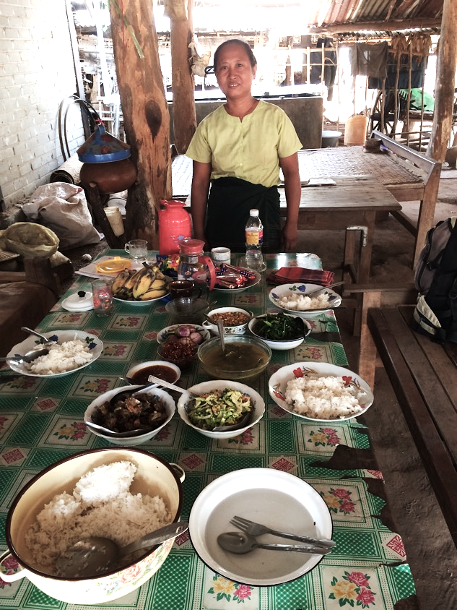
Results

Slide 28
Food basket energy shares
Energy-Based
Healthy Diet
Notes:
This slide shows the energy composition of the two baskets.
Micronutrient food groups outlined in white
The energy-based basket closely resembles an average diet of relatively poor households scaled to hit an energy target while the healthy diet basket reflects the same diet but is also aligned to hit the recommended food group quantities presented in the previous slide.
As poorer households typically over consume calorically cheap staple foods, it is not surprising that 3/4 of dietary energy in the energy-based basket is derived from starchy staples compared to about half in the healthy diet basket.
Animal source foods, pulses, fruits and vegetables comprise nearly 3 times the energy share in the healthy diet basket compared to the energy-based basket

Slide 29
Energy-based food basket falls far short of nutrient needs
% of EARs for a 30-year old woman
 | Energy-based | Healthy diet
Protein | 152 | 207
Calcium | 48 | 110
Iron | 100 | 136
Magnesium | 89 | 137
Phosphorous | 132 | 172
Zinc | 85 | 105
Copper | 200 | 266
Vitamin C | 62 | 212
Thiamin | 79 | 119
Riboflavin | 47 | 82
Niacin | 105 | 128
Vitamin B6 | 95 | 130
Folate | 71 | 166
Vitamin B12 | 52 | 146
Vitamin A | 56 | 136
EAR: nutrient intake that satisfies the needs of half the healthy individuals in a specified age-gender group
Notes:
As a result of the excessively high share of staples in the energy-based food poverty basket, the basket falls far short of meeting nutrient needs. This table shows the nutrient adequacy of the two baskets in terms of the nutrient needs of a reference 30-year old adult woman.
The healthy diet basket meets or exceeds nutrient guidelines of all key nutrients except riboflavin.
In contrast the staple heavy energy-based basket is deficient in many key nutrients,
The traditional energy standard generates a food poverty line that is insufficient for poor households to cover the cost of a nutrient adequate diet without substantially deviating from preferred types of foods or without diverting more non-food expenditure to food than is required to meet their basic non-food needs

Slide 30
Food basket costs (2011 PPP$/person/day)
Notes:
Costs of the healthy diet and energy-based food baskets in total and by food group
Though not the focus of the analysis, also showing the CoHD least cost healthy diet, calculated using the same data
(Using food expenditures from 2015 household survey in 2011 $. Different price data than the ICP dataset used in SOFI, which showed a higher least-cost healthy diet, $3.70 for 2017)
The healthy diet basket is about twice as expensive as the energy-based basket and the least-cost healthy diet falls roughly in the middle. Animal source foods and vegetables in particular, drive up the healthy diet food poverty line
The cost differences are a combination of two factors.
The energy-based and healthy diet baskets are both based on observed consumption patterns and the cost difference is driven by a difference in the nutrition standards
The least-cost healthy diet and healthy diet poverty line baskets are aligned with the same nutrition standard and the cost difference is driven by the method of selecting food items into the baskets.

Slide 31
Poverty
Poverty Rate
(% of population)
Depth of poverty
(poverty gap as a % of poverty line)
Notes:
Poverty rates and poverty gaps
more than twice as many people are poor under the healthy diet standard compared to the energy-based standard.
This difference is particularly high in urban areas where more than three times as many people are healthy diet poor compared to the energy-based poverty rate.
Those who are poor face about three times the consumption-expenditure shortfall under the healthy diet standard compared to the energy-based standard.
Which means that the % shortfall between total consumption-expenditure and the poverty line is much greater using the healthy diet poverty line

Slide 32
Distribution of total consumption-expenditure
Total energy-based poverty line ($3.16)
Total healthy diet poverty line ($4.69)
Notes:
Distribution of real total consumption-expenditure and the 2 poverty lines
A large concentration of the population in Myanmar falls between the two poverty lines, households that are not poor in terms of an energy-based standard but are poor according to the healthy diet standard.
This picture helps identify further policy rationale and relevance of the healthy diet poverty lines. In settings where poverty rates based on standard energy-based poverty lines remain high, where the bulk of the distribution is to the left of the poverty line, the energy-based poverty line continues be quite informative and relevant - though assessing poverty based on a healthy diet would also be informative.
However, in countries where the bulk of the income distribution is to the right of the energy-based poverty line, standard poverty methods quickly become less relevant.
As the share of the population that is unable to meet caloric needs, while also meeting other basic nonfood needs shrinks, there is scope to expand the definition of what constitutes basic food needs to include healthy diet parameters.
Identifying a nutrition sensitive poverty line for countries with income distributions like Myanmar, prior to political instability, draws policy attention to the large share of the population concentrated between the two lines. These are households that have the ability to afford a calorically adequate diet but certainly face food insecurity in acquiring adequate nutrition for good health.
In order to align poverty estimates with an increasingly common measure of food security, the healthy diet poverty line become increasingly relevant and informative, particularly as standard poverty rates fall.

Slide 33
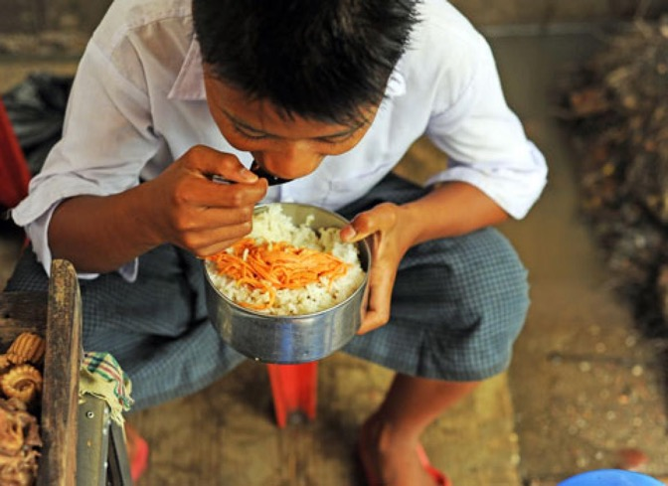
Application in practice

Slide 34
Country applications
Poverty measurement is a contentious, but also a country-driven process
Healthy diet poverty lines could complement existing energy-based poverty lines
Could also replace current national poverty lines
A key point is to avoid providing incentives for cheaper calories for populations where excess calorie consumption is a major problem.
Notes:
While reporting higher poverty rates may often be politically unpalatable, in some settings (e.g. UMICs) the greater granularity of poverty measurement using a healthy diet standard can be useful to show progress.

Slide 35
Implementation
Simple to apply healthy diet standards
  Prices/consumption patterns already identified when defining energy based CBN poverty line
  If using a single national food bundle with spatial price indices, additional computational efforts are straightforward and relatively simple
Additional data requirements
  Food composition tables – do not need to be national
  Food based dietary guidelines
  No FBDG? No problem: International healthy diet basket; FBDG from the region
Food group parameters may be flexible
  Food group targets often specified in ranges. We use the average in the range.
  A lower target could be considered? Does it meet nutrient targets?
  Only scale less expensive foods or most commonly consumed foods within good groups?
Notes:
Large difference between the energy-based and healthy diet poverty lines and poverty rates.
Might be scope for estimating a less expensive poverty line that is still informed by consumption patterns while meeting dietary guidelines.
There is flexibility within most FBDG in terms of recommended food group quantities.
We use the average recommendation which corresponds well with the energy needs of an adult woman.
Lower targets in the range could be used → would be good to then check the EARs
Alternatively, within food groups, more expensive or less frequently consumed foods could remain fixed while scaling the less expensive or more common foods,
(This deviates from observed within food group consumption patterns. But at the same time, we can’t observe the counter factual where households are actually consuming the recommended quantities. Could be substitution effects).

Slide 36
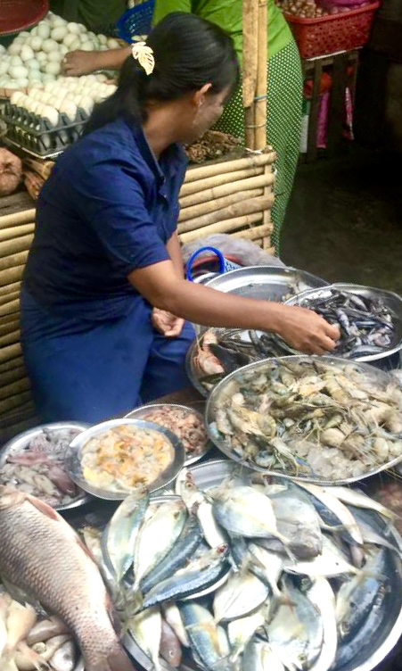
Summary and Conclusions

Slide 37
Summary and Conclusions (1)
The energy based-standard typically used to define food poverty lines
  Basket severely deficient in most essential nutrients
  Undercounts the share of the population unable to meet basic nutrition needs
Healthy diet poverty lines
  Meet nutrient needs
  Align with national food based dietary guidelines
  Adhere to the cost of basic needs reference utility level– realize the original ambition of basic needs: “lead a healthy and active life, including fully participating in the society

Slide 38
Conclusion (2)
  Many more people should be counted as poor under a nutritionally sensible food poverty line
  Nutritionally sensible poverty lines may also help foster better multisectoral strategies for simultaneously addressing poverty and malnutrition – provide “common ground” metric for economics and nutrition
  Using the healthy diet standard may help explain large disconnects between poverty and malnutrition rates
    Affordability is just one barrier - availability, accessibility, desirability are also driving factors in diets.
    However, if people cannot afford to eat healthy diets, difficult to argue that their basic needs are met

Slide 39
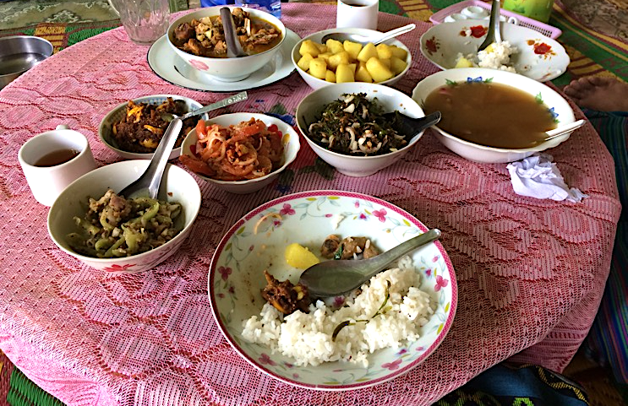
Thank you!
Mahrt, Kristi; Herforth, Anna W.; Robinson, Sherman; Arndt, Channing; and Headey, Derek D. 2022. Nutrition as a basic need: A new method for utility-consistent and nutritionally adequate food poverty lines. IFPRI Discussion Paper 2120. Washington, DC: International Food Policy Research Institute (IFPRI).
https://doi.org/10.2499/p15738coll2.135901
Kristi Mahrt – k.mahrt@cgiar.org

Slide 40
References
Allen, L.H., Carriquiry, A.L., & Murphy, S.P. 2020. Perspective: Proposed Harmonized Nutrient Reference Values for Populations. Advances in Nutrition, 11(3): 469–483.
Arndt, C. and K.R. Simler. 2005. ‘Estimating Utility-Consistent Poverty Lines’, Food Consumption and Nutrition Division Discussion Paper No. 189. Washington, DC: International Food Policy Research Institute (IFPRI).
———. 2007. ‘Consistent Poverty Comparisons and Inference’, Agricultural Economics, 37: 133–9.
———. 2010. ‘Estimating Utility-Consistent Poverty Lines with Applications to Egypt and Mozambique’, Economic Development and Cultural Change, 58(3): 449–74.
Arndt, C. and K. Mahrt. 2017. ‘Estimation in Practice.’ In C. Arndt and F. Tarp (Eds.), Measuring Poverty and Wellbeing in Developing Countries, WIDER Studies in Development Economics. Oxford, New York: Oxford University Press.
Arndt, C., K. Mahrt, and F. Tarp. 2017. ‘Absolute Poverty Lines.’ In C. Arndt and F. Tarp (Eds.), Measuring Poverty and Wellbeing in Developing Countries, WIDER Studies in Development Economics. Oxford, New York: Oxford University Press.
Arndt, C. and F. Tarp. 2017. Measuring Poverty and Wellbeing in Developing Countries, WIDER Studies in Development Economics. Oxford, New York: Oxford University Press.
Decerf, B. 2023. A Meta-Theory for Absolute Poverty Lines. World Bank Policy Research Working Paper 10519. Washington, DC: World Bank Group.
FAO (Food and Agriculture Organization). 1996. Rome Declaration on World Food Security and World Food Summit Plan of Action. Rome, Italy: FAO.
FAO, IFAD, UNICEF, WFP, and WHO. 2020. The State of Food Security and Nutrition in the World 2020. Transforming food systems for affordable healthy diets. Rome, FAO.
———. 2021. The State of Food Security and Nutrition in the World 2021. Transforming food systems for food security, improved nutrition and affordable healthy diets for all. Rome, FAO.
Herforth, A., Y. Bai, A. Venkat, K. Mahrt, A. Ebel, W.A. Masters. 2020. Cost and affordability of healthy diets across and within countries. Background paper for the State of Food Security and Nutrition in the World 2020. Rome: FAO.
IOM (Institute of Medicine of the National Academies). 2006. Dietary reference intakes: The Essential Guide to Nutrient Requirements. Washington, DC: The National Academies Press.
Institute of Nutrition, Mahidol University. 2014. ASEAN Food Composition Database, Electronic version 1, February 2014. Thailand. http://www.inmu.mahidol.ac.th/aseanfoods/composition_data.html

Slide 41
References, cont.
MEXT (Ministry of Education, Culture, Sports, Science and Technology). 2015. Standard Tables of Food Composition in Japan - 2015 - (Seventh Revised Edition). Tokyo. https://www.mext.go.jp/en/policy/science_technology/policy/title01/detail01/1374030.htm
MoPF and World Bank. 2017b. Myanmar Poverty and Living Conditions Survey: Technical Poverty Estimate Report. Nay Pyi Taw, Myanmar.
Moncada, L., A.P. De la O Campos, and L. Tornarolli. 2022. Food insecurity and poverty – A cross-country analysis using national household survey data. FAO Agricultural Development Economics Working Paper, No. 22-14. Rome, FAO. https://doi.org/10.4060/cc3393en
Nahar, Q., S. Choudhury, M.O. Farugqu, S.S.S. Sultana, M.A. Siddiquee. 2013. Dietary Guidelines for Bangladesh. Dhaka: Bangladesh Institute of Research and Rehabilitation in Diabetes, Endocrine and Metabolic Disorders.
Ravallion, M. 2016. The Economics of Poverty: History, Measurement, and Policy. Oxford: Oxford University Press.
Scott, J. 2019. Nutrient Database for Fish in Myanmar. Unpublished database. Yangon, Myanmar: World Fish.
Shaheen, N., A.T.M.A. Rahim, M. Mohiduzzaman, C.P.Banue, M.L. Bari, A.B. Tukun, M.A. Mannan, L. Bhattacharjee, and B. Stadlmayr. 2013. Food Composition Table for Bangladesh. Dhaka, Bangladesh: University of Dhaka, Institute of Nutrition and Food Science.
Stadlmayr, B., U.R. Charrondiere, V.N, Enujiugha, R.G. Bayili, E.G Fagbohoun, B. Samb, P. Addy, I. Barikmo, F. Ouattara, A. Oshaug, I. Akinyele, G.A. Annor, K. Bomfeh, H. Ene-Obong, I.F. Smith, I.Thiam, B. Burlingame. 2012. West African Food Composition Table. Rome: FAO.
USDA (US Department of Agriculture), Agricultural Research Service, Nutrient Data Laboratory. 2016. USDA National Nutrient Database for Standard Reference, Release 28. Version Current: May 2016.
WHO (World Health Organization). 2003. Diet, nutrition and the prevention of chronic diseases. Technical Report Series, No. 916. Geneva.

Slide 42
Comparisons of the nutrient content of food baskets
 | EAR for adult woman | Nutrient content of food baskets
 |  | Energy-based | Healthy diet
Protein, g | 33 | 50 | 68
Calcium, mg | 750 | 360 | 874
Iron, mg | 11 | 11 | 17
Magnesium, mg | 265 | 236 | 363
Phosphorous, mg | 580 | 764 | 1,023
Zinc, mg | 9 | 8 | 9
Copper, mg | 1 | 1.4 | 1.9
Vitamin C, mg | 80 | 49 | 169
Thiamin, mg | 0.9 | 0.7 | 1.1
Riboflavin, mg | 1.3 | 0.6 | 1.0
Niacin, mg | 11 | 12 | 14
Vitamin B6, mg | 1.3 | 1.2 | 1.7
Folate, μg | 250 | 178 | 411
Vitamin B12, μg | 2.0 | 1.0 | 2.6
Vitamin A, μg RAE | 490 | 274 | 627

Slide 43
Food basket cost shares
Energy-Based
Healthy Diet
Notes:
Micronutrient food groups outlined in white

Slide 44
ECLAC poverty lines aligned with macronutrient requirements
  Method used in 18 Latin American counties
  Food consumption of poorer households with staple, protein-rich, and fats food groups scaled to meet macronutrient requirements – potentially small adjustments
  Does not address micronutrients

Slide 45
Macronutrient percentages of dietary energy
 |  | Protein | Total fat | Carbohydrate
Targets | Acceptable Macronutrient Distribution Range (IOM 2006) | 10-35 | 20-35 | 45-65
 | Bangladesh FBDG target | 10 | 20 | 70
 | ECLAC (WHO 2003) | 10 | 15-25 | 35-75
Food Baskets | Energy-based | 9 | 16 | 72
 | Healthy diet | 12 | 19 | 68
Notes:
For macronutrients, we compare the carbohydrate, protein, and fat content of each basket to the acceptable macronutrient distribution ranges (AMDRs) specified in IOM (2006).
Bangladesh and ECLAC - World Health Organization population nutritional targets, 2003
Both baskets contain energy from macronutrients (protein, fats, and carbohydrates) generally consistent with the Bangladesh dietary guidelines and ECLAC

