Slide 1
The new economics of food: agriculture and nutrition
UP Los Banos, College of Economics and Management 105th Anniversary Symposium on Food System Transformation September 5th, 2024
William A. Masters
Friedman School of Nutrition and Department of Economics, Tufts University
https://sites.tufts.edu/foodeconomics
https://bit.ly/FoodEconBook

Slide 2
What is the new Food Economics?
Food economics includes agriculture
Agriculture is a huge and consequential sector, with a distinctive structure and large role for policy
When farm productivity is low, subsistence requirements create a poverty trap
Even if non-farm growth lifts people out of poverty, low farm productivity depletes natural resources
Food economics adds nutrition and health
Most nutritional and health attributes cannot be seen, tasted or smelled
Food demand is not generally aligned with food for health
Food economics is familiar but surprising
The value of product attributes is often unobservable, so price is a signal of value (more expensive=better)
Personal experience, media stories and marketing efforts lead to strongly held beliefs
Existing beliefs are often wrong, leading to research opportunities and teachable moments!
Food economics offers a lot to share today
Research results
Food Prices for Nutrition: using retail prices to measure food access and affordability of healthy diets
Teaching materials
Food Economics book: a gentle introduction, using graphical economics and data visualization

Slide 3
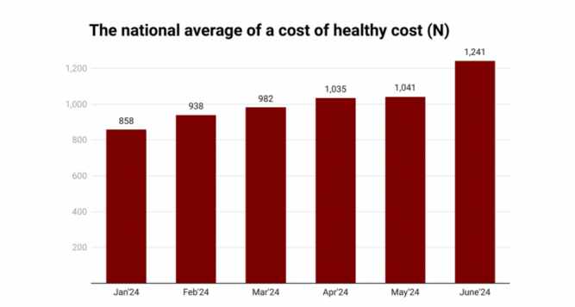
Innovation in food economics research: A new price index for diet costs
https://sites.tufts.edu/foodpricesfornutrition
We use retail prices to identify the lowest-cost foods to meet health needs for each population
Match locally available items to food composition and nutritional requirements
Compute least-cost diets for each market location at each time period
Compare that benchmark to available income and actual food consumption
Measuring food access using lowest-cost healthy diets helps target innovation and intervention
If prices for lowest-cost foods are high, need more efficient supply and distribution
If incomes available for food are low, need income growth and social protection
If unhealthy items displace low-cost healthy items, need to ask why those are chosen
Since 2020, global monitoring data published annually in July
Since Jan. 2024, national monitoring done in Nigeria
Rapid adoption globally, perhaps eventually in the Philippines as an adjustment of the food poverty line?

Slide 4
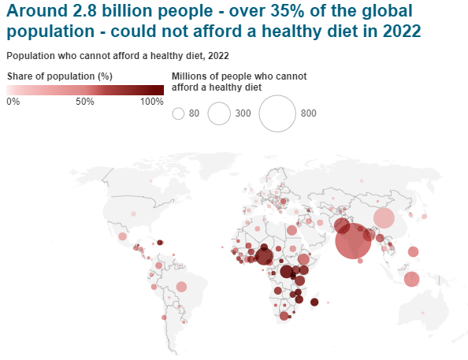
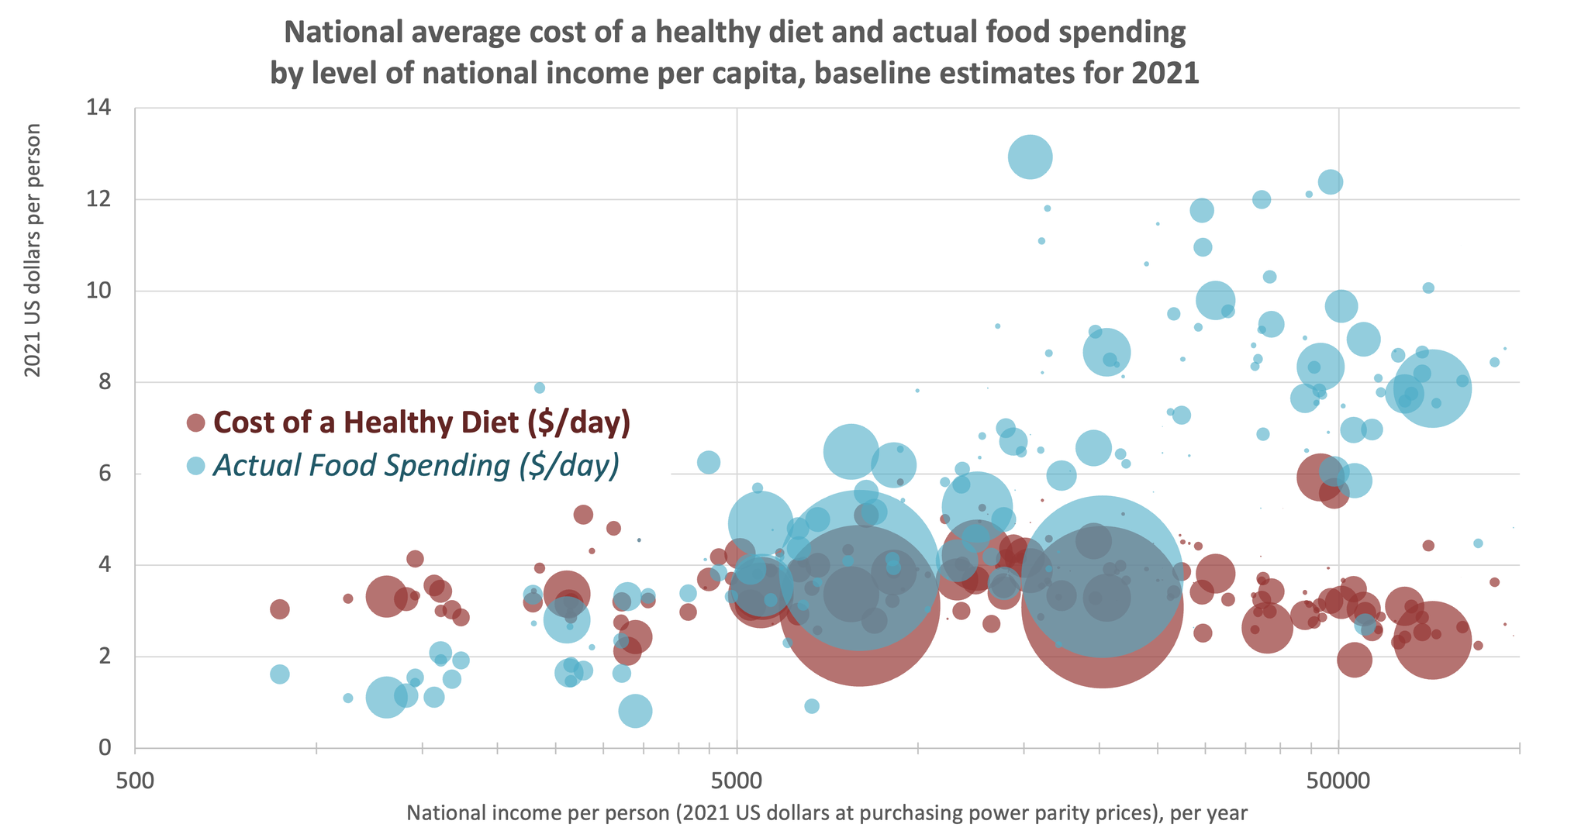
Innovation in food economics research: A new price index for diet costs
https://sites.tufts.edu/foodpricesfornutrition
Our main discovery is that least-cost locally available items for a healthy diet cost about $3-4/day
About 2.8 billion people (35% of the world) cannot afford the least-cost healthy diet in their country
PHL is here
6.19
3.84
Healthy diets cost about 2x what people in the poorest countries actually spend on food
At middle and higher incomes, least-cost healthy items are displaced by more expensive foods

Slide 5
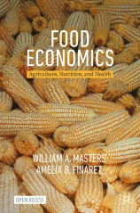
Innovation in communication about food economics: A new open-access (text)book
https://bit.ly/FoodEconBook
Principles of Economics (Chapters 1-6)
Data about the food system (Chapters 7-12)
1. Introduction Motivating food economics
2. Individual Choices Consumption and production theory
3. Societal Outcomes Supply, demand, trade, elasticity
4. Social Welfare Economic surplus, externalities
5. Market Power Imperfect competition, game theory
6. Collective Action Public goods, non-market goals
7. Poverty and Risk Inequality, safety nets, vulnerability
8. Food and Health Behavioral economics, interventions
9. Food in the Macroeconomy Recessions, unemployment, inflation
10. International Development Ag. transformation, diet transition, urbanization
11. From Local to Global International trade, globalization, value chains
12. The Future of Food Agribusiness and agroecology, food environments

Slide 6
Source: Figure 5.1 Scale economies in agrifood systems, from Masters & Finaret (2024), Food Economics: Agriculture, Nutrition and Health.
The book covers all aspects of the food system
A large and consequential sector of the economy, with an unusual industrial structure
Farming remains mainly owner-operated by family enterprises, without employees or outside investors
…but big scale economies and rapid innovation in farm inputs and food businesses of all kinds
Agribusinesses, supplying farm inputs of all kinds
Rapid change occurs here
Innovation, scale and network effects, intellectual property, market power
Many farms, almost all of which are self-employed households
Consumers often want to buy traditional foods directly from farmers
Land tenure and land use, geographic specialization and risk
Food businesses, for product transformation and marketing
Innovation, scale and network effects, intellectual property, market power
Households, using time and money to meet food needs
Food choice is driven by prices and income, time use and meal preparation costs, marketing and taste, as well as biological needs (e.g. for total calories per day)
Lots of new data and insights to discuss today, including large role of government

Slide 7
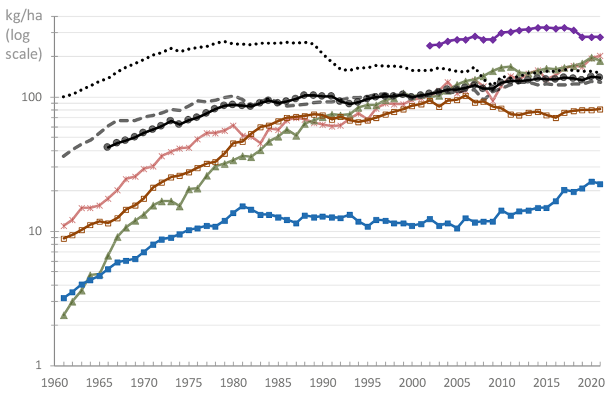
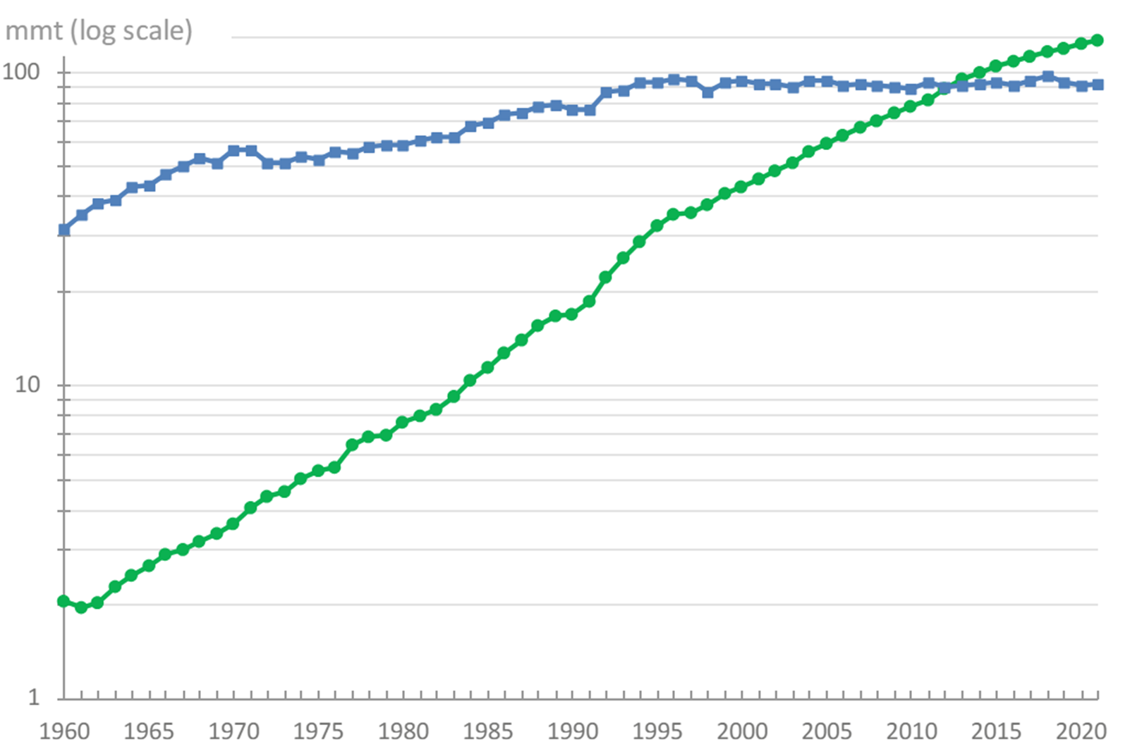
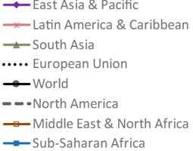
The book has lots of data, e.g. for the future of food production
We emphasize induced innovation and choices for the speed and direction of productivity and decarbonization
…and describe how agribusiness and agroecology can work together for sustainability and health
Figure 12.1 Crop intensification as measured by fertilizer use, 1961–2021
Figure 12.4 The global transition from capture fisheries to aquaculture, 1960–2021

Slide 8
The book builds on new evidence, e.g. for food consumption
Drivers of food choice: interaction of conscious and unconscious mechanisms
Economic and psychosocial factors: Perception, cognition, and intentional efforts
Biological and physiological processes: Hormones, neurotransmitters and autonomous regulation
Trends to discuss today?
Big impact of GLP-1 agonists
(Wegovy, Ozempic etc.)?
Shifts in preferences,
e.g. from meat and
from ‘ultra-processed’ food
towards other options?
Innovations in food production and distribution?
Energy balance
Source: Figure 7.15 Interaction of conscious and unconscious mechanisms for energy balance, from Masters & Finaret (2024)

Slide 9
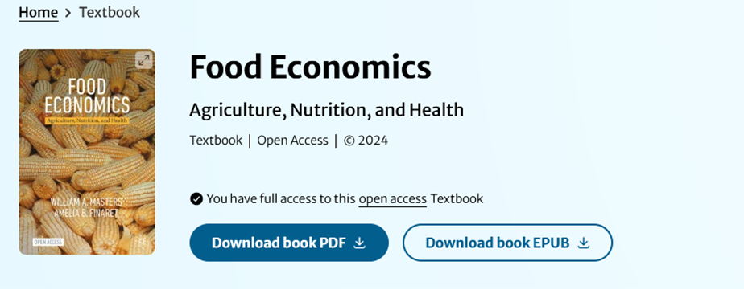
Conclusions about the book
Can use the book via any device, or in print
Features of the online version
• Syllabus can link to specific pages online
• Students can share comments on the text itself
• All figures are available as powerpoint slides
• Analytical diagrams can be edited
• Data visualizations can be updated
Other teaching materials coming soon
Class materials developed for and with Tufts students
https://sites.tufts.edu/foodecon
• Warm-up exercise finding errors in ChatGPT
• Excel exercise on nutrient adequacy of real diets
• Weekly exercises to draw analytical diagrams matched to current news stories
Welcome to our resource page for the new open-access textbook on Food Economics: Agriculture, Nutrition and Health, published in May 2024 from Palgrave MacMillan.
This site will soon have password-protected links to course materials (slides, exercise prompts, past exams and answer keys). For now we invite you to subscribe to our elist so that you can receive and share teaching material and updates related to the book.
• Midterm or course project (partial draft)
• Weekly exercises to make data visualizations with downloaded data from official sources
• Final or course project (report + slides)

