Slide 1



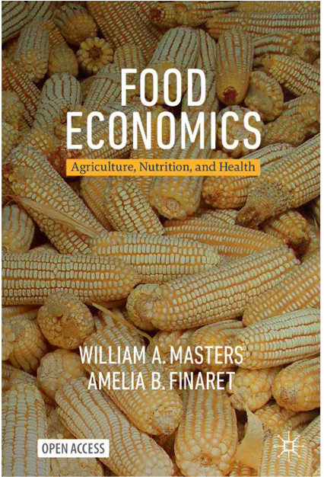
https://sites.tufts.edu/foodpricesfornutrition
Food prices and affordability
of healthy, sustainable diets worldwide
William A. Masters
Friedman School of Nutrition Science and Policy
Tufts University
sites.tufts.edu/willmasters
sites.tufts.edu/foodeconomics
Institute for Global Nutrition
UC Davis, 29 January 2025
Open access, at
bit.ly/FoodEconBook

Slide 2
Global hunger and nutrition measures are changing
Global hunger and nutrition measures are changing
Food consumption and dietary intake data are collected in various ways for various metrics
of nutritional adequacy, diet diversity and diet quality, since the 19th and early 20th centuries
  Global definitions and targets set by UN system agencies and their member governments
Undernourishment has been reported by FAO since 1974 for “global hunger”, developed in 1960s
based on countries’ total energy in available food, if it were distributed log-normally
  Now 9% of the world population (0.7 billion people) are undernourished in this sense
Food insecurity has been reported by FAO since 2014, developed in 1990s and 2000s
based on surveys asking people if lack of resources to acquire food caused them to
skip a meal, eat less, eat fewer foods, go to bed hungry etc. at any time over the past year
  About 25% of the world population (2 billion people) are food insecure in this sense
Cost and affordability of healthy diets has been reported by FAO and others since 2020,
based on lowest-cost locally available foods for a healthy diet, relative to available income
  About 35% of the world (now 2.8 billion people) cannot afford a healthy diet in this sense
Tracking lowest-cost healthy diets helps identify remedies for malnutrition
  If prices for lowest-cost foods are high, need more efficient supply and distribution
  If incomes available for food are low, need income growth and social protection
  If unhealthy items displace the available low-cost healthy items, need to ask why those are chosen

Slide 3
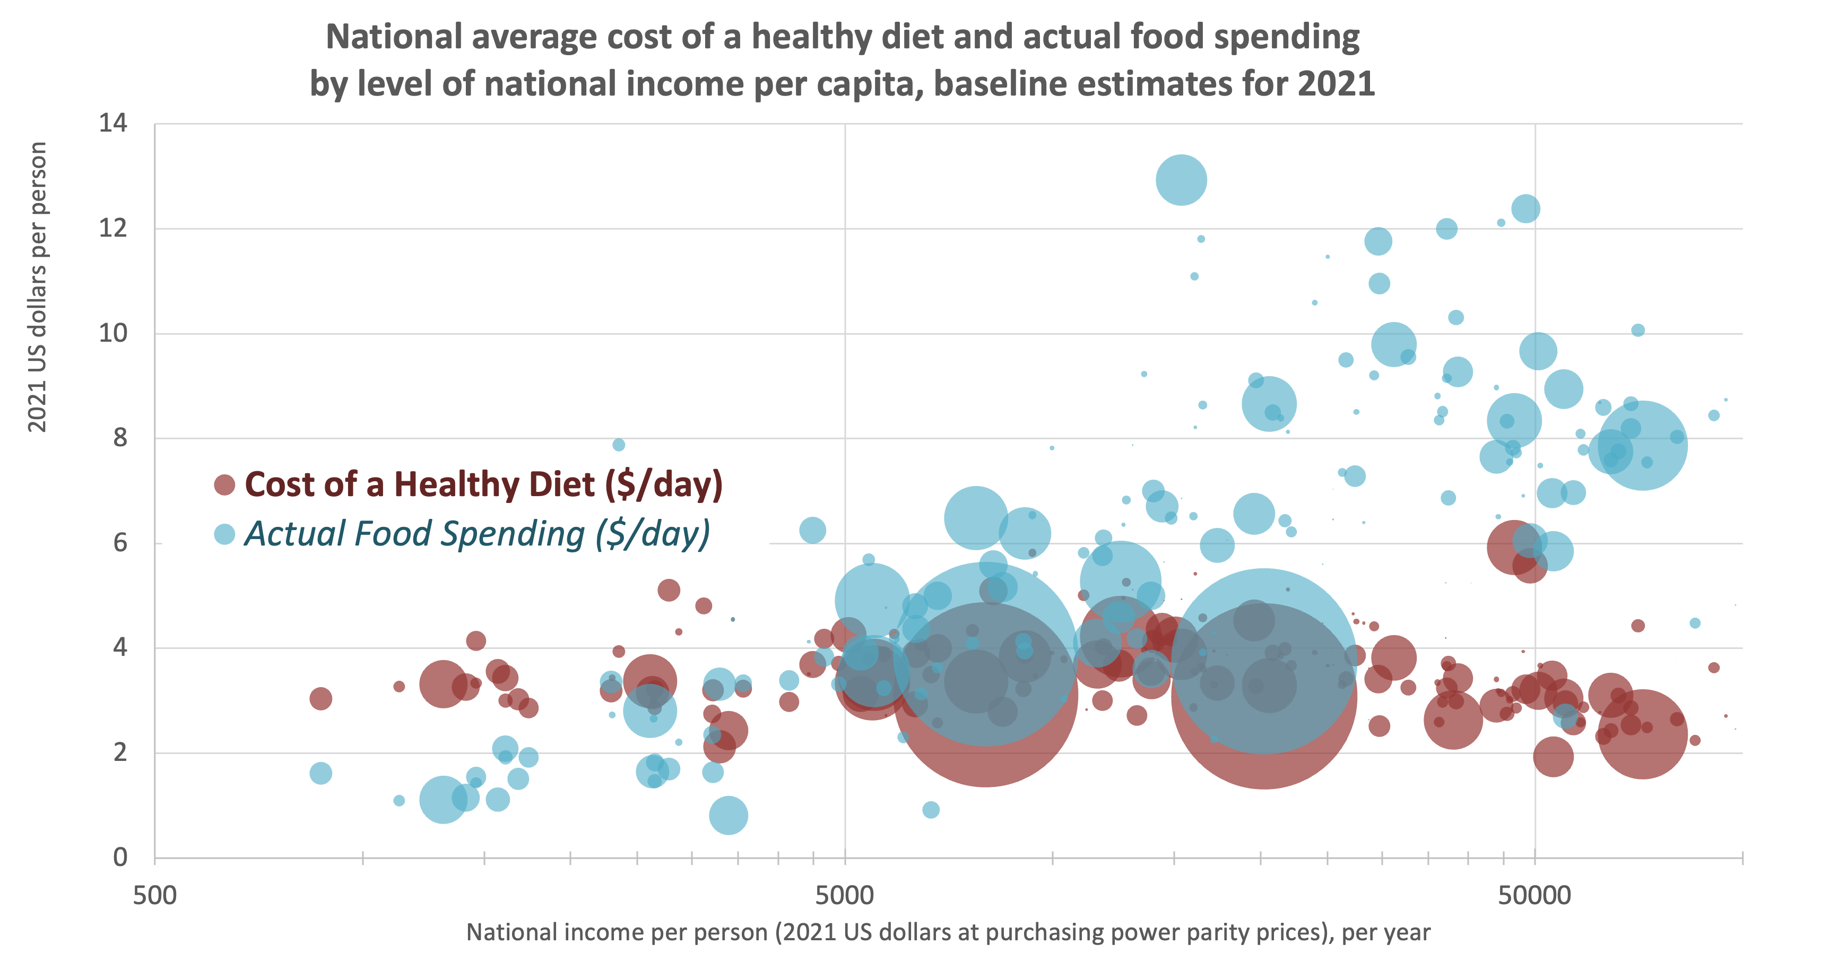
Our discovery is that the least-cost locally available items
in sufficient quantities for a healthy diet cost about $3-4/day
2021 US dollars
National income per person, at purchasing power parity prices (2021 US dollars)
Source: FAO and World Bank, 2023. The latest Cost of a Healthy Diet data are at https://www.fao.org/faostat/en/#data/CAHD,
and published simultaneously alongside actual food spending at https://databank.worldbank.org/source/food-prices-for-nutrition.
Circles are proportional to population size, and countries are arrayed by level of national income using World Development Indicators data.
Notes:
One key finding is that CoHD doesn’t vary systematically with national income...
Actual food spending and number/proportion of people who can afford a healthy diet varies widely between countries

Slide 4
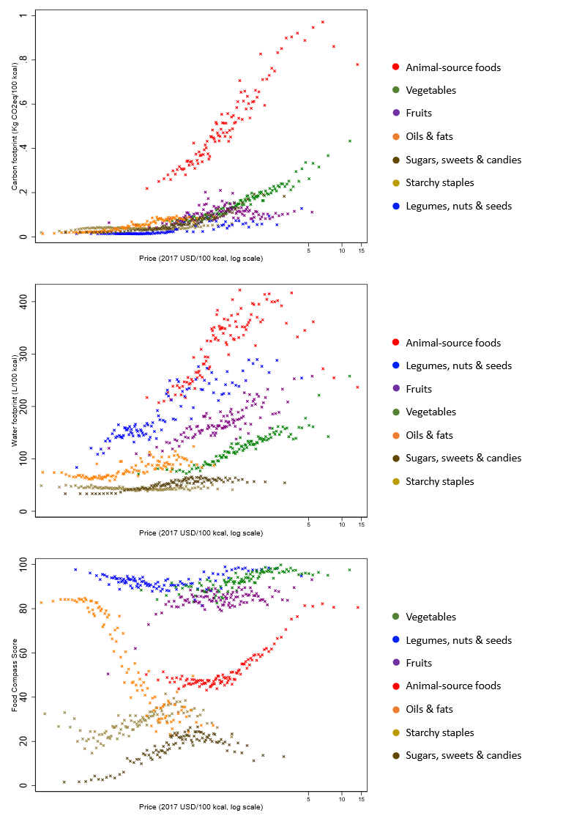
Least cost healthy diets are also sustainable, because
lower-cost items in each food group use less resources
Emissions
(kg of CO2-eq./100 kcal)
Water footprint
(liters of water/100 kcal)
Cost of each food item ($/100 kcal, log scale)
Cost of each food item ($/100 kcal, log scale)
Source: Elena Martinez, “Market and non-market costs of affordable, healthy diets.” PhD dissertation, Friedman School of Nutrition, Tufts University.
Prices shown are for n=811 food items in 181 countries observed in 2011 and 2017, reported by national statistical agencies through the International Comparison Program (ICP), matched to climate and water footprint estimates from Petersson et al. (2021). Figures are binned scatter plots, where each food group is represented by 100 data points, each of which is the mean value of the y-axis variable at the mean level of the x-axis variable across 100 equal-sized bins.

Slide 5
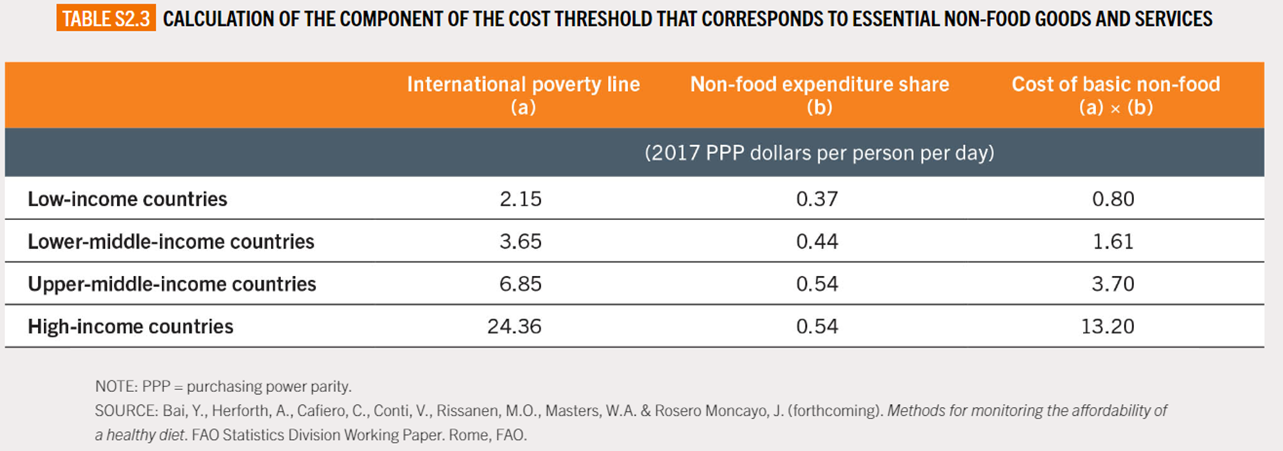
To track affordability, we compare the least-cost healthy diet in each country to household income, minus non-food needs
The new affordability method used by FAO and the World Bank for global monitoring in SOFI 2024
allows for higher non-food needs in higher-income countries
Average of poorer residents’ spending on nonfood goods & services
Required nonfood spending used to obtain income available for food
Average of national governments’ poverty lines
X
=
Source: FAO, IFAD, UNICEF, WFP and WHO. 2024. The State of Food Security and Nutrition in the World 2024. Rome, https://doi.org/10.4060/cd1254en.

Slide 6
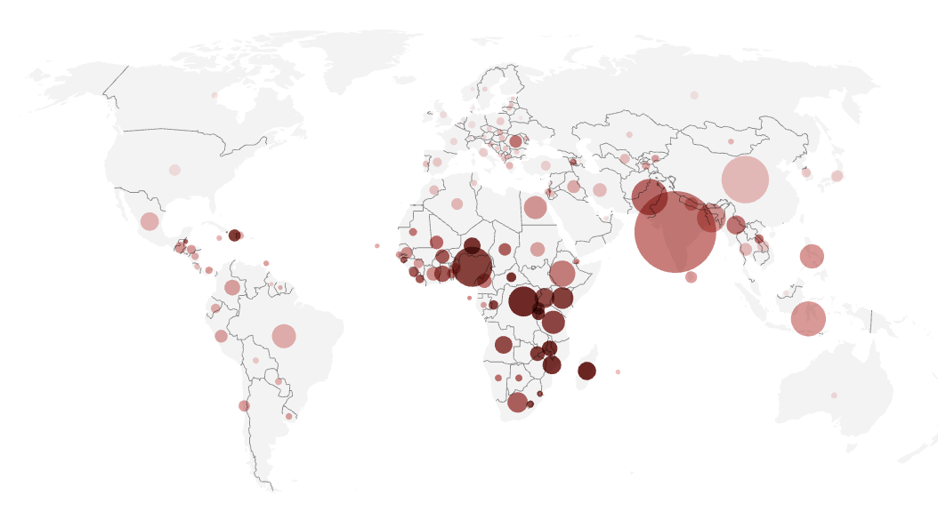
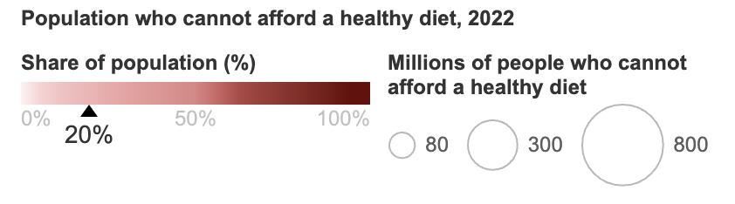
The latest UN estimate is that 2.8 billion people
(35% of the world) could not afford a healthy diet in 2022
Number and proportion of people who cannot afford a healthy diet
Note: Data shown are based on 2021 item prices projected forward to 2022, relative to income data in 2022.
Source: FAO and World Bank, 2024. The latest data are at https://www.fao.org/faostat/en/#data/CAHD and https://www.worldbank.org/foodpricesfornutrition.
Notes:
Key messages from SOFI 2024 updates:
Affordability improved, with # of people who cannot afford now below pre-pandemic levels, in Asia and in Northern America and Europe
Affordability decreased substantially in Africa, where the number of people who can’t afford a healthy diet rose to ~925 million in 2022, up by ~25 million from 2021
Unequal recovery from pandemic and other financial crises also occurred across country income groups – low income countries at worst rates since monitoring began in 2017
~60% of people who can’t afford are in LMIC
---
Updated from previous rounds of the SOFI, now using ICP 2021 prices and a new affordability method
Previous finding from SOFI 2022 (?) was that over 3 billion people (42% of population) could not afford a healthy diet in 2021
Now reporting on 2022
New affordability method has different non-food costs depending on country income level
------
This statistic was published by FAO et al., and you can find the information on FAOSTAT and our [FPN] DataHub hosted at the World Bank.
The Cost and Affordability of a Healthy Diet is an indicator recently adopted by FAO as a global food security indicator to complement the Prevalence of Undernourishment and Food Insecurity Experience Scale. This indicator has revealed that approximately three billion people cannot afford a healthy diet, meaning a least-cost diet that satisfies dietary guidelines. The majority of those who cannot afford a healthy diet are living in sub-Saharan Africa and South Asia.

Slide 7
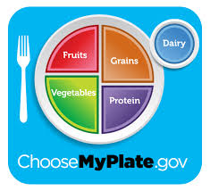
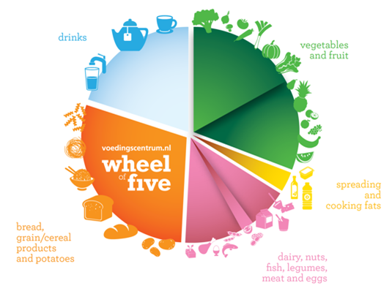
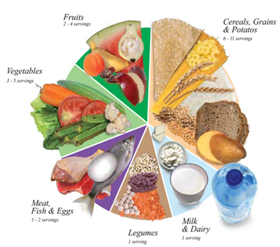
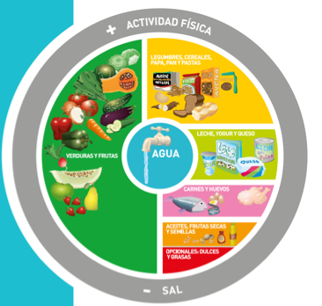
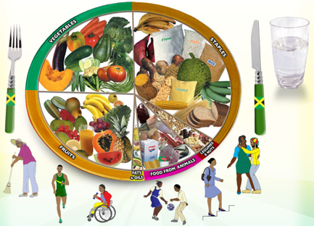
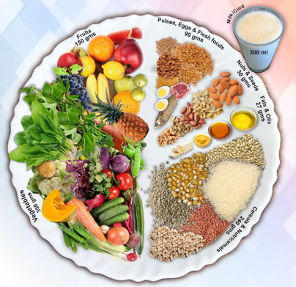
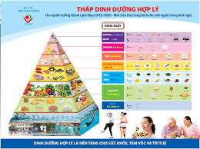
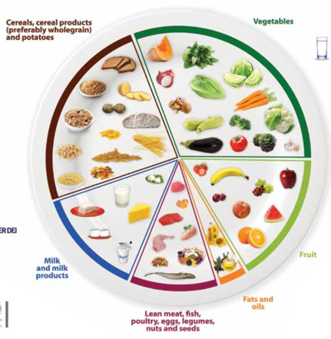
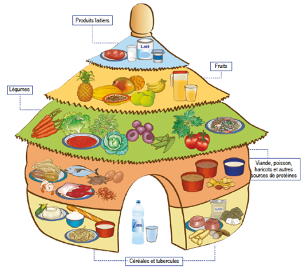
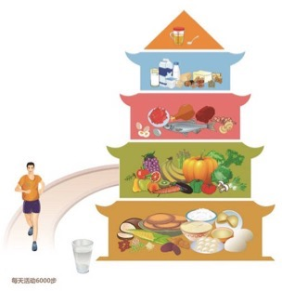
Our benchmark least cost healthy diets use locally available items that meet national food-based dietary guidelines
Dietary guidelines define healthy diets in terms of food groups
  To allow substitution within food groups, we convert volume and weight to energy shares
Food group targets can differ and change over time
  For SOFI 2020, used median cost of 10 quantified guidelines from all UN regions
  For SOFI 2022, introduced the Healthy Diet Basket from 31 guidelines with food guides
  For SOFI 2024, use updated price and income data but same health criteria
  In Jan. 2024, Nigeria became first country to publish national statistics using global HDB
  Ethiopia and others also publish the cost of meeting their own dietary guidelines
Energy shares
50%
5%
7%
13%
13%
13%
Quantities of typical items
Typical weight (grams) | Typical volume (plate share)
322g dry rice | 25%
270-400g veg. | 25%
230-300g fruits | 25%
210g egg | 25%
85g dry bean
34g oil
Definition of the global Healthy Diet Basket
Food group | Number of items | Dietary energy (kcal/day)
1. Starchy staples | 2 | 1,160
2. Vegetables | 3 | 110
3. Fruits | 2 | 160
4. Animal-source foods | 2 | 300
5. Legumes, nuts & seeds | 1 | 300
6. Oils and fats | 1 | 300
11
2,330
Source: Herforth et al., (2022), Methods and options to monitor the cost and affordability of a healthy diet globally. Background paper for FAO, IFAD, UNICEF, WFP and WHO.

Slide 8
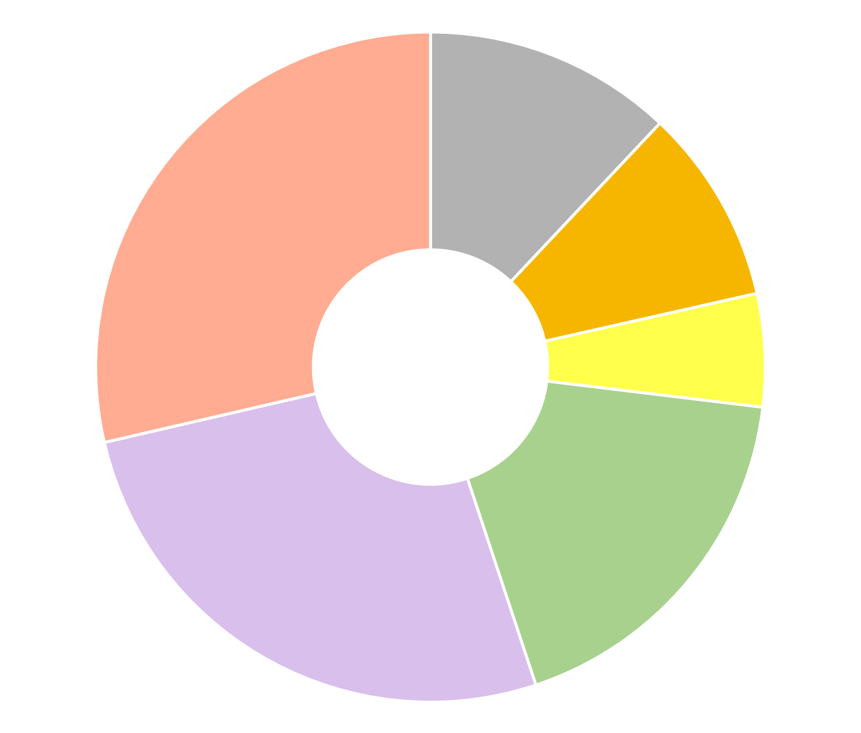
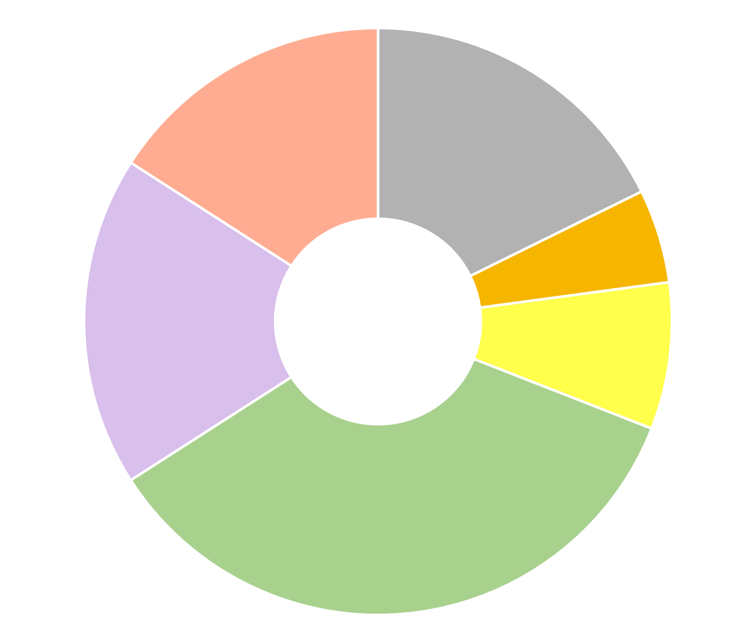
Identifying least-cost healthy options reveals whether
poor diets are due to high cost, low incomes, or food choice
The benchmark Cost of a Healthy Diet is the least expensive Healthy Diet Basket of 11 items in 6 food groups
using data reported by each country about the availability and price of locally consumed foods
Pakistan
Senegal
Animal source foods
(2 items, 150 kcal each)
Starchy staples
(2 items, 580 kcal each)
Wheat flour, maize
(12% of cost)
Legumes, nuts & seeds
(1 item, 300 kcal)
Sardines, small fish
(dried)
16%
Areas show share of cost needed to
meet HDB targets
Maize,
rice (25% broken) 18%
Buffalo milk,
live chicken
(29% of cost)
Red lentils
(9% of cost)
Oils & fats
(1 item, 300 kcal)
Groundnuts
5%
$3.41
per day
Vegetable oil
(5% of cost)
Dates, mangoes
18%
$2.19
per day
Palm oil
8%
Bananas, coconut
(27% of cost)
Onions, carrots,
water spinach
(18% of cost)
Onions, carrots, eggplant
35%
Fruits
(2 at 80 kcal each)
Vegetables
(3 at 30 kcal each)
Note: Each item’s cost is for a sufficient weight or volume to meet the HDB targets, based on matching item descriptions to food composition data. In food groups requiring multiple items, the lowest-cost foods are listed first. Item descriptions are standardized across countries, with its availability and national average price reported by each country’s statistical agency to the International Comparison Program (ICP) for 2017. Cost levels are as published by FAO and the World Bank with methods detailed at Food Prices for Nutrition (2022). https://sites.tufts.edu/foodpricesfornutrition
Notes:
Items selected reflect local availability and price, delivering the same balance across food groups in all settings.
All items shown are widely consumed in each country, but in very different quantities from these benchmark diets;
in these countries actual diets are mostly starchy staples which results in undernutrition.
Benchmark costs shown here are for based on national average item availability and price reported for 2017, converted to US dollars at purchasing-power parity exchange rates

Slide 9
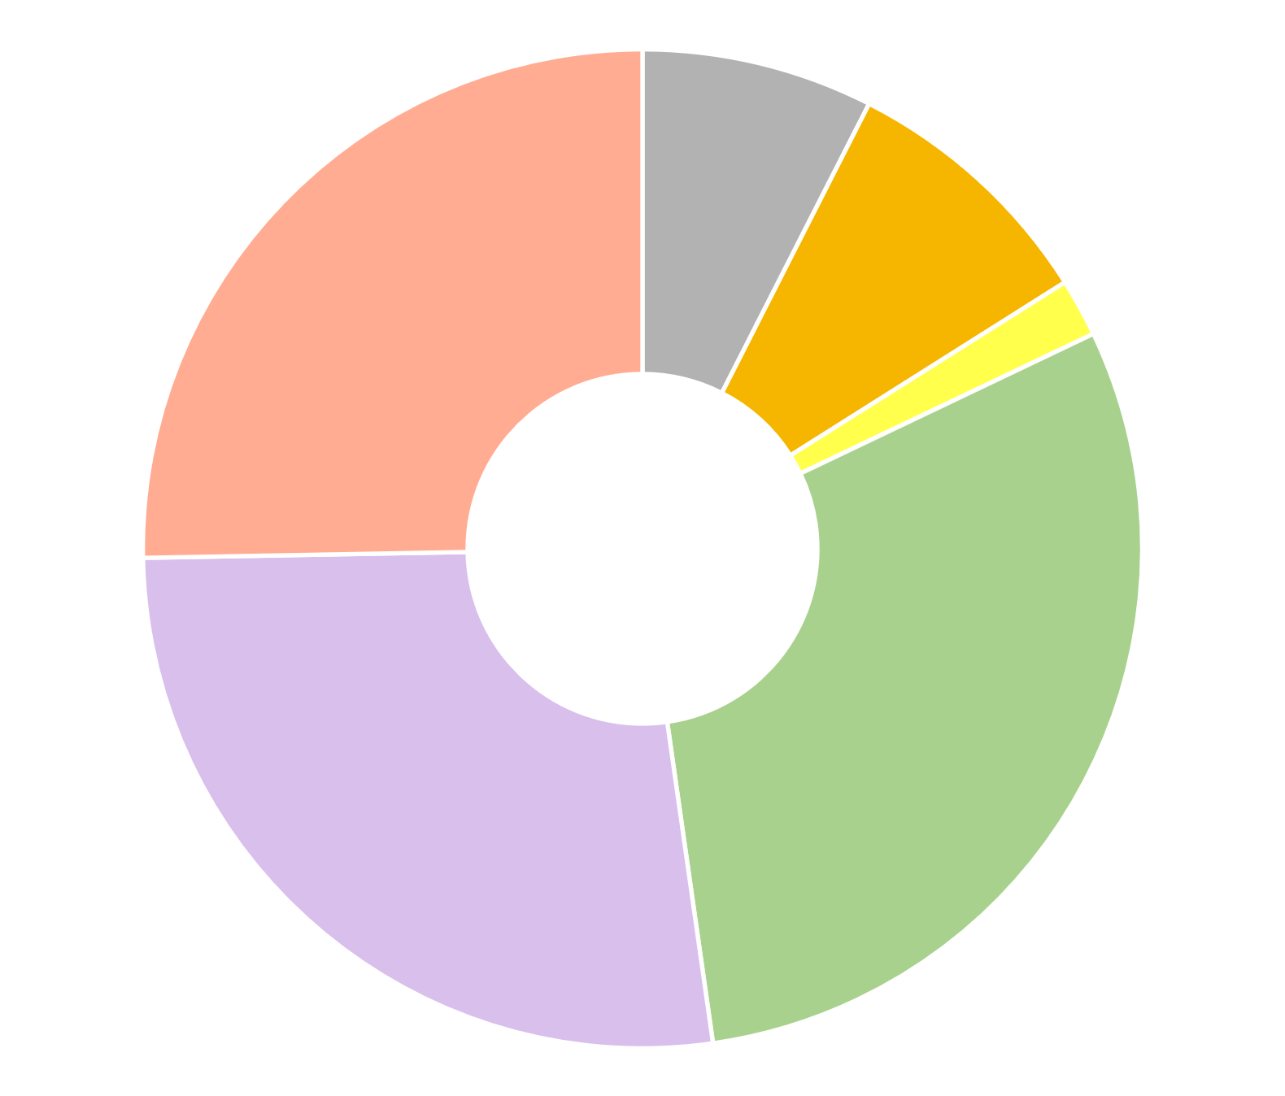
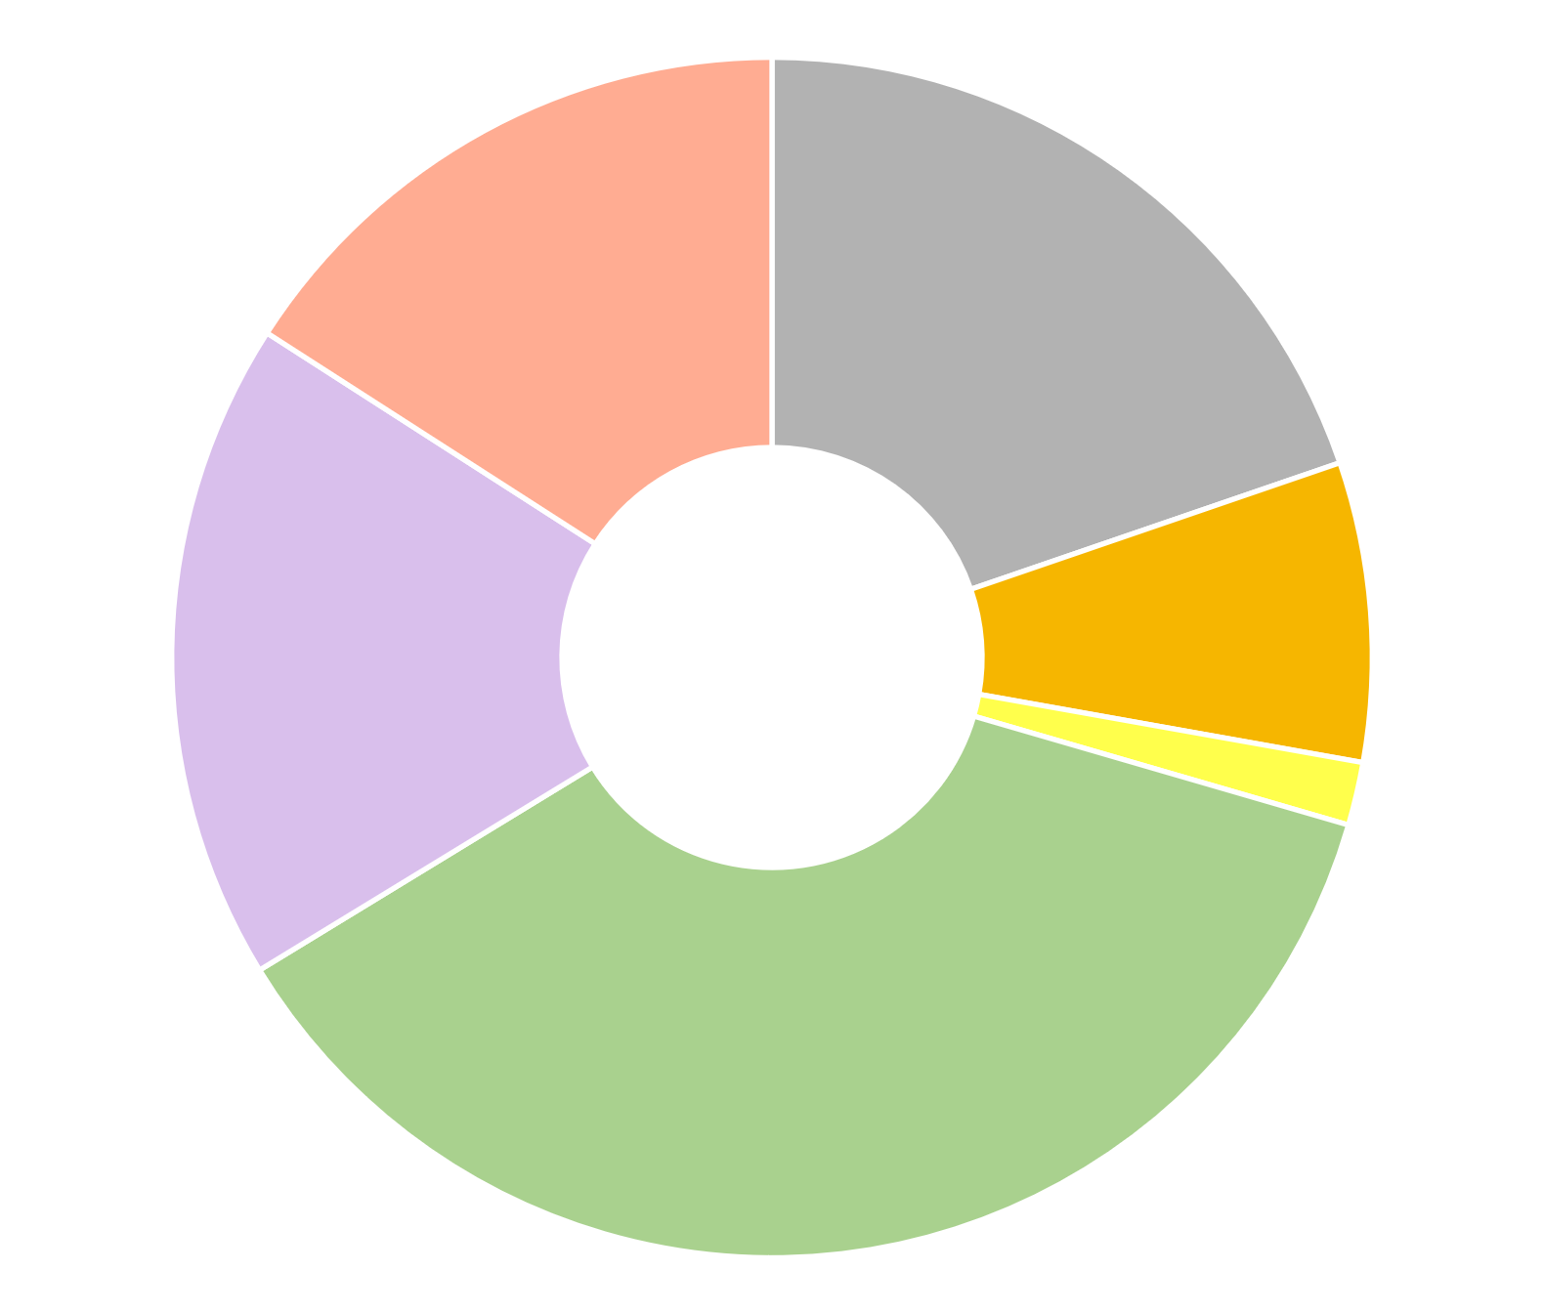
Identifying least-cost healthy options reveals whether
poor diets are due to high cost, low incomes, or food choice
The benchmark Cost of a Healthy Diet is the least expensive Healthy Diet Basket of 11 items in 6 food groups
using data reported by each country about the availability and price of locally consumed foods
Italy
United States
Wheat flour, pasta
(7% of cost)
White beans, dried
(9% of cost)
Whole milk,
semisoft cheese
(16% of cost)
Boxed UHT milk,
frozen chicken
(25% of cost)
Sunflower oil
(2% of cost)
Rice, spaghetti
(20% of cost)
$2.89
per day
Bananas, apples
(18% of cost)
$3.23
per day
White beans, dried
(8% of cost)
Carrots,
onions,
cabbage
(30% of cost)
Sunflower oil
(1% of cost)
Bananas, apples
(27% of cost)
Carrots,
cabbage,
Iceberg lettuce
(37% of cost)
Note: Each item’s cost is for a sufficient weight or volume to meet the HDB targets, based on matching item descriptions to food composition data. In food groups requiring multiple items, the lowest-cost foods are listed first. Item descriptions are standardized across countries, with its availability and national average price reported by each country’s statistical agency to the International Comparison Program (ICP) for 2017. Cost levels are as published by FAO and the World Bank with methods detailed at Food Prices for Nutrition (2022). https://sites.tufts.edu/foodpricesfornutrition
Notes:
The HDB target is designed for global monitoring, based on commonalities among national dietary guidelines.
Resulting diets are close but may not exactly meet all DRI requirements for nutrients, or the U.S. DGAs
Additional costs to meet DRIs or DGAs would be small, but actual spending in Italy or
the U.S. is much greater due to other attributes of foods being purchased

Slide 10
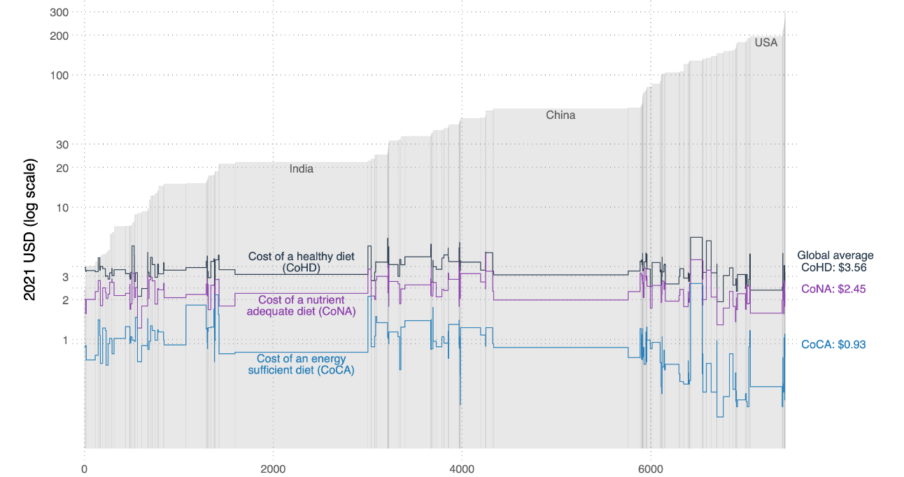
How do least-cost healthy diets compare to
other diet costs at each level of national income?
Diet costs using the lowest-priced locally available items in each country
to meet nutritional requirements of a representative adult woman, 2021
National income per person
Global average
Diet costs:
Cost of Healthy Diets (CoHD)
$3.56
Cost of Nutrient Adequacy (CoNA)
$2.45/day
Cost of Caloric Adequacy (CoCA)
$0.93
Population (cumulative)
Source: W.A. Masters, J.K. Wallingford, A.W. Herforth and Y. Bai (2024), Measuring food access as affordability of least-cost healthy diets worldwide. Agricultural Economics, forthcoming. Diet costs are from FAO and the World Bank’s Food Prices for Nutrition data, using item prices reported by national statistical organizations through the International Comparison Program (ICP), downloaded from https://databank.worldbank.org/source/food-prices-for-nutrition, and national income (GNI) is from the World Development Indicators https://databank.worldbank.org/source/world-development-indicators.

Slide 11
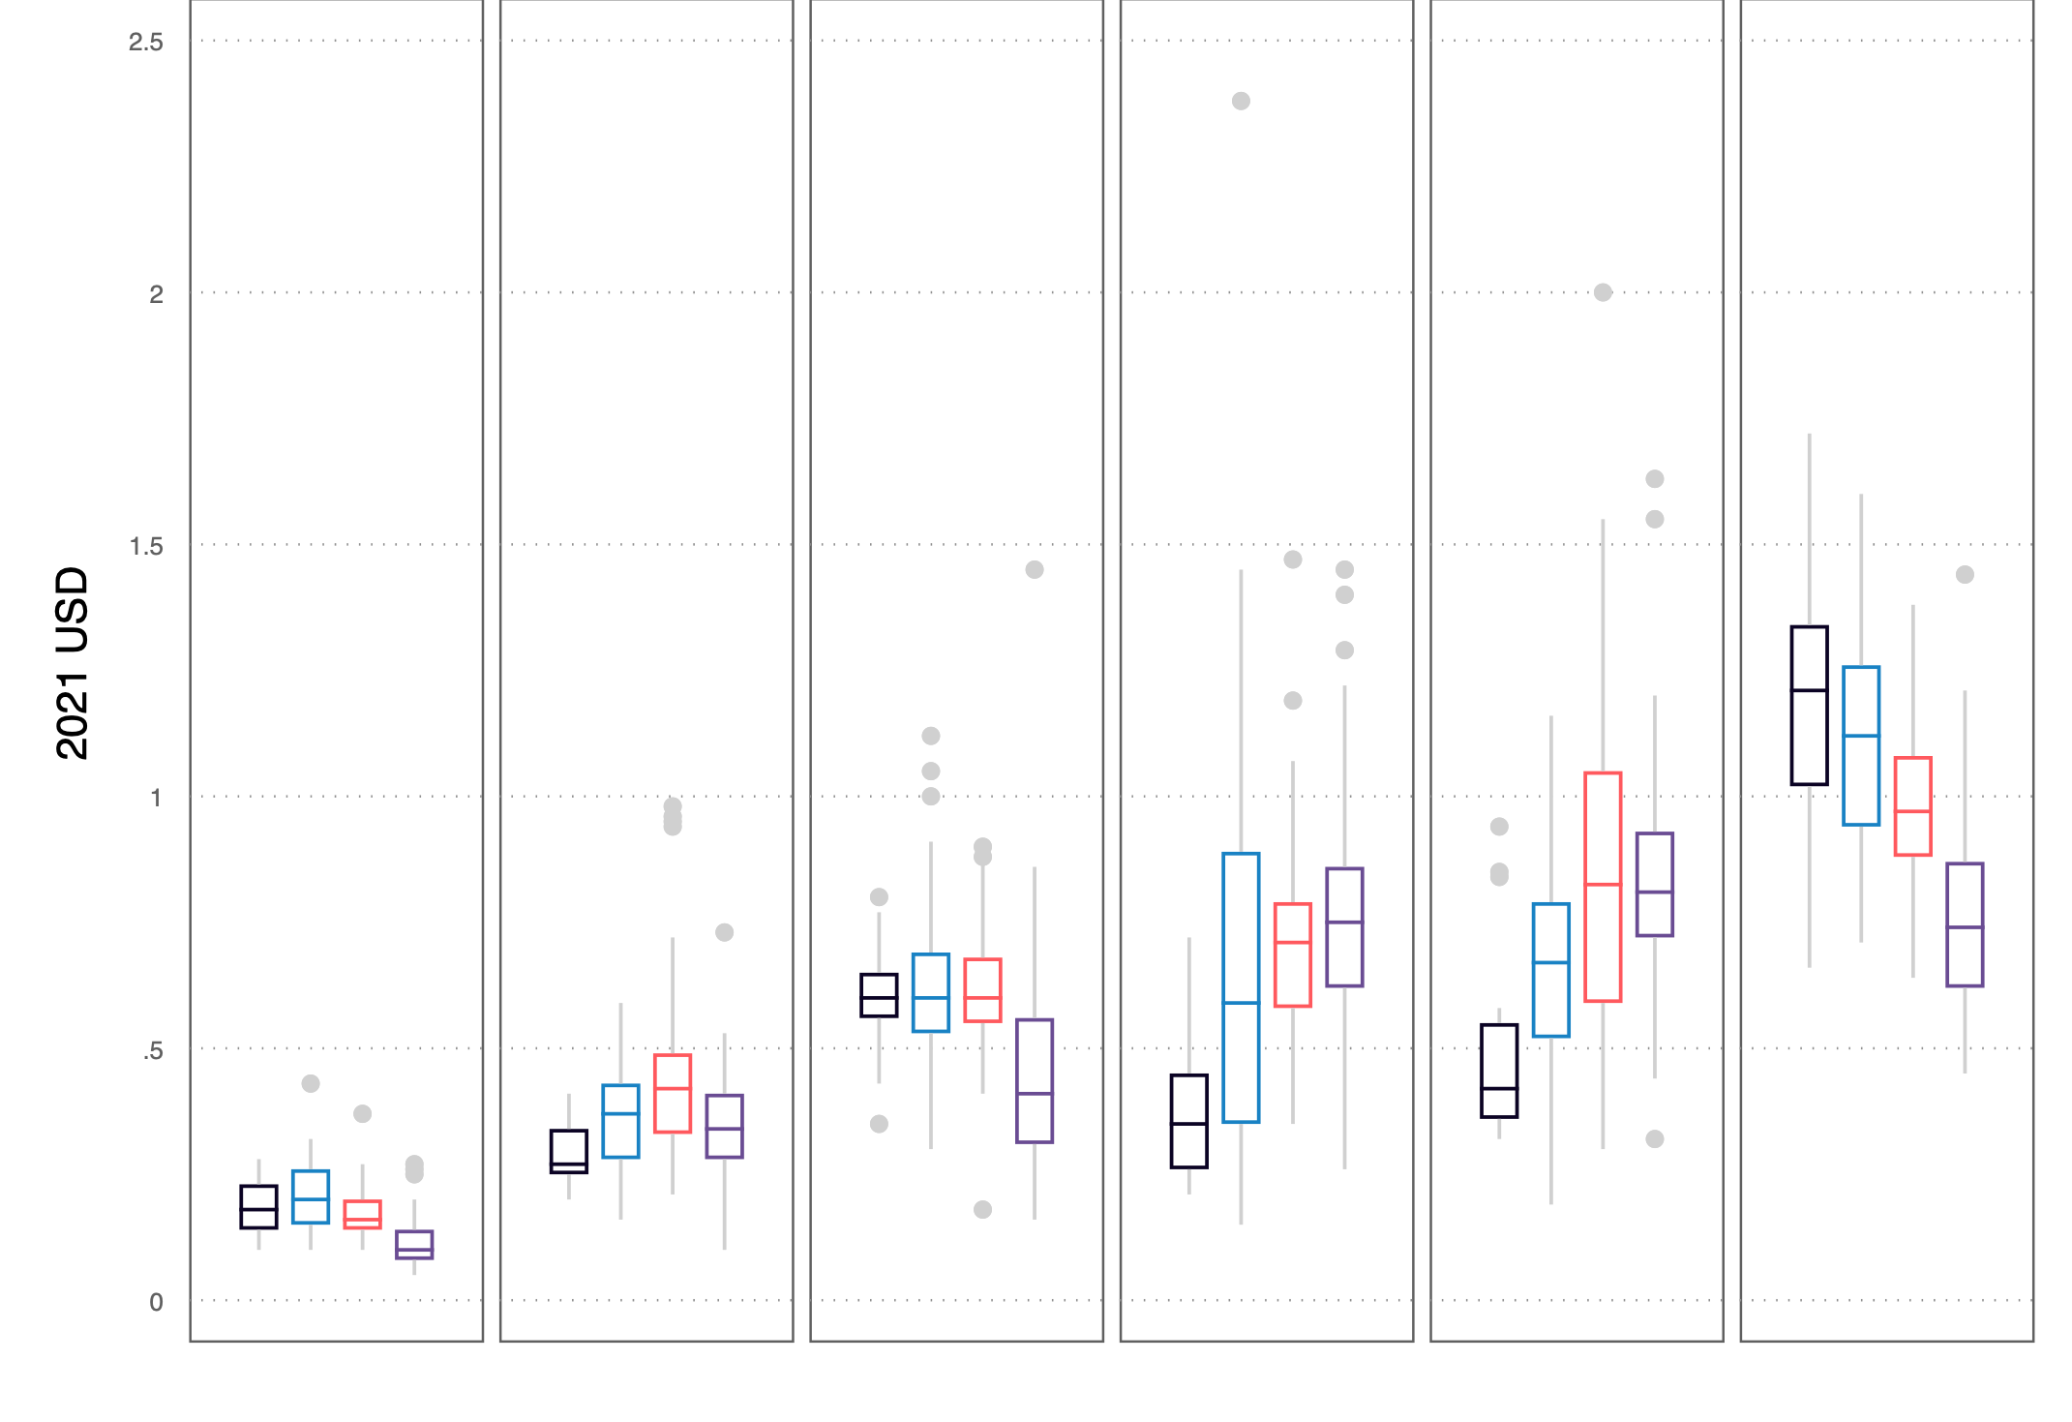
How do costs for the lowest-priced items in each food group
vary across countries at each level of national income?
Range of costs per day by food group in each World Bank income category, 2021
Oils & fats
1 item
(300 kcal)
Legumes,
nuts & seeds
1 item
(300 kcal)
Starchy
Staples
2 items
(1160 kcal)
Fruits
2 items
(160 kcal)
Vegetables
3 items
(110 kcal)
Animal
source
foods
2 items
(300 kcal)
Least-cost F&V are
less expensive in
low-income countries
Low income
Lower middle income
Upper middle income
High income
Least-cost animal source foods are less expensive in richer
than in poorer countries
Source: Masters WA, Wallingford JK, Herforth AW and Bai Y. Measuring food access using the Cost of a Healthy Diet (CoHD): Insights from retail prices worldwide. VeriXiv 2024, 1:12 (https://doi.org/10.12688/verixiv.97.1)

Slide 12
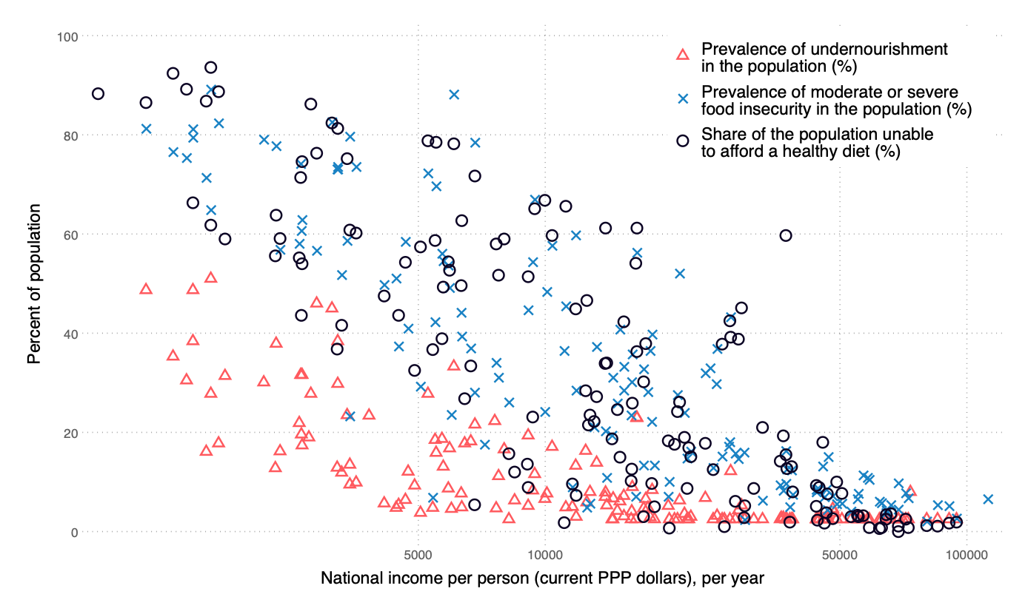
How do least-cost ‘healthy’ diets compare to
other metrics of global food security?
Prevalence of each global food security metric and national income per person, 2021
Prevalence of unaffordability
Remember, “food insecurity” is a person’s answers to whether they ate less, skipped meals, went hungry etc. for lack of money to buy food at least once in the previous year, relative to their usual diet
“Undernourishment” is the country’s total food supply (in kcals)
relative to the country’s population, with an assumed log-normal distribution of kcals and a target level of energy per person
Unaffordability of healthy diets is higher than the other metrics in the poorest countries, and lower than the others in the richest countries
Prevalence of food insecurity
This is due to:
-- some variation in prices for least-cost items in each food group
-- large variation in income available for food,
which depends on both total income and nonfood needs
Prevalence of undernourishment
Source: W.A. Masters, J.K. Wallingford, A.W. Herforth and Y. Bai (2024), Measuring food access as affordability of least-cost healthy diets worldwide. Agricultural Economics, forthcoming. Diet costs are from FAO and the World Bank’s Food Prices for Nutrition data, using item prices reported by national statistical organizations through the International Comparison Program (ICP), downloaded from https://databank.worldbank.org/source/food-prices-for-nutrition, and national income (GNI) is from the World Development Indicators https://databank.worldbank.org/source/world-development-indicators.

Slide 13
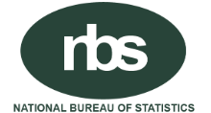

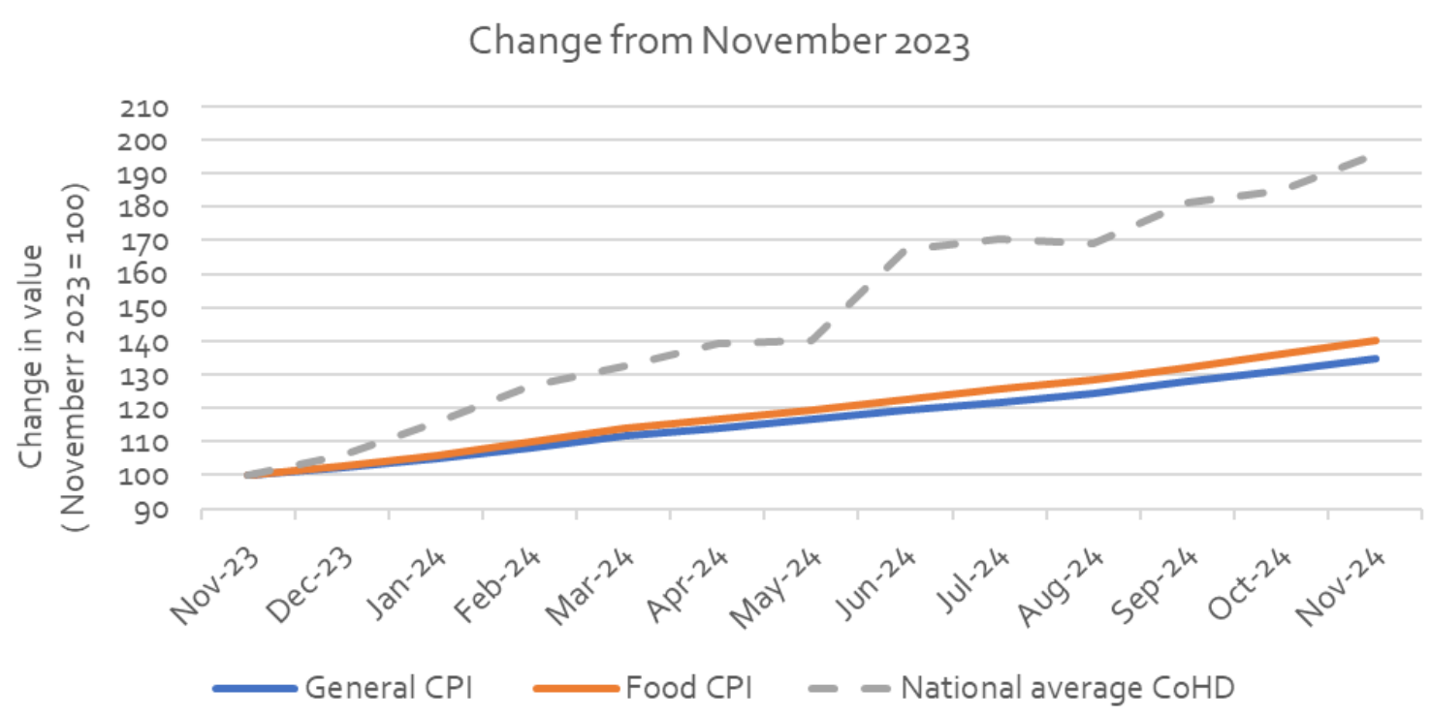
Nigeria now publishes a monthly bulletin showing local variation in least-cost locally available healthy diets
Food group in the Healthy Diet Basket | Food name and frequency included as least-cost item
Starchy staples | Millet (whole grain) | 25%
 | Garri (white) | 14%
 | Cassava flour (loose) | 12%
Oils | Palm oil | 80%
 | Margarine | 12%
 | Vegetable oil | 4%
Fruits | Coconut | 43%
 | Date palm fruit | 30%
 | Avocado pear | 22%
Vegetables | Bitter leaf | 27%
 | Okra (dried) | 27%
 | Kuka (dried) | 18%
Legumes, nuts & seeds | Groundnut (shelled) | 47%
 | Melon seeds | 28%
 | Soya beans | 24%
Animal source foods | Crayfish (small white) | 36%
 | Shrimps (red dried) | 10%
 | Fresh milk (industrial) | 9%
Note: Data shown are for November 2024
Published monthly since January 2024
Figure 4b. CoHD and Consumer Price Indexes in Nigeria, Nov 2023 - Nov 2024
In food crises, prices of the
least-cost items in each food group may rise faster than other items
Source: National Bureau of Statistics, Cost of a Healthy Diet Monthly Bulletin. Abuja: https://microdata.nigerianstat.gov.ng/index.php/catalog/146

Slide 14
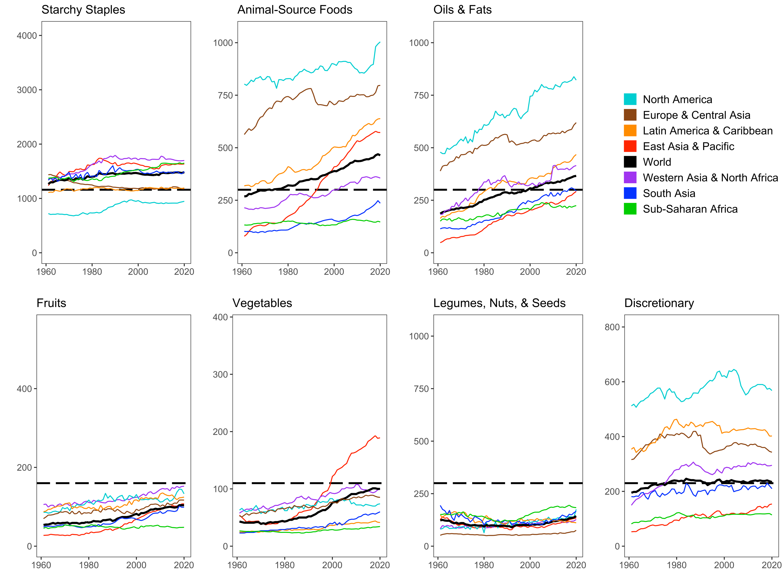
Globally, actual food use is far from Healthy Diet Basket targets in ways that differ by region and over time
North America has highest use of animal foods, oils & fats, and sugar
Africa has low use of all food groups
that are relatively costly per calorie
Source: Leah Costlow, doctoral dissertation in progress, Friedman School of Nutrition, Tufts University.
Data shown are from FAO Food Balance Sheet data, for total daily kilocalories available per capita in each region aggregated by HDB food group.
Reproduced in Masters & Finaret (2024), Food Economics: Agriculture, Nutrition and Health. Palgrave MacMillan, open access at https://link.springer.com/book/9783031538391.

Slide 15
Conclusion:
Matching prices to food attributes and dietary guidelines reveals how to bring healthy, sustainable diets within reach
For about 2.8 b. people (35% of the world), healthy diets remain unaffordable
  Nutrient-rich foods are more costly to grow and ship than starchy staples, vegetable oil & sugar
  At times and places where prices are unusually high, supply improvements can lower cost
  Most unaffordability is due to low incomes, so healthier diets requires higher income or safety nets
Even if healthy diets are affordable, they may be displaced by less healthy items
  Many factors beyond health drive food choice, as people transition from inadequacy to excess
    overshooting on animal-source foods, sweeteners and oils, even for home-cooked meals
    switching to food service and packaged items, leading to excess salt, refined grains etc.
  Frontiers for future work include time use and cost of meal preparation, role of nonfood factors
Identifying least-cost items and diet costs helps guide intervention
  Improvements in agriculture & food distribution to lower diet costs
  Improvements in livelihoods & social protection to raise incomes available for food
  Improvements in food choice to limit displacement by more expensive and less healthy items
  Within food groups, lower-priced items generally have less environmental cost
    …but healthiness is not visible and often misleading, making food choice difficult

Slide 16




https://sites.tufts.edu/foodpricesfornutrition
Thank you!
We are grateful to many price data collectors, analysts and project collaborators,
and to the Bill & Melinda Gates Foundation and the UKAid government for funding
…and there’s more:
Open-access textbook at https://bit.ly/FoodEconBook
Global monitoring is done jointly by the FAO and the World Bank, with the most recent data updated on December 20th, 2024

Slide 17
Other slides

Slide 18
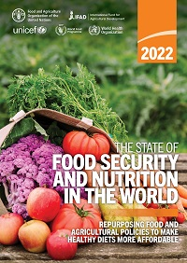
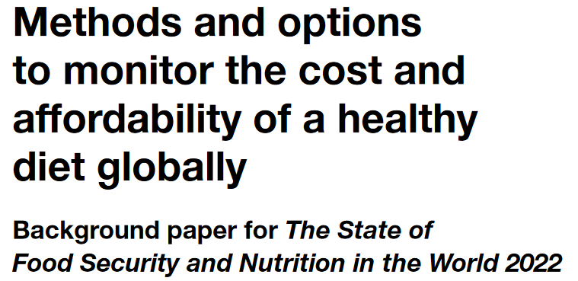
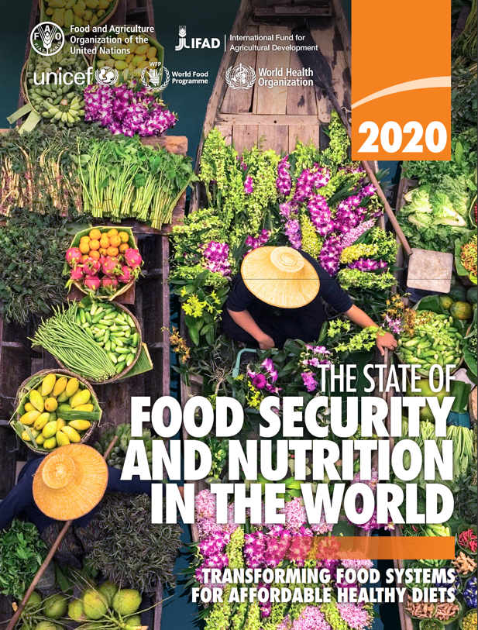
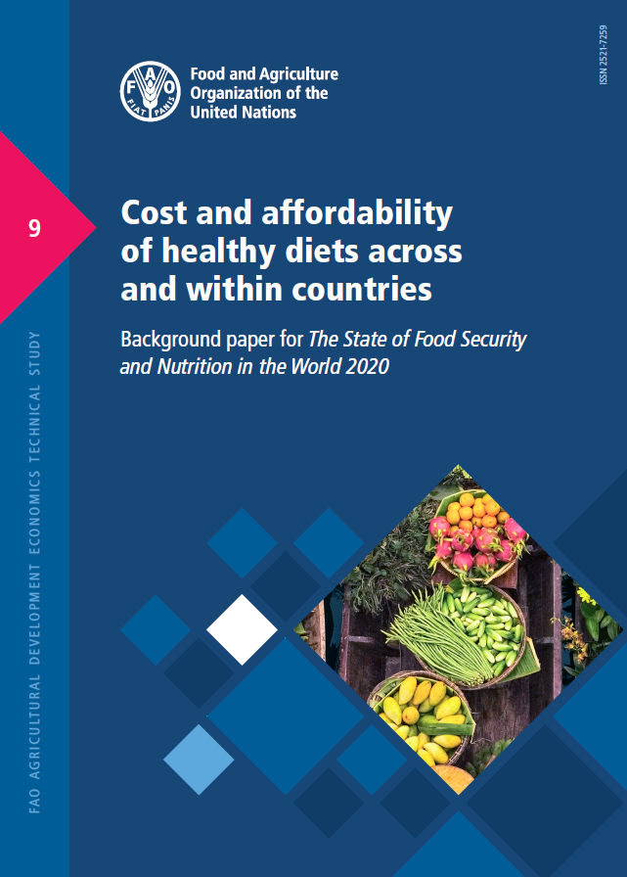
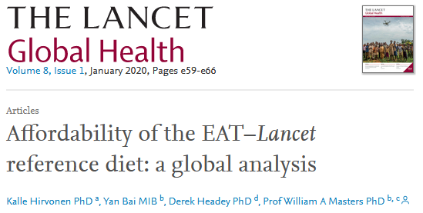
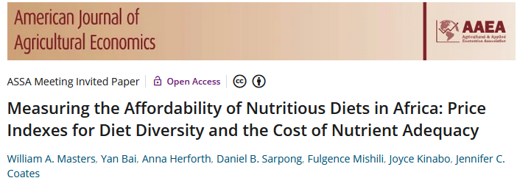

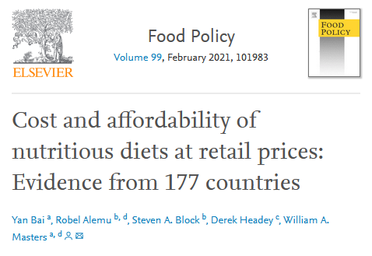
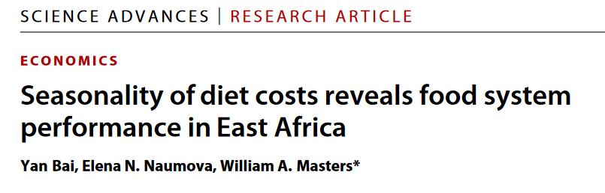
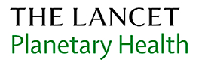
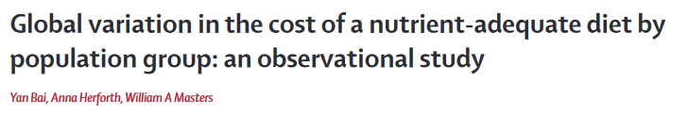
Diet costs use local availability and price data,
matched to food composition and health needs
We find a ladder of diet costs, from the cheapest energy source to higher-priced foods
…so we can now compare low-cost healthy diet benchmarks to actual food choice
SOFI 2024 updated the price data to items observed in 2021, and
updated the income data & method to compute unaffordability
SOFI 2022 introduced the Cost of a Healthy Diet (CoHD) based on the
“Healthy Diet Basket” of each country’s 11 least-cost items in 6 food groups
 |  |  | Food preferences, convenience and other goals (including food security, diet diversity, sustainability, equity and inclusion)
 | Caloric adequacy (short-term subsistence)
SOFI 2020 used 10 national guidelines
for the Cost of Recommended Diets (CoRD)
 |  |  | Healthy diets Meets national dietary guidelines by food group
 |  | Nutrient adequacy Avoids deficiency or excess of essential macro- and micronutrients
 | Daily energy Meets only calorie needs, for short-term survival and physical work
Our 2018 journal article introduced a Cost of Diet Diversity (CoDD) metric
and we have many other studies analyzing other aspects of diet costs
Global ave. in 2021 = $3.56/day
Global average in 2021 = $2.45/day
Global average in 2021 = $0.93/day
Source: Food Prices for Nutrition (2023). https://sites.tufts.edu/foodpricesfornutrition

Slide 19
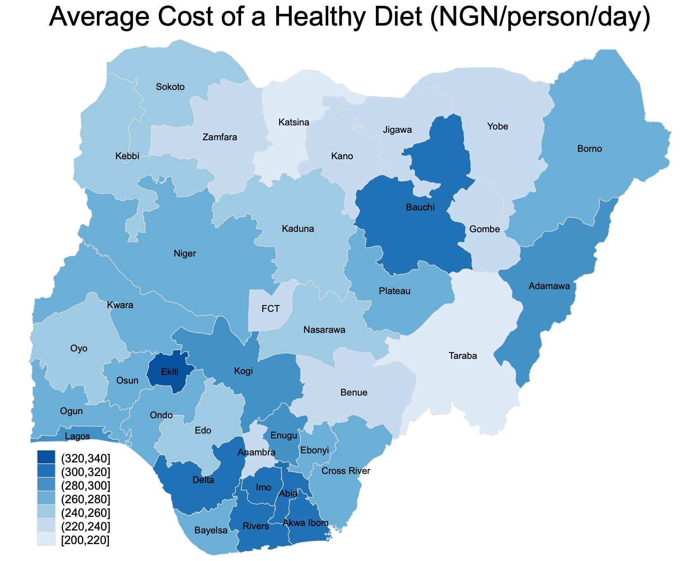
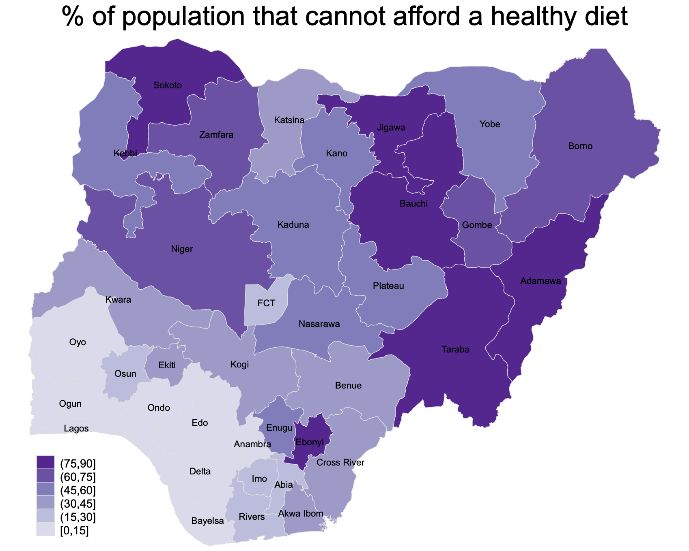
Nigeria’s data reveals how affordability depends on
both prices for low-cost items, and income available for food
Cost of a healthy diet and prevalence of unaffordability in Nigeria, 2018-19
Costs are highest
in these oil-rich states
…but incomes there are also high,
so there is less unaffordability
Source: Food Prices for Nutrition project analysis of Nigerian NBS data for diet costs and household incomes, using 2018-19 National Living Standards Survey

