Slide 1
Choosing a Statistical Software
Kyle M Monahan
Senior Data Science Specialist
Tufts Technology Services
TNDS 2021
Notes:
Some original content by Uku, Data Science Specialist, Tufts University

Slide 2
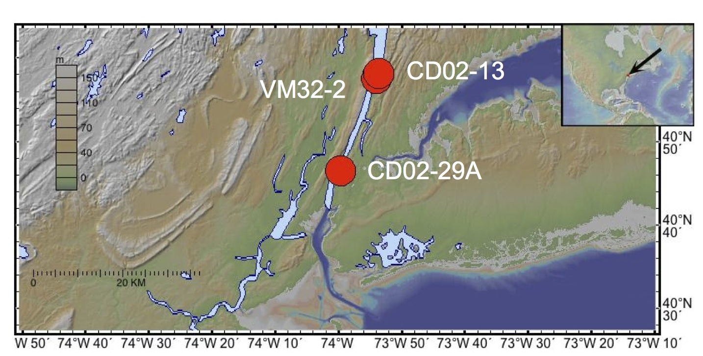
Who am I?
Originally from Albany, NY
Started in environmental health
Sr. Data Science Specialist
Support students, staff and faculty
Perpetually caffeinated

Slide 3
Welcome!

Slide 4
All slides, code, recording: https://tufts.box.com/v/TNDSComparingStatsPrograms

Slide 5
Your background…

Slide 6
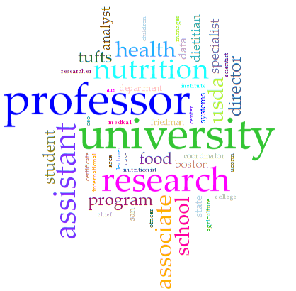
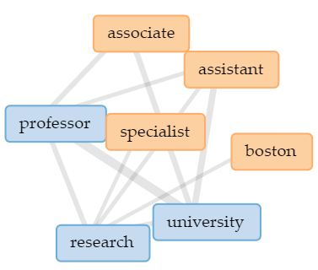
Who is attending?

Slide 8
Our goals

Slide 9
Presentation Goals
Discuss common professional roles
Provide an overview of the statistical language R
Compare R to other statistical programs (SAS, SPSS, etc.)
Learn about what you can do with R and other programs
Walk through all interfaces together
Selecting which software(s) to use
Learn about resources beyond Tufts and troubleshooting

Slide 10
Learning Objectives
Differentiate between data roles: analyst, scientist, engineer.
Understand the strengths of R versus SAS, SPSS, etc.
Learn when to use specific languages and statistical programs, based on key benefits.
Be "comfortable in the confusion" in selecting software and know how to compare them.
Learn how to further develop these skills on your own.

Slide 11
Professional roles

Slide 12
Data roles
Notes:
Source: https://elu.nl/careers-in-data-science-data-analyst-vs-data-engineer-vs-data-scientist/

Slide 13
Data roles – Data science
Can be statisticians, depending on company/role
Requires skills in math, programming, communication of results, and sometimes subject knowledge.
Common languages: R, Python, SQL
Role can vary depending on organization and size of team
Notes:
Source: https://elu.nl/careers-in-data-science-data-analyst-vs-data-engineer-vs-data-scientist/

Slide 14
Data science – tasks
79% of time organizing data (Forbes, 2016)
Notes:
https://www.forbes.com/sites/gilpress/2016/03/23/data-preparation-most-time-consuming-least-enjoyable-data-science-task-survey-says/?sh=197004276f63

Slide 15
Research roles
Titles can vary by project scope:
Data cleaning and analysis: Data analyst, research assistant, internship
Communication: Data analyst, web developer, public relations specialist
Takeaway: Think about the tasks and roles, and remember to leave time for data cleaning!
Notes:
Source: https://elu.nl/careers-in-data-science-data-analyst-vs-data-engineer-vs-data-scientist/

Slide 16
What is R?

Slide 17
What is R?
Fully-featured statistical analysis software
But also…
Turing-complete programming language
Runtime environment
Resembles Stata, SPSS, SAS … and Python

Slide 18
How did R come to be?
Written by Ross Ihaka and Robert Gentleman in 1996
Department of Statistics, University of Auckland (New Zealand)
Developed to blend the benefits of the Schema statistical platform with the easy to read S language
Became popular in statistical literature
Notes:
Ihaka R. & Gentleman R. 1996. R: a language for data analysis and graphics. Journal of Computational and Graphical Statistics 5: 299–314.

Slide 19
Why use R?
It is free for you and everyone!
Share code with anyone, anywhere, cross-platform
R is good at multicore task distribution – for free
Community designed packages are easy to access
We focus on R in these slides as you are free to download and use it

Slide 20
What does R consist of?
R – the programming language
RStudio – the IDE
Integrated Development Environment
This is where you write the code!
RShiny – interactive web development in R
Will not be covered in this workshop

Slide 21
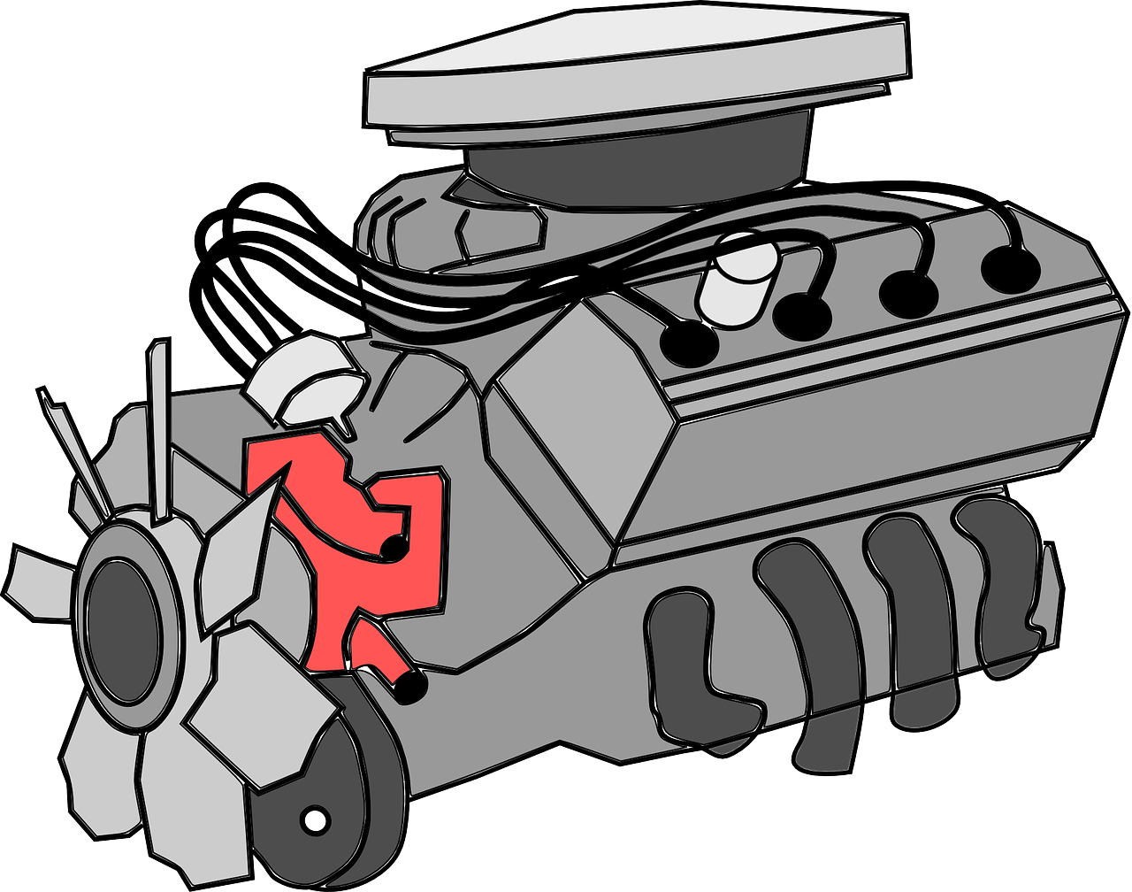
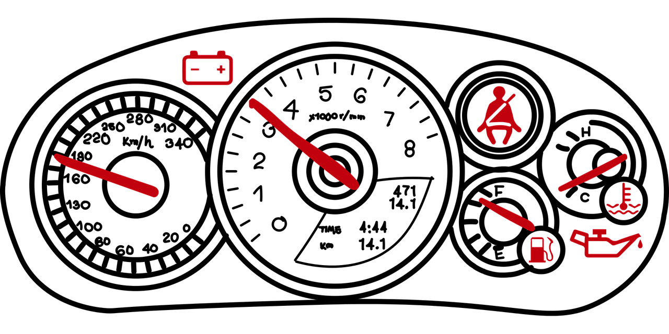
R
RStudio
Notes:
https://pixabay.com/images/download/pedometer-2830155_1280.png
https://storage.needpix.com/rsynced_images/engine-160230_1280.png

Slide 22
Let’s open R

Slide 23
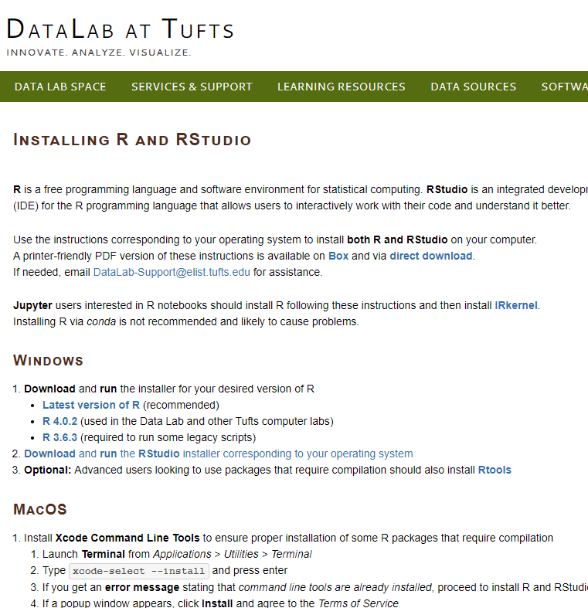
Getting started with R
Must install both R and RStudio
Instructions at:
go.tufts.edu/InstallingR

Slide 24
Comparing R with...

Slide 25
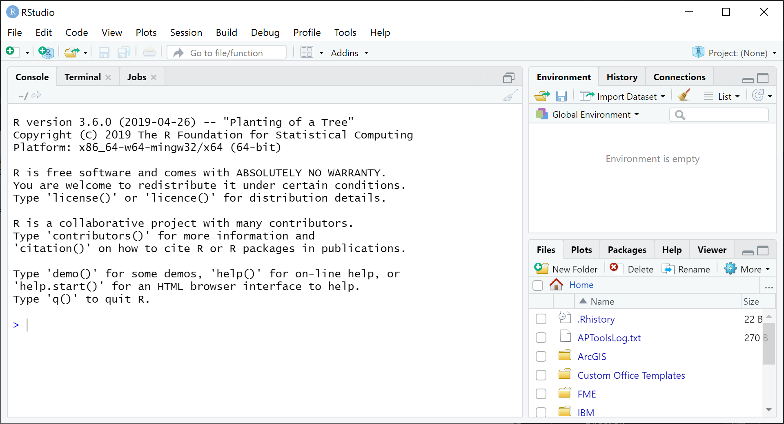
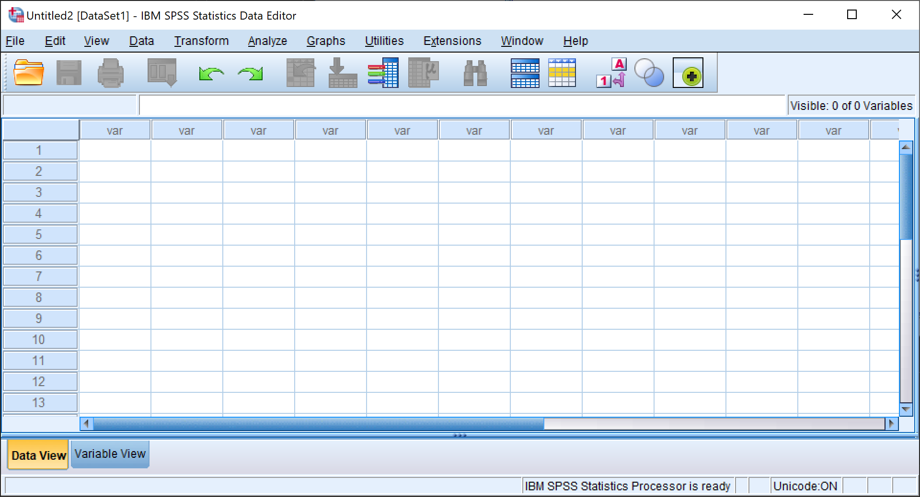
R vs SPSS

Slide 26
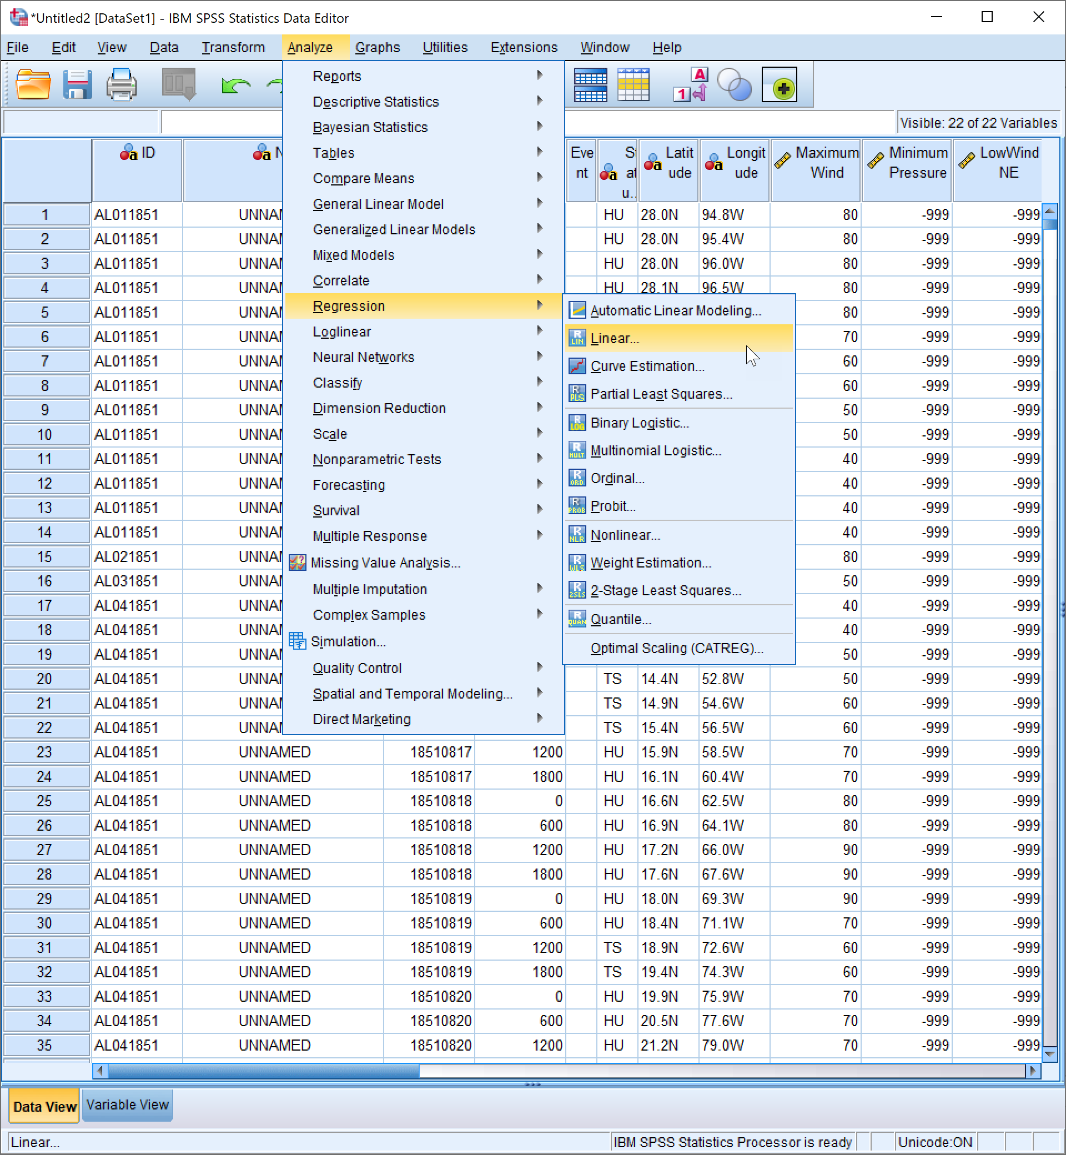
R vs SPSS
SPSS resembles Excel
Rows and Columns
Initial exploration easier
Pull down menus
Social science tools
Data manipulation and cleaning more difficult in SPSS

Slide 27
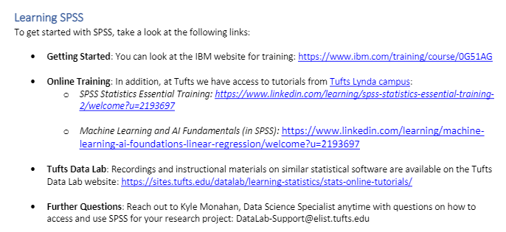
Learning SPSS
https://tufts.box.com/v/GettingStartedWithSPSS

Slide 28
Let’s open SPSS

Slide 29
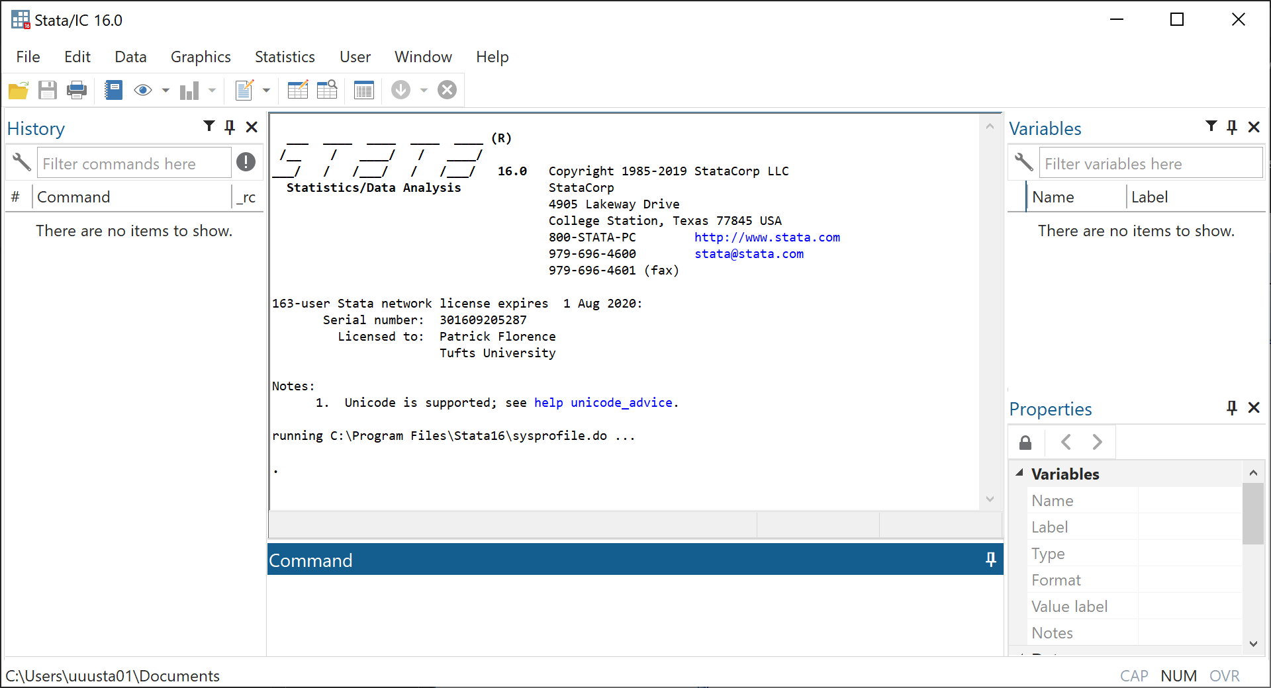
R vs Stata

Slide 30
R vs Stata
Similar design, different focus
Has scripts and a language
Less intuitive for programmers
Harder to control advanced tasks
Easier to start out with
Explore menus and resulting code
Notes:
Developed by StataCorp, LLC
Focus on ease of use for statistical methods
Advanced tasks require high level of programming

Slide 31
Learning Stata
https://tufts.box.com/v/UsingInstallingStata
Notes:
Developed by StataCorp, LLC
Focus on ease of use for statistical methods
Advanced tasks require high level of programming

Slide 32
Let’s open Stata

Slide 33
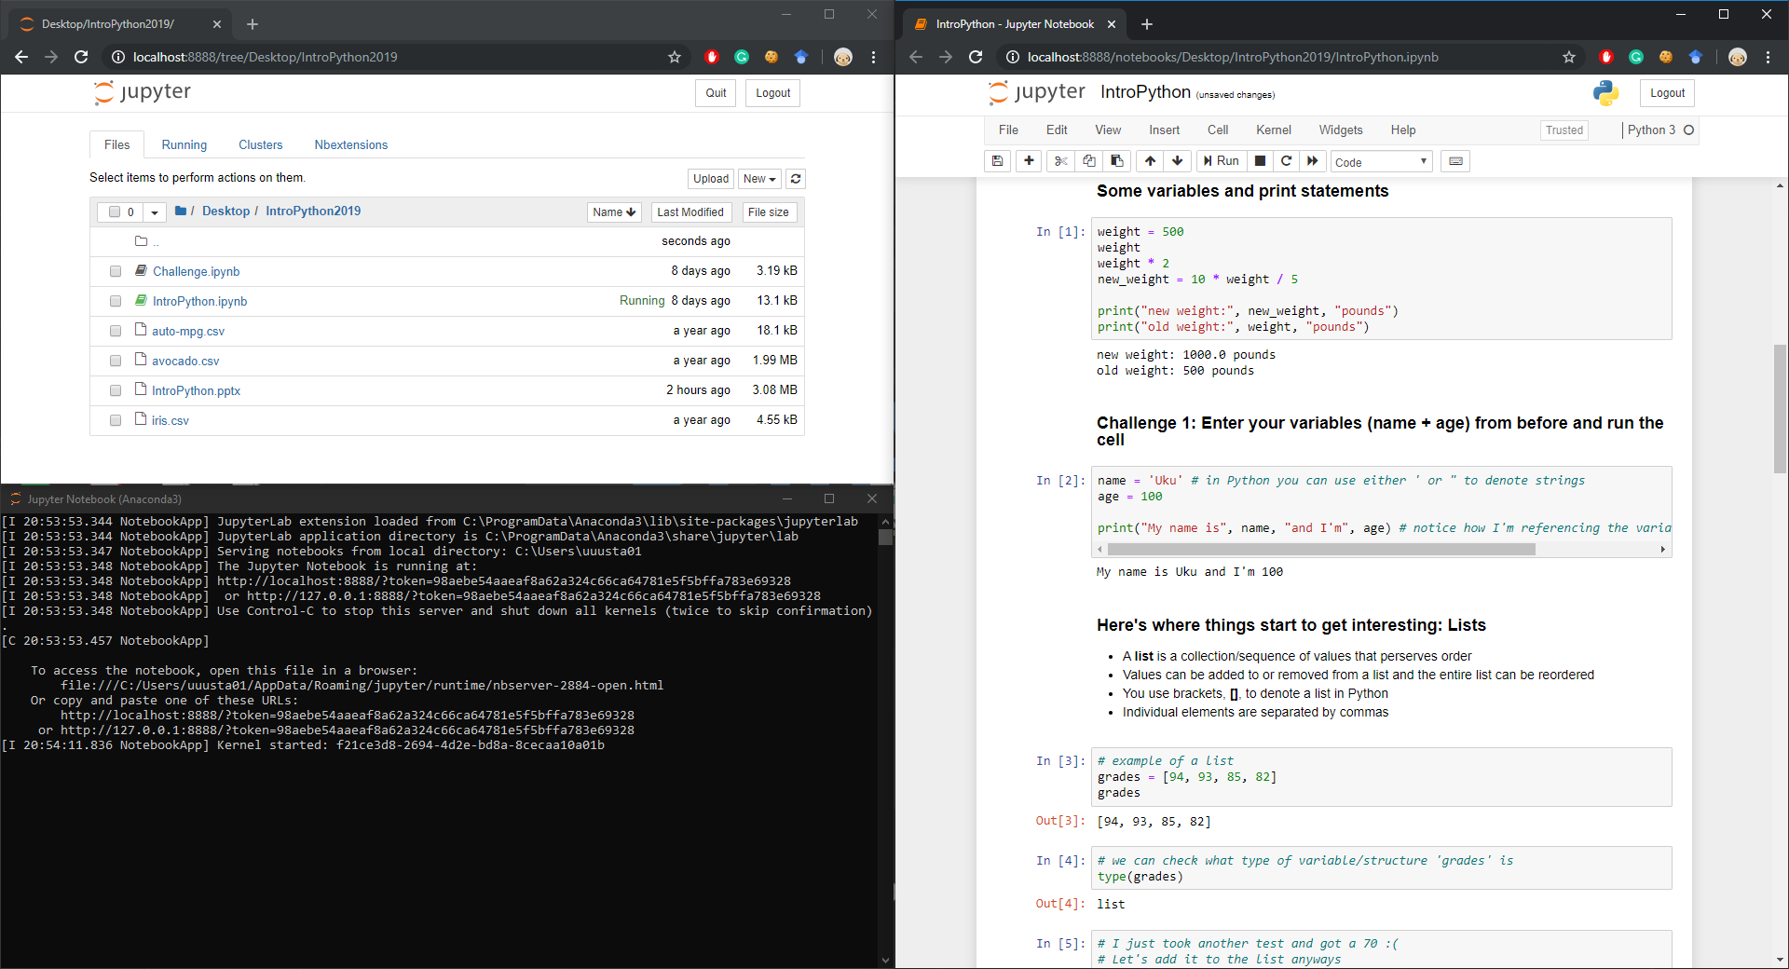
R vs Python

Slide 34
R vs Python
Easy to transition between
R better for simple analysis and data cleaning
Python better for advanced analysis and machine learning
…but do not forget RShiny!

Slide 35
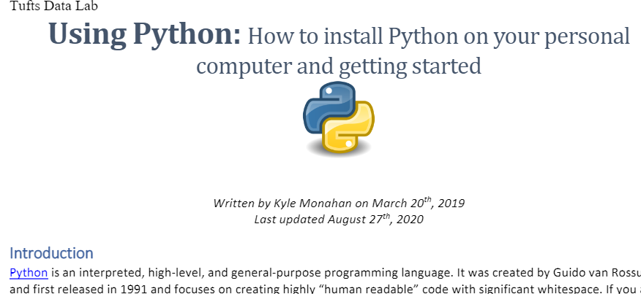
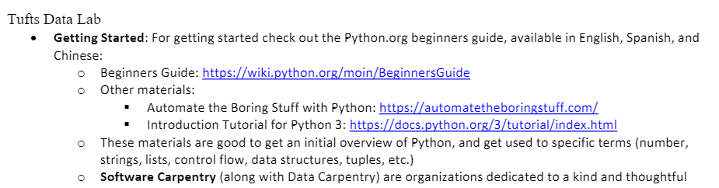
Learning Python
https://tufts.box.com/v/UsingInstallingPython

Slide 36
Let’s open Python (Anaconda)

Slide 37
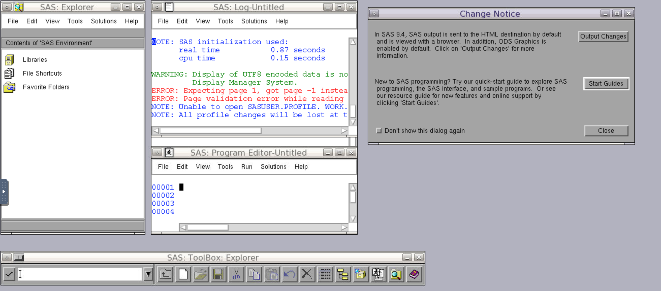
R vs SAS

Slide 38
R vs SAS
Easy to transition between
SAS is better if you already have a SAS script
E.g. International Classification of Diseases (ICD 10) codes
E.g. 2 NHANES
But this is changing!

Slide 39
Learning SAS
https://tufts.box.com/v/InstallingSAS

Slide 40
Let’s open SAS

Slide 41
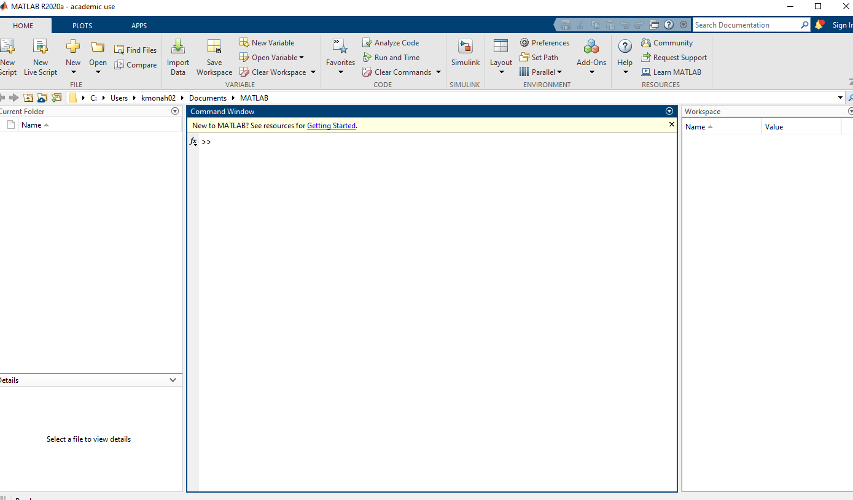
R vs MATLAB
Both great at complex analyses
MATLAB is excellent at signal processing and electrical engineering workflows.
ML is possible in MATLAB

Slide 42
Learning MATLAB
https://tufts.box.com/v/UsingInstallingMATLAB

Slide 43
Let’s open MATLAB

Slide 44
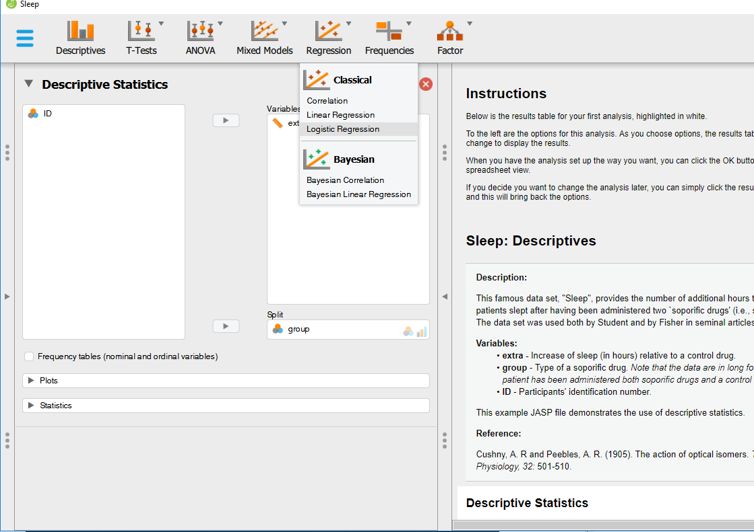
R vs JASP
Both are open source
JASP has frequentist and Bayesian approaches
JASP is better for those just getting started, as it provides guidance and examples.

Slide 45
Let’s open JASP

Slide 46
Choosing a statistical software
What does my advisor/company/supervisor/funding organization use?
What is the best tool for the grant/proposal/research question/business logic?
For students – what is in demand on LinkedIn Jobs for my future job titles?
Review these slides and try them out – you can always switch!
Also see our comparative list…

Slide 47
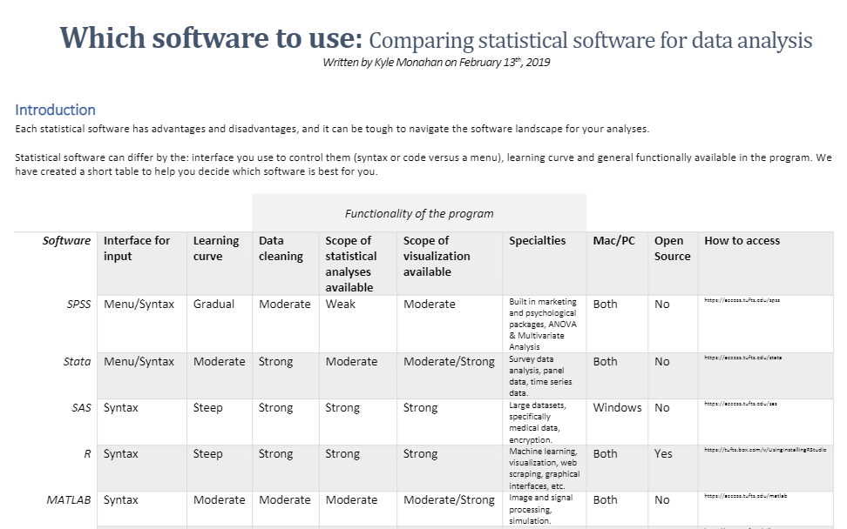
Choosing a statistical software
https://tufts.box.com/v/WhichStatisticalSoftwareToUse
Notes:
https://tufts.box.com/v/WhichStatisticalSoftwareToUse

Slide 48
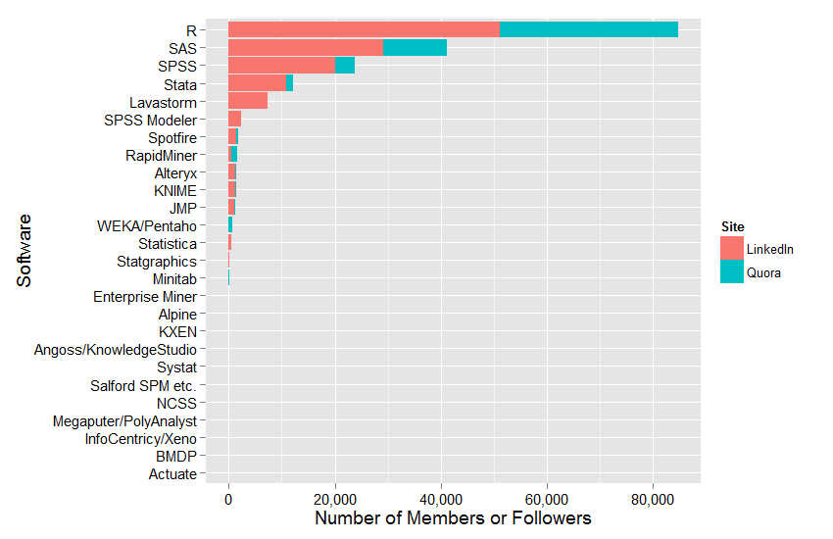
R
vs
The
World
Notes:
2015

Slide 49
Who uses R?

Slide 50
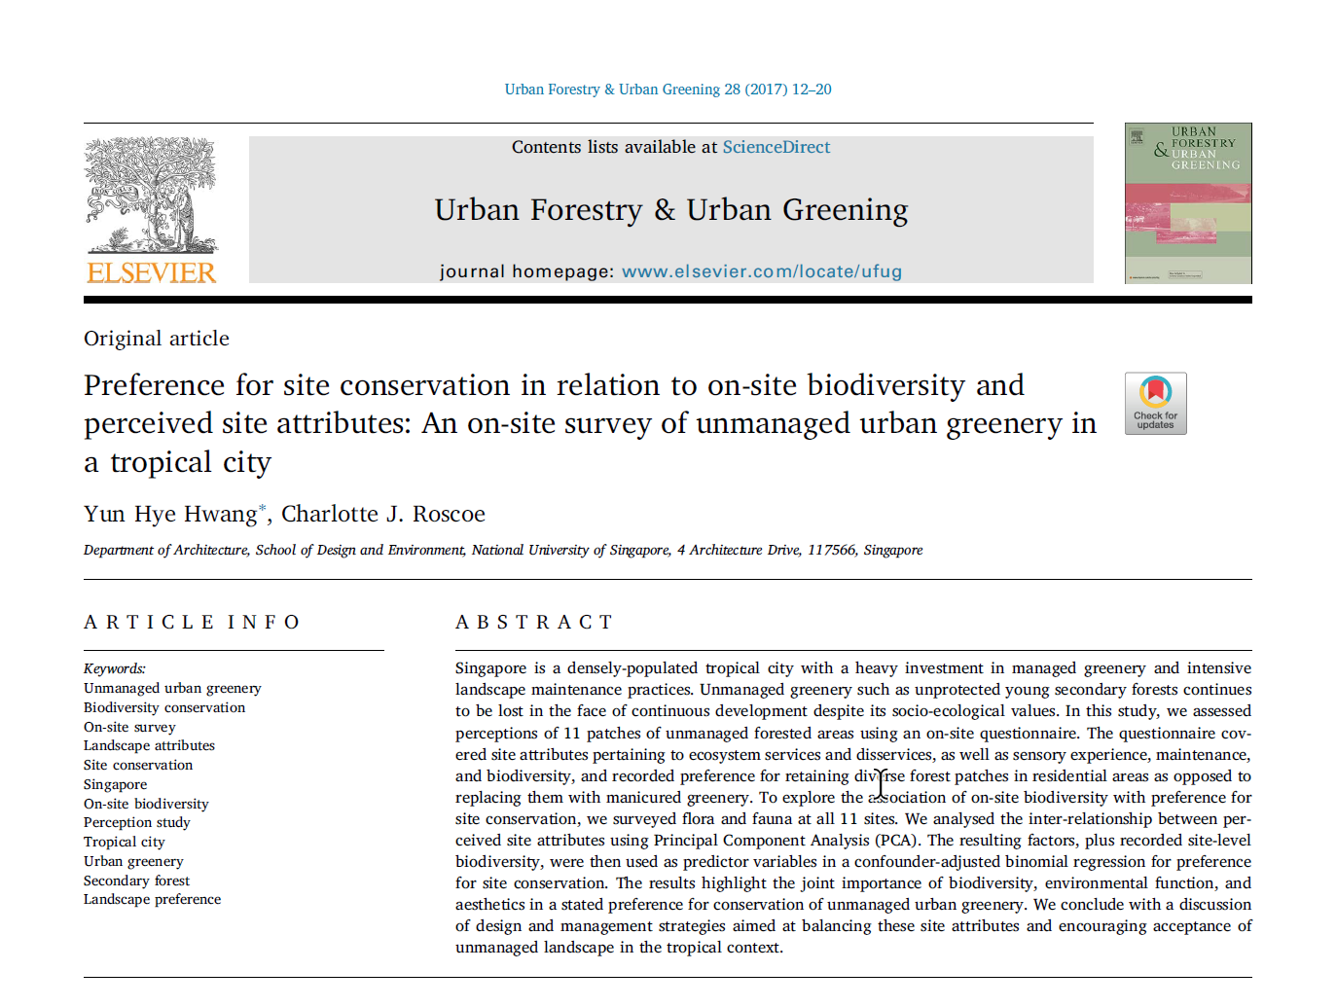
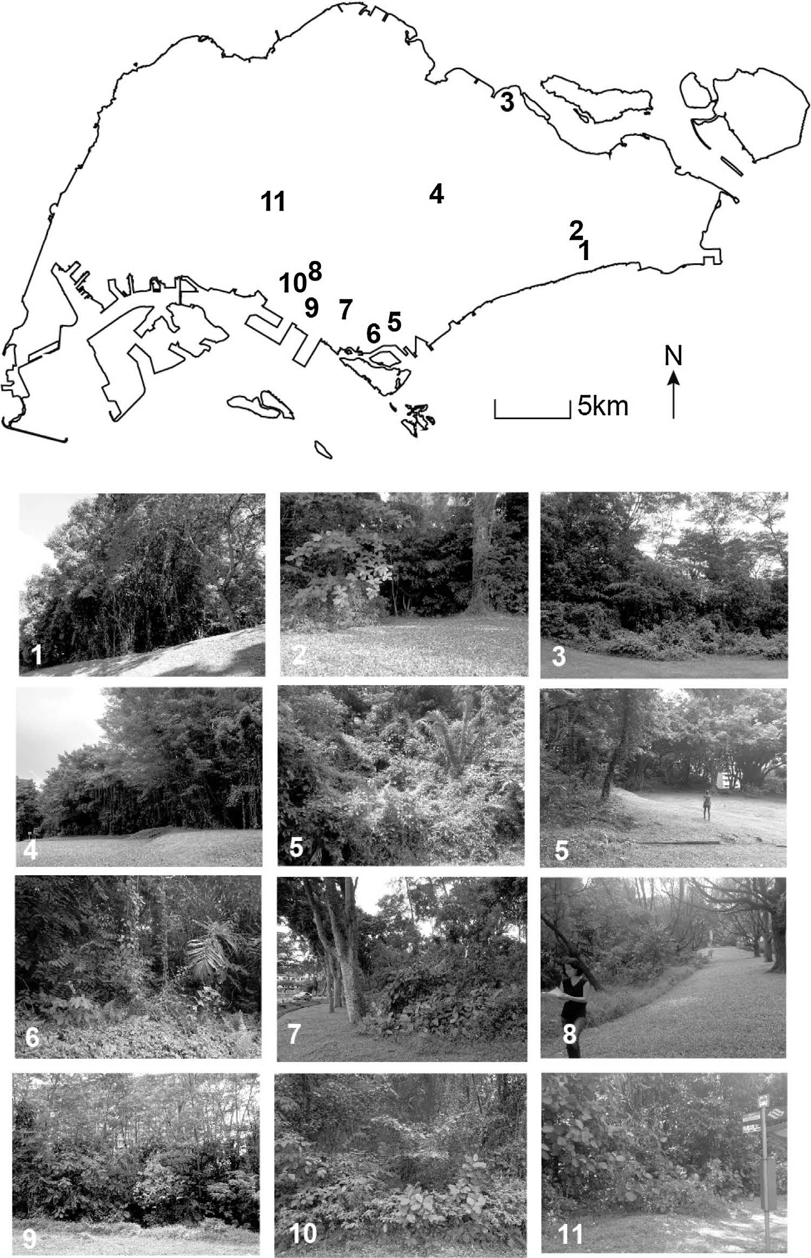
Notes:
Unmanaged urban greenery in Singapore
Explore association of on-site biodiversity with preference of site conversation
Principal Component Analysis (PCA)
Hwang, Yun Hye, and Charlotte J. Roscoe. "Preference for site conservation in relation to on-site biodiversity and perceived site attributes: an on-site study of unmanaged urban greenery in a tropical city." Urban Forestry & Urban Greening (2017). https://www.sciencedirect.com/science/article/pii/S1618866717304260

Slide 51
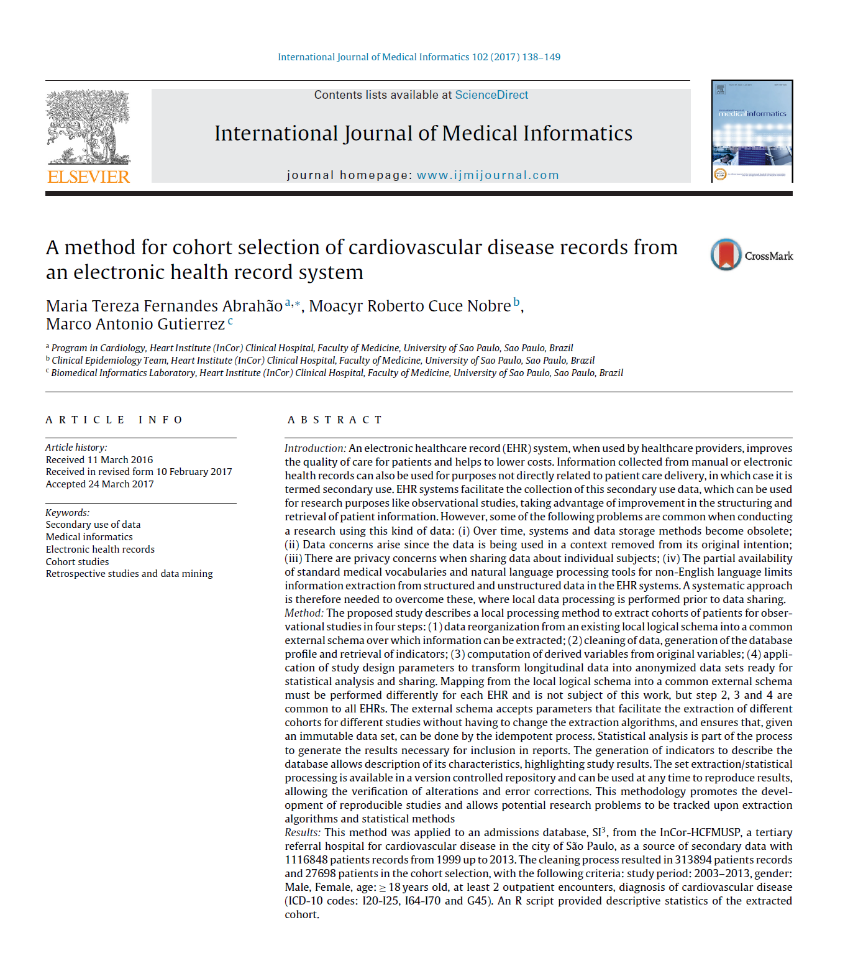
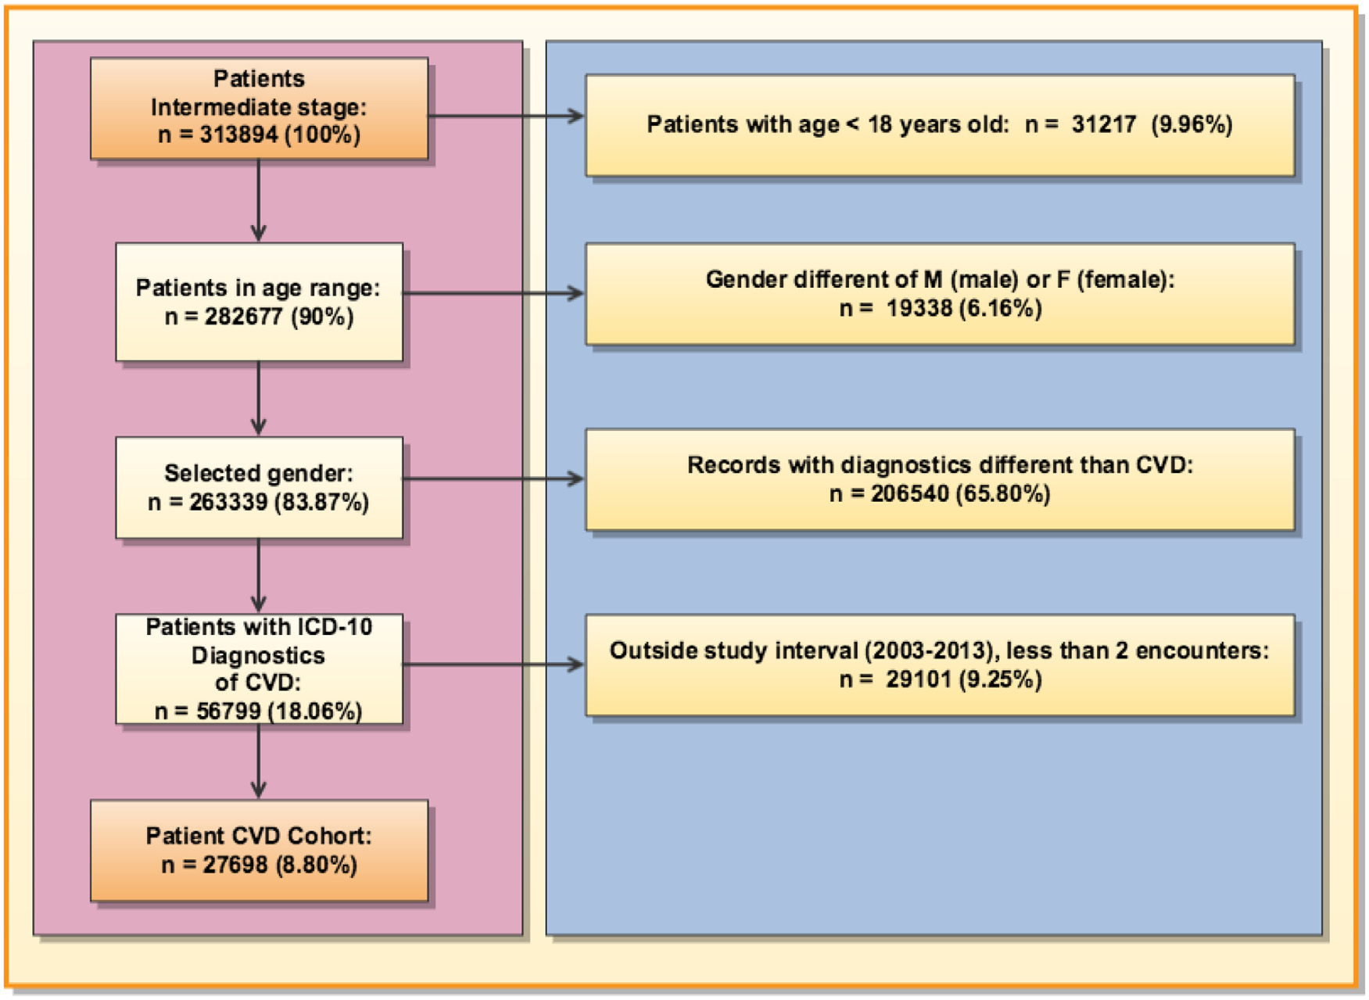
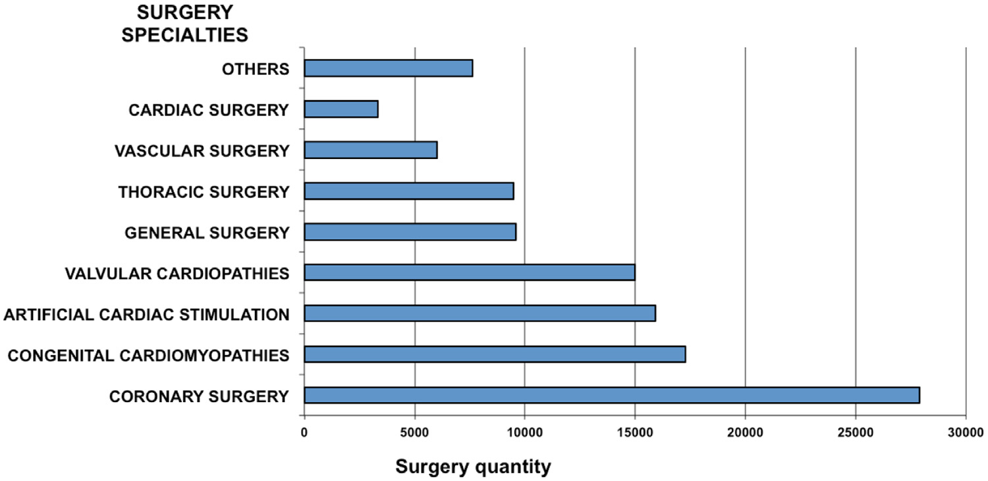
Notes:
Method for cohort selection from electronic health records (HER) systems
Reorganize data into a common schema
Clean data, generate database profile, retrieve indicators
Compute derived variables from original
Transform longitudinal data into anonymized data sets
Allow for sharing and reproducible statistical analysis
Abrahão, Maria Tereza Fernandes, Moacyr Roberto Cuce Nobre, and Marco Antonio Gutierrez. "A method for cohort selection of cardiovascular disease records from an electronic health record system." International Journal of Medical Informatics 102 (2017): 138-149. https://www.sciencedirect.com/science/article/pii/S138650561730076X

Slide 52
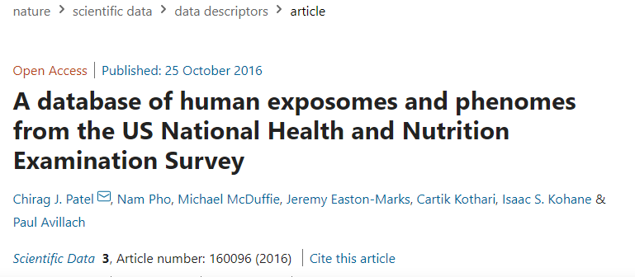
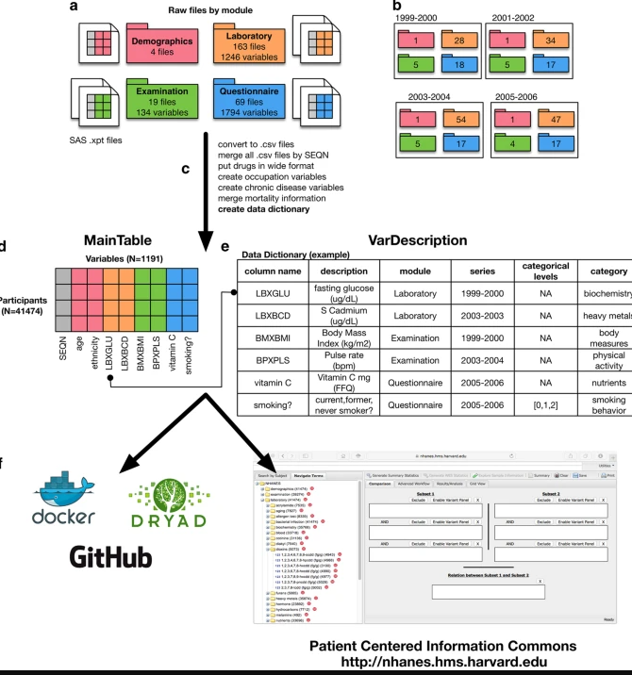
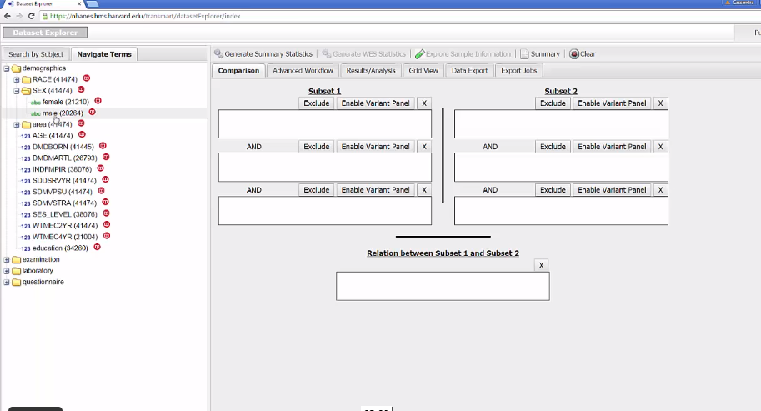
Notes:
Patel, Chirag J., et al. "A database of human exposomes and phenomes from the US National Health and Nutrition Examination Survey." Scientific data 3.1 (2016): 1-10.

Slide 53
You!

Slide 54
But how?

Slide 55
Where is R at Tufts?
Medford campus:
Data Lab
Eaton Lab
Mark Lab
Mugar Lab
EPDC
Boston campus:
Data Lab
Hirsch Library
Jaharis Student Lounge

Slide 56
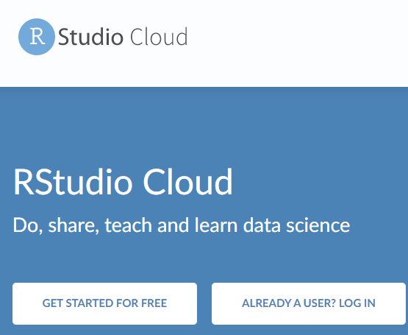
Where is R beyond Tufts?
You can download the program for Windows and Mac!
Also, for Chromebooks or mobile: Rstudio Cloud

Slide 57
Installing R/RStudio
Instructions: tufts.box.com/v/UsingInstallingRStudio
Also contains links to various learning resources!
MacOS users must also install XCode Command Line Tools

Slide 58
Time check

Slide 59
Also, remote computing

Slide 60
vdi.it.tufts.edu

Slide 61
The Cluster

Slide 62
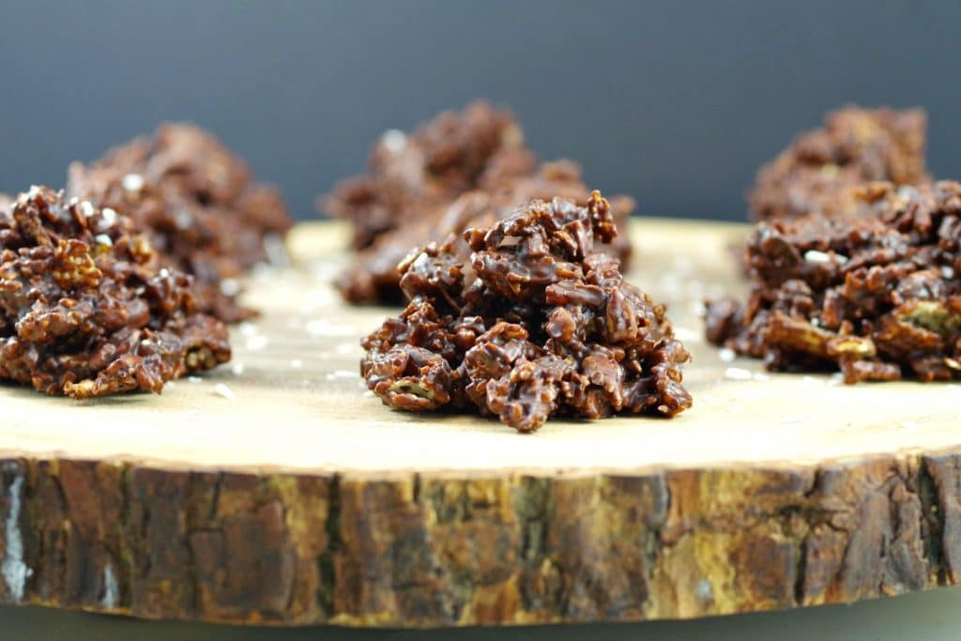
Not this
Notes:
Image source: https://foodmeanderings.com/wp-content/uploads/2019/03/Chocolate-Clusters-healthy-recipe-1024x683.jpg

Slide 63
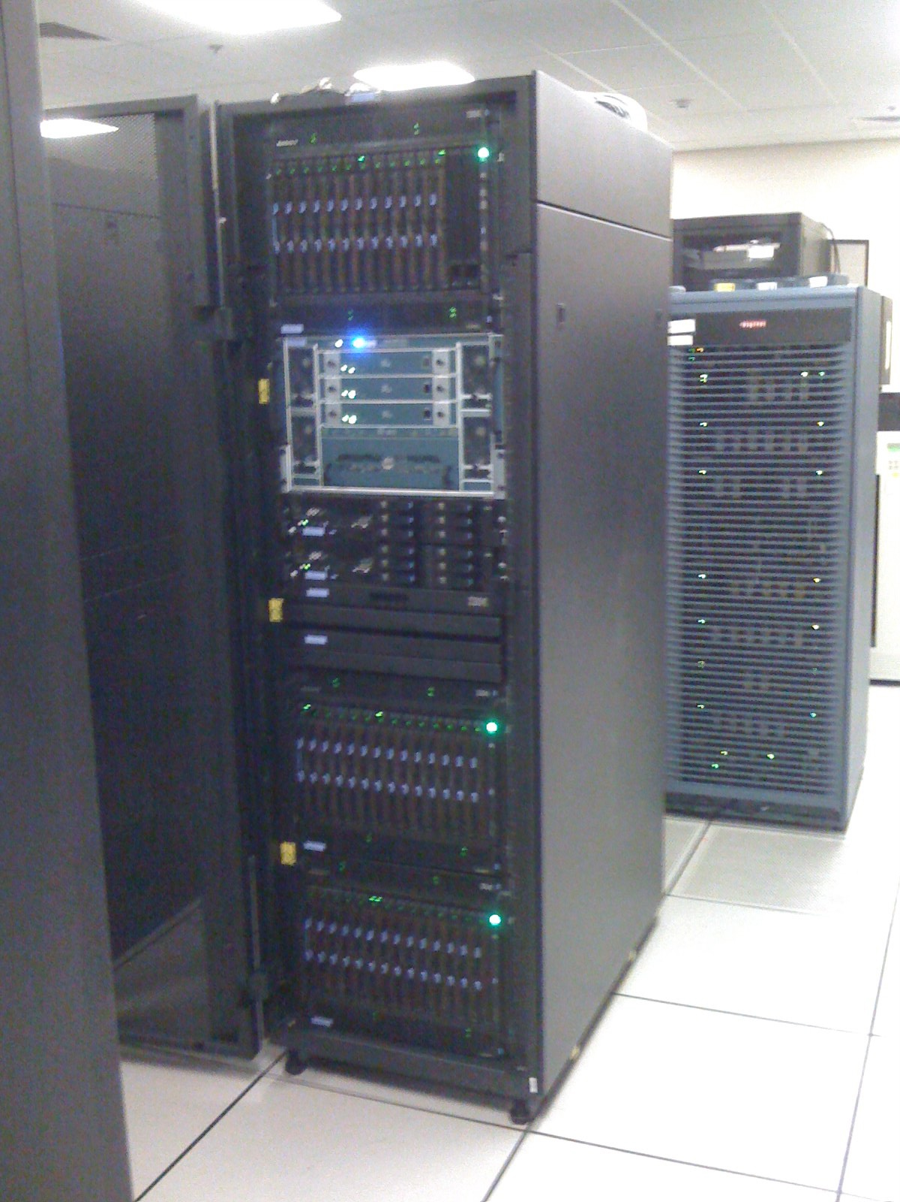
The HPC Cluster

Slide 64
Tufts HPC

Slide 66
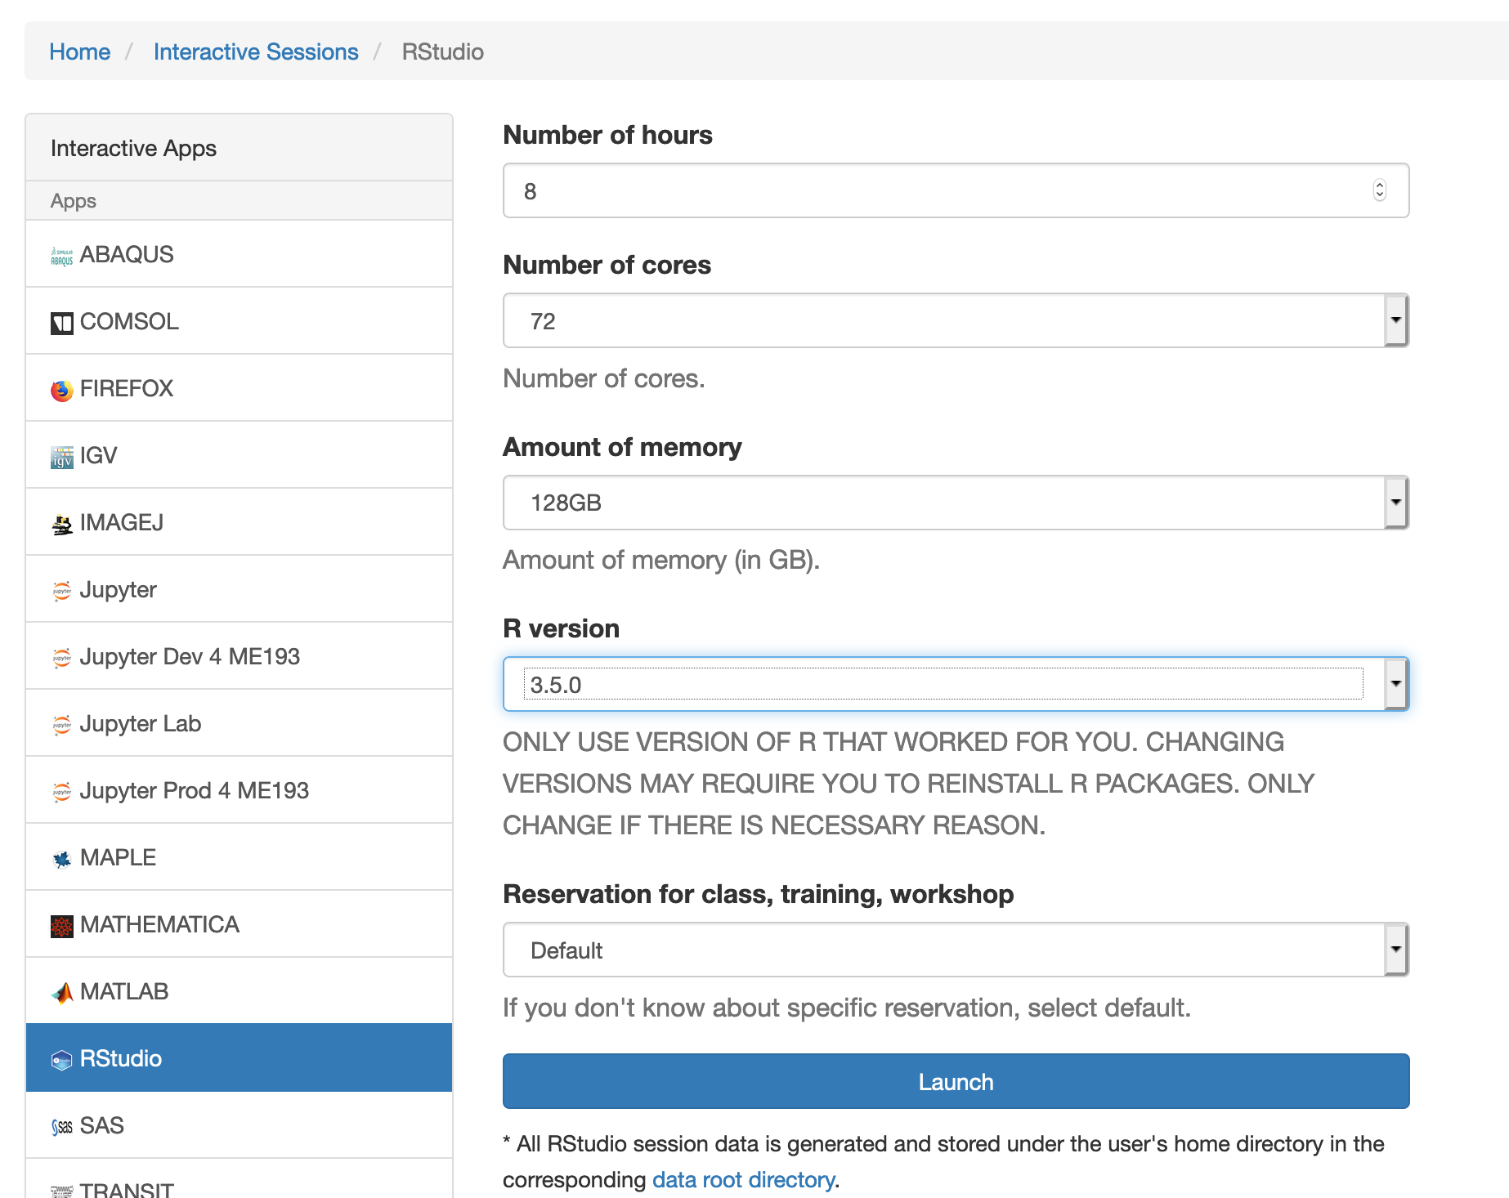

Slide 67
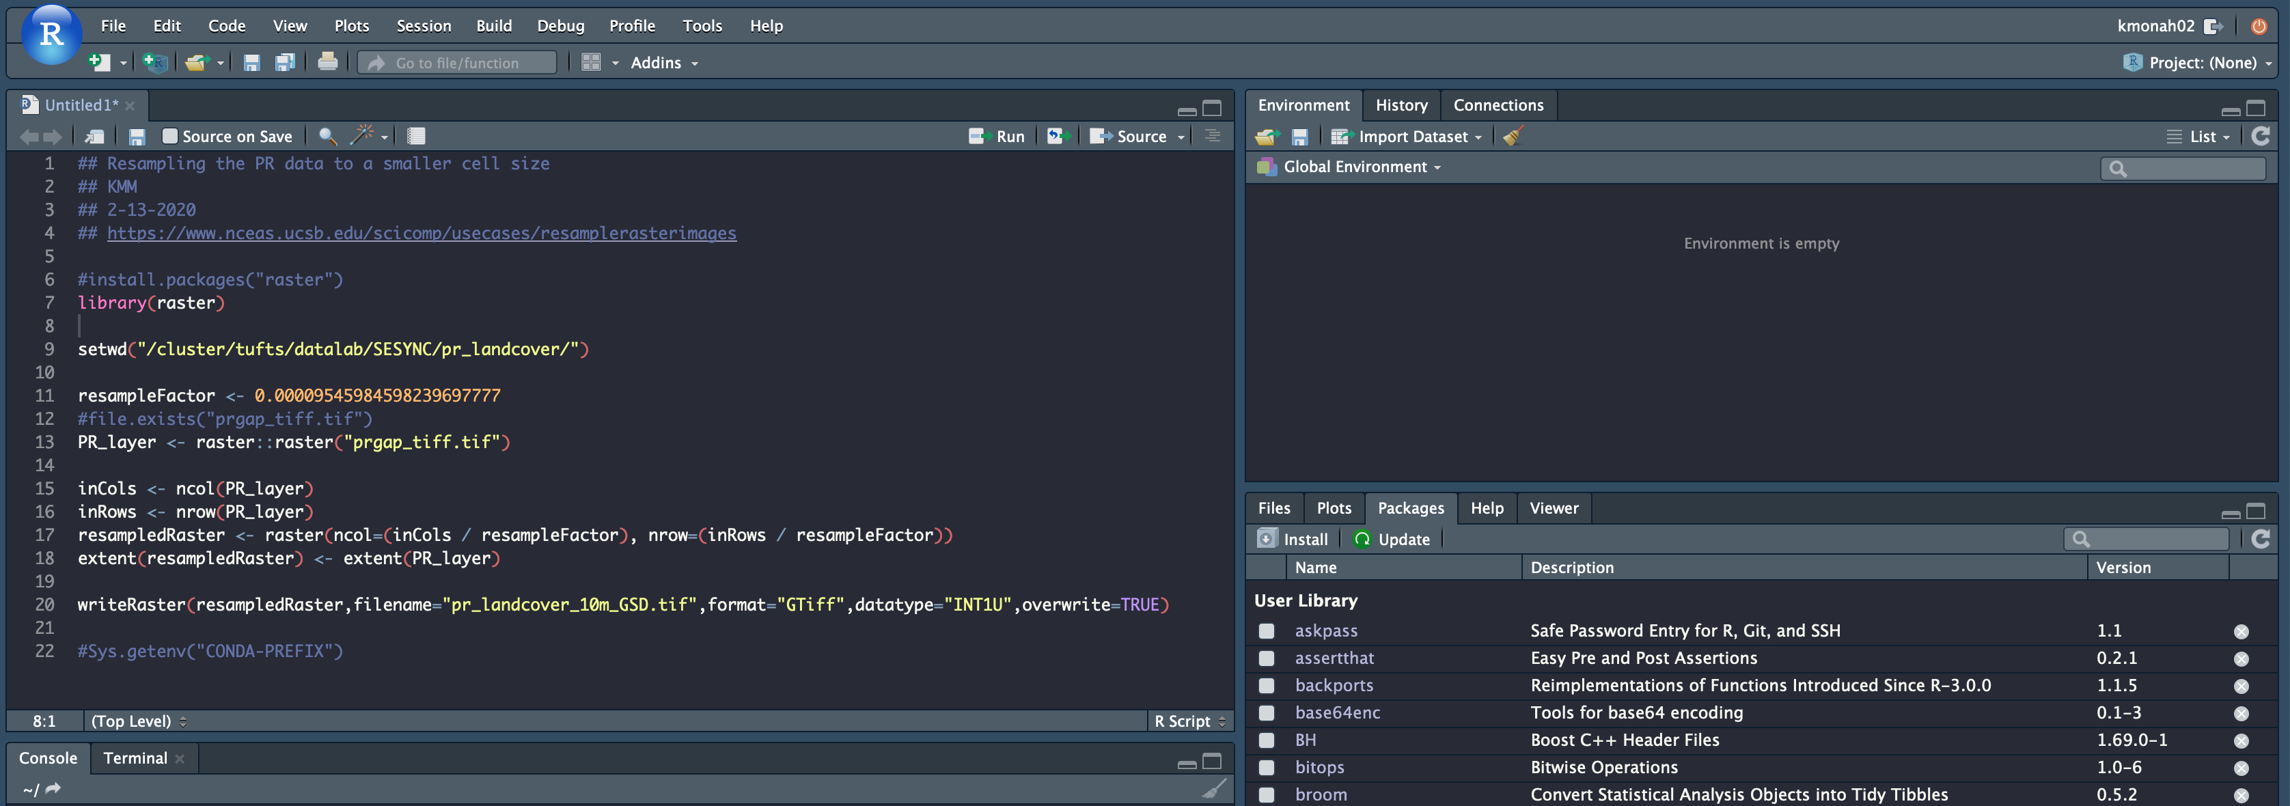
Why? When you wait for weeks to get results …

Slide 68
Your organization may have a cluster

Slide 69
If not, there’s always AWS

Slide 70
How to learn R?
This workshop!
Next steps:
Getting started: Quick-R
Analysis: Getting Help with R on CRAN
Visualization: See The R Graph Gallery for inspiration

Slide 71
Additional Resources
Tutorials and guides: go.tufts.edu/stats
RStudio Support: support.rstudio.com
Detailed introductory guide: An Introduction to R

Slide 72
Scripts & Notebooks
A set of R code is called an R script (.R)
Scripts can be compiled into an R notebook (.Rmd)
Like a journal of statistical analysis
Formatted R snippets of R code and markdown
Can run and re-run code snippet (block) at a time
For research it is recommended to use R Notebooks
We can run Python and R in R Notebooks

Slide 73
Two Scripts in One Notebook?
We will go through R code today
Alongside each set of R code, you’ll find Python code which we will run
As needed, I have sprinkled Stata code, which we can’t run
Use these as reference for the future!

Slide 74
Questions?

Slide 75
But wait! Aren’t we forgetting something?

Slide 76
How to avoid this?

Slide 77
help()

Slide 78
?

Slide 79
rdocumentation.org

Slide 81
Object + Verb + R (+ Error)

Slide 82
We made it!

Slide 83
Any questions?

Slide 84
Other resources

Slide 85
Building your Data Science Resume
Kyle Monahan
Sr. Data Science Specialist
Tufts Technology Services
Link: https://tufts.box.com/v/CreatingYourDataScienceResume
Notes:
Some original content by Kyle Monahan, Senior Data Science Specialist, Tufts University

Slide 86
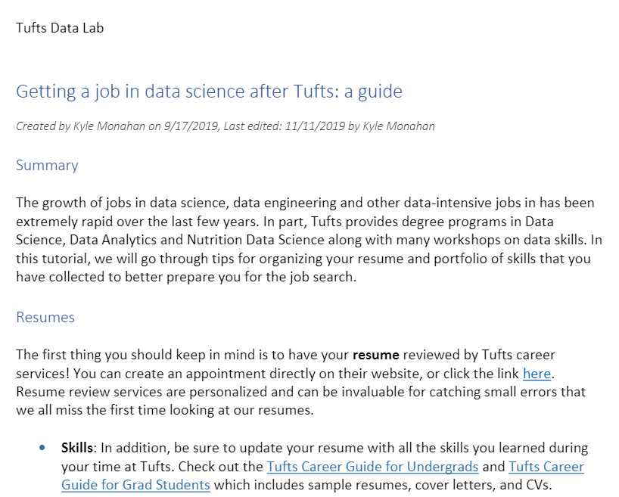
https://tufts.box.com/v/GettingAJobInDataScience
Kyle Monahan
Sr. Data Science Specialist
Tufts Technology Services
Notes:
Some original content by Kyle Monahan, Senior Data Science Specialist, Tufts University

Slide 87
Intermediate Stats in R : From Surveys to Statistics
https://tufts.box.com/v/IntermediateStatsR
Notes:
https://pixabay.com/en/fruit-bowl-fruits-food-fresh-diet-2411828/

Slide 88
go.tufts.edu/StatsWorkshopRecordings
Ten more workshops and recordings, with slides and code.

Slide 89
Questions?
Kyle Monahan
Sr. Data Science Specialist
kyle.monahan@tufts.edu
Thank you!

