Slide 1

Research and Data Symposium for Food and Nutrition
Friedman School of Nutrition Science and Policy
Tufts University
Naglaa H. El-Abbadi, PhD, MPH
TNDS 2021 Workshop: Metrics of diet sustainability

Slide 2
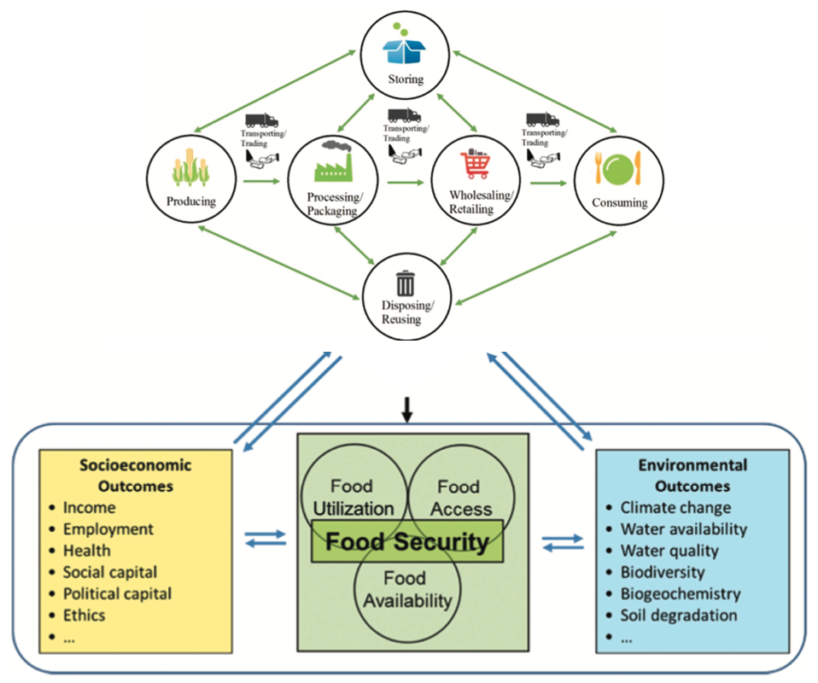
“The notion of a ‘good’ diet is no longer the preserve of public health nutrition”
“Overall, it is clear that environmental sustainability adds further dimensions to dietary guidance; not just what we eat but where and how food production, processing, and transportation are managed, and waste is decreased.”
- DGAC 2015 Scientific Report

Slide 3
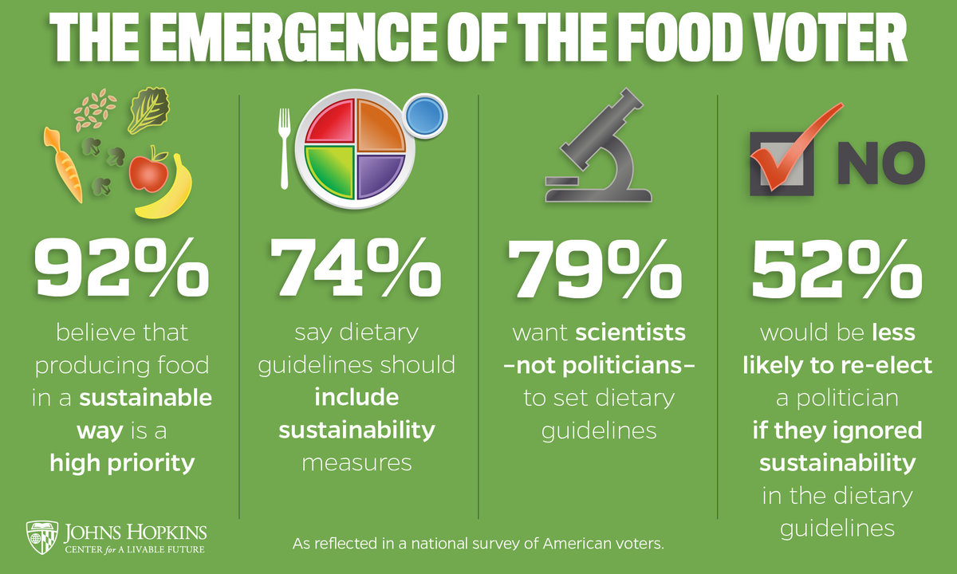
Public opinion on sustainability in DGA
2015 DGA public comments: 29,000
  Sustainability in 19,763 letters + 26 petitions
  Large majority favoring inclusion of sustainability.
2020 DGA public comments: 26,511
  Sustainability in 14,102 comments
Johns Hopkins Center for a Livable Future

Slide 4
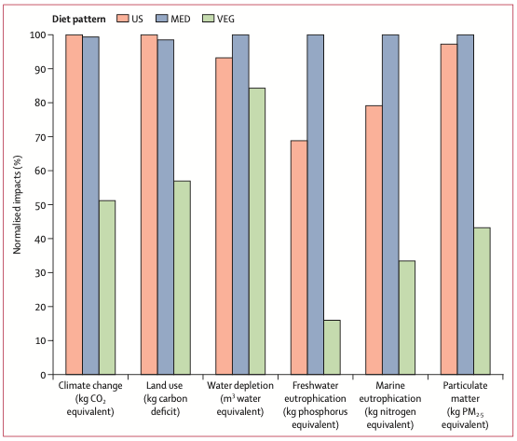
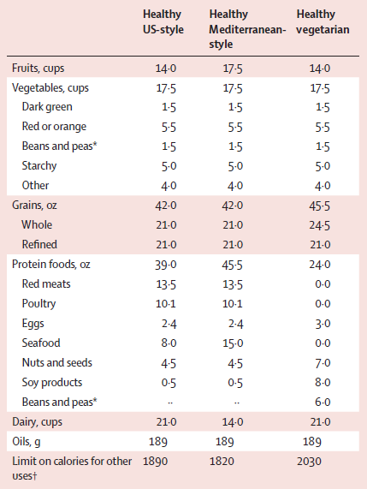
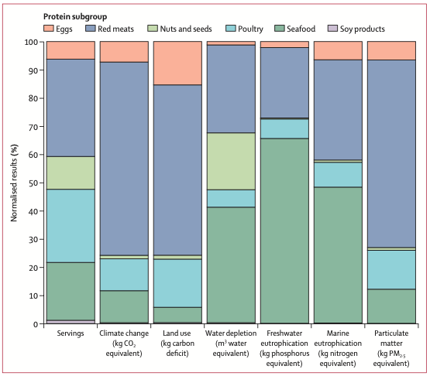

Modeled environmental impacts of the 2015 DGA
Recommended weekly amounts for healthy patterns
at 2000 kcal/day

Slide 5
Modeled environmental impacts of the 2015 DGA
“if everybody around the world followed the national dietary guidelines of the USA and UK… then food-related emission would exceed the food-system limits for avoiding dangerous levels of climate change by more than 3 times.”
- Springmann et al. BMJ opinion – Why food based dietary guidelines need to be more sustainable
Recommended weekly amounts for healthy patterns
at 2000 kcal/day

Slide 6

Unhealthy and confusing food environment
Malnutrition (nutrient deficiency, or overweight/obesity) can increase risk and severity of both infectious diseases and noncommunicable chronic health condition
Low-cost foods that are energy dense and high in saturated fat, sugar, and salt
Confusion among consumers of how to navigate nutritionally and environmentally

Slide 7




















Ethical and environmental labels
http://www.ecolabelindex.com/ecolabels/

Slide 8
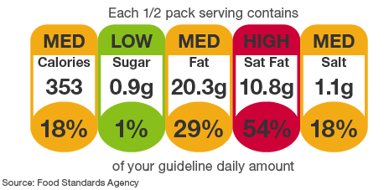
Nutrient Profiling Systems (NPS) - Principles
“The science of classifying or ranking foods according to their nutritional composition for reasons related to preventing disease and promoting health” – WHO
Quantitative score representing a range of food healthfulness
    Account for nutrients / dietary factors of public health concern
    Presence and value of qualifying and/or disqualifying factors
    Scoring thresholds derived from guidelines authoritative bodies

Slide 9
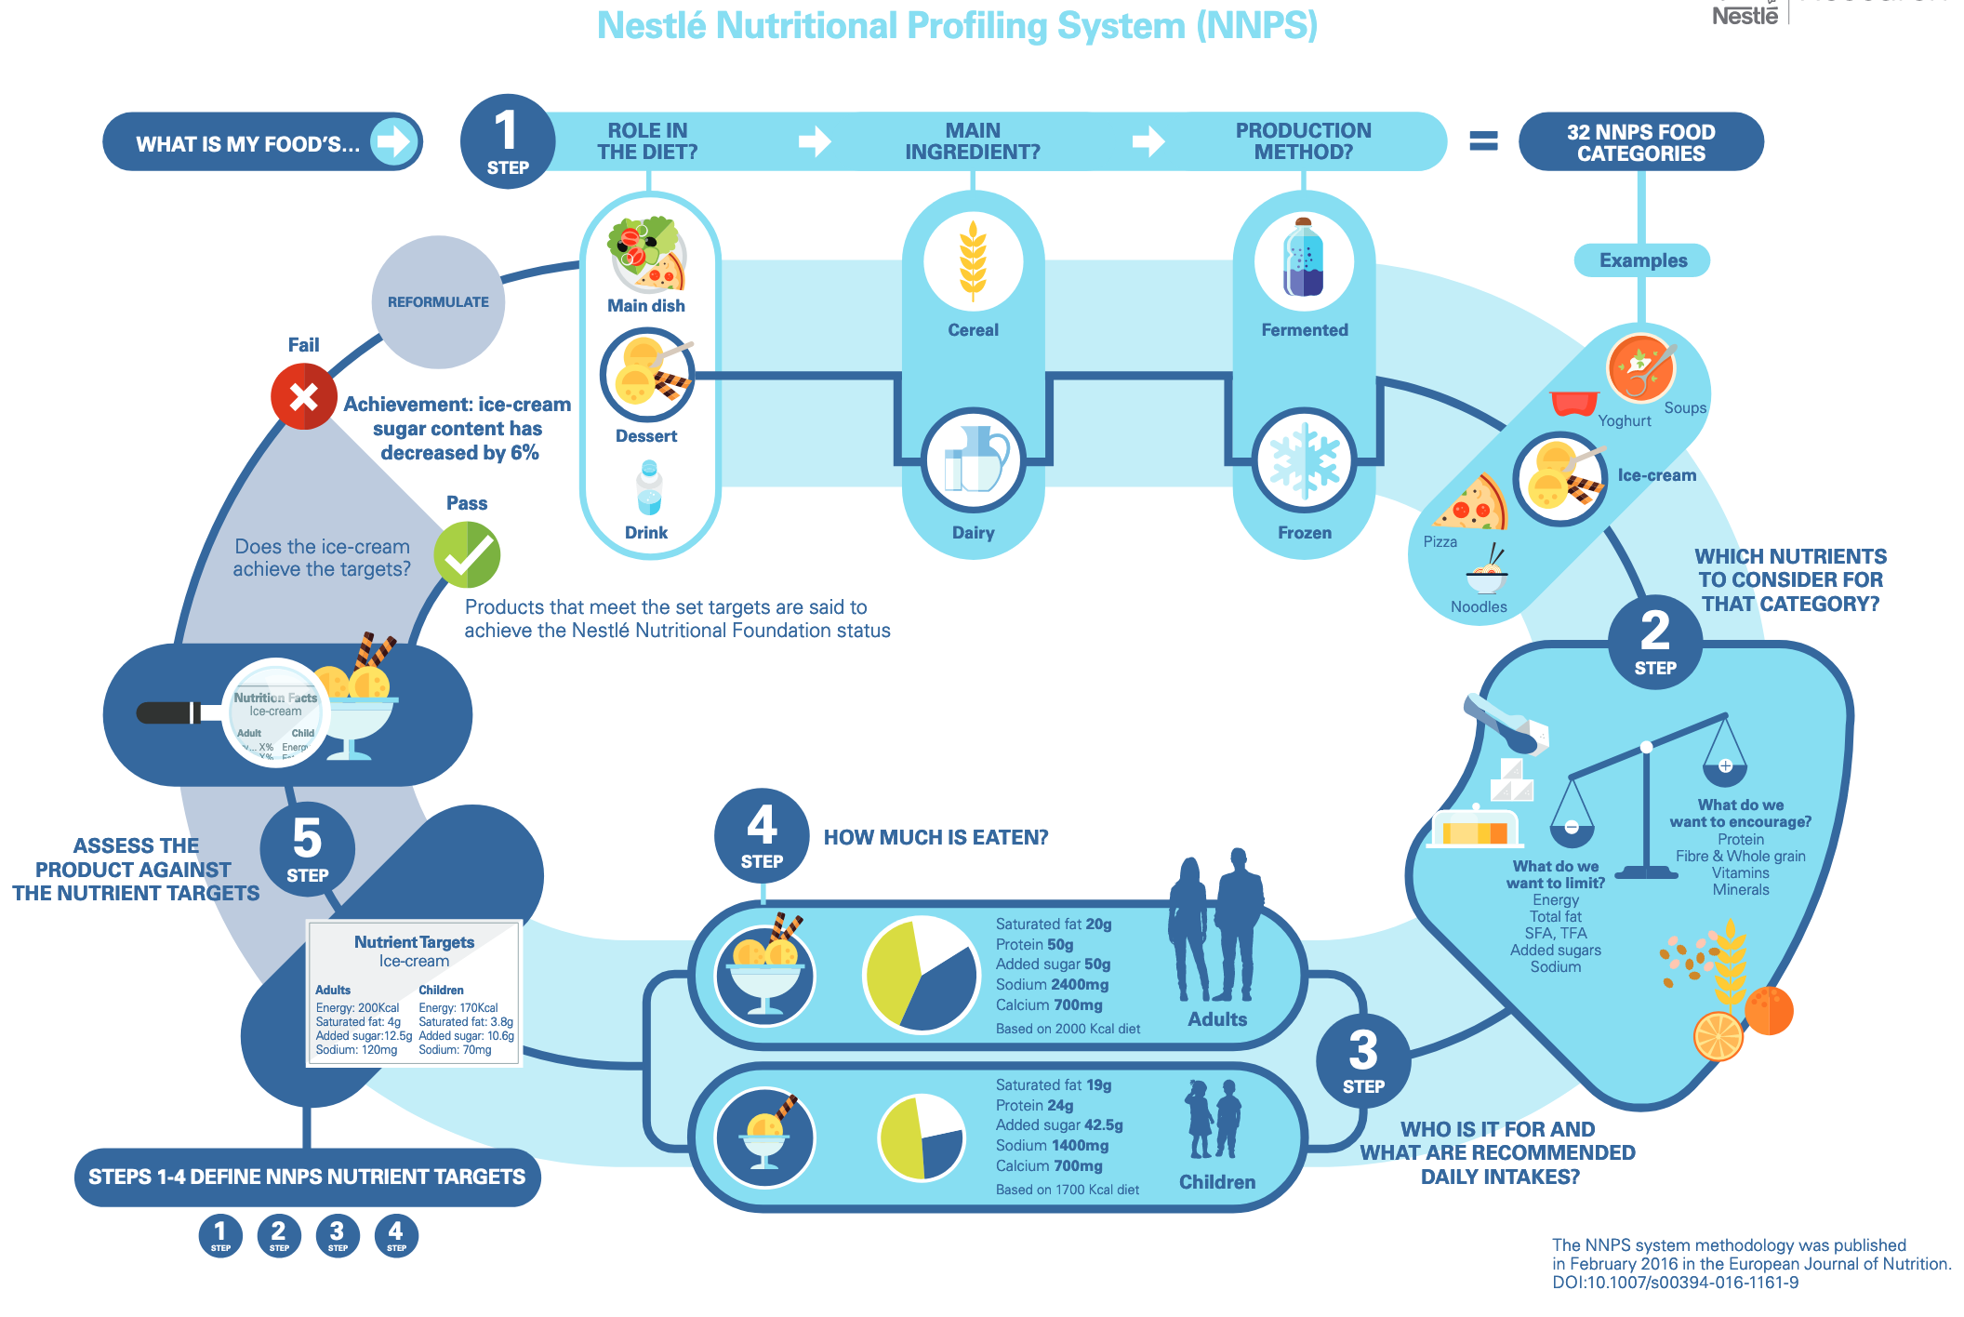
NPS Structure and Development - example
Scope and principles
Food categorization
Selection of attributes (nutritional factors)
Selection of reference values or threshold targets
Selection of the unit base
Determining the calculation method & algorithm
Validation
Application

Slide 10
NPS to DSM Scope & Principles
Scope and principles
Food categorization
Selection of attributes
Selection of reference values or threshold targets
Selection of the unit base
Determining the calculation method & algorithm
Validation
Application
Nutrient Profiling System
    Diet, food(s), individual nutrients
    Quality, density
    Diversity, comprehensive
Diet Sustainability Metrics
    Nutrition/diet + Environment
    In balance, or warning?
    Key elements

Slide 11
NPS to DSM Categorization Systems
Scope and principles
Food categorization
Selection of attributes
Selection of reference values or threshold targets
Selection of the unit base
Determining the calculation method & algorithm
Validation
Application
NPS
Exclusions
Food groups categorizations
Group-specific evaluations?
DSM
Priority categories
Level of food (individual or food group)
Complicated by additional dimensions

Slide 12
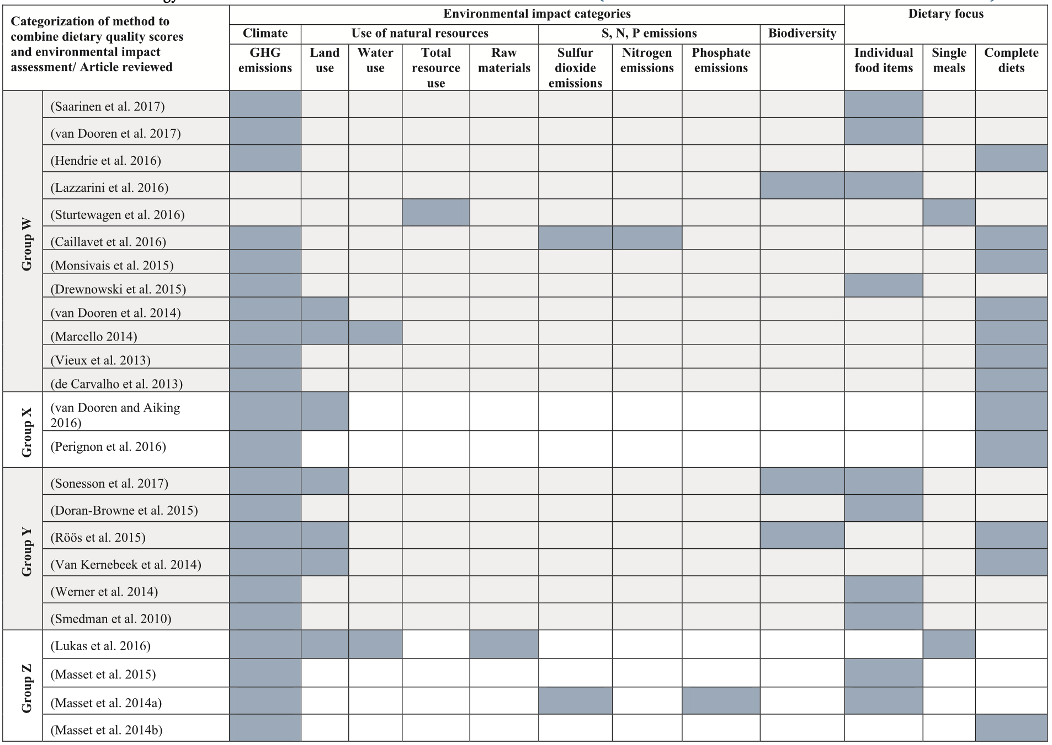
Methodologies to combine environmental and nutritional assessment

Slide 13
NPS to DSM Selection of Attributes
Scope and principles
Food categorization
Selection of attributes
Selection of reference values or threshold targets
Selection of the unit base
Determining the calculation method & algorithm
Validation
Application
NPS most common types of attributes
  Nutrients to limit and/or encourage
    Fats, nutrients, minerals (typically considered, including added sugar and sodium)
  Ingredients
    Food groups as a whole*: healthful, neutral, harmful
Additional to consider
  Non-nutritive (e.g., phytochemicals, pre- and probiotics)
  Fortification
  Other additives (e.g., artificial and natural food colorings)
  Food Processing
  Environmental and social sustainability
  Organic, GMO
  For DSM…

Slide 14
Environmental Indicators
Greenhouse Gas Emissions n=71 (63%) |  | GHGEs
 |  | Non-CO2 GHGEs (i.e., N20, CH4)
 |  | Global warming potential
 |  | Carbon footprint
 |  | Carbon neutral product
 |  | Climate change
 |  | Carbon cycling
Land use n=32 (28%) |  | Land use
 |  | Land use requirements
 |  | Virtual land imports
 |  | Nature occupation
 |  | Ecological footprint (referring to land use)
 |  | Agricultural land availability
Energy use n=26 (23%) |  | Primary energy use
 |  | Primary energy consumption
 |  | Fossil fuel energy use
 |  | Cumulative energy demand
 |  | Use of renewable and non-renewable energy sources
Water use n=20 (18%) |  | Water use
 |  | Water consumption
 |  | Water demand
 |  | Water footprint
 |  | Water scarcity
 |  | Irrigation water use
Environmental Indicators
Eutrophication potential n=11 (10%) |  | Eutrophication potential
 |  | Eutrophication
Reactive nitrogen n=9 (8%) |  | Ammonia emissions
 |  | Nitrogen oxides
 |  | Reactive nitrogen species
 |  | Nitrogen losses, excretion
 |  | Fertilizer use
 |  | Nitrogen cycle
 |  | High NOx areas
 |  | Nitrogen footprint
Acidification potential n=8 (7%) |  | Acidification potential
 |  | Acidification
Human toxicity/ ecotoxicity n=8 (7%) |  | Pesticide use
 |  | Aquatic and terrestrial ecotoxicity
 |  | Human toxicity
 |  | Respiratory inorganics
 |  | Smog production
 |  | Carcinogenic substances
 |  | Heavy metals
 |  | Radioactive releases
Ozone layer depletion n=6 (5%) |  | Ozone layer depletion
 |  | Photochemical ozone creation potential
 |  | Photochemical ozone
Other n=1 (1%) |  | Abiotic resource use
 |  | Mineral extraction
 |  | Landscape character
Diet & Health Indicators
Consumption of meat and dairy n=30 (27%) |  | Animal-source foods
 |  | Animal agriculture
 |  | Animal-based compared with vegetarian or vegan diets
 |  | Consumption of dairy, red meat, or processed meat
 |  | Limiting meat consumption overall
 |  | Consuming meat alternatives
Diet quality n=27 (24%) |  | Adequate dietary energy and nutrients
 |  | Overall diet quality
 |  | Adequacy and moderation/limits of nutrient intake
 |  | Nutritional content or quality of diets
 |  | Nutrient density of diets
 |  | Healthfulness of diets
 |  | Consumption of fruits and/or vegetables
 |  | Consumption of fish
 |  | Calorie availability
 |  | Protein availability
 |  | Intake of energy, macronutrients, SFAs, trans-fats, total fat, dietary fiber, free sugar, sodium, iron
 |  | Amount of processing of foods
 |  | “Junk” food
Health n=11 (10%) |  | Cardiovascular disease
 |  | Cancer
 |  | Mortality
 |  | All-cause mortality
 |  | Chronic disease risk
 |  | Non-communicable disease incidence
 |  | Health or healthfulness
Environmental Management & Ethics
Management practices/organic food n=21 (19%) |  | Organic food
 |  | Organic production
 |  | Free-range meats
 |  | Antibiotic-free meats
Local or seasonal food procurement n=18 (16%) |  | Food miles
 |  | Foods transported by airplane
 |  | Local purchasing
 |  | Local procurement
 |  | Local food
 |  | Regional food
 |  | Seasonal food
 |  | Seasonality
Ecology/environment n=5 (4%) |  | Ecologically and socially sound
 |  | Reducing ecological footprint
 |  | Accounting for the environment
 |  | Environmental friendliness
 |  | Natural
Animal welfare n=5 (4%) |  | Respect for animal welfare
Fisheries n=3 (3%) |  | Overfishing
 |  | Aquaculture management
 |  | Aquaculture feeding
Food waste n=7 (6%) |  | Food waste
Socio-Economic Indicators
Cost of diets and revenue generation n=13 (12%) |  | Cost of diets
 |  | Food costs
 |  | Cost of food basket
 |  | National revenue
 |  | Profitability of agriculture sector
Social equity n=8 (7%) |  | Fair trade
 |  | Fair incomes for producers
 |  | Social equity
 |  | Social justice
 |  | Equality of food distribution
Community n=2 (2%) |  | Community building
 |  | Collective action
How do we select which
indicators to score
diet sustainability?

Slide 15

DSM Selection of indicators
Social equity
Health
Ultimate goal
Population characteristics
Data availability
Expertise / literature
Align with UN Sustainable Development Goals
Diet quality
ghge
LCA
Diet cost
Food waste
Consumer
Sustainable Food Score

Slide 16
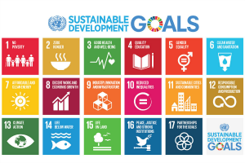
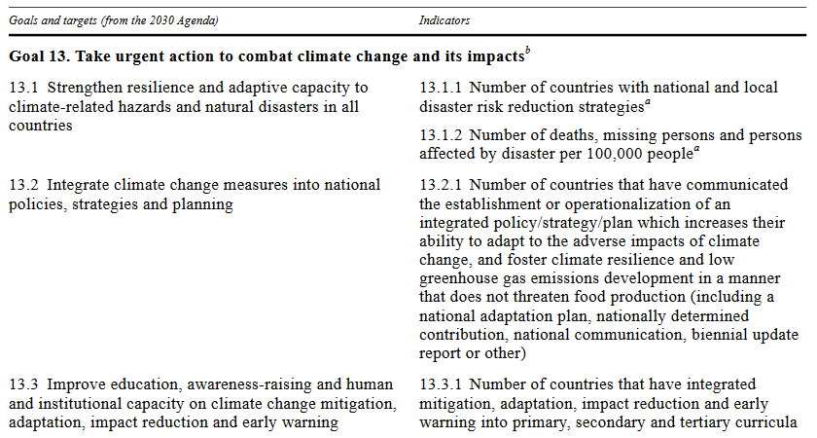
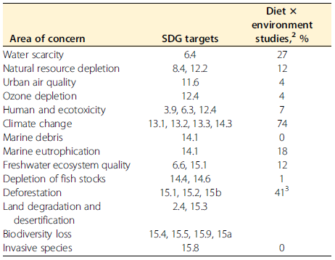
Linking indicators to the Sustainable Development Targets
https://sustainabledevelopment.un.org/content/documents/11803Official-List-of-Proposed-SDG-Indicators.pdf
Ridoutt et al. Adv Nutr 2017: Dietary Strategies to reduce environmental impact: a critical review of the evidence base

Slide 17
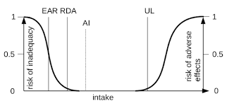
NPS to DSM Reference Values
Scope and principles
Food categorization
Selection of attributes
Selection of reference values or threshold targets
Selection of the unit base
Determining the calculation method & algorithm
Validation
Application
NPS: Derivation of Nutrient Scores from DRIs
    Risk curves used for DRI
DSM: Standardization/normalization, reference values

Slide 18
NPS to DSM Unit Base
Scope and principles
Food categorization
Selection of attributes
Selection of reference values or threshold targets
Selection of the unit base
Determining the calculation method & algorithm
Validation
Application
Mass-based
    100g
    Serving size (standardized)
Energy based
    100 kcal
Other
    Unit of protein, or other nutrient of concern

Slide 19
NPS to DSM Formulas
Scope and principles
Food categorization
Selection of attributes
Selection of reference values or threshold targets
Selection of the unit base
Determining the calculation method & algorithm
Validation
Application
Complexity
    Scoring criteria
    Weighting and inclusion thresholds
    Algorithm
Examples…

Slide 20
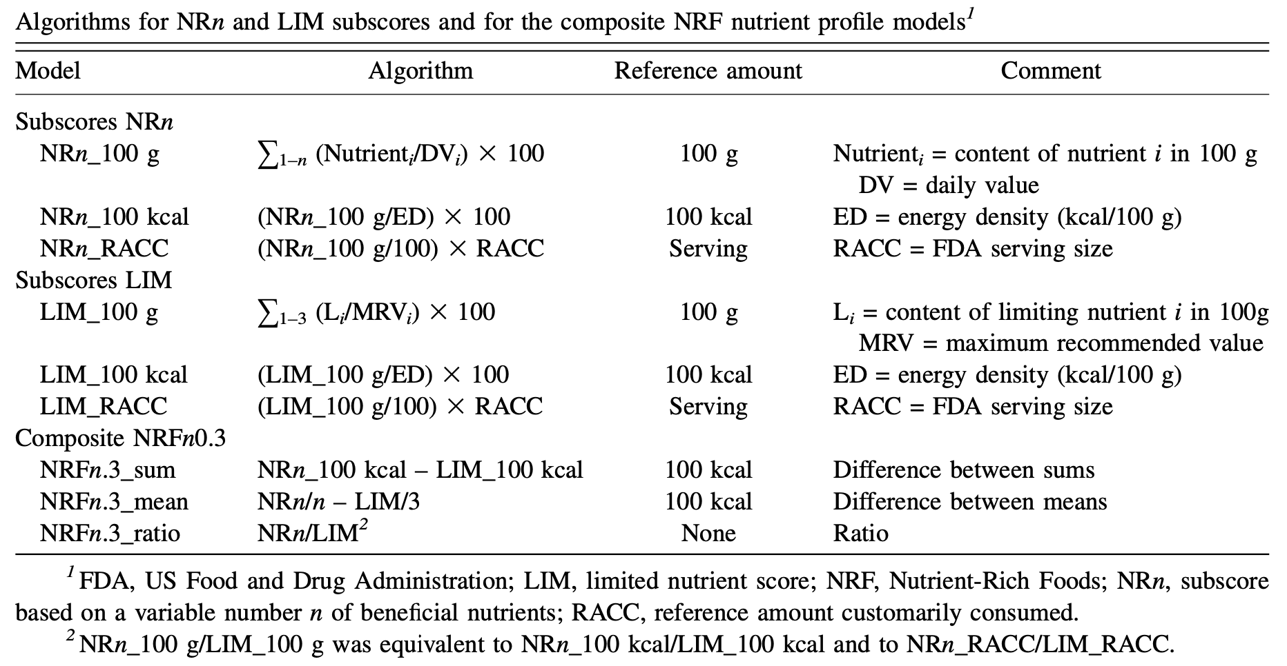
NPS formulations
BREAKFAST IN BED

Slide 21
DSM methodologies
Categorization of dietary quality scores
Ratio between nutrient/food content and a reference amount, for qualifying and/or dis-qualifying nutrients/foods
Scoring based on fulfillment of certain positive or negative criteria based on adherence to guidelines on healthy eating.
Categorization of methods to combine dietary quality scores and environmental impact assessment
Separate scores for nutritional and environmental impact | Separate analysis of nutritional and environmental impacts and correlation between them
 | Optimization of meals and diets based on both nutritional and environmental impact
Combined nutritional and environmental impact | Environmental impact divided by dietary quality score
 | Integrated sustainability score based on both environmental and nutritional impact

Slide 22
NPS to DSM Validation
Scope and principles
Food categorization
Selection of attributes
Selection of reference values or threshold targets
Selection of the unit base
Determining the calculation method & algorithm
Validation
Application
Content validity
    Account for indicators of public/planetary health concern
Criterion validity
    Comparison against a ‘gold standard’
Convergent and discriminant validity
    Comparison among similar NPS
Construct validity
    Evaluate NPS against diet quality indices scoring in population dietary intake data

Slide 23
NPS to DSM Validation
Scope and principles
Food categorization
Selection of attributes
Selection of reference values or threshold targets
Selection of the unit base
Determining the calculation method & algorithm
Validation
Application
Sensitivity testing
  Targets based on different thresholds/reference values
  Unit of food for assessment
  Scoring zero-level attributes
  Weights of attributes

Slide 24
Applications of NPS – what else for DSM?
Scope and principles
Food categorization
Selection of attributes
Selection of reference values or threshold targets
Selection of the unit base
Determining the calculation method & algorithm
Validation
Application

Slide 25
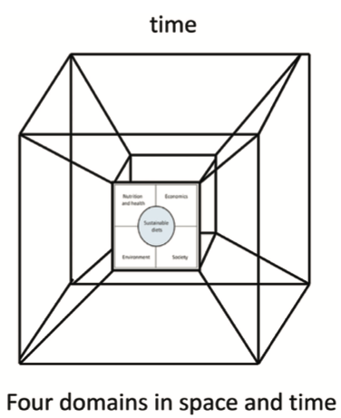
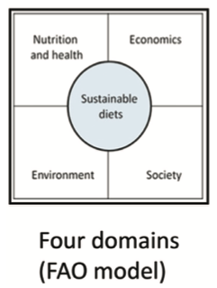
Future directions
geographies
Further data development and refinement for
Food processing and systems beyond farm gate
Social and cultural indicators
Economic assessment
Adapting to alternative dietary patterns and food systems

Slide 26
Acknowledgements
  Faculty & Colleagues
  Food Compass team: Dr. Jeff Blumberg, Dr. Renata Micha, Dr. Dariush Mozaffarian, Dr. Will Masters, Dr. Paul Jacques
  PhD Committee: Dr. Paul Jacques, Dr. Chris Peters, Dr. Timothy Griffin, Dr. Miriam Nelson
  DEX mentors: Dr. Nicole Blackstone, Dr. Greg Norris
  HNRCA Nutrition Epi group
  Dr. Elena Naumova & NEDS division
  Ryan Simpson & the TNDS Team
  Alexandra Stern, Nayla Bezares & the Sustainable Diets Journal Club @ Friedman
  Planetary Health Alliance @ Harvard
Agency Support from
  The National Institute of Food and Agriculture Fellowship Program
  Quantis Environmental LCA Consultants
  Danone
  American Society for Nutrition PRICE Fellowship

Slide 27
References
Allen, T., Prosperi, P., Cogill, B., Padilla, M., and Peri, I. (2019). A Delphi Approach to Develop Sustainable Food System Metrics. Soc. Indic. Res. 141, 1307–1339.
Blackstone, N.T., El-Abbadi, N.H., McCabe, M.S., Griffin, T.S., and Nelson, M.E. (2018). Linking sustainability to the healthy eating patterns of the Dietary Guidelines for Americans: a modelling study. Lancet Planet. Health 2, e344–e352.
Brécard, D. (2014). Consumer confusion over the profusion of eco-labels: Lessons from a double differentiation model. Resour. Energy Econ. 37, 64–84.
Grunert, K.G., Hieke, S., and Wills, J. (2014). Sustainability labels on food products: Consumer motivation, understanding and use. Food Policy 44, 177–189.
Hallström, E., Davis, J., Woodhouse, A., and Sonesson, U. (2018). Using dietary quality scores to assess sustainability of food products and human diets: A systematic review. Ecol. Indic. 93, 219–230.
Jones, A.D., Hoey, L., Blesh, J., Miller, L., Green, A., and Shapiro, L.F. (2016). A Systematic Review of the Measurement of Sustainable Diets. Adv. Nutr. 7, 641–664.
Lang, T., and Mason, P. (2018). Sustainable diet policy development: implications of multi-criteria and other approaches, 2008–2017. Proc. Nutr. Soc. 77, 331–346.
Reinhardt, S.L., Boehm, R., Blackstone, N.T., El-Abbadi, N.H., McNally Brandow, J.S., Taylor, S.F., and DeLonge, M.S. Systematic Review of Dietary Patterns and Sustainability in the United States. Adv. Nutr.
Ridoutt, B.G., Hendrie, G.A., and Noakes, M. (2017). Dietary Strategies to Reduce Environmental Impact: A Critical Review of the Evidence Base. Adv. Nutr. 8, 933–946.
Seferidi, P., Scrinis, G., Huybrechts, I., Woods, J., Vineis, P., and Millett, C. (2020). The neglected environmental impacts of ultra-processed foods. Lancet Planet. Health 4, e437–e438.
Springmann, M., Spajic, L., Clark, M.A., Poore, J., Herforth, A., Webb, P., Rayner, M., and Scarborough, P. (2020). The healthiness and sustainability of national and global food based dietary guidelines: modelling study. BMJ 370.
THANK YOU!
E-mail:
naglaa.el_abbadi
@tufts.edu
Twitter:
@nel_abbadi

Slide 28
Discussion questions
What do you think should be considered in construction of diet sustainability metrics?
Should the emphasis be on negative warning (warning for unhealthy and/or enviro-harming), or positive promotion (focus on healthy aspects and/or enviro-beneficial), or both?
Have you seen environmental claims on food products when you buy groceries? Do they affect your choices of which food to buy?
Should environmental assessment labels be voluntary or regulated? In either case, how and by who?

