Slide 1
E³ Data Visualizations
Tania M. Alarcon Falconi, Ph.D.
Environmental Health & Engineering
Tufts University
March 3, 2021

Slide 2
Objectives
Discuss key concepts
Critically evaluate graphical displays
Identify best practices

Slide 3



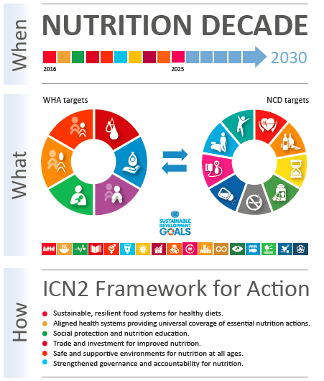
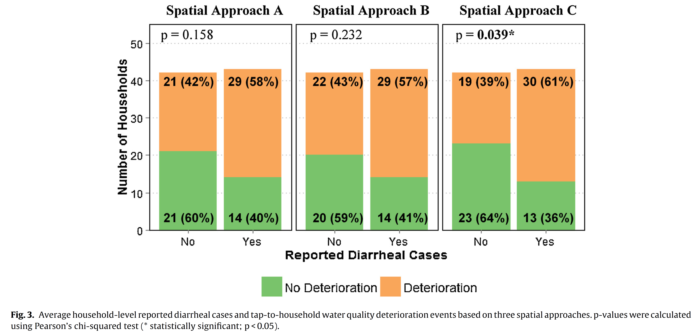
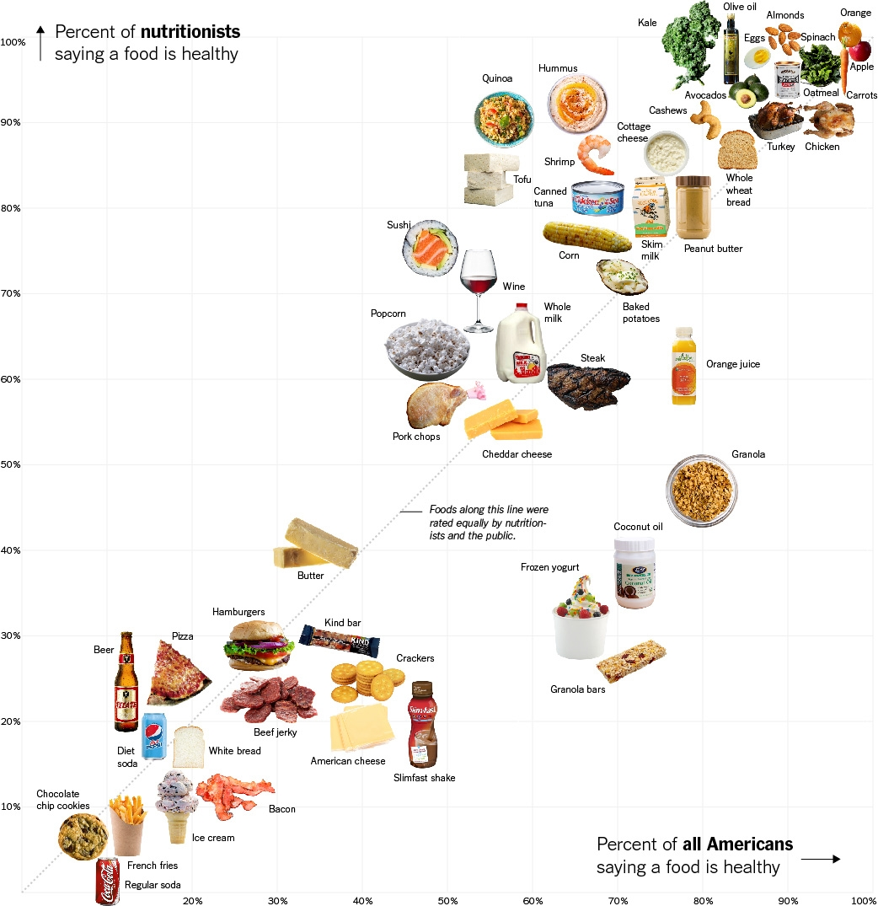
Source: Alarcon et al., 2017, Int. J. Hyg. Environ. Health

Slide 4
"A picture is worth a thousand words"
Advantage: graph vs table or text
Quality:
  Data
  Analysis
  Visualization

Slide 5

Key concepts of data visualization
$$E^{3}$$
Evidence
Emphasis
Efficiency

Slide 6
Key concepts of data visualization
$$E^{3}$$
Evidence
  What data are presented in the graph?
  Do data descriptions match the information the graph conveys?
Emphasis
  Who is the target audience?
  Why is the visualization needed?
Efficiency
  How is the visualization constructed?
  Is the graph based on good visual properties?

Slide 7

$$E^{3}$$
Evidence
Emphasis
Efficiency

Slide 8
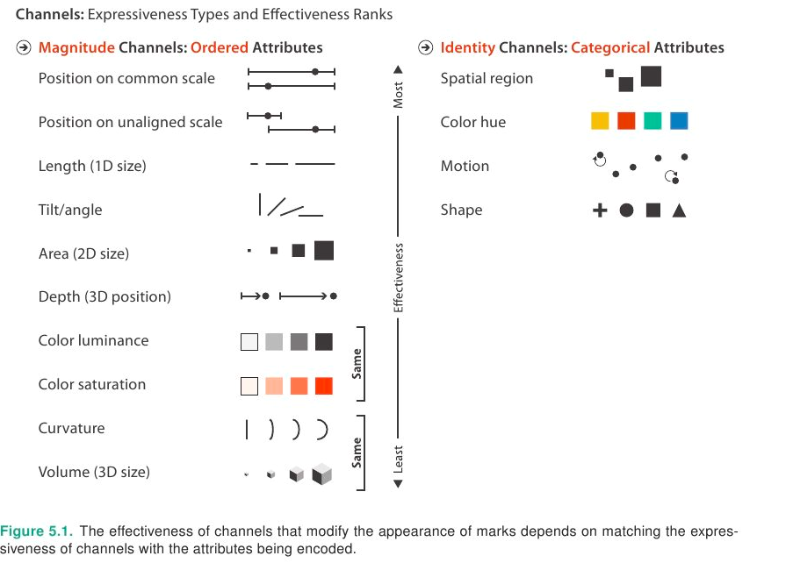
Visualization Analysis and Design by Dr. Tamara Munzner

Slide 9
Key concepts of data visualization
$$E^{3}$$
Evidence
  What data are presented in the graph?
  Do descriptions match the information the graph conveys?
Emphasis
  Who is the target audience?
  Why is the visualization needed?
Efficiency
  How is the visualization constructed?
  Is the graph based on good visual properties?

Slide 10
Objectives
Discuss key concepts
Critically evaluate graphical displays
Identify best practices

Slide 11
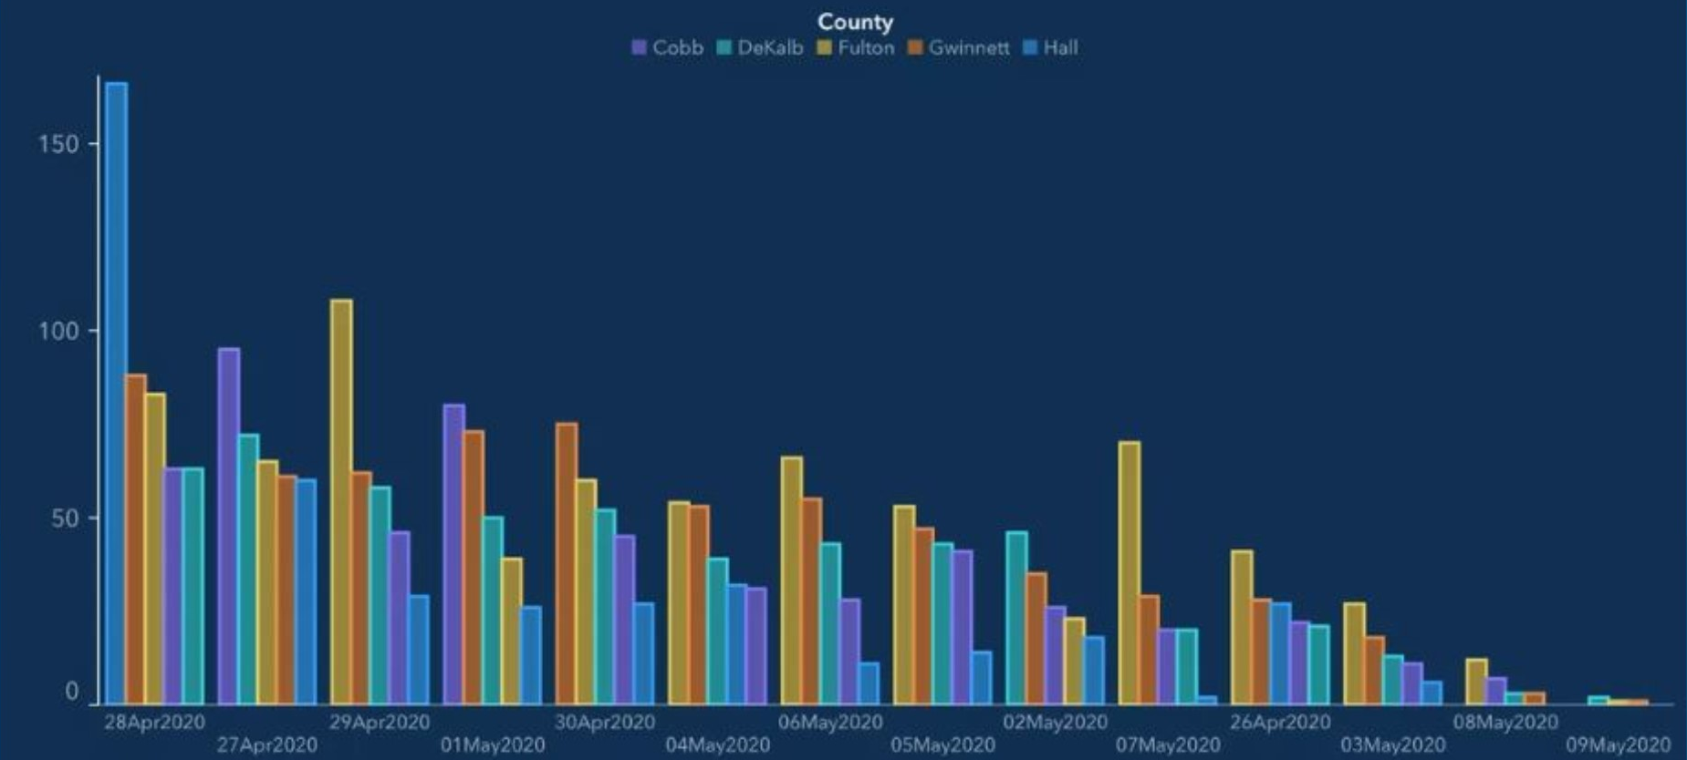

Top 5 counties with the greatest number of confirmed COVID-19 cases.
The chart below represents the most impacted counties over the past 15 days and the number of cases over time.
$$E^{3}$$
Source: https://teachdatascience.com/ethicaldataviz/

Slide 12
Top 5 counties with the greatest number of confirmed COVID-19 cases.
The chart below represents the most impacted counties over the past 15 days and the number of cases over time.
$$E^{3}$$

Slide 13
Top 5 counties with the greatest number of confirmed COVID-19 cases.
The chart below represents the most impacted counties over the past 15 days and the number of cases over time.
$$E^{3}$$

Slide 14
Top 5 counties with the greatest number of confirmed COVID-19 cases.
The chart below represents the most impacted counties over the past 15 days and the number of cases over time.
$$E^{3}$$
https://dph.georgia.gov/covid-19-daily-status-report

Slide 15
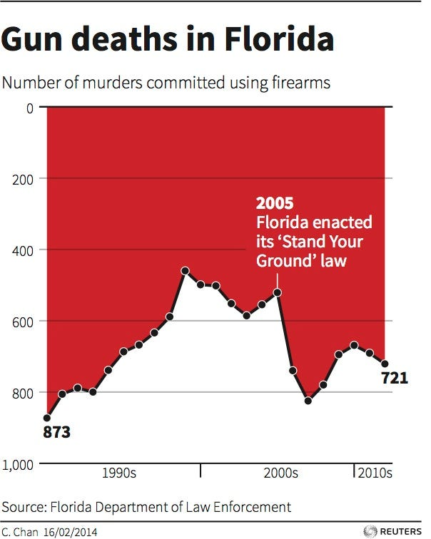
$$E^{3}$$
Source: https://www.businessinsider.com/gun-deaths-in-florida-increased-with-stand-your-ground-2014-2

Slide 16
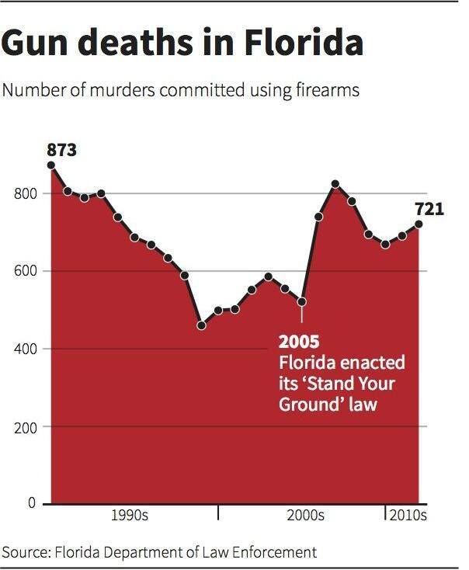
$$E^{3}$$
Source: https://www.businessinsider.com/gun-deaths-in-florida-increased-with-stand-your-ground-2014-2

Slide 17
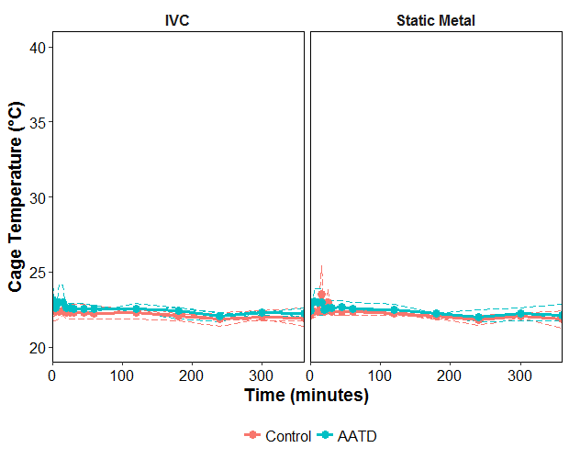
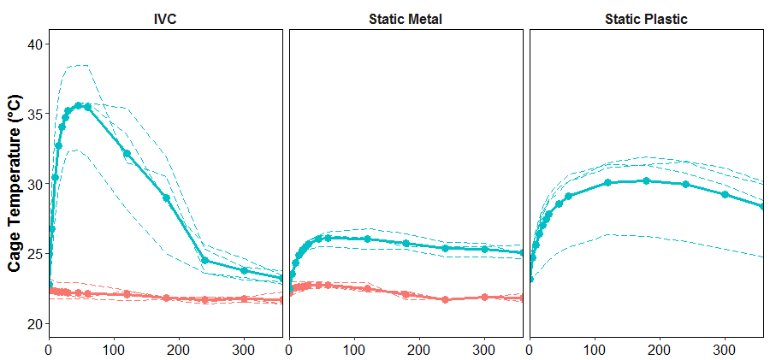
Figure 2. Cage temperature in environmental conditions over time in A) Zone 1 and B) Zone 3. Each experiment is shown with a dashed line, and the mean for all experiments as a solid line.
A)
B)
$$E^{3}$$
Adapted from: Beale et al., 2018, JAALAS

Slide 18
Figure 2. Cage temperature in environmental conditions over time in A) Zone 1 and B) Zone 3. Each experiment is shown with a dashed line, and the mean for all experiments as a solid line.
A)
B)
$$E^{3}$$
Adapted from: Beale et al., 2018, JAALAS

Slide 19
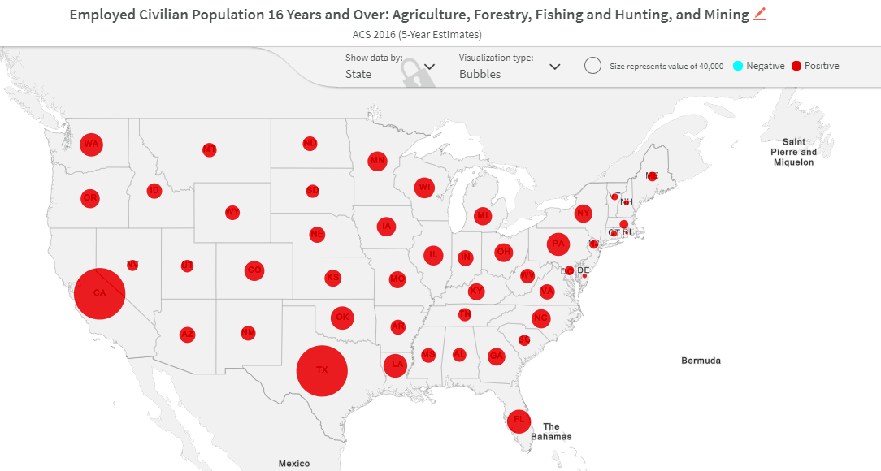

$$E^{3}$$
Source: https://www.socialexplorer.com/a9676d974c/explore

Slide 20
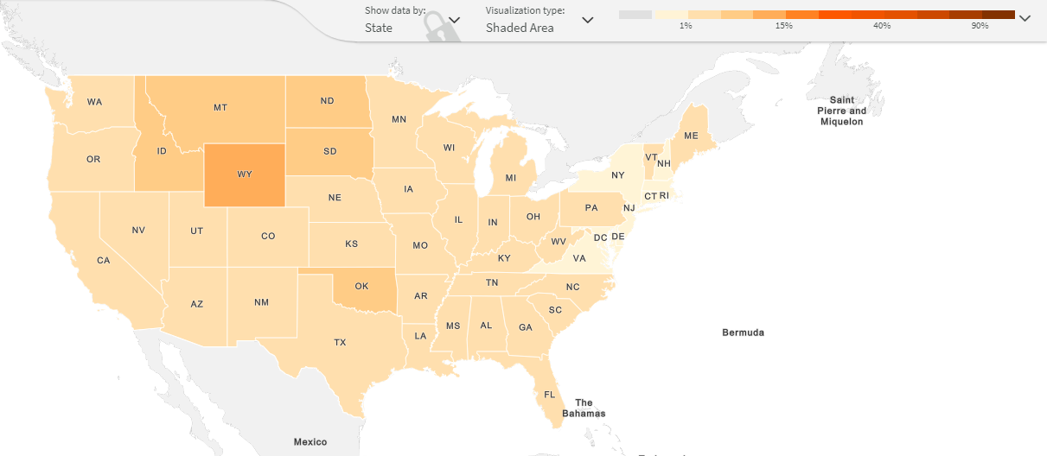
Misleading information
Number of people (absolute)
vs
% of people (relative)
$$E^{3}$$
Source: https://www.socialexplorer.com/a9676d974c/explore

Slide 21
Common problems
Distortion
Ambiguity & confusion
Misleading information
Missing information
Data noise
Unnecessarily complex
Too simplistic

Slide 22
Objectives
Discuss key concepts
Critically evaluate graphical displays
Identify best practices

Slide 23

Best practices
Consider the key concepts of graphical presentation
Avoid common problems
Avoid pie charts
$$E^{3}$$

Slide 24
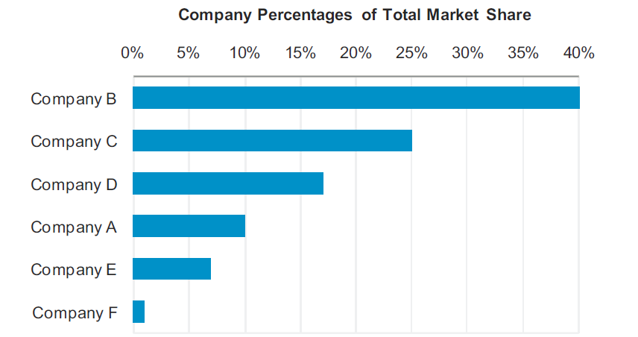
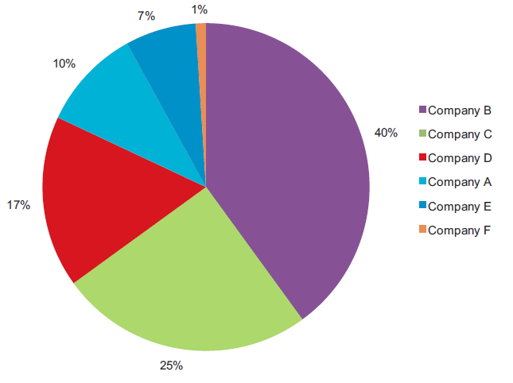
Source: https://www.perceptualedge.com/articles/visual_business_intelligence/save_the_pies_for_dessert.pdf

Slide 25
Best practices
Consider the key concepts of graphical presentation
Avoid common problems
Avoid pie charts
Consider colors

Slide 27
Best practices
Consider the key concepts of graphical presentation
Avoid common problems
Avoid pie charts
Consider colors
Create multiple graphs
Share graphs with peers

Slide 28
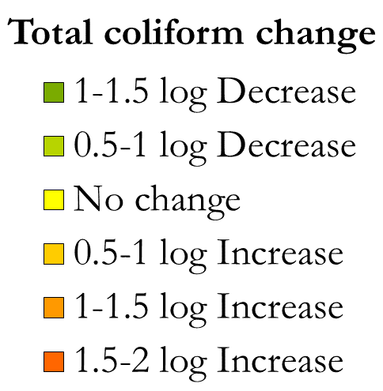
Figure 1. Comparison of 4 methods to link households and source taps. Percentages indicate the number of households classified as having a decrease, no change, or increase in log Total Coliform concentrations between source and household.
Source: Alarcon, 2015

Slide 29
Source: Alarcon et al., 2017, Int. J. Hyg. Environ. Health

Slide 30
Best practices
Consider the key concepts of graphical presentation
Avoid common problems
Avoid pie charts
Consider colors
Create multiple graphs
Share graphs with peers
TEXT

Slide 31
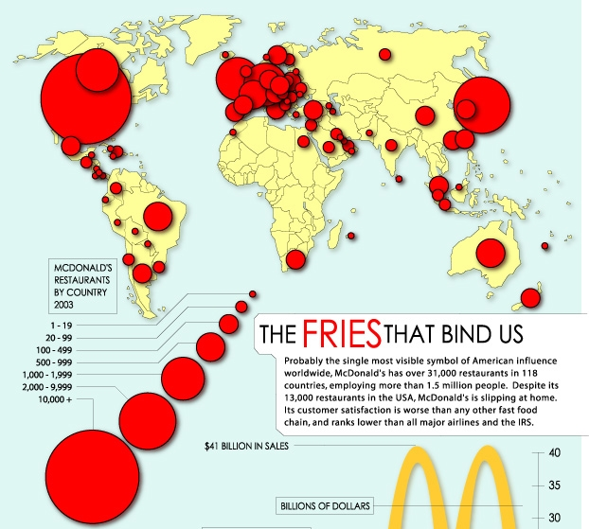
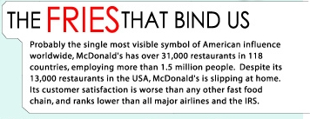
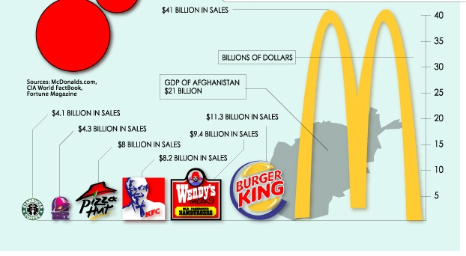


Slide 32
Objectives
Discuss key concepts
Critically evaluate graphical displays
Identify best practices

Slide 33
Thank you!

