Slide 1
Progress on the Green New Deal: Radical Keynesian and Ecological Perspectives Jonathan M. Harris Tufts University Global Development and Environment Institute Boston University Global Development Policy Center Economics In Context Initiative
http://ase.tufts.edu/gdae
Copyright © 2022 Jonathan M. Harris
Notes:
The Global Development and Environment Institute offers material for free download on green economics Green Economics – Global Development And Environment Institute (tufts.edu))and climate policy Climate Policy Briefs – Global Development And Environment Institute (tufts.edu)

Slide 2
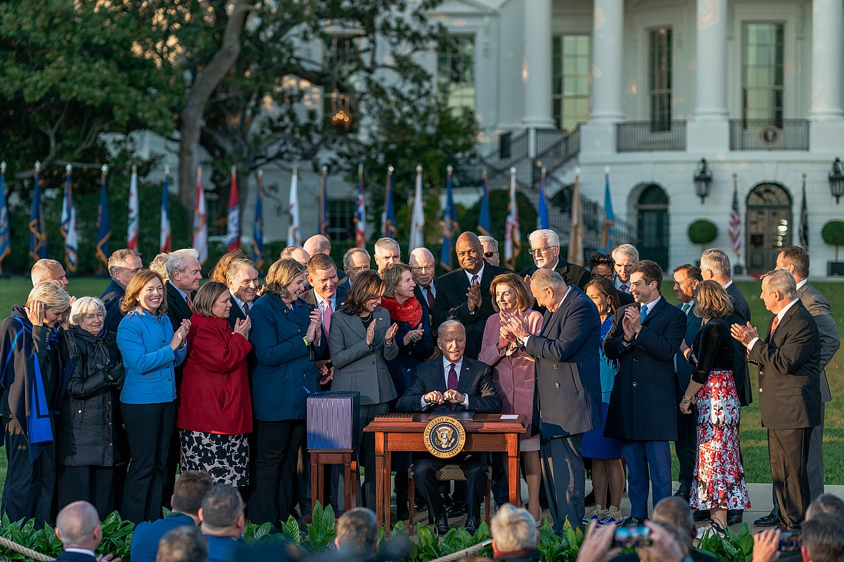
President Biden signing the Infrastructure Investment and Jobs Act into law on November 15, 2021
Notes:
The Green New Deal has been a political proposal for some time, but now elements of it have become a reality, signed into law in 2021. Others are still in limbo.

Slide 3
Major Goals of a Green New Deal
Transformation to a low-carbon economy including renewable energy sources and energy efficiency.
Protection and restoration of forests and wetlands; sustainable farming and soil restoration.
Expanding employment in renewable energy, energy efficiency, infrastructure investment, environmental protection, ecological resilience, water management, other areas.
Notes:
Though there are various versions of a Green New Deal, they all include the major elements of energy transition, natural climate solutions, and green jobs.

Slide 4
The Original New Deal of the 1930s
A pragmatic response to high unemployment, but consistent with Keynesian economics.
Direct effect of government employment and government spending plus indirect, or multiplier, effects leading to additional economic activity and employment creation.
Principle of social investment to achieve goals not well served by private markets.
Significant “green” aspect: Civilian Conservation Corps, erosion and flood control, forest protection and tree planting, streambed protection, agricultural extension for crop rotation and soil restoration.
Notes:
The inspiration of the GND is the original New Deal of the 1930s – which had its own “green” aspects even then.

Slide 5
Keynesian Social Investment Principle
“The outstanding faults of the society in which we live are its failure to provide for full employment and its arbitrary and inequitable distribution of wealth and incomes.”
-- John Maynard Keynes, 1936. The General Theory of Employment, Interest, and Money.
Environmental issues were not central to Keynes’ original theory, but are an obvious example of the shortcomings of an unregulated market system.
Notes:
Both the original new deal and the GND reflect the more radical approach to Keynesianism – not just trying to get aggregate demand “right” but filling the need for social investment in areas where market solutions are inadequate.

Slide 6
Ecological Economics and Green New Deal
Ecological economics, as distinct from mainstream environmental economics, is based on a specific and powerful insight: the economy, as a subsystem of the planetary ecological system, is fundamentally limited by the physical realities of that planetary system.
Since about 1950, there have been staggering increases in global population, energy use, and carbon emissions—more than threefold for global population and more than sixfold for energy use and carbon emissions.
Climate crisis, parallel crises in water resources, forests and wetlands, agricultural soils, ocean pollution, fisheries decline, and biodiversity loss all arise from pressures associated with economic growth.
Notes:
The ecological economics perspective sees unlimited economic growth as an impossibility on a finite planet, and traces many of our current environmental problems to unrestrained population growth, resource use, and waste production.

Slide 7
Nature of Economic Production Must Change
Ecological economics perspective implies that a reorientation will be required as the period of steady economic growth, characteristic of the past 200 years and especially of the last 75 years, comes up against firm ecological limits, including climate change.
An end to conventional growth need not mean an end to employment growth or improvement in human well-being, but production must be reoriented to services and energy-efficient outputs.
Many of the standard Keynesian policy tools are relevant, including social investment, but in a new context of developing a sustainable economy.
Notes:
The global economy has moved from a phase where growth seemed unlimited to one in which long-term sustainability and respect for ecological limits must be paramount. Fortunately, a combination of Keynesian and ecological economics offers a toolkit for building the sustainable economy.

Slide 8
Climate Change Could Cut World Economy by $23 Trillion in 2050, Insurance Giant Warns
WASHINGTON — Rising temperatures are likely to reduce global wealth significantly by 2050, as crop yields fall, disease spreads and rising seas consume coastal cities, a major insurance company warned Thursday. The effects of climate change can be expected to shave 11 percent to 14 percent off global economic output by 2050 compared with growth levels without climate change. That amounts to as much as $23 trillion in reduced annual global economic output.
Poor nations would be particularly hard hit, but few would escape, Swiss Re said. The findings could influence how the industry prices insurance and invests its mammoth portfolios.
-- Christopher Flavelle, New York Times, April 22, 2021.
Notes:
Even measured in conventional terms, the potential economic costs of climate change are huge, as confirmed by Swiss Re, a major reinsurance company whose business includes paying out in the event of major disasters.

Slide 9
Paris Climate Targets and Catastrophic Impacts
Source: Schellnhuber et al, 2016.
Note: The vertical bar represents the range of the Paris climate targets, from 1.5°C to 2.0°C
Notes:
Scientists confirm the ongoing and potential ecological damages from climate change. The horizontal bar for each impact reflects scientific uncertainty about how much temperature rise will make that impact inevitable. The darker the shading, the higher the probability the impact will occur. The vertical bar represents the range of the Paris climate targets, from 1.5°C to 2°C.

Slide 10
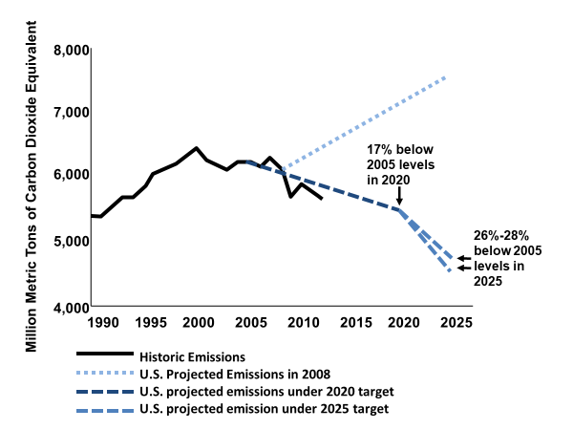
US Emissions Targets (2015)
Source: U.N. Framework Convention on Climate Change, http://unfccc.int/2860.php.
Note: In 2018, actual U.S. emissions were 10% below 1995 levels. In 2020, due to the covid-19 crisis, emissions were 21% below 2005 levels.
Notes:
Under Paris Agreement targets, the U.S. committed to emissions reduction targets of 26-28% below 2005 levels by 2025. By 2018, US emissions of CO₂ equivalent were 10% below 2005 levels, and they have continued to fall, with the emissions-reducing impacts of the covid recession meaning that the US exceeded its 2020 target, with emissions down 21% below 2005 levels. Since then they have bounced back somewhat with economic recovery.

Slide 11
US Emissions Targets (2020)
50% emissions reduction by 2030.
100% reduction in power sector emissions by 2035.
100% reduction of all emissions by 2050
( = net zero).
Notes:
The Biden administration has set more ambitious carbon reduction targets including decarbonizing the power sector by 2035 and overall net zero by 2050.

Slide 12
To Cut Emissions to Zero, U.S. Needs to Make Big Changes in Next 10 Years
In 2020 energy companies installed 42 gigawatts of new wind turbines and solar panels, smashing records. That annual pace would need to nearly double over the next decade.
The capacity of the nation’s electric grid would have to expand roughly 60 percent by 2030 to handle vast amounts of wind and solar power.
Today, electric-vehicle models are just 2 percent of new sales. By 2030, at least 50 percent of new cars sold would need to be battery-powered, with that share rising thereafter.
Most homes today are heated by natural gas or oil. In 10 years, nearly one-quarter would need to be warmed with efficient electric heat pumps, double today’s numbers.
Virtually all 200 remaining coal-burning power plants would have to shut down by 2030.
Today, there are no cement plants that bury their emissions underground, and there are no facilities sustainably producing hydrogen, a clean-burning fuel. By the mid-2020s, several such plants would need to be operating to prepare for wider deployment.
-- Brad Plumer, New York Times, December 15, 2020
Notes:
These ambitious targets demand major economic changes and investments, as well as development of new technologies for energy storage and emissions reduction.

Slide 13
Biden’s Original American Jobs Plan
$621 billion for roads, bridges, transit and transportation infrastructure, electric vehicles.
$300 billion for clean manufacturing.
$213 billion for green housing and retrofit.
$180 billion for technology R&D including battery storage, hydrogen systems.
$111 billion for water infrastructure.
$100 billion for workforce development including displaced workers, equal access.
Notes:
The original goals of Biden’s American Jobs plan have been trimmed back in the attempt to gain passage through a narrowly-divided Congress.

Slide 14
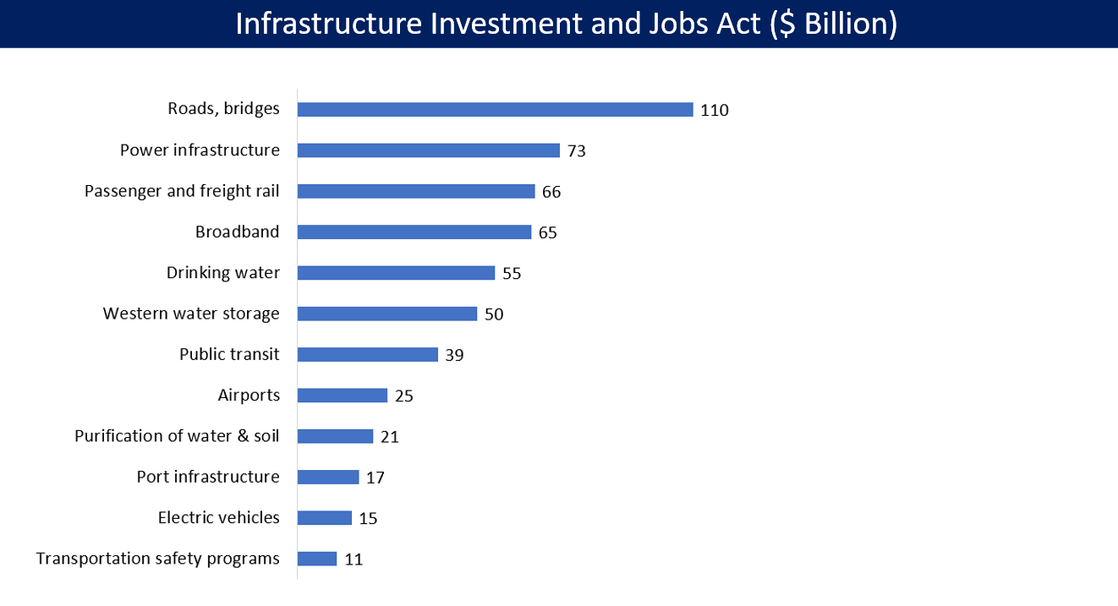
Notes:
The Infrastructure Investment and Jobs Act is now law, reflecting the first implementation of some Green New Deal goals.

Slide 15
Green Elements of Infrastructure Bill
$110 billion roads and bridges funding includes climate mitigation, bicycle infrastructure
$39 billion for public transit including zero-emissions buses, intercity and hi-speed rail
$15 billion for EV fleets and charging systems
$65 billion for grid upgrade and expanding renewables
$55 billion for upgrading water systems
$21 billion for chemical cleanup
$50 billion for climate resilience and weatherization
Notes:
While the bipartisan infrastructure bill included more conventional investments, it also provided funding for numerous climate and environmental investments moving the economy towards lower carbon emissions.

Slide 16
Build Back Better Act Green Provisions
$320 billion for clean energy tax credits for businesses and households, energy efficiency and electrification rebates
$105 billion for mitigating extreme weather events, pollution reduction, coastal restoration, forest management and restoration, soil conservation and regenerative agriculture, Civilian Climate Corps
$110 billion for U.S. renewable energy production including R&D for new technology
$20 billion for clean energy procurement via government purchasing power
Methane emissions reduction program
Notes:
The Build Better Act would provide more sweeping tax credit and investment support for a green transition, but has run into opposition in the Senate after being passed by the House.

Slide 17
Coal miners join climate activists to back Biden's $2 trillion infrastructure plan
Coal country is in free fall and is pleading for help from Washington. That's why the largest union in one of the dirtiest industries is broadly backing President Joe Biden's $2 trillion green infrastructure package -- an ambitious plan that has also won support from climate activists.
"Anybody who would not accept jobs where jobs are desperately needed is making a horrendous mistake," said Cecil Roberts, president of the United Mine Workers of America, the country's largest mine workers union.
Biden's American Jobs Plan calls for improving the nation's infrastructure and shifting to greener energy in a bid to simultaneously address inequality and the climate crisis.
"We're for infrastructure. We're for jobs. We're for moving manufacturing into coalfields. We'll work with the president on that," said Roberts, who has known Biden for decades.
-- Brad Plumer, CNN News, April 20, 2021
Notes:
Some surprising support for the Build Back Better plan from the coal miners’ union.

Slide 18
Coal Miners Support Build Back Better Act
WASHINGTON — For years, burly men in camouflage hunting jackets have been a constant presence in the Capitol Hill office of Senator Joe Manchin III, their United Mine Workers logos giving away their mission: to lobby not only for the interests of coal, but also on pensions, health care and funding for black lung disease.
So when the miners’ union and the West Virginia A.F.L.-C.I.O. came out last month with statements pleading for passage of President Biden’s Build Back Better Act — just hours after Mr. Manchin, Democrat of West Virginia, said he was a “no” — the Capitol took notice.
With the miners now officially on the opposite side of the mine owners, it signaled the escalation of a behind-the-scenes struggle centered in Mr. Manchin’s home state to sway the balking senator.
-- New York Times, Jan 10, 2022
Notes:
While coal plant owners oppose it, the miners’ union recognizes its job-creating potential and has lobbied in favor of its passage.

Slide 19
Some Good News, Maybe
Manchin raises hopes on climate spending
Jan 4th: Sen. Joe Manchin (D-W.Va.) said it's likely Democrats will have an easier time coming to an agreement on climate change than on other areas of President Biden's proposed climate and social spending bill.
Manchin, who last month said he would vote against the Build Back Better Act in its current form, seemed relatively open to its climate components in the first workweek of the new year.
"The climate thing is one that we probably can come to an agreement much easier than anything else," he told reporters. Asked about the climate provisions, he said, "There's a lot of good things in there."
"We have a lot of money in there for innovation, technology, tax credits for basically clean technologies and a clean environment," the Senate Energy and Natural Resources Committee chairman said.
Notes:
As of January 2022, the fate of the Build Back Better bill still hung in the balance, and discussion revolved around whether some parts of it might be able to gain approval while others fell short.

Slide 20
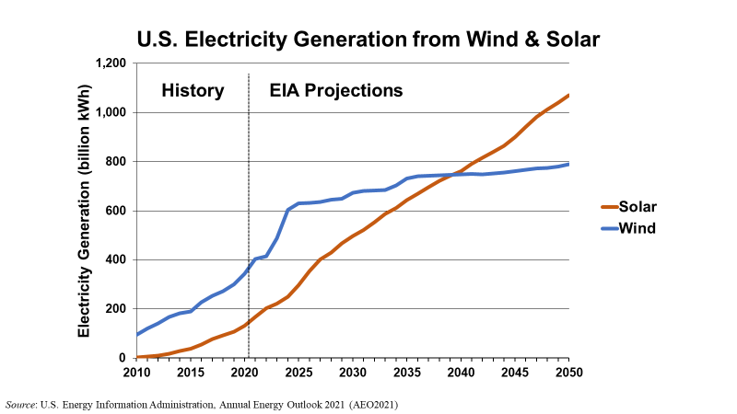
Notes:
The first element of a green transition is a rapid shift to renewable energy. The Department of Energy’s “reference case” projection sees continued increase in wind power, and a more rapid increase in solar. But these projections could well be exceeded if there is any significant policy effort to promote renewables.

Slide 21
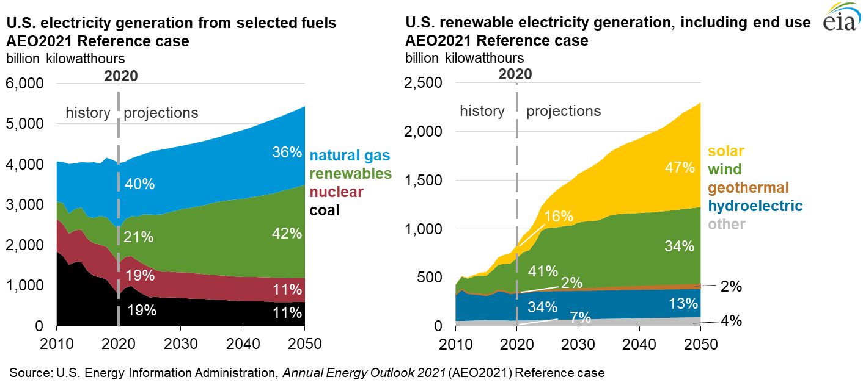
Notes:
In the “reference case”, fossil fuels still provide a substantial portion of power generation through 2050, though renewable expand significantly. This is not good enough for the net zero transition envisioned in the Green New Deal. More raid expansion of renewables, decommissioning of fossil fuel plants, and a major increase in energy efficiency are all essential to reach net zero.

Slide 22
Potential of Energy Efficiency
A 2017 analysis by the International Renewable Energy Agency (IRENA) found that successful decarbonization of the world’s energy system by 2050 to limit warming to 2°C could be accomplished with 50% of the carbon reduction coming from a transition to renewable energy and 45% from energy efficiency gains (with the remaining reduction being reduced emissions from remaining fossil fuel sources).
“Lowering the ceiling” of total energy demand is as important as “raising the floor” of renewable supply to squeeze fossil fuels use close to zero.
Notes:
Energy efficiency is the “sleeper” in effective climate policy. Less visible than new wind or solar installations, it nonetheless can contribute up to half the needed transition by reducing overall energy demand, allowing the remaining needed supply to be provided by renewable sources only.

Slide 23
Potential of Forests and Land Use Change
An amount equal to 29% of annual anthropogenic CO₂ emissions is removed from the atmosphere by terrestrial ecosystems (IPCC 2019)
Forests and grasslands could sequester twice as much CO₂ annually as they do now (Erb et al. 2018)
Primary forests store more than twice as much carbon as do harvested forests and plantations (Harmon 1990)
Allowing secondary forests to continue growing will sequester an additional 2.8 GtC/yr
Halting land use change would sequester an additional 1.5 GtC/yr
In total, this would be 4.3 of the 4.7 GtC/yr gap between emissions and removal rates (Houghton and Nassikas 2018)
-- Moomaw, William R., Susan A. Masino and Edward K. Faison. 2019. “Intact Forests in the United States: Proforestation Mitigates Climate Change and Serves the Greatest Good.” Frontiers in Forests and Global Change, June 11. https://www.frontiersin.org/articles/10.3389/ffgc.2019.00027/full
Notes:
Another neglected area is the enormous potential of natural systems to absorb carbon. Forested lands now absorb nearly a third of anthropogenic CO₂ emissions, and this amount could be doubled by protecting existing forests and expanding forested area.

Slide 24
Potential of Healthy Soils Carbon Storage
Global soils contain 2 to 3 times more carbon than the atmosphere (1,500 Gigatons).
If this carbon level increased by 0.4% in the first 30-40 cm of soil, the annual increase of carbon dioxide (CO₂) in the atmosphere would be significantly reduced.
4 per 1000 Initiative: healthy soils for food security and climate stabilization.
There are 570 million farms in the world and more than 3 billion people living in rural areas could implement these practices.
This initiative is part of the Global Climate Action Plan (GCAA) adopted by the UNFCCC at COP 22.
--“4 Per Thousand” Initiative, https://www.4p1000.org/
Notes:
Soils are the largest carbon sink on earth, and regenerative agricultural techniques could allow them to store much more carbon annually, offsetting current emissions and eventually even contributing to net negative emissions.

Slide 25
Will the GND be Extremely Costly?
An important issue in assessing costs is the standard economic principle of increasing marginal cost. This implies that the initial costs are the lowest.
A major study of greenhouse gas abatement costs by McKinsey & Company found that the costs of abating up to about a third of total emissions were negative – implying that for these abatement programs, especially increasing energy efficiency, economic advantages outweighed costs even without considering environmental gains.
The second third involved relatively low cost, less than $20 per ton of CO₂ equivalent. On a global scale, the total cost of reducing 2030 emissions by 35% compared to 1990 levels, or 70% compared with business-as-usual levels, would be less than 1% of global GDP.
McKinsey and Company, 2009 and 2013, Pathways to a Low-Carbon Economy, https://www.mckinsey.com/business-functions/sustainability/our-insights/pathways-to-a-low-carbon-economy
Notes:
Despite the trillions in needed investment to accomplish all GND goals, much of the initial carbon reduction can come at low or even negative cost.

Slide 26
Global Greenhouse Gas Abatement Cost Curve for 2030
Carbon capture and storage, reduced intensive agriculture conversion
New building efficiency, pasture, grassland, soil and forest management
Wind and solar power, forest restoration
Waste recycling, small hydro, other efficiency improvement
Abatement cost (€ per tCO₂e)
Hybrid cars, electricity from landfill gas, other industrial efficiency
Improved cropland management, insulation retrofit (residential)
Efficiency improvement, LED lighting, insulation retrofit (commercial)
Abatement potential (GtCO₂e per year)
Source: Adapted from McKinsey & Company, 2009.
Notes:
The least expensive, often net negative, carbon abatement costs are associated with energy efficiency and land use improvements. About a third of current emissions could be abated at minimal or negative cost. Another third can be accomplished at low cost, and even the final and most expensive third does not exceed costs of $100/ton of CO₂.

Slide 27
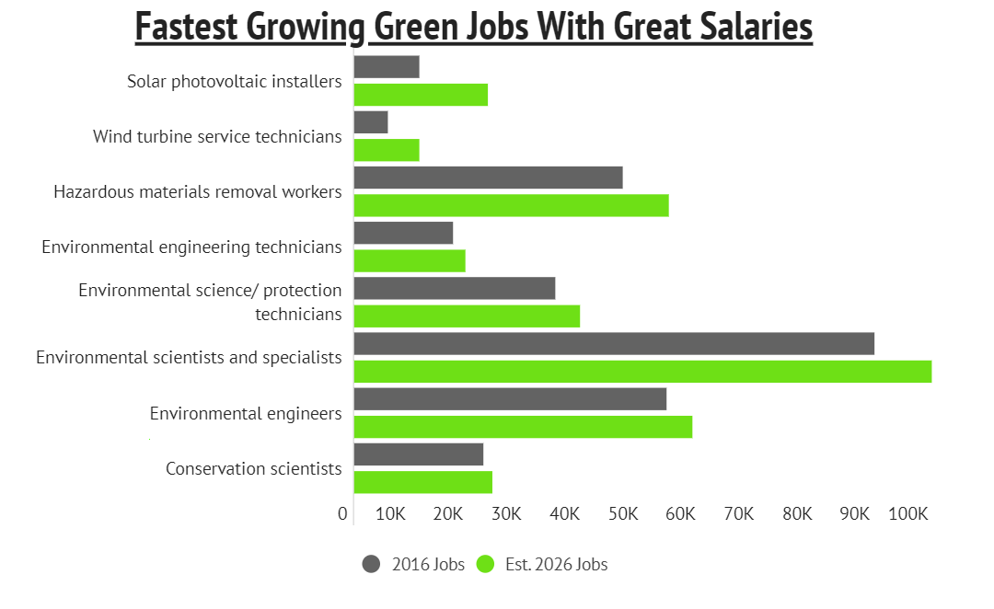
Employment Benefits
A U.S. Department of Energy (DOE) report on jobs and the economy found that 6.4 million Americans work in the energy sector, with 300,000 jobs added last year. A huge percentage of these new jobs are in renewable energy and efficiency. - Dept of Energy, 2017
Notes:
Green New Deal policies generate significant employment benefits. Green jobs are already some of the fastest growing areas of the labor market, and this could be greatly accelerated with appropriate policies and investment.

Slide 28
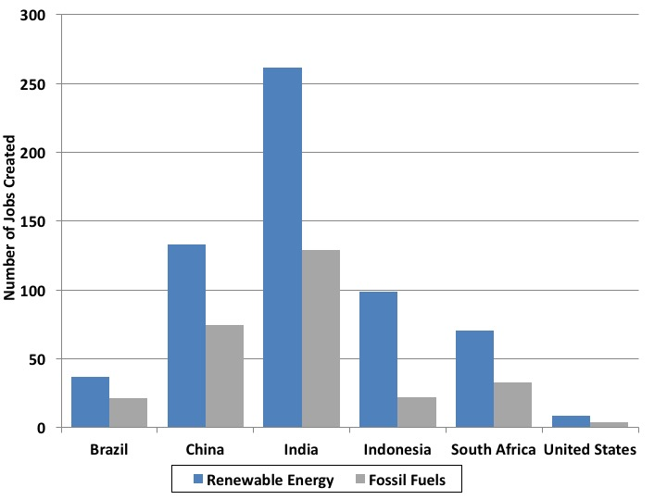
Jobs Generated by Investing One Million Dollars in Clean Energy versus Fossil Fuel Production
Source: Pollin, 2015.
Notes:
The employment benefits are even greater in developing economies where production is typically more labor-intensive.

Slide 29
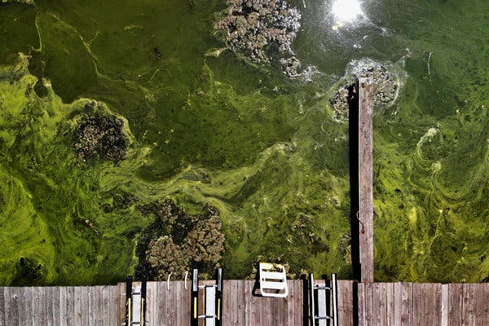
The Need for Infrastructure Investment
Algae Bloom Fouls N.J.’s Largest Lake, Indicating Broader Crisis
“Around Lake Hopatcong, New Jersey’s largest lake, workers have been laid off, sailing lessons canceled and summers ruined. The reason: clouds of blue-green algae in the water, blooming in quantities never before recorded.”
“The biggest challenge is in places with older sewer and stormwater systems that have been overwhelmed by fast-moving storms, as has happened repeatedly this summer in New Jersey and New York. The Environmental Protection Agency has put the cost of upgrading New Jersey’s stormwater system at $16 billion.”
-- New York Times, August 5, 2019.
Notes:
Much of the infrastructure investment called for by the GND is essential to maintain quality of life. Water pollution associated with climate change and obsolete sewage and stormwater systems requires $16 billion of investment in a single state, New Jersey, and comparable problems exists across the country.

Slide 30
Financing a Green New Deal
Raising revenue: Minimum tax on corporate profits, surcharge on stock buybacks, surtax for multi-millionaires, improve tax collection, new Superfund fees, eliminate fossil fuel subsidies.
Deficit spending: depends how you look at it:
“The US national debt isn't actually very high, Bank of America says: if you value the US economy like a company, using a discounted cash flow analysis, the debt to GDP ratio is just 0.7%, the lowest since 2004, based on research by former White House officials Larry Summers and Jason Furman.” -- Business Insider, April 19, 2021
CBO estimates of deficit impact of BBB about 1/10 of 1% of GDP. --Michael Klein, Tufts University, “Why spending $2 trillion on childcare, health care, and fighting climate change won’t make inflation any worse”
Notes:
The Build Back Better proposal includes new source of revenue to offset investment costs. Taxes on corporations and the rich, along with eliminating fossil fuel subsidies, can bring in trillions over time, while deficit impacts are modest and possibly even negative.

Slide 31
Environmental and Employment Benefits Outweigh Costs
Many GND policies require minimal spending and deliver net benefits in terms of employment and environmental improvement, including health co-benefits.
In terms of carbon reduction, the higher costs would potentially come later: 30% reduction would be cheap, 100% could be expensive.
Infrastructure investment will ultimately involve trillions in spending, but will generate tremendous employment potential, including in economically lagging areas.
If initiated with an emphasis on energy efficiency, low-cost renewables, and employment generation, GND would demonstrate major employment and environmental benefits, and could be ramped up over time.
Notes:
Overall, the environmental and employment benefits of the GND clearly outweigh costs. This is especially true when long-term effects are fully taken into consideration, since the benefits of these investments last for many decades or even centuries in the case of long-term greenhouse gas reduction.

