Slide 1
i
Assessing Site Response Complexity Using Single Station HVSR: Mexico City Case Study
Marshall Pontrelli¹ and Dr. Laurie Baise²
¹Graduate Research Assistant, ²Professor and Chair
Tufts University, Medford, MA, 02155, USA
VII International Conference on Earthquake Geotechnical Engineering, Roma (Italy), 17-20 June 2019

Slide 2
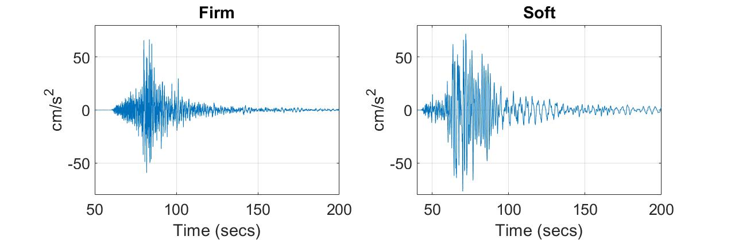
Introduction
1
Site Response: Firm Site vs. Soft Site
Firm
Soft
Soft

Slide 3
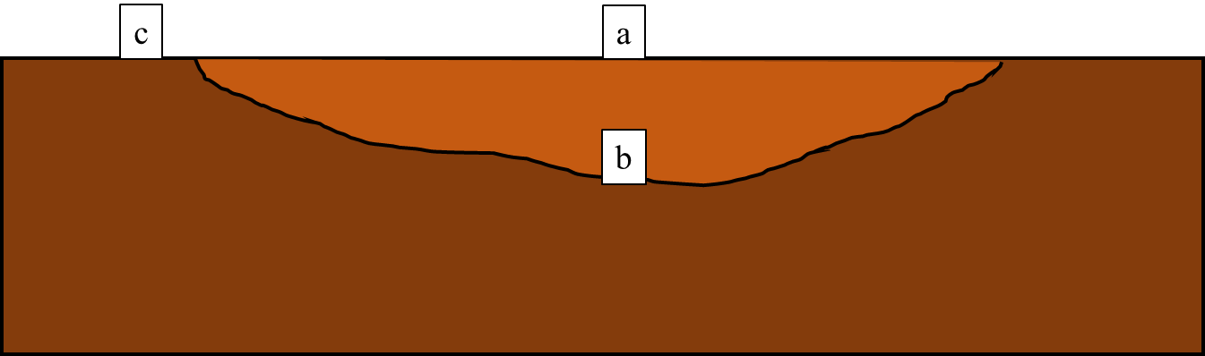
Introduction
2
Transfer Functions
Theoretical transfer function SH1D assumptions:
Vertically propagating shear waves
Horizontally stratified medium
Frequency independent damping
Strain independent shear modulus
Empirical transfer function computation methods:
Surface-borehole: b -> a
Simple spectral ratio (SSR): c-> a
Horizontal to vertical spectral ratio (HVSR): a -> a (proxy)

Slide 4
Introduction
3
Motivation – Thompson et al. 2012 Taxonomy
Does a site conform to the SH1D assumptions or is it complex?
Uses borehole ETF
Two Statistics:
Interevent variability (median standard deviation)
Goodness of fit to the SH1D transfer function (Pearson’s r)
a
b
Four classifications:
LG
LP
HG
HP
Thompson et al. 2012

Slide 5
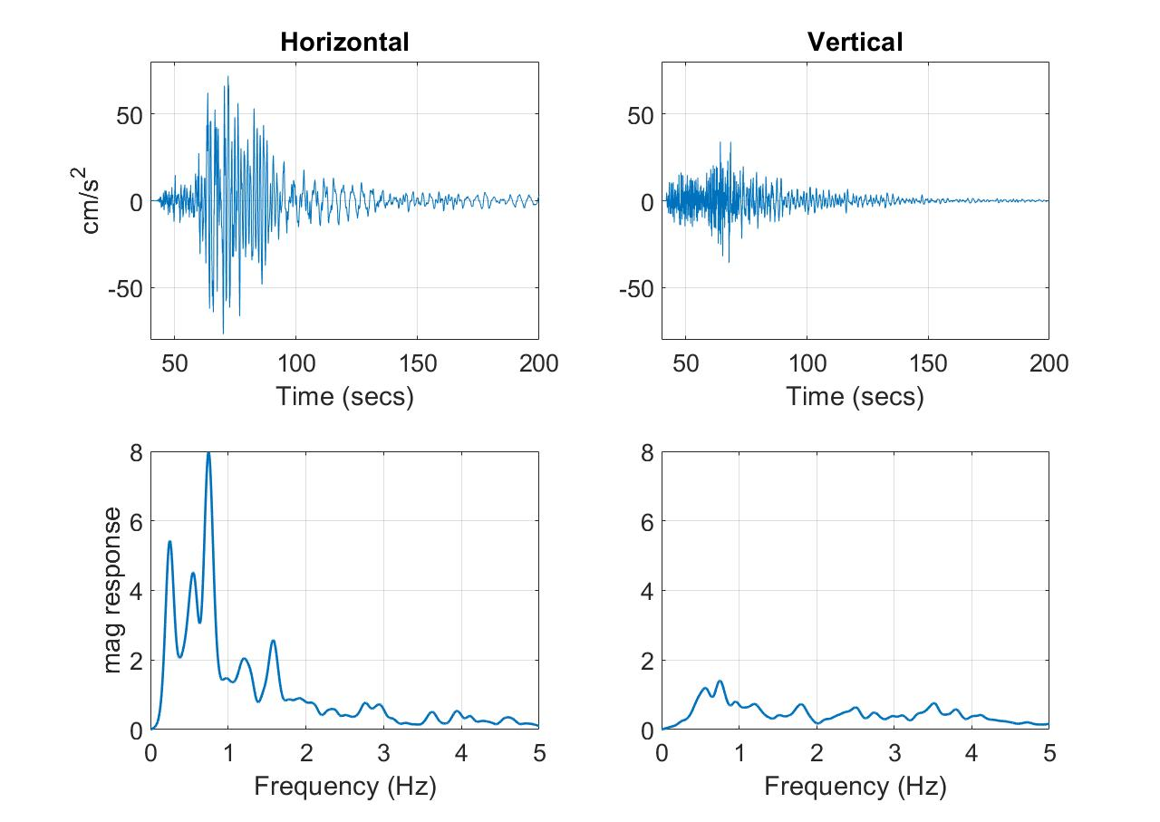
Introduction
4
H/V Spectral Ratio (HVSR)
Uses single station to estimate ETF
a

Slide 6
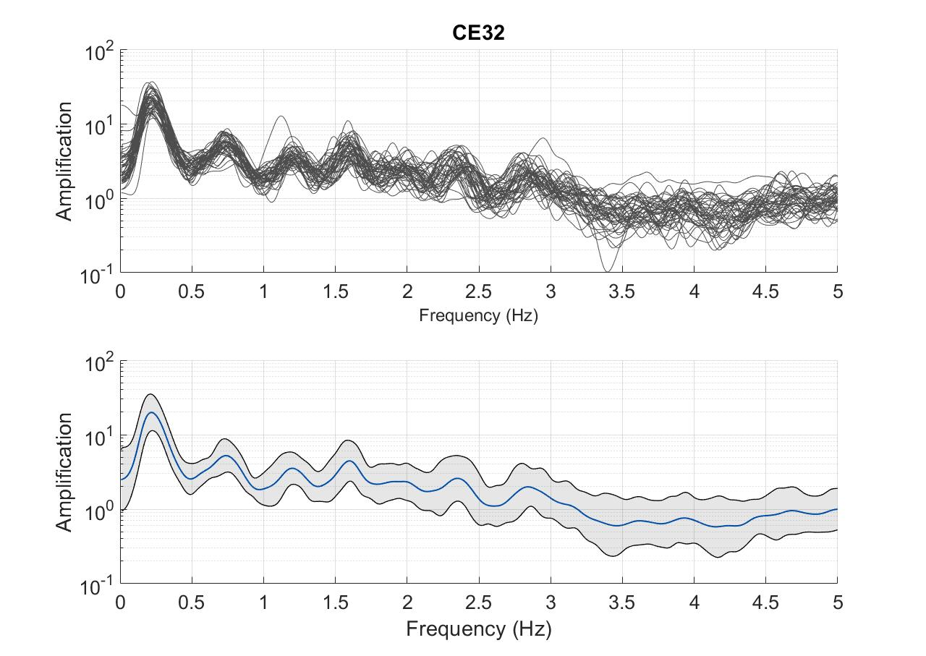
Introduction
5
H/V Spectral Ratio (HVSR)

Slide 7
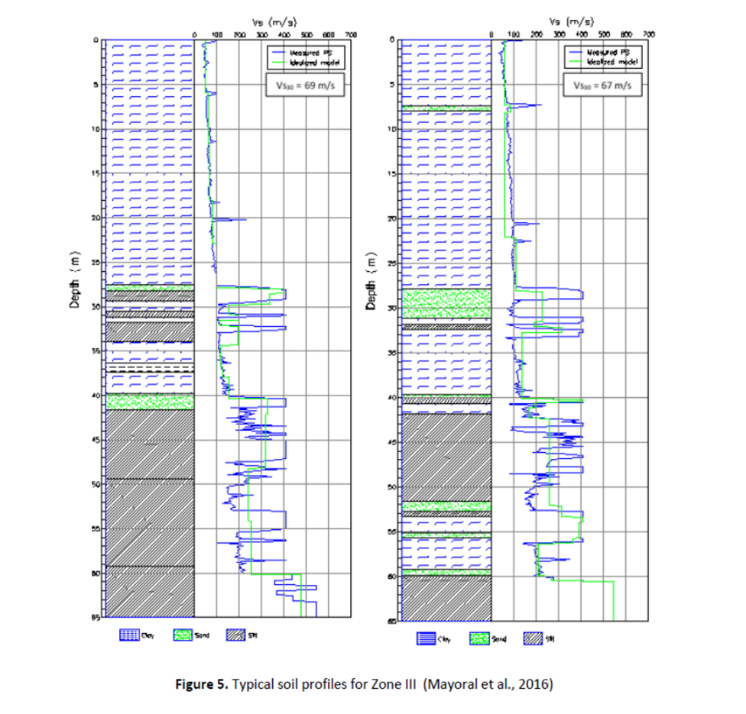
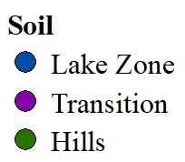
Data and Case Study
6
Mexico City Case Study
V_{s} (m/s)
V_{s} (m/s)
0
300
700
0
300
700
0
0
5
5
10
10
15
15
20
20
25
25
Depth (m)
30
30
35
35
A
40
40
45
45
50
50
55
55
60
60
65
65
Çelebi et al. 2017
Mayoral et al. 2016
Typical lake zone soil profile

Slide 8
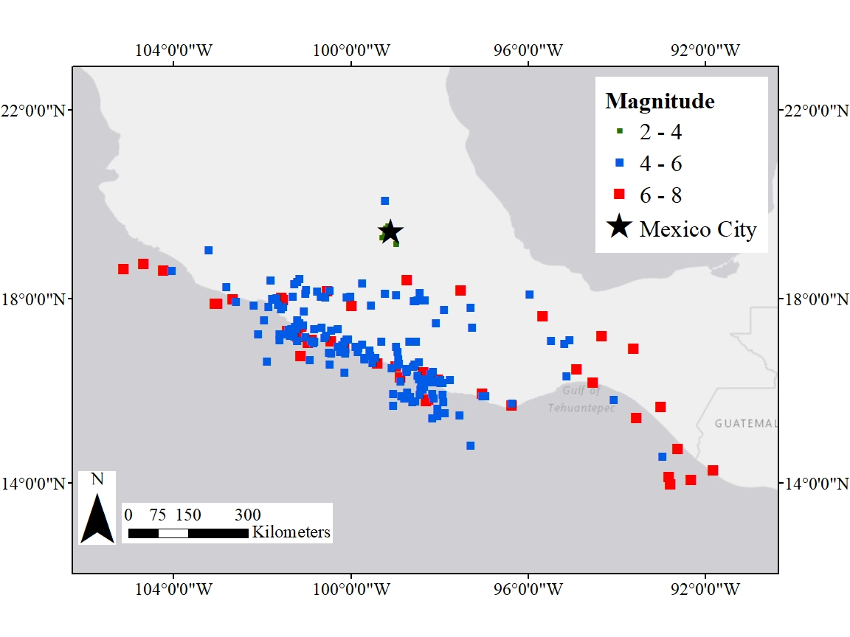
Data and Case Study
7
Mexico City Case Study

Slide 9
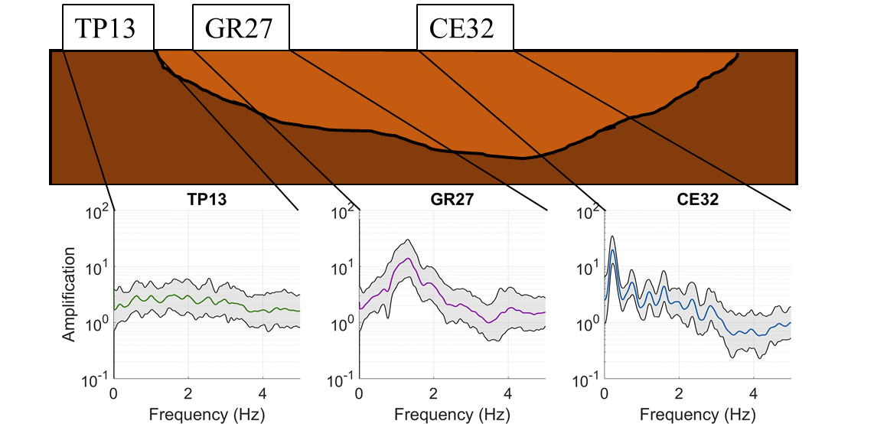
Data and Case Study
8
Mexico City Case Study HVSRs

Slide 10
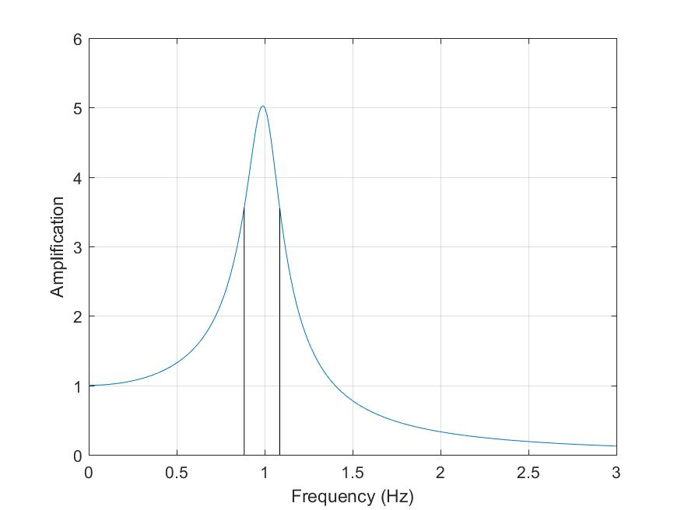
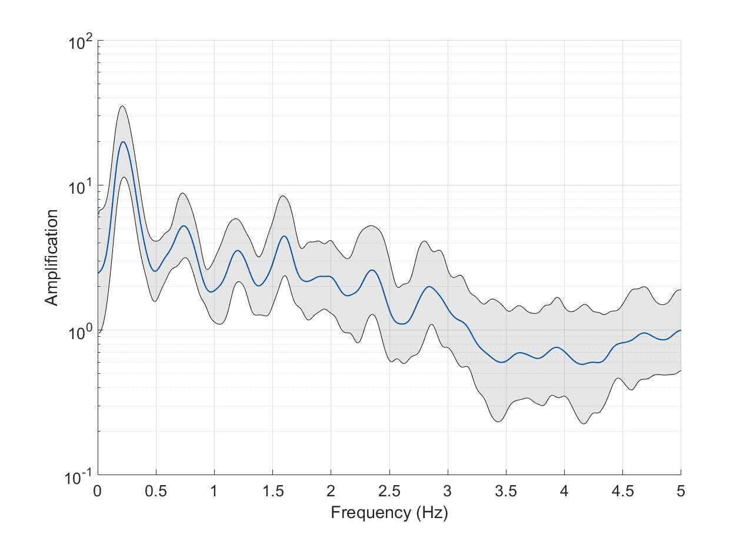

Methods
9
Peak Shape Statistics
Four Peak Shape Statistics:
Amplitude (a)
Fundamental frequency (f_{n})
Half power bandwidth (HPB)
Interevent variability (σ_{i})
Amplitude
σ_{i} = median σ
between f_{a} and f_{b}
Amplitude
HPB
$1/\sqrt{2}$ * amplitude
HPB
f_{n}
f_{a}
f_{b}
f_{n}

Slide 11
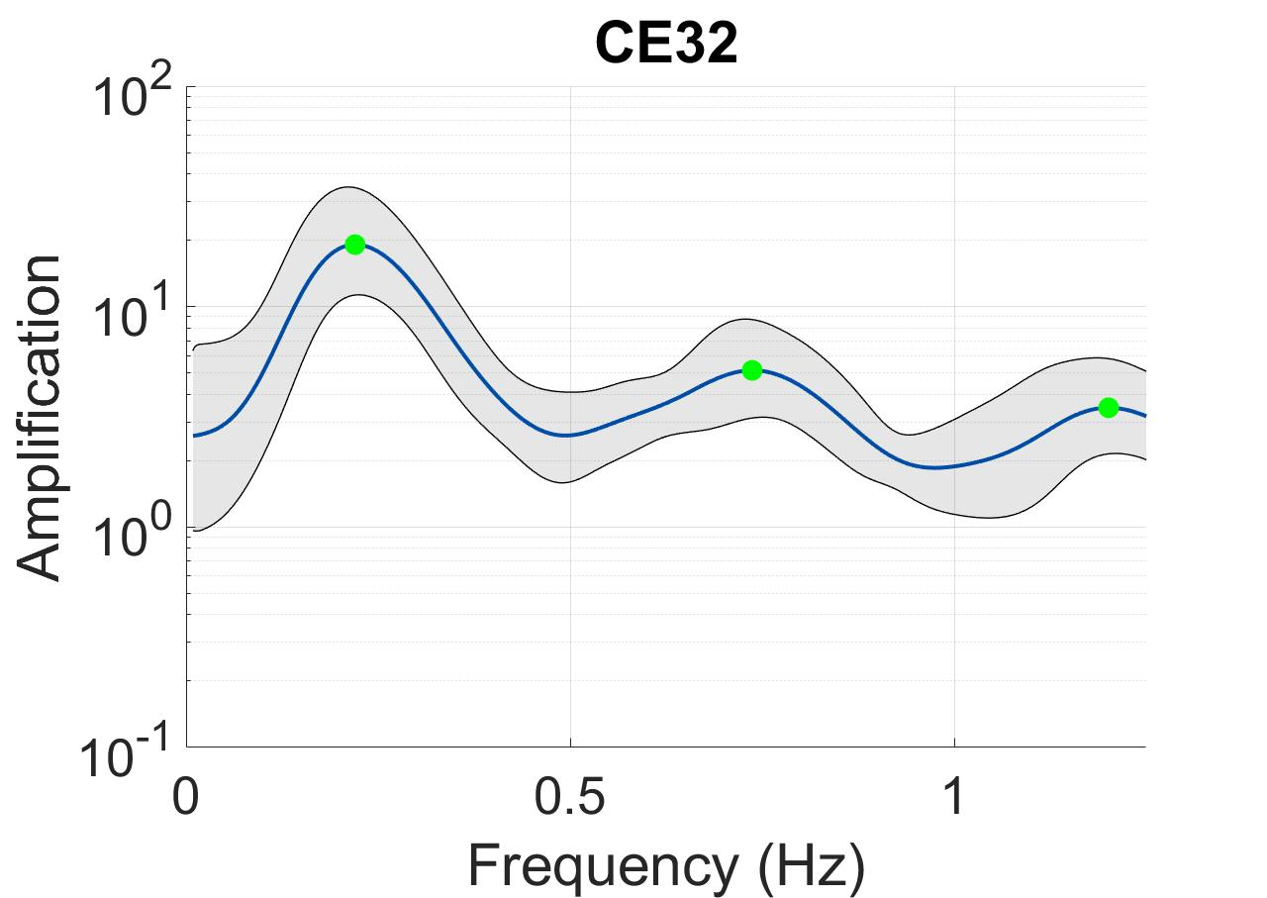
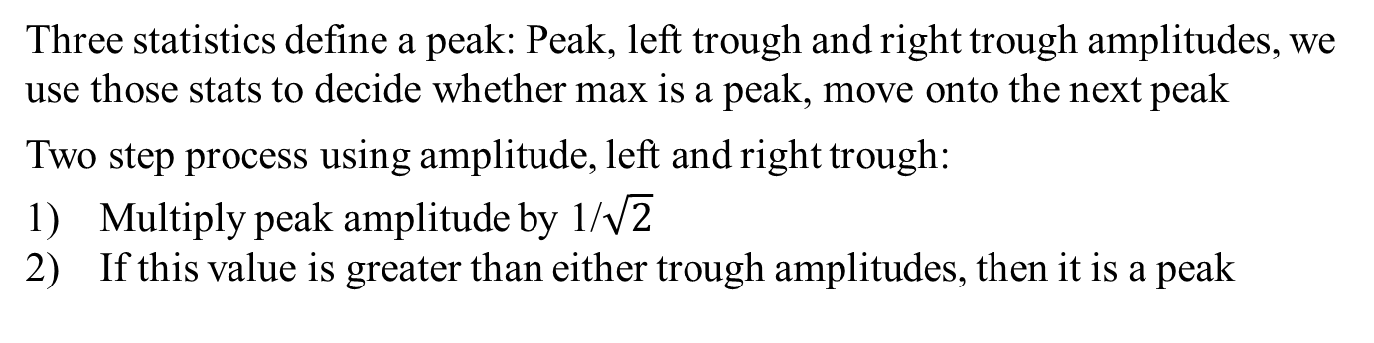
Methods
10
Peak Definition
Three statistics define a peak: Peak, left trough and right trough amplitudes, we use those stats to decide whether max is a peak, move onto the next peak
Two step process using amplitude, left and right trough:
Multiply peak amplitude by 1/$\sqrt{2}$
If this value is greater than either trough amplitudes, then it is a peak

Slide 12
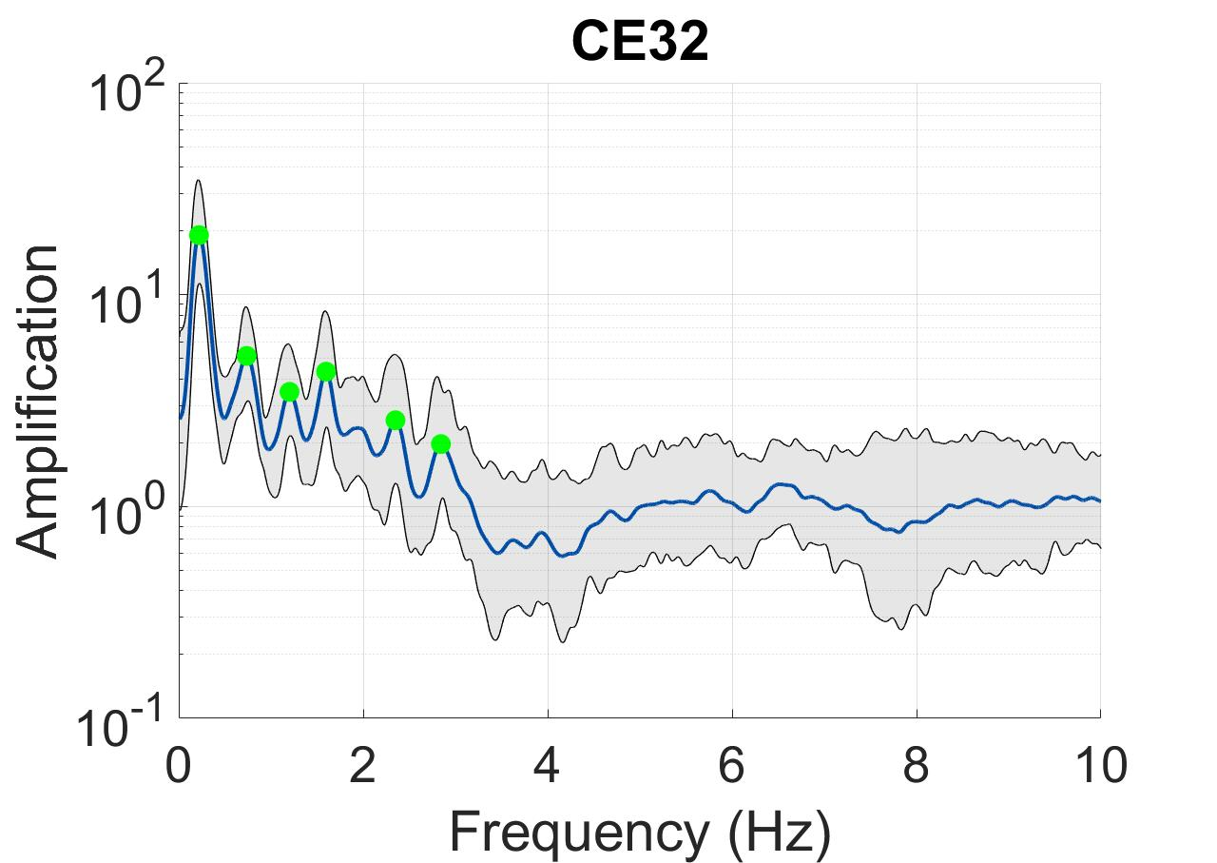
Methods
11
Peak Definition
Using this peak definition this station has 6 peaks, at each we compute f_{n}, a, HPB and σ_{i}

Slide 13
Methods
12
System Design
User inputs:
1. Ground motion database
2. Ground motion options
3. Filter options
Start
Perform H/V
Part 1
Compute average, std dev and 95% confidence and plot
Determine which peaks are significant
2n+1 statistics where n is the number of peaks:
1. n
2. f_{n}
3. a_{n}
4. HPB_{n}
5. σ_{in}
Part 2
Compute desired statistics on those peaks
Interpret results for applicability
Part 3
End

Slide 14
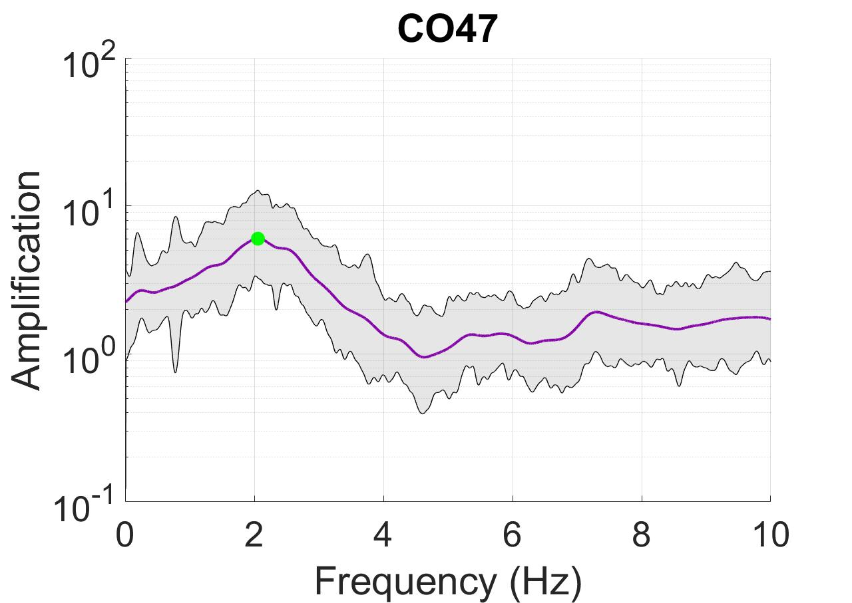
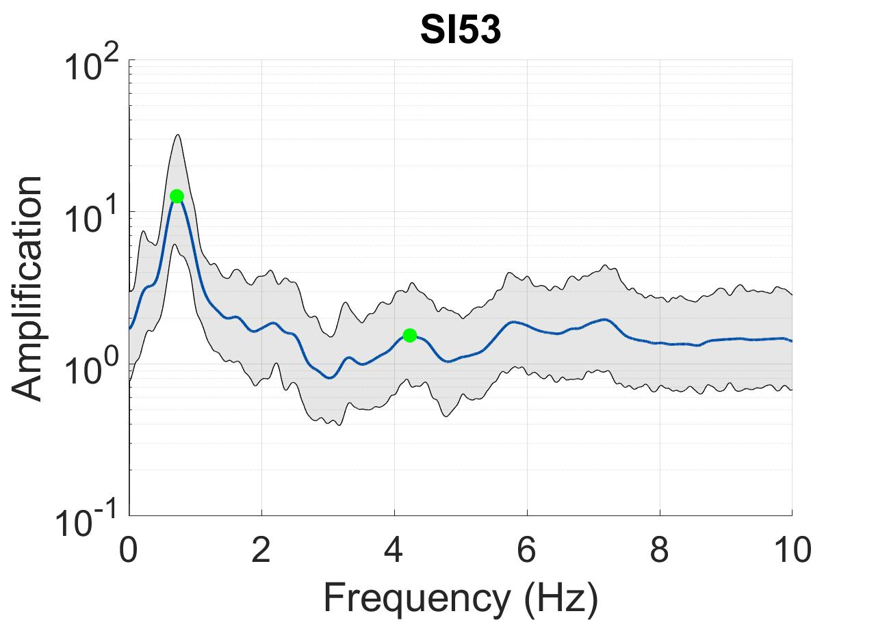
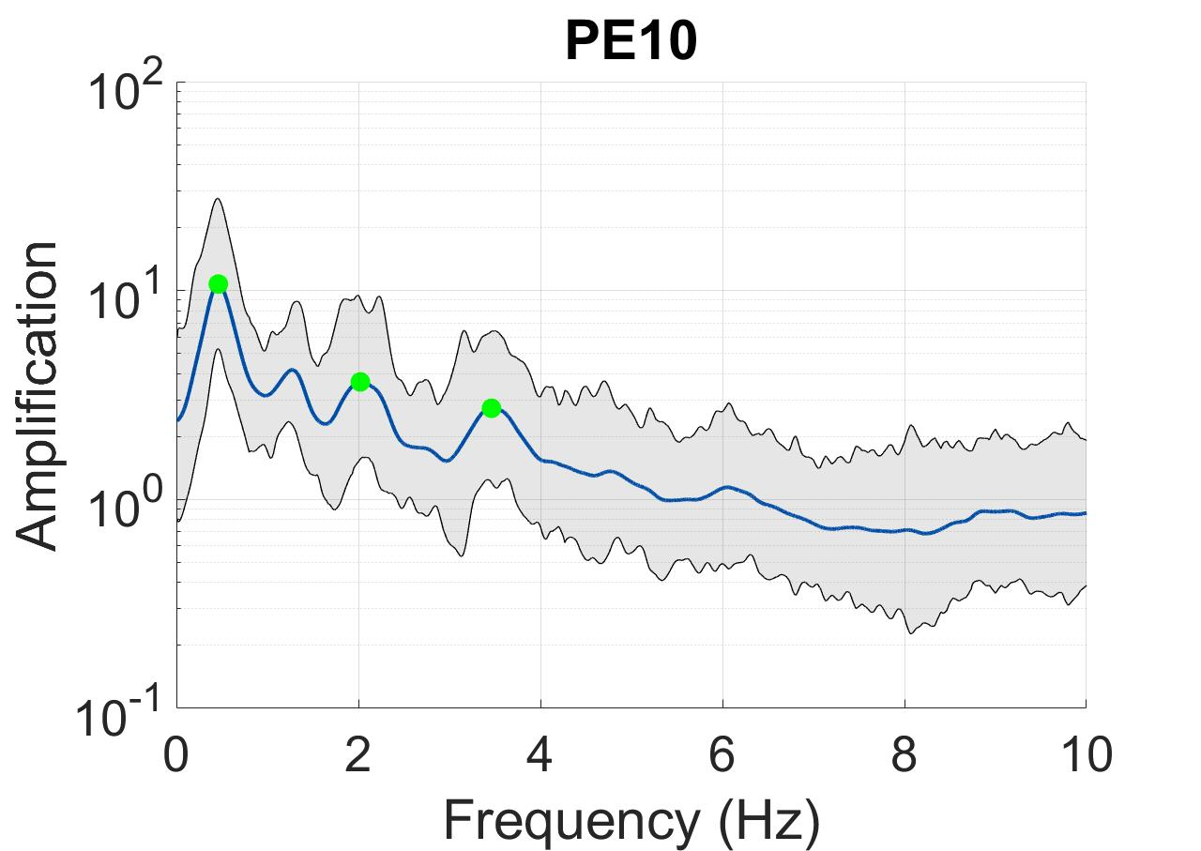
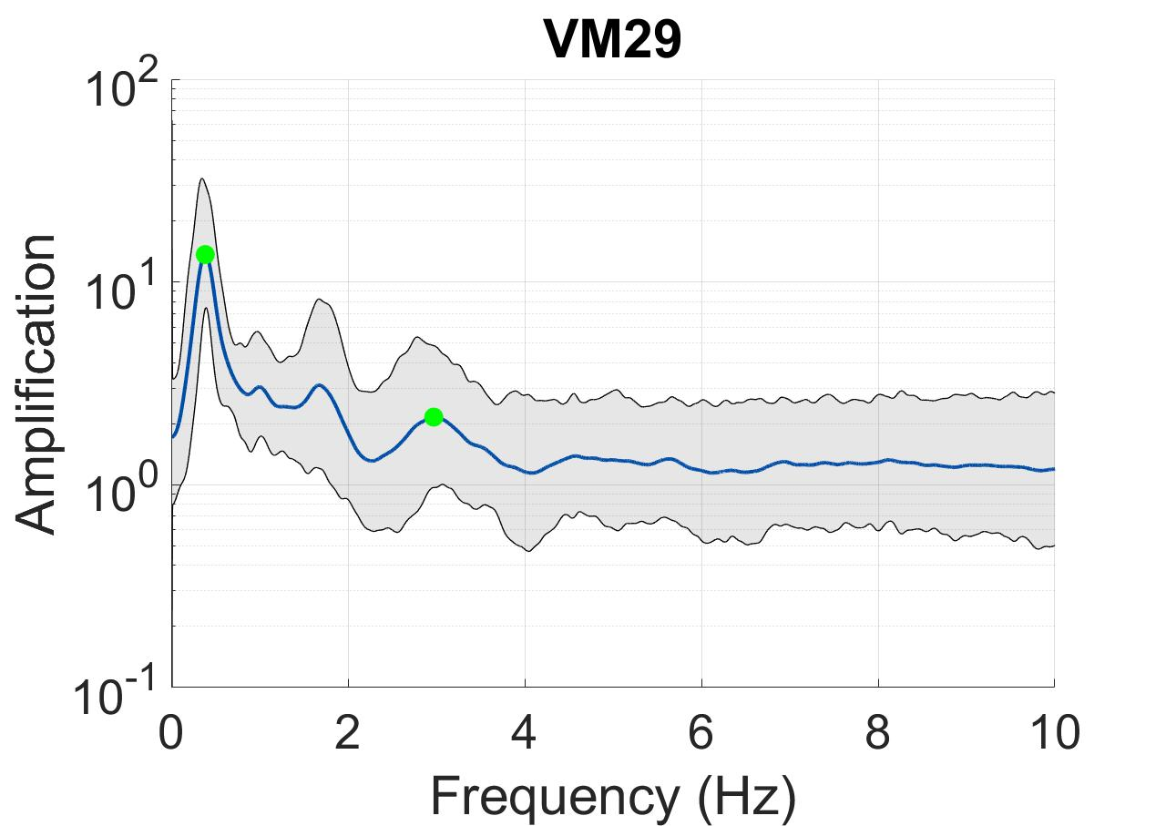
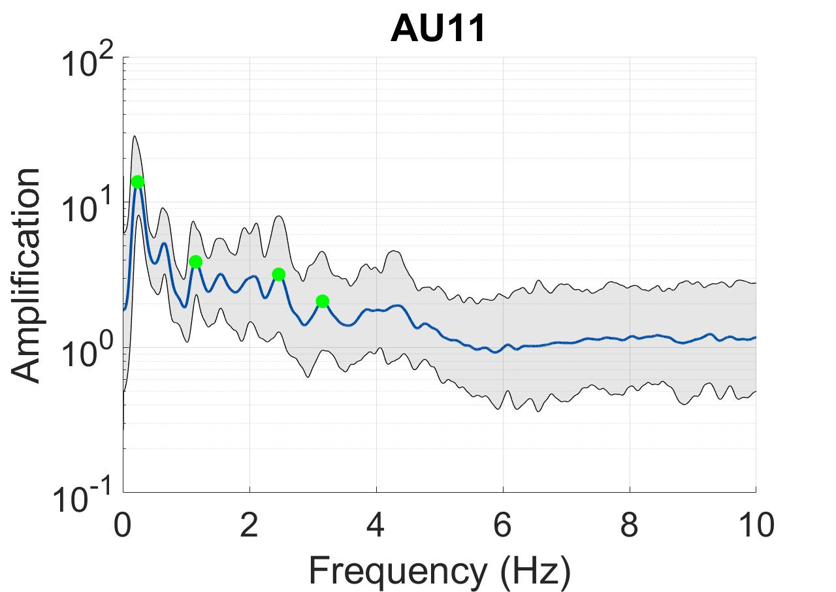
Results
13
Transects
A’
A
Çelebi et al. 2017

Slide 15
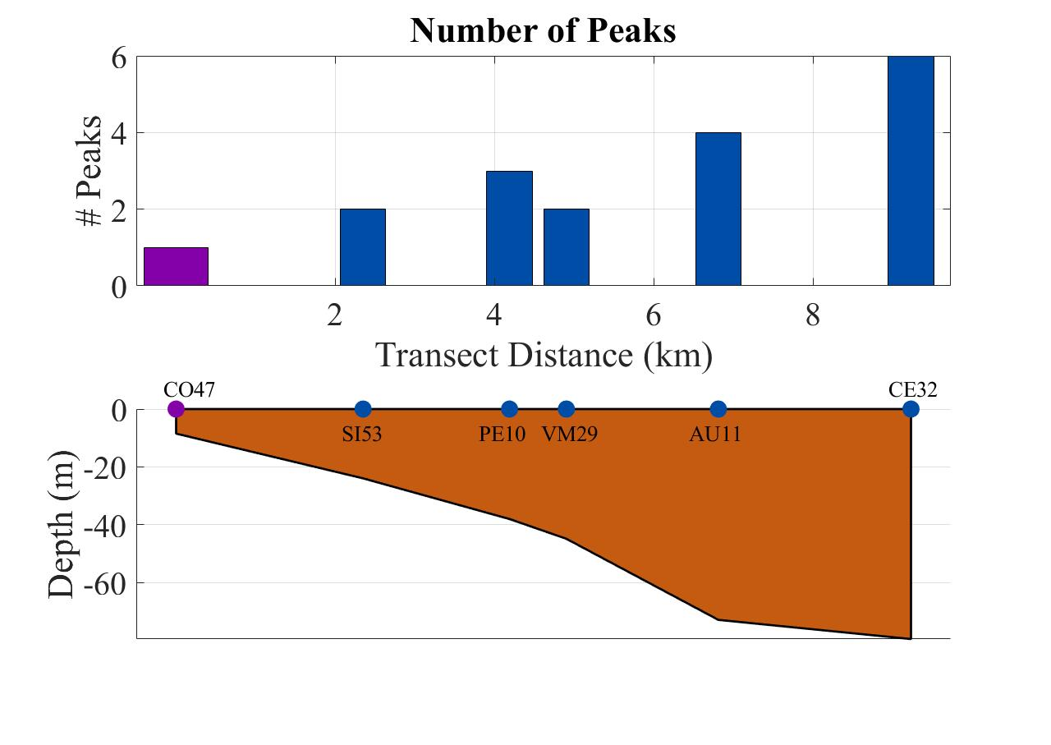
Results
14
Transect
Analyze statistics of the first peak of each HVSR in the transect

Slide 16
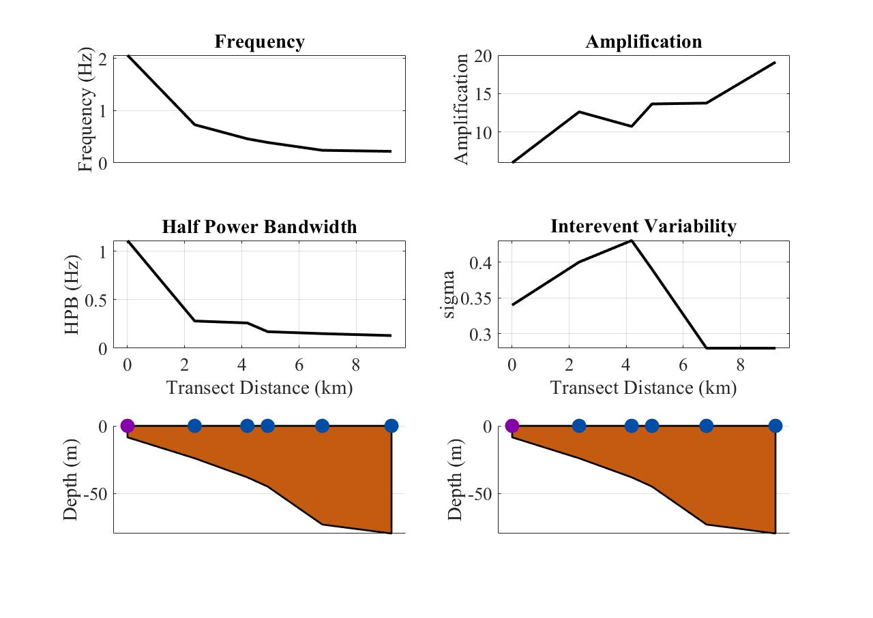
Results
15
Transect
Transect trends:
f_{n} decreases with depth
HPB decreases with depth
a increases with depth
σ_{i} has no trend

Slide 17
16
Conclusions
We have presented a new set of statistics to be used with HVSR for assessing site response complexity: n, f_{n}, a, HPB and σ_{i}
Frequency of the fundamental peak HVSR decreases with depth along the transect in Mexico City
Half power bandwidth of the fundamental peak decreases along the transect
Amplification of the fundamental peak increases along the transect
There is no distinct trend in interevent variability of the fundamental peak along the transect
The number of peaks of the HVSR increases along the transect. We think that this is indicative of greater resonance in the middle of the basin than the edge. It also may indicate greater wave scattering on the edge than the center of the basin.
The geometry of the basin edge could be causing complexity in the site response such as wave scattering that is observed in terms of higher HPB, and fewer peaks

Slide 18
17
Thank you
Questions?

