Slide 1

i
Soil Amplification in Glaciated Terrain
USGS Award No. G20AP00040
Marshall Pontrelli¹, Dr. Laurie Baise², Jeremy Salerno^{1,} Dr. John Ebel³
¹Graduate Research Assistant, ²Professor and Chair, ³Senior Research Scientist
Tufts University, Medford, MA, 02155, USA
Boston College, Chestnut Hill, MA, 02467, USA
ESSA Meeting, 10/14/2020

Slide 2
1
New England Vs30 and geologic terrain
Geologic Units of interest:
1) Glacial Lakes*
2) Till-filled topographic depressions*
3) River flood plains
4) Terminal moraines
5) Marine clay deposits
*No data presented in this presentation

Slide 3
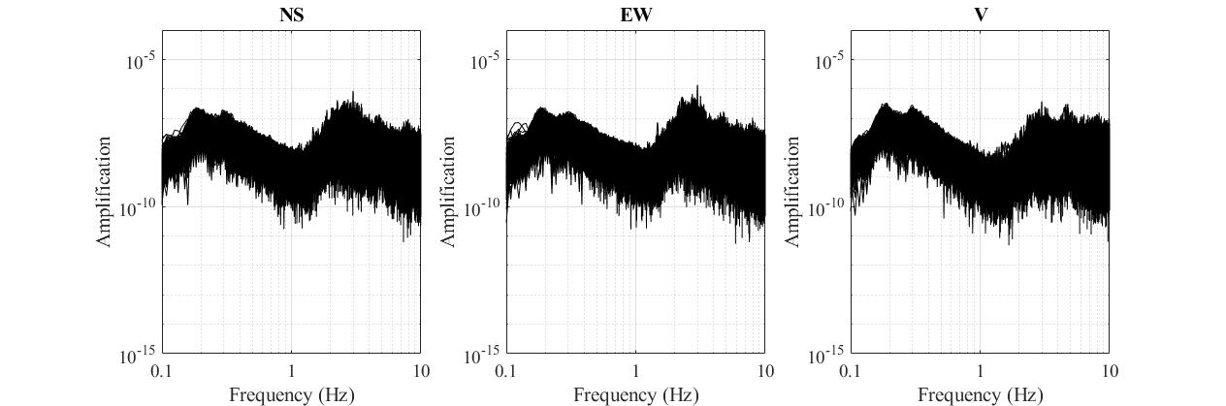
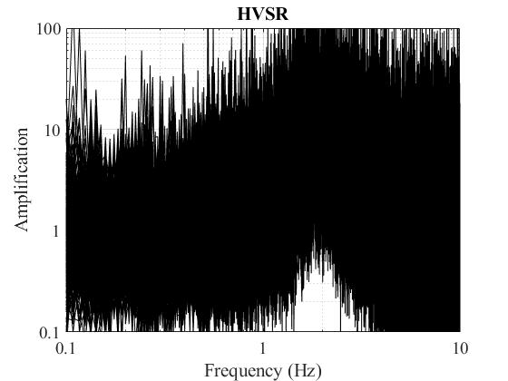
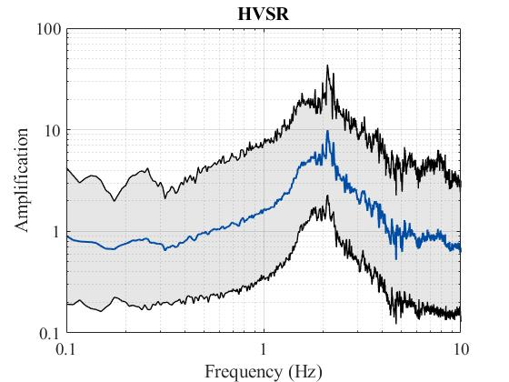
2
Processing steps for the HVSR

Slide 4
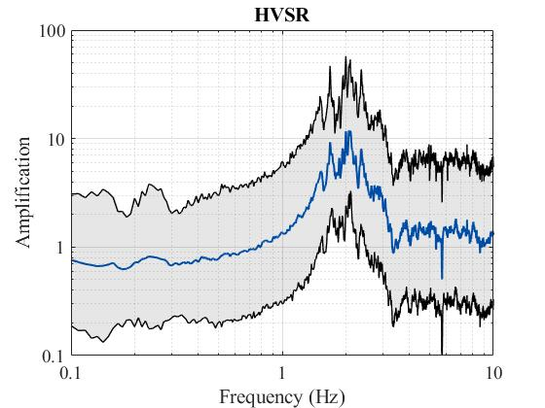
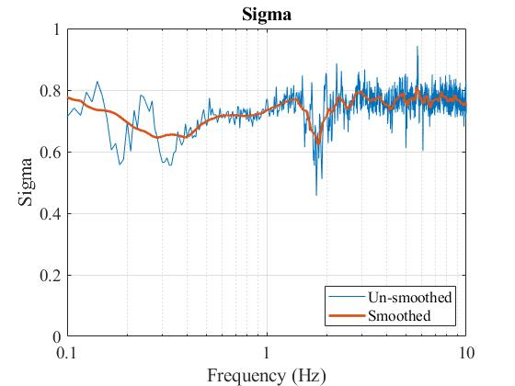
3
NE FFD, Pemigewasset river

Slide 5
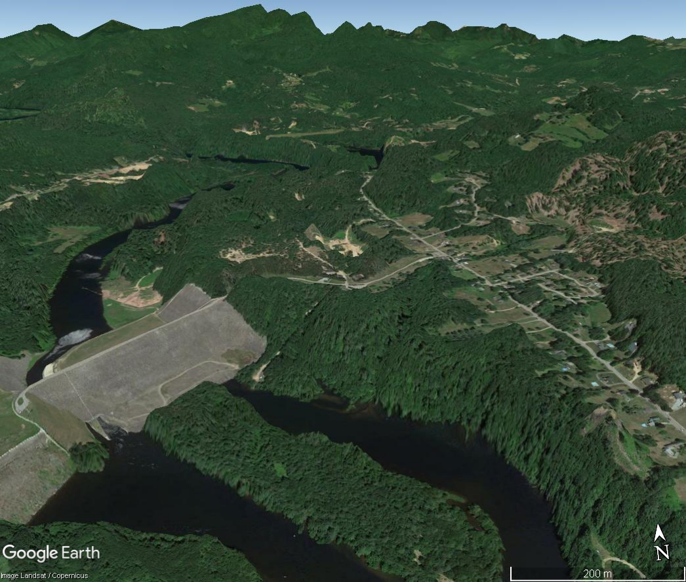
4
FFD, from Google Earth
Vertical exaggeration 3x
Pemigewasset River
FFD
Franklin Falls Dam

Slide 6
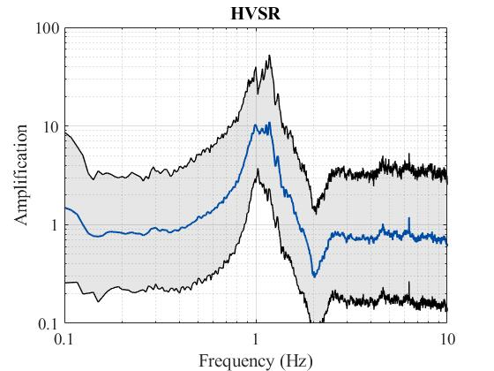
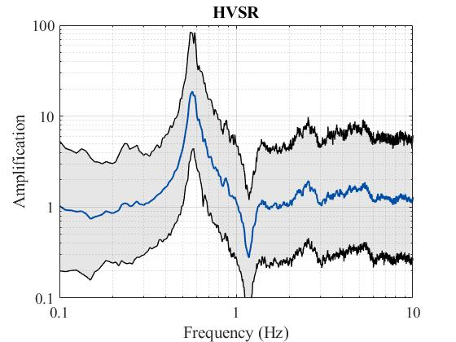
5
TA stations M65A and L65A on the Cape
M65A
L65A
M65A
L65A

Slide 7
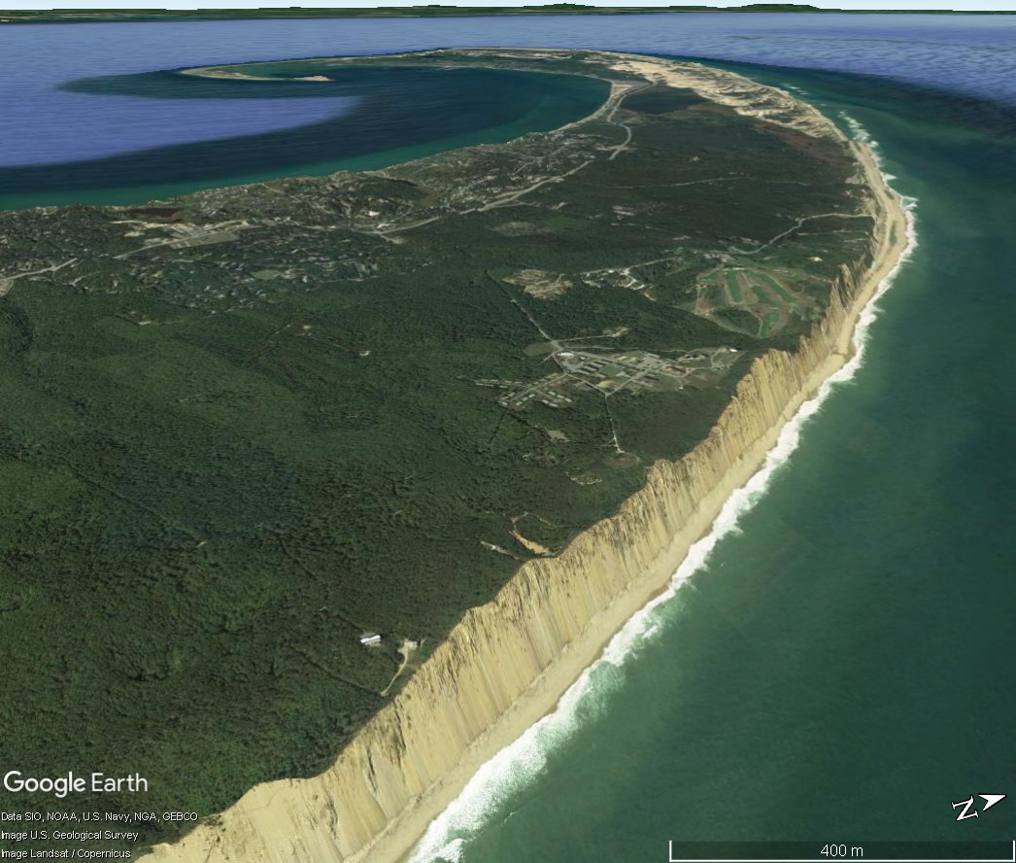
6
L65A, from Google Earth
L65A

Slide 8
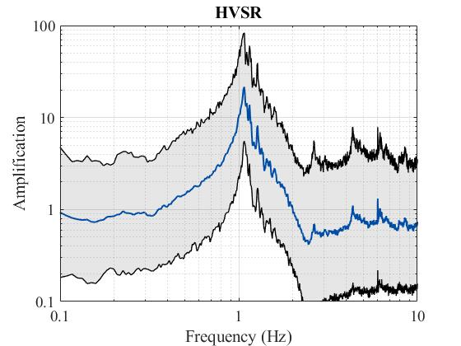
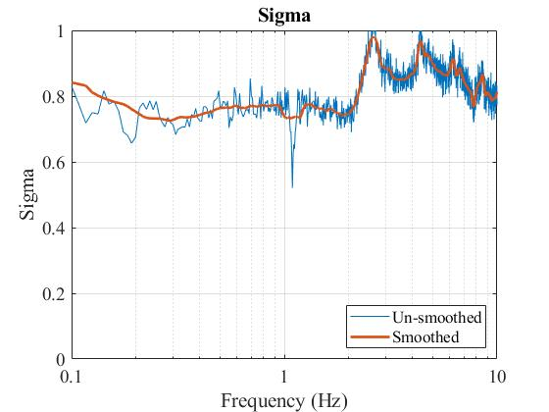
7
Champlain Sea Sediments TA station F58A

Slide 9
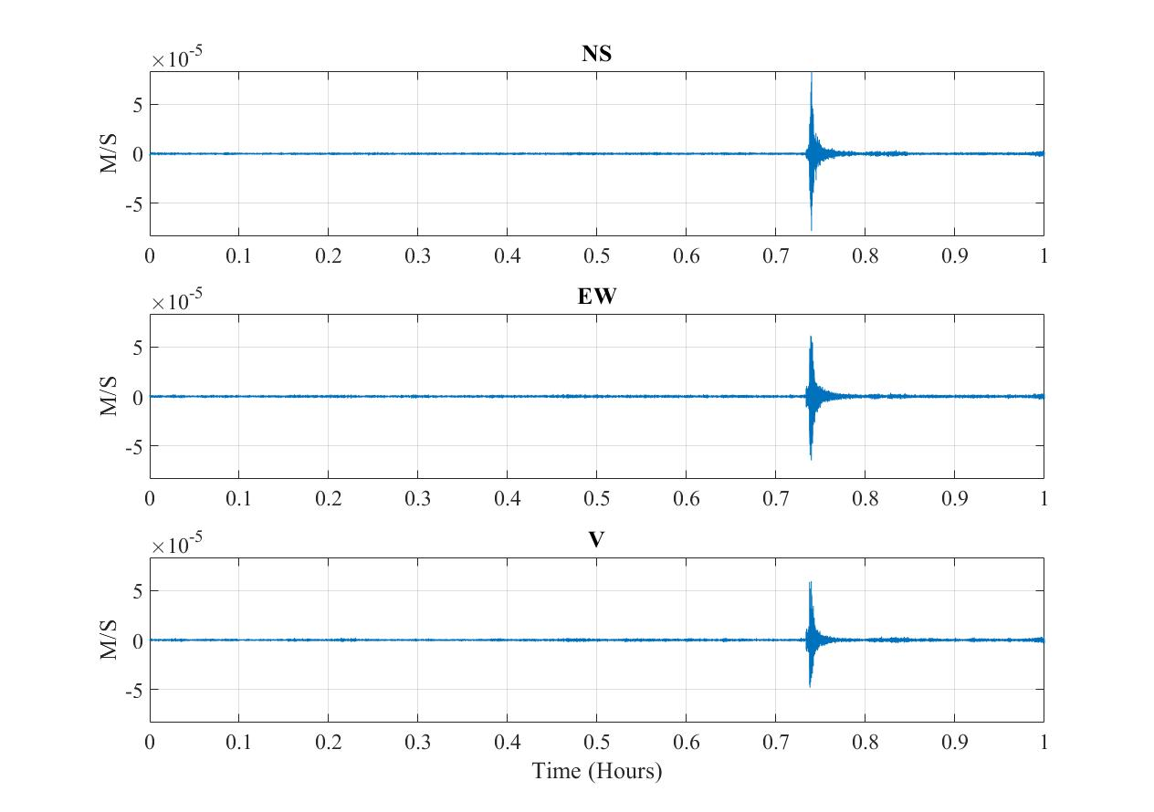
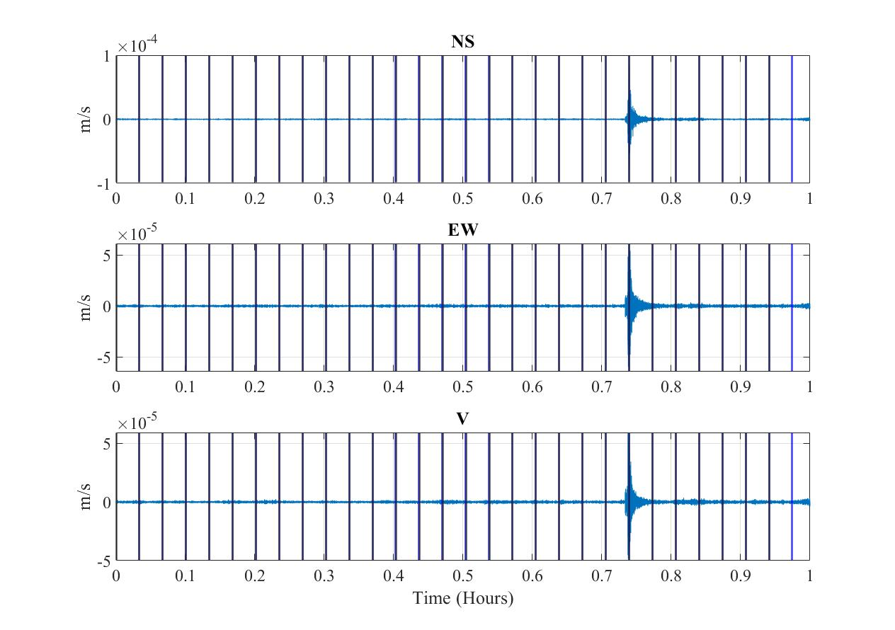
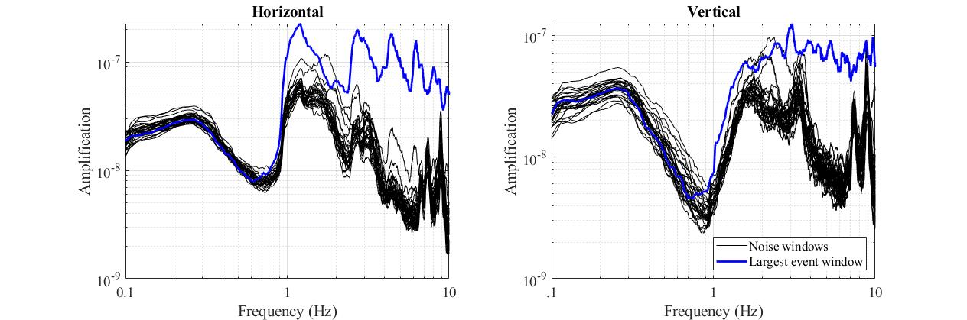
8
M3.1 recorded at F58A

Slide 10
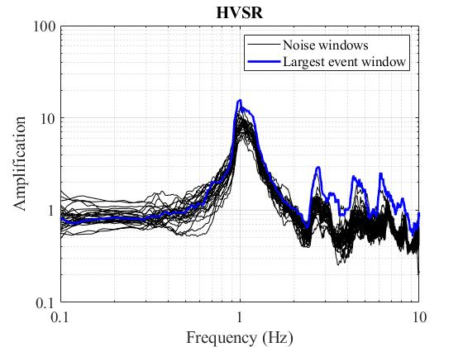
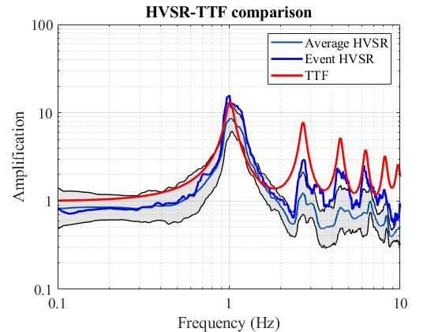
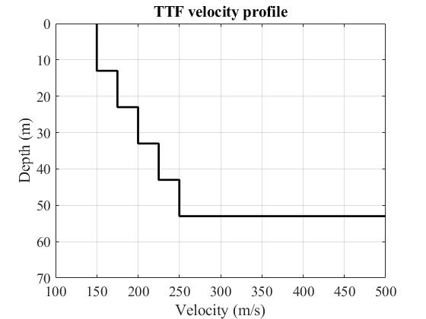
9
M3.1 recorded at F58A
S-wave velocity (m/s)
0
100
200
300
400
500
10
20
30
40
From Hunter et al. 2007
50
Depth (m)
60
70
80
90
100
110

Slide 11
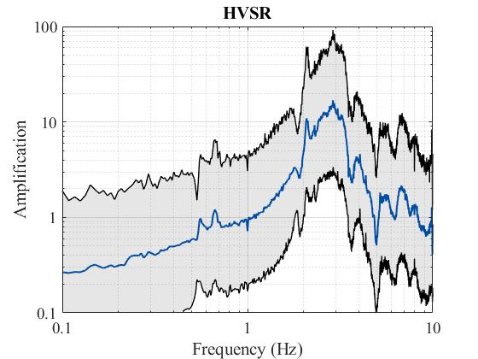
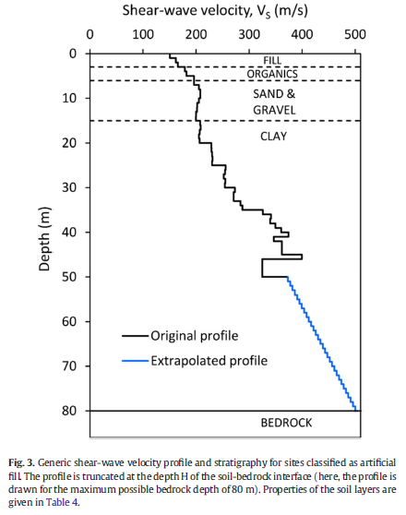
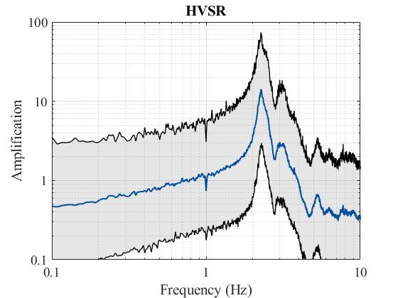
10
Boston Blue clay
MIT
MIT
East Boston
Northeastern
East Boston

Slide 12
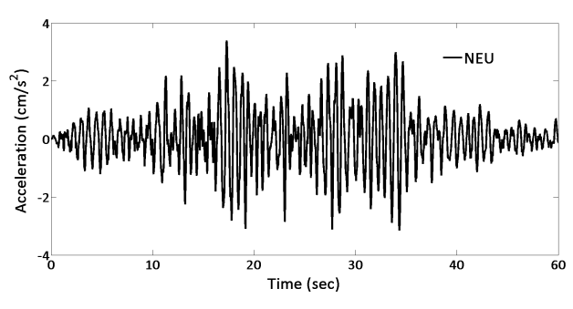
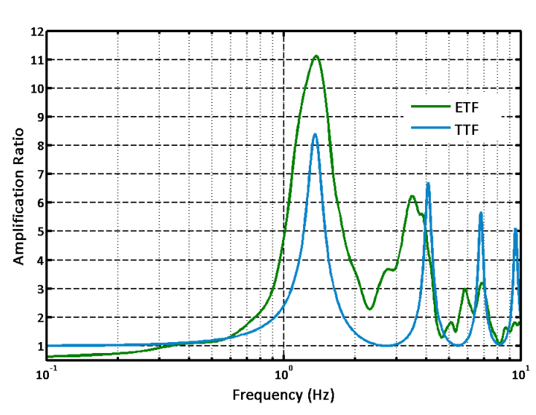
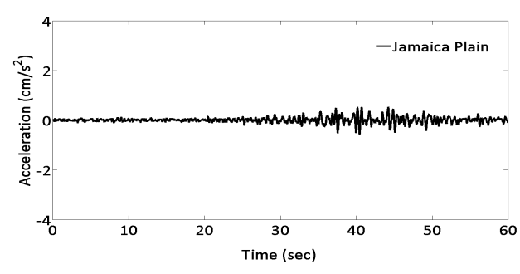
12
Northeastern SSR
Site amplification at Northeastern University. The bedrock recordings are at the Jamaica Plain rock site at a distance of 2 km way from the NEU site. The earthquake transfer function is calculated by the field data (green) and theoretical transfer function (blue) is calculated with the available site information. From Baise et al. 2016

Slide 13
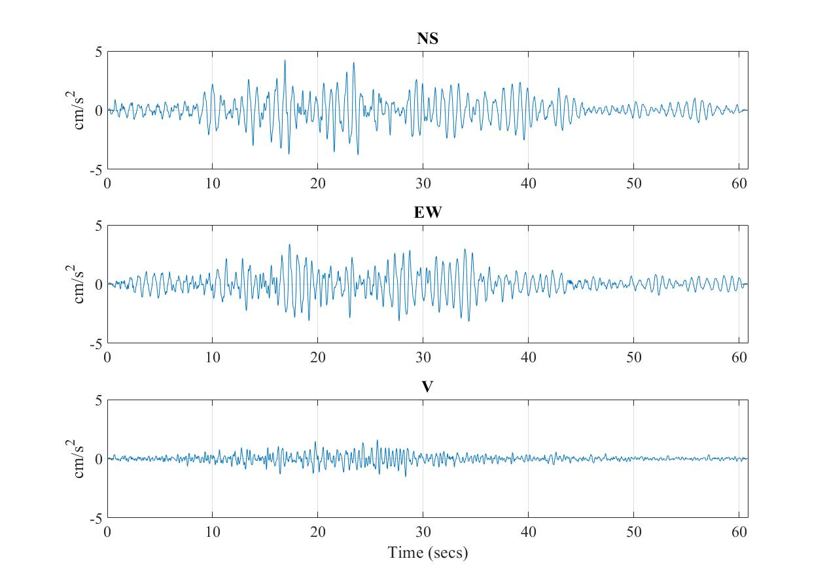
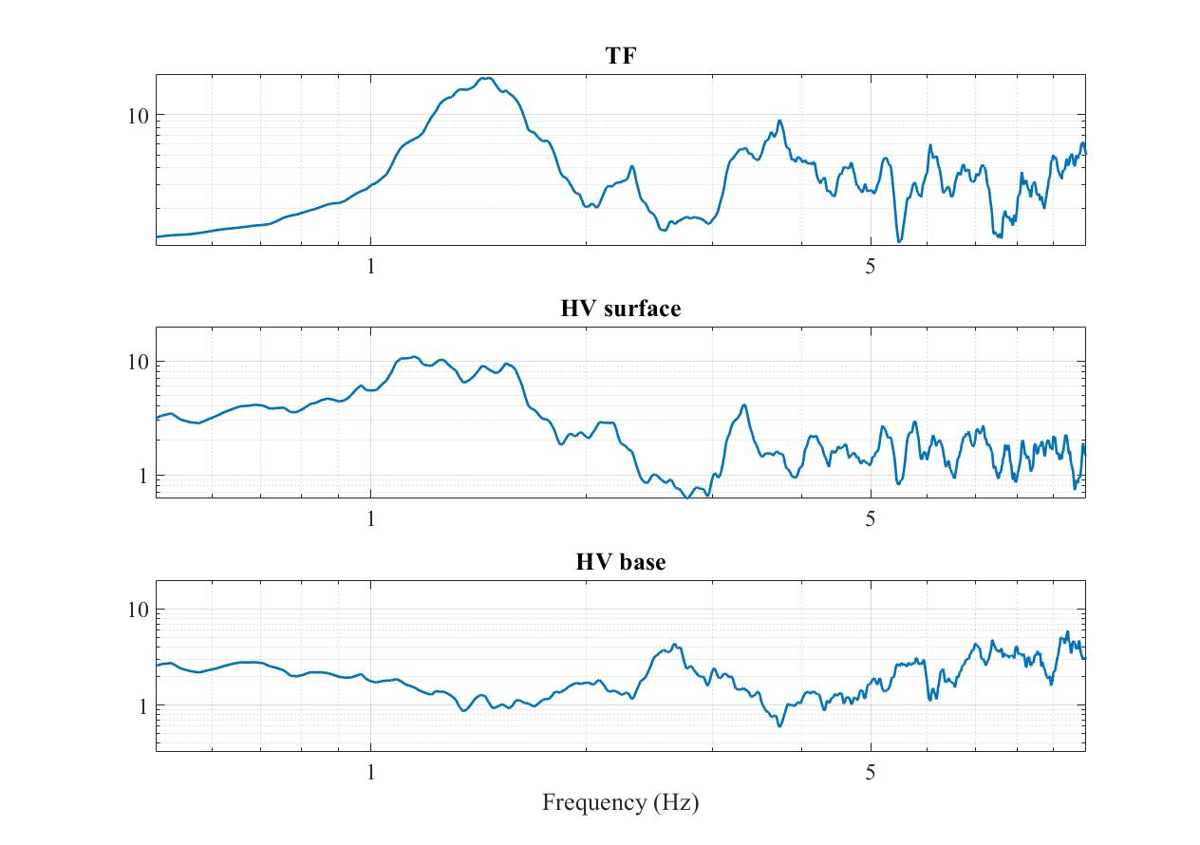
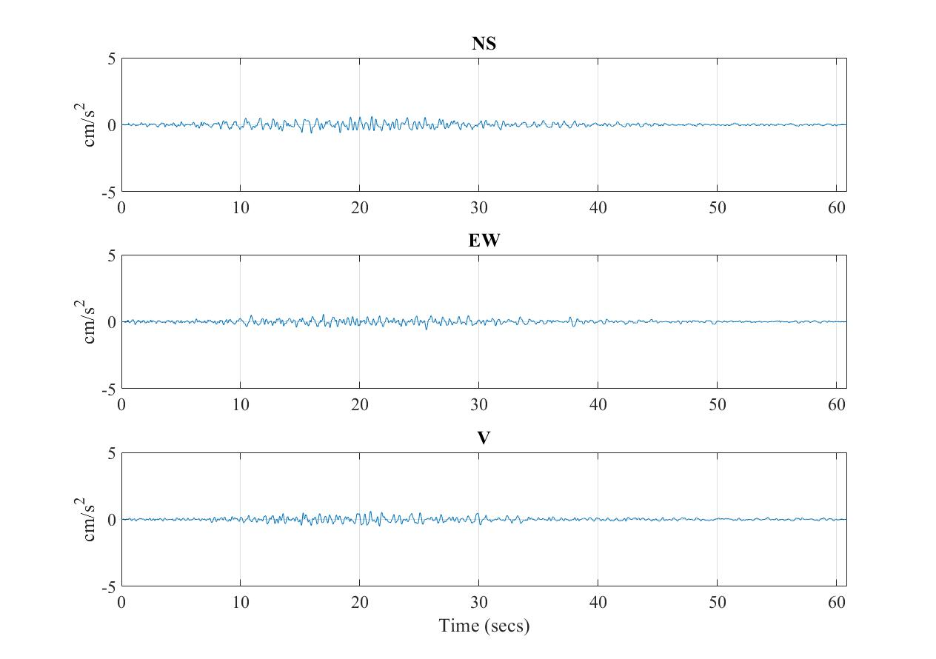
13
Northeastern BSR and HVSR
Surface
Base
Spectral ratios

Slide 14
14
Conclusions
The 5 New England terrains we present here all have stations on them that exhibit site response.
Soft, glacially deposited soils vary in frequency due to variations in depth and shear wave velocity
By first approximation, marine clay deposits, terminal moraines and glacial lakes appear to significantly amplify soils.
In the presented Canadian station, the higher harmonics in the HVSR are enhanced by earthquake signals but the fundamental peak remains like the microtremor peak.
At the Northeastern station in Boston, the borehole spectral ratio of the mineral earthquake event and the HVSR of the same event match peak to peak.
The sigma vector of the microtremor HVSR decreases across the fundamental peak.

Slide 15
15
Thank you
Questions?
References
Baise, L. G., Kaklamanos, J., Berry, B.M., Thompson, E.M. (2016). Soil Amplification with a strong impedance contrast: Boston Massachusetts. Engineering Geology 202 (2016) 1-13.
Hunter, J.A., Burns, R. A., Good, R.L., Aylsworth, J.M., Pullan, S.E., Perret, D., Bouma, M. 2007. Borehole shear wave velocity measurements of Champlain Sea sediments in the Ottawa-Montreal region. Geological Survey of Canada. Open file 5345
Wald, D. J., and Allen, T. I., 2007, Topographic slope as a proxy for seismic site conditions and amplification, Bulletin of the Seismological Society of America, 97, no. 5, 1379-1395.
Yilar, E., Baise, L.G., Ebel, J.E. (2017) Using H/V measurements to depth to bedrock and Vs30 in Boston, Massachusetts. Engineering Geology 217, 12determine-22.

