Slide 1

Site characterization mapping of New England using local geologic and geophysical data
Marshall Pontrelli
PhD Candidate
Tufts University, Medford, MA, 02155, USA
Dissertation Proposal Defense: 8/31/2022
Committee: Dr. Laurie Baise, Dr. John Ebel,
Dr. Juan Pestana, Dr. Jon Lamontagne

Slide 2

1
Presentation structure
Introduction
Dissertation chapter 1: Site characterization maps of New England based on geophysical and geologic data (in review)
Dissertation chapter 2: Improving site characterization by using high resolution geology maps and a subregion grouping layer (in development)
Dissertation chapter 3: Geology-based normalized HVSR curves for the New England f₀ dataset (proposal)

Slide 3

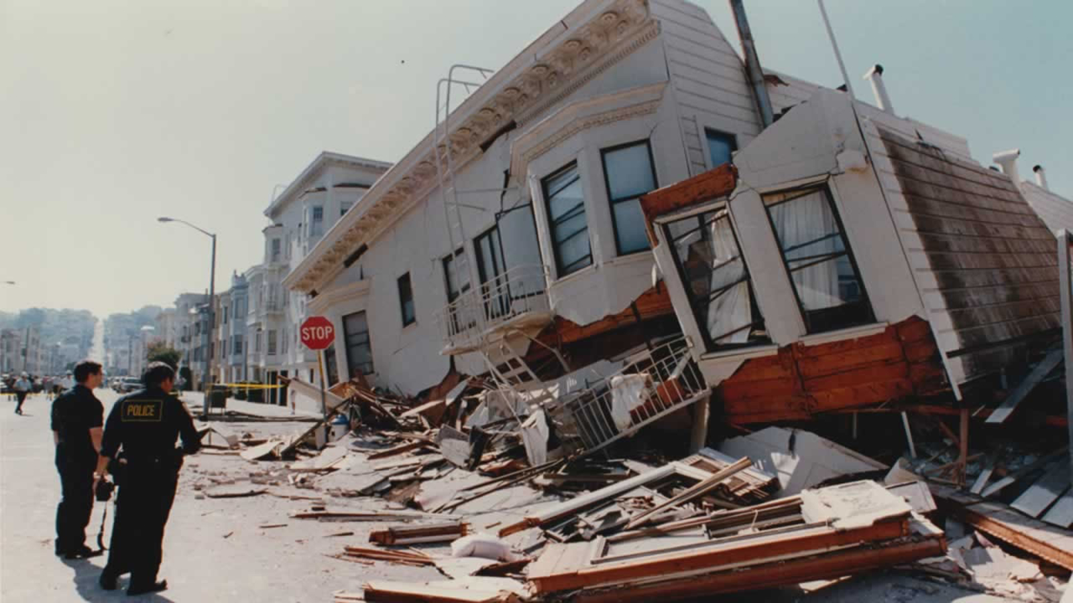
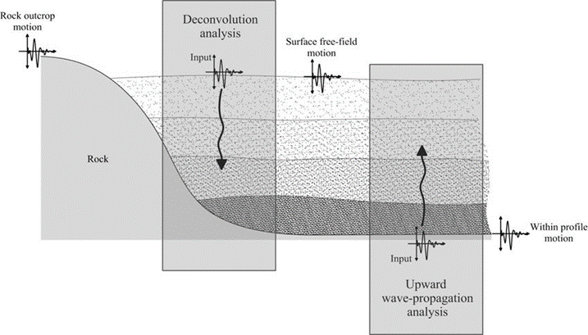
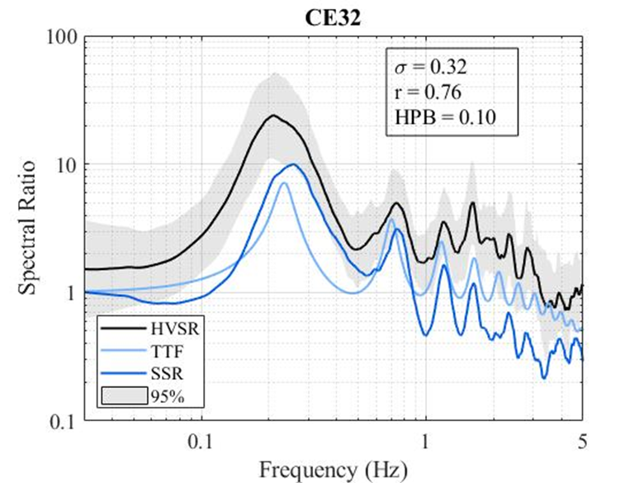
Introduction
2
Figure 1. Loma Prieta 1989
Figure 2. Mexico City 1985
Figure 3. One dimensional site response analysis schematic.
Figure 4. Suite of transfer functions from a soil site in Mexico City

Slide 4
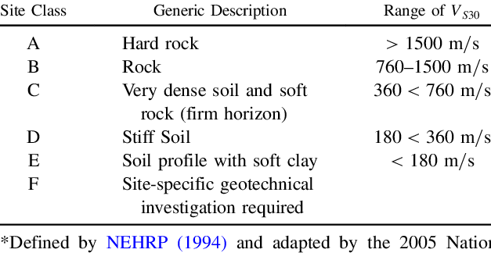
3
Seismic site classification
Table 1. Vs30 based site class definitions.

Slide 5
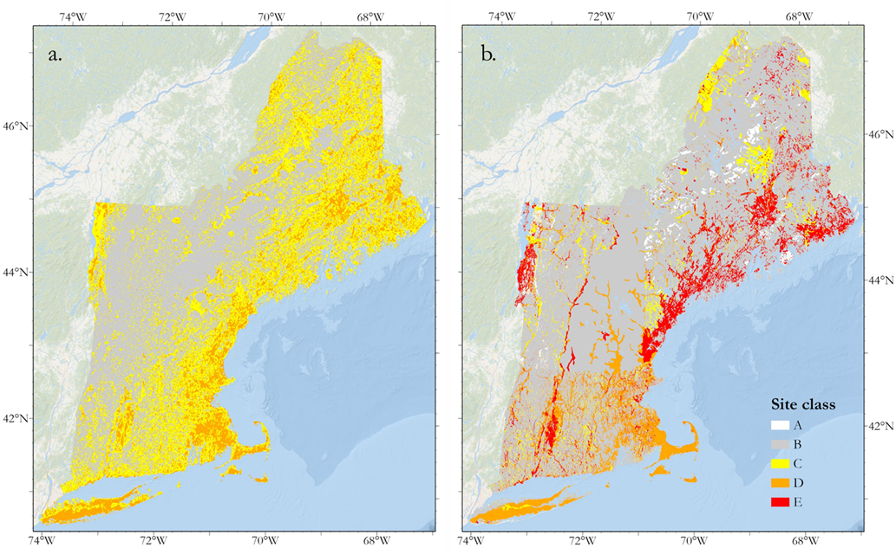
4
New England site response
Figure 5a. Slope-based Vs30 site class map of New England from Wald and Allen (2007)
Figure 5b. Geology-based site class map of New England from Becker et al. (2011)
Notes:
-Regional site characterization maps are useful for earthquake planning, seismic hazard assessment, loss estimation and many other applications.
-Two site characterization maps currently exist with coverage that includes the New England region.
-The Wald and Allen (2007) model is a 1 km pixel resolution global model that uses a relationship derived between slope data from the Shuttle Radar Topography Mission 30-sec (SRTM30) global digital elevation model and Vs30 (figure 5a)
-the Becker et al. (2011) model is a geology based Vs30 map of New England which uses a relational table converting surficial geology into seismic site class (Figure 5b).
-This paper improves on the existing Wald and Allen (2007) and the Becker et al. (2011) maps by developing site characterization maps for New England using geophysical field measurements across the region to update the surficial geology-based classifications.
-The maps developed in this study incorporate uncertainty into the characterization by providing distributions of f₀ and Vs30, something that is possible with enough local geophysical data and when applying the methodology that we use.

Slide 6
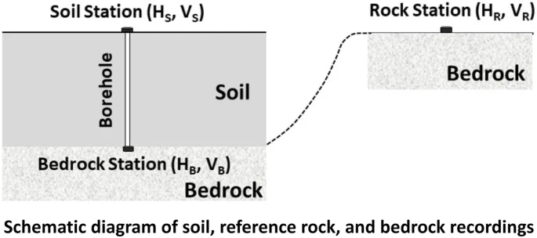
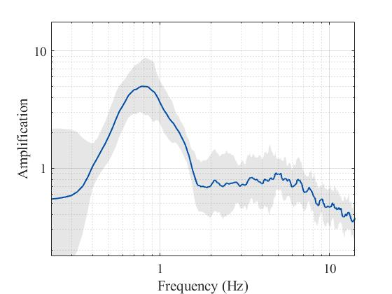

5
HVSR analysis
Figure 6. Schematic of soil, reference rock, and bedrock recordings
Station a
Station a
$f_{0}=\frac{V_{s}}{4d}$
f₀ = 0.8 Hz
β = 220 m/s
d = 68.75 m
Figure 8. If Vs of the soil column underlying station a is 220 m/s, then d is 68.75 m.
Figure 7. HVSR curve with f₀ labeled.

Slide 7
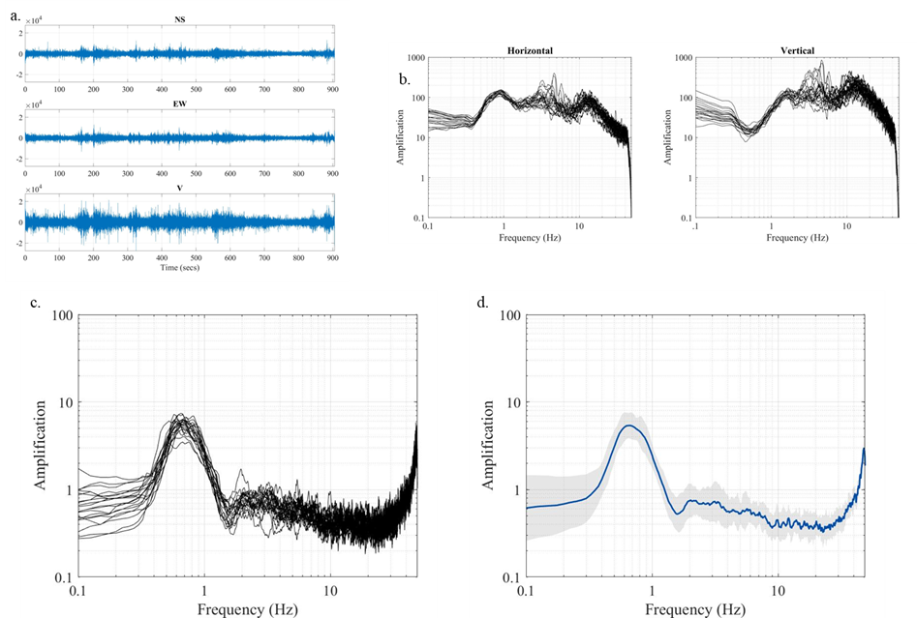
6
HVSR curve development
Figure 9. Processing steps for computing HVSR curves, a) time series, b) Fourier amplitude spectra (horizontal and vertical), c) individual HVSR curves and d) final averaged HVSR curve.

Slide 8
Site characterization maps of New England based on geophysical and geologic data
Dissertation chapter 1 (in review)

Slide 9
Data

Slide 10
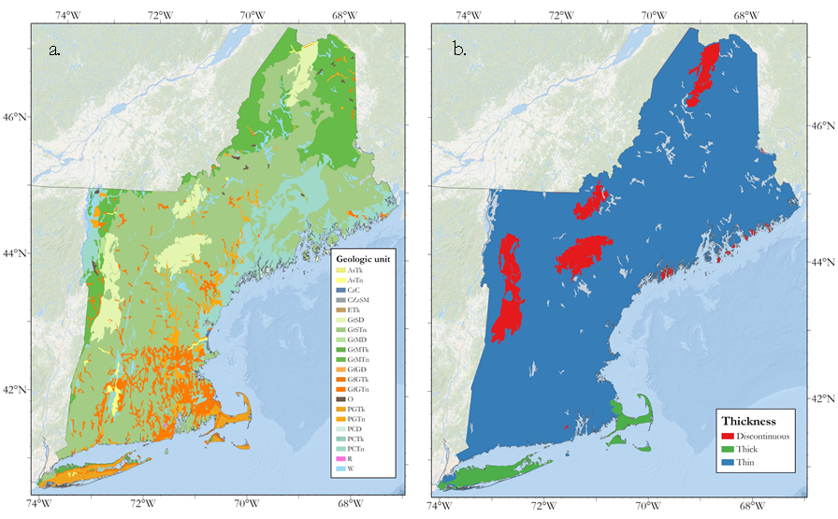
7
US Conterminous surficial geology map
Figure 10a. US Conterminous map of surficial geology clipped to New England (Soller et al. 2009).
Figure 10b. Conterminous map overburden thickness.
Notes:
-Talk about New England site response

Slide 11
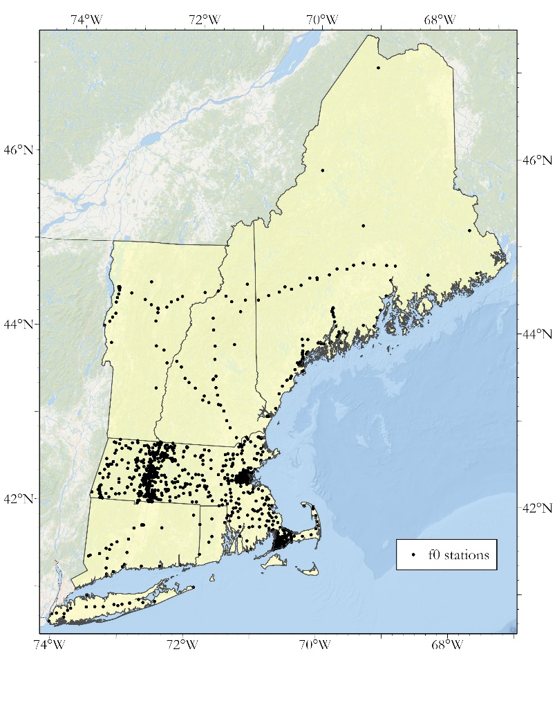
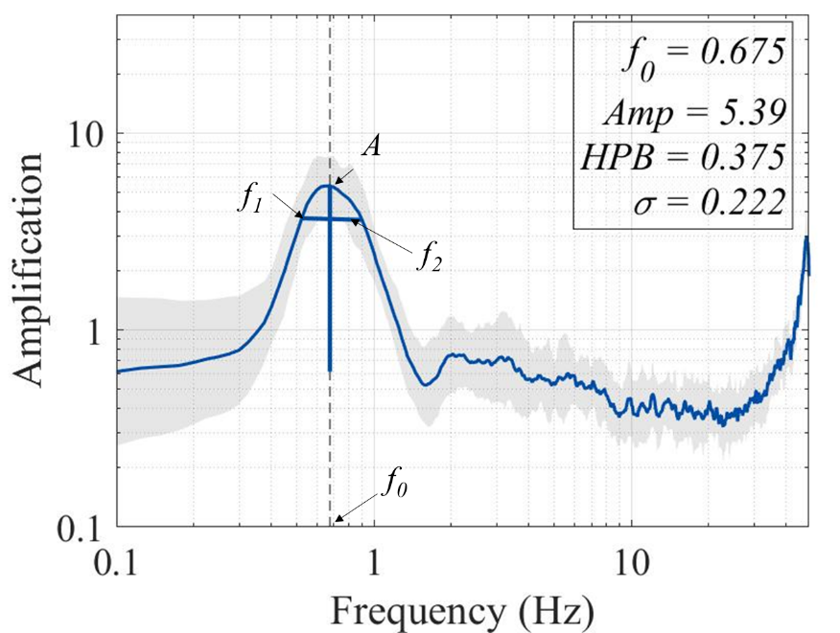
8
HVSR database
Figure 12. HVSR fundamental peak shape statistics. Half power bandwidth is equal to f₂ – f₁ and σ is the median of the 20 HVSR curves from the 20 noise windows across the frequency band from f₁ to f₂.
Figure 11. Spatial distribution of the HVSR database developed in this study.

Slide 12
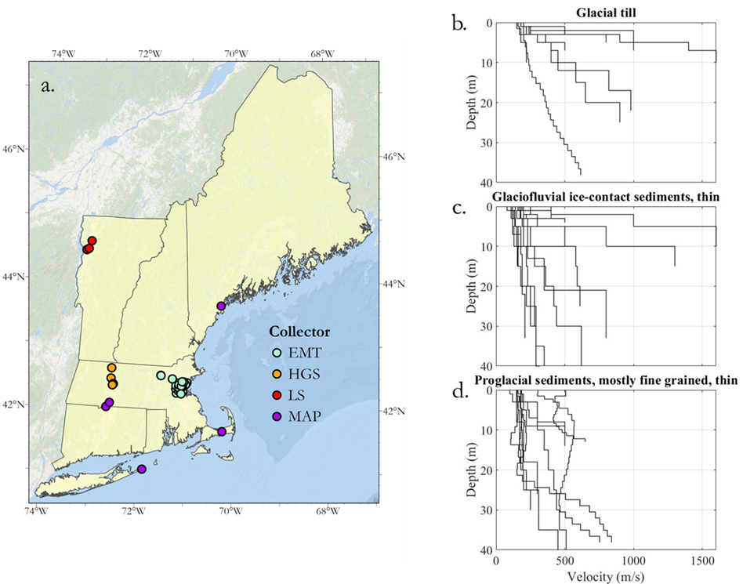
9
Vs database
Figure 13. a) Locations of shear wave velocity profiles in the study. Collector EMT is Thompson et al. (2014), HGS is Hager Geoscience (2016), LS is Lens and Springston (2013), and MAP is the data collected in this study. Profiles grouped by their geology for b) glacial till, c) glaciofluvial ice-contact sediments, thin, and d) proglacial sediments, mostly fine-grained, thin.

Slide 13
Methods

Slide 14
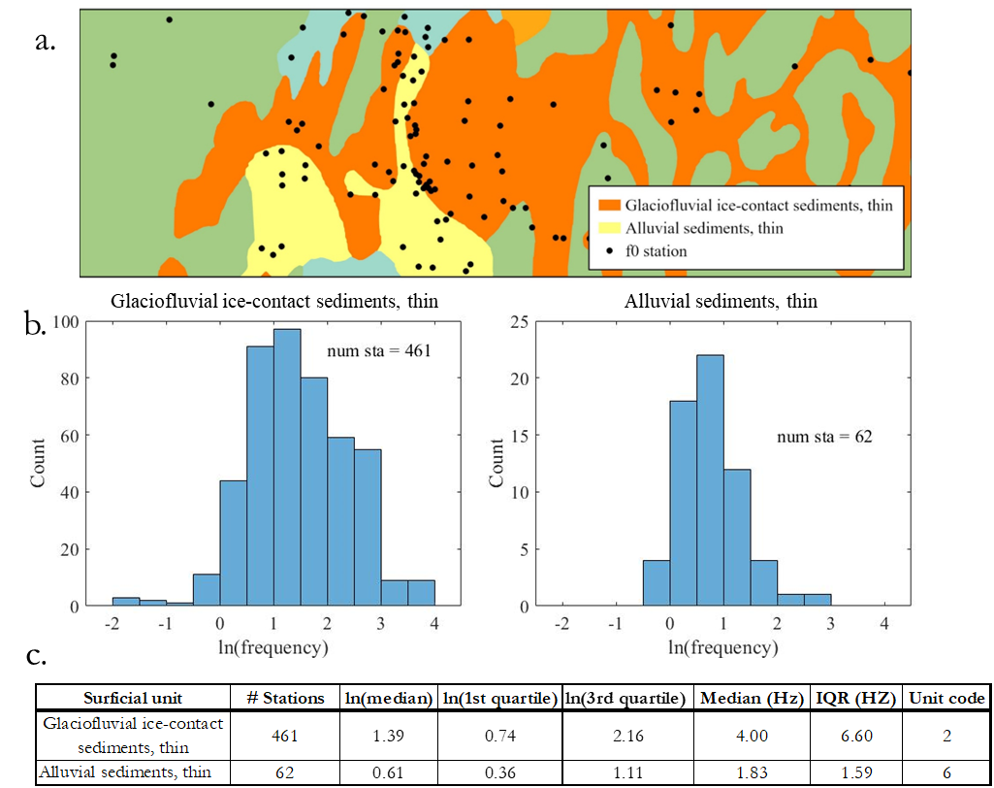
10
Wills and Clahan methodology for combining f₀ points and geologic polygons
Figure 14. Example of the process used to group f₀ points by their respective geologic unit. a) A zoomed in section of the Connecticut River Valley and the f₀ points within that area. b) The actual f₀ distributions of two of the geologic units in this study, and c) the table developed from the distributions in Figure 15b.
Notes:
Wills and Clahan (2006) used a database of Vs30 points and surficial geologic polygons to develop distributions of Vs30 within each surficial geologic unit in their study. In our study, we apply the same technique to f₀ stations. We first group the HVSR database within each surficial geologic unit by performing a spatial join between the f₀ database and the surficial geologic grouping layer. We then develop distributions of f₀ within each unit and calculate summary statistics of that distribution.

Slide 15
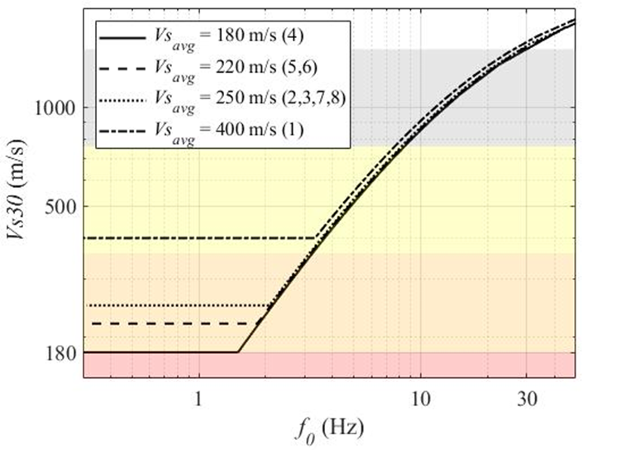

11
Computing Vs30 from f₀
Vs_{avg}
d_{s}
30 m
V_{R}
d_{R}
$$Vs30=\frac{30}{\frac{1}{4f_{0}}\left(1−\frac{{Vs}_{avg}}{V_{R}}\right)+\frac{30}{V_{R}}}$$
Figure 15. Relationship between f₀ and Vs30 for the 4 Vs_{avg} estimates of the 8 surficial units in the study.

Slide 16
Results

Slide 17
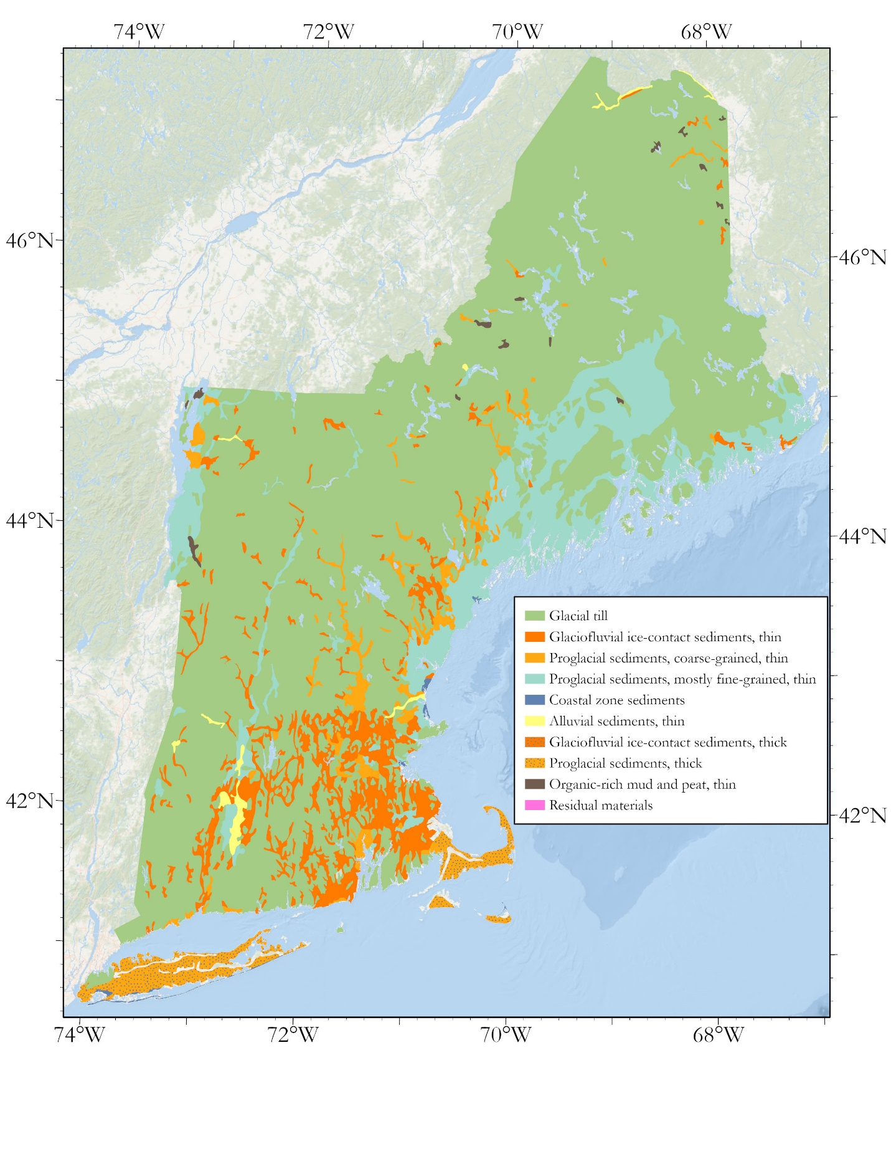
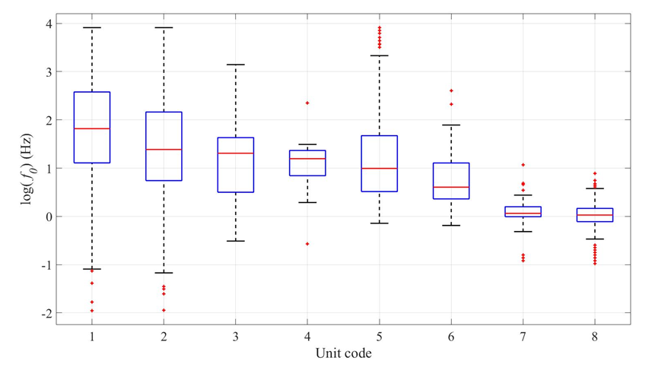
12
f₀ groupings by surficial geologic unit
Figure 16. Merged geologies.
Figure 17. Box and Whisker plots of the f₀ distributions within each surficial geologic unit.
Table 2. Final output table for the f₀ stations joined to their respective merged surficial geologic units with calculated medians and IQRs of the distribution of f₀ values in each unit.
Notes:
After performing the spatial join of the f₀ stations with the regrouped surficial geologic units, there are eight map units. Of these, glacial till has the highest f₀ median (6.16 Hz) and thick, proglacial sediments has the lowest f₀ median (1.03 Hz) (Table 5, Figure 8). The high frequency glacial till unit is distributed throughout New England where there is a shallow, fast veneer of till. The low frequency thick proglacial sediments and thick glaciofluvial sediments are both contained entirely on Cape Cod and Long Island where the conterminous map has “Thick” classified sediments. There are two classifications with low to mid-range f₀ medians of 1.83 and 2.70 Hz: these are thin, alluvial sediments and the thin, fine grained proglacial sediments respectively. The alluvial sediments are predominantly deposited in the Connecticut River Valley and the thin, fine-grained proglacial sediments are contained on the seacoast in Maine and Massachusetts and the coast of Lake Champlain. These sediments are also in the Connecticut River Valley where the Glacial Lake Hitchcock lacustrine sediments are located. There are three classifications with mid to high-range frequencies of 3.31, 3.70 and 4.00 Hz: the coastal zone sediments, the thin, coarse-grained proglacial sediments and the thin glaciofluvial ice-contact sediments, respectively. The coastal zone sediments are located in pockets along the coast. The thin, coarse-grained proglacial sediments are deposited in large areas where moraines formed. The thin glaciofluvial ice-contact sediments are deposited in the river valleys that are smaller than the Connecticut River Valley with less sediment build-up in their river beds.

Slide 18
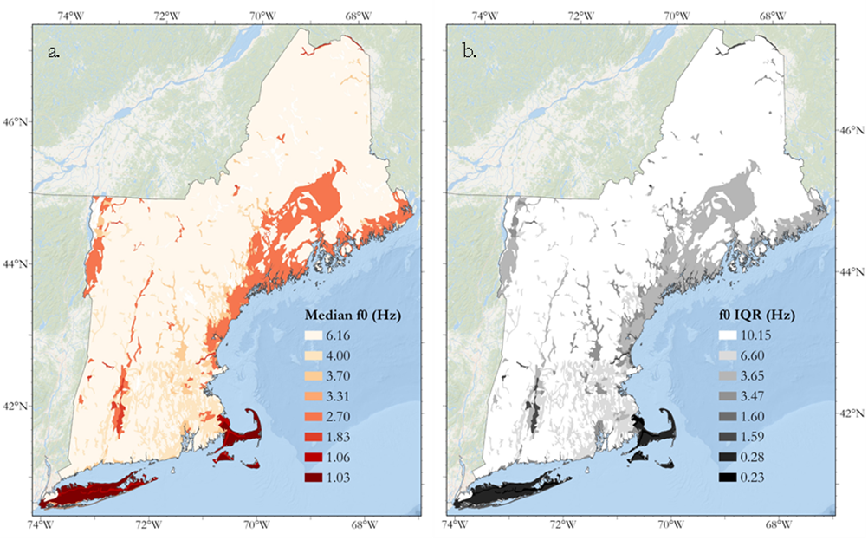
13
Mapping each unit f₀ distribution median and interquartile range
Figure 18. a) Map of the median f₀ of each surficial geologic unit’s f₀ distribution. b) Map of the interquartile range of each surficial geologic unit’s f₀ distribution.
Notes:
With a database of distributions of f₀ for each surficial geologic unit, we can observe the central tendency and dispersion of each distribution as a map. In Figure 9a, we plot the median f₀ value of each surficial geologic distribution and in Figure 9b, we plot the IQR of the distribution of each surficial geologic unit. The low frequency geologic units are entirely contained on Cape Cod and Long Island where sediments are deep and average shear wave velocities are estimated at around 250 m/s. The low to mid ranged frequency units are on the Coast of Lake Champlain, the Coast of Maine, the Boston Basin, and the Connecticut River Valley. Cape Cod and Long Island also have the lowest IQR followed by the previously listed regions and units. The till across the entire region tends to have high f₀ values with high variability indicating shallow, laterally varying sediments (Figure 9b). In general, as the distribution central tendency decreases, the IQR also decreases, implying that deeper deposits have lower lateral fundamental frequency variation than shallower deposits.
What? Something seems to be missing here.
Addressed

Slide 19
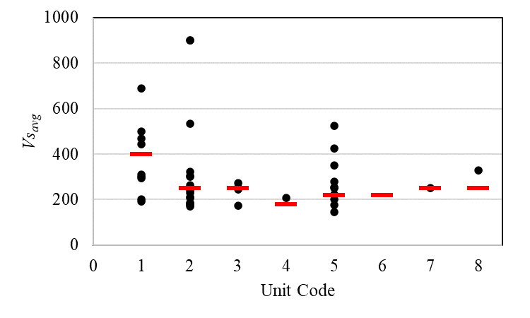
14
Developing estimates for Vs_{avg}
Figure 19. Vs_{avg} measurements of each of the 42 shear wave velocity profiles grouped by geologic unit. The red line in each grouping is the value for Vs_{avg} that we chose to use in this study. Unit codes are in Table 3.
Table 3. Vs_{avg} distribution characteristics for the 42 shear wave velocity profiles in the database grouped by surficial geologic unit.
Notes:
Our shear-wave velocity database for the region contains 42 profiles. We group these profiles by their surficial geologic unit and plot the Vs_{avg} measurements (Equation 4) for each geologic unit (Figure 11). For glacial till, the mean value of the 9 profiles (Figure 5b) within the unit is 378 m/s and the median is 310 m/s (Table 6). We will use a slightly higher Vs_{avg} for this unit of 400 m/s because several of the low Vs_{avg} profiles in glacial till are areas abutting softer geologies like the Boston Basin. Additionally, Becker et al. (2011) classified all tills as site class B, a higher Vs_{avg} than the averages of our profiles, so we think increasing the estimate is a fair judgement given the small number of measurements we have. For thin glaciofluvial ice contact sediments, the mean value of the 16 profiles (Figure 5c) within the unit is 335 m/s and the median is 245 m/s. The difference in median and mean of these values implies that there are several outliers skewing the distribution, which is apparent in Figure 11, so we will use 250 m/s for this unit’s Vs_{avg}. The thin coarse grained proglacial sediments unit has a mean value of 236 m/s for the 4 profiles within the unit and a median of 250 m/s. We will use 250 m/s for this unit’s Vs_{avg}. We only have one profile for the coastal zone sediments unit with a Vs_{avg} of 206 m/s. We will use a conservative (lower than the data indicate) Vs_{avg} of 180 m/s for this unit so that where profiles have a low f₀ and a depth of greater than 30 meters, they will be classified as site class E. The thin mostly fine-grained proglacial sediments unit has a mean Vs_{avg} value of 282 m/s and a median of 253 m/s for the 10 profiles within the unit (Figure 5d). This unit contains the significant marine and lacustrine clay layers in the region and in the Becker et al. (2011) model is mapped as site class E. We will therefore use a conservative Vs_{avg} value of 220 m/s for this unit. There are no profiles within the alluvial sediments, but the information in Table 2 suggests Vs_{avg} values between 200 and 280 m/s (Mike Howley, personal comm.). We will use a Vs_{avg} value of 220 m/s for this unit. The thick glaciofluvial ice contact sediments have one profile with a Vs_{avg} value of 250 m/s which we will use as the Vs_{avg} estimate for the unit. Finally, the thick proglacial sediments unit has one profile with a Vs_{avg} value of 329 m/s. We will use 250 m/s for this unit since these deposits are located on Cape Cod and Long Island which we expect to have Vs_{avg} values of around 250 m/s. These estimates are presented in Table 6 and Figure 11.

Slide 20
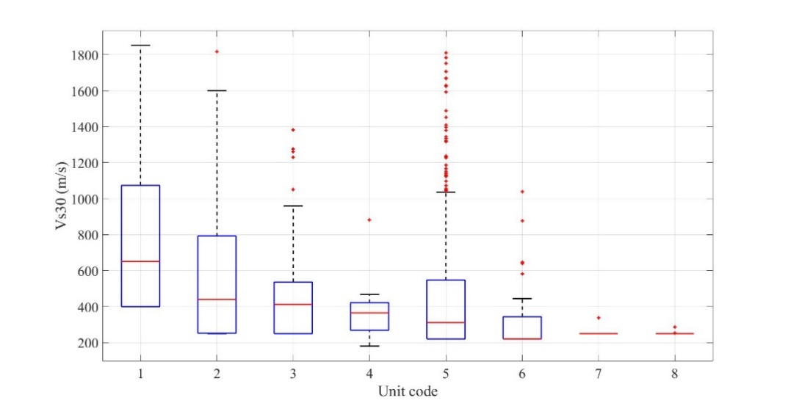
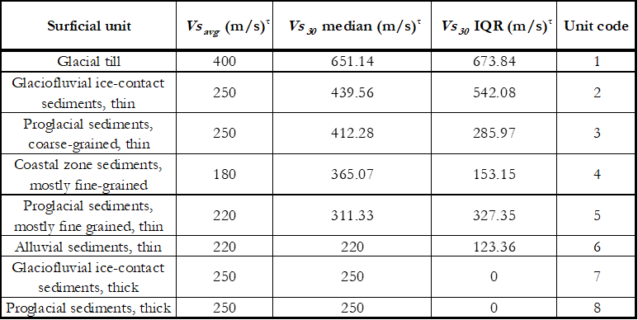
15
Developing Vs30 distributions from the f₀ database
Figure 20. Distributions of Vs30 of each station within each surficial geologic unit in the database. This plot is the distribution that results from converting the f₀ distributions to Vs30 using the f₀ to Vs30 relationship.
Table 4. Vs_{avg} for each surficial geologic unit as well as measures of central tendency and dispersion (median and IQR) for each Vs30 distribution computed from converting f₀ to Vs30.
Notes:
Applying equation 6 to all the f₀ values of each geologic unit (across the individual f₀ values of the distributions in Figure 8), and computing Vs30 and site class for each station (the relationship in Figure 12), we can develop a distribution of Vs30 for each site class in each unit (Figure 13, Table 7). For glacial till, the median Vs30 value is the highest of any grouping at 651.14 m/s. Additionally, the IQR is the highest, indicating the greatest range of Vs30 values of the groupings. The 25th percentile is 400 m/s, which is the estimate of Vs_{avg} for the unit meaning that greater than 25 percent of the stations in this grouping in the database have low enough f₀ values to compute a depth greater than 30 meters and thus a Vs30 value equal to Vs_{avg}. Thin glaciofluvial ice contact sediments have the next lowest median with a value of 439.56 m/s. Like glacial till and many of the other groupings, the 25th percentile is equal to Vs_{avg}. Thin coarse grained proglacial sediments have a similar median to thin glaciofluvial ice contact sediments of 412.28 m/s, but a low IQR of 285.97 m/s indicating a greater number of stations clustered around the median and therefore less variability in depth of the unit. Fine grained coastal zone sediments are the only distribution in the groupings where the 25th percentile does not equal Vs_{avg} indicating few f₀ values low enough (and analogously few sites with deep enough profiles greater than 30 meters) where Vs30 = Vs_{avg}. Thin, mostly fine-grained proglacial sediments have a high IQR of 327.35 m/s relative to their adjacent groupings (153.15 and 123.36 m/s) and a significant number of high outliers. This unit is composed of marine and lacustrine clays and has extensive spatial coverage across the Boston Basin, Connecticut River Valley, coast of Lake Champlain and coast of Maine. The unit has a low Vs_{avg} value of 220 m/s and this large range of possible Vs30 values is due to large variations in depth across these stations in the database. For example, despite low Vs_{avg} values, a shallow basin edge station still has a high Vs30 value in the layer-over-halfspace model. Thin alluvial sediments have a median equal to the 25th percentile, indicating that more than 50% of the stations measured in that grouping have f₀ values low enough to indicate a depth profile greater than 30 meters. This is consistent with local knowledge in the Connecticut river valley where most of these stations are located. Finally, thick glaciofluvial and thick proglacial sediments have an IQR of 0 m/s and a median, 25th and 75th percentile equal to Vs_{avg}. This indicates that all the points in these distributions have low enough f₀ values that computed depth is greater than 30 meters, and Vs30 = Vs_{avg}. Indeed, these stations are entirely located on Cape Cod and Long Island where soil profiles are deep and thus Vs30 is expected be equal to Vs_{avg} over the top 30 meters.

Slide 21
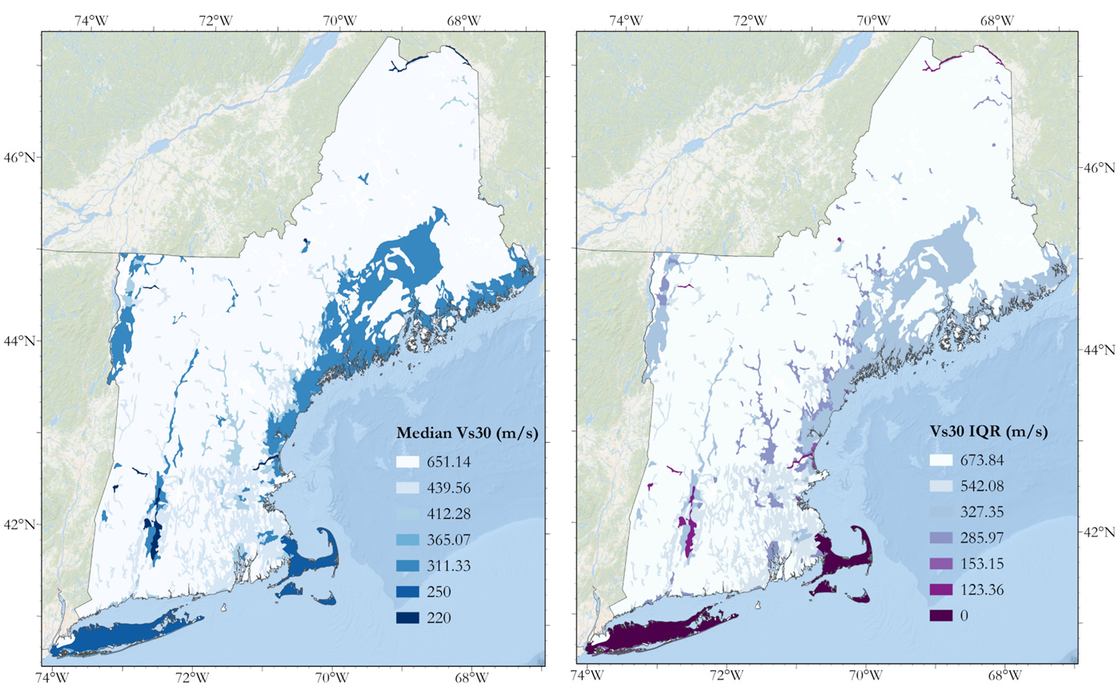
16
Mapping each unit Vs30 distribution median and interquartile range
Figure 21. a) Map of the median Vs30 value of each surficial geologic unit’s Vs30 distribution. b) Map of the interquartile range of each surficial geologic unit’s Vs30 distribution.
Notes:
Like with the f₀ distributions, we plot the Vs30 distribution’s median and IQR to look at the central tendency and dispersion of each unit and how they vary across the region (Figure 15a and b). Glacial till has the highest Vs30 median and IQR and is spatially distributed throughout most of the region in the mountainous areas and highlands. The thin, fine-grained proglacial sediments (marine and lacustrine clays) on the coast of Maine, Boston Basin, coast of Lake Champlain and Connecticut River Valley have a Vs30 median of 311.33 m/s. The Vs_{avg} of this unit is 220 m/s so the higher Vs30 median indicates many instances of shallow profiles. The IQR of this unit is relatively high which is caused by the same reason. The second lowest Vs30 median (250 m/s) and lowest IQR (0 m/s) are thick glaciofluvial ice contact sediments and thick proglacial sediments located on Cape Cod and Long Island where all the stations have low f₀ values and therefore deep profiles. The lowest Vs30 median is in the thin alluvial sediments located predominantly in the Connecticut River Valley. Unlike the Cape Cod and Long Island sediments, these sediments have a non-zero IQR (123.36 m/s), so some of the stations have shallow profiles. The majority, however, are deep and so the median of the unit is equal to Vs_{avg}.

Slide 22
17
Discussion
-The methodology used in this study is ideal to apply to New England because the region consists of glaciated terrain with has consistently high impedance contrasts due to high velocity bedrock and soft, unconsolidated overburden yielding subsurface conditions with high site response hazard.
-The methodology incorporates local geophysical information, grouped by surficial geologic unit resulting in a site characterization with uncertainty in the form of a distribution of f₀ and Vs30, something the Wald and Allen (2007) and Becker et al. (2011) methods cannot provide.
-The patterns between the maps of median f₀ and median Vs30 are similar: where f₀ is low Vs30 tends to be low and where f₀ is high Vs30 tends to be high. The actual underlying distributions are more complexly related. A low f₀ value results in a low Vs30 value is a good rule of thumb, but one that should be applied cautiously and with understanding of the assumptions involved as the relationship between f₀ and Vs30 is not linear.

Slide 23
Conclusion
18
-Fine-grained proglacial sediments contain the marine clays of the Boston Basin (Boston Blue clay), the coast of Lake Champlain (Champlain Sea sediments) and the coast of Maine (Presumpscot formation) as well as the lacustrine clays of Glacial Lake Hitchcock in the Connecticut River Valley.
-Thick glaciofluvial ice contact sediments and thick proglacial sediments, both of which make up Cape Cod and Long Island are consistently deep with a high impedance contrast, but they are high site response hazard. Simply knowing that one is at a site on Cape Cod or Long Island is enough to know that site response hazard is high.
-Thin alluvial sediments are located adjacent to major rivers, predominantly the Connecticut River and have stations that exhibit consistently low f₀ and Vs30 values both with low variability. Most of the stations in our database located on these sediments are site class D. These results imply that sites near major rivers likely have deep soil profiles with low velocity overburden and likely pose high site response hazard.
-Coastal zone sediments have the potential to be the most hazardous deposits as they have low estimated Vs_{avg} values of 180 m/s and high impedance contrasts. Many in our database, however, had high f₀ values indicating shallower profiles. When confronted with a site located on these sediments, it is essential to know the depth of the profile and, where deep, assign the site high site response hazard.
Notes:
Fine-grained proglacial sediments -With an estimated Vs_{avg} value of 220 m/s, they have a high impedance contrast and therefore amplify at their site fundamental frequency. They have a high variability distribution of f₀ (Figure 9), indicating that there is a great variability in depth in this unit in all the studied regions. This makes the unit complicated, as it has the potential to exhibit high site response hazard where depths are high but could exhibit little hazard where the overburden is shallow. One must know depth-to-bedrock or f₀ at a site to truly make a site response judgement about a site in this unit.

Slide 24
Conclusion continued
19
-Thin glaciofluvial ice contact sediments and thin, coarse grained proglacial sediments are found in smaller river valleys and topographic depressions and can have potential for high site response hazard where the soil profile is shallow. On the average, however, sites on these geologies likely have lower hazard than the geologies already discussed.
-Glacial till sites are likely low site response hazard with a higher estimated Vs_{avg} value of 400 m/s, but still have the potential for higher site response hazard in the few locations with deep till deposits.
-This methodology can be applied to make regional site characterization maps anywhere with a high impedance contrast, a regional geologic map, an f₀ database with decent coverage of that region, and a way to estimate Vs_{avg} for each of the surficial units in that region.

Slide 25
Improving site characterization by using high resolution geology maps and a subregion grouping layer
Dissertation chapter 2 (in development)

Slide 26
Data

Slide 27
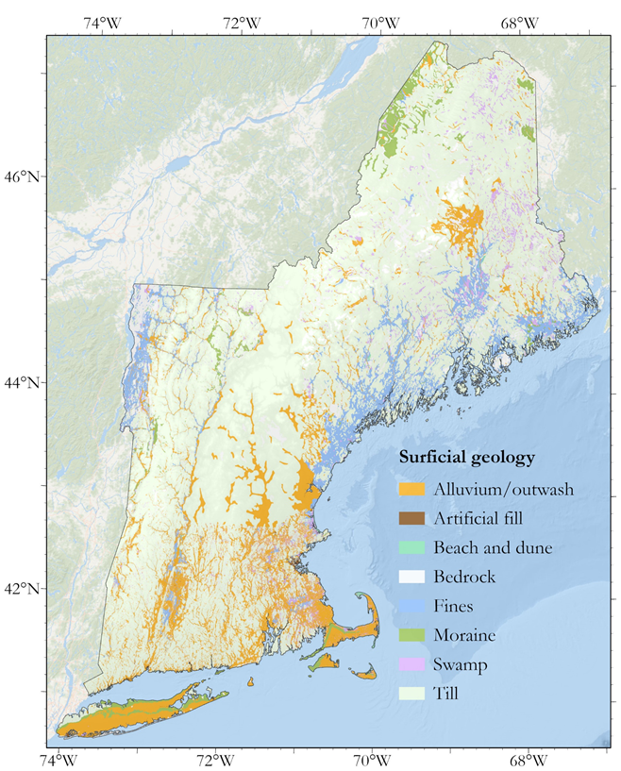
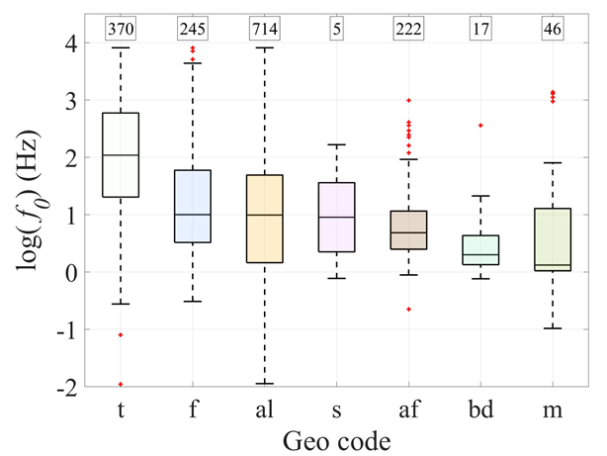
20
State-scale surficial geology map
Table 5. The number of geologies that were reduced to 7 classification and merged to form a unified map.
Figure 22. Final geology map developed from the state geological databases.
Figure 23. f₀ distributions within geologic classifications in figure 13.

Slide 28
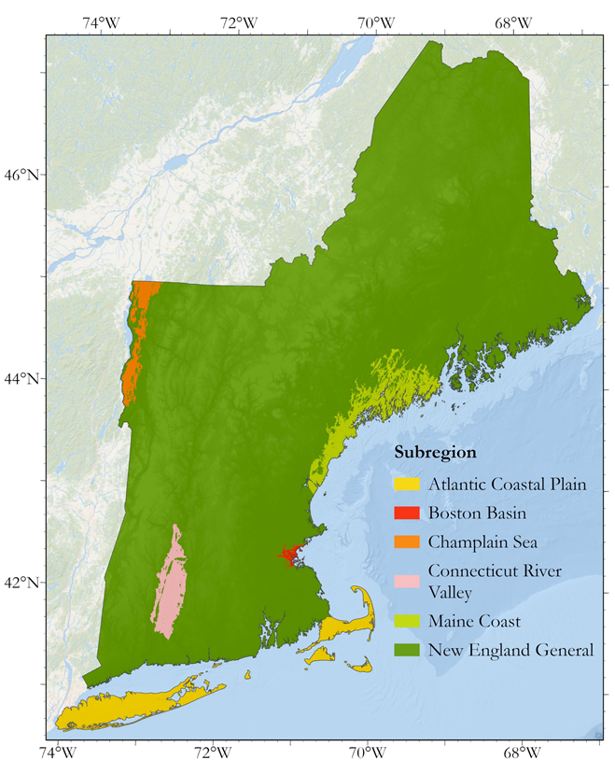
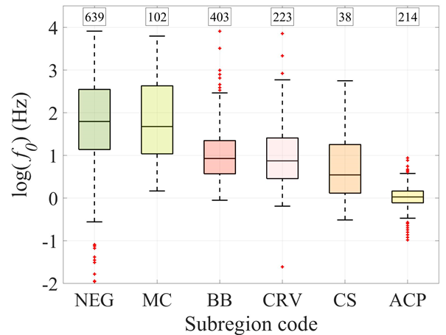
21
Subregion boundaries
Table 6. Subregion elevation below which each subregion was defined.
Figure 24. Map of the extent of the subregions defined in this study.
Figure 25. f₀ distributions within the subregion classifications in Figure 15.

Slide 29
Methods

Slide 30
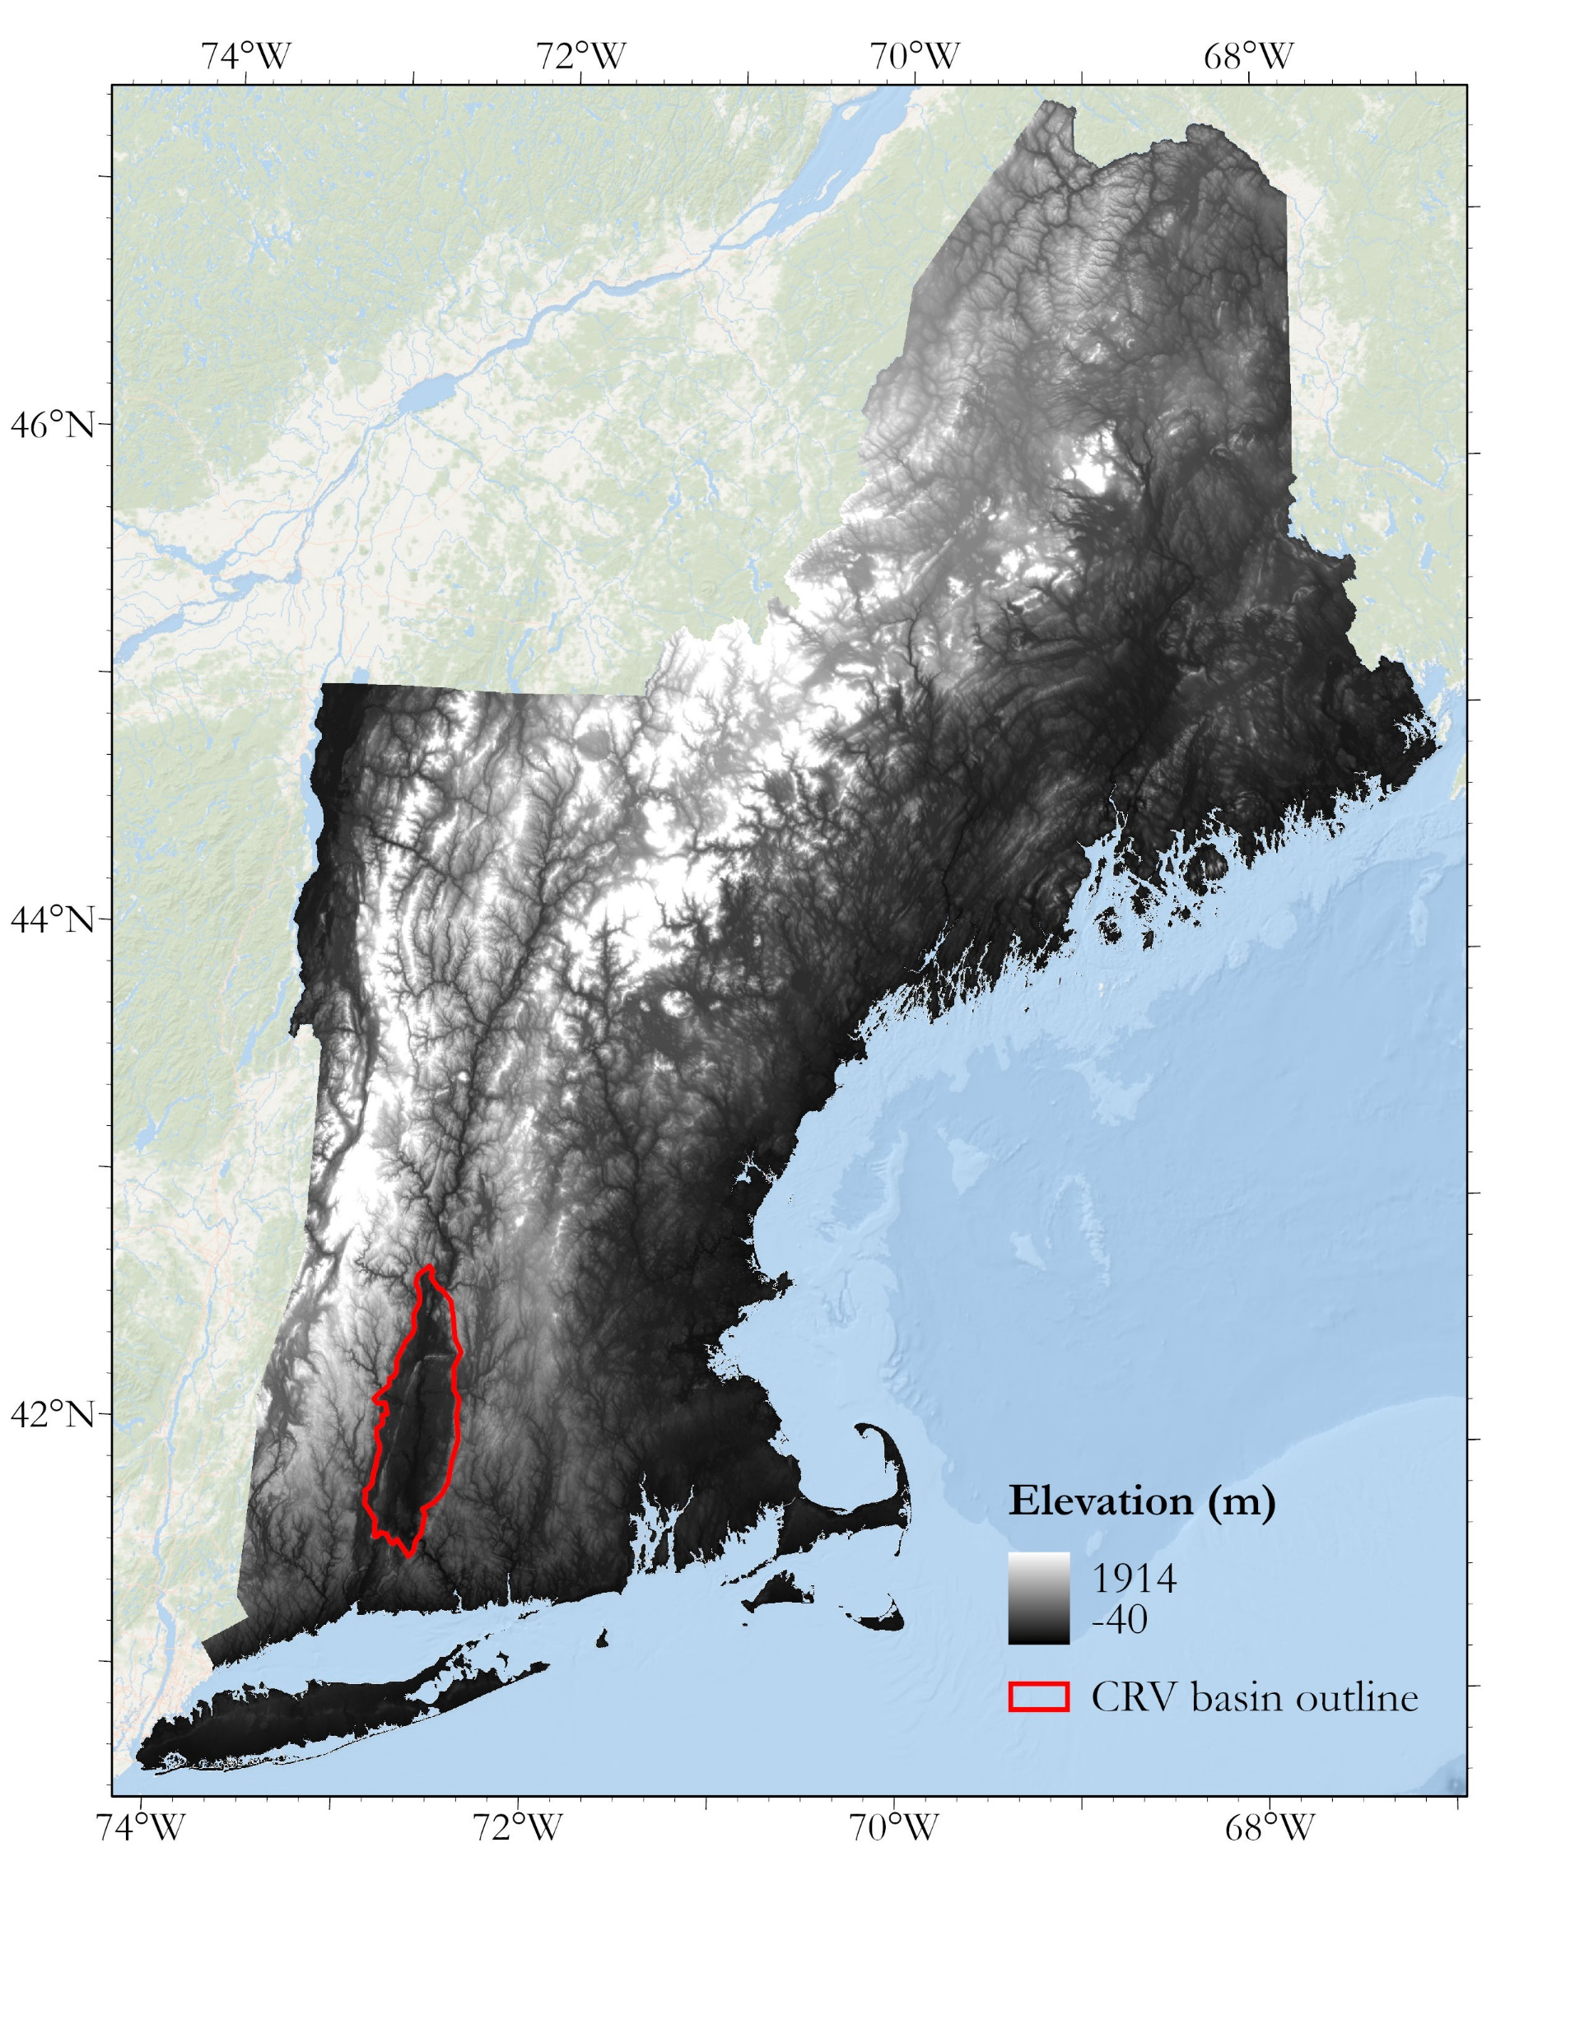
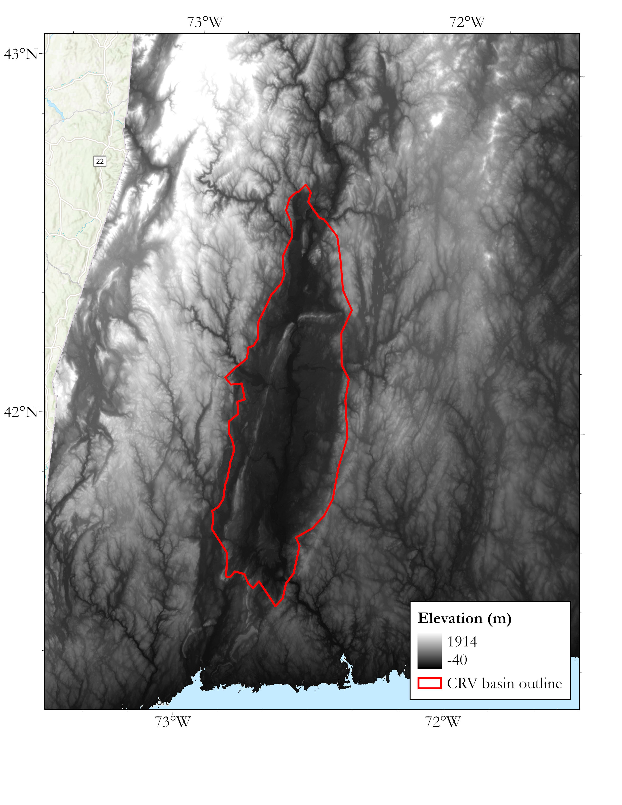
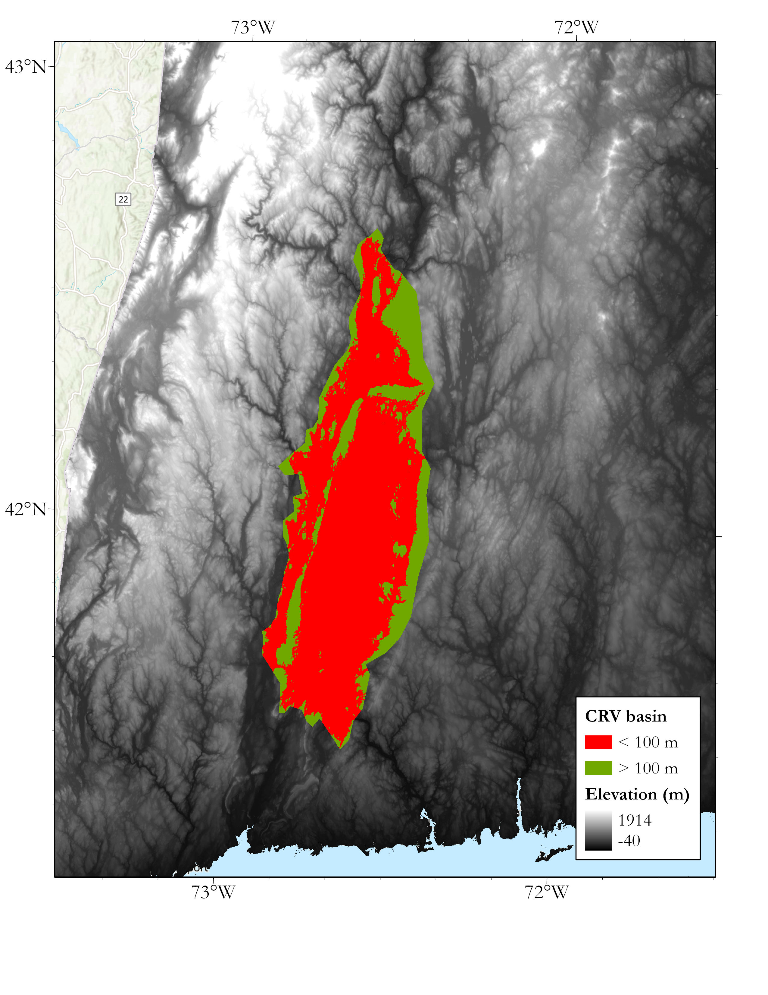
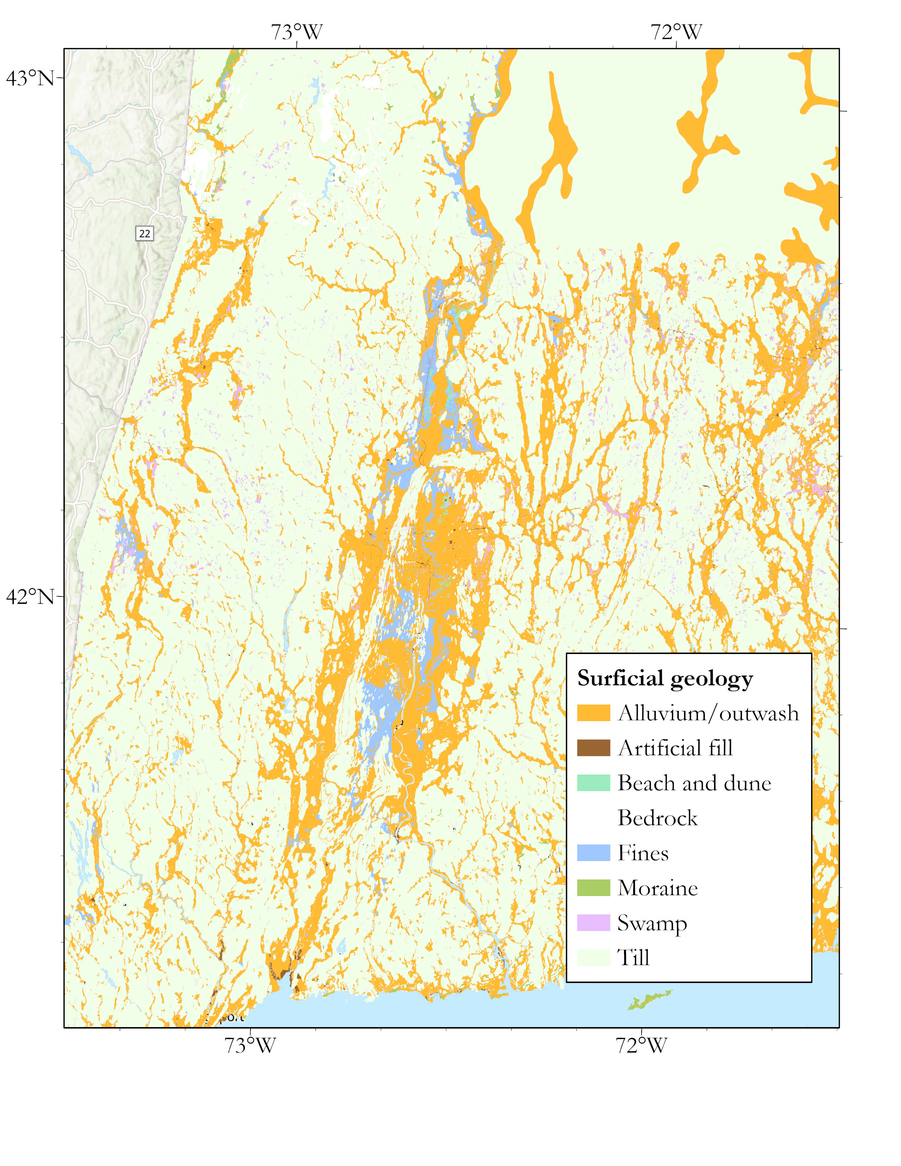
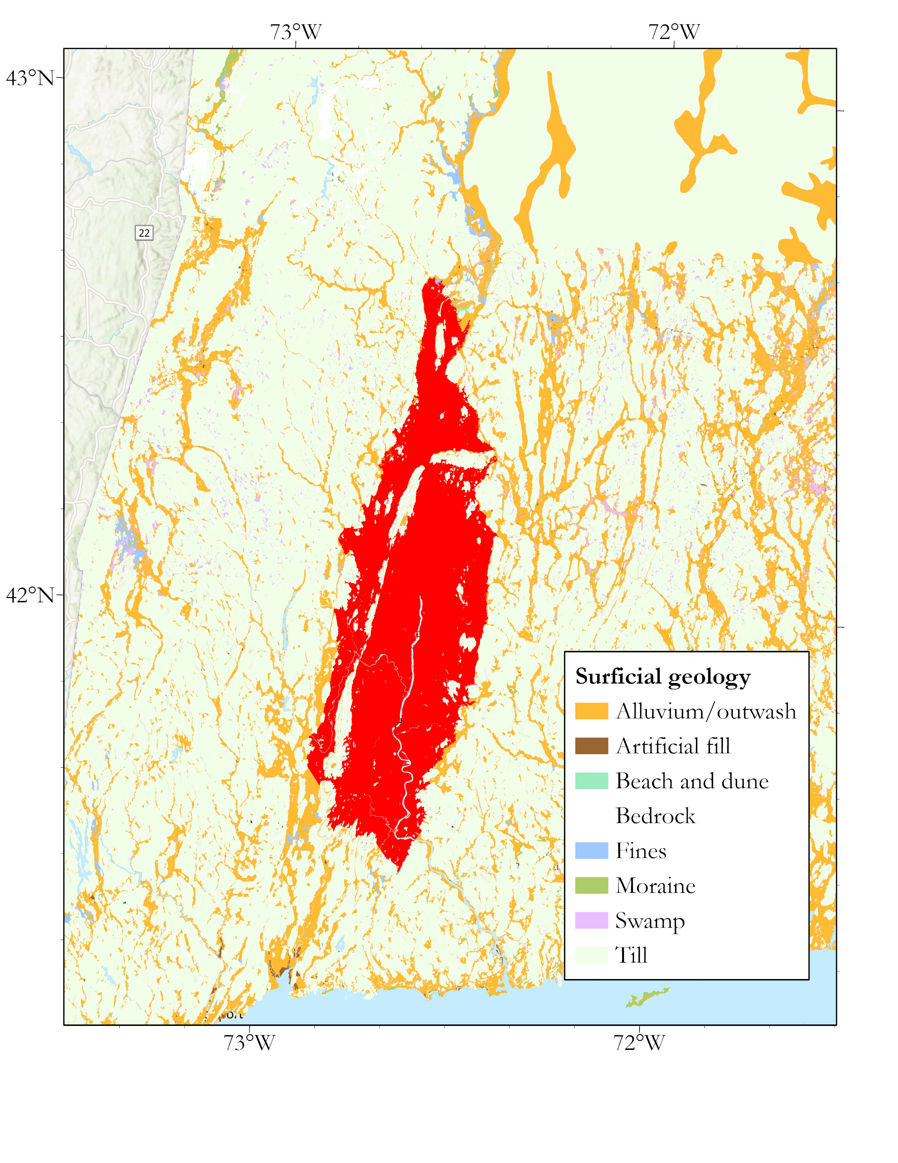
22
Process of defining subregion boundaries
Figure 26. Demonstration of the process used in this study to create basin polygons. a and b) draw and cut out the general region surrounding the basin. c) select pixels from the DEM below an elevation threshold, in this case that threshold is 100 m. d) select a threshold at which the pixels overlap the soft surficial geologies from the tills.

Slide 31
Results

Slide 32
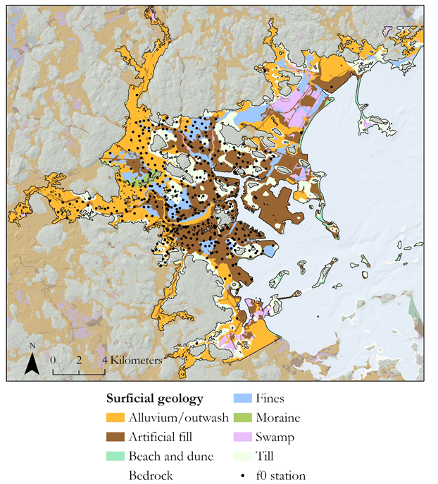
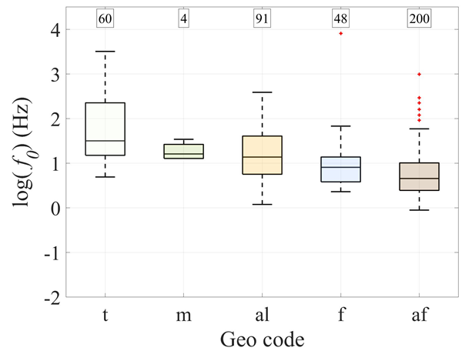
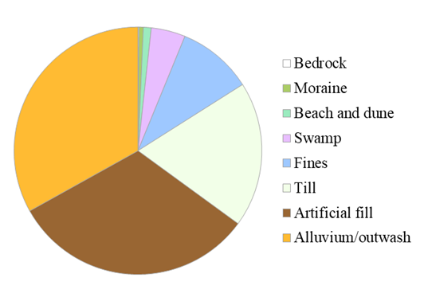
23
The Boston Basin
Figure 28. f₀ distributions within the Boston Basin.
Figure 27. Geology of the Boston Basin with f₀ stations overlain
Figure 29. Relative area of the different geologies within the Boston Basin.

Slide 33
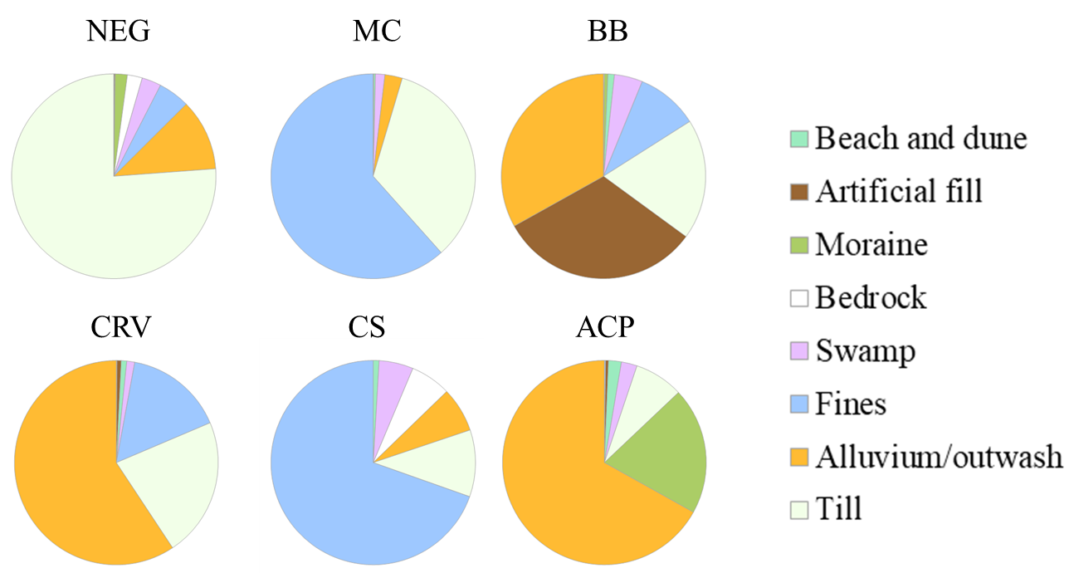
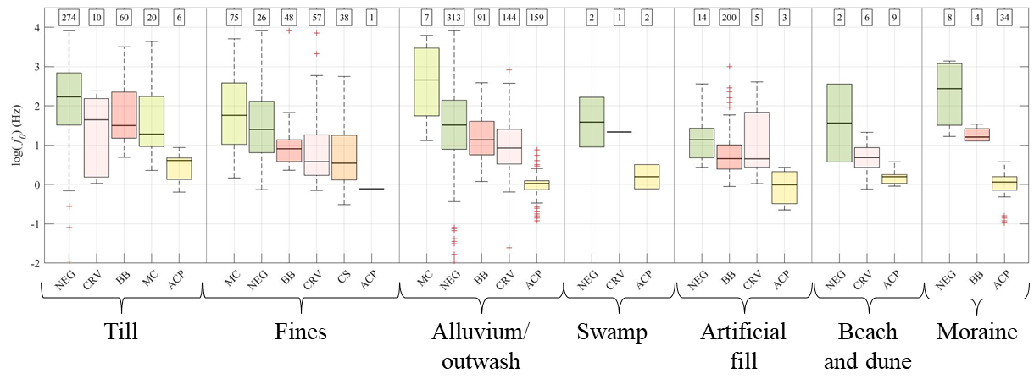
24
Summary figures from all distributions
Figure 30. Pie charts of areas of each surficial geology within each subregion
Figure 31. Box and whisker plots of f₀ distributions of each subregion grouped by geology.

Slide 34
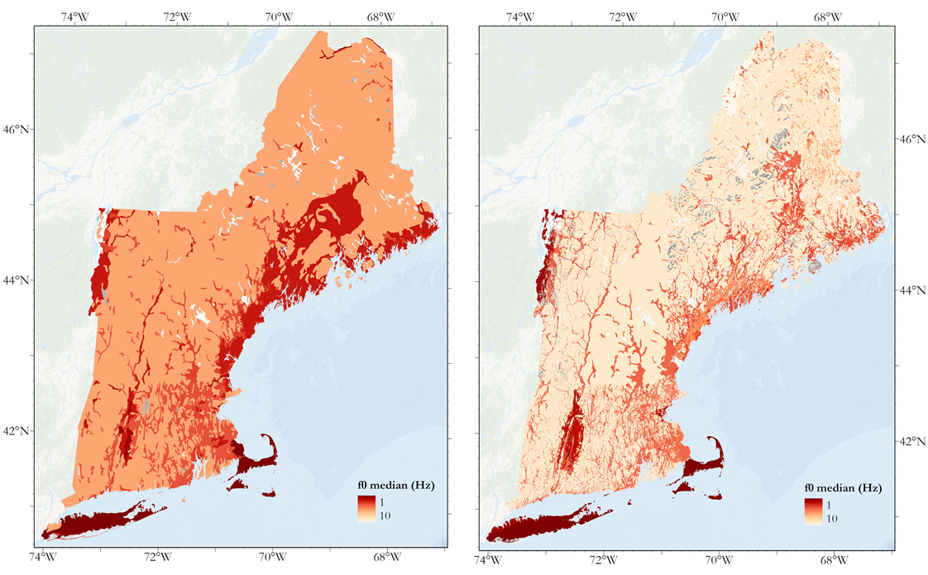
25
f₀ median site characterization map comparison
Figure 32. a) Final f₀ median map based on the Soller (2009) map. b) f₀ median map developed in chapter 2 using high resolution geologic maps and subregions.

Slide 35
26
Discussion and conclusion
-By subdividing the region into subregions, each subregion has geology-based distributions developed entirely from data within that subregion.
-Using high resolution state-scale surficial geology maps as a grouping layer improves the resolution of the characterization maps.
-The region with the lowest median frequency in the study is the Atlantic Coastal Plain sediments with a median of 1 Hz.
-The Champlain Sea Sediments (1.64 Hz)and the Boston Basin (2.01 Hz) are predominantly fine deposits of glaciomarine clay with similar distributions of fundamental frequencies
-The Connecticut River Valley (2.03 Hz) is mostly flood-plain alluvium from the Connecticut River with some fines deposited by Glacial Lake Hitchcock.
-The Maine Coast, though also mapped with significant amounts of glaciomarine deposits has a higher median frequency (4.95 Hz) than the rest of the fine-dominated subregions on the map indicating that it is likely shallower on average.
-The state-scale model enhances smaller, important subregions like the Boston Basin and resolves the issue of the Maine coast having high f₀ residuals in the national scale map.

Slide 36
Geology-based normalized HVSR curves for the New England f₀ dataset
Dissertation chapter 3 (in development)

Slide 37
Introduction

Slide 38
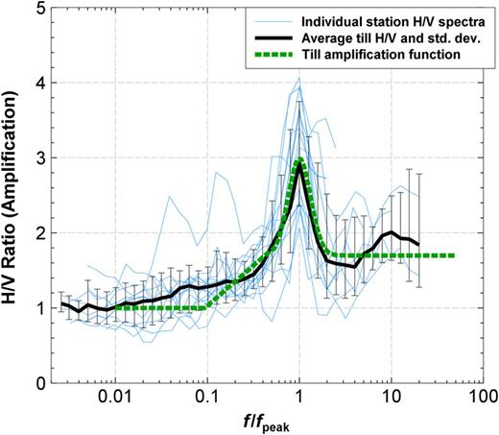
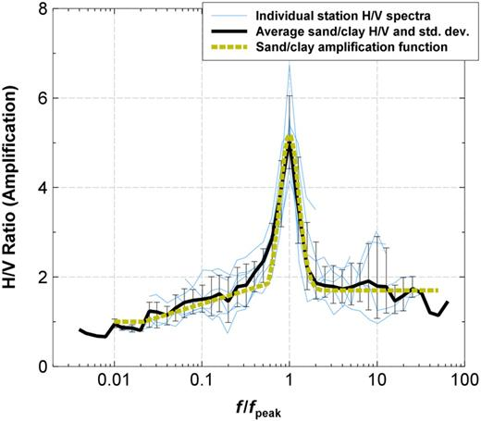
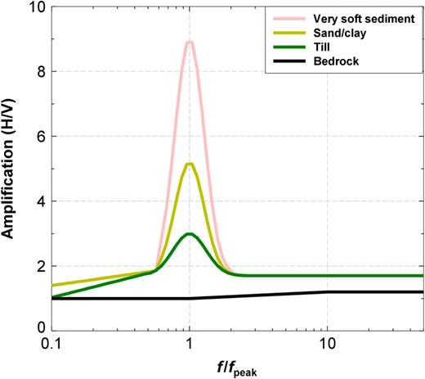
27
Normalized HVSR curve development
Figure 33. HVSR curves for the 15 stations located on till plotted by f/fpeak from Braganza et al. 2016.
Figure 34. HVSR curves for the 7 stations located on sand/clay plotted by f/fpeak
Figure 35. Comparison of HVSR functions for different geology types.

Slide 39
Data

Slide 40
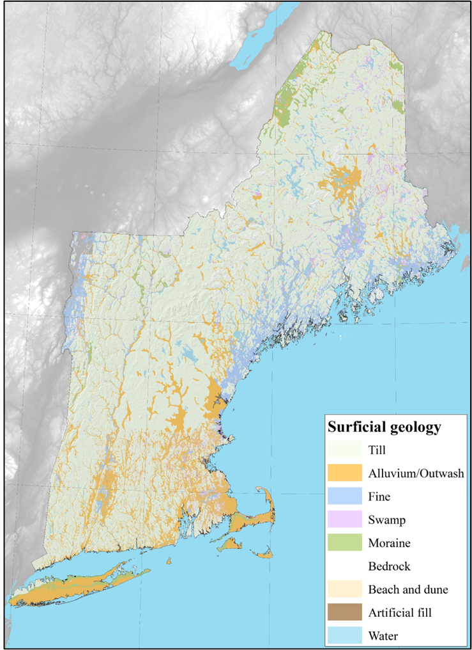
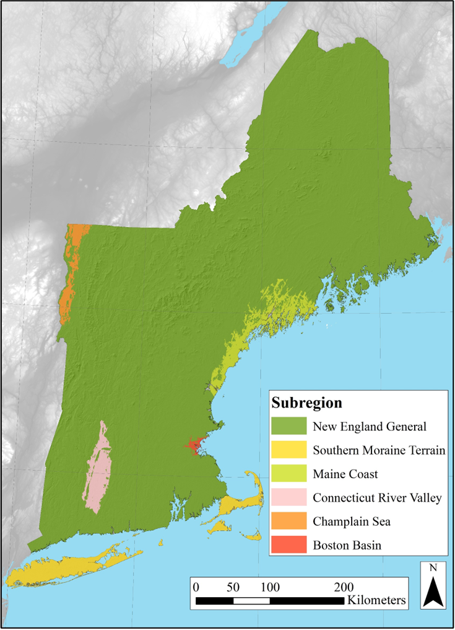
28
HVSR database and grouping layers for normalized curve development
Figure 36. Locations of HVSR stations in the database. Each station has a curve and an f₀ value, the information necessary to create a normalized curve
Figure 37. Surficial geology grouping layer develop in Chapter 2 using the state scale maps.
Figure 38. Subregion grouping layer in developed in Chapter 2.

Slide 41
Methods

Slide 42
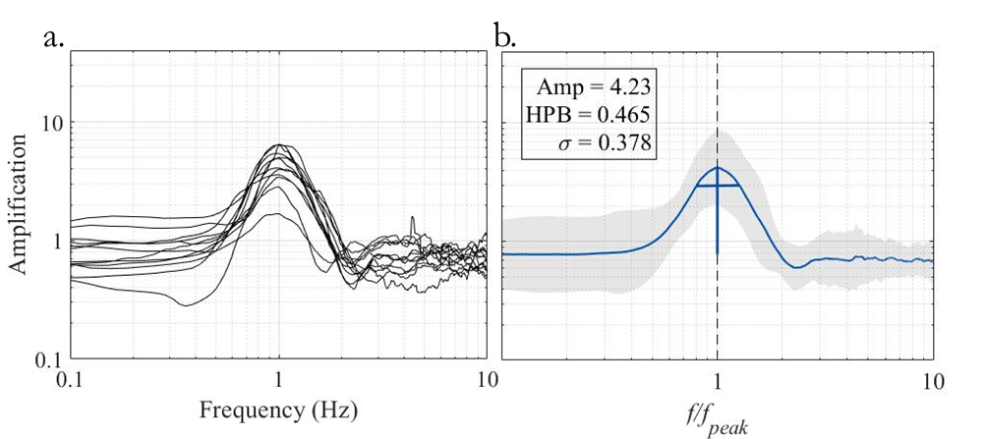
29
Methods
Following the methodology of Braganza et al. (2016):
1. Group HVSR curves by 1) subregion and 2) geology.
2. Divide each HVSR curve frequency axis by its f₀ value.
3. Combine all the curve groupings and calculate an average normalized curve.
4. Compute shape statistics on that curve’s peak.
5. Compare normalized curve peaks between groupings.
Figure 39. Example of averaging together HVSR curves in a grouping to develop a normalized curve. This example contains curves from the Atlantic Coastal Plain subregion.

Slide 43
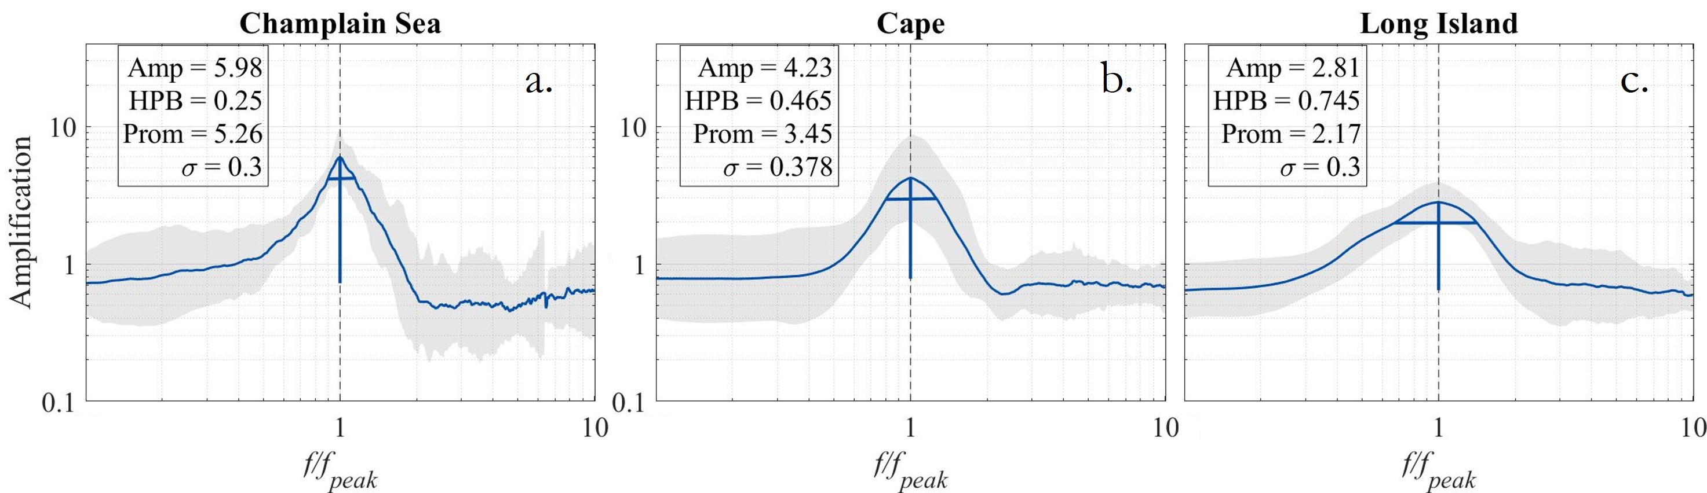
30
Preliminary results
Figure 40. Normalized HVSR curves for a) the Champlain Sea, b) Cape Cod and c) Long Island. With 8 geologies and 6 subregions, there are 48 possible groupings for the normalized curve development.

Slide 44
31
Goals of chapter 3
1. Develop a normalized HVSR curve and summary statistics for each geology in each subregion
2. Compare the curve shapes and statistics of each normalized curve and see if these vary from geology to geology and region to region.
3. Determine what causes differences in peak shape

Slide 45
32
Summary of dissertation
In chapter 1, lay the foundations for the work, specifically, the layer-over halfspace model and calculations that can be formed using it, the data processing and peak statistics of the HVSR curve, the process for estimating Vs_{avg} with limited information, and the combination of f₀ points with surficial geologic polygons to develop f₀ distributions.
In chapter 2, refine the data with higher resolution grouping layers and include subregions to further subdivide the dataset.
In chapter 3, use the most up-to-date geology and basin grouping layers developed in chapter two to group HVSR curves and apply the methodology of Braganza et al. (2016) to develop normalized HVSR curves for all groupings.

Slide 46
Thank you
Questions?

