Slide 1





Site characterization in New England using high resolution geology maps and a subregion grouping layer
Marshall Pontrelli¹, Dr. Laurie Baise², Dr. John Ebel³
¹PhD Candidate (Tufts), ²Professor and Chair (Tufts), ³Senior Research Scientist (Boston College)
Marshall Center, Tampa Bay, FL, 33620, USA
ESSA annual meeting 10/25/2022
Research supported by USGS Award #s G20AP00040 and G20AP00040

Slide 2
1
Presentation structure
Site response
Motivation
Layer-over-halfspace model
Introduction
4. f₀, Vs_{avg} , and surficial geology database
Data
Subregion development and map
f₀ distribution development
Vs_{avg} distribution development
Methods
Results
Summary and conclusion

Slide 3

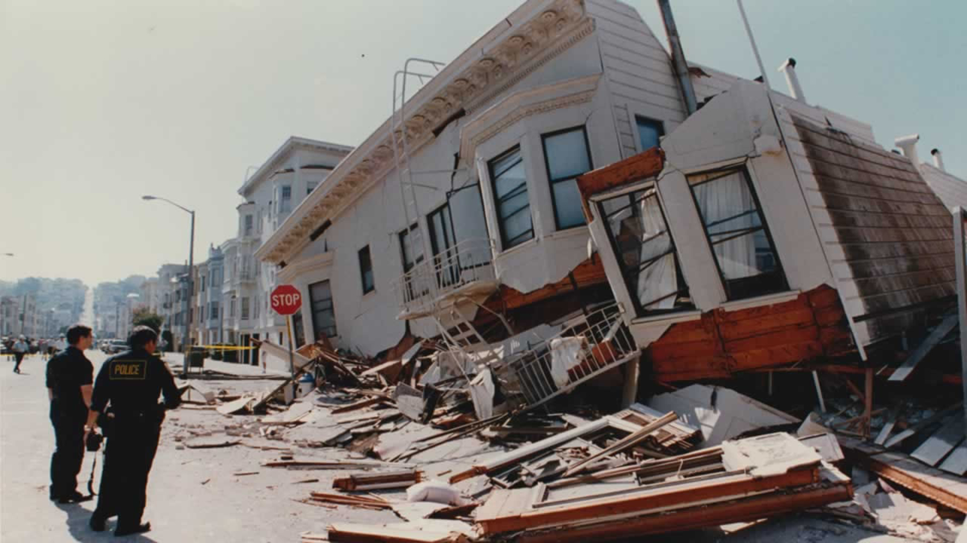
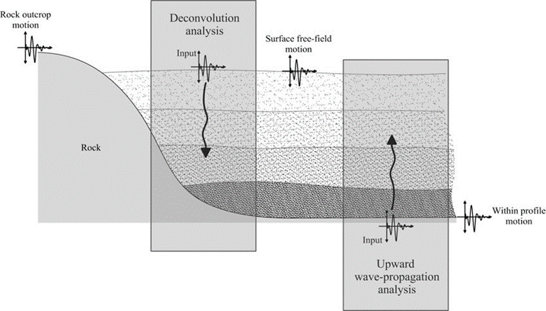
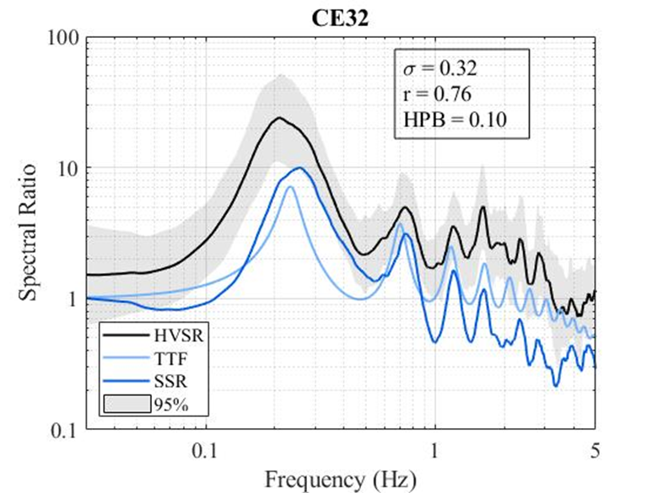

Introduction
2
Site Response
Figure 1. Loma Prieta 1989
Figure 2. Mexico City 1985
Figure 3. One dimensional site response analysis schematic.
Figure 4. Suite of transfer functions from a soil site in Mexico City

Slide 4
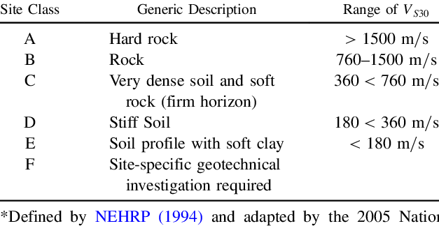
Introduction
3
Seismic Site Classification
Table 1. Vs30 based site class definitions.

Slide 5
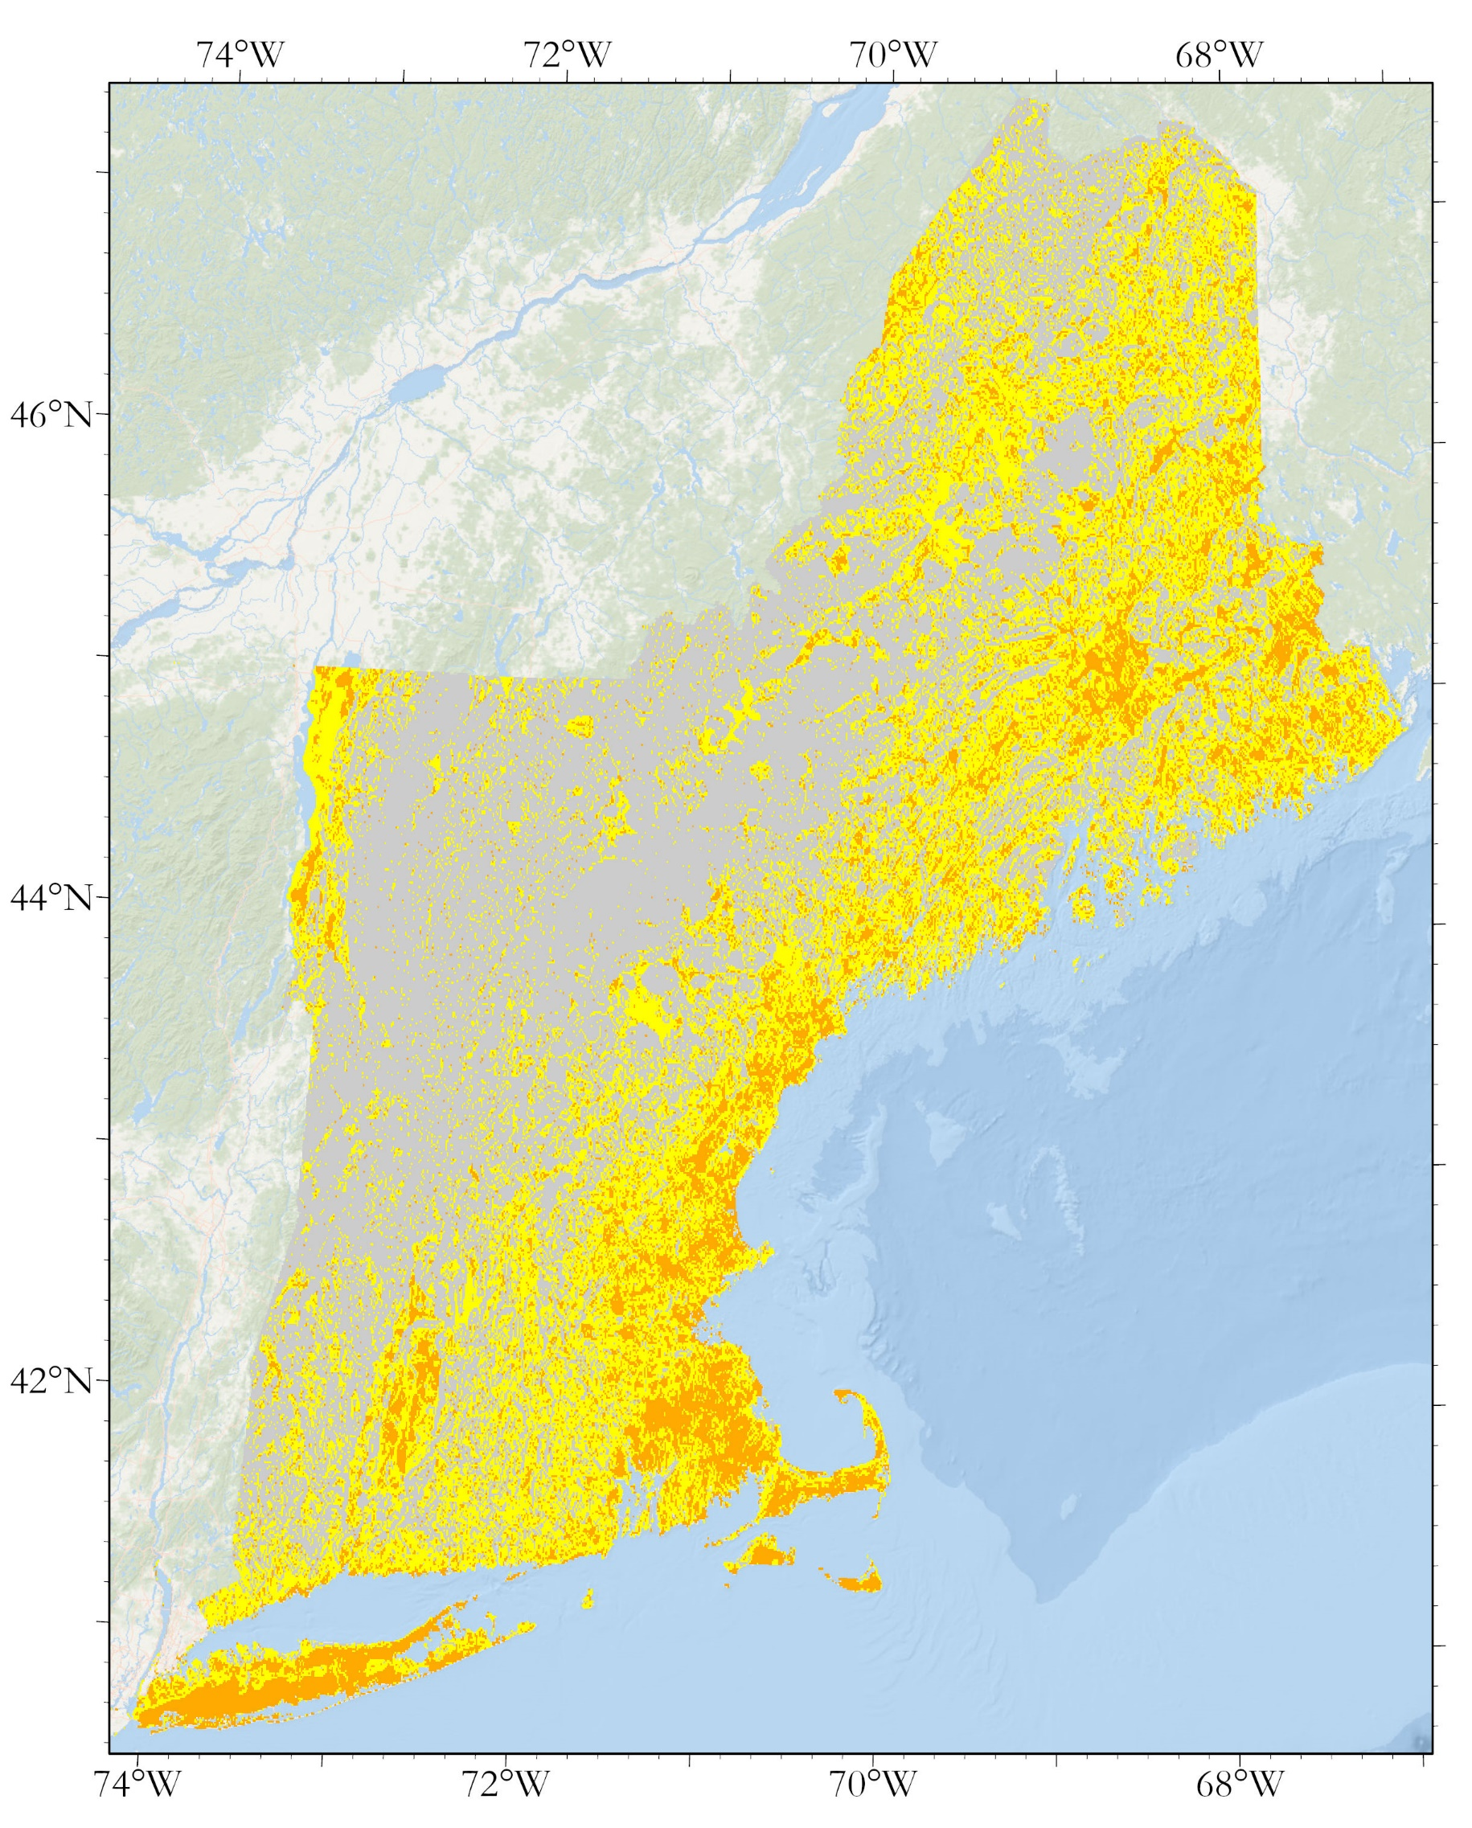
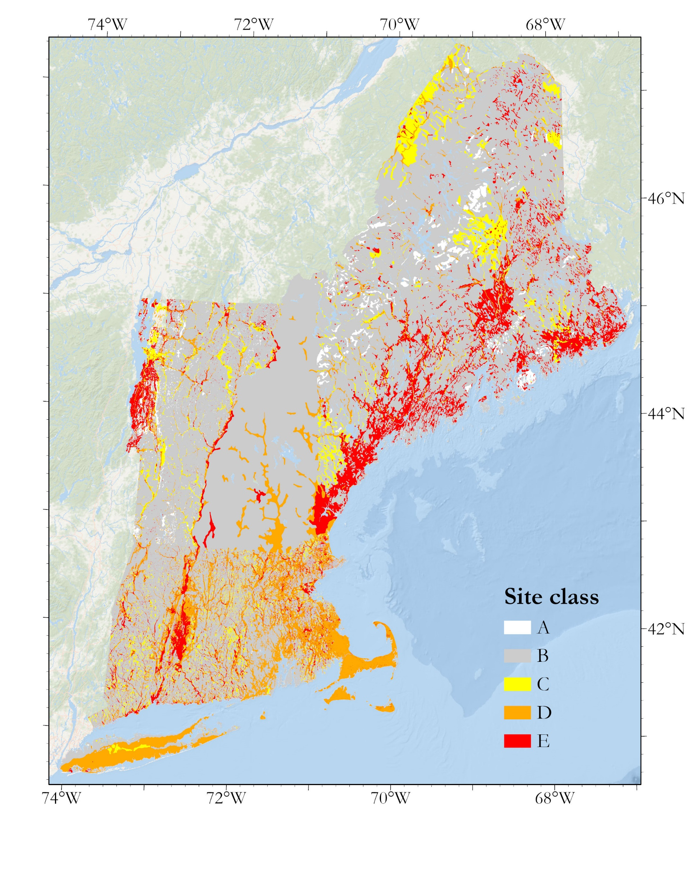
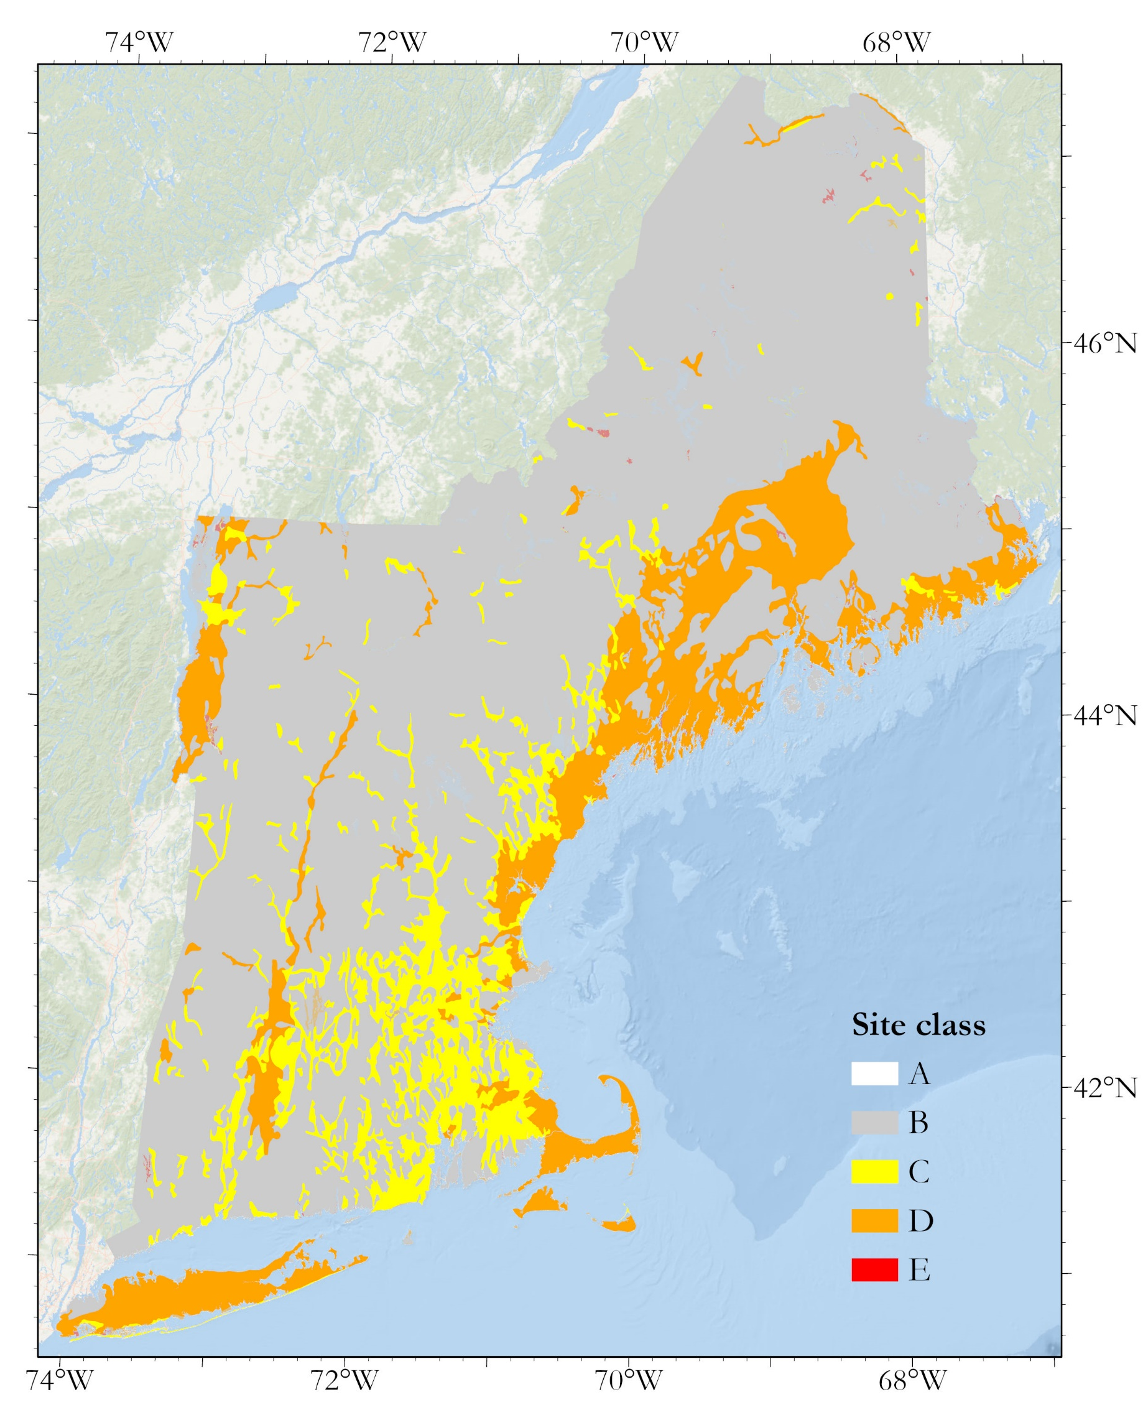
Introduction
4
Motivation
Existing New England site response models:
Figure 5. Slope-based Vs30 site class map of New England from Wald and Allen (2007)
Figure 6. Geology-based site class map of New England from Becker et al. (2011)
Figure 7. f₀, Vs_{avg} and geology-based site class map of New England from Pontrelli et al. (2022)

Slide 6
Introduction
5
Where existing models can be approved upon
-Wald and Allen (2007) uses global data to develop Vs30-slope relationship – at the local and regional scale, this relationship will change based on local soil properties and basin geometries. The paper states: “[m]aps of seismic site-conditions on regional scales are relatively rare since they require substantial investment in geological and geotechnical data acquisition and interpretation”. This work is an attempt to make that investment.
-Becker et al. (2011) uses local surficial geologic maps to map geologic units straight onto seismic site classes. This works well in terms of resolution but does not take into account depth – an essential variable in Vs30 calculations. In their model, if a surficial material is mapped as a marine clay, it will be a site class E soil no matter the depth.
-Pontrelli et al. (2022) takes depth into account by using geophysical (f₀) measurements but uses lower resolution geologic maps and doesn’t take into account depth variations between basins, only looking for variation across geologic units. Additionally, the methodology doesn’t propagate shear wave velocity uncertainty, only f₀ uncertainty.

Slide 7
Introduction
6
In this work we:
-Develop site characterization maps of New England by developing distributions of f₀, Vs_{avg}, and Vs30 across the region.
-Use the highest available surficial geologic data available.
-Create a subregion grouping layer using a digital elevation model to subdivide our geophysical database, reducing dispersion in the parameter distributions.
-Develop distributions of f₀ and Vs_{avg} using subregions and propagate these distributions through the layer-over-halfspace model to create Vs30 distributions.
Research question: What are the mean and standard deviation values of the distributions of f₀, Vs_{avg}, and Vs30 in New England?

Slide 8
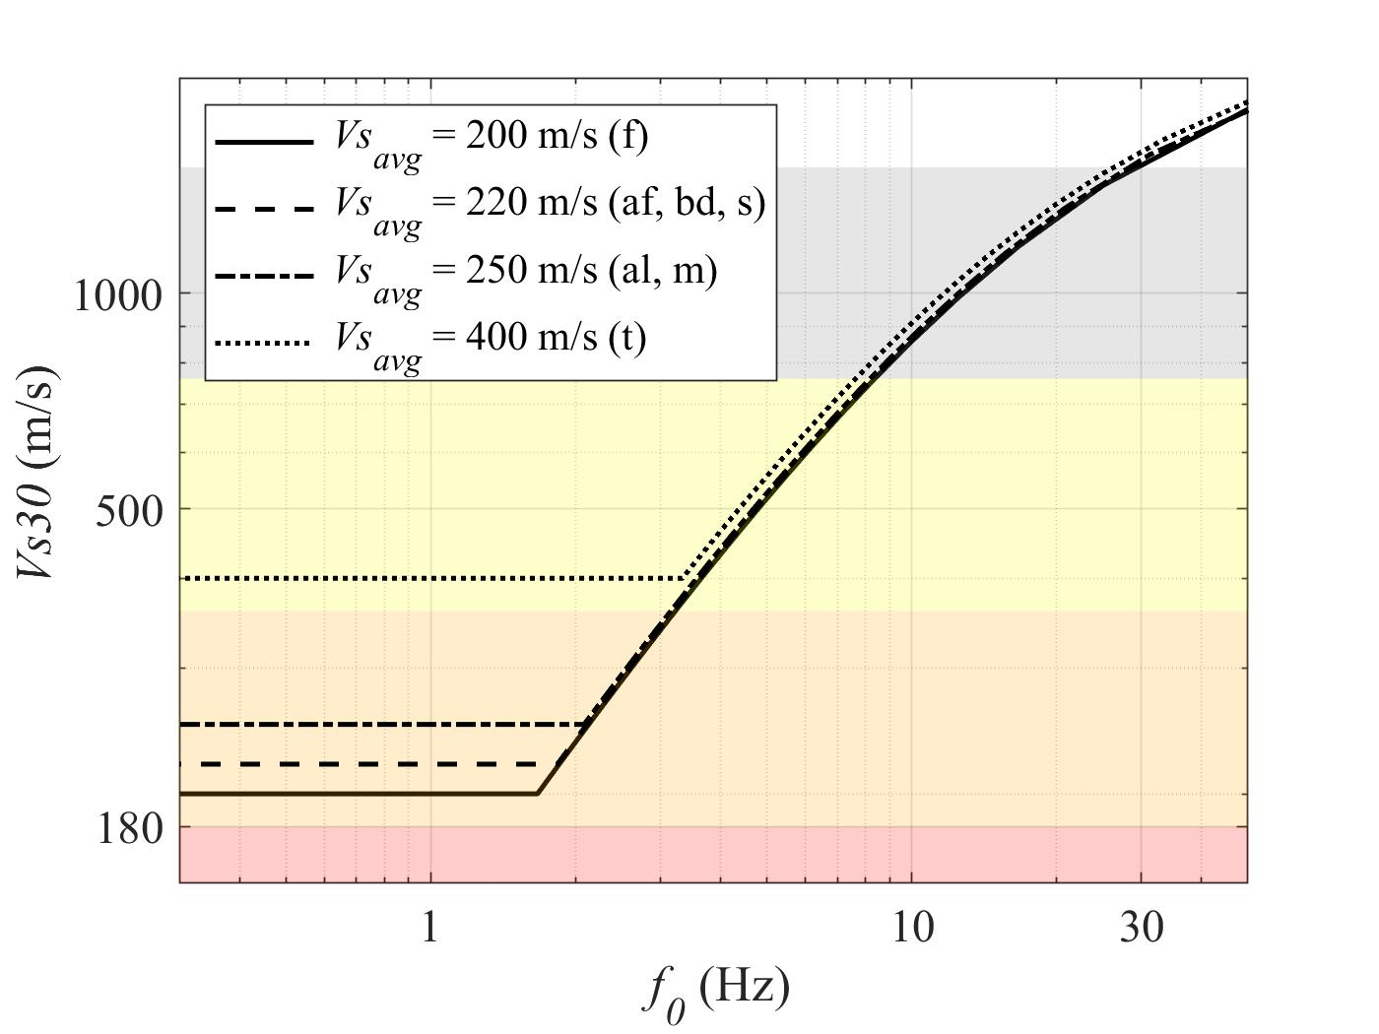

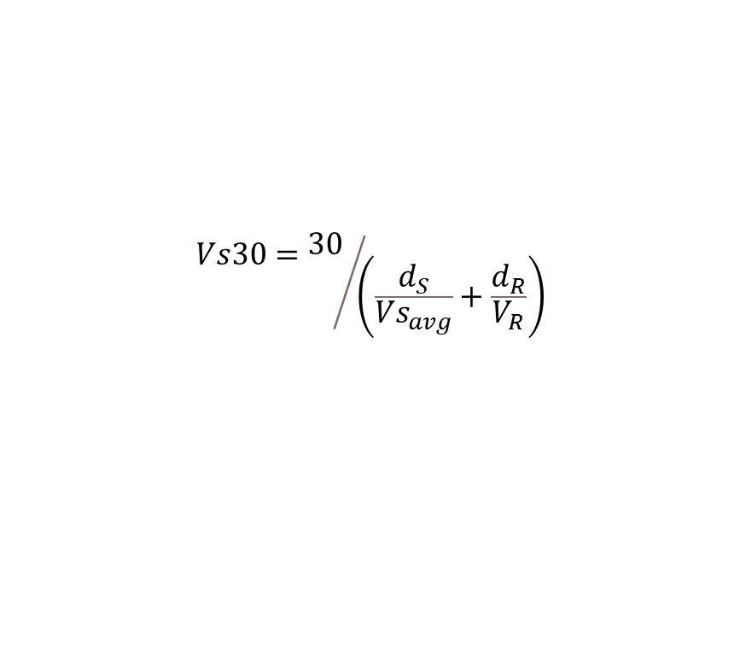


Introduction
7
Layer-over-halfspace model
Relationship is valid when d_{s} < 30 m. When d_{s} > 30 m, Vs30 =Vs_{avg}
$$f_{0}={{Vs}_{avg}}/{4d_{s}}$$
$${Vs}_{avg}=\sum_{i=1}^{n}{\frac{h_{i}}{V_{i}}}$$
$$Vs30={30}/{\left(\frac{d_{S}}{{Vs}_{avg}}+\frac{d_{R}}{V_{R}}\right)}$$
Vs_{avg}
d_{s}
30 m
d_{R}
Figure 8. Relationship between f₀ and Vs30 for the 4 Vs_{avg} estimates of the 7 surficial units in the study.
V_{R}
$$Vs30=\frac{30}{\frac{1}{4f_{0}}\left(1−\frac{{Vs}_{avg}}{V_{R}}\right)+\frac{30}{V_{R}}}$$
Derivation is in Hassani and Atkinson (2016)

Slide 9
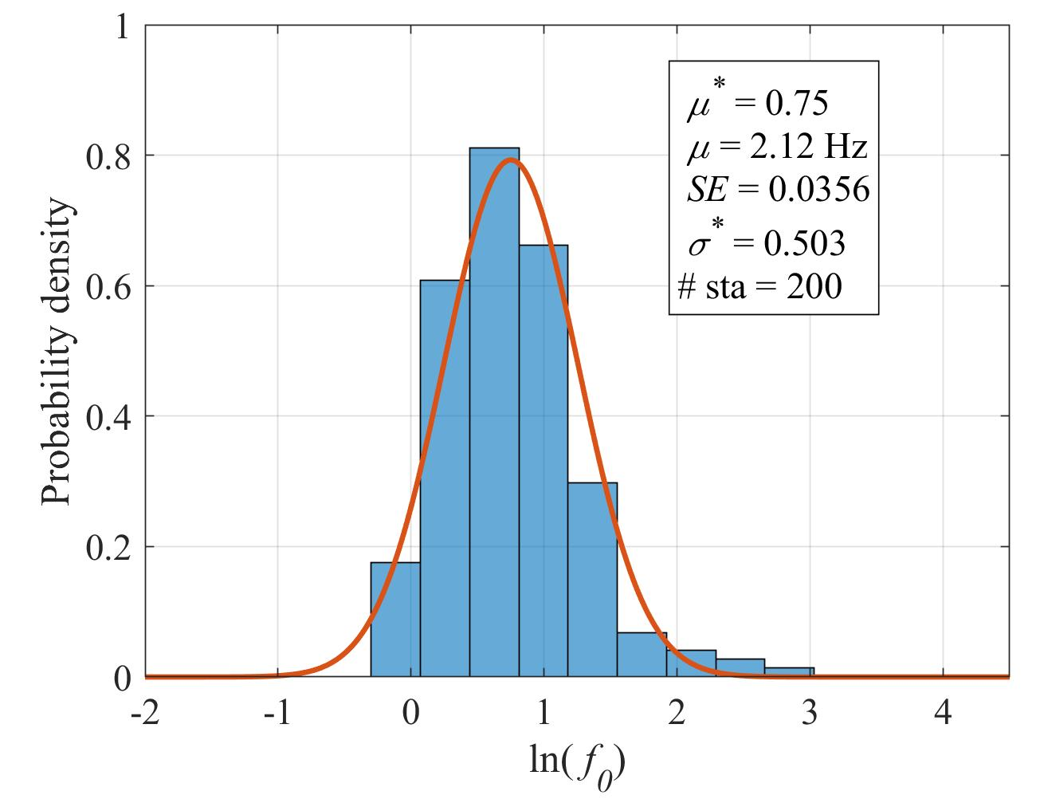
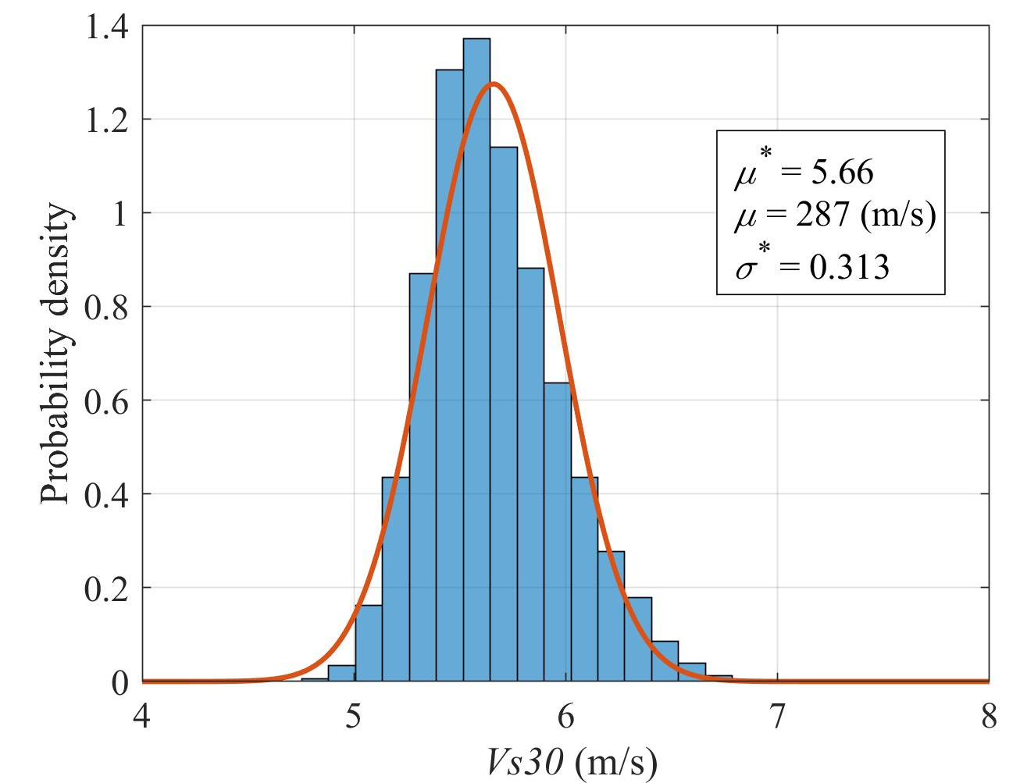
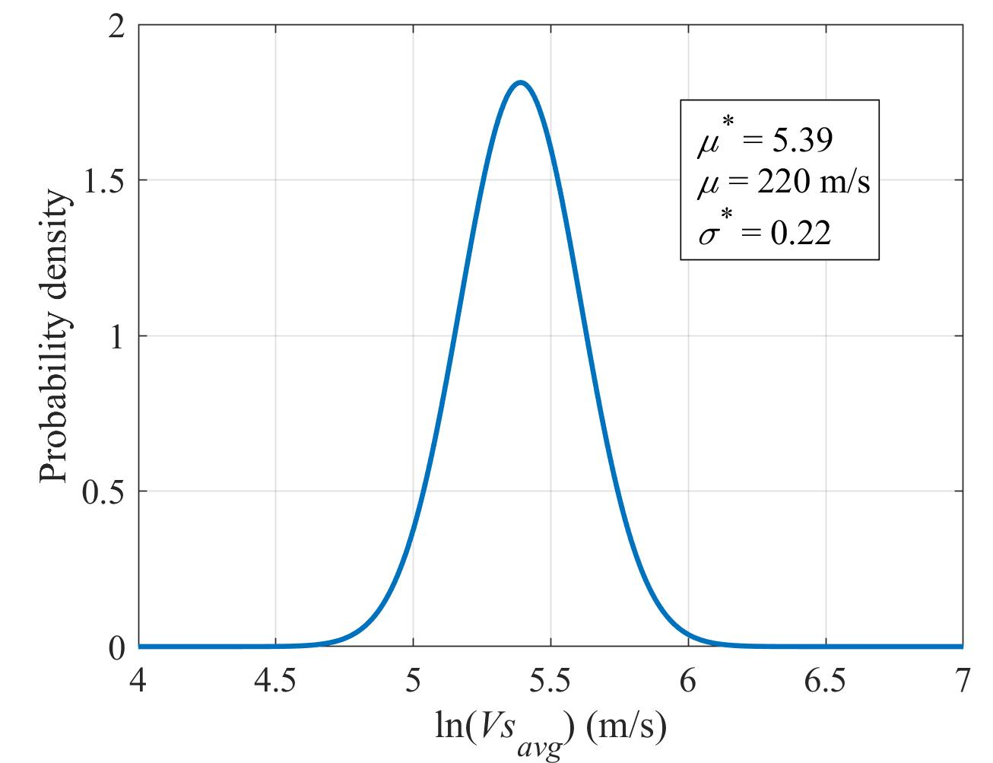

Introduction
8
Propagating uncertainty through the layer-over-halfspace model
$$\frac{30}{\frac{1}{4f_{0}}\left(1−\frac{{Vs}_{avg}}{V_{R}}\right)+\frac{30}{V_{R}}}=Vs30$$
a)
c)
d)
b)
Figure 9. f₀ and Vs_{avg} distribution inputs for Boston Basin artificial fill and the accompanying Vs30 distribution output.

Slide 10
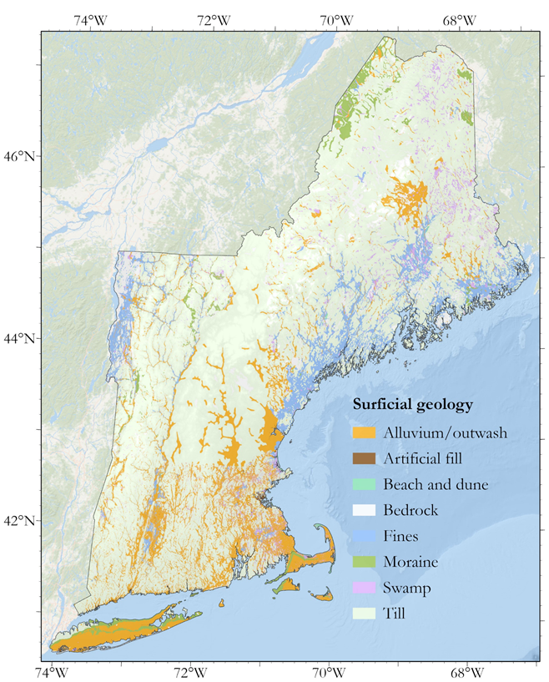
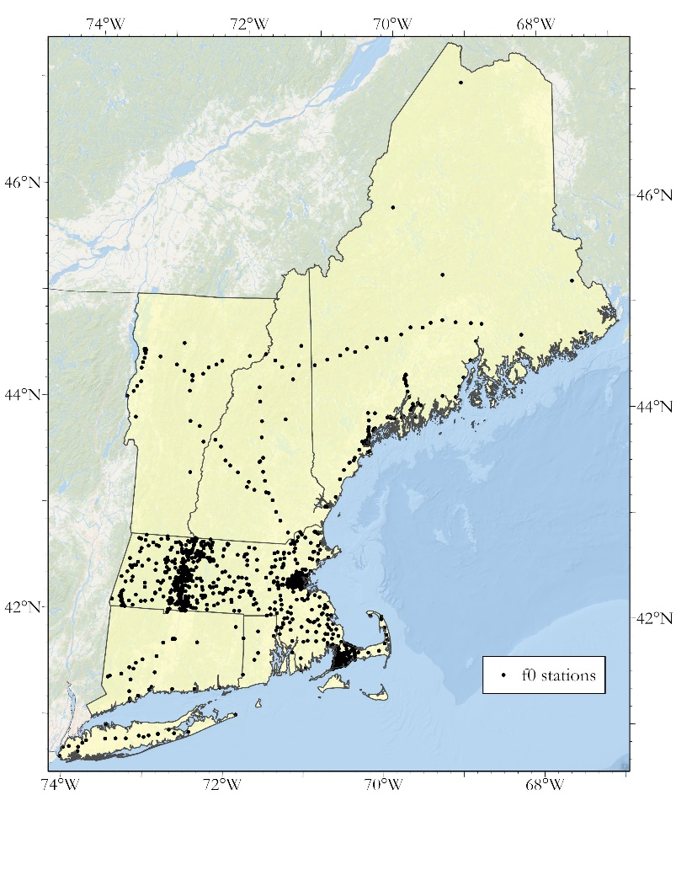
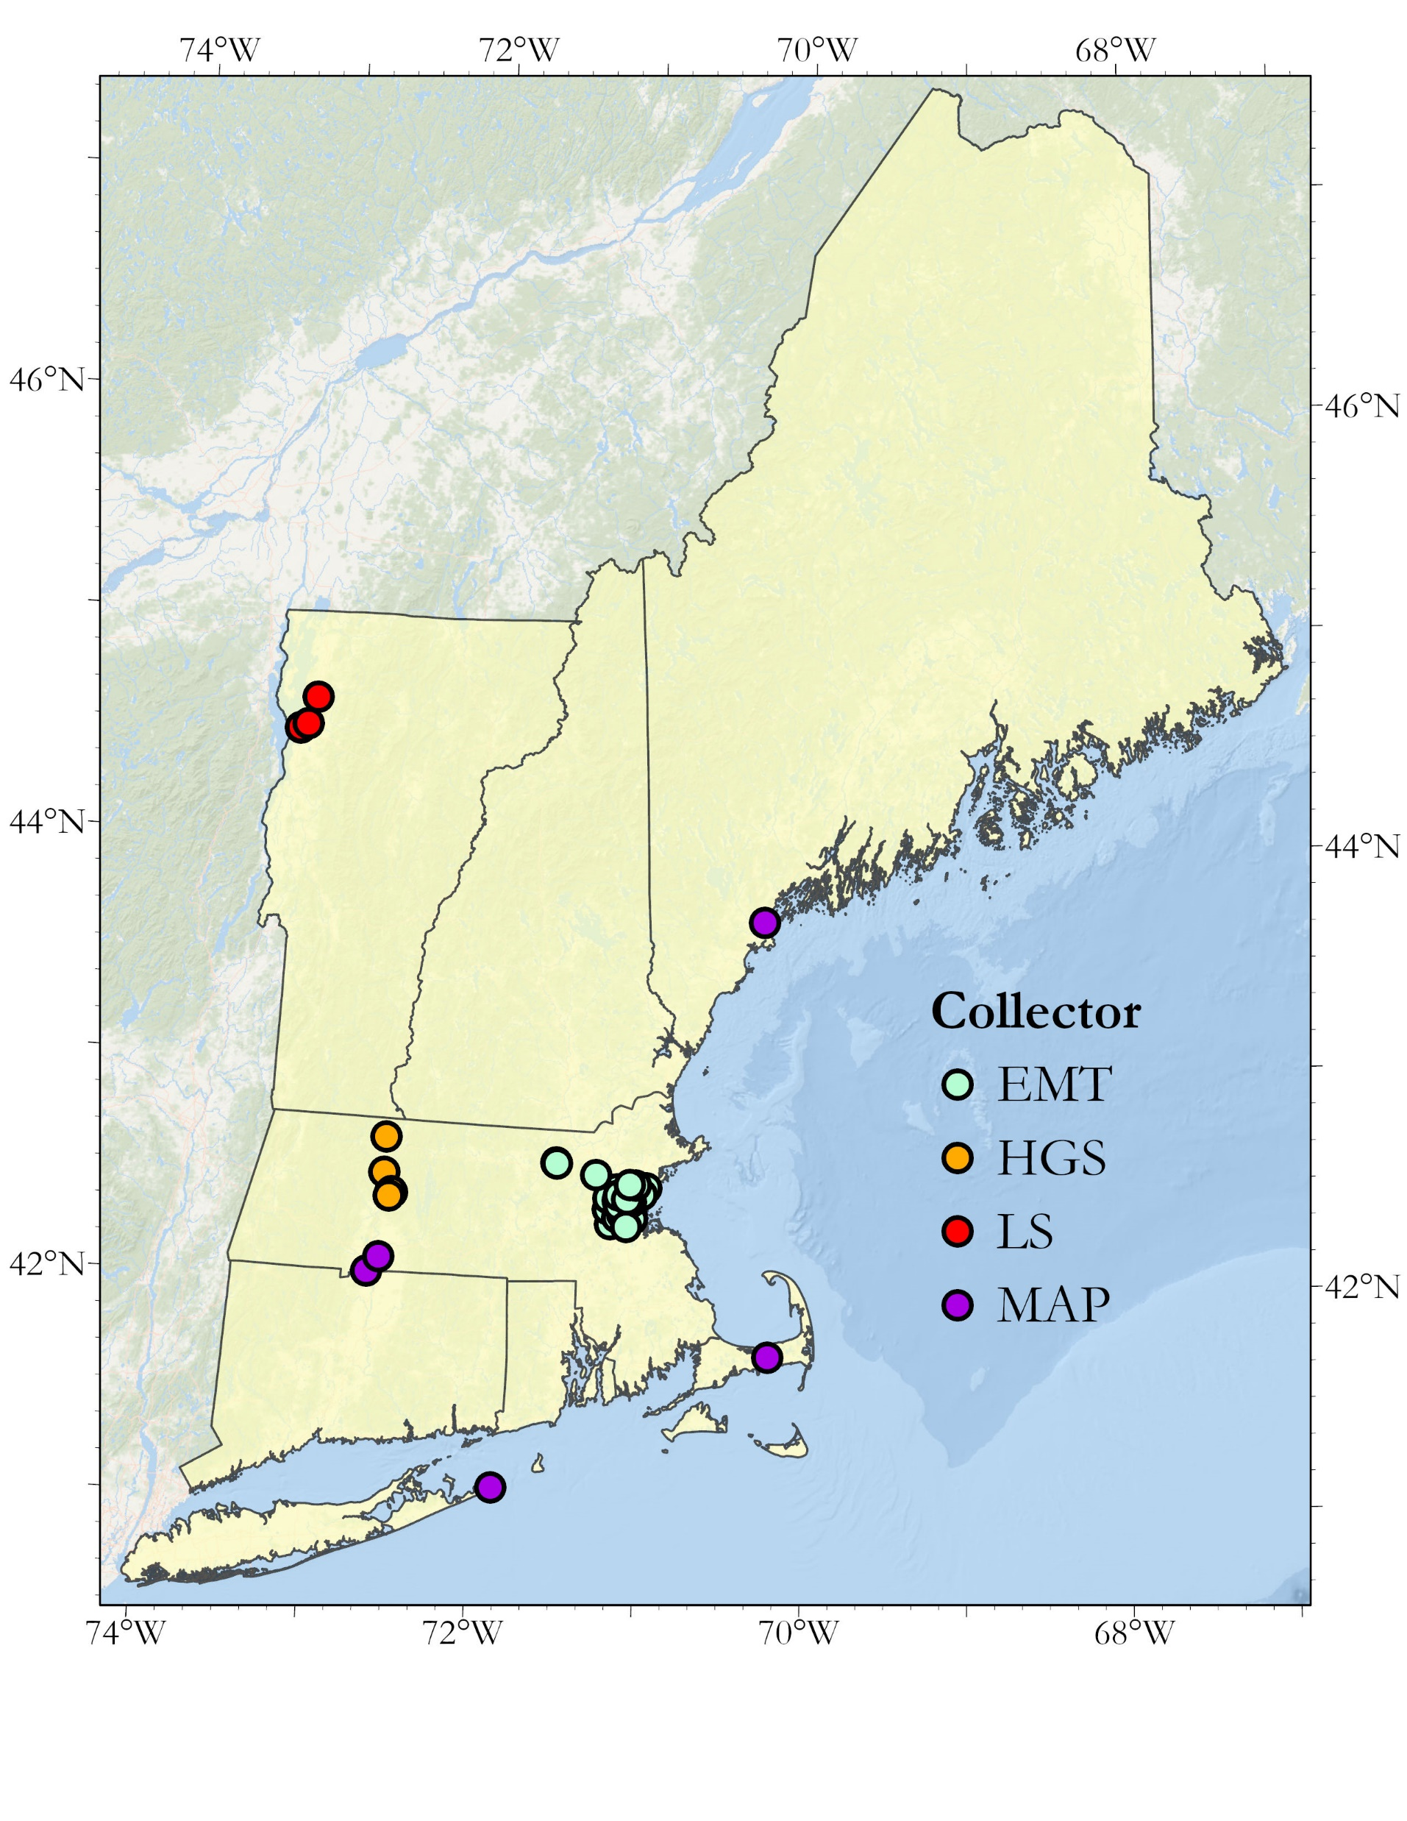
Data
9
Data to develop the f₀ and Vs_{avg} distributions
Figure 10. Final geology map developed from the state geological databases.
Figure 11. Spatial distribution of the HVSR database developed in this study.
Figure 12. a) Locations of shear wave velocity profiles in the study

Slide 11
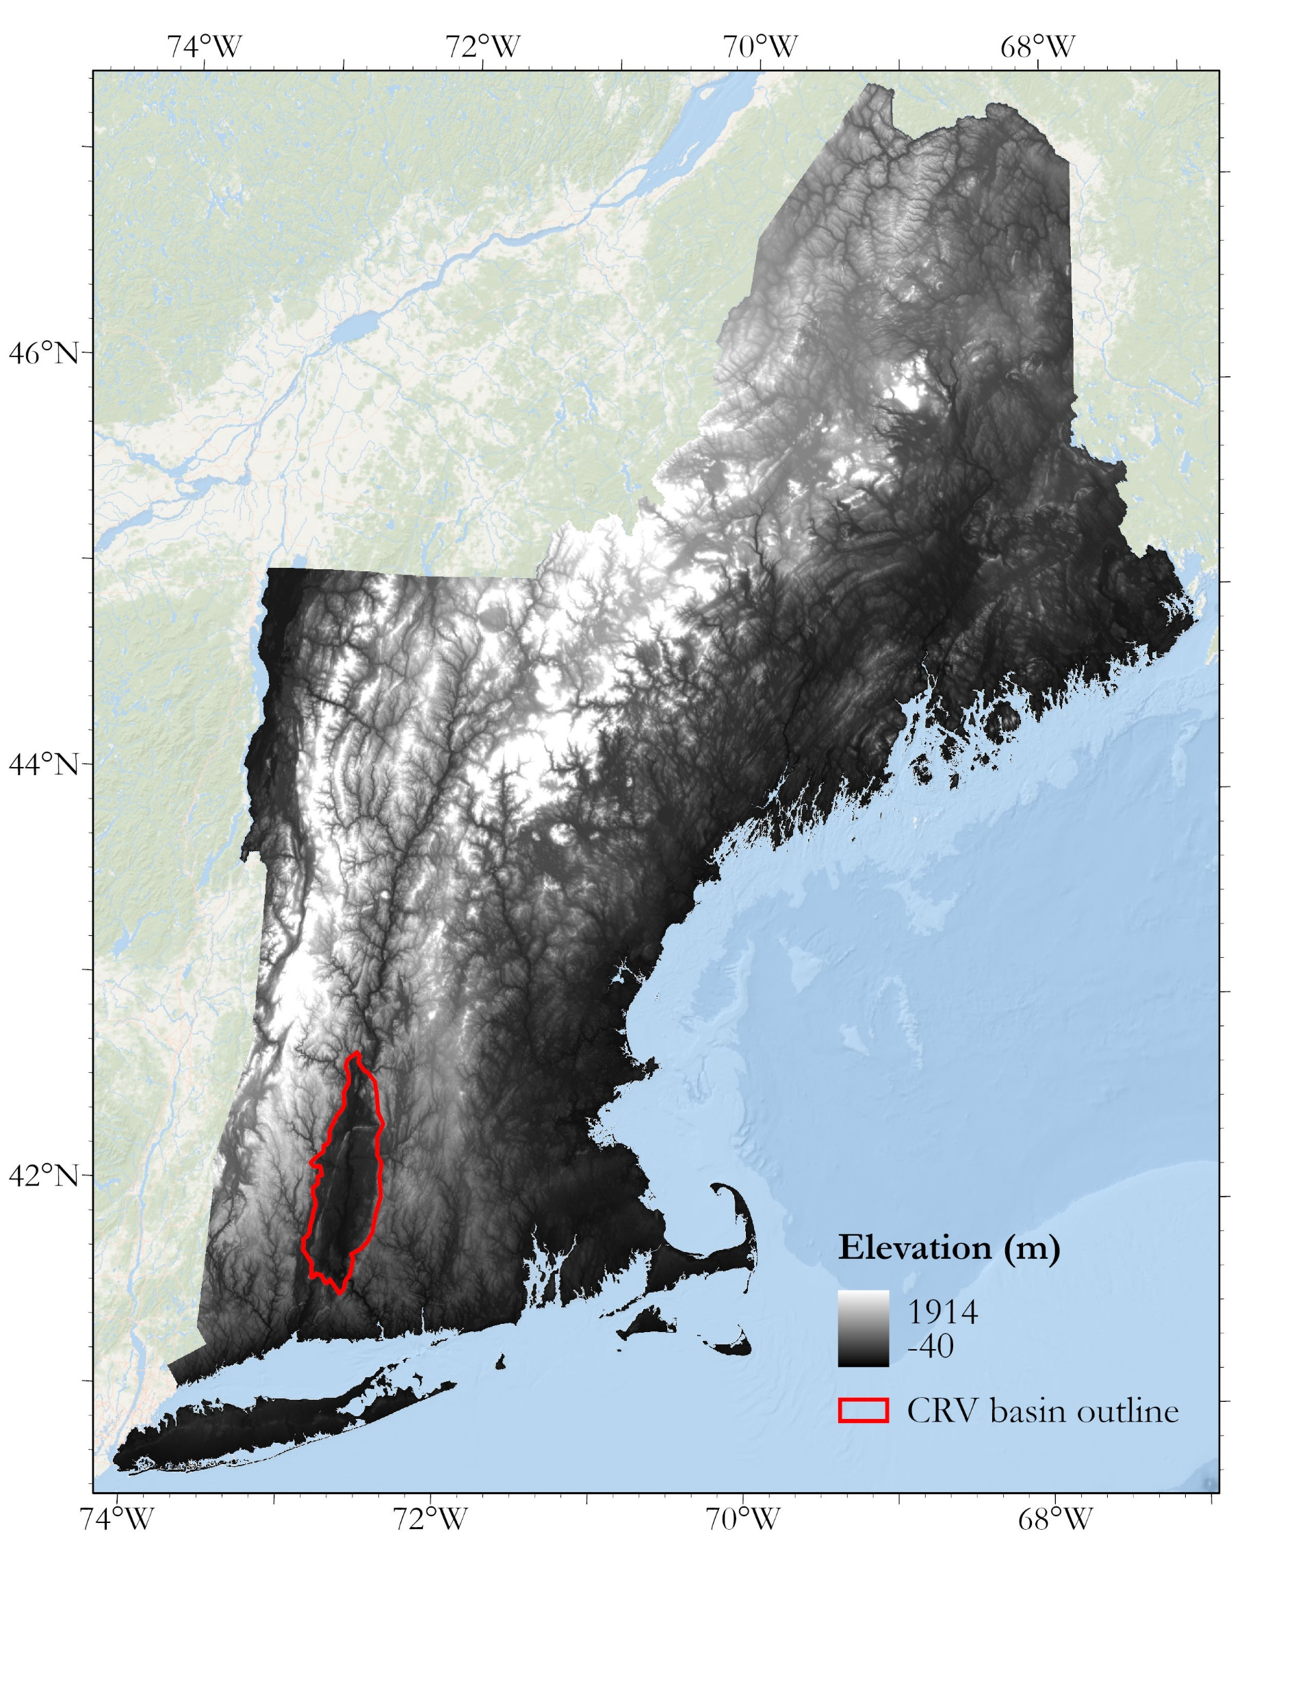
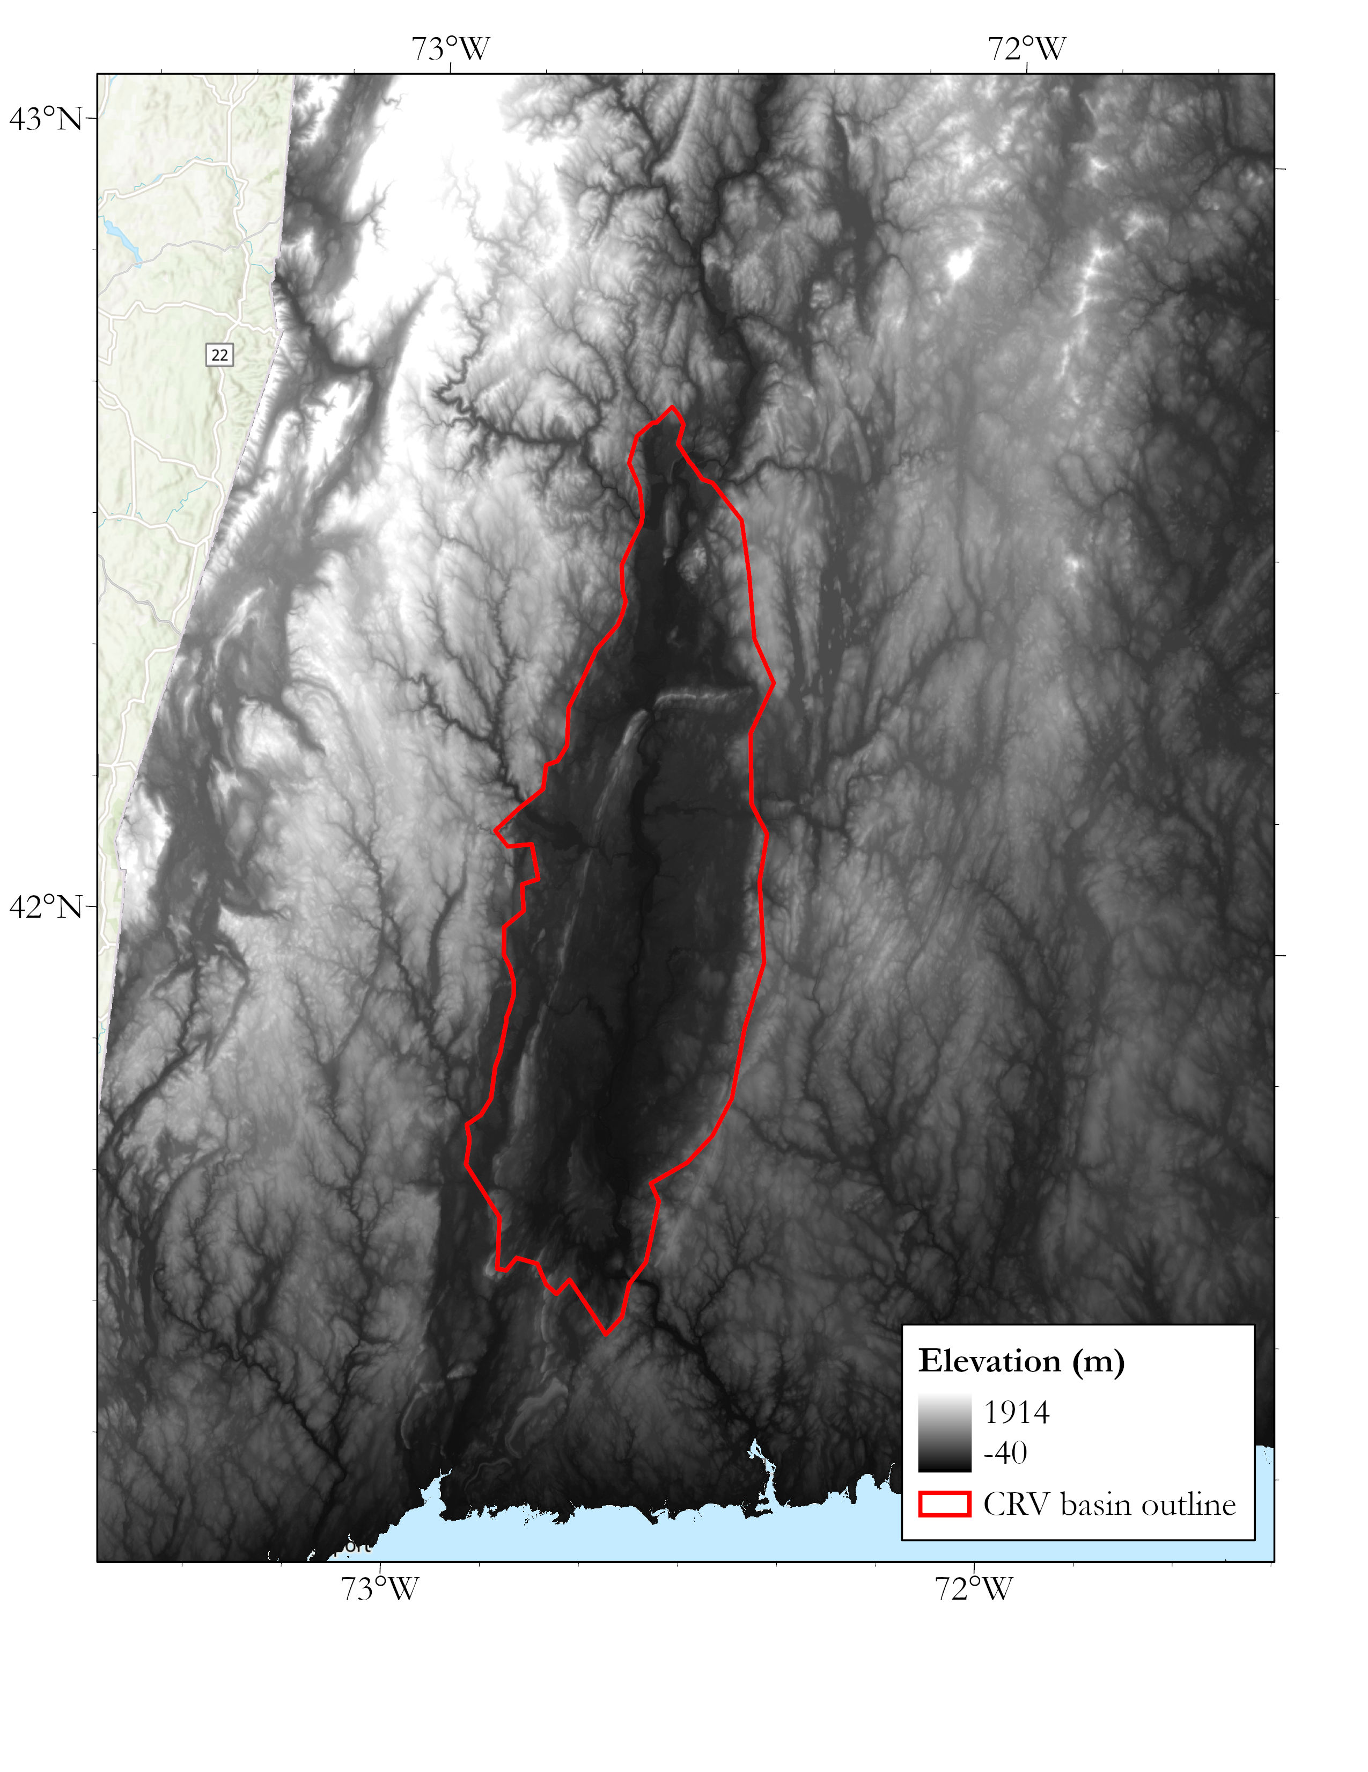
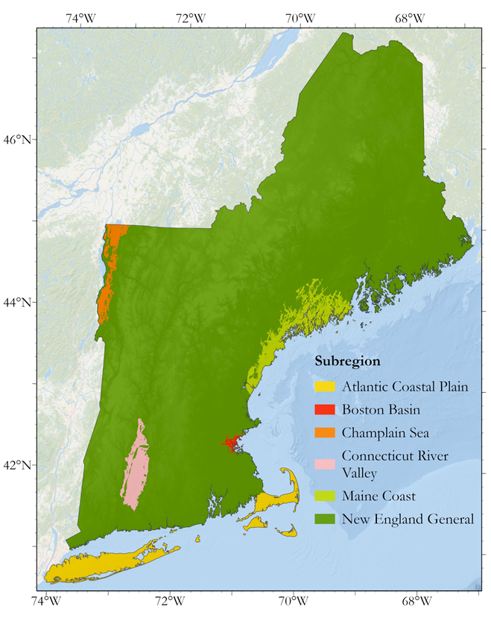
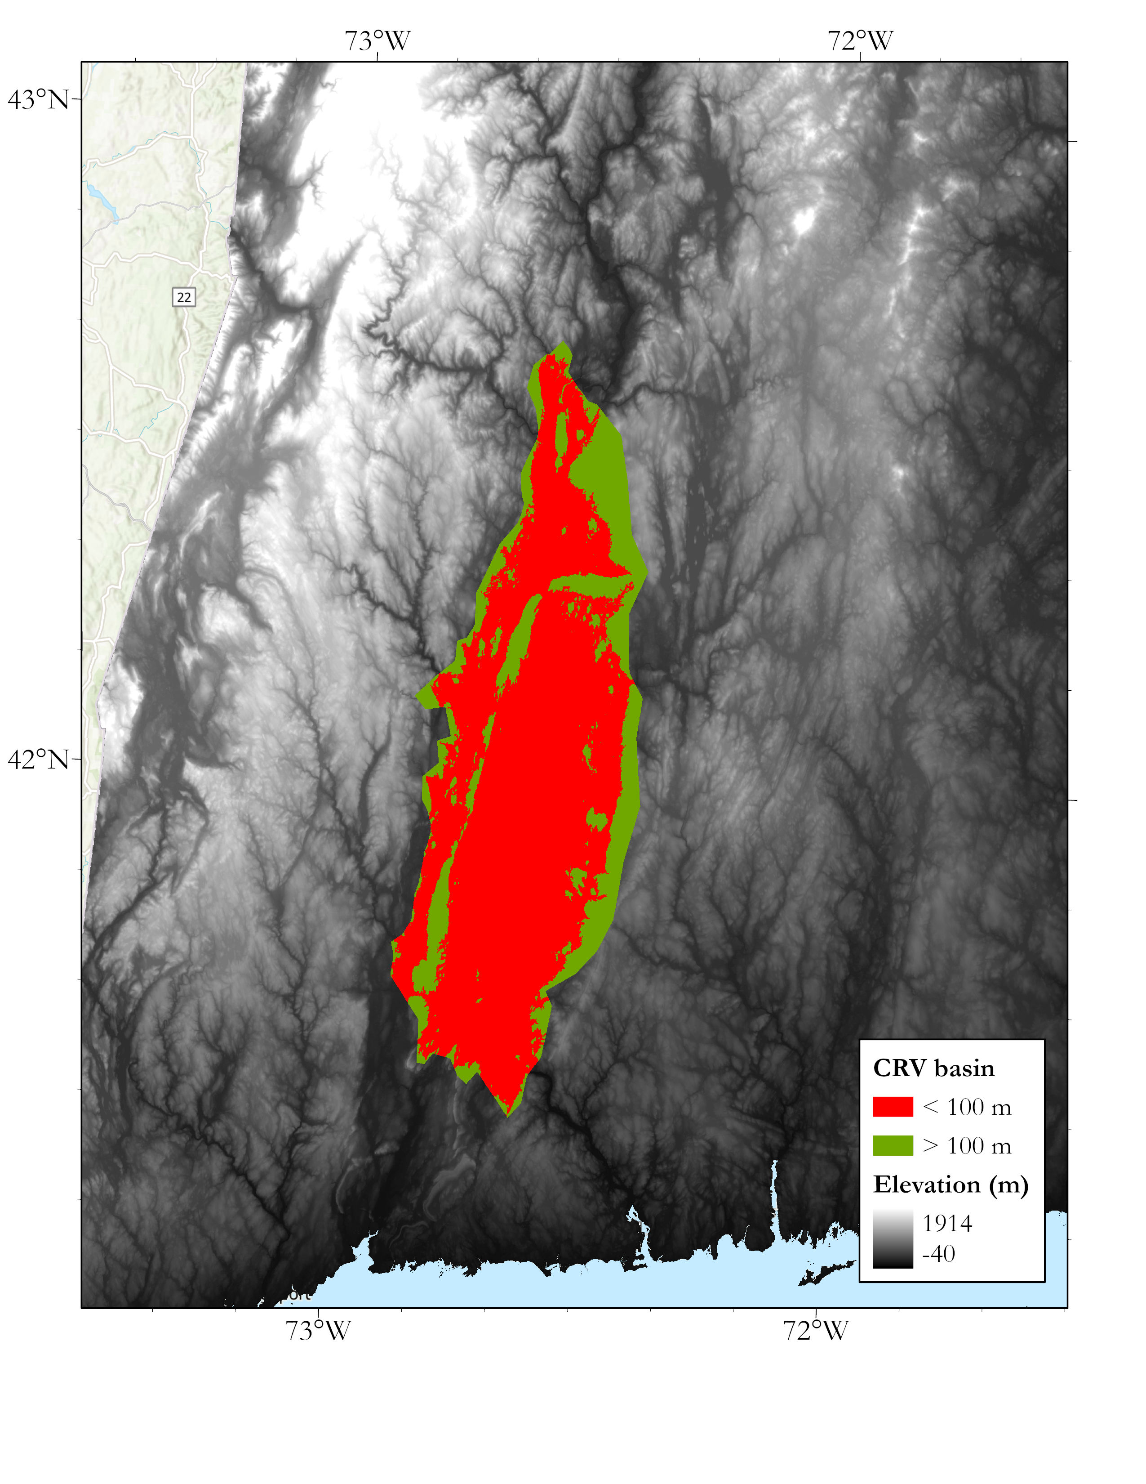
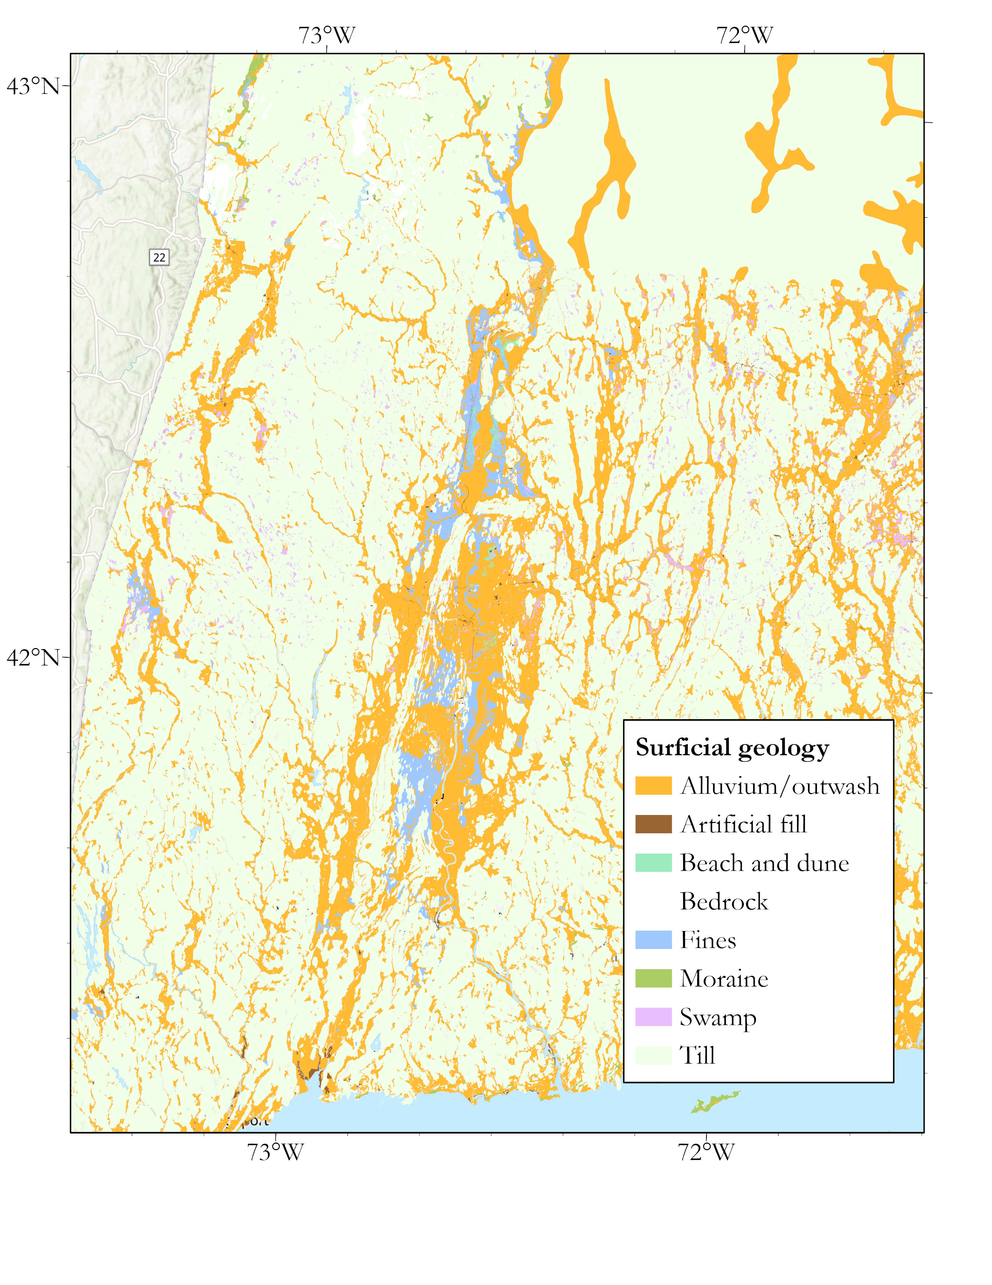
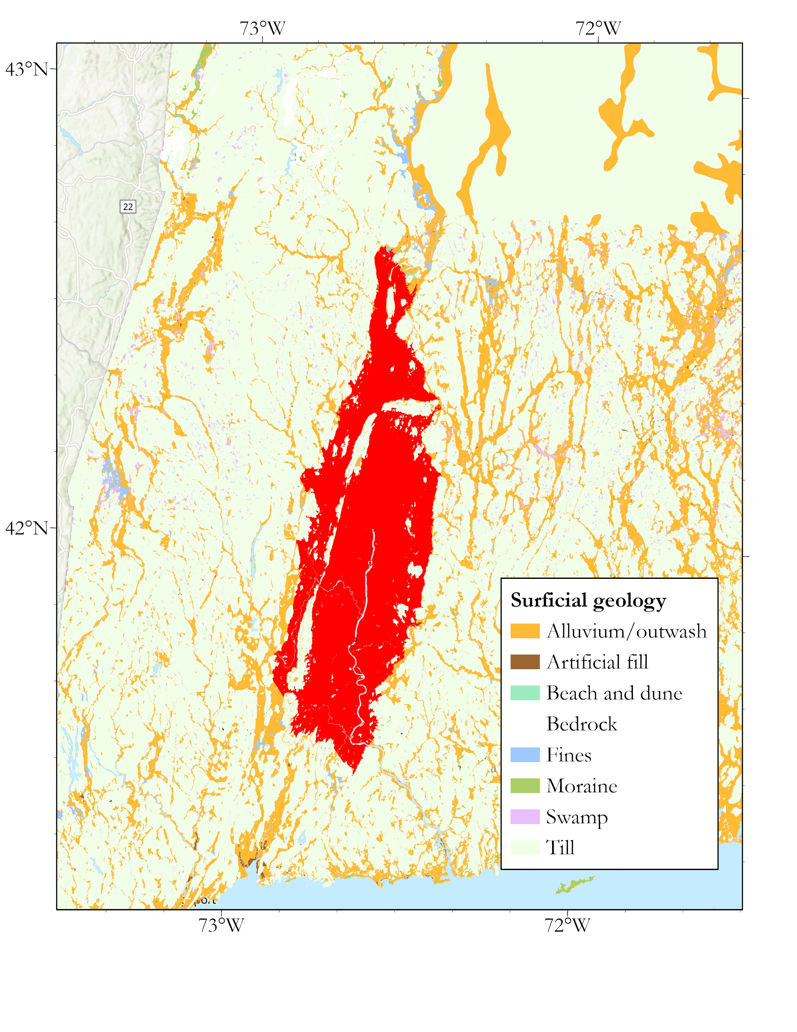
10
Subregion development
Figure 13. Demonstration of the process used in this study to create subregion polygons.

Slide 12
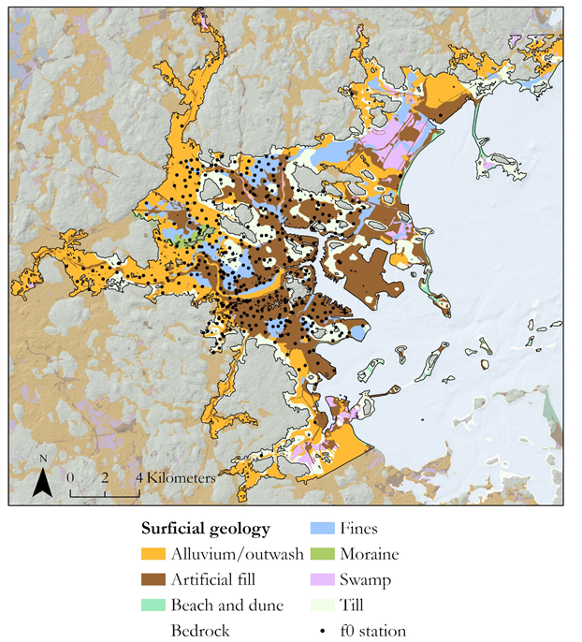
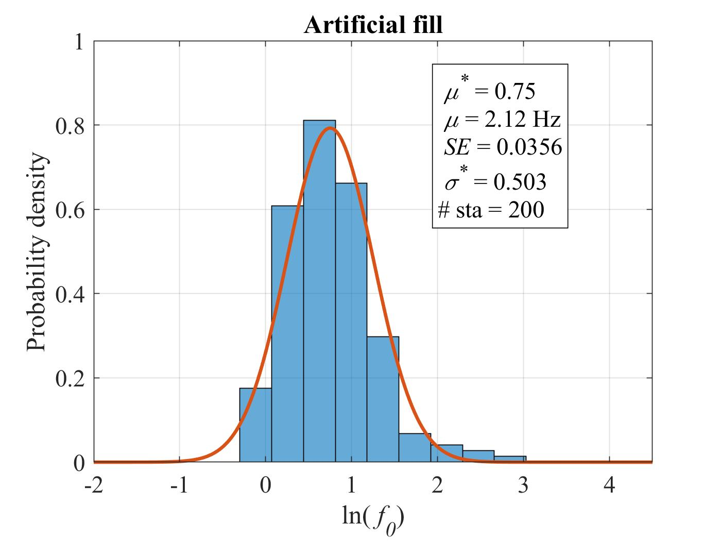
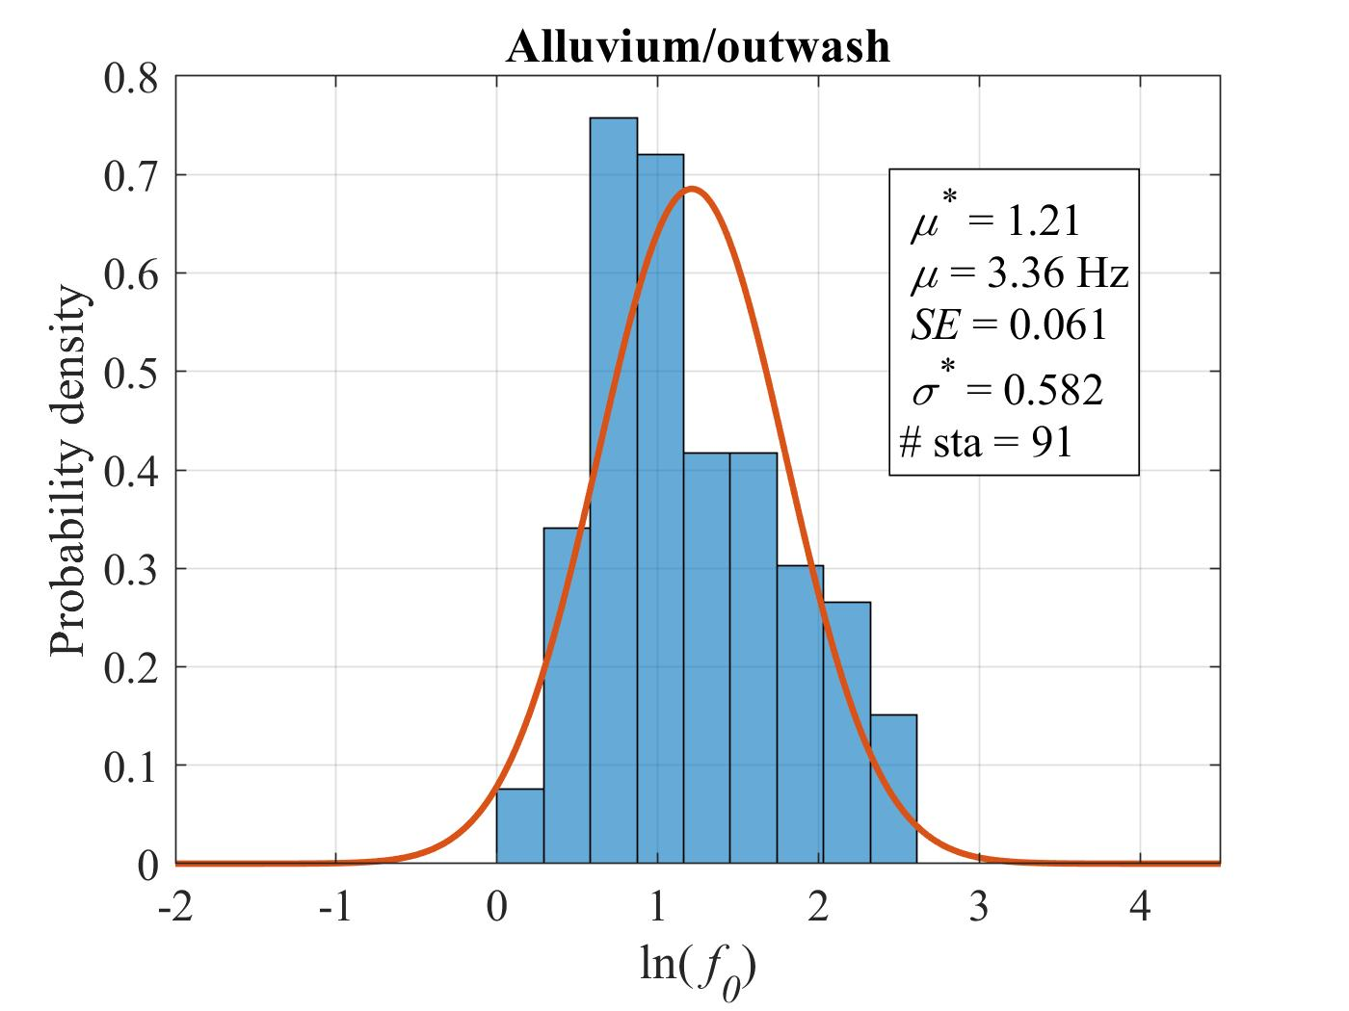
Methods
11
Developing f₀ distributions
Figure 15. Distributions of Boston Basin artificial fill and alluvium/outwash f₀ station values.
Table 2. Example of two rows of the output table from the grouping of f₀ values in the Boston Basin.
Figure 14. Geology of the Boston Basin with f₀ stations overlain.

Slide 13
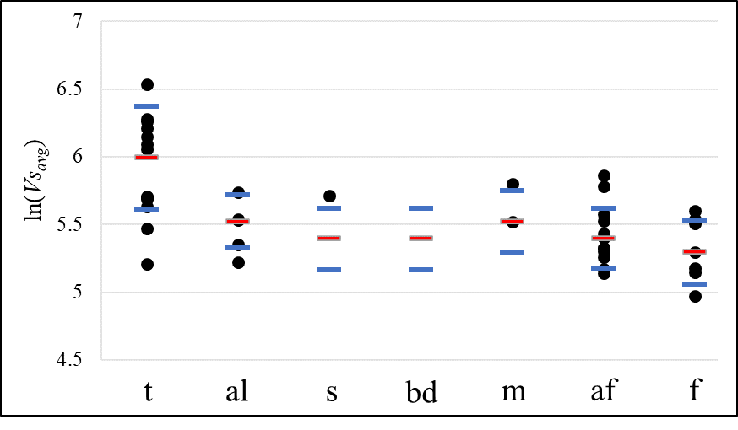
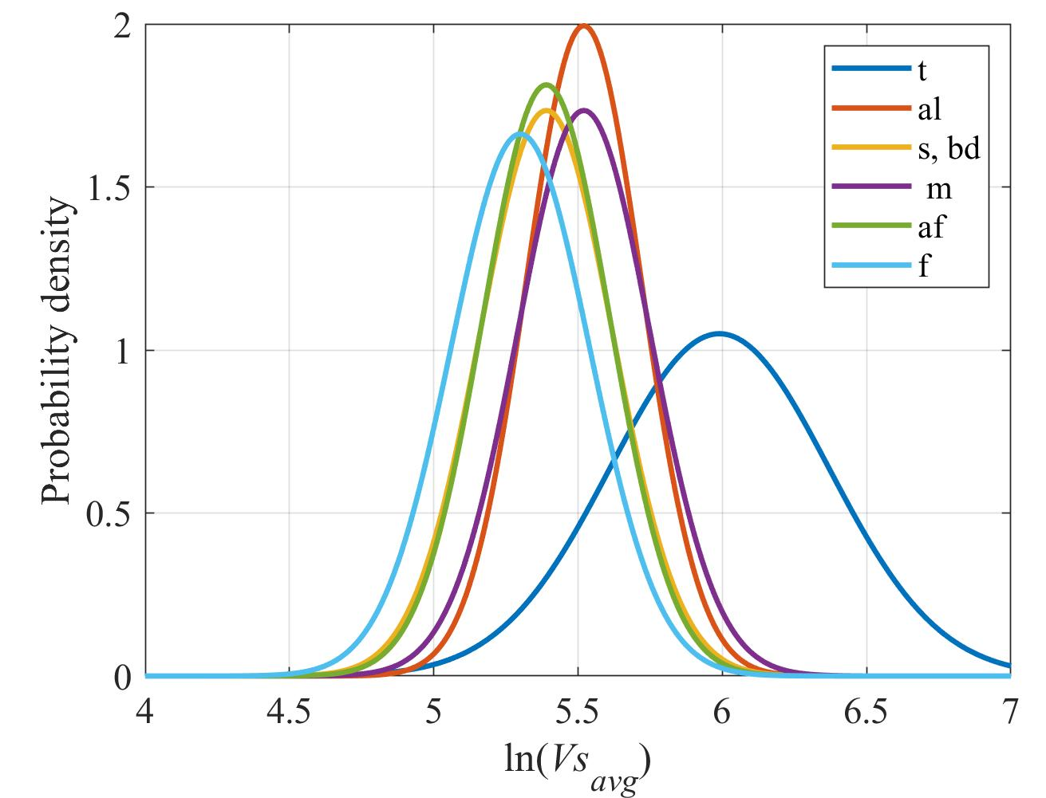
Methods
12
Developing Vs_{avg} distributions
Figure 16. The 40 Vs_{avg} values grouped by surficial geology with the selected mean value shown in red and the selected standard deviation value plus and minus the mean shown in blue.
Figure 17. The 6 distributions used for the eight surficial units in the study.

Slide 14
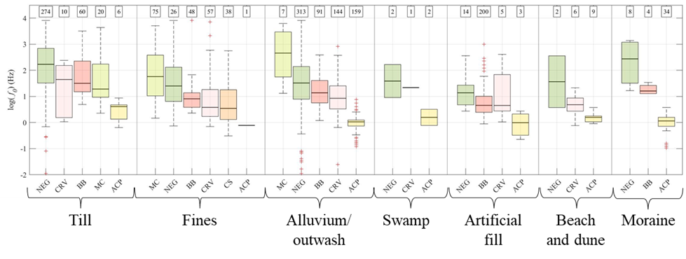
Results
13
f₀ grouping distributions in each geology and subregion
Figure 18. Box and whisker plots of the f₀ distributions of each subregion grouped by surficial geologic unit. This figure allows to compare across the same geology between different subregions, (e.g. a Maine coast fine and a Boston Basin fine).

Slide 15
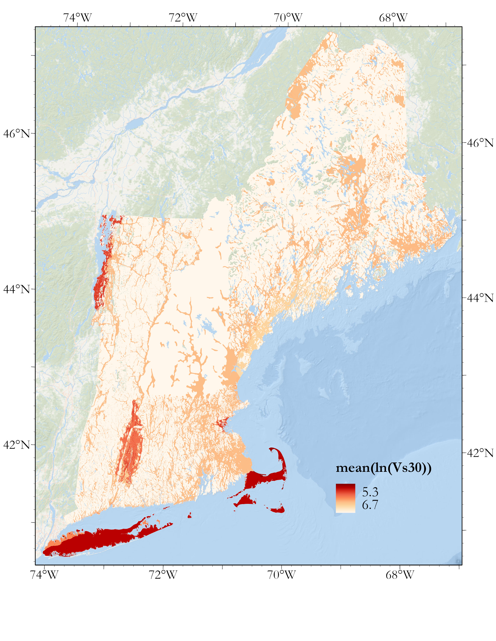
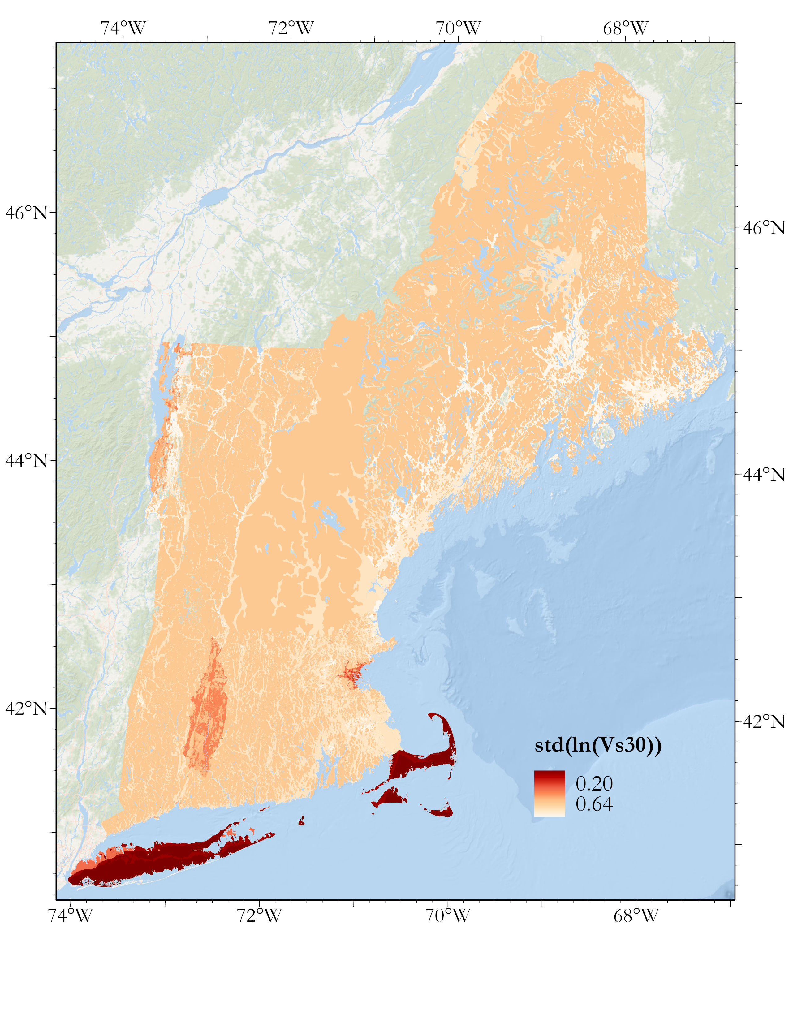
14
Mapping Vs30 mean and standard deviation
Figure 19. Map of Vs30 mean.
Figure 20. Map of Vs30 std.

Slide 16
15
Summary and conclusion
-Using the methodology presented here one can develop distributions of f₀ and Vs_{avg} from measurements, surficial geology and a subregion grouping layer and propagate that uncertainty to a computation of a distribution of Vs30.
-In New England, the lowest Vs30 mean regions are Cape Cod and Long Island, the Boston Basin, the Connecticut River Valley, and the Champlain Sea sediments.
-Vs30 calculations using the layer-over-halfspace model are very sensitive to f₀ (depth) – when depth is greater than 30 m, Vs30 = Vs_{avg} and where it is less than 30 m, the value changes significantly depending on the depth to the impedance contrast. This has implications in geology-based site classification – even soft soils have high Vs30 values when the deposit is shallow.

Slide 17
16
References
Becker, L.R., Fratto, E.S., Patriarco, S.P., Marvinney, R.G., Mabee, S.B., Thomas, M.A. (2001) Utilizing the Surficial Geology of the Northeast United States to Improve NEHRP Site Effect Classifications in HAZUS-MH: Collaborative Research with NESEC and the NESEC State Geologists. U.S Geological Survey National Earthquake Hazard Reduction Program Award No. G10AP00014.
Hassani, B., Atkinson, G.M. (2016) Applicability of the Site Fundamental Frequency as a VS₃₀ Proxy for Central and Eastern North America. Bulletin of the Seismological Society of America 2016; 106 (2): 653–664. doi: https://doi.org/10.1785/0120150259
Pontrelli, M.A., Baise, L.G., Ebel, J.E. (2022) Site Characterization Maps of New England Based on Local Geophysical and Geological Data. (In review in Engineering Geology). DOI: https://dx.doi.org/10.2139/ssrn.4214053
Wald, D. J., and Allen, T. I., 2007, Topographic slope as a proxy for seismic site conditions and amplification, Bulletin of the Seismological Society of America, 97, no. 5, 1379-1395. https://doi.org/10.1785/0120060267
We’d like to acknowledge Dr. Steve Mabee of UMASS Amherst for his HVSR data and shear wave velocity estimates and Dr. Weiwei Zhan at Tufts for his help propagating uncertainty through the layer-over-halfspace model

Slide 18
Thank you
Questions?

Slide 19
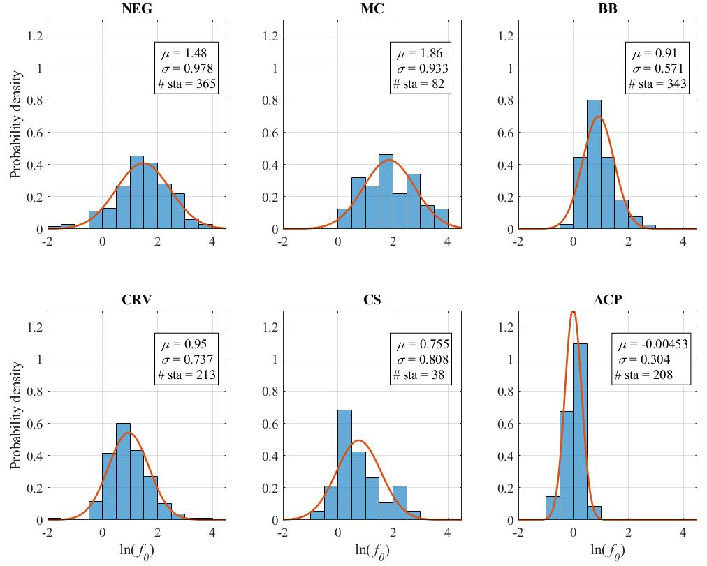
Extra
17
Handling groupings with little data in them
Create general “soft” geology distributions and use their mean and standard deviation when a grouping has few f₀ stations.
Figure 20. Histograms and theoretical PDFs of the “soft” geologies of each subregion. “Soft” geologies are all units that are not defined as “till”.

Slide 20
Extra
18
Discussion
Table 3. Several rows from the final output table of the analysis with Vs30 and depth means for the significant units of each of the subregions. Note that there are 39 of these rows for each of the geologic units in each of the subregions.

Slide 21
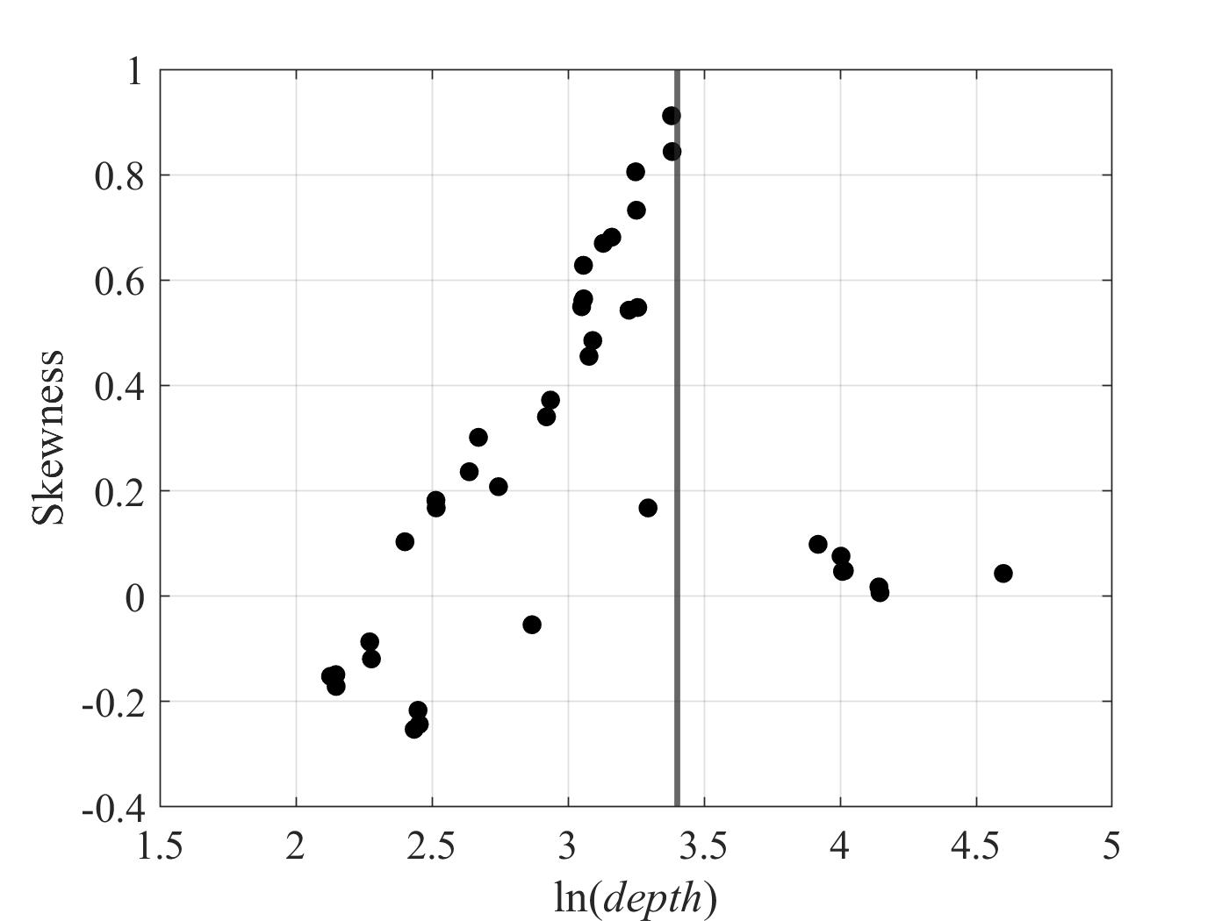
Extra
19
Issue with Vs30 distribution
Depth = 30 m
Figure 21. Mean depth vs Vs30 distribution skewness. As the mean depth approaches 30 m, the distribution skewness approaches a maximum.
Figure 22. Relationship between f₀ and Vs30 is not linear - where the mean depth of the unit is around 30 meters, the distributions become skewed.

Slide 22
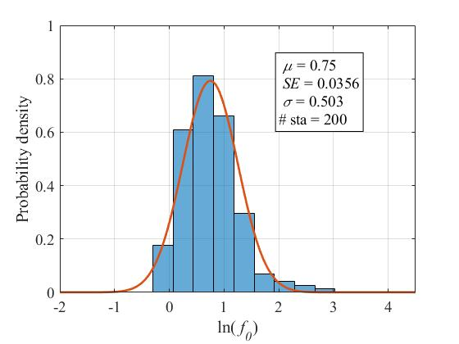
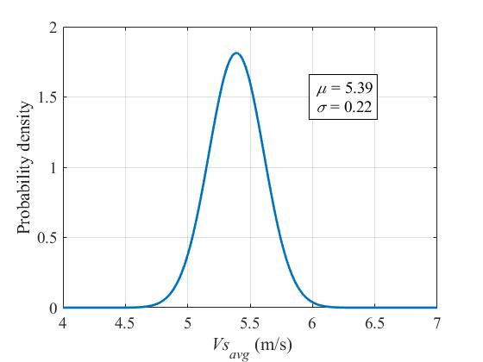






Extra
20
Analytical solution to the layer-over-halfspace model reducing computation (work in progress, derivation by Dr. Weiwei Zhan)
$μ_{ln⁡(Vs30)}=\ln\left(120∗μ_{f_{0}}∗μ_{V_{R}}\right)−ln⁡(μ_{V_{R}}$- $μ_{{Vs}_{avg}}+120∗μ_{f_{0}})$
$$σ_{ln⁡(Vs30)}^{2}≈σ_{ln⁡(f_{0})}^{2}+σ_{ln⁡(V_{R})}^{2}+\frac{σ_{V_{R}}^{2}+σ_{{Vs}_{avg}}^{2}+{120∗σ}_{f_{0}}^{2}}{A^{2}}$$
Where
$$A=V_{R}−{Vs}_{avg}+120∗f_{0}$$
$μ_{{ln⁡(f}_{0})}=0.75$(from data)
$μ_{{ln⁡(Vs}_{avg})}=5.39$(estimate)
$σ_{ln⁡(f_{0})}^{2}=0.25$(from data)
$σ_{ln⁡({Vs}_{avg})}^{2}=0.048$(estimate)

Slide 23
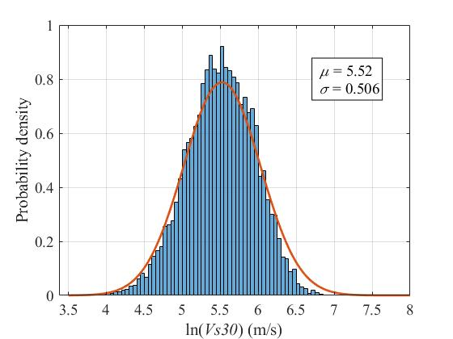
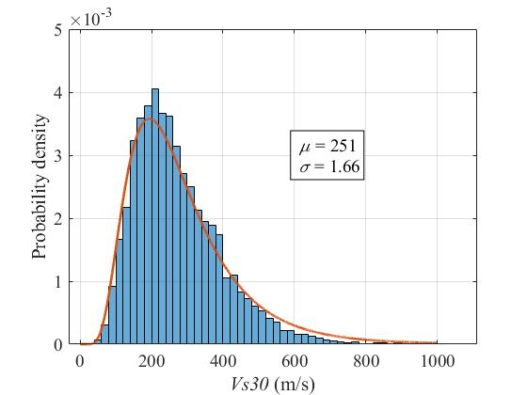


Extra
21
Vs30 outputs from the analytical solution
$μ_{Vs30}=251 m/s$(from solution)
$σ_{Vs30}^{2}=1.66$(from solution)

