Slide 1
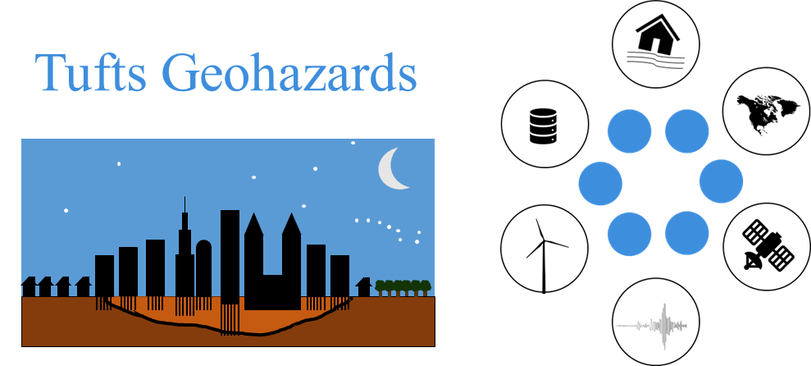
Regional Seismic Site Characterization Maps of Massachusetts using a Depth to Bedrock and a Surficial Geology Map
Marshall Pontrelli¹, Dr. Laurie Baise², Dr. John Ebel³
¹PhD Candidate, Tufts University; ²Professor and Chair, Tufts University, ³Senior Research Scientist, Boston College
From Sensors and Networks to Site Characterization and Site Response: Coming Full Circle
Seismological Society of America Meeting 4/18/2023
Puerto Rico Convention Center, San Juan, Puerto Rico

Slide 2
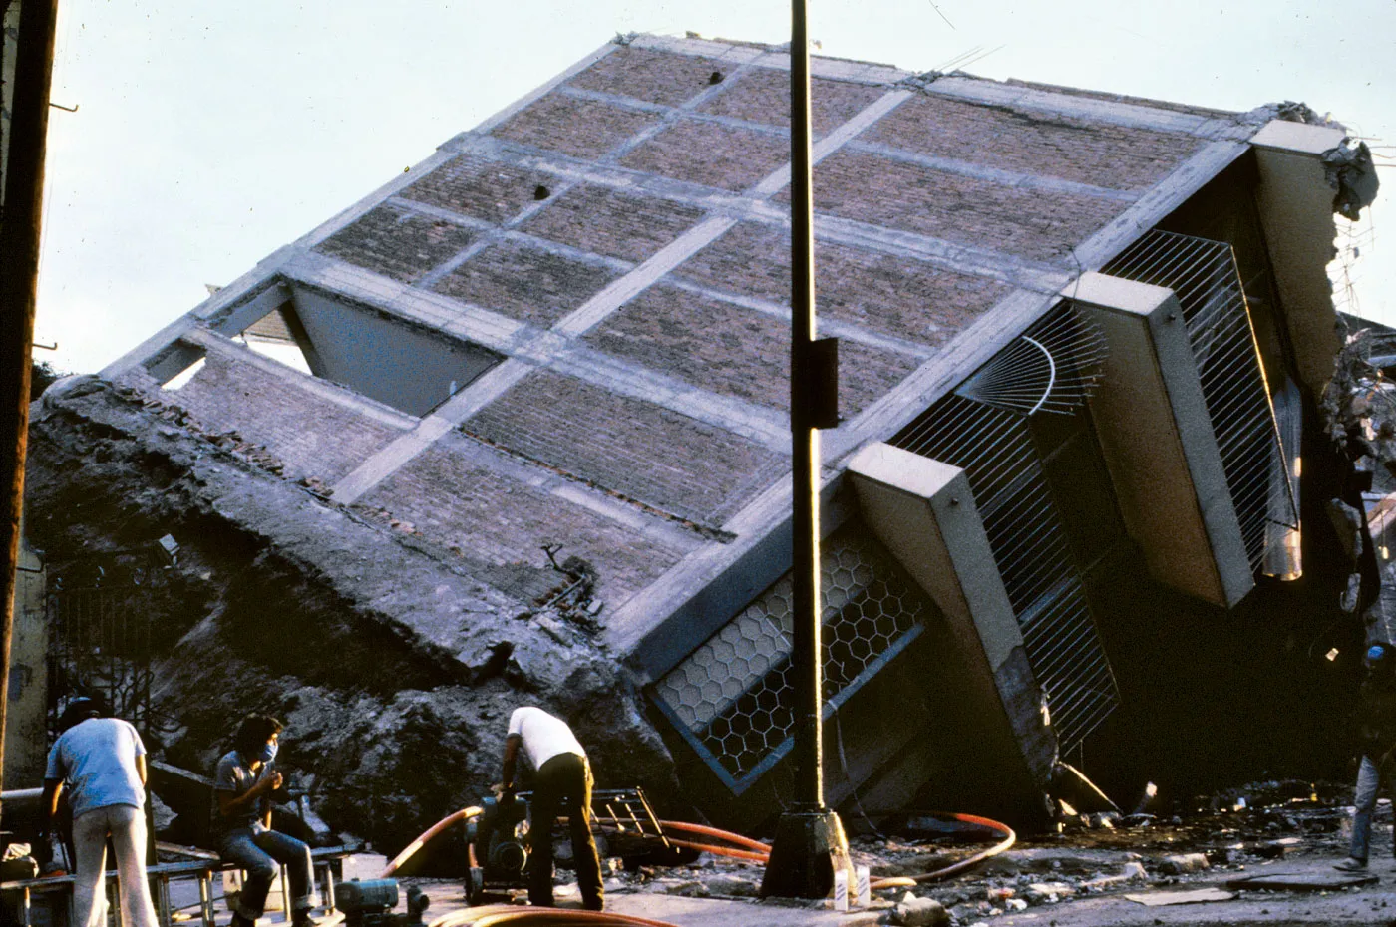
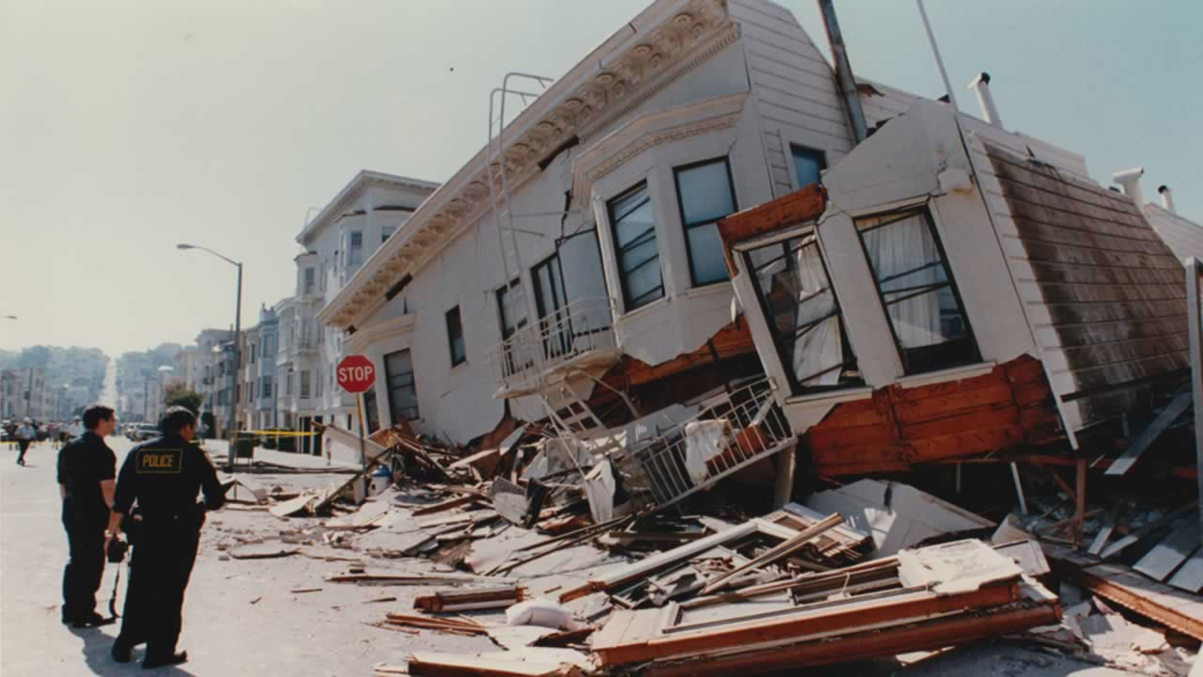
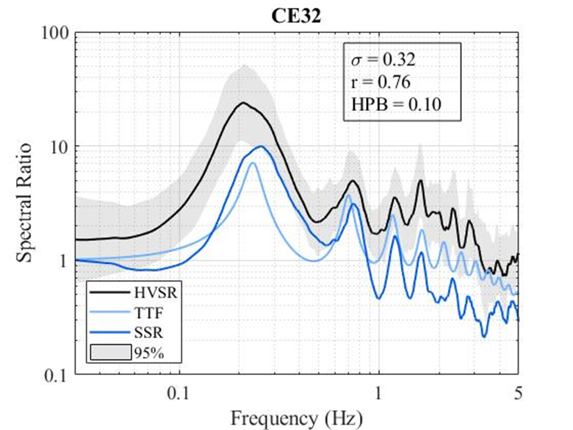
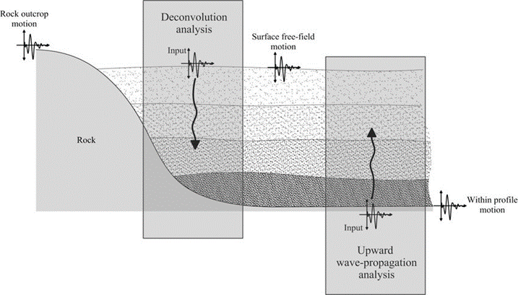
Introduction
1
Site Response

Slide 3
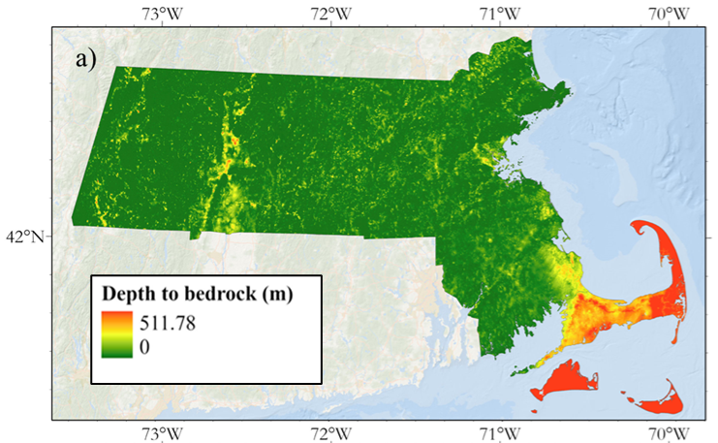
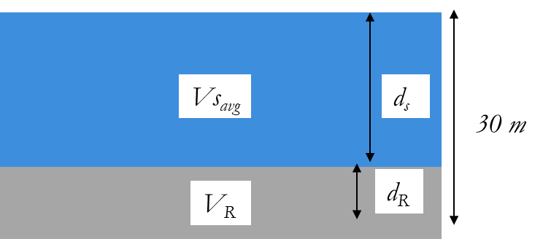
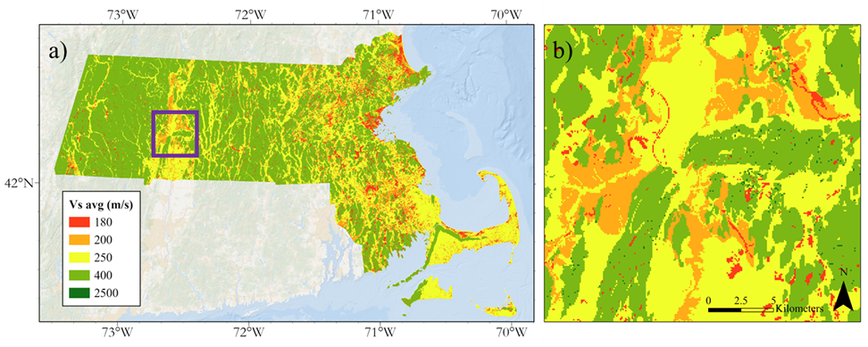
Motivation
2
Depth-to-bedrock model and Vs30 map
$$Vs30=\frac{30}{\left(\frac{d_{S}}{{Vs}_{avg}}+\frac{d_{R}}{V_{R}}\right)}$$
Mabee et al. (2023)

Slide 4
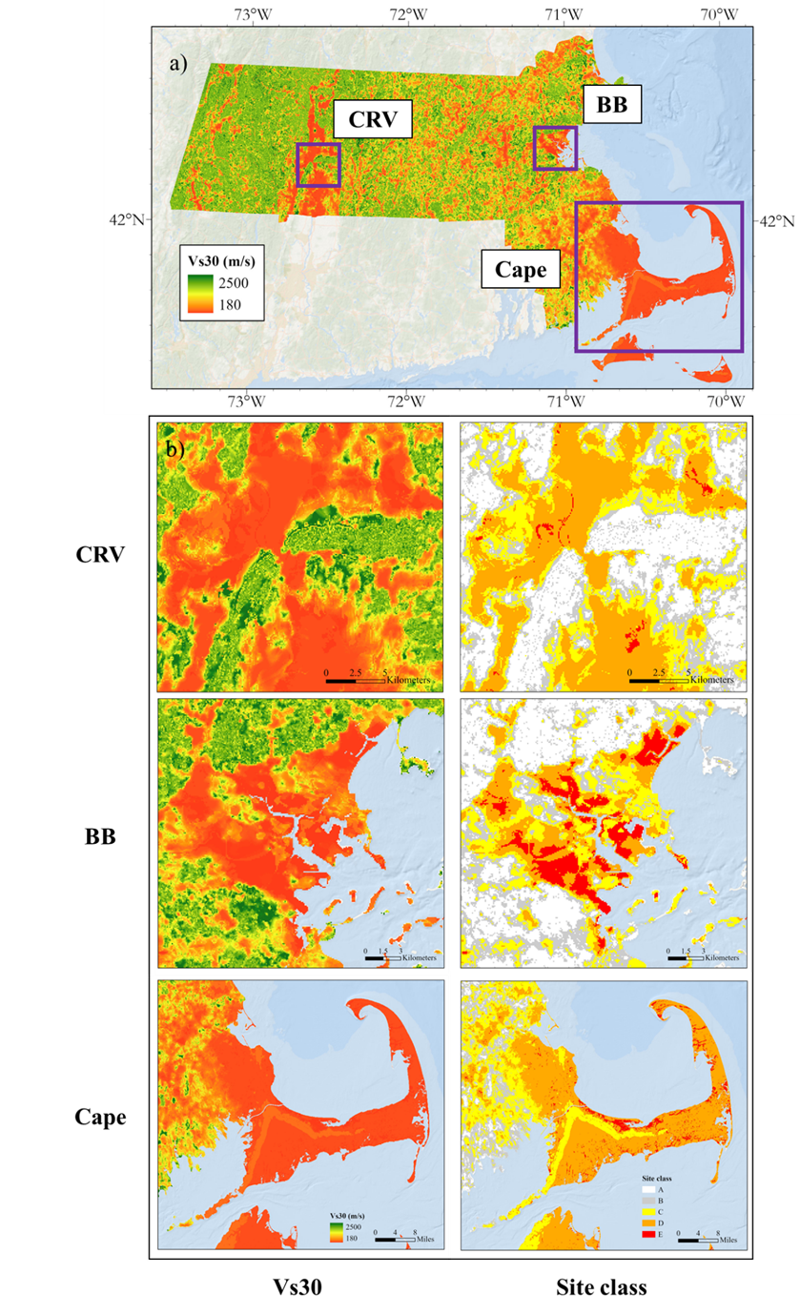
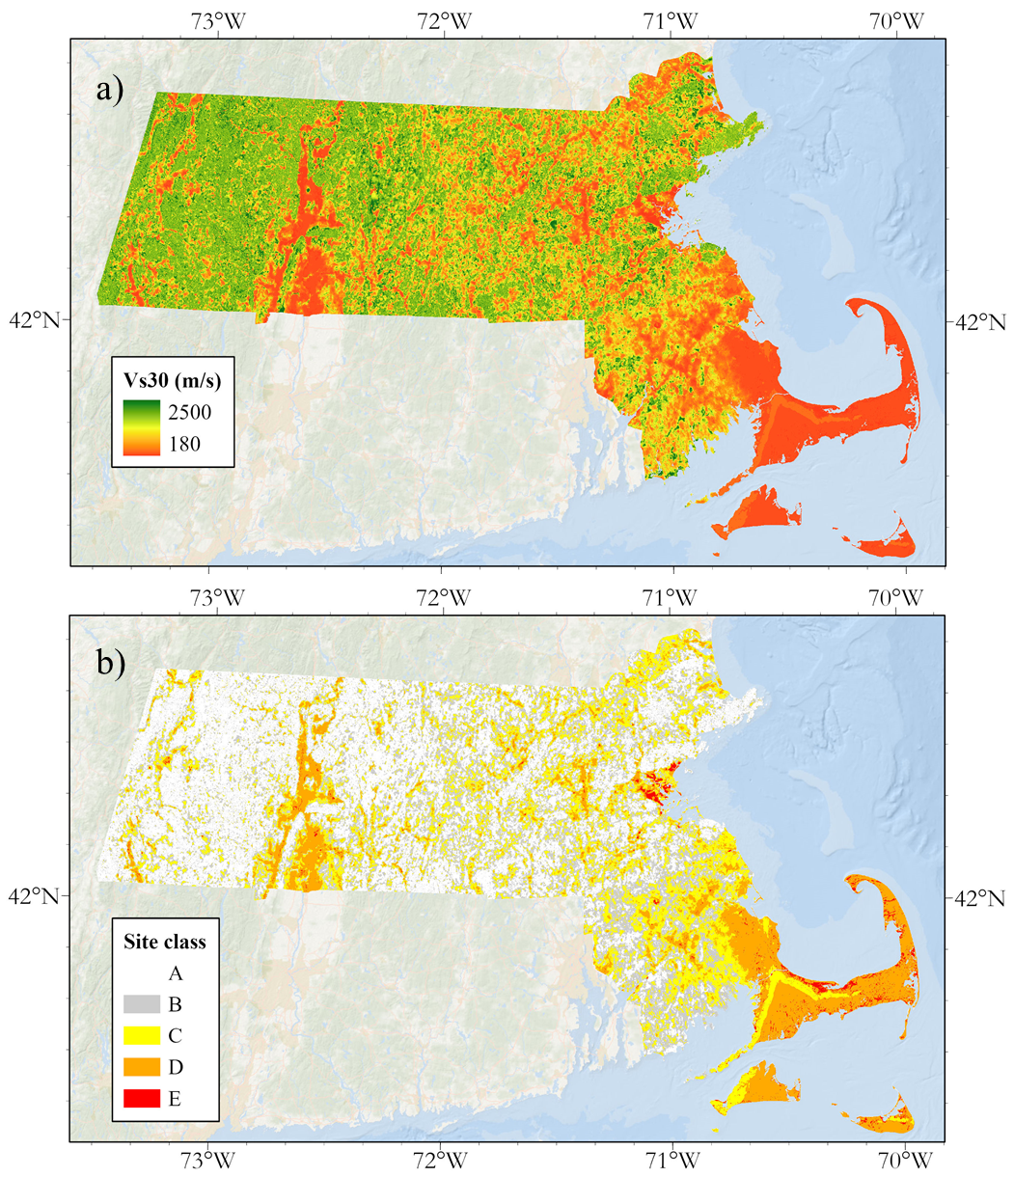
Motivation
3
Vs30 map
Mabee et al. (2023)

Slide 5
Motivation
4
Motivation after helping make the Vs30 map
Doesn’t account for uncertainty in the depths or velocities.
Exists within the Vs30 framework. What if we use to the depth information to instead estimate f₀?
This study uses the depth-to-bedrock model of Mabee et al. 2023, a database of f₀ measurements, and a map of local geologic deposits to map f₀ across Massachusetts that includes uncertainty.

Slide 6
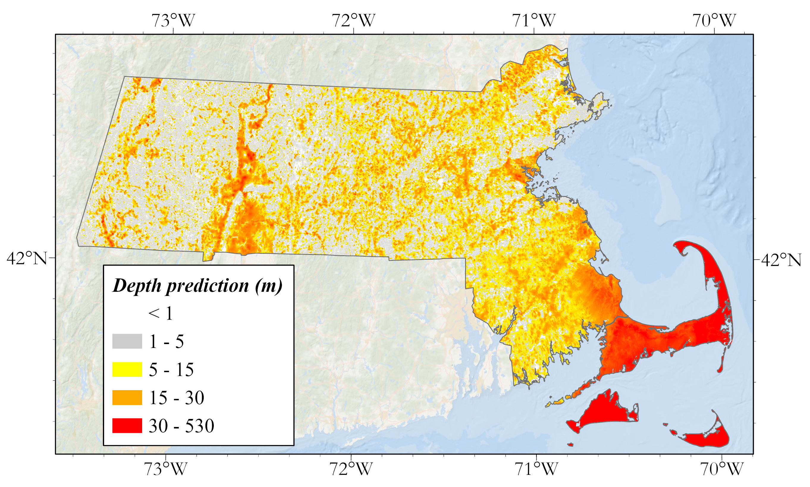
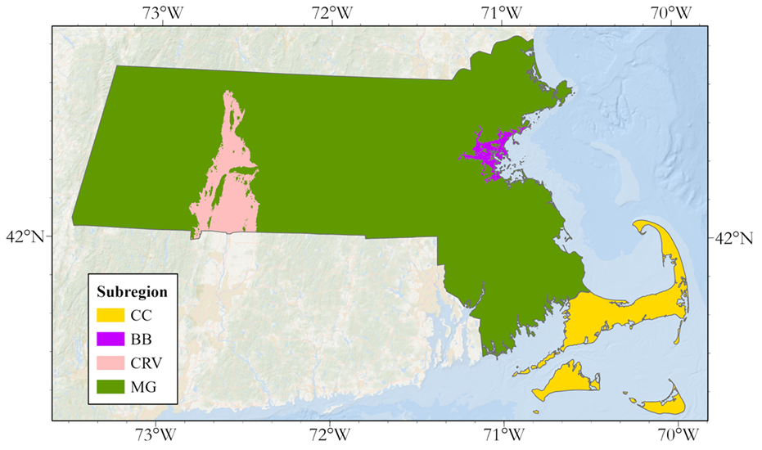
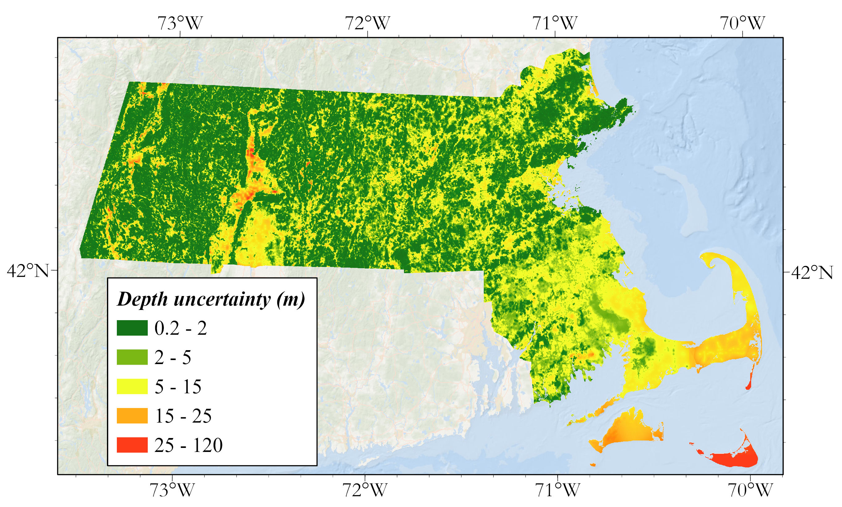
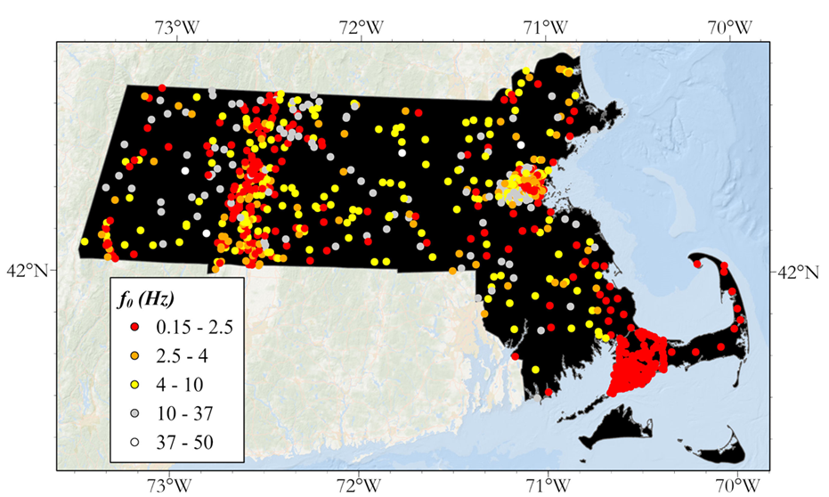
Data
5
Data

Slide 7
Methods
6
Basic methodological framework
Develop f₀ – z relationships for each geologic subregion
Monte Carlo sample each depth-to-bedrock map pixel distribution and propagate it through the f₀ – z relationships to compute f₀ distributions and calculate f₀ μ_{ln} and σ_{ln}
Mask the final f₀ map based on an f₀ threshold

Slide 8
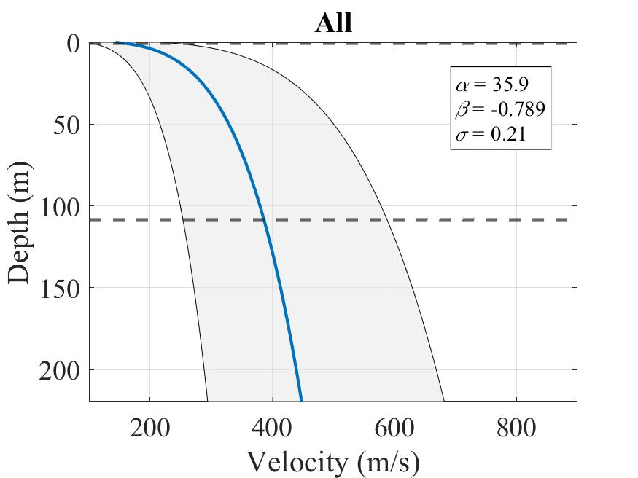
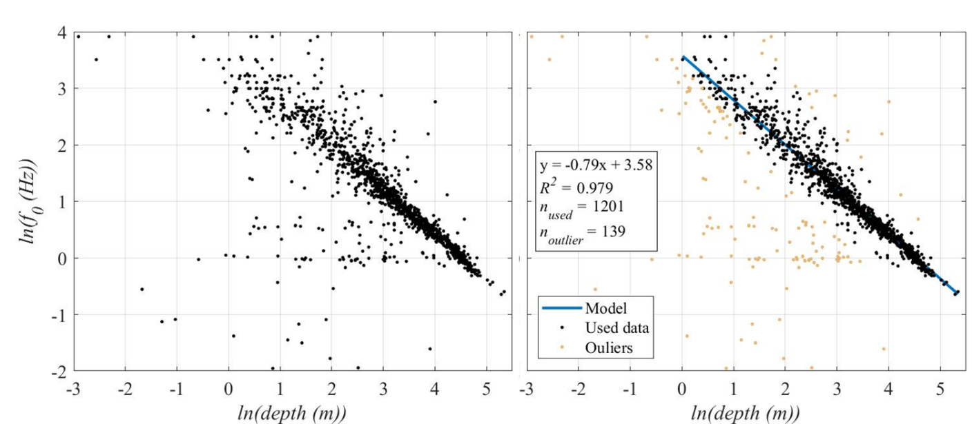
Methods
Developing the f₀ – z relationships
7
$f_{0}={Vs}/{4z}$
$Vs\left(z\right)=v_{0}∗({(1+z)}^{x}$
$$f_{0}=αz^{β}$$
$$\ln{f_{0}}=\ln\left(α\right)+ β\ln\left(z\right)$$
$$Vs=4αz^{β+1}$$
Ibs-von Seht and Wohlenberg (1999); Delgado (2000); Parolai (2002)

Slide 9
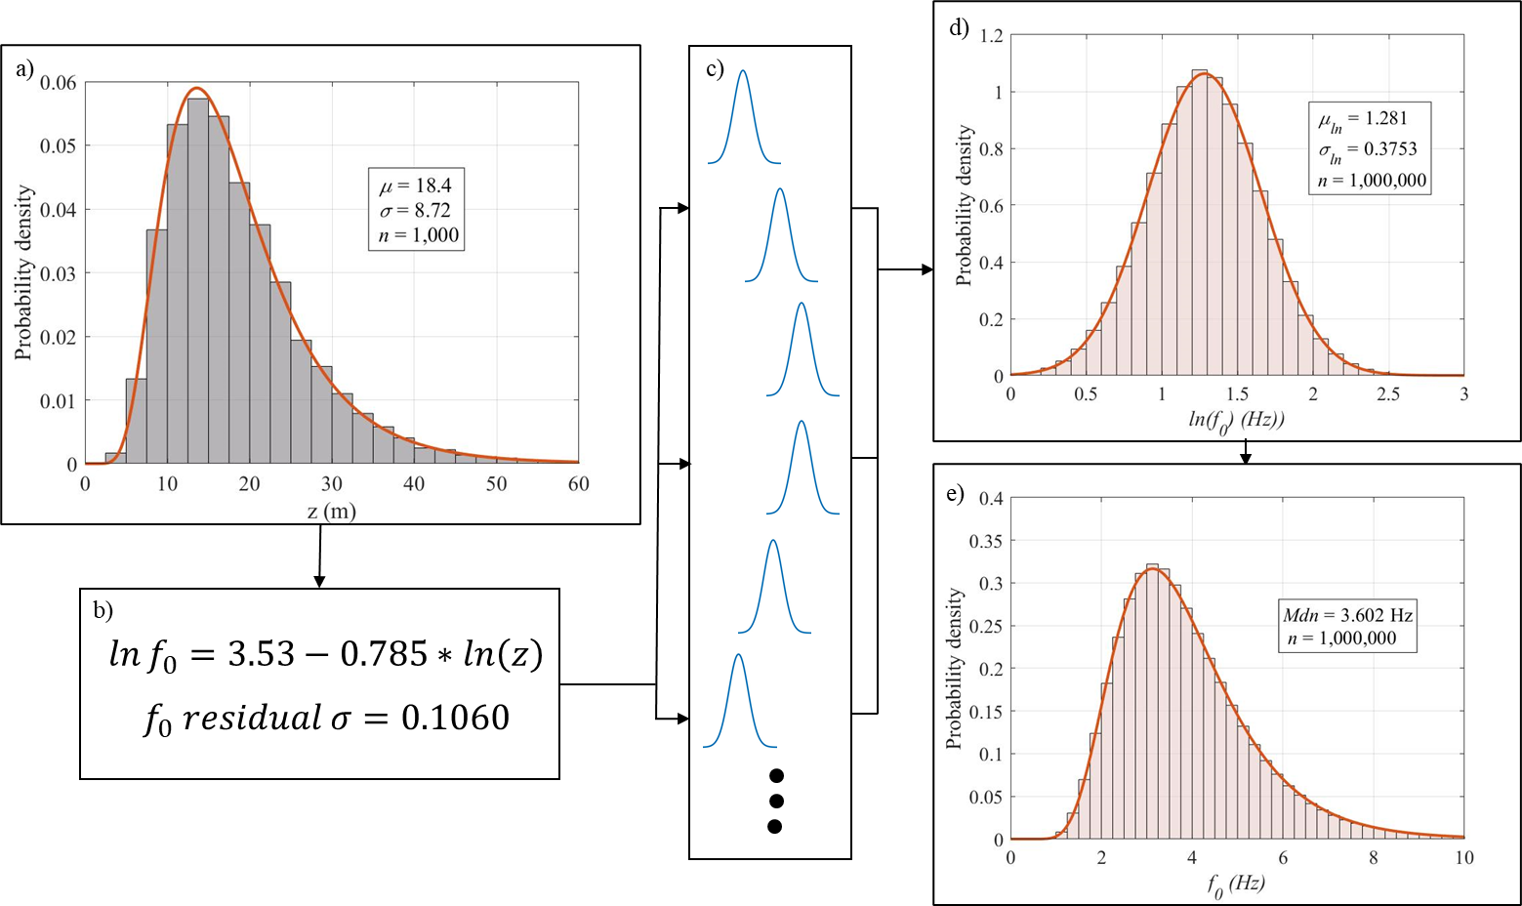
Methods
8
Computing f₀ distributions from the depth-to-bedrock model
$μ_{ln}=ln⁡(\frac{μ^{2}}{\sqrt{μ^{2}+σ^{2}}})$
$σ_{ln}=\sqrt{ln⁡(1+\frac{σ^{2}}{μ^{2}})}$

Slide 10
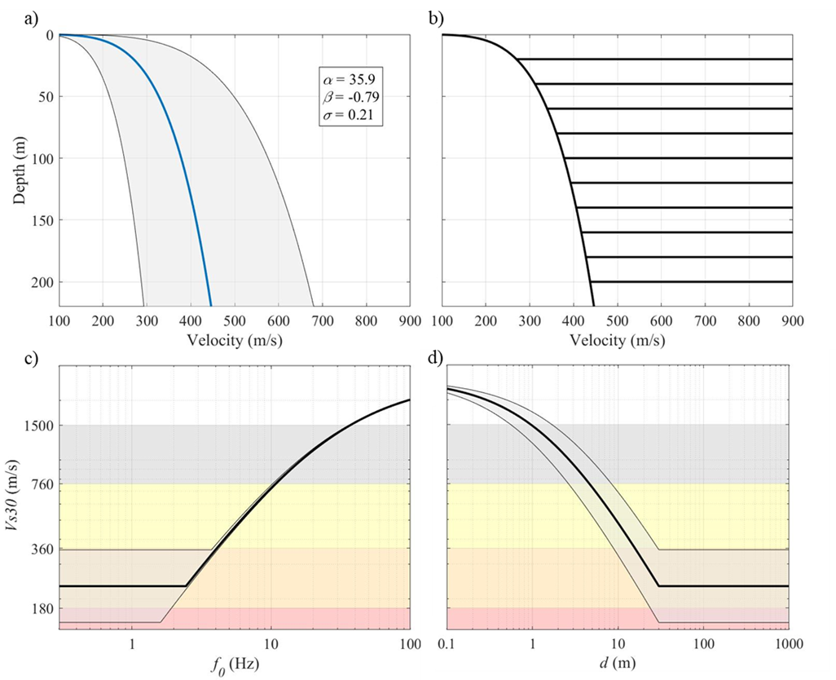
Methods
9
Selecting an f₀ threshold to mask the f₀ map
10.73 Hz
4.61m

Slide 11
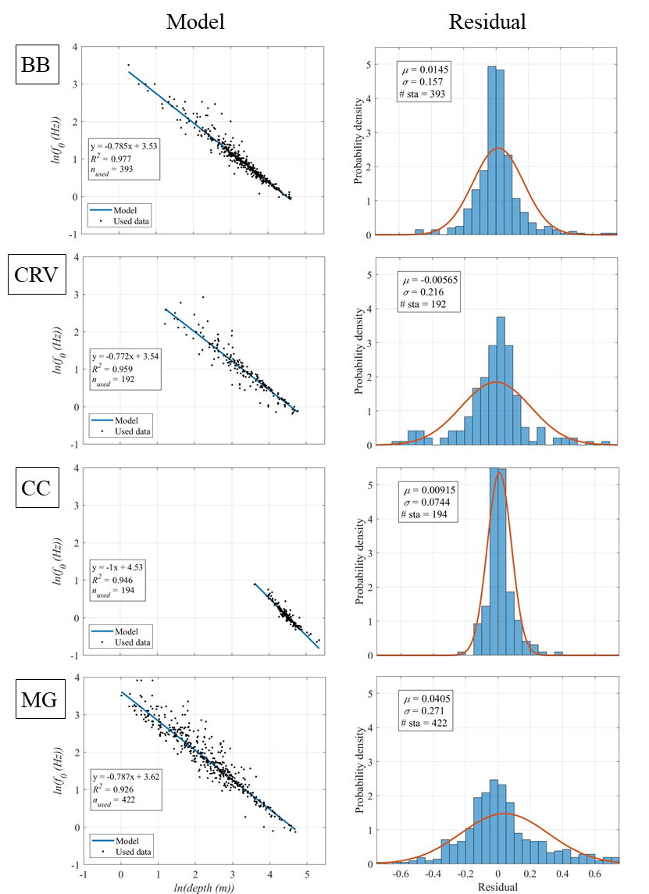
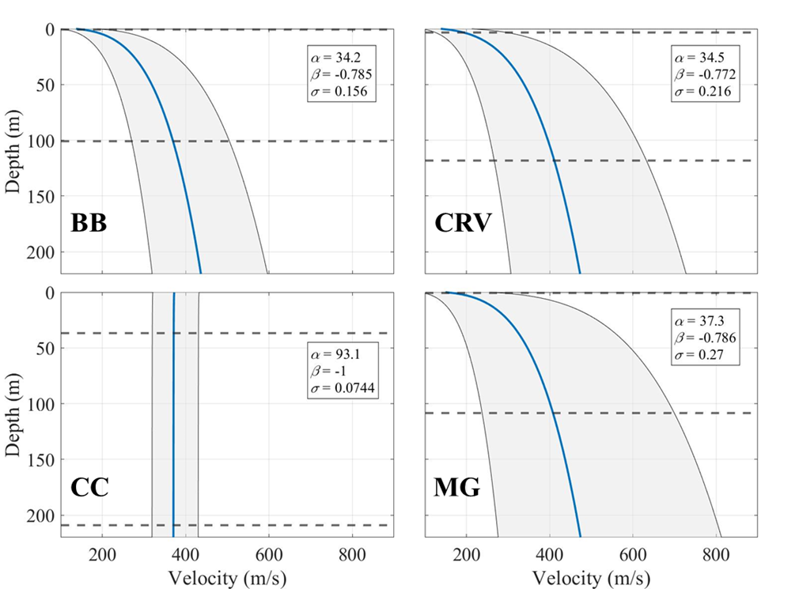
Results
10
f₀ – z relationships and corresponding S-wave profiles

Slide 12
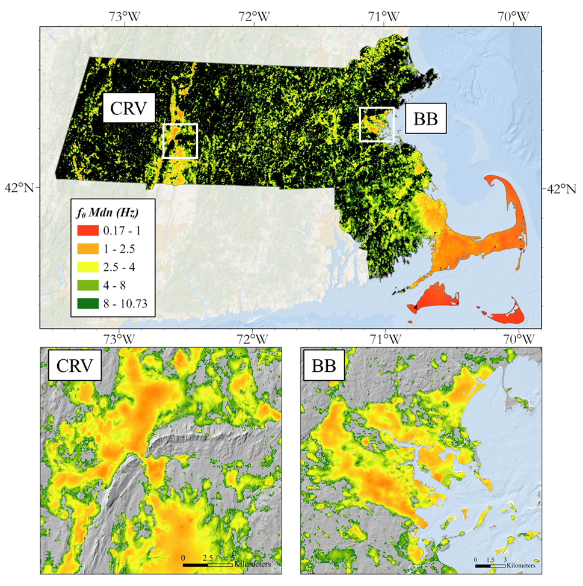
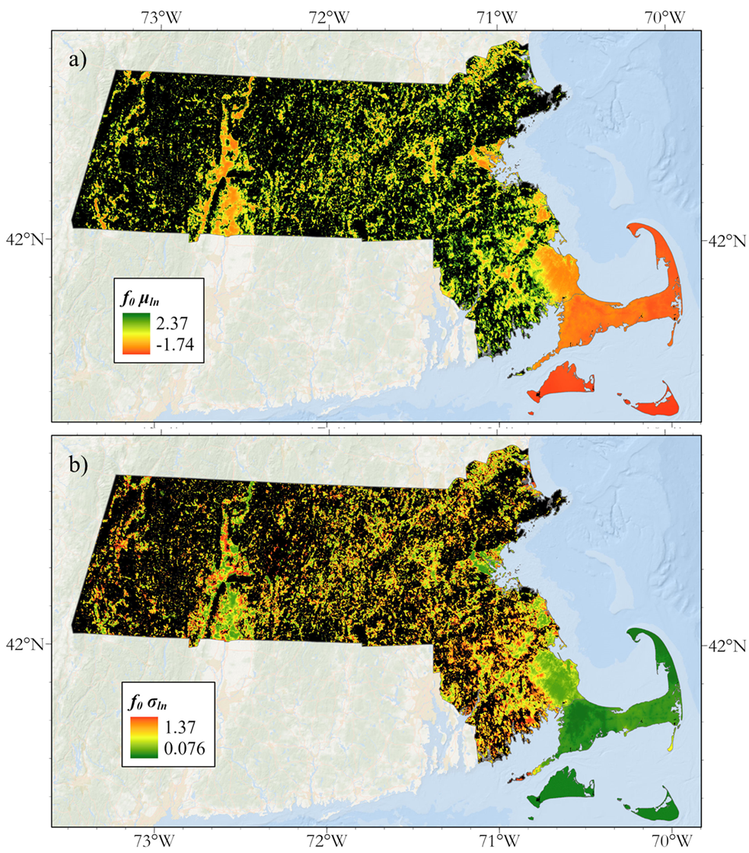
Results
11
Maps of masked f₀, μ_{ln}, and σ_{ln} and Mdn

Slide 13
Conclusion
12
Discussion/Conclusions
-The methodology used in this study is physics-based and allows for the mapping of f₀ that includes uncertainty.
-The f₀, depth-to-bedrock, overburden velocity framework is a valuable physical model for understanding site response, particularly in high impedance environments.
-The f₀ – z relationships developed in this study use a simplifying assumption (power law with depth) that greatly increases the ease with which shear-wave velocity profile uncertainty estimation can be quantified.
-The procedure presented in this study can be applied to make regional site characterization maps, using a regional depth-to-bedrock map, and an f₀ database with decent spatial coverage of that region.

Slide 14
13
References
Delgado, J., López Casado, C., Giner, J., Estévez, A., Cuenca, A., Molina, S. (2000) Microtremors as a geophysical exploration tool: Applications and limitations. Pure and Applied Geophysics, 157: 1445–1462, 2000.
Ibs-von Seht, M., Wohlenberg, J. (1999) Microtremor measurements used to map thickness of soft sediments. Bulletin of the Seismological Society of America, 88(1):250–259, 1999
Mabee, S.B., C.C. Duncan and W.P. Clement, 2023, Map of overburden thickness for Massachusetts. Massachusetts Geological Survey (in prep.)
Parolai, S., Bormann, P., Milkereit, C., (2002). New Relationships between Vs, Thickness of Sediments, and Resonance Frequency Calculated by the H/V Ratio of Seismic Noise for the Cologne Area (Germany). Bulletin of the Seismological Society of America, Vol. 92, No. 6, pp. 2521–2527, August 2002.
Pontrelli, M.A., Basie, L.G., Ebel, J.E. (2023a) Regional-scale site characterization mapping in high impedance environments using soil fundamental resonance (f₀): New England USA. Engineering Geology, Vol. 315, doi: https://doi.org/10.1016/j.enggeo.2023.107043
I’d like to acknowledge Dr. Steve Mabee and Dr. Bill Clement of UMASS Amherst and Dr. Chris Duncan of GISmatters, Inc. for letting me apart of the development of the NEHRP soil model. The depth-to-bedrock project is an amazing piece of work.

Slide 15
Thank you
Questions?

