Slide 1
M-Kopa in Rural Kenya
The Role of Technology in the Business Model
By Lyndon Sam
Supervisors: Jonathan Greenacre &
Shinsuke Tanaka
Summer 2020

Slide 2
The Problem
45% of the population (84% of rural population) is off-grid – meaning they are using unsustainable sources of energy like firewood, kerosene, and paraffin.
Solar technology is available – but companies can’t reach rural areas due to unreliable infrastructure, high fixed costs, low information on demand and lack of familiarity with local communities
Multilateral Development Banks are throwing money at the problem – World Bank provided over $11.5bn towards renewable energy, but Sub-Saharan Africa has the slowest rate of growth in renewables capacity.

Slide 3
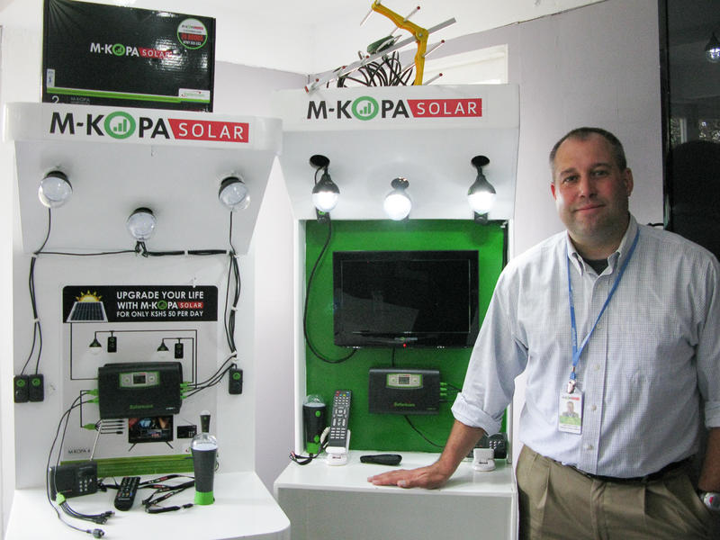
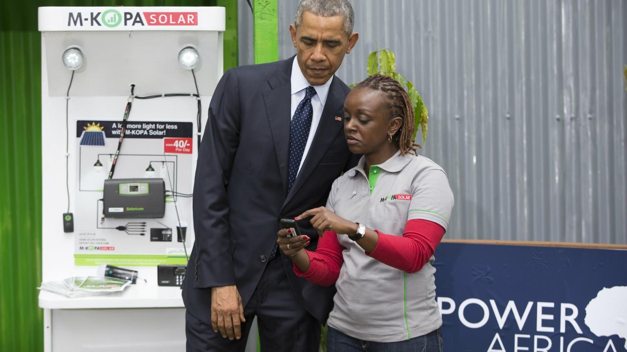

Slide 4
M-Kopa’s Secret to Success
Pay-As-You-Go Model
(Based on Mobile Money)
Sales Agent Network Equipped with Smartphones
Remote-Controlled Solar Panels

Slide 5
PAYGO Model
Basic M-Kopa Package: $27.63 for installation and $0.46 daily.
Total Cost over 365 days: $195.71
Total Cost of Alternatives (Kerosene, Batteries, Firewood, Mobile Charging Services): $272
M-Kopa offers better technology and $76.30 of savings

Slide 6
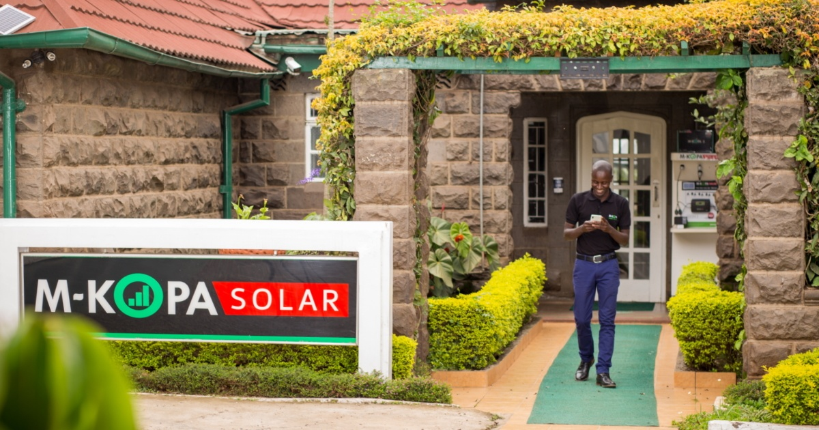
Sales Agent Network
2000 commission-based sales agents
8-10% Commission
Recruited based on familiarity with local areas
Navigate using Geographic Mapping
Use “tea parties” to aggregate demand and create social incentives to buy
Use Microsoft Kaizala for communication, training, sales data and stock management.
Register New Customers on the Spot by taking a picture and creating a profile.

Slide 7
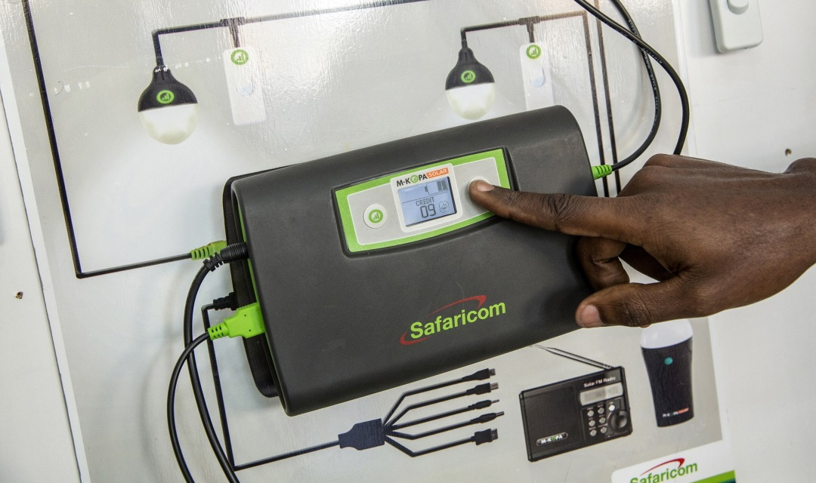
GSM-Enhanced Solar Equipment
Allows M-Kopa to monitor customer behavior, energy consumption patterns, extend credit to device owners, and transmit data between machines.
M-Kopa can also shut off and restore service based on payment regularity
Customers facing financial hardship can suspend payment for 30 days with no penalty

Slide 8
M-Kopa’s Impact
Generates over 72,000 mobile payments per day
80% of clients report an increase in income after using an M-Kopa product
Average household saves approx. $750 over 4 years
46% of households use M-Kopa to support a business or income-generating activity
Customers enjoy 62.5 million hours of kerosene-free lighting per month
84% reduction in kerosene usage (2017)
Tons of CO2 to be reduced over product lifetimes: 1.7 million
Increased security
More family time
Better educational outcomes for children
Better access to information

Slide 9
Research Methods, Limitations
& Next Steps

