Slide 1
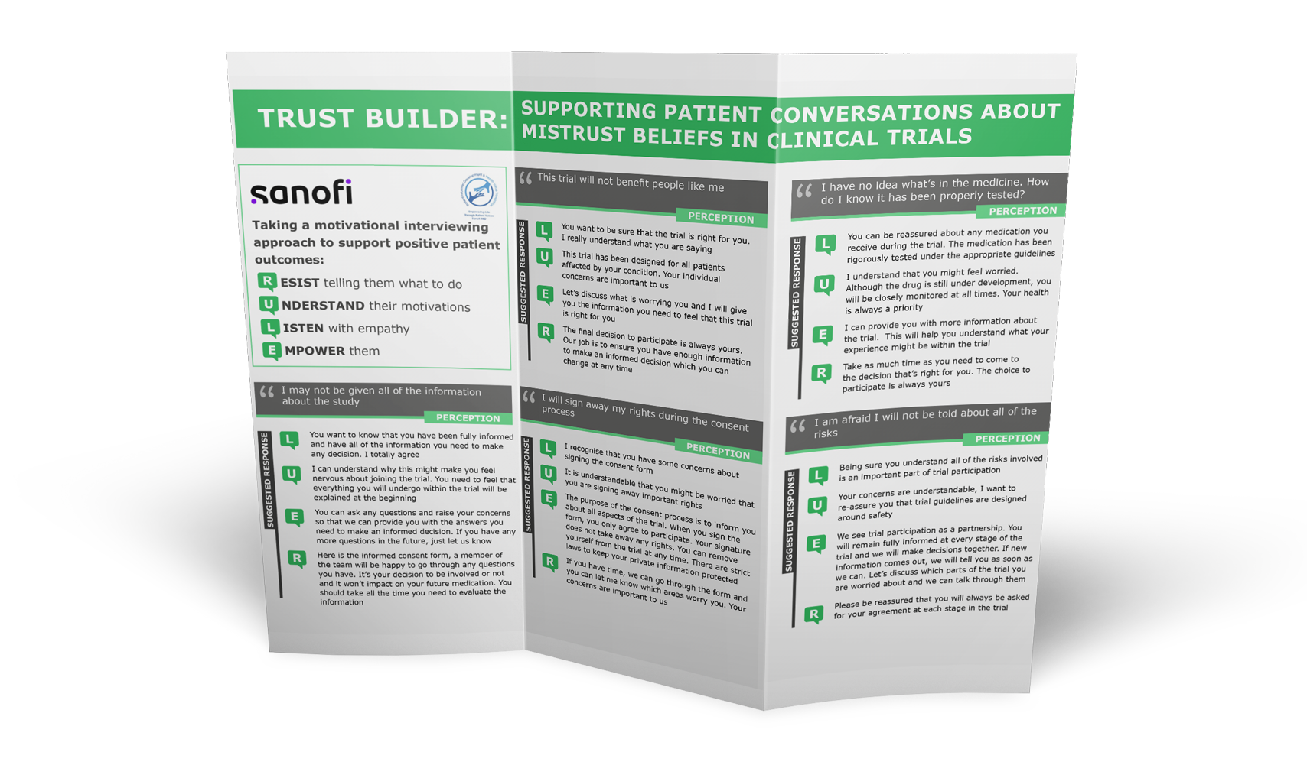
Trust Builder Discussion Aid
Supporting patient conversations about mistrust beliefs and perceptions
V3-Nov 28th 2022
Notes:
How to motivate patients to enter into clinical trials when there is no benefit for the patient?
Conversation guide for newly diagnosed patients, to support difficult conversations
How to keep patients motivated in a long study when the treatment effect occurs only within 4 to 6 months, or perhaps never (in the placebo arm)?

Slide 2
Introduction to the Trust Builder
INTRODUCTION
The aim of this module is to support site teams when talking to patients about participating in a clinical trial
One of the main barriers to participation in clinical trials is mistrust in medical research
Patients may present with many reasons and perceptions as to why they mistrust the healthcare system. It is important for clinical trials teams to have the knowledge and resources to support with proactive engagement on these issues
In this module, you have been provided with a list of the most common mistrust beliefs, behavioral science guidance on motivational interviewing as well ready-to-use responses to support with patient conversations
Participating in a clinical trial is a very personal decision and it is vital that we are able to really understand each individual patient and their specific needs

Slide 3
TRUST BUILDER:
SUPPORTING PATIENT CONVERSATIONS ABOUT MISTRUST BELIEFS IN CLINICAL TRIALS
Taking a motivational interviewing approach to support positive patient outcomes:
R ESIST telling them what to do U NDERSTAND their motivations L ISTEN with empathy
E MPOWER them
This trial will not benefit people like me
I have no idea what’s in the medicine. How do I know it has been properly tested?
PERCEPTION
PERCEPTION
SUGGESTED RESPONSE
L
U
You want to be sure that the trial is right for you. I really understand what you are saying
This trial has been designed for all patients affected by your condition. Your individual concerns are important to us
Let’s discuss what is worrying you and I will give you the information you need to feel that this trial is right for you
The final decision to participate is always yours. Our job is to ensure you have enough information to make an informed decision which you can change at any time
SUGGESTED RESPONSE
L
You can be reassured about any medication you receive during the trial. The medication has been rigorously tested under the appropriate guidelines
I understand that you might feel worried. Although the drug is still under development, you will be closely monitored at all times. Your health is always a priority
I can provide you with more information about the trial. This will help you understand what your experience might be within the trial
Take as much time as you need to come to the decision that’s right for you. The choice to participate is always yours
U
E
E
R
R
I may not be given all of the information about the study
I will sign away my rights during the consent process
I am afraid I will not be told about all of the risks
PERCEPTION
PERCEPTION
PERCEPTION
SUGGESTED RESPONSE
L
You want to know that you have been fully informed and have all of the information you need to make any decision. I totally agree
I can understand why this might make you feel nervous about joining the trial. You need to feel that everything you will undergo within the trial will be explained at the beginning
You can ask any questions and raise your concerns so that we can provide you with the answers you need to make an informed decision. If you have any more questions in the future, just let us know
Here is the informed consent form, a member of the team will be happy to go through any questions you have. It’s your decision to be involved or not and it won’t impact on your future medication. You should take all the time you need to evaluate the information
SUGGESTED RESPONSE
L
U E
I recognise that you have some concerns about signing the consent form
It is understandable that you might be worried that you are signing away important rights
The purpose of the consent process is to inform you about all aspects of the trial. When you sign the form, you only agree to participate. Your signature does not take away any rights. You can remove yourself from the trial at any time. There are strict laws to keep your private information protected
If you have time, we can go through the form and you can let me know which areas worry you. Your concerns are important to us
SUGGESTED RESPONSE
L
Being sure you understand all of the risks involved is an important part of trial participation
U
U
Your concerns are understandable, I want to
re-assure you that trial guidelines are designed around safety
E
We see trial participation as a partnership. You will remain fully informed at every stage of the trial and we will make decisions together. If new information comes out, we will tell you as soon as we can. Let’s discuss which parts of the trial you are worried about and we can talk through them
E
R
R
R
Please be reassured that you will always be asked for your agreement at each stage in the trial

Slide 4
TRUST BUILDER:
SUPPORTING PATIENT CONVERSATIONS ABOUT MISTRUST BELIEFS IN CLINICAL TRIALS
Taking a motivational interviewing approach to support positive patient outcomes:
R ESIST telling them what to do U NDERSTAND their motivations L ISTEN with empathy
E MPOWER them
The costs & insurance implications may not
Staff will not treat all participants equally
be fully explained (costs of participation)
PERCEPTION
PERCEPTION
SUGGESTED RESPONSE
L
U
If you have financial concerns over participation in the trial it is our role to help you resolve them
I can hear that you are worried about unseen costs or insurance complications that would be a worry for anyone
Let’s sit down and try to address them together. As a starting point, which of these are worrying you?
SUGGESTED RESPONSE
L
U E
I can hear that it is important for you to be treated fairly and with respect
Clinical trials should be a place where people believe everyone is treated with equal respect
Every participant matters and we have detailed guidance to ensure these ethics are at the center of how we treat everyone
Your participation will help with advancing successful treatment of this condition but your health is always a priority
E
Transport
Work Childcare Other Schedule
R
R
Please be reassured that most of the costs are
covered in a clinical trial, such as treatments and examinations. All clinical trials have insurance coverage (country specific)
The staff won’t understand the challenges I will face while participating
The trial will benefit the pharmaceutical company and not me
I am concerned that I will be given a placebo
and have wasted my time
PERCEPTION
PERCEPTION
PERCEPTION
SUGGESTED RESPONSE
L
U
I can hear that you feel unsure that you will receive support from the staff during the trial
You have made it clear that you may have a number of logistical challenges in participating. We will support you with them in any way we can. If you decide not to participate, it will not affect your future medical care
I am here to discuss this with you if you have time. Let’s work together and identify any additional support you might need
Once we have identified the challenges and the support we can provide, you can then make an informed decision in your own time. As a starting point do any of these look likely to be an issue?
SUGGESTED RESPONSE
L
U
Your concerns about who will benefit from a clinical trial is a valid issue
You rightly want to know if the people that benefit are the patients who have the same condition as you
Trials are designed for and with patients. Patients are involved from the beginning. Patients’ needs come first. The sole priority is to find ways to improve the treatment of your condition
The choice to participate is always yours. You should be comfortable the trial has been set- up and designed for all patients living with this disease
SUGGESTED RESPONSE
L
U
I hear that you are concerned about the use of placebo medication in the clinical trial
Understandably you want to know if you might receive the placebo and what that might mean for your condition
In clinical trials, the treatments being investigated are compared with placebo to better evaluate the treatment’s effectiveness and is a way for scientists to find new treatment options for patients
Once you have reviewed the information and only when you are ready, you can decide if it’s right for you
E
E
E
R
R
R
Language Access Issues
Other Medical Needs
Family Approval

Slide 5
Trust Builder Toolkit
We will provide you with:
1
A Micro learning video module
The Trust builder (printable version)
A Slide deck
2
3
Notes:
How to motivate patients to enter into clinical trials when there is no benefit for the patient?
Conversation guide for newly diagnosed patients, to support difficult conversations
How to keep patients motivated in a long study when the treatment effect occurs only within 4 to 6 months, or perhaps never (in the placebo arm)?

Slide 6
Understanding mistrust beliefs
Listen to Dr David Rosen, health psychology researcher, discuss why patients present with mistrust beliefs and the most common perceptions heard in a clinical trial setting. David then discusses how these perceptions can be overcome with the behavioral science R.U.L.E approach to motivational interviewing and how you can use the Trust Builder Discussion Aid with ready-to-use responses to support your conversations with patients.

