Slide 1
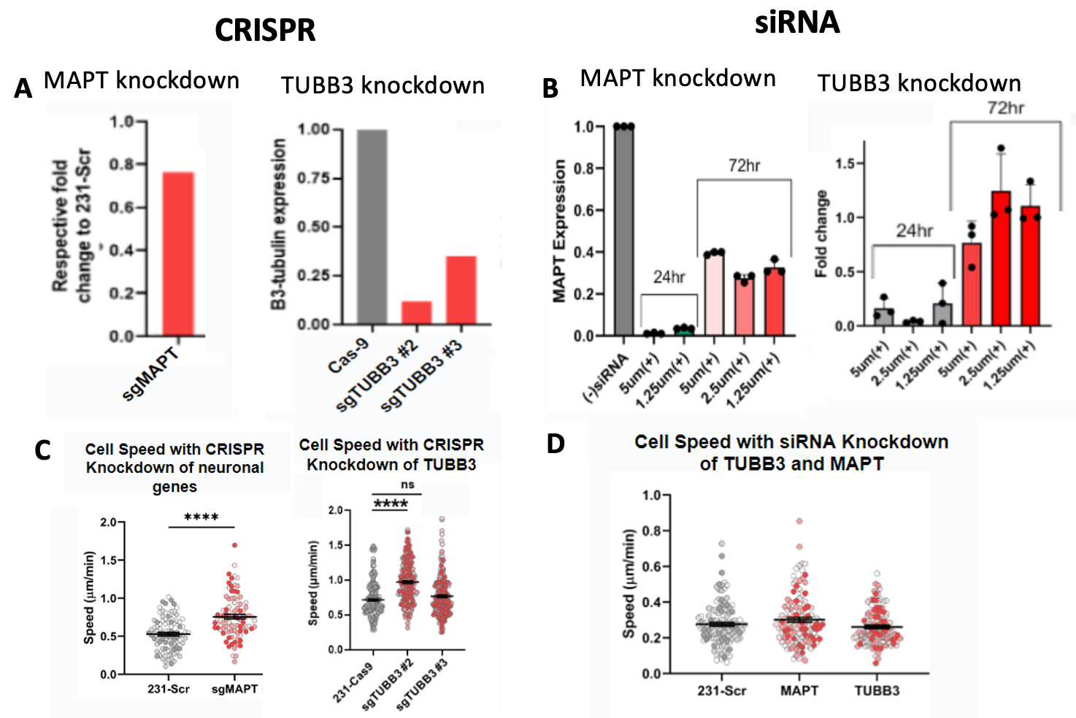
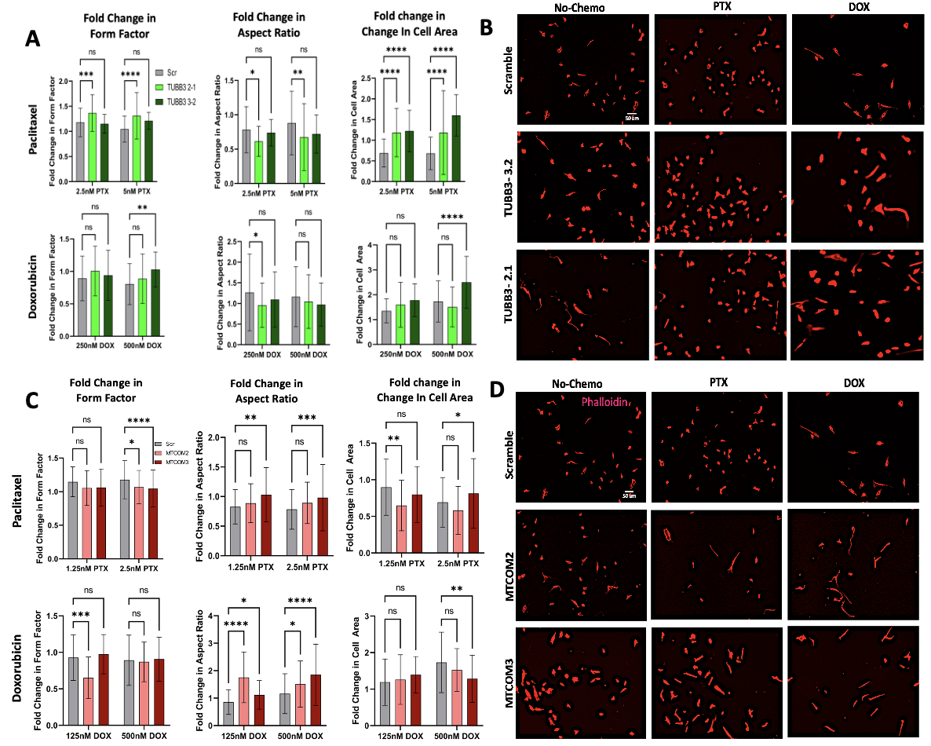
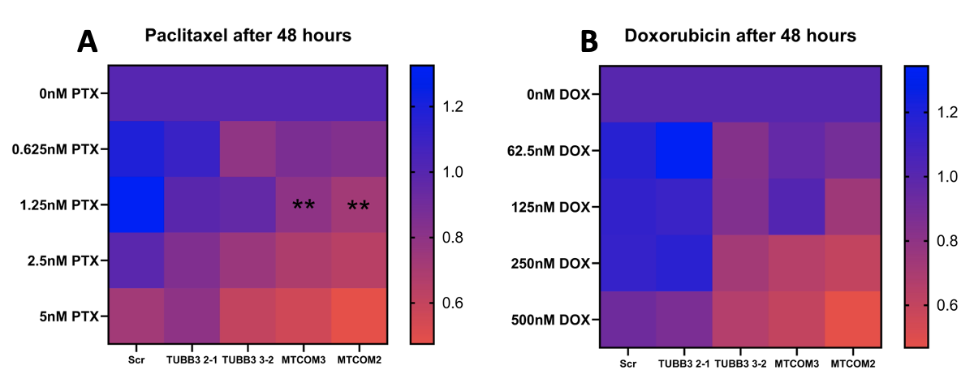
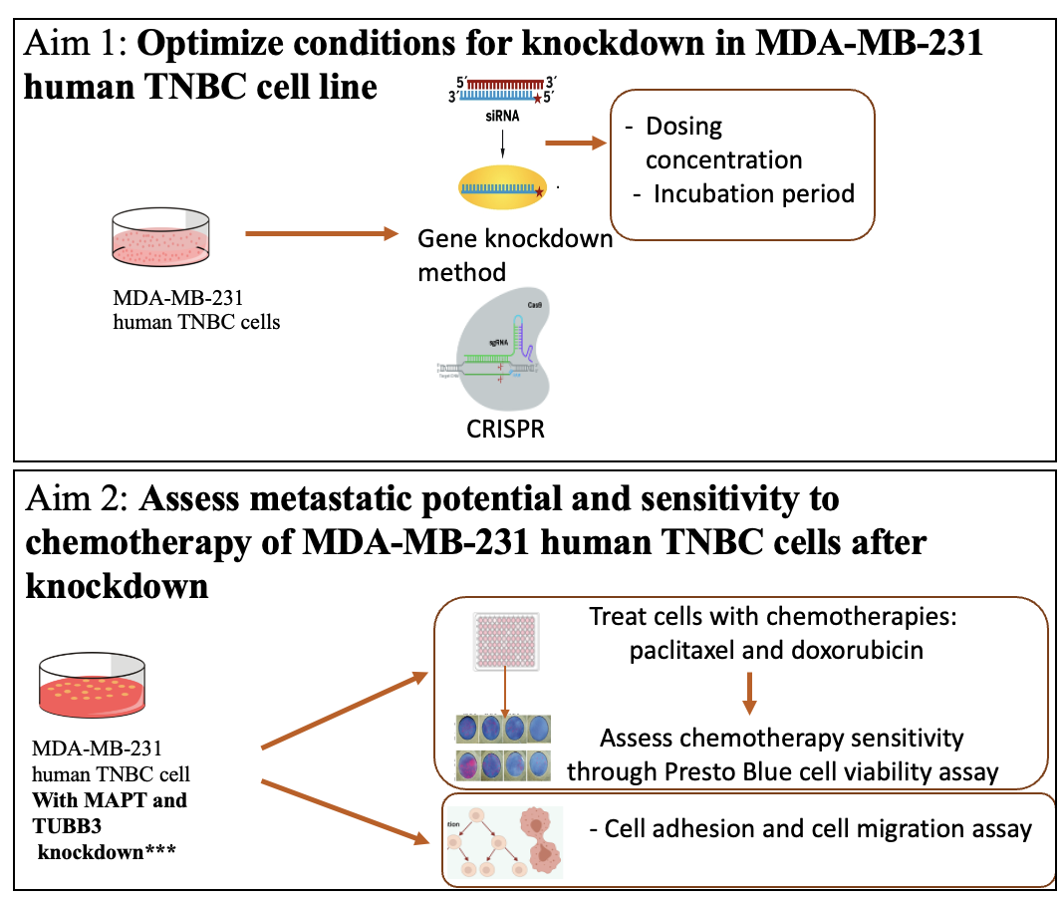
Investigating the Role of Neuronal Genes in Breast Cancer Metastasis and Chemotherapy
Maia Buckwald¹, Ariana Barreiro¹, Kevin Lyons¹ and Madeleine Oudin¹
Background
CRISPR, More Efficient Tool to Study Knockdown in TNBC
Knockdown induces Morphological Changes After Chemotherapy Exposure
3 out of 25 women will be diagnosed with breast cancer and Triple-negative breast cancer (TNBC) is prevalent in 20% of all breast cancer diagnoses¹.
TNBC is characterized by a lack of targetable receptors that other subtypes express².
Neuronal markers have been correlated with increased metastasis in lung cancer.
Oudin Lab identified that TUBB3 and MAPT neuronal markers are upregulated in TNBC and correlated with worst outcomes. Both genes affect microtubule dynamics³.
A
Figure 1: A) mRNA expression of neuronal genes TUBB3, CNTNAP2, SEMA4D and MAPT in human invasive ductal carcinoma versus normal breast tissue, each column represents a patient ³
Figure 2: A) CRISPR knockdown quantification for MAPT using qpcr (left) and for TUBB3 using Western blot (right). B) SiRNA knockdown quantification for MAPT using qpcr (left) ,TUBB3 using immunostaining (right). C) 2D migration speed of 231-Scr control and CRISPR MAPT and TUBB3 knockdown and D) siRNA MAPT and TUBB3 knockdown cells. One- way ANOVA (***p<0.001, ****p<0.0001).
Objective
To optimize a gene knockdown platform to study TUBB3 and MAPT neuronal gene expression effect in metastasis and chemotherapy sensitivity in human TNBC cells.
MAPT Knockdown Sensitizes Cells to Paclitaxel
Project Aims
Figure 4: Effects of chemotherapy treatment on cell morphology of TUBB3 and MAPT CRISPR knockdown cells. A) Fold change in form factor, aspect ratio, and cell area of TUBB3 knockdown cells after paclitaxel and doxorubicin treatment. B) Representative images C) Fold change in form factor, aspect ratio, and cell area of MAPT knockdown cells after paclitaxel and doxorubicin treatment. D) Representative images
Discussion
CRISPR knockdown is a more efficient tool than siRNA knockdown for studying neuronal genes MAPT and TUBB3 in TNBC cells. Genes quickly regained expression, cells became too proliferative, and data obtained was skewed by heterogeneity after siRNA knockdown.
Our data suggests that up regulation of MAPT plays a role in taxane-based chemotherapy resistance
TUBB3 knockdown may increase cell metastasis susceptibility, indicated by morphological changes. MAPT knockdown decreases invasive capacity after chemotherapy (Fig 4).
Figure 3: MAPT knockdown sensitizes MDA-MB-231 cells to taxane chemotherapy. A) Day3/Day1 viability fold change of CRISPR MAPT and TUBB3 knockdown cells after paclitaxel treatment and B) doxorubicin treatment. Each group was compared to control (Scr). Significance: two-way ANOVA (**p<0.01).
Results & Conclusions
Future Directions
Validate role of neuronal genes TUBB3 and MAPT in additional TNBC cell lines to account for heterogeneity of cancer
Investigate effects of larger fold change of MAPT knockdown
CRISPR knockdown of MAPT and TUBB3 resulted in permanent knockdown and significant cell behavior differences (Fig. 2)
MAPT knockdown sensitizes cells to paclitaxel; TUBB3 knockdown has no significant effect on chemotherapy sensitivity. Knockdown has no effect on sensitivity to doxorubicin (Fig 3).
TUBB3 cells gained larger form factors and larger cell areas after chemotherapy exposure. MAPT cells had longer aspect ratios and smaller form factors after chemotherapy exposure (Fig. 4)
References
Acknowledgments
1. Rakha, E. A., & Chan, S. (2011). Metastatic triple-negative breast cancer. Clin Oncol (R Coll Radiol), 23(9), 587-600. doi:10.1016/j.clon.2011.03.013 PMID: 21524569
2. Fan, Y., & Guo, Y. (2015). Knockdown of eIF3D inhibits breast cancer cell proliferation and invasion through suppressing the Wnt/β-catenin signaling pathway 8(9), 10420–10427.
3. Le, Thanh T. (2022). The neural identity of triple-negative breast cancer. A thesis in partial fulfillment of the requirements for the degree of Ph.D. in Biomedical Engineering. Tufts University.
We would like to thank Professor Oudin and all of her lab for their mentorship and support. We would also like to thank Professor Kaplan, Professor Brown, and Olivia for their guidance and feedback.
Notes:
delete numbers with lab

Slide 2
